Slide 1
ANATOMY OF THE LARGE INTESTINE
Prof. Ahmed Fathalla Ibrahim
Professor of Anatomy
College of Medicine
King Saud University
E-mail: ahmedfathala@gmail.com

Slide 2
OBJECTIVES
At the end of the lecture, students should:
List the different parts of large intestine.
List the characteristic features of colon.
Describe the anatomy of different parts of large intestine regarding: the surface anatomy, peritoneal covering, relations, arterial & nerve supply.

Slide 3
PARTS OF LARGE INTESTINE
CECUM
APPENDIX
ASCENDING COLON
TRANSVERSE COLON
DESCENDING COLON
SIGMOID COLON
RECTUM
ANAL CANAL
ABDOMEN
PELVIS
PERINEUM

Slide 4
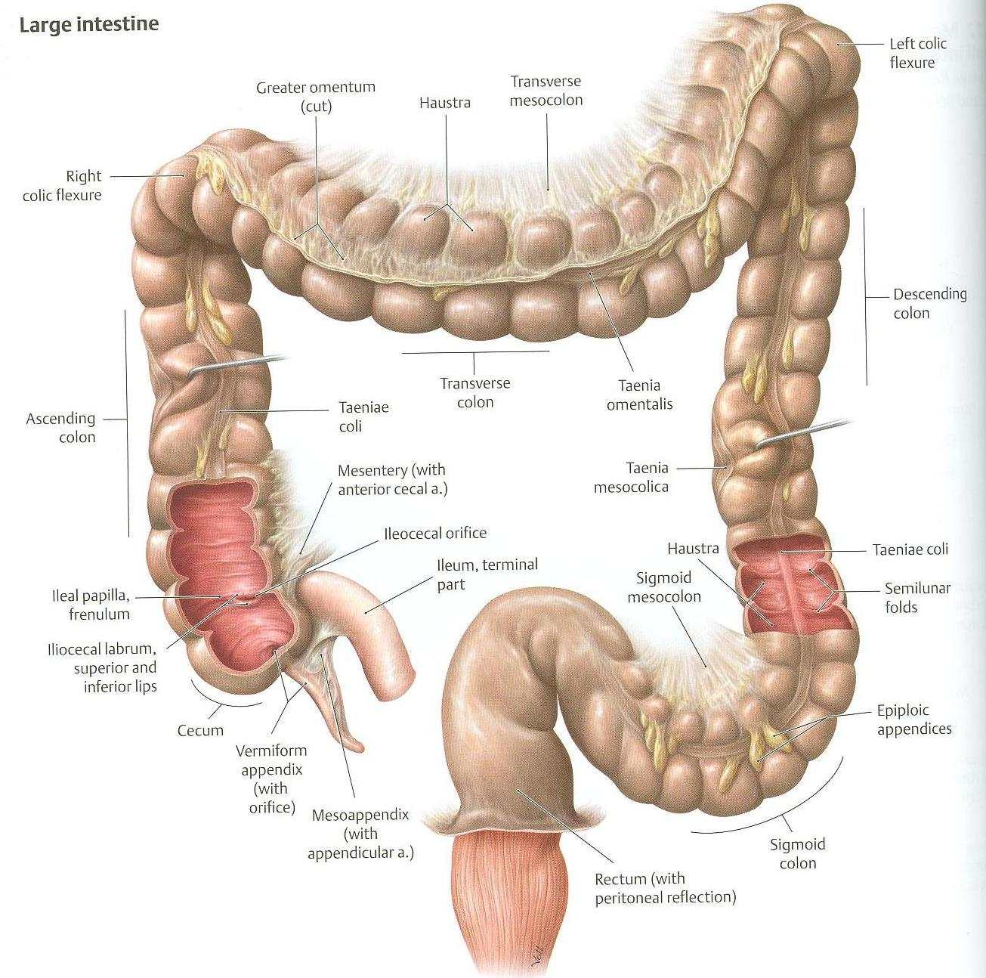

Slide 5
CHARACTERISTICS OF COLON
(NOT FOUND IN RECTUM & ANAL CANAL)
Teniae coli: 3 longitudinal muscle bands
Sacculations (haustra): teniae coli are shorter than large intestine
Epiploic Appendices : short peritoneal fold filled with fat

Slide 6
PERITONEAL COVERING
PARTS WITH MESENTERY:
Transverse colon
Sigmoid colon
Appendix
Cecum
RETROPERITONEAL PARTS:
Ascending colon
Descending colon
Upper 2/3 of rectum
PARTS DEVOID OF PERITONEAL COVERINGS:
Lower 1/3 of rectum
Anal canal

Slide 7
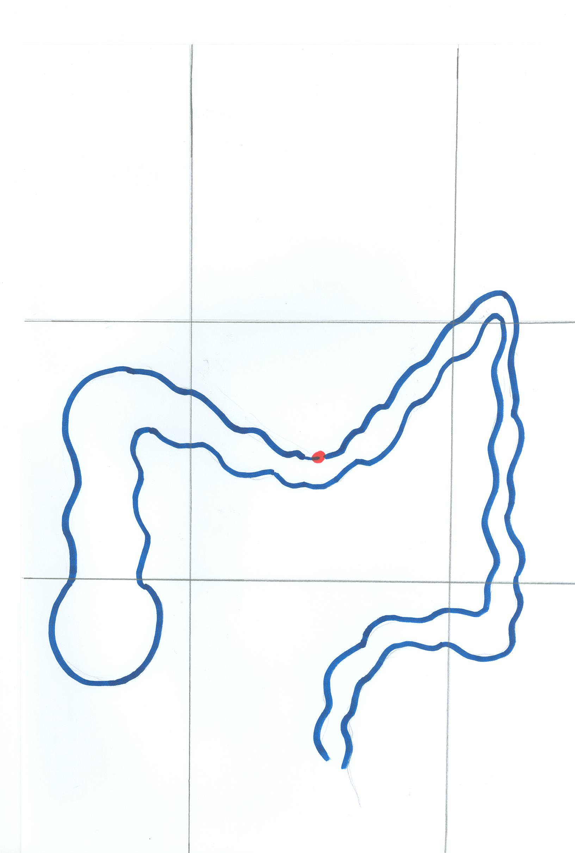
SURFACE ANATOMY
Right hypochondrium
Epigastrium
Left hypochondrium
Right lumbar region
Umbilical region
Left lumbar region
2/3
McBurney’s point
1/3
ASIS
Right iliac fossa
Hypogastrium
Left iliac fossa

Slide 8
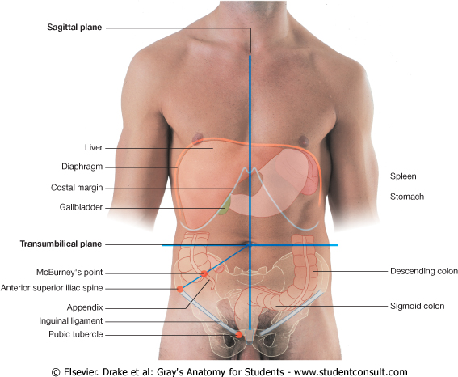
APPENDIX
Surface Anatomy
The base of appendix is marked by Mc’Burney’s point:
A point at the junction of lateral 1/3 & medial 2/3 of a line traced
from right anterior superior iliac spine to umbilicus

Slide 9
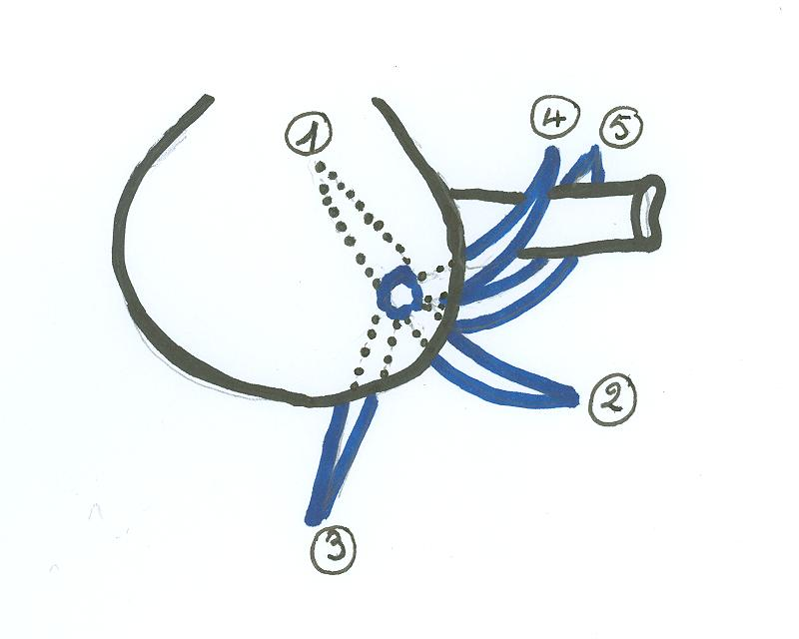
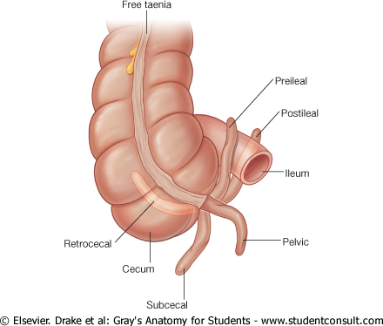
APPENDIX
Opening: at posteromedial aspect of cecum, 1 inch below ileo-cecal junction
Positions:
1.Retrocecal: most common
2.Pelvic 3.Subcecal 4.Preilieal 5.Postileal: least common

Slide 10
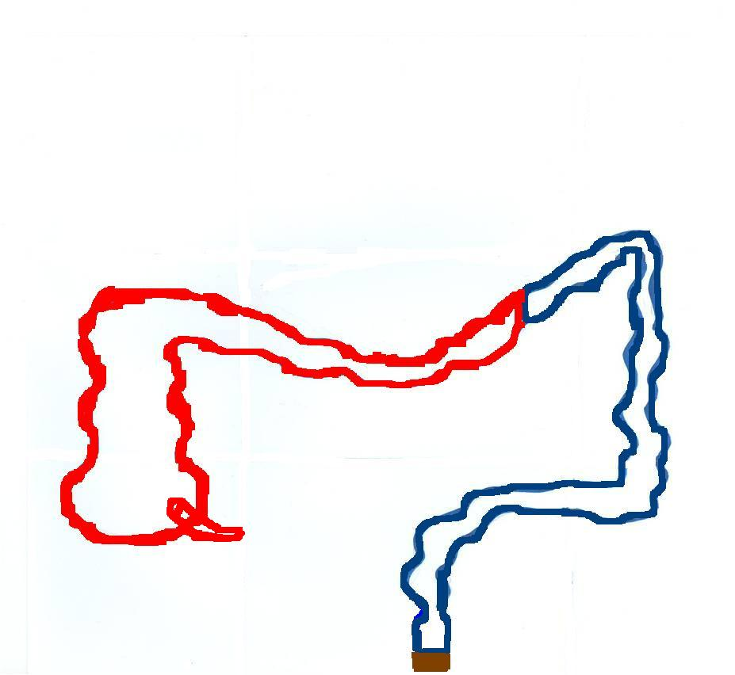
RELATION BETWEEN ORIGIN & SUPPLY
Origin: Midgut (endoderm)
Artery: Superior Mesenteric
Nerve: Autonomic:
Sympathetic + vagus
Origin: Hindgut (endoderm)
Artery: Inferior Mesenteric
Nerve: Autonomic:
Sympathetic + pelvic splanchnic nerves
Left 1/3
Right 2/3
Origin: ectoderm
Artery: inferior rectal
Nerve: Somatic: inferior rectal
Lower part of anal canal

Slide 11
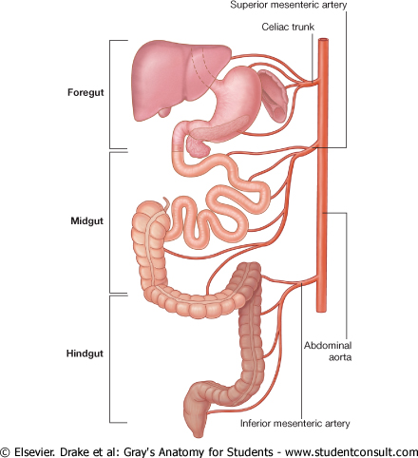
RELATION BETWEEN EMBRYOLOGICAL ORIGIN OF GUT & ITS ARTERIAL SUPPLY

Slide 12
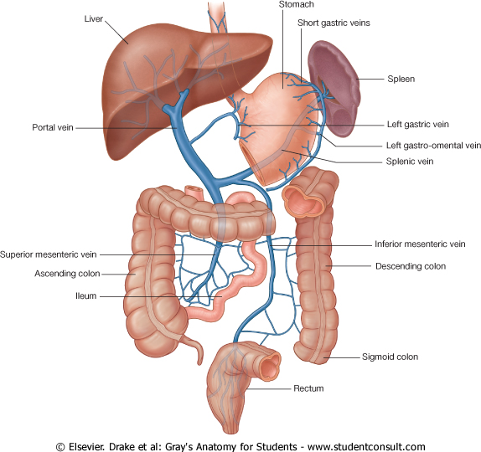
VENOUS DRAINAGE OF GUT
Veins draining gut form the portal circulation
All veins finally end into portal vein which enters the liver

Slide 13
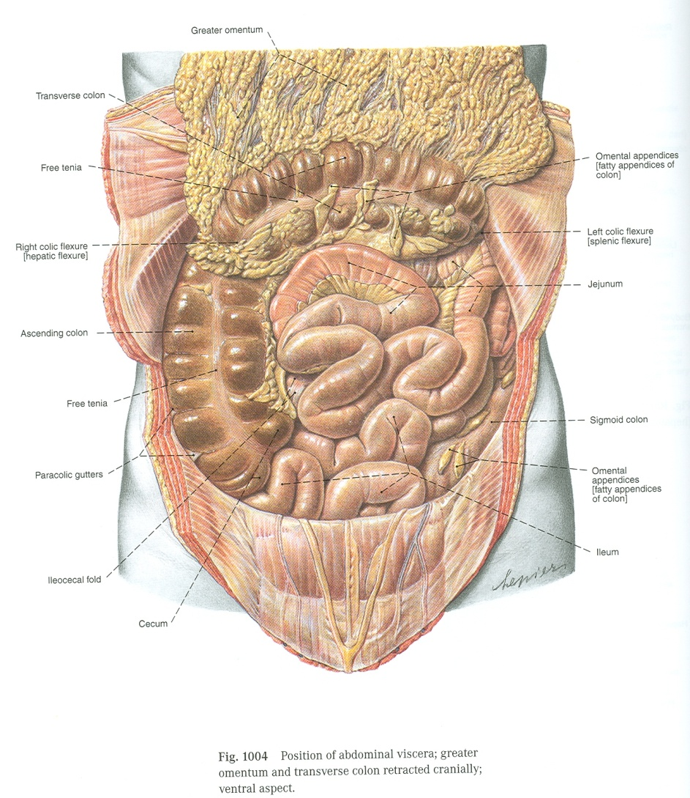
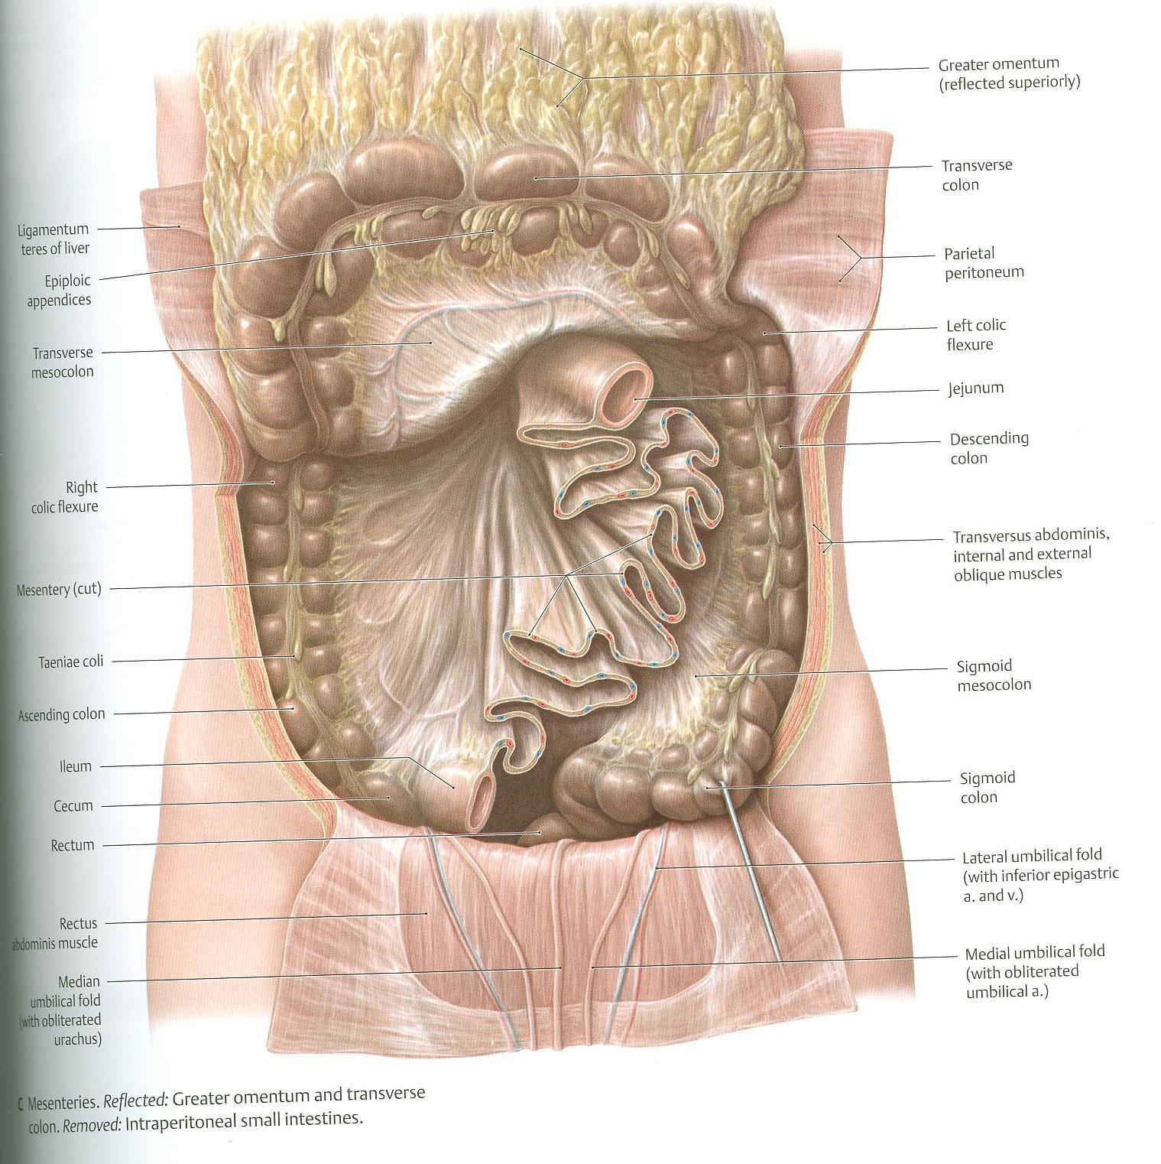
CECUM – ASCENDING & DESCENDING COLONS (ANTERIOR RELATIONS)
Coils of small intestine
Greater omentum
Anterior abdominal wall

Slide 14
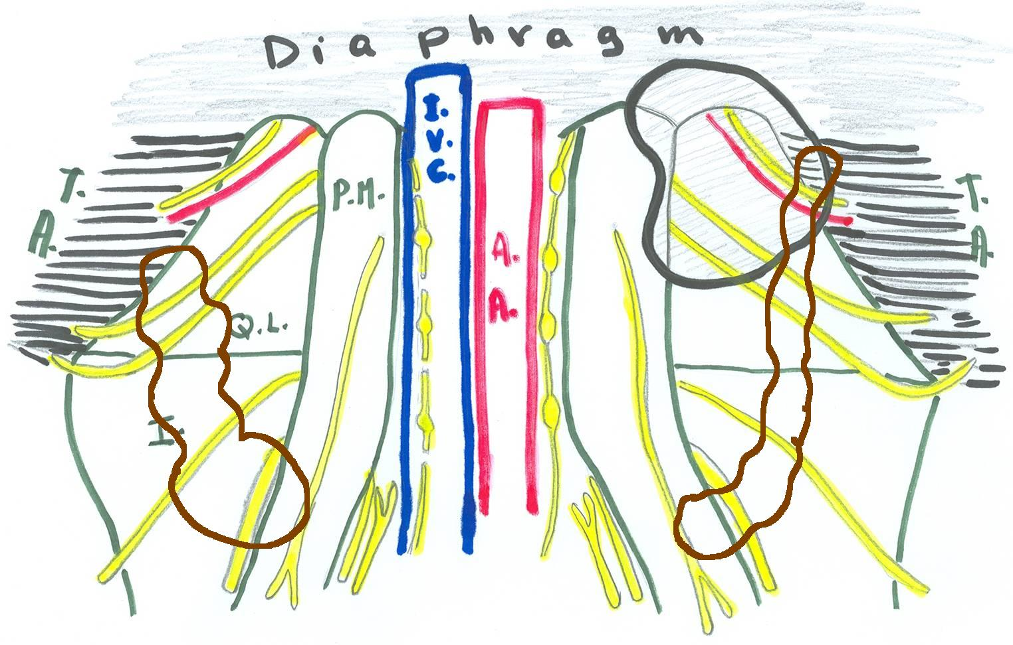
1
2
3
5
4
6
1: Iliohypogastric nerve; 2: Ilioinguinal nerve; 3: lateral cutaneous nerve of thigh
4: Femoral nerve; 5: Genitofemoral nerve; 6: Obturator nerve
P.M.= psoas major; Q.L.=quadratus lumborum; I.=iliacus;
T.A.= transversus abdominis; I.V.C.=inferior vena cava; A.A.=abdominal aorta

Slide 15
CECUM – ASCENDING & DESCENDING COLONS (POSTERIOR RELATIONS)
Cecum:
Psoas major
Iliacus
Ascending colon:
Iliacus
Quadratus lumborum
Descending colon:
Left kidney
Quadratus lumborum
Iliacus
Psoas major

Slide 16
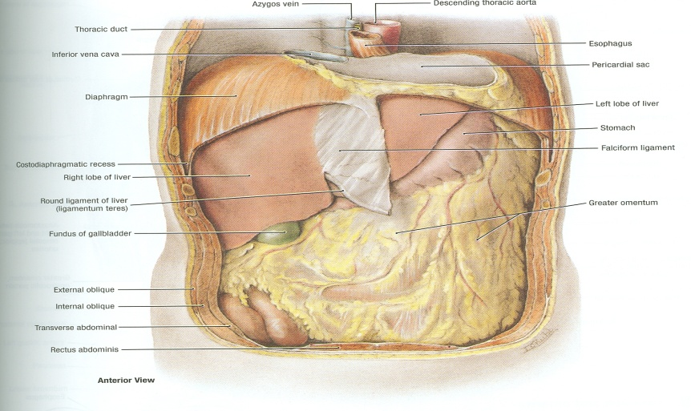
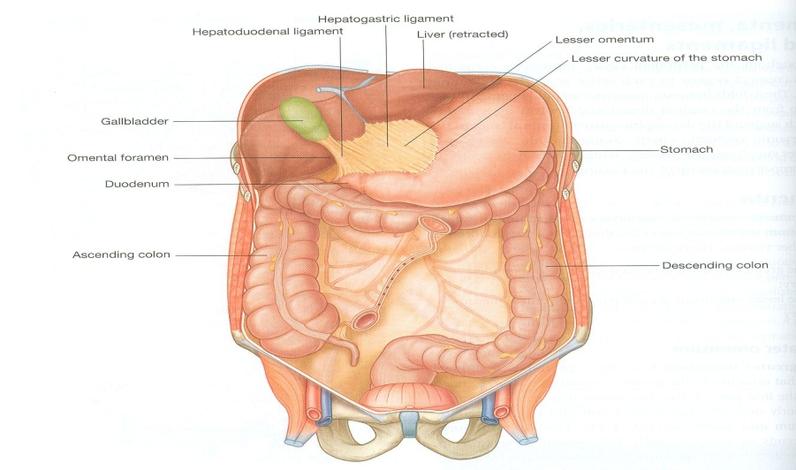
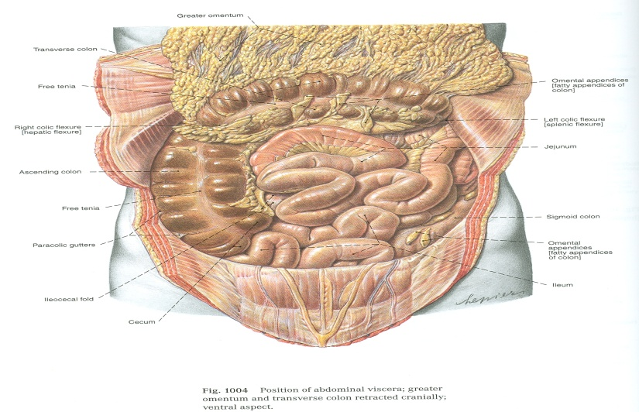
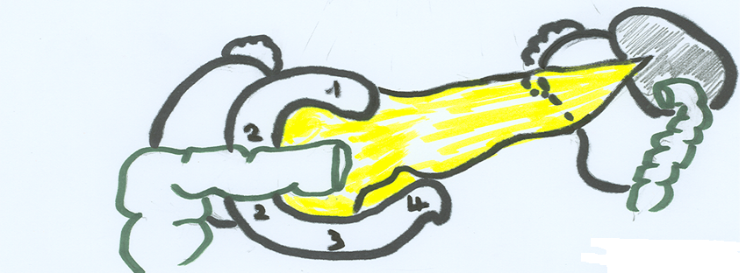
RALATIONS OF TRANSVERSE COLON
Anterior: greater omentum, anterior abdominal wall
Superior: liver, gall bladder, stomach
Inferior: coils of small intestine
Posterior: 2nd part of duodenum, pancreas

Slide 17
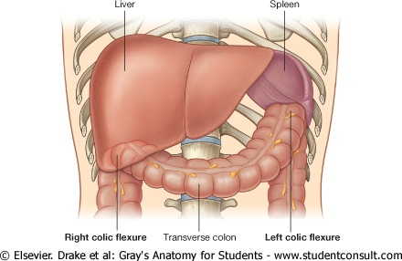
COLIC FLEXURES
Position: higher
Angle: more acute
Hepatic flexure
Splenic flexure

Slide 18
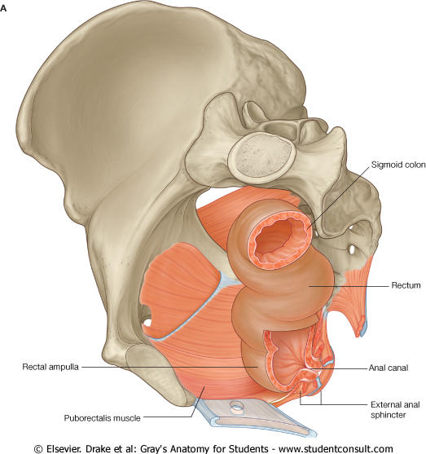
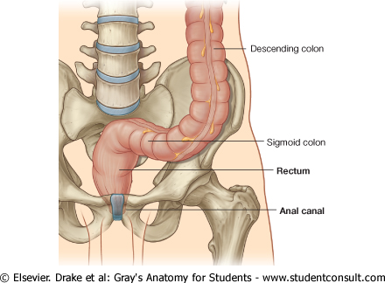
RECTUM
Beginning: as a continuation of sigmoid colon at level of S3.
Termination: continues as anal canal, one inch below & in front of tip of coccyx. Its end is dilated to form the rectal ampulla.
Length: 13 cm(5 inches)

Slide 19
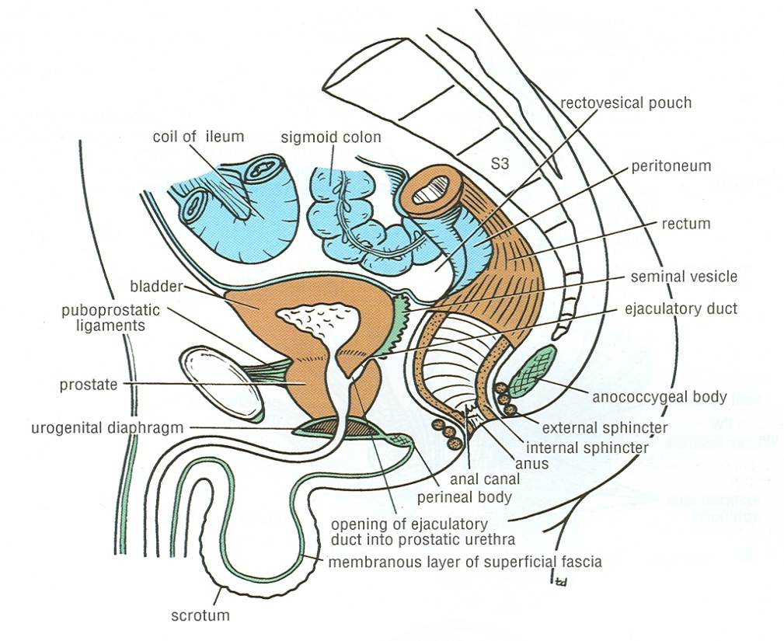
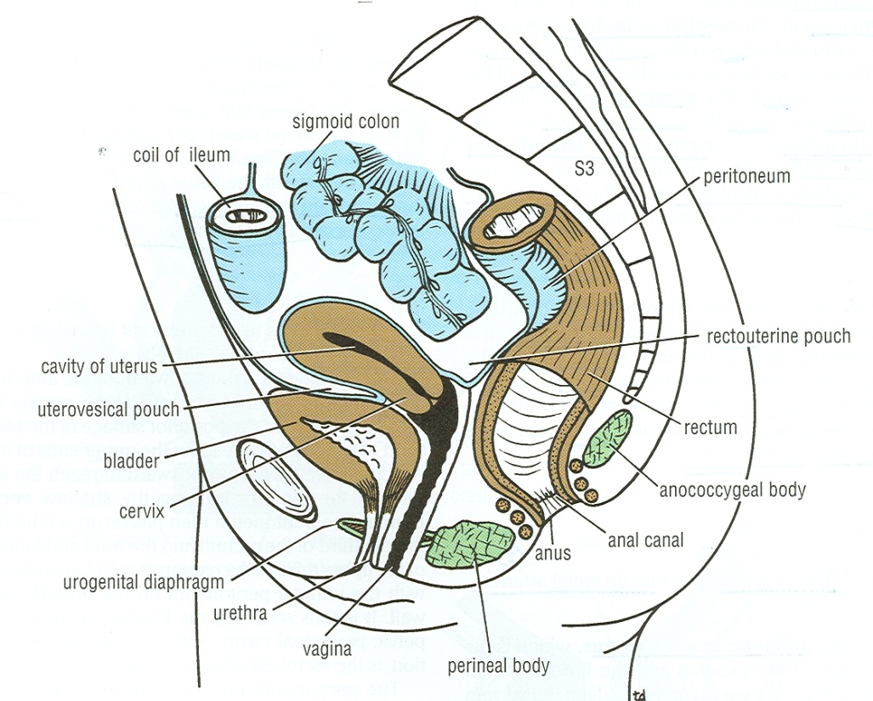
RELATIONS OF RECTUM IN PELVIS
MALE PELVIS
Anterior: seminal vesicles, posterior surfaces of urinary bladder & prostate gland
Posterior: sacrum & coccyx
FEMALE PELVIS
Anterior: posterior wall of vagina
Posterior: sacrum & coccyx
R
R

Slide 20
QUESTION 1
In which one of the following regions lies McBurney’s point?
Right iliac fossa
Hypogastrium
Right lumbar region
Umbilical region

Slide 21
QUESTION 2
Which one of the following parts of large intestine is found in the pelvis?
Transverse colon
Anal canal
Rectum
Cecum

Slide 22
THANK YOU

