Slide 1
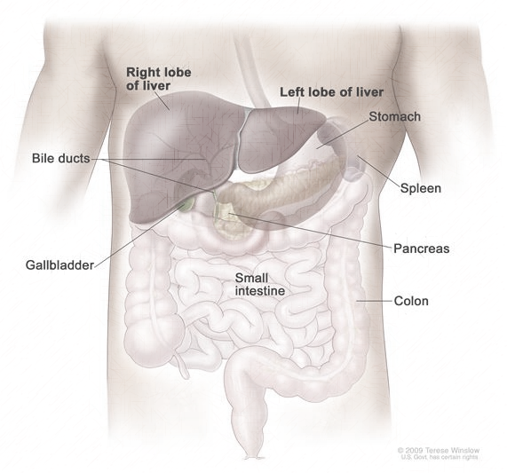
Anatomy of Liver & Spleen

Slide 2
Objectives
By the end of the lecture, you should be able to describe the:
Location, subdivisions and relations and peritoneal reflection of liver and Spleen.
Blood supply, nerve supply and lymphatic drainage of the liver and spleen.

Slide 3
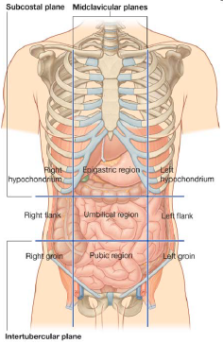
Liver
The largest gland in the body
Weighs approximately 1500 g. (approximately 2.5% of adult body weight).
Lies mainly in the:
Right hypochondrium,
Epigastrium, and extends into the
Left hypochondrium.
Protected by the thoracic cage and diaphragm, lies deep to ribs 7-11 on the right side and crosses the midline toward the left nipple.
Moves with the diaphragm and is located more inferiorly when one is erect because of gravity.

Slide 4
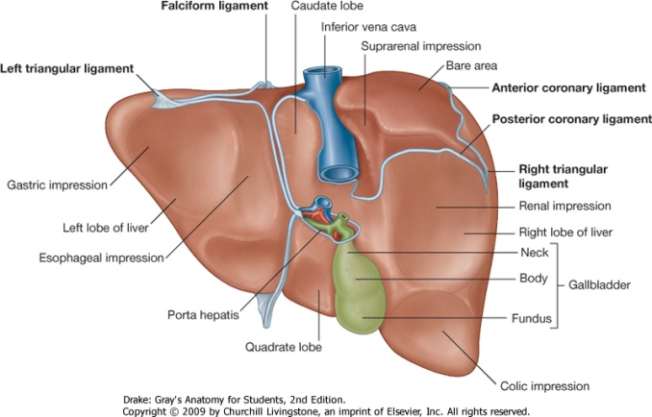
Surfaces of Liver
It has two surfaces:
1. Diaphragmatic surface, convex.
2. Visceral surface relatively flat or even concave, (posteroinferior).

Slide 5
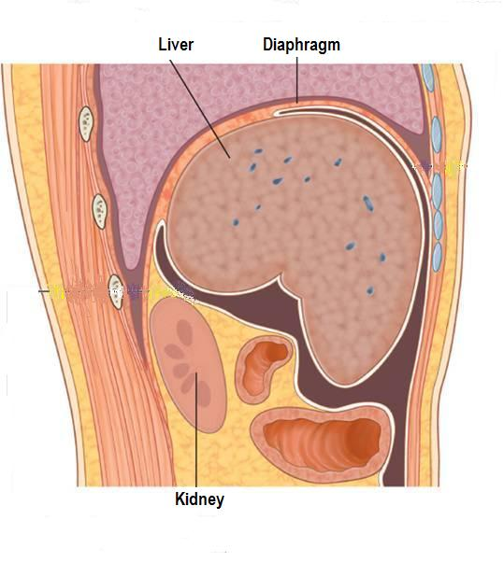
Diaphragmatic Surface
The convex upper surface is smooth and molded to undersurface of domes of diaphragm which separates it from the base of pleurae, lungs, pericardium, and heart .
Covered with visceral peritoneum, except posteriorly in the bare area of the liver, where it lies in direct contact with the diaphragm.

Slide 6
Visceral Surface
It is the posteroinferior surface, related to abdominal viscera.
It is covered with peritoneum, except at the fossa for the gallbladder and the porta hepatis
It bears multiple fissures and impressions from contact with other organs.

Slide 7
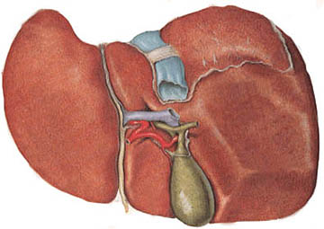
Fissures
Two sagittally oriented fissures, linked centrally by the transverse porta hepatis, to form the letter H on the visceral surface.
The left fissure is the continuous groove formed:
Anteriorly by the fissure for the round ligament.
Posteriorly by the fissure for the ligamentum venosum.
The right fissure is the continuous groove formed:
Anteriorly by the fossa for the gallbladder
Posteriorly by the groove for the inferior vena cava.
Ligamentum venosum
Inferior vena cava
Round ligament
Porta hepatis
Gall bladder

Slide 8
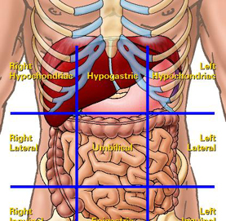
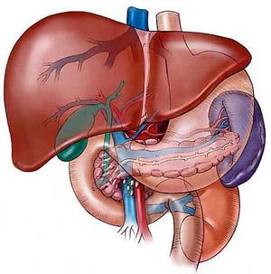
Anterior:
Diaphragm,
Right & left costal margins,
Right & left pleura,
Right & left lower margins of both lungs,
Xiphoid process, and
Anterior abdominal wall.
Relations
Posterior:
Diaphragm,
Right kidney,
Right hepatic flexure of the colon,
Duodenum,
Gallbladder,
Inferior vena cava,
Esophagus and fundus of stomach.

Slide 9
Relations of Visceral Surface of the Liver
The visceral surface is related to the:
Stomach and duodenum.
Esophagus.
Lesser omentum.
Gallbladder.
Right colic flexure.
Right kidney and right suprarenal gland.
1
2
6
3
4
5

Slide 10
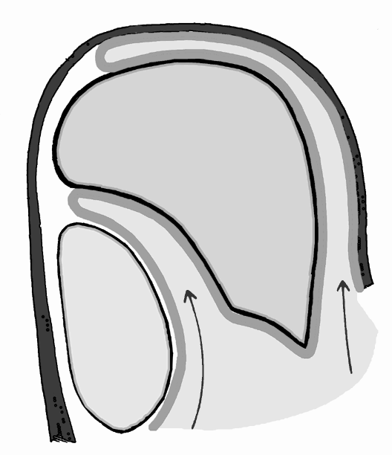
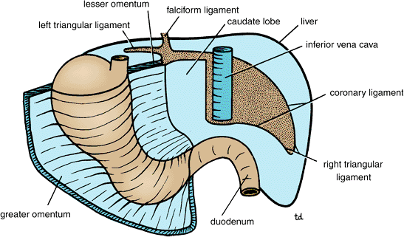
Peritoneal Reflection
Superior layer of coronary ligament
Diaphragm
The liver is completely surrounded by a fibrous capsule and covered by partially by peritoneum.
The bare area of the liver is an area of the liver on the diaphragmatic surface where there is no intervening peritoneum between the liver and the diaphragm
Boundaries of Bare area:
Anterior: superior layer of coronary ligament
Posterior: inferior layer of coronary ligament
Laterally: right and left triangular ligaments.
Peritoneum
Inferior layer of coronary ligament
Anterior abdominal wall
Posterior abdominal wall
Other bare areas include porta hepatis, fossa for gall bladder & grooves for IVC.

Slide 11
Porta Hepatis (Hilum of the Liver)
A transverse fissure found on the posteroinferior surface and lies between the caudate and quadrate lobes.
The upper part of the free edge of the lesser omentum is attached to its margins.
Structures passing through the porta hepatis:
Right and left hepatic ducts.
Right and left branches of the hepatic artery.
Right and left branches of the portal vein.
Sympathetic and parasympathetic nerve fibers.
A few hepatic lymph nodes lie here; they drain the liver and gallbladder and send their efferent vessels to the celiac lymph nodes.

Slide 12
Ligaments of the Liver
Falciform ligament
It is a two-layered fold of the peritoneum, ascends from the umbilicus to the liver.
Its sickle-shaped free margin contains the ligamentum teres (round Ligament) of liver.
It is the remains of the umbilical vein, which carry oxygenated blood and nutrients from the placenta to the fetus.
Ligamentum venosum
IVC
Ligamentum venosum
It is the fibrous remnant of the fetal ductus venosus, which shunted blood from the umbilical vein to the IVC, short-circuiting the liver.
Porta Hepatis
Round ligament of liver
GB

Slide 13
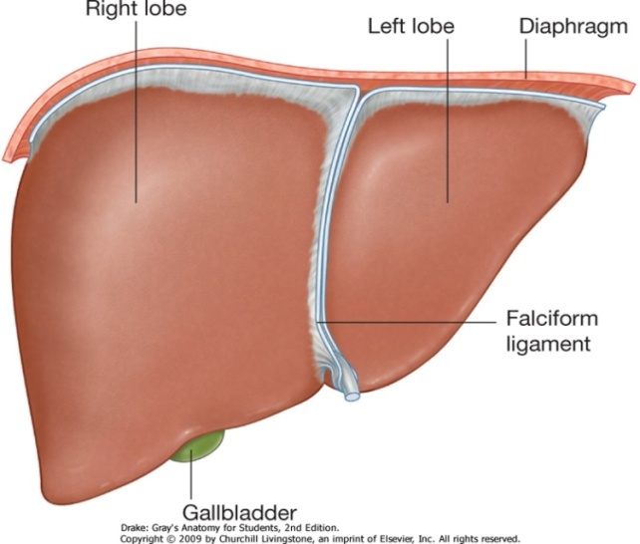
Lobes of The Liver
The liver is divided into a large right lobe and a small left lobe by the attachment of the falciform ligament.
The right lobe is further divided into a quadrate lobe and a caudate lobe by the presence of the gallbladder, the fissure for the ligamentum teres, the inferior vena cava, and the fissure for the ligamentum venosum.
The caudate lobe is connected to the right lobe by the caudate process.
NB. The quadrate and caudate lobes are functionally parts of the left lobe of the liver.
Caudate process
Cauate lobe
Left lobe
Right lobe
Quadrate lobe

Slide 14
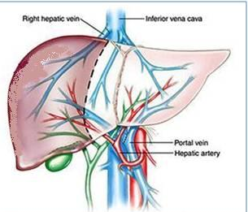
Blood Circulation through the Liver
The blood vessels conveying blood to the liver are:
Hepatic artery (30%),
Portal vein (70%).
The hepatic artery brings oxygenated blood to the liver.
The portal vein brings venous blood rich in the products of digestion, which have been absorbed from the gastrointestinal tract.
The venous blood is drained by right & left hepatic veins which drain into the inferior vena cava

Slide 15
Blood Circulation through the Liver
At or close to the porta hepatis, the hepatic artery and portal vein terminate by dividing into right and left primary branches which supply the right and left parts of liver, respectively.
Within the liver, the primary branches divide to give secondary and tertiary to supply the hepatic segments independently
The hepatic veins, are intersegmental in their distribution and function, draining parts of adjacent segments.
The attachment of these veins to the IVC helps to hold the liver in position. (The peritoneal ligaments and the tone of the abdominal muscles play a minor role in the support of liver).

Slide 16
Lymph Drainage
The liver produces a large amount of lymph—about one third to one half of all body lymph.
The lymph vessels leave the liver and enter several lymph nodes in the porta hepatis.
The efferent vessels pass to the celiac nodes.
A few vessels pass from the bare area of the liver through the diaphragm to the posterior mediastinal lymph nodes.
Nerve Supply
Sympathetic and parasympathetic nerves from the celiac plexus.
The anterior vagal trunk gives rise to a large hepatic branch, which passes directly to the liver.

Slide 17
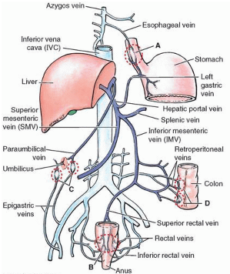
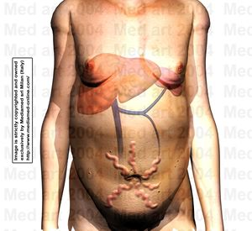
Portal-Systemic (Portacaval) Anastomoses

Slide 18
Portal-Systemic (Portacaval) Anastomoses
It is a specific type of anastomosis that occurs between the veins of portal circulation and those of systemic circulation
In portal hypertension, these anastomosis open and form venous dilatation called varices.
Sites:
Lower end of esophagus.
Lower end of anal canal.
Paraumbilical region.
Retroperitoneal
Intrahepatic (Patent ductus venosus)

Slide 19
Spleen
1,3,5,7,9,11
Measurement 1X3X5
Weighs 7 oz (210 gm)
Lies between the 9th and 11th ribs. or
“Clenched fist”

Slide 20
Spleen
Largest single mass of lymphoid tissue.
Located in the left hypochondrium, deep to 9, 10 & 11 ribs
Long axis lies along the shaft of the 10th rib and separated from them by the diaphragm and the costodiaphragmatic pleural recess.
Ovoid in shape with notched anterior border.
Lower pole extends forward as far as the midaxillary line
Normal size spleen can not be palpated on clinical examination.

Slide 21
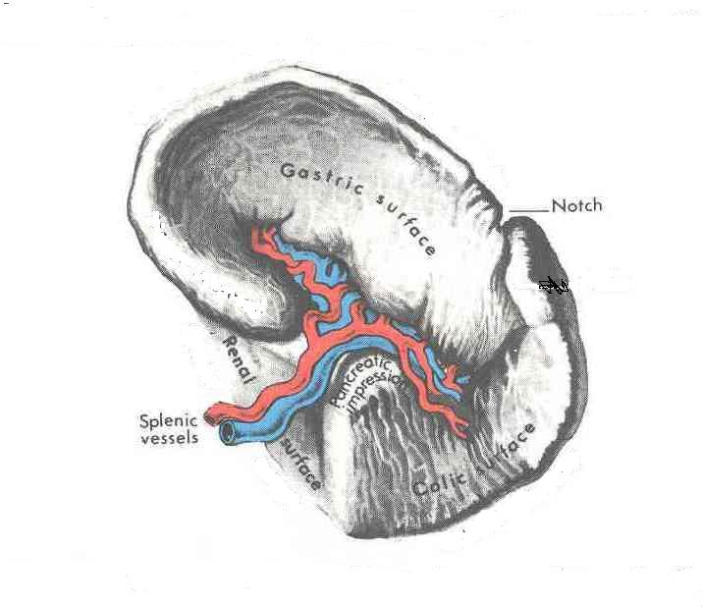
Surfaces:
Diaphragmatic surface:
It is convexly curved to fit the concavity of the diaphragm and curved bodies of the adjacent ribs.
Visceral surface:
It is related to the viscera.
Borders:
The anterior and superior borders are sharp.
Anterior border is notched
The posterior (medial) and inferior borders are rounded.

Slide 22
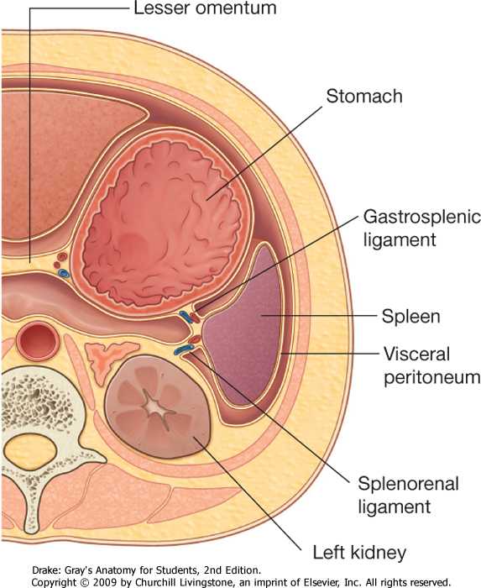
Peritoneal Reflections/Ligaments
Spleen is completely surrounded by peritoneum which passes from its hilus as:
Gastrosplenic ligament to the greater curvature of stomach (carrying the short gastric and left gastroepiploic vessels).
Lienorenal ligament to the front of left kidney (carrying the splenic vessels and the tail of pancreas).

Slide 23
Relations
Anteriorly:
Stomach,
Tail of pancreas,
Left colic flexure &
Left kidney.
Posteriorly:
Diaphragm, that separates it from the left pleura (left costo-diaphragmatic recess), left lung & 9, 10 & 11 ribs.
Inferiorly:
Left colic flexure.
Medially:
Left kidney.

Slide 24
Arterial Supply
Splenic artery
Largest branch of the celiac artery.
Runs a tortuous course along the upper border of the pancreas.
Passes within the lienorenal ligament.
Divides into 4-5 terminal branches, which enter the spleen at the hilus.
The lack of anastomosis of these arterial vessels within the spleen results in the formation of vascular segments of the spleen with relatively avascular planes between them, enabling subtotal splenectomy.

Slide 25
Venous Drainage
Splenic vein
Leaves the hilum.
Runs horizontally behind the tail & body of the pancreas.
Reaches behind the neck of pancreas, where it joins the superior mesenteric vein to form the portal vein.
Tributaries:
Short gastric veins.
Left gastroepiploic vein.
Pancreatic veins.
Inferior mesenteric vein.

Slide 26
Lymph Drainage
Lymphatics emerge from the hilus and drain into several nodes lying at the hilum.
Efferents from the hilar nodes pass along the course of splenic artery, and drain into the celiac lymph nodes.
Nerve Supply
Derived from the celiac plexus.
Are distributed mainly along branches of the splenic artery, and are vasomotor in function.

Slide 27
Thank You

