Slide 1

بسم الله الرحمن الرحيم

Slide 2
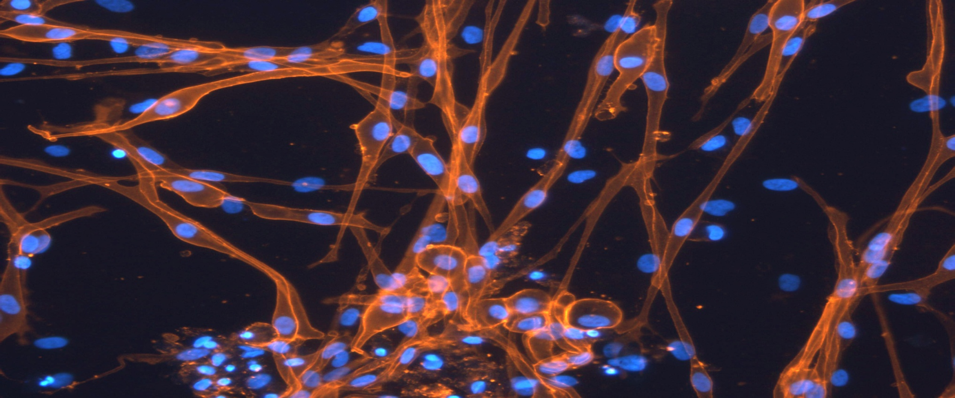


Introuduction to Pluripotnet Stem Cells
Dr. Amer Mahmood
Dr. Mona Elsafadi

Slide 3
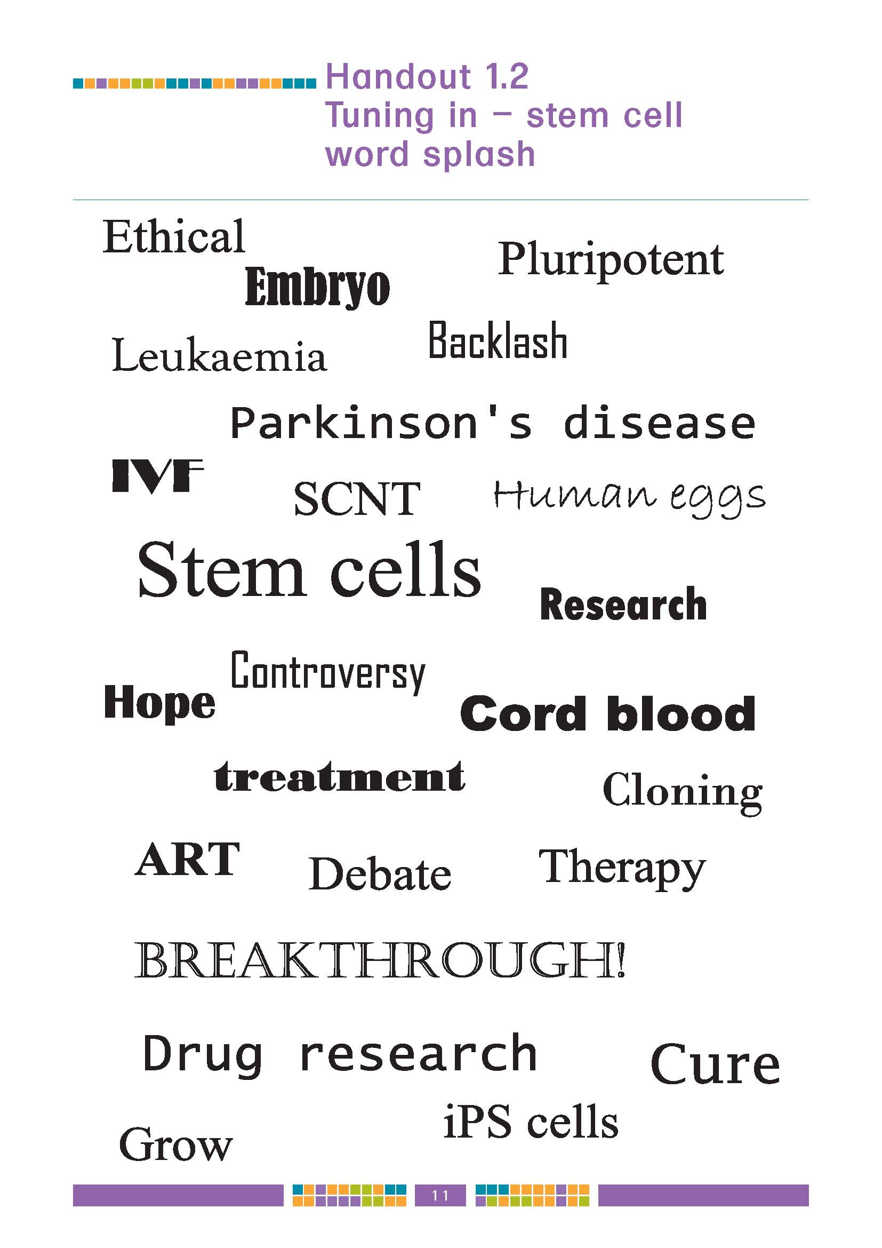

Introducing….stem cells!
Notes:
3

Slide 4


Slide 5
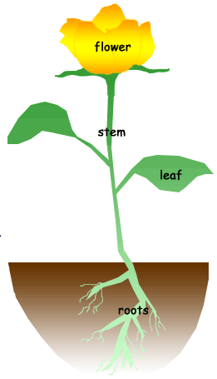
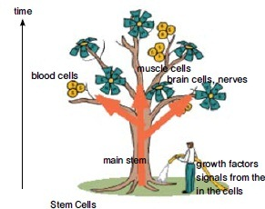
Stem Cells

Slide 6
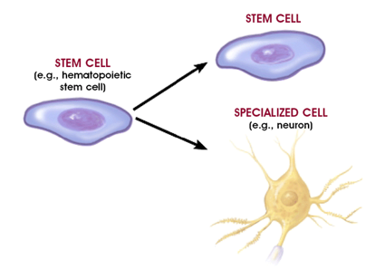
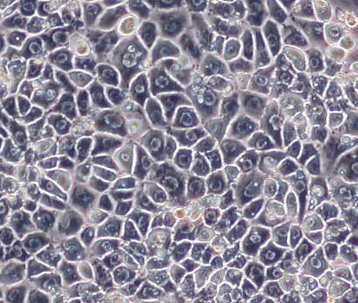
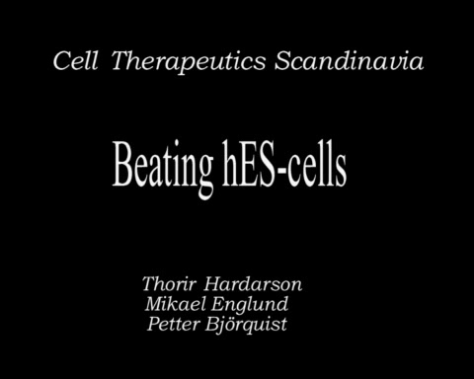
Unique Characteristics of Stem Cells
Endoderm
(hepatocytes)
Mesoderm
(cardiac
myotubes)
Unlimited self renewal (Regeneration)
Differentiation (eg. beating cells of the heart muscles):
    Internal signals (specific genes)
    External signals (GF, cytokines)
Ectoderm
(Neurons)

Slide 7
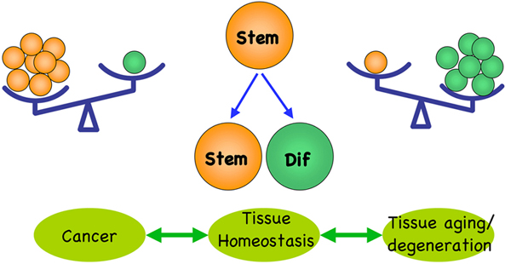

Slide 8
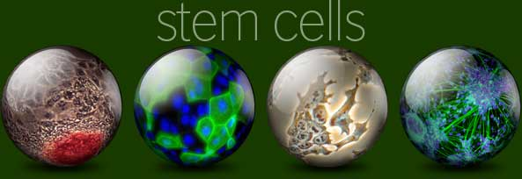

What are Stem Cells?
A cell that has the ability:
to continuously divide and give rise to new copy of itself (self-renew)
and other specialized ( differentiated ) cells/tissues.
Stem Cell – main function within the body
Continuous Repair of defective cell types and regeneration of tissues.

Slide 9
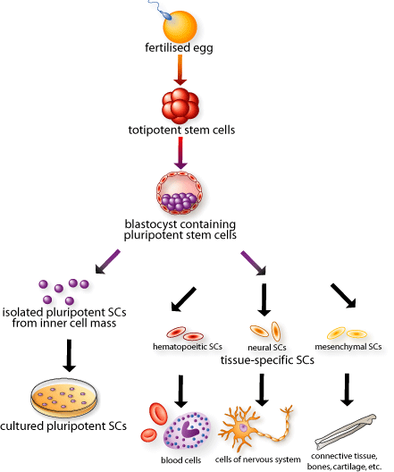
Totipotent
This cell
Can form the
Embryo and placenta
Pluripotent
This cell
Can just form the
embryo
Multi-
potent
Unipotent
Notes:
9

Slide 10
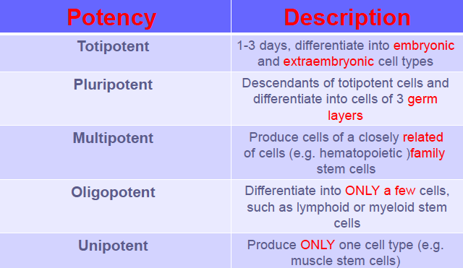
Classification of Stem Cells ”1”
(Potency Based)

Slide 11
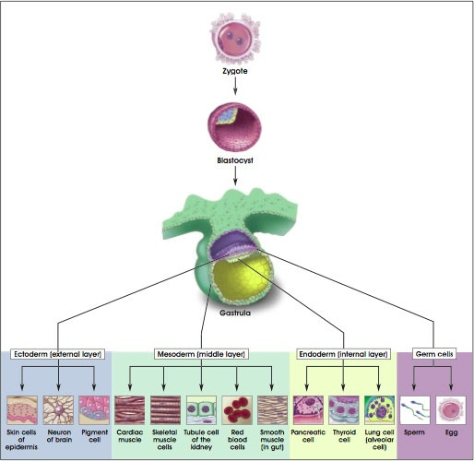
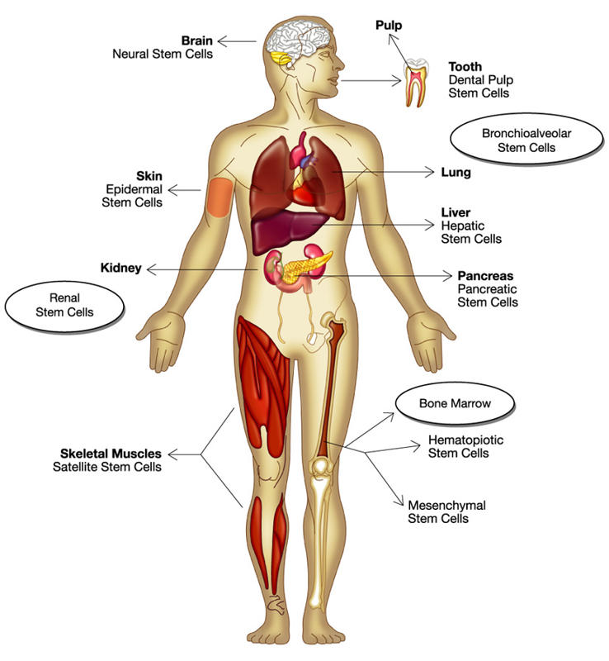
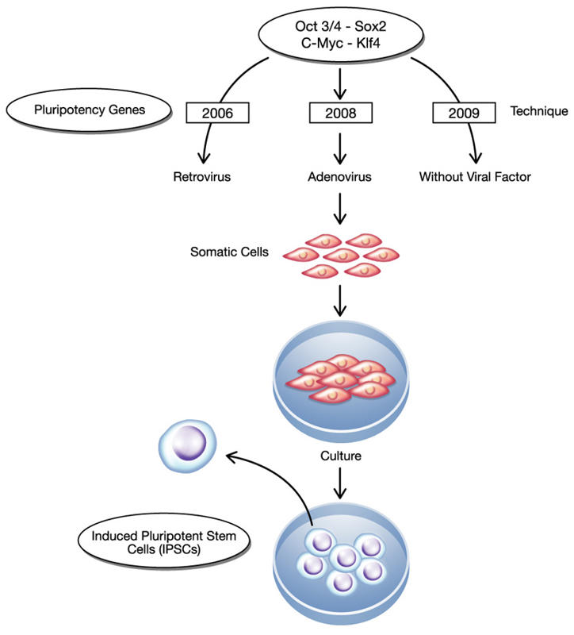
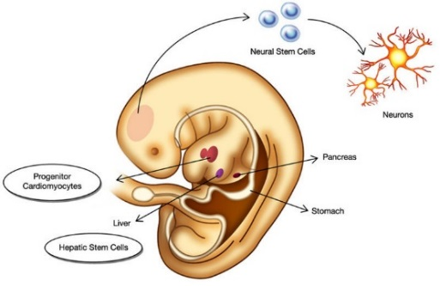
Classifications of Stem Cells (2)
(Sourced Based)
Embryonic
Adult
(Tissue Specific)
Induced

Slide 12
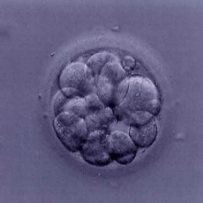
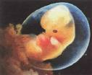
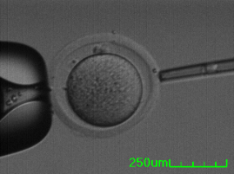

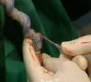
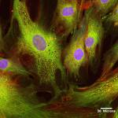


Sources of Stem Cells
Embryonic Stem Cells (ESC)
    IVF embryos
    Aborted embryos
    cloned embryos
Adult Stem Cells (ASC):
    Bone Marrow
    Placental Cord
    Mesenchymal Stem cells

Slide 13
Adult stem cells
(Tissue Specific Stem Cells)
Found in specific mature body tissues as well as the umbilical cord and placenta after birth.
They also can be isolated of developing embryos’ different tissues

Slide 14
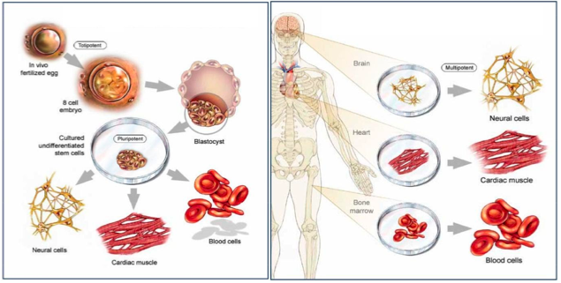
Embryonic Stem Cells
Adult Stem Cells

Slide 15
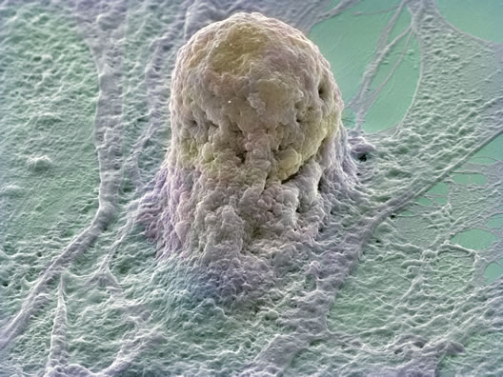
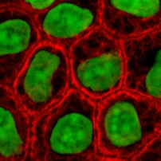
ESC
ASC
Multipotent
Limited numbers and more difficult to isolate
No immune rejection
No Ethical concerns
Pluripotent
large number can be harvested
May cause immune rejection
Ethical concerns

Slide 16
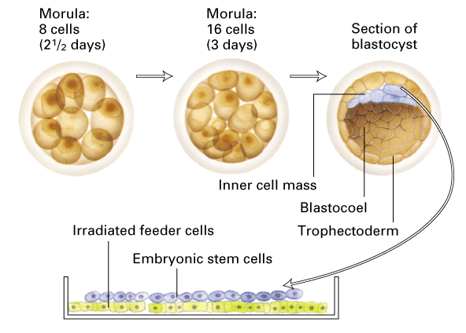
Generation of embryonic stem cells
Embryonic human stem cells were first isolated in 1995 by Dr. James Thomson.
derived from 4-5 day old embryo (Blastocyst):
  Trophoblast
  Blastocoel
  Inner Cell Mass (ICS)

Slide 17
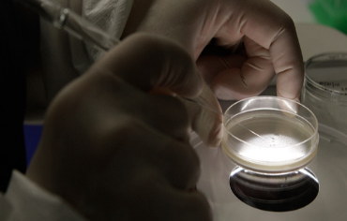
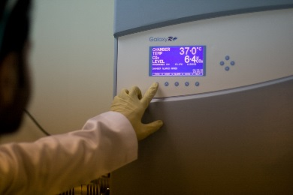
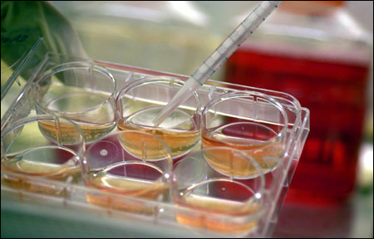
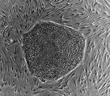
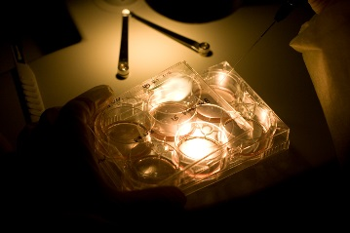
Generation of embryonic stem cells
Isolate and transfer of ICS into culture dish in culture media
Culture at 37c and 5% CO₂
Inner surface of culture dish is coated with inactivated MEFs as a feeder layer:
    provides sticky surface for attachment
    release nutrients
Cells divide and spread over the dish
ESCs are removed gently and plated into several different culture plates.

Slide 18
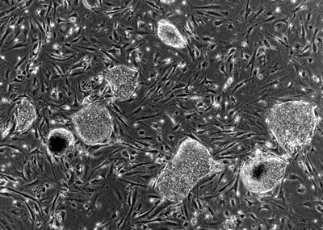
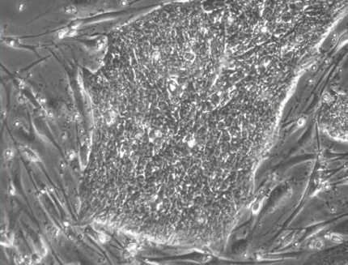
Human Embryonic Stem Cell Colony

Slide 19
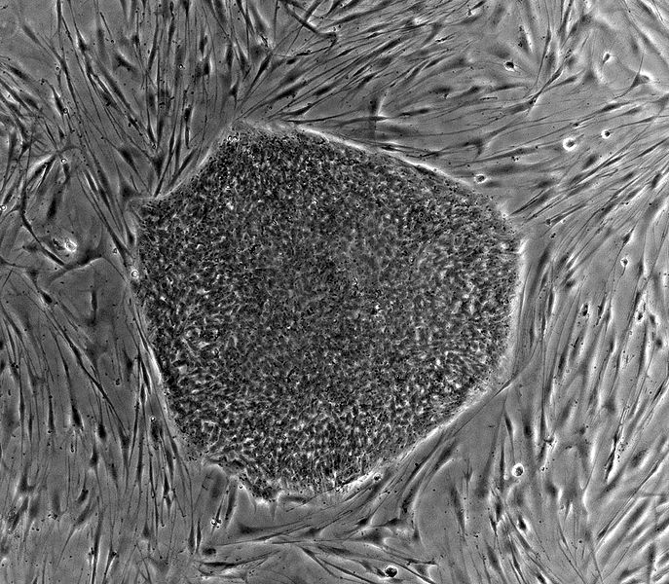
Embryonic stem cells in the dish
What do cultured ES cells look like?

Slide 20
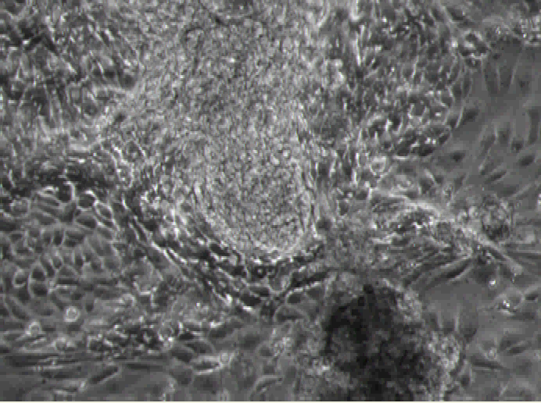
Beating cardiomyocytes derived from hESCs

Slide 21
Challenges with Embryonic Stem Cells
Abnormalities in chromosome number and structure were found in some human ESC lines.
Stem cells need to be differentiated to the appropriate cell types before they can be used clinically.
Stem cell development or proliferation must be controlled once placed into patients (risk of teratoma formation).
The use of mouse “feeder” cells to grow ESC could result in problems due to xenotransplantation.
Possibility of rejection of stem cell transplants as foreign tissues is very high.

Slide 22
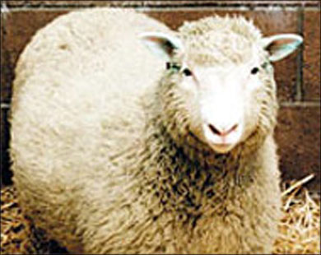

CLONING
Somatic Cell Nuclear Transfer
SCNT
Reproductive Cloning
(July 1996 – February 2003)

Slide 23
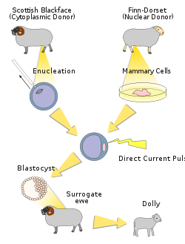

Slide 24
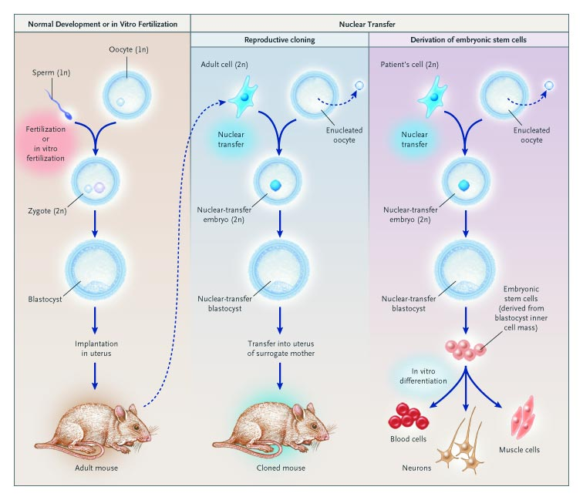

Slide 25
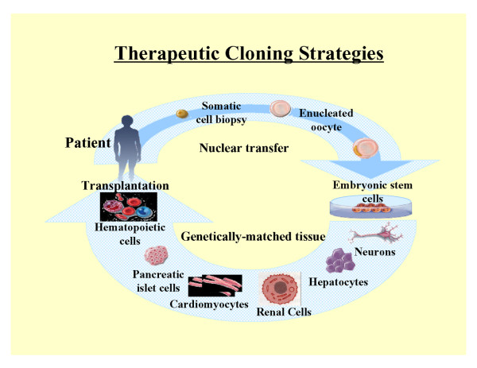
Therapeutic Cloning
Therapeutic cloning uses stem cells to correct diseases and other health problems that someone may encounter.
Therapeutic cloning does not cloned to make full humans but rather is used for the stem cells of embryo

Slide 26
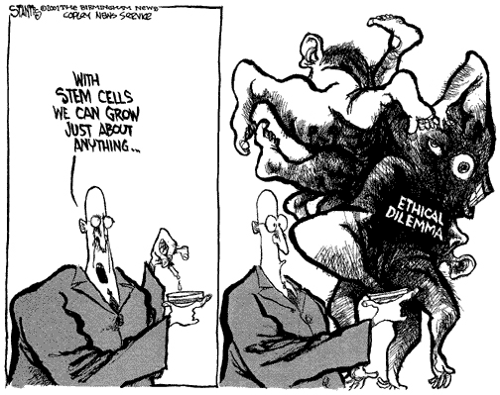

Slide 27
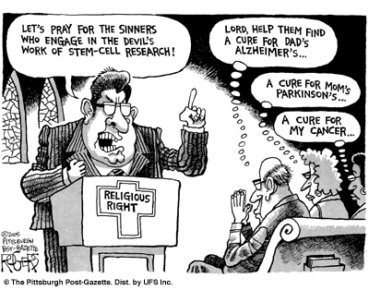

Slide 28
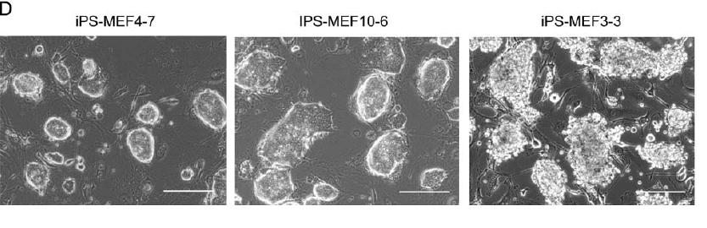
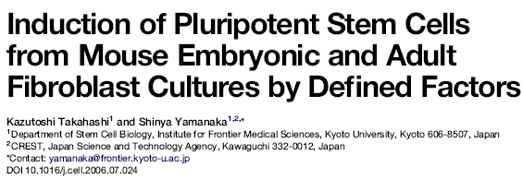

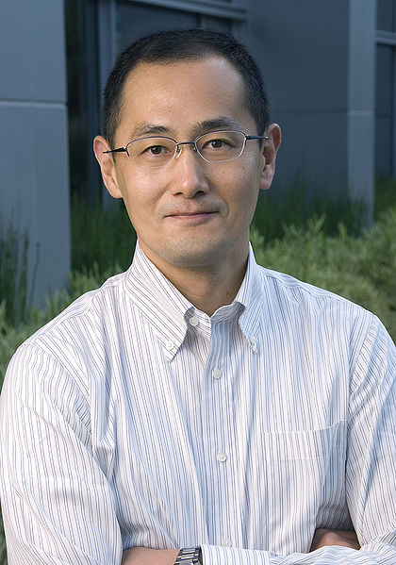
The first iPSCs
In late 2006 the group of Takahashi and Yamanaka reported the stimulation of cells of adult and embryonic origin to pluripotent stem cells called induced pluripotent stem (iPS) cells.

Slide 29
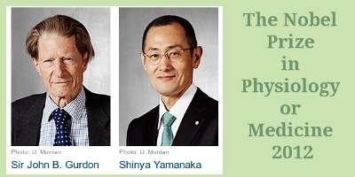

Slide 30
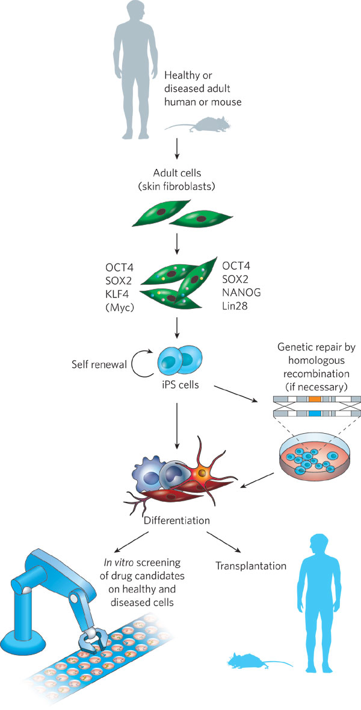
iPS Cells
Thomson Factors
Yamanaka Factors

Slide 31
Induced Pluripotent Stem Cell
(iPS) cells
The method was described by Yamanaka in which the skin cells of laboratory mice were genetically manipulated and returned back to their embryonic state.
iPS are somatic cells that have been reprogrammed to a pluripotent state (embryonic stem cell like state).
Several difficulties are to be overcome before iPS cells can be considered as a potential patient-specific cell therapy.
It will be crucial to characterize the development potential of human iPS cell line in the future.

Slide 32
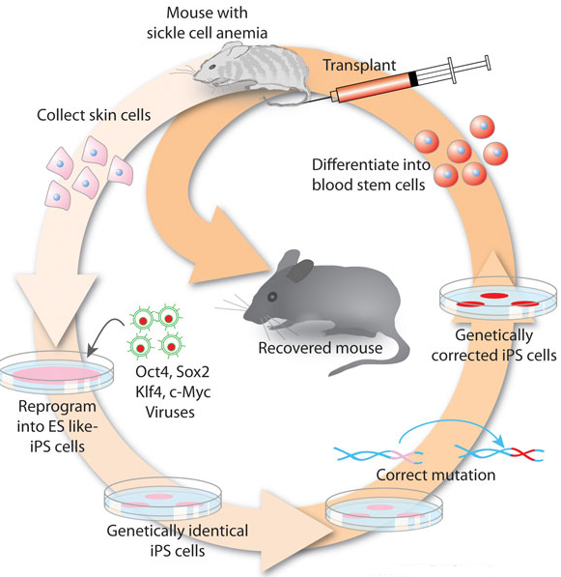
Induced Pluripotent Stem Cell
(iPS) cells
Skin cells were taken from the tail tip of a sickle-cell model mouse.
The cells were differentiated into hematopoietic cells.
The produced cells were transfused back into the sick mouse
Hanna J. et.al., 2007

Slide 33
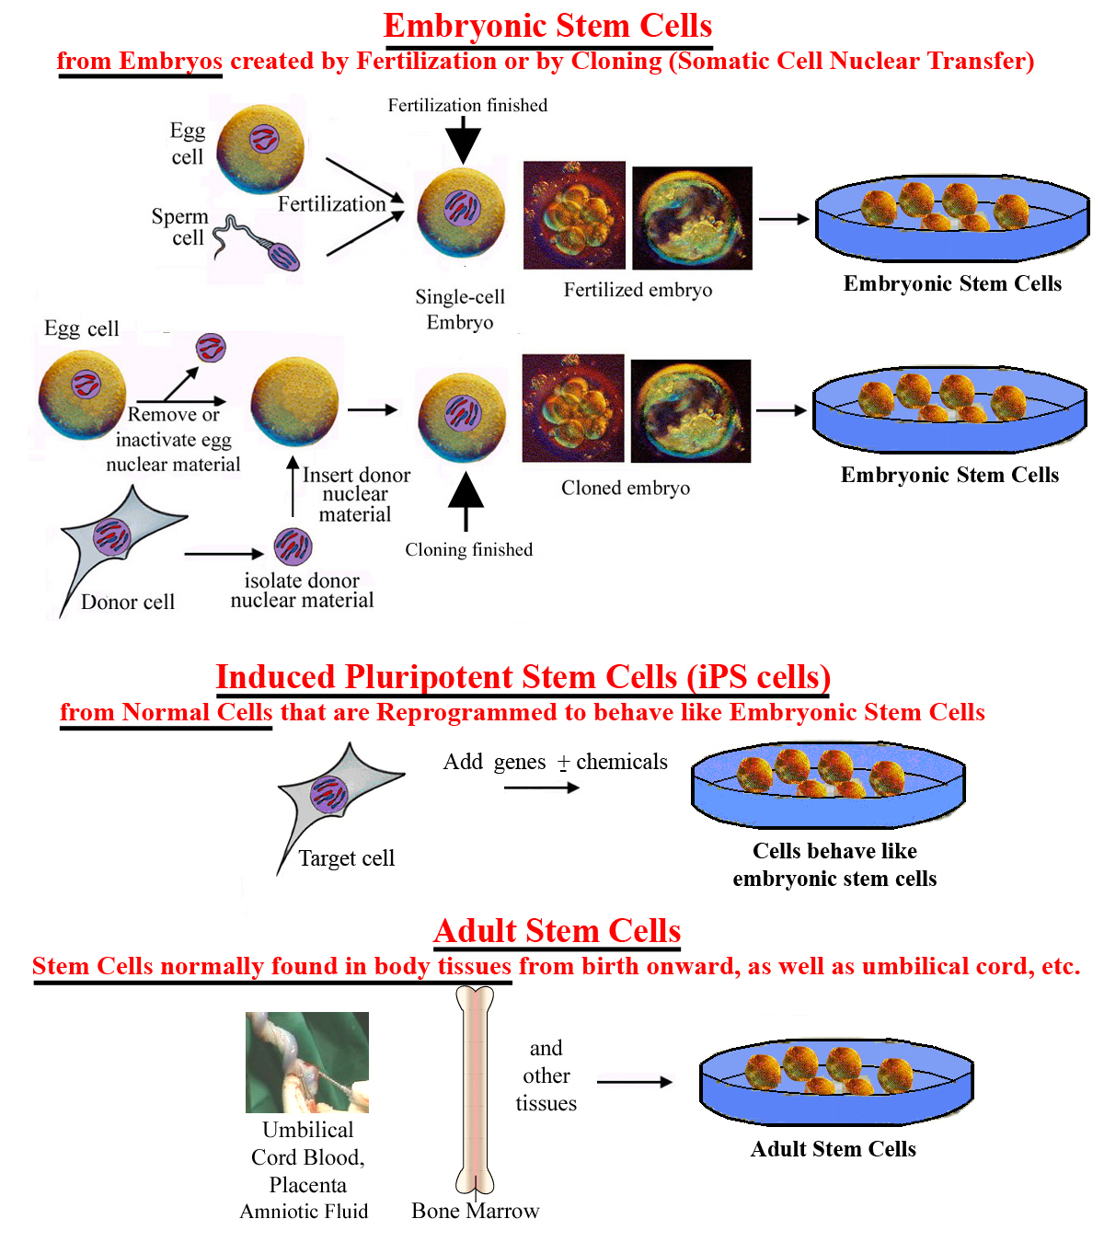

Slide 34
Characterization of Human Pluripotent Stem cells (ESCs)
SSEA-4
Sox-2
Oct-4
Sox17
Sox9
Beta-III tubulin

Slide 35
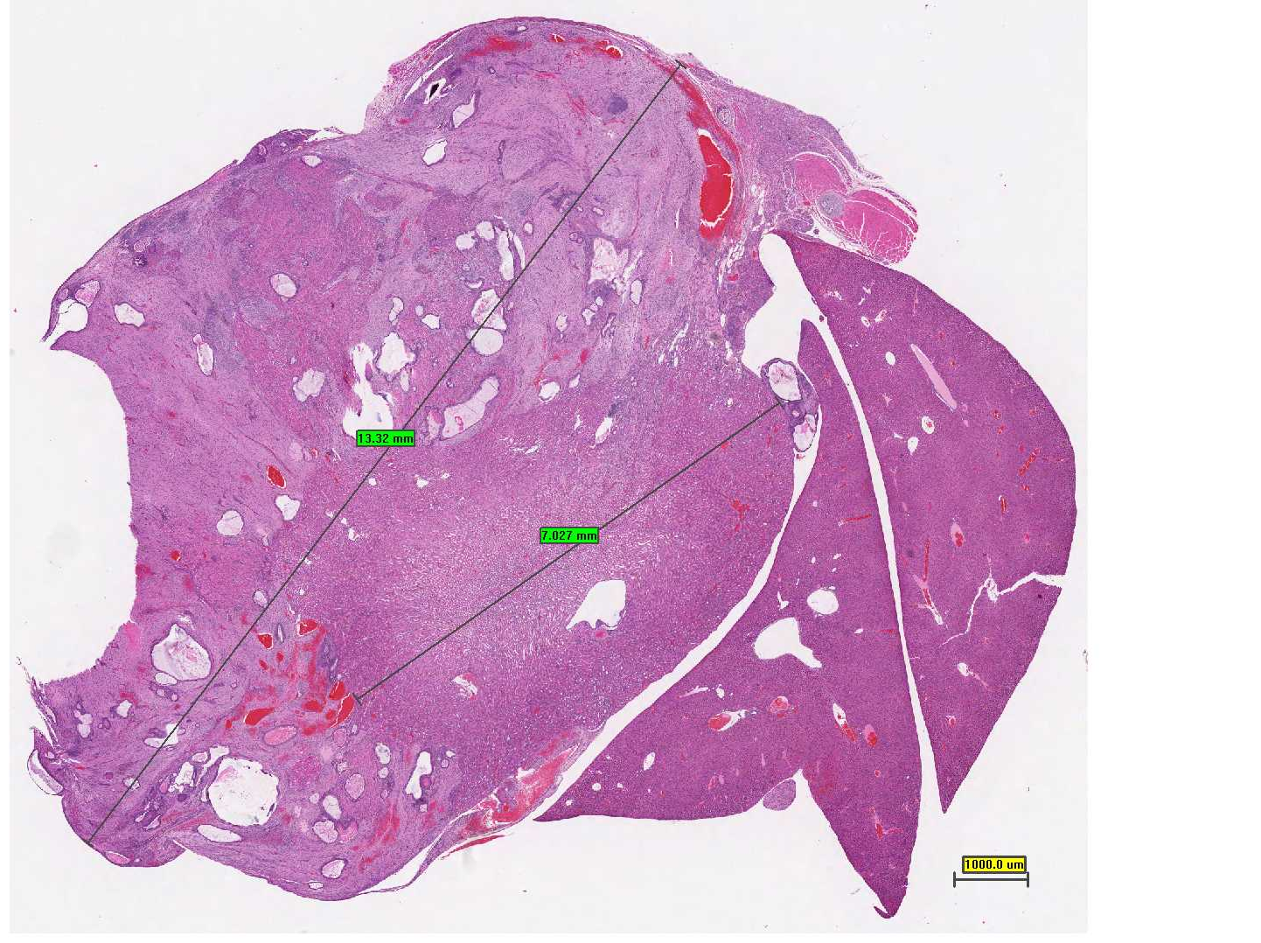
Teratoma
Kidney
Liver
A large tumor mass measuring twice as the kidney is compressing it.

Slide 36
Teratoma Formation in Immunocompetent Mice After Syngeneic and Allogeneic Implantation of Germline Capable Mouse Embryonic Stem Cells, 2013

Slide 37
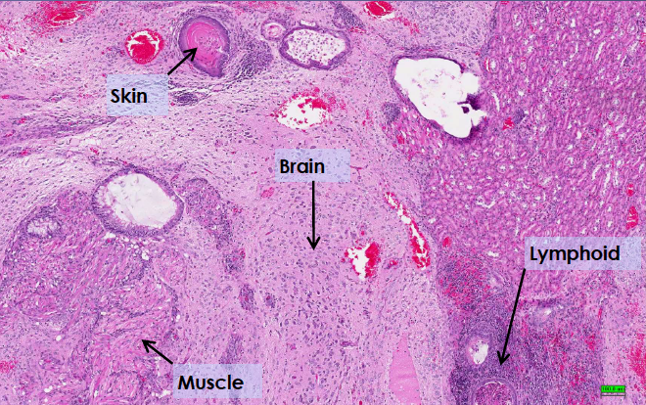
The teratoma was composed of mixed tissue patterns: skin with keratin, brain tissue, striated and smooth muscle, lymphoid tissue,….

Slide 38
Goal of Stem Cell Therapies
The goal of stem cell therapies is to promote cell replacement in organs that are damaged and do not have the ability for self repair

Slide 39
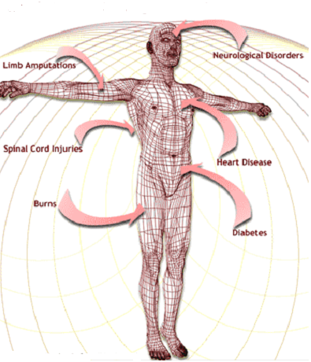
The Promise of Stem Cell Technology
Replacement of tissues/organs
Repair of defective cell types
Study cell differentiation
Toxicity testing.
Understanding prevention and treatment of birth defects.
Study of development and gene control.
Study of drugs therapeutic potential.

Slide 40
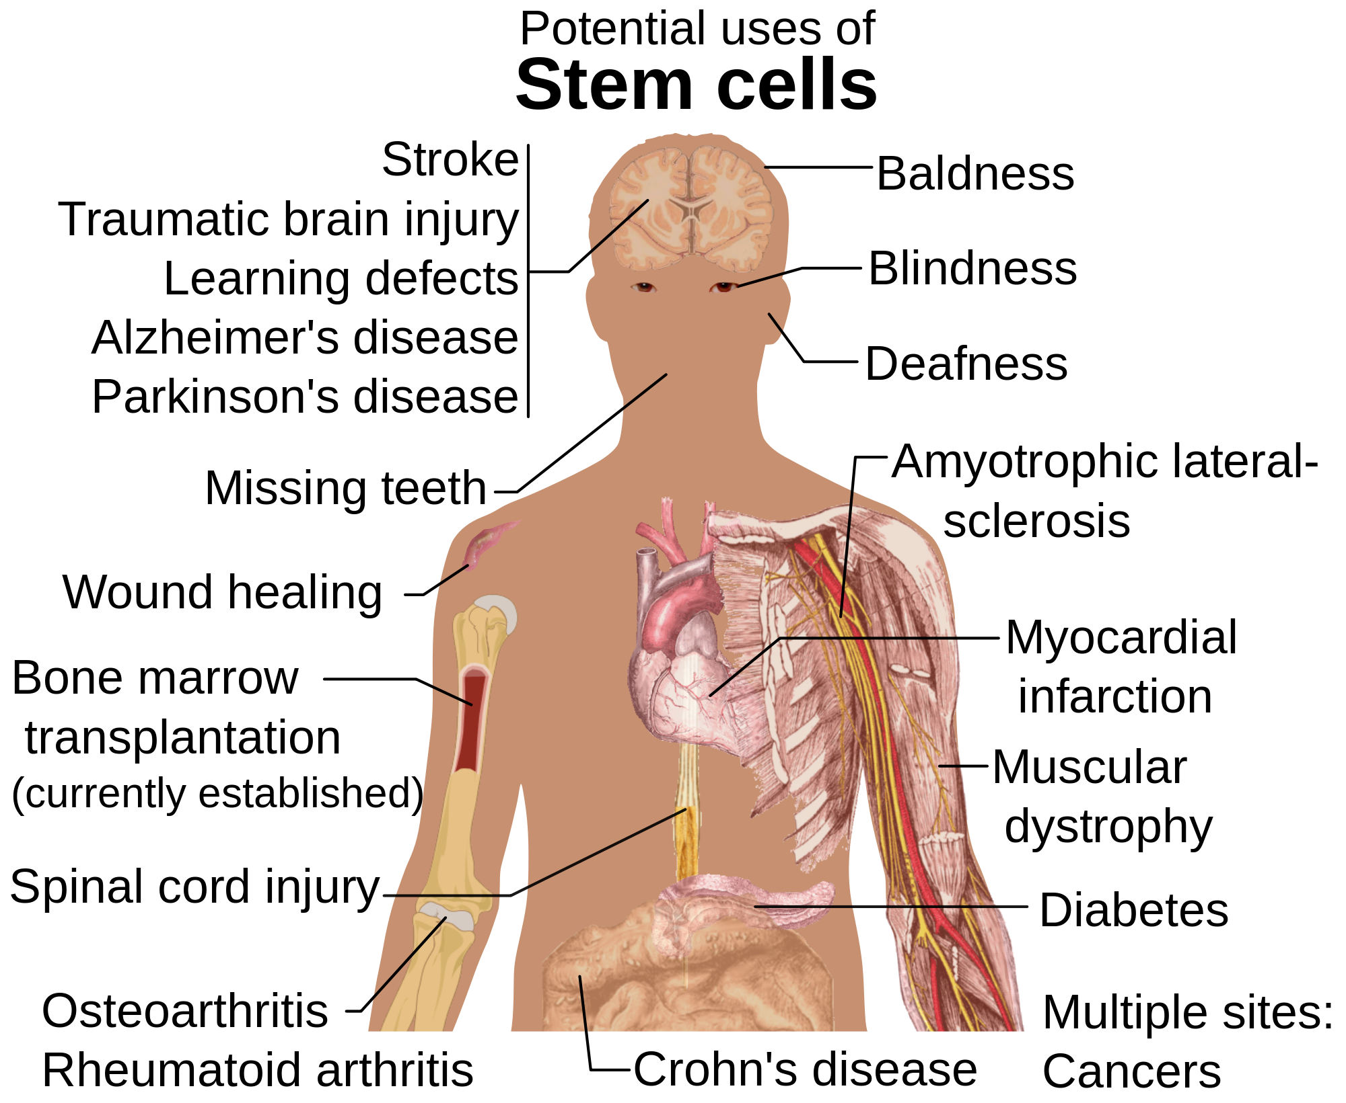

Slide 41
Obstacles of Stem Cell Research
How to find the right type of stem cells?
How to completely differentiate Stem Cells to desired cell type?
How to put the stem cells into the right place?
Will the stem cells perform the desired function in the body?
Differentiation protocols for many cell types have not been developed.

Slide 42
Question 1
Which of the following are pluripotent stem cells?
  Cells has the potential to differentiate into any adult cell type forming an entire organism
  Cells that has limited potential to form only multiple adult cell types
  Cells that don’t have the ability for self renewal
  Cells has the Potential to form all differentiated cell types except placenta

Slide 43
Question 2
Important limitation of using cloned ESCs (SCNT-ESCs) clinically:
  Immune rejection
  Produce limited number of cell types
  Destruction of human embryos
  Difficult to grow and culture in the laboratory

Slide 44
Question 3
What are Yamanaka factors?
  OCT3/4, SOX2, KLF4, c-Myc
  Growth factors
  Cytokines
  OCT3/4, SOX2, Nanog

Slide 45
Question 4
Mesenchymal stem cells are examples of:
  Pluripotent stem cells
  Multipotent stem cells
  Totipotent stem cells
  Induced pluripotent stem cells (iPS cells)

Slide 46

Thank You

