Slide 1
Biochemical Aspects of Bile Acids and Salts
GNT block
Clinical Biochemistry Unit, Path. Dept.
College of Medicine, King Saud University

Slide 2
Objectives
Structure of primary bile acids and salts
Structure of secondary bile acids and salts
Functions of bile salts
Enterohepatic circulation
Malabsorption syndrome
Cholelithiasis

Slide 3
Cholesterol
Cholesterol (27 C) is the:
Parent steroid compound
Precursor of bile acids and salts

Slide 4
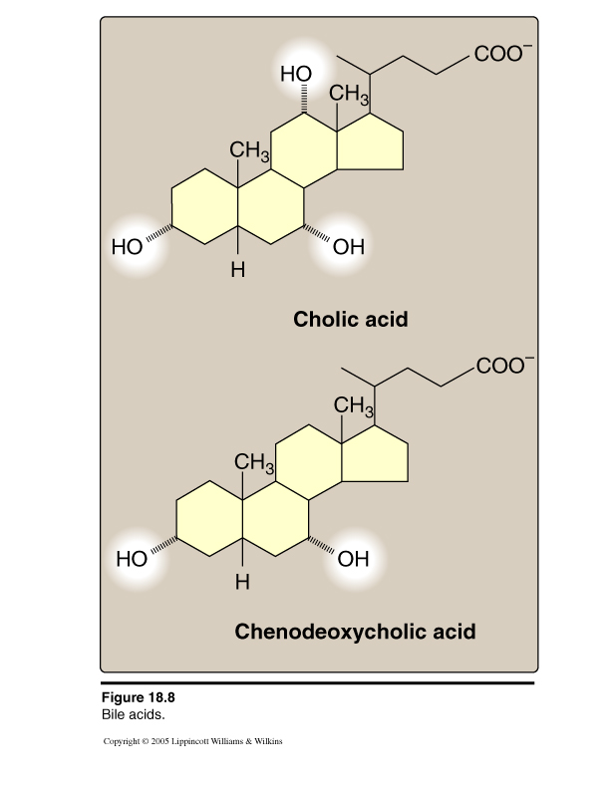
Primary Bile Acids
Primary bile acids (24 C):
Amphipathic
-COOH at side chain
Cholic acid: 3 OH
Chenodeoxycholic: 2 OH

Slide 5
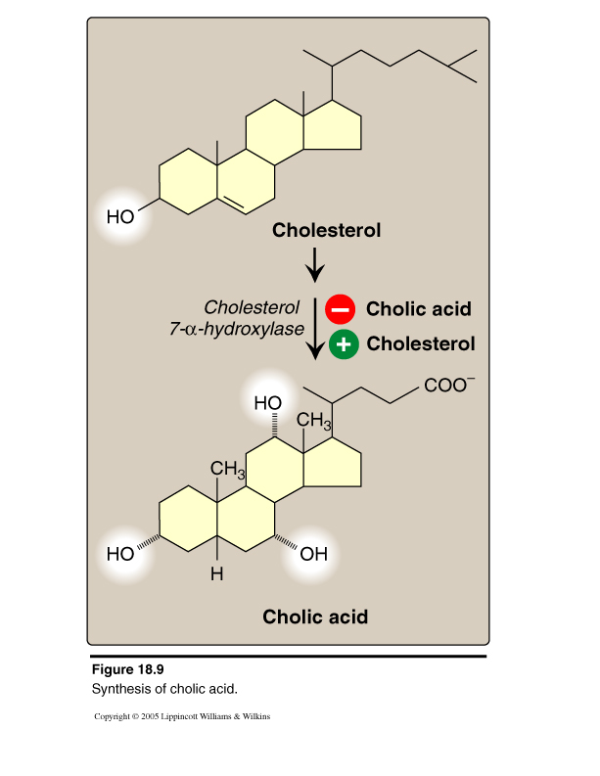
Hepatic Synthesis of Bile Acids
The rate-limiting step is
catalyzed by:
Cholesterol 7-α-hydroxylase
Regulation:
Down-regulated by end products (bile acids) “Enzyme repression”
Up-regulated by cholesterol “Enzyme induction”

Slide 6
Primary Bile Acids and Salts
Cholic acid
BILE ACIDS
Chenodeoxycholic acid
Glycocholic
Taurocholic
Glycochenodeoxycholic
Taurochenodeoxycholic
BILE SALTS
Bile salts (Conjugated bile acids):
amide-linked with glycine or taurine
The ratio of glycine to taurine forms in the bile is
3:1

Slide 7
Bile Salts
Addition of glycine or taurine results in the presence of fully ionized groups at pH 7.0:
-COOH of glycine & -SO₃ of taurine (hence, its name as bile salts e.g., Sodium or potassium glycocholate)
More effective detergent than bile acids
Only bile salts, but not acids, found in bile

Slide 8
Bile Salts
Na or K Glycocholate
Na or K Taurochenodeoxycholate
3

Slide 9
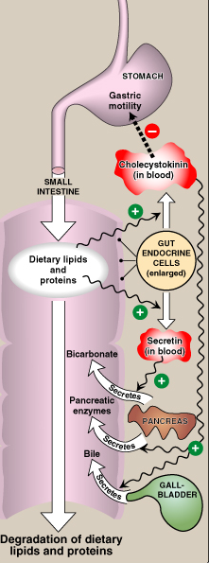
Hormonal Control of Bile Secretion
Stimulus: Undigested lipids and partially digested proteins in duodenum
Hormone from gut cells: Cholecystokinin (CCK)
Responses:
Secretion of pancreatic enzymes
Bile secretion
Slow release of gastric contents

Slide 10
Functions of Bile Salts
Important for cholesterol excretion:
1. As metabolic products of cholesterol
2. Solubilizer of cholesterol in bile
Emulsifying factors for dietary lipids, a prerequisite step for efficient lipid digestion
Cofactor for pancreatic lipase and PLA2
Facilitate intestinal lipid absorption by formation of mixed micelle

Slide 11
Emulsification of Dietary Lipids in Duodenum: Role of Bile Salts
Emulsification increases the surface area of lipid droplets, therefore the digestive enzymes can effectively act.
Mechanisms:
1. Mechanical mixing by peristalsis
2. Detergent effect of bile salts:
Bile salts interact with lipid particles and aqueous duodenal contents, stabilizing the particles as they become smaller, and preventing them from coalescing.

Slide 12
Absorption of Lipids by Intestinal Mucosal Cells: Role of Bile salts
Mixed micelles:
Disc-shaped clusters of amphipathic lipids.
Arranged with their hydrophobic groups on the inside and their hydrophilic groups on the outside.
Micelle includes end products of lipid digestion, bile salts and fat-soluble vitamins
Note: Short- and medium-chain fatty acids do not require mixed micelle for absorption by intestinal cells

Slide 13
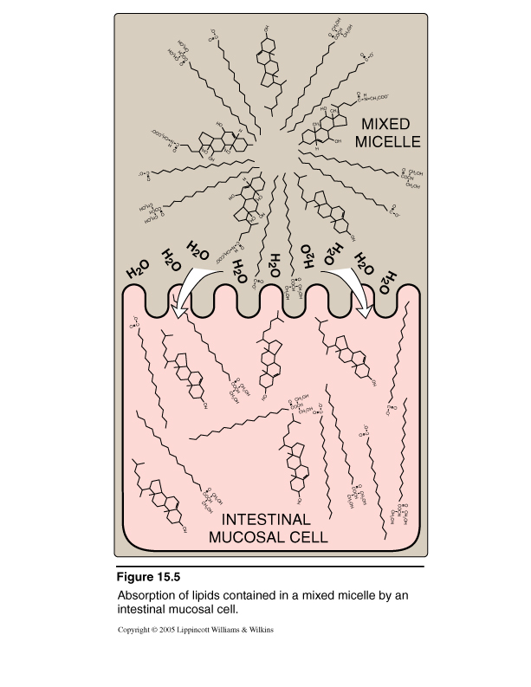
The Role of Bile Salts in Absorption of Lipids by Intestinal Cells
Mixed Micelle Formation:
Bile salts
End products of lipid digestion
Fat-soluble vitamins

Slide 14
Secondary Bile Acids
Bile salts Glyco- or Tauro-cholate -Chenodeoxycholate
Glycine
Intestinal bacteria
Taurine
Bile acids Cholic acid Chenodeoxycholic
Intestinal bacteria
OH
2° Bile acids Deoxycholic acid Lithotomic

Slide 15
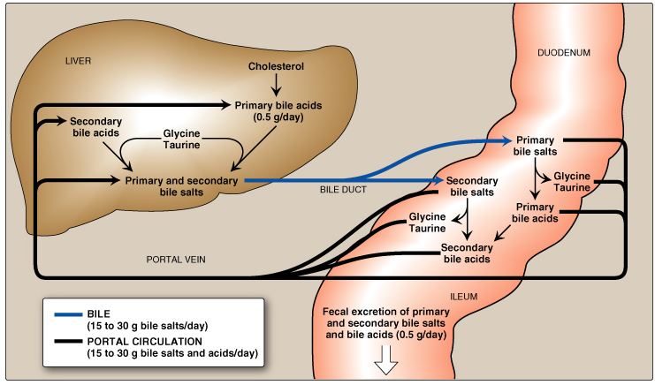
Enterohepatic Circulation

Slide 16
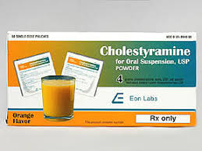
Enterohepatic Circulation
CONT’D
Cholestyramine: Bile acid sequestrants
It binds to bile acids in the gut,
preventing their reabsorption &
Promoting their excretion
It is used for treatment of hypercholesterolemia
Dietary fiber:
It binds to bile acids, increasing their excretion

Slide 17
Maldigestion / Malabsorption of Lipids
Decreased bile secretion by:
Liver diseases:
e.g., Hepatitis or cirrhosis
Gall bladder diseases:
e.g., Gall stones
Malabsorption of lipids

Slide 18
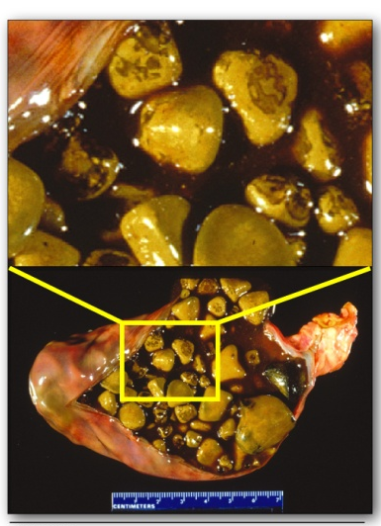
Cholelithiasis Cholesterol Gallstone Disease
Causes:
Bile salts in bile:
Biliary tract obstruction (intereferes with enterohepatic circulation)
Hepatic dysfunction ( synthesis)
Biliary cholesterol excretion
Treatment:
• Bile acid replacement therapy
• Surgical

Slide 19
Thank you

