Slide 1
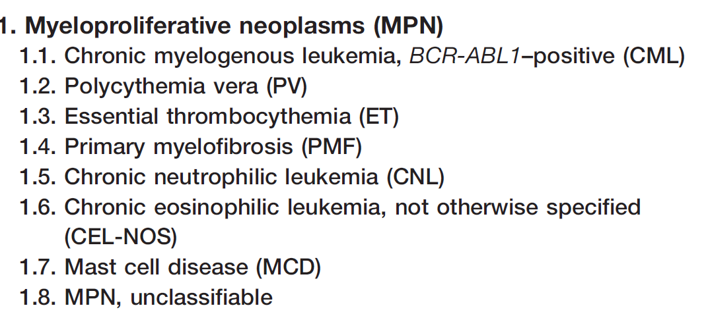
Myeloproliferative Neoplasms

Slide 2
MPN features
Cytosis
Organomegaly (mainly splenomgaly)
High uric acid
Hypercellular bone marrow
Progression to acute leukaemia (mainly AML)

Slide 3
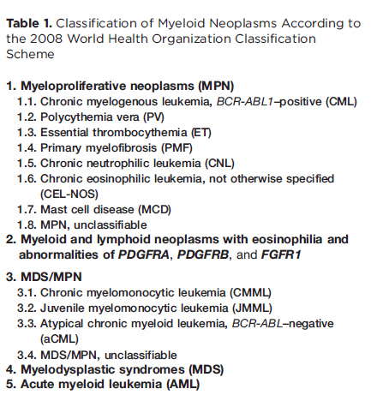
BCR-ABL must be
negative

Slide 4
Polycythemia
In Greek “too many cells in the blood.”.
Absolute increase in total body red cell volume (or mass)
Manifests itself as a raised Hb or packed cell volume (PCV)
Hb is >16.5or 18.5 g/dl in women and men, respectively.

Slide 5
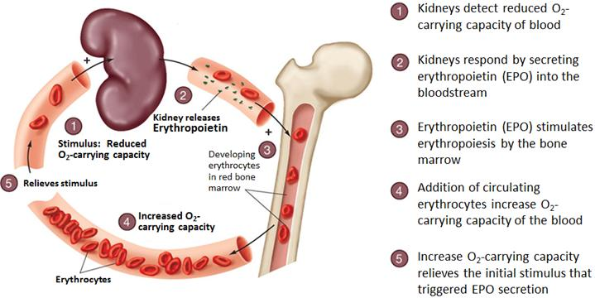
Regulation of Erythropoiesis

Slide 6
Classification of Polycythemia
normal
normal
normal
Relative
Polycythemia
2nd Polycythemia
Polycythemia vera
Decreased plasma volume due to severe dehydration
Increased RBC mass due to high EPO:
1-COPD, Sleep apnea, smoking..
2-High altitude
3-High affinity HB
4-Renal disease
5-Epo secreating tumor (Parathyroid adenoma …)
Increased RBC mass due to malignant proliferation

Slide 7
For reading

Slide 8
Polycythemia Vera
MPN characterized by increased red blood cell production independent of the mechanisms that normally regulate erythropoiesis.
Diagnostic Features:
HB >18.5g/dl in men ,16.5g/dl in women
Hypercellular bone marrow
JAK2 mutation in >95% of cases
Low Serum erythropoietin level

Slide 9
Clinical features of PV
1-Increased blood viscosity
Hypertension
Headache, dizziness, visual disturbances & paresthesia
2- Thrombosis
Deep vein thrombosis
Myocardial infarction
Mesenteric, portal or splenic vein thrombosis
3-Splenomegaly in 70%
4-Hepatomegaly in 40%
Dr.Mansour Aljabry

Slide 10
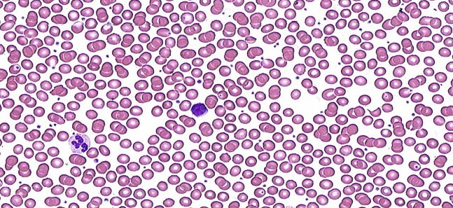
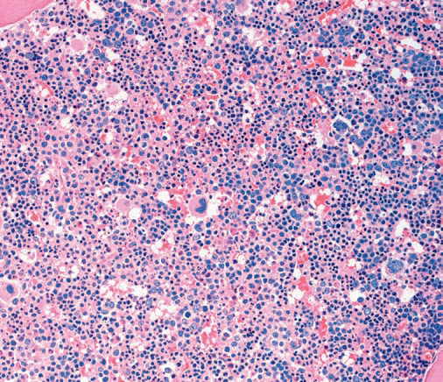
Investigations
CBC:
*RBC: increased *Hb: increased
*WBC & PLT :mildly increased (usually)
Blood smear:
Excess of normocytic normochromic RBC
±Leukocytosis &thrombocytosis
Bone marrow
Hypercellular
Predominant erythroid precursors
± Increased megakaryocytes &Myeloid precursors.
Blasts AL transformation

Slide 11
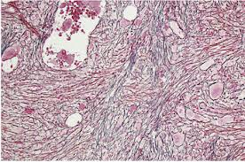
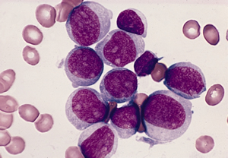
Complication &treatment
Diagnosis of Polycythemia Vera
Treatment:
Venesection + Aspirin
± Myelosuppressive drugs (hydroxyuria)
10-15 years
20%
10%
Myelofibrosis
Acute leukemia

Slide 12
Primary Myelofibrosis

Slide 13
Primary Myelofibrosis
Clonal MPN characterized by a proliferation of megakaryocytes & granulocytes in the bone marrow that associated with deposition of fibrous connective tissue and extramedullary haematopoiesis
Clinical features
Anemia
Leukoerythroblastic blood picture.
Massive splenomegaly
Fibrotic bone marrow
JAK2 mutation (50%)
Risk of AML transformation (20%)

Slide 14
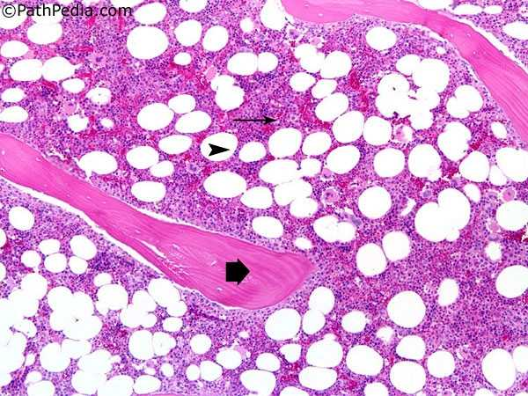
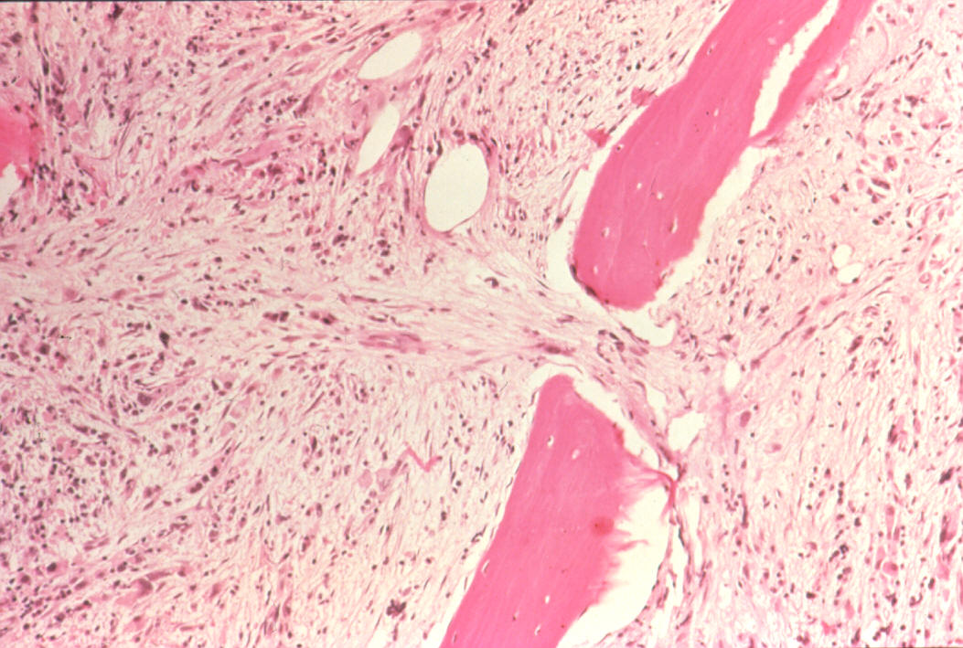
Bone marrow in Myelofibrosis
Normal BM
Fibrotic BM

Slide 15
Stages of PMF
7-10 years survival
Proliferation of megakaryocytes &Granulocytes
Leukocytosis
Thrombocytosis
Prefibrotic stage
3-7 years survival
Fibrotic stage
Anemia
Leukopenia
Thrombocytopenia
Extramedullary hematopoesis
≤1
year survival
AML transformation

Slide 16
Essential Thrombocythemia

Slide 17
Essential Thrombocythemia
ET is MPN that involves primarily the megakaryocytic lineage.
& characterized by sustained thrombocytosis .
Diagnostic Features
Sustained thrombocytosis ≥45O×10⁹.
Hypercellular BM with megakaryocytic proliferation
Exclusion of: CML, MDS,PV &Primary Myelofibrosis
JAK2 mutation (60%),If negative ;no evidence of
reactive thrombocytosis:
Iron def. ,splenoctomy, surgery, infection ,autoimmune disease….

Slide 18
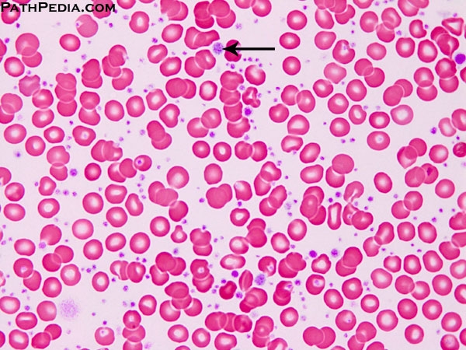

Slide 19
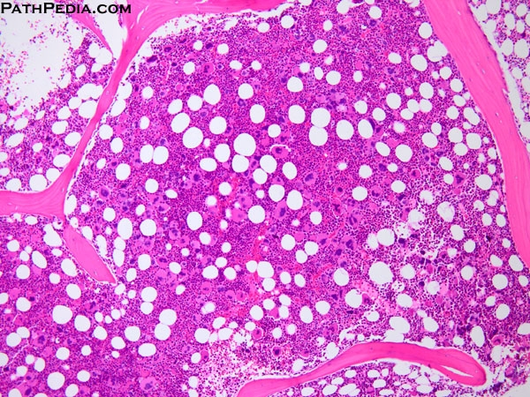

Slide 20
Essential Thrombocythemia
Clinical Presentation
Asymptomatic (50%)
Thrombosis
Bleeding
Mild splenomegaly (50%)
Mild hepatomegaly (20%)
Very indolent
(5% risk of AML transformation )
Treatment
Aspirin ±Hydroxyuria

Slide 21
JAK2 Mutation
JAK2: Non receptor protein tyrosine kinase involved in signal transduction pathway
JAK2 kinase domains structure
JH6
JH5
JH4
JH3
JH2
JH1
Negative feed back
JAK2 mutation :
Point mutation (at codon 617 in JH2) leads to loss of auto inhibitory control over JAK2.
The mutated JAK2 is in a constitutively active state,

Slide 22
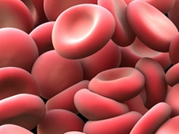
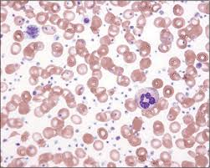
JAK2 Mutation
EPO
JAK2
JH2
JH1
P
-ve
P
RAS
P
95%
STAT
JAK2 (V617) mutation
P
MAPK
+ve
+ve
60%
Transcriptional factors
Increased proliferation
Decreased apoptosis
50%
Dr.Aljabry

Slide 23
??

