Slide 1
PRACTICAL HAEMOGLOBINOPATHIES
Dr. Osamah T. Khojah, MBBS, Ms. Med, Ms. Sc, KSUF, IFCAP, CPHQ
Assistant Professor & Consultant
Program Director of Clinical Pathology
Department of Pathology – Hematology Unit
asd@ksu.edu.sa, 0555485892

Slide 2
Golden Rules to Evaluate Hemoglobin Electrophoresis
1) You must know the CBC results (RBC count, Hb, MCV, MCH, RDW & Plt).
2) Peripheral blood film might be useful (target, sickle, pencil, rhomboidal, golf).
3) different methods has its own issues (gel: alkaline or acid, HPLC & capillary electrophoresis)
4) Family history and molecular tests are critical in difficult cases and to confirm the diagnosis.
5) As a physician, do not under estimate the medical history (blood transfusion) and clinical examination.

Slide 5
Pencil cell

Slide 7
Golden Rules to Evaluate Hemoglobin Electrophoresis
6) Are all normal hemoglobin variants present? And if present, are they in normal amount?
7) Beta thalassemia trait has a higher Hb A2 (>3.6) & beta thalassemia major has a very high Hb F (>80%).
8) Is there any abnormal Hb? What is the percentage?
9) Sickle cell trait has 35% - 45% Hb S. If it is >45%, it is a sickle cell disease (when high Hb A2 then likely S/beta thal).
10) Alpha thalassemia reduced other abnormal Hb level.

Slide 8
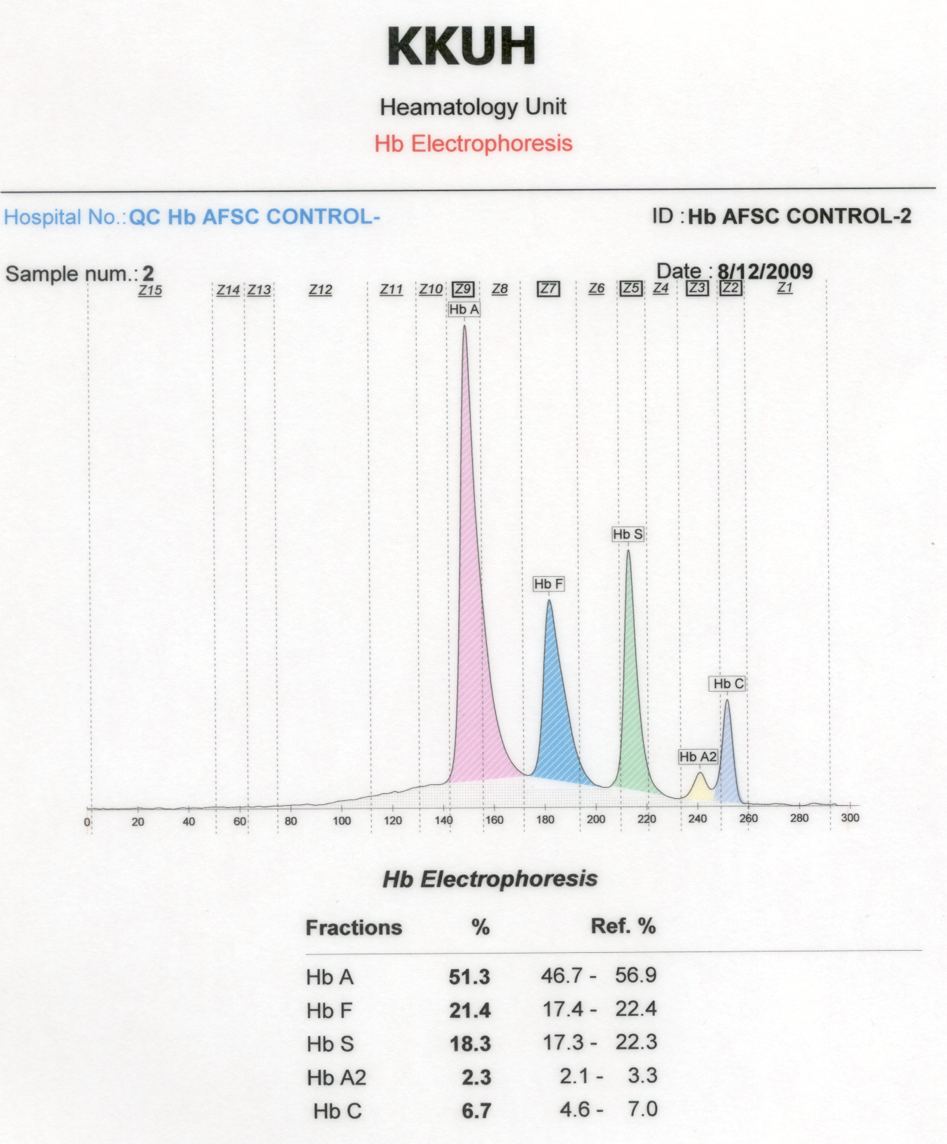
This a QC to ensure accurate results of Hb Electrophoresis

Slide 9
RBC= 4.8 (N).
Hb= 14 (N).
MCV= 83 (N).
MCH= 29 (N).
RDW= 14 (N).
Plt= 230 (N).
This is a normal Hb pattern.

Slide 10
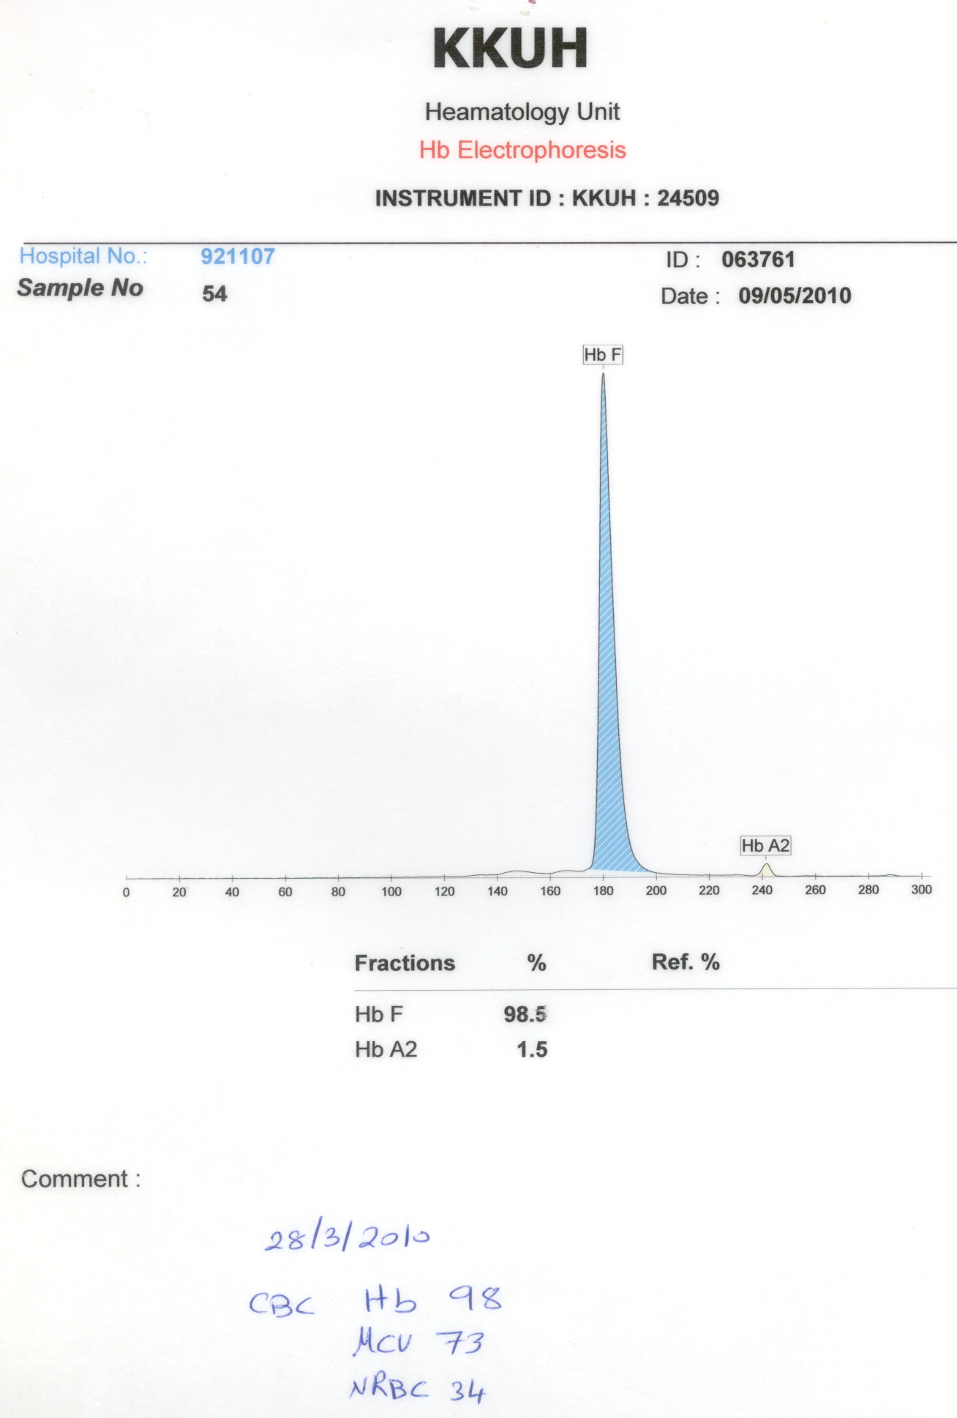
Beta thalassemia major (B0/B0).
There is NO Hb A.

Slide 11
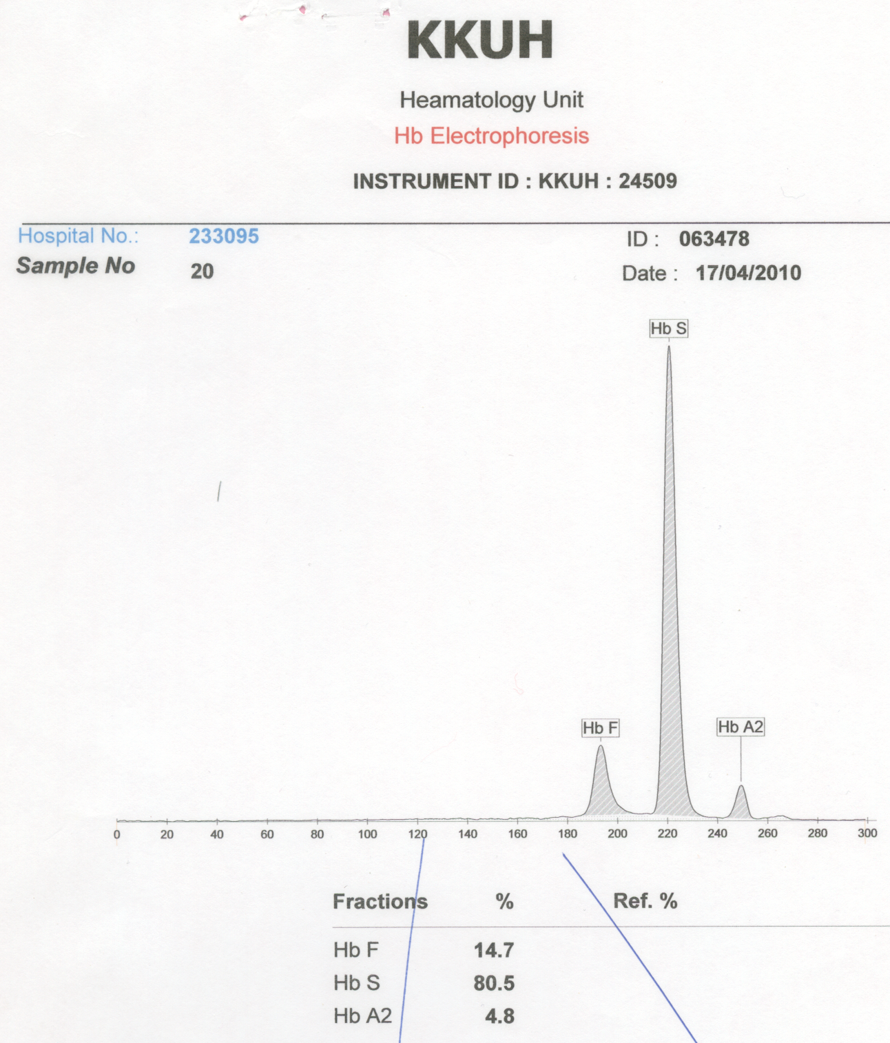
RBC= 2.8 (L).
Hb= 7.2 (L).
MCV= 72 (L).
MCH= 22 (L).
RDW= 16 (H).
Plt= 340 (N).
Sickle cell disease, likely (S/beta0) + HPFH.
PBF might show target & NRBCs.

Slide 12
RBC= 2.8 (L).
Hb= 7.2 (L).
MCV= 83 (N).
MCH= 29 (N).
RDW= 16 (H).
Plt= 340 (N).
Sickle cell disease, likely (S/S). Pt likely on Hydroxyurea (HU, elevated Hb F).

Slide 13
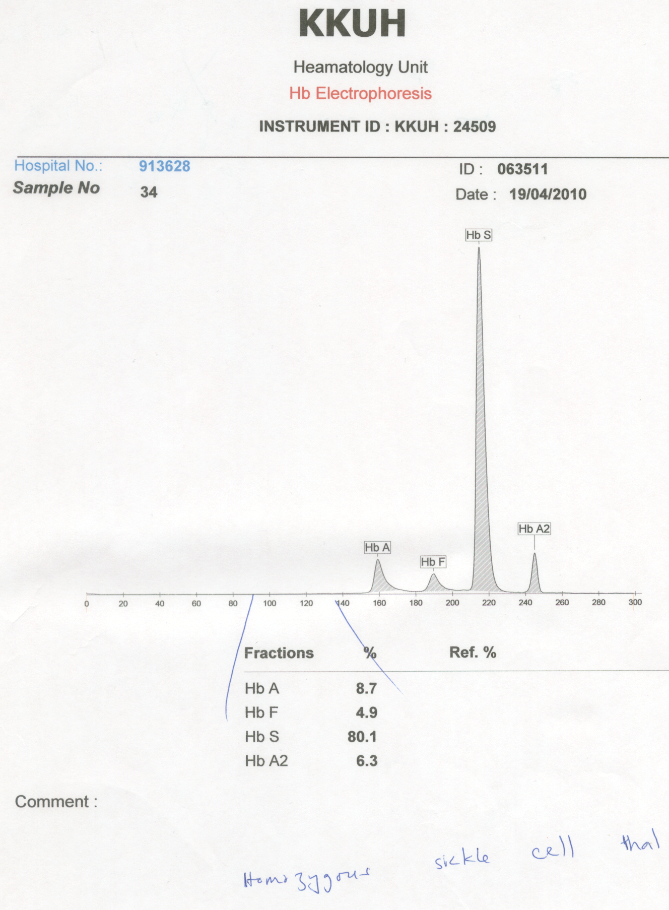
RBC= 2.8 (L).
Hb= 7.2 (L).
MCV= 72 (L).
MCH= 22 (L).
RDW= 16 (H).
Plt= 340 (N).
Sickle cell disease, likely (S/beta thal).
Pt has blood Tx + HU and PBF might show target & NRBCs.

Slide 14
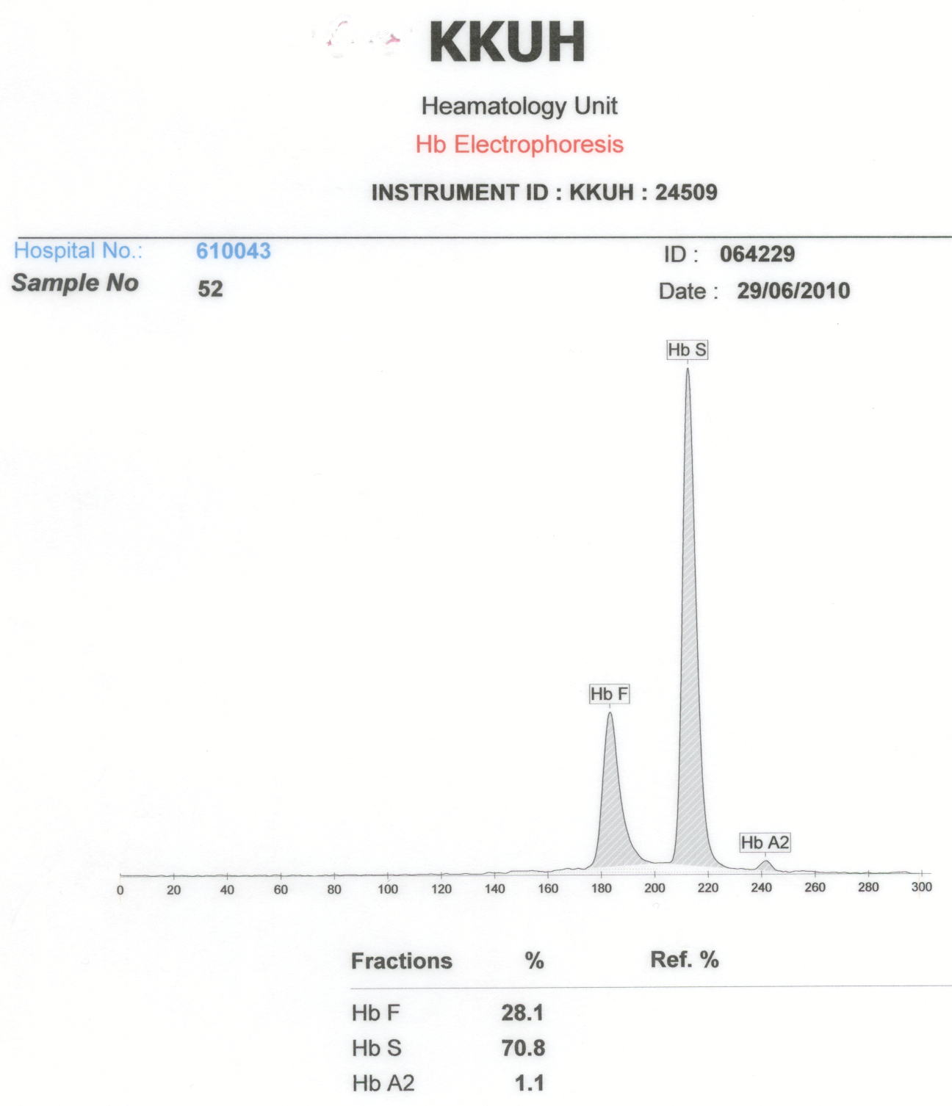
Sickle cell disease, (S/S) + HPFH & alpha thalassemia (low MCV, MCH & Hb A2). High Hb F might protect from crisis. Confirm by family & molecular .
RBC= 2.8 (L).
Hb= 7.2 (L).
MCV= 72 (L).
MCH= 22 (L).
RDW= 16 (H).
Plt= 340 (N).

Slide 15
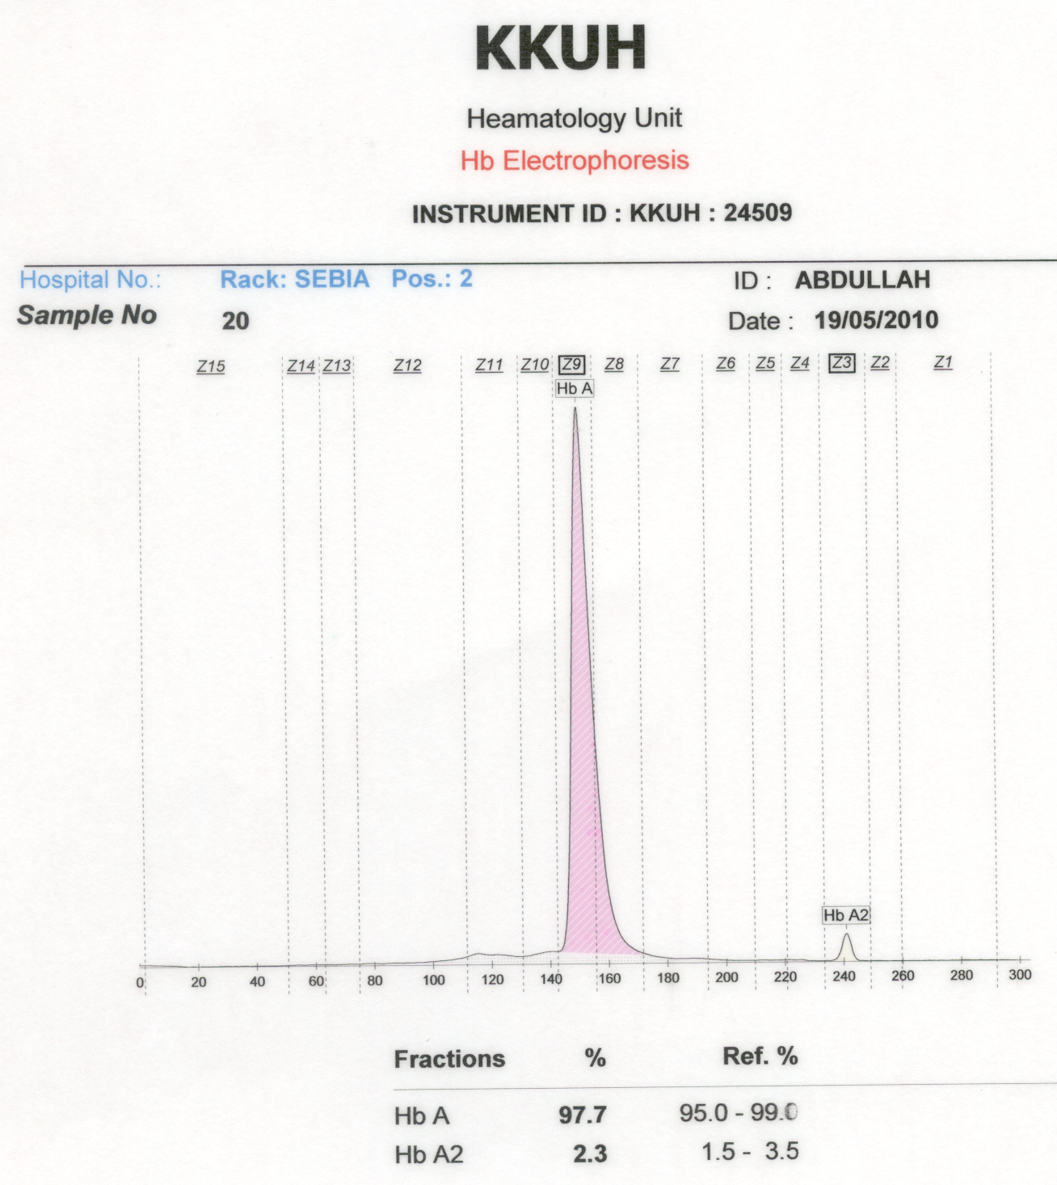
RBC= 4.8 (N).
Hb= 14 (N).
MCV= 67 (L).
MCH= 23 (L).
RDW= 13 (N).
Plt= 230 (N).
Normal Hemoglobin pattern but likely alpha thalassemia trait.
Family and molecular studies to confirm.

Slide 16
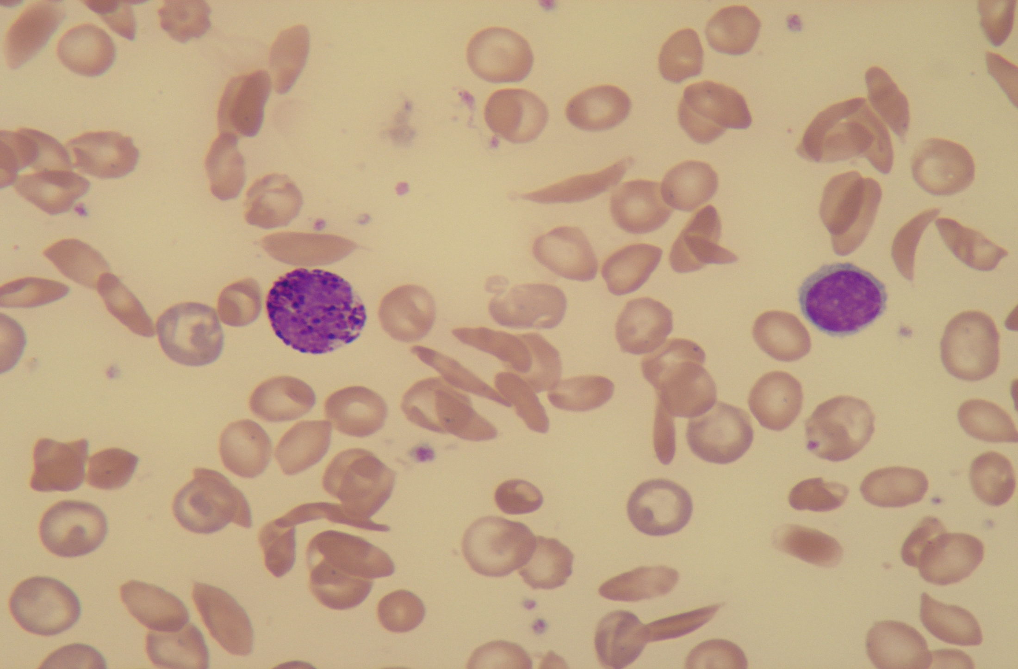
Frequent sickle cells seen with few target cells.
If Hb A2 is normal with low MCV & MCH, this SCD maybe (S/S) with likely an alpha thalassemia trait.

Slide 17
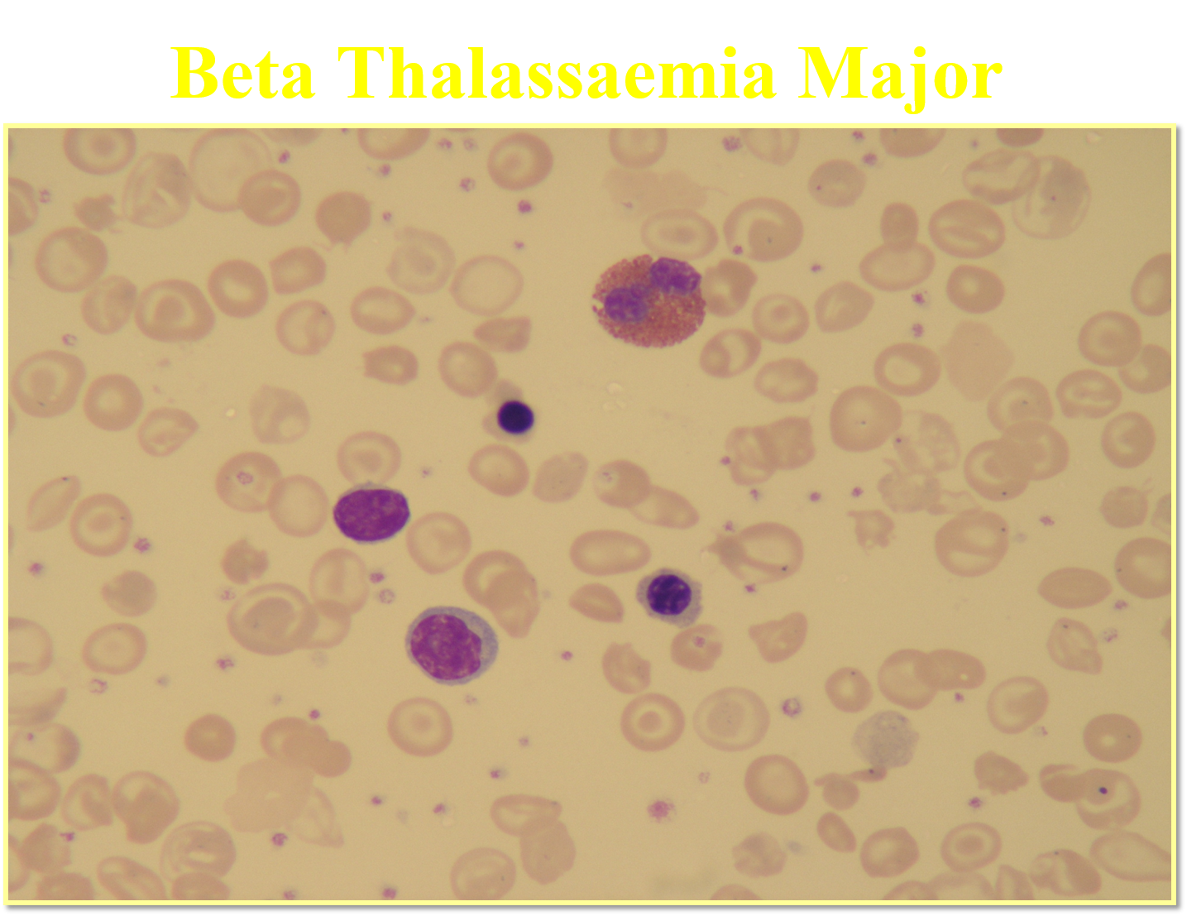
Microcytic RBCs.
Hypochromic RBCs.
Many target cells.
Frequent NRBCs.
WBCs (2 lymphocytes and eosinophil).
IF Hb F is ~ 95%, this is beta thalassemia major. If NO Hb A, then, (B0/B0).

Slide 18
RBC= 4.8 (N).
Hb= 14 (N).
MCV= 67 (L).
MCH= 23 (L).
RDW= 13 (N).
Plt= 230 (N).
Sickle cell trait with likely alpha thalassemia.
Family and molecular studies to confirm.

Slide 19
RBC= 2.8 (L).
Hb= 7.2 (L).
MCV= 82 (N).
MCH= 27 (N).
RDW= 16 (H).
Plt= 340 (N).
- Sickle cell disease, (S/S) + HPFH.
- (normal MCV, MCH & Hb A2). High Hb F might protect from crisis.
- Confirm by family & molecular .

Slide 20
Normal results even with slight elevated Hb A2 (NOT beta thalassemia trait).
Family and molecular studies to confirm.

Slide 21
Thank you

