Slide 1
Pathophysiology of Ascites in Cirrhosis
Khalid Alswat, MD, MRCP, FACP
Associate Professor, Consultant Gastroenterologist/hepatologist
College of Medicine, King Saud University

Slide 2
Objectives
To understand basic pathophysiologic steps in the development of ascites secondary to cirrhosis.
To correlate the anatomic and pathophysiologic changes with clinical manifestations.
To understand the basic steps in evaluation of patients with ascites

Slide 3
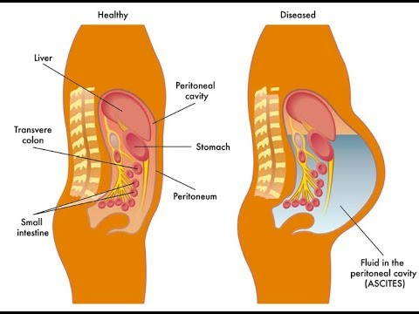
Definition
  The pathologic accumulation of fluid in the peritoneal cavity
  It is the most common complication of cirrhosis
  Ascites:
  Cirrhosis 85%
  Other causes 15 %

Slide 4
Causes of ascites
Sherlock′s Diseases of the Liver and Biliary System

Slide 5
Anatomy of portal system
https://www.hopkinsmedicine.org/gastroenterology_hepatology/_pdfs/liver/alcoholic_liver_disease.pdf

Slide 6
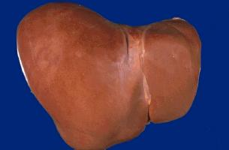
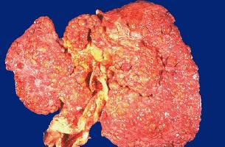
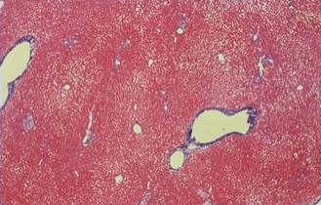
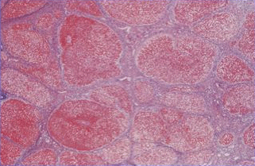
Cirrhosis: Late stage of chronic liver inflammation and fibrosis, in which liver parenchyma is distorted and replaced by fibrous tissue and regenerating nodules.
NORMAL LIVER
CIRRHOTIC LIVER

Slide 7
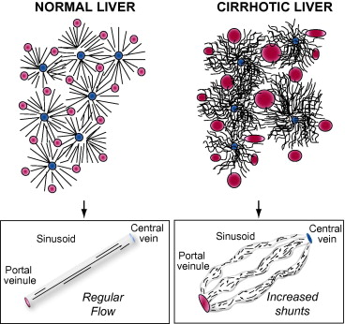
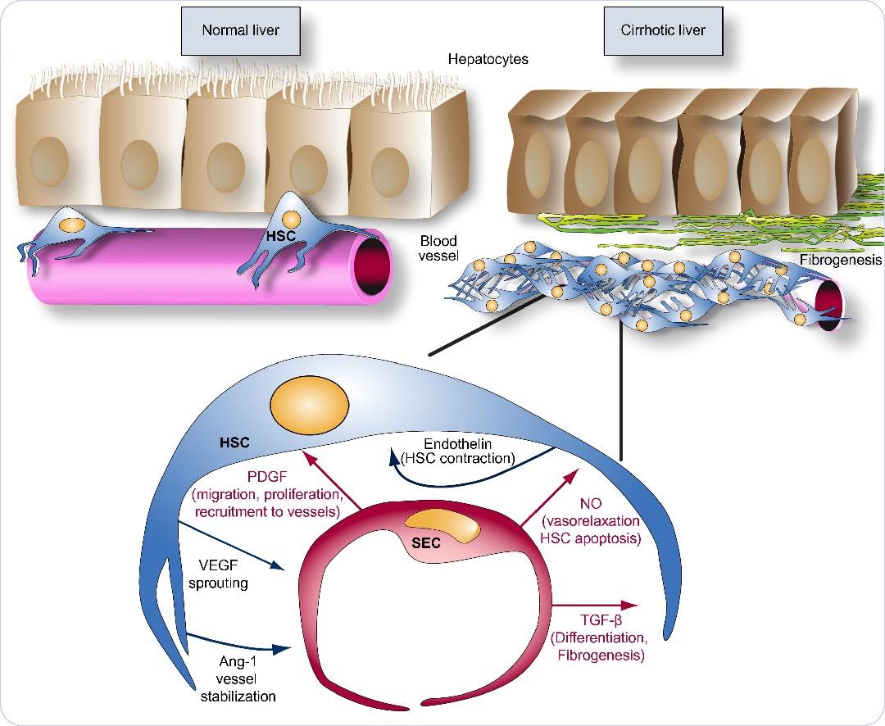
Liver microcirculation
In normal physiologic conditions, HSC contractility and coverage of sinusoids is sparse
In cirrhosis, increased numbers of HSC with increased cellular projections, wrap more effectively around sinusoids thereby contributing to a high-resistance, constricted sinusoidal vessel.
https://www.sciencedirect.com/science/article/pii/S016882781000632X#f0010

Slide 8
PORTAL HYPERTENSION
The development of portal hypertension (PHT) is the first step toward fluid retention in the setting of cirrhosis.
Patients with cirrhosis but without PHT do not develop ascites or edema
A portal pressure >12 mmHg appears to be required for fluid retention

Slide 9
PORTAL HYPERTENSION
How portal hypertension develop?
2 main mechanisms involved in portal hypertension:
Mechanical (due to structural changes in the liver with fibrosis and regenerative nodules)
Hemodynamic changes (circulatory, vascular, functional, and biochemical)

Slide 10
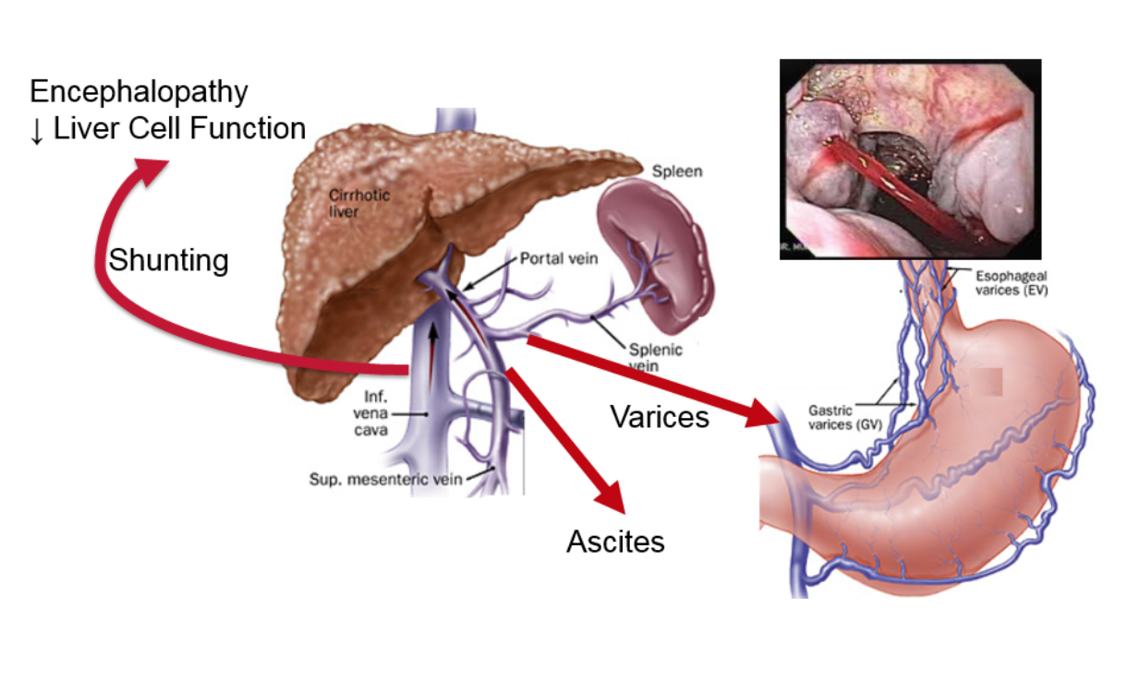

Slide 11
Pathophysiology of ascites in cirrhosis
How ascites develop?
Sherlock′s Diseases of the Liver and Biliary System

Slide 12
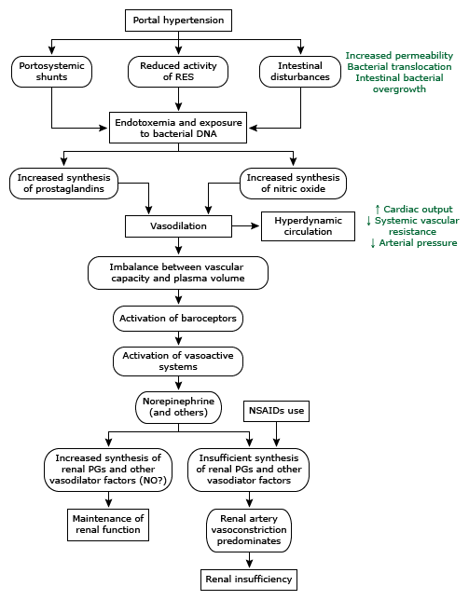
Pathogenic mechanisms responsible for the activation of vasoactive systems and hyperdynamic circulation in cirrhosis
Uptodate®

Slide 13
Vasodilation(VD)
Portal hypertension leads to VD (How?)
VD initially in the splanchnic circulation, later in systemic systemic circulation. (arterial underfilling)
Mechanisms of vasodilation
  Increase production of nitric oxide (NO), which is the primary mediator of VD in cirrhosis (for splanchnic and peripheral vasodilation).
  Increased levels of other circulating VDs. (Glucagon , vasoactive intestinal peptide(VIP), prostacyclin. (Why?)
  Production of these VDs may be stimulated by endotoxins or other bacterial products

Slide 14
Consequences of vasodilation
Activation of endogenous vasoconstrictors.(compensatory)
Sodium and water retention.
Increase renal vasoconstriction.

Slide 15
1-Activation of endogenous vasoconstrictor agents
VD→ The reduction in pressure (or stretch) at the carotid and renal baroreceptors → activation of the sodium-retaining neurohumoral mechanisms (in an attempt to restore perfusion pressure to normal
  renin-angiotensin-aldosterone system
  sympathetic nervous system
  antidiuretic hormone (vasopressin).
The net effect is avid sodium and water retention

Slide 16
2-Sodium and water retention
In patients with cirrhosis and ascites, the normal regulation of sodium balance is lost. (Impaired sodium excretion)
Initially water excretion is normal in patients with cirrhosis before the development of ascites and then becomes increasingly impaired as the liver disease progresses. (Increase ADH)
Thus, patients with cirrhosis and ascites usually demonstrate urinary sodium retention, increased total body sodium, and dilutional hyponatremia.

Slide 17
3-Renal vasoconstriction
VC → renal hypoperfusion→ decrease GFR (Glomerular filtration rate)
Renal perfusion may initially be maintained due to vasodilators such as prostaglandins and perhaps nitric oxide (local )
However, progression renal hypoperfusion can lead to gradual decline in the glomerular filtration rate, and, in some patients, the hepatorenal syndrome

Slide 18
Finally
This excess retained blood volume leaks-out (filtered )(extravasate) directly from both the liver surface, and the mesenteric vessels.
Due to:
  Increased hydrostatics pressure
  Increase vascular wall permeability
  Concurrently decreased oncotic (osmotic) pressure (hypoalbuminemia)

Slide 19
Pathogenic mechanisms responsible for the activation of vasoactive systems and hyperdynamic circulation in cirrhosis

Slide 20
Evaluation of patient with ascites
History: symptoms of chronic liver disease, abdominal distention
Examination: Flank fullness, shifting dullness or fluid thrill
Imaging : Ultrasound
Ascitic fluid analysis

Slide 21
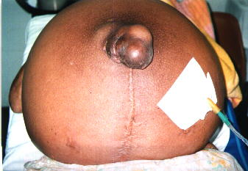
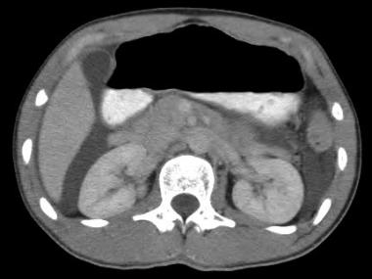

Slide 22
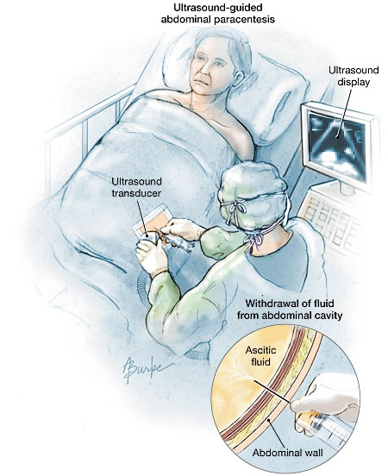
Any new ascites should be tapped and analyzed!

Slide 23
Summary -1
Ascites is the most common liver cirrhosis complication.
Development of ascites indicates advanced stage of liver disease and poorer prognosis.
Development of ascites is complex process.

Slide 24
Summary -2
Pathophysiology is mostly explained by portal
(sinusoidal) hypertension and sodium retention due
to vasodilation and consequent activation of sodium retaining systems.
Explained:
Portal hypertension is first step in ascites development in patient with cirrhosis.
Possible bacterial toxin trigger VDs.

Slide 25
Summary -3
VD with activation of secondary mechanisms;
  renin-angiotensin-aldosterone system
  sympathetic nervous system
  antidiuretic hormone (vasopressin).
  LEADS TO SALT AND WATER RESTENTION and Increase plasma volume
  All these with hypoalbuminemia and increase vascular permeability lead to fluid extravasation.

Slide 26
Thank you

