Slide 1
Malaria
An Overview of
Life-cycle, Morphology and
Clinical Picture

Slide 2
Malaria Species
Five species of malaria infect humans:
Plasmodium falciparum
Plasmodium vivax
Plasmodium ovale
Plasmodium malariae
Plasmodium knowlesi

Slide 3
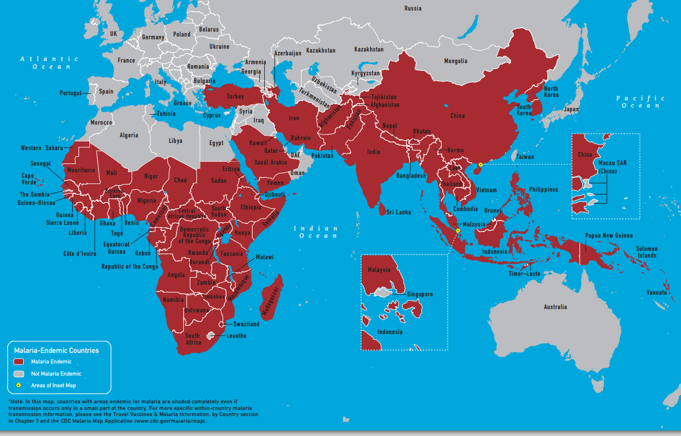
Malaria –Endemic Countries

Slide 4
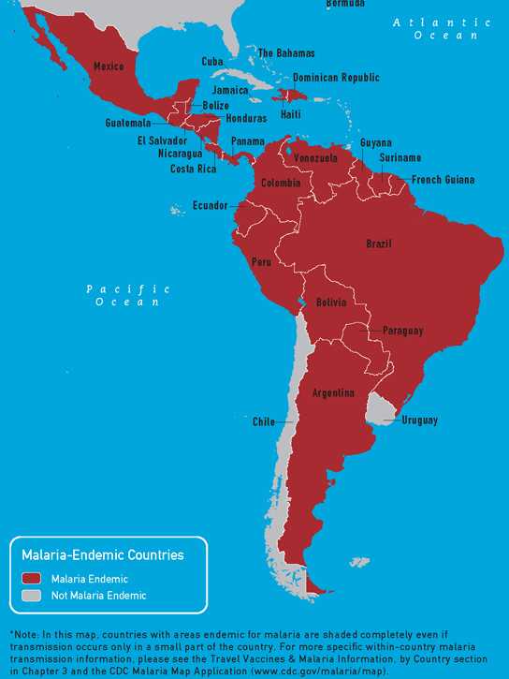
Malaria –Endemic Countries

Slide 5
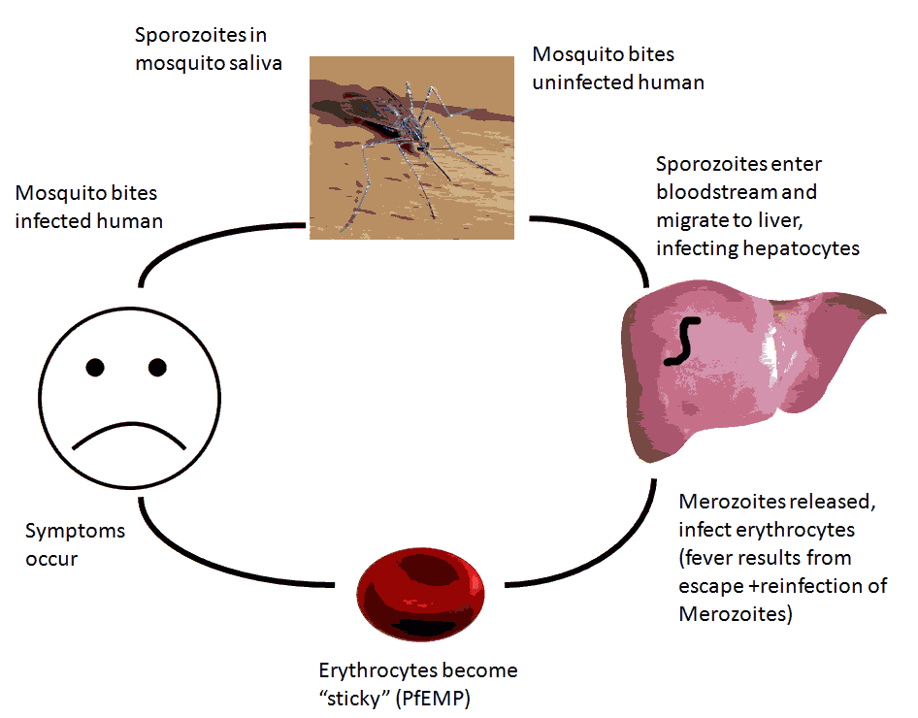

Slide 6
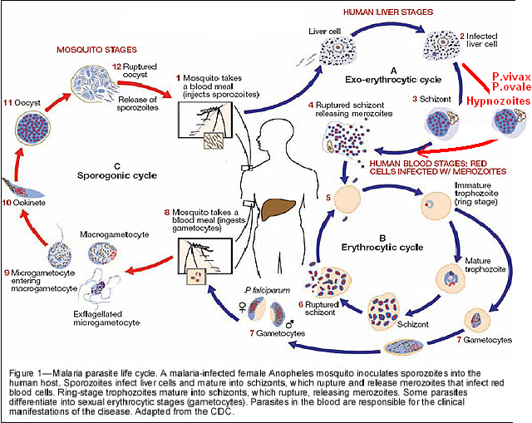

Slide 7
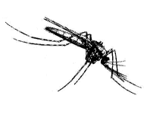
LIFE CYCLE OF MALARIA
Oocyst
Sporozoites
Zygote
Stomach Wall
Salivary Gland
sporozoites
Gametocytes
Pre-erythrocytic
(hepatic) cycle
Exo-erythrocytic
(hepatic) cycle
Erythrocytic
Cycle
Hypnozoites

Slide 8
Components of the Malaria Life Cycle
Sporogonic cycle
Infective
Period
Mosquito bites
uninfected
person
Mosquito Vector
Parasites visible
Human Host
Mosquito bites
gametocytemic
person
Prepatent
Period
Symptom onset
Recovery
Incubation Period
Clinical Illness

Slide 9
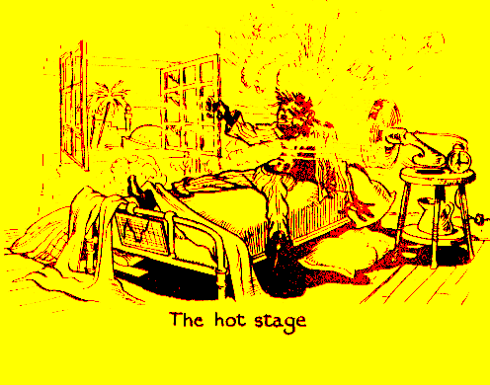
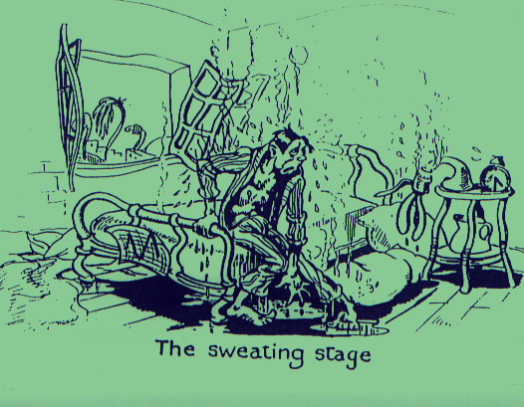
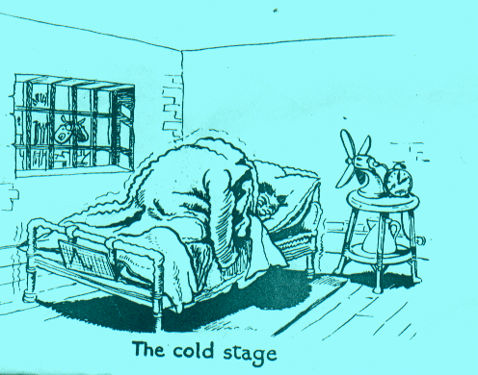
CLINICAL SIGNS & SYMPTOMS OF MALARIA
Fever
Sweating
Chills

Slide 10
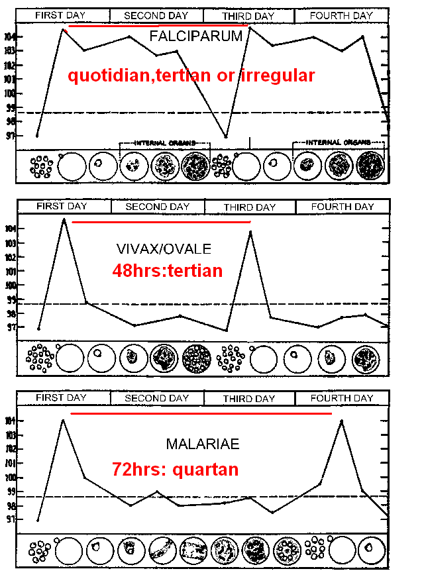
Plasmodium falciparum:
Plasmodium vivax,
Plasmodium ovale
Plasmodium malariae:

Slide 11
CLINICAL PICTURE
Acute Disease
Chronic Disease
Non-severe
Acute Febrile
disease
Chronic
Asymptomatic
Infection
Infection
During
Pregnancy
Severe malaria e.g.
Cerebral
Malaria
Placental
Malaria
Anemia
Low
Birth weight
Developmental
Disorders;
Transfusions;
Death
Increased
Infant
Mortality
Death

Slide 12
Definition
Severe malaria is defined as symptomatic malaria in a patient with
P. falciparum with one or more of the following complications:
Cerebral malaria (unrousable coma not attributable to other causes).
Generalized convulsions (> 2 episodes within 24 hours)
Severe normocytic anaemia (Ht<15% or Hb < 5 g/dl)
Hypoglycemia (blood glucose < 2.2 mmol/l or 40 mg/dl )
Metabolic acidosis with respiratory distress (arterial pH < 7.35 or bicarbonate < 15 mmol/l)
Fluid and electrolyte disturbances
Acute renal failure (urine <400 ml/24 h in adults; 12 ml/kg/24 h in children)
Acute pulmonary edema and adult respiratory distress syndrome
Abnormal bleeding
Jaundice
Haemoglobinuria
Circulatory collapse, shock, septicaema (algid malaria)
Hyperparasitaemia (>10% in non-immune; >20% in semi-immune)

Slide 13
Definition
Uncomplicated malaria is defined as:
Symptomatic infection with malaria parasitemia without signs of severity and/or evidence of vital organ dysfunction.

Slide 14
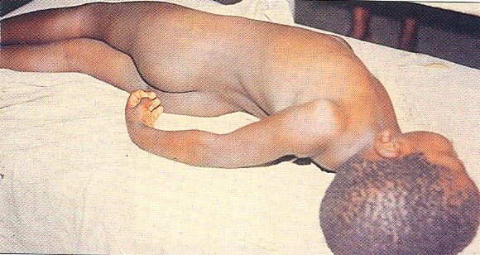
Complications of malaria:
Cerebral malaria

Slide 15
Malarial Paroxysm
cold stage feeling of intense cold vigorous shivering lasts 15-60 minutes hot stage intense heat dry burning skin throbbing headache lasts 2-6 hours sweating stage profuse sweating declining temperature exhausted and weak → sleep lasts 2-4 hours

Slide 16
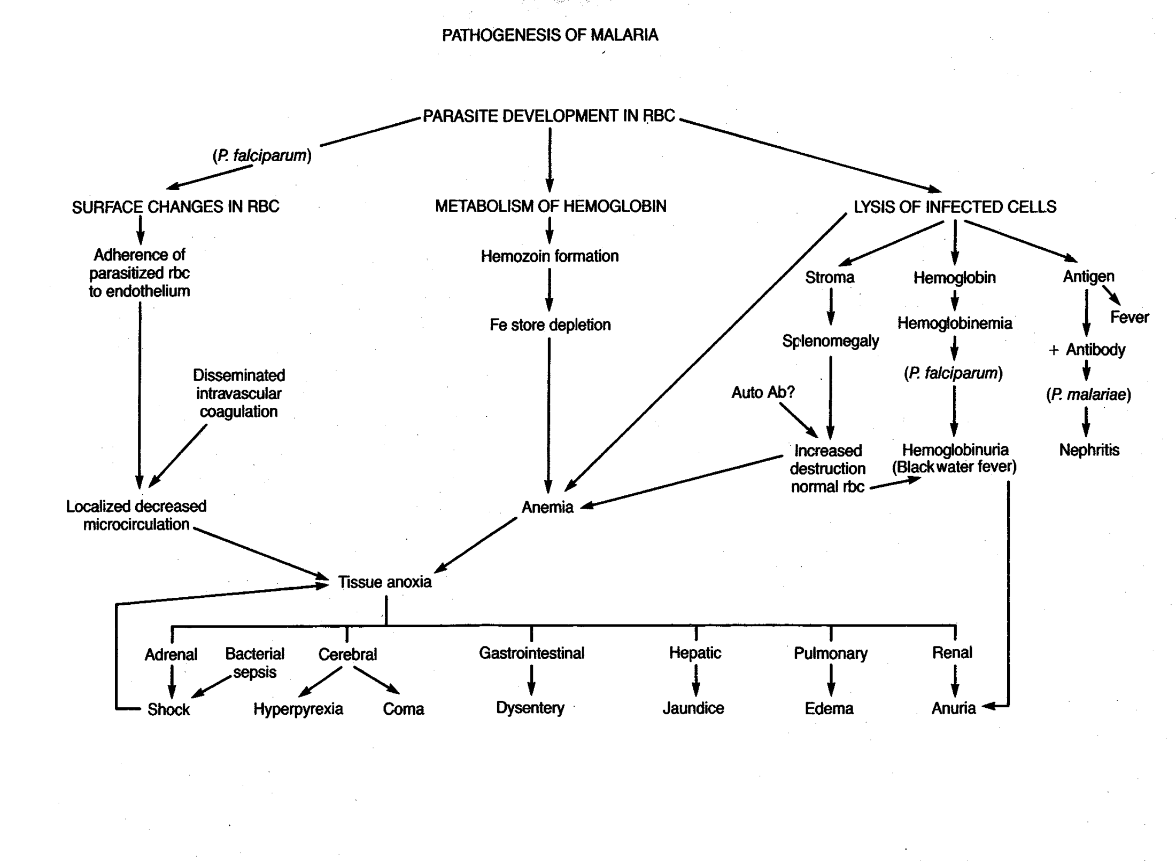

Slide 17
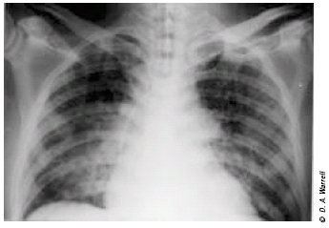
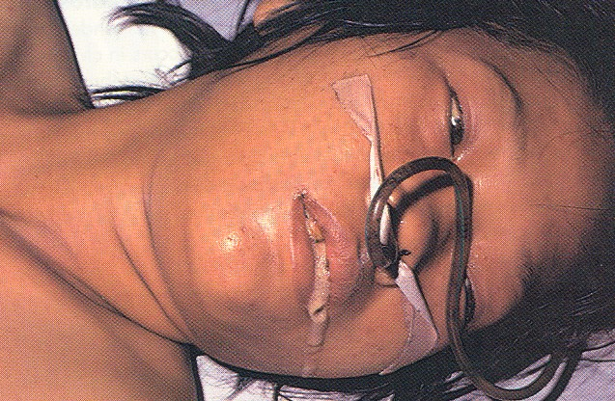
Complications of malaria:
Pulmonary oedema

Slide 18
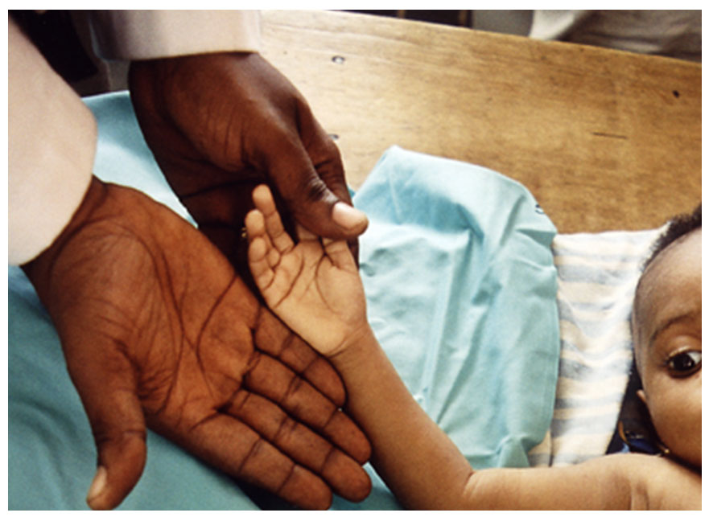
Complications of malaria:
anaemia
Child with severe malaria anaemia and no other malaria complication

Slide 19
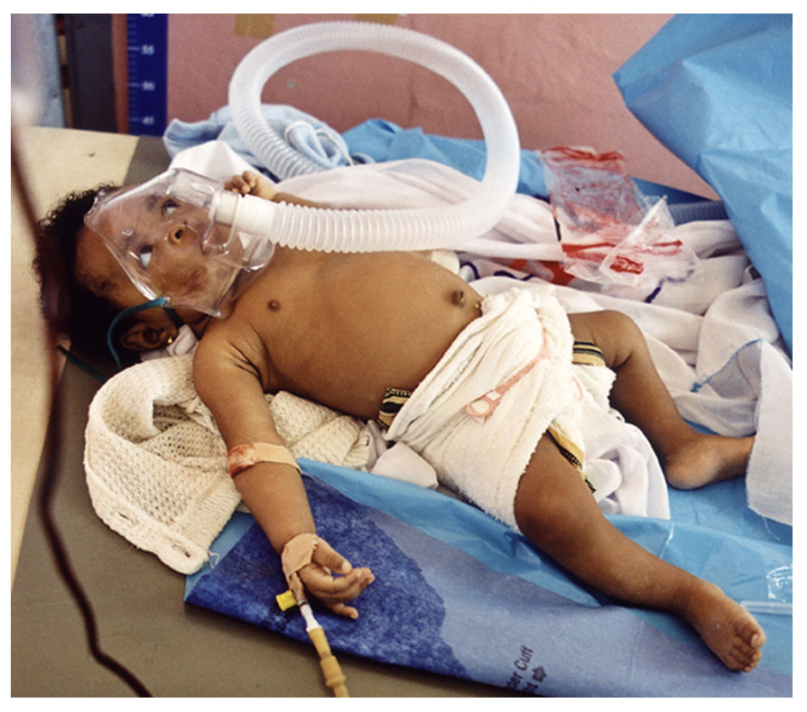
Child with severe malaria anaemia in conjunction with acidosis and respiratory distress

Slide 20
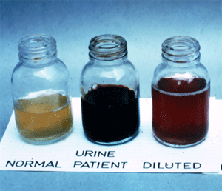
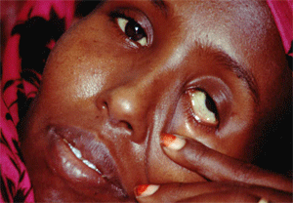
Malarial haemoglobinuria
Clinical Picture:
Haemoglobinuria associated with malaria (“blackwater fever”) is uncommon and malarial haemoglobinuria usually presents in adults as severe disease with anemia and renal failure.

Slide 21
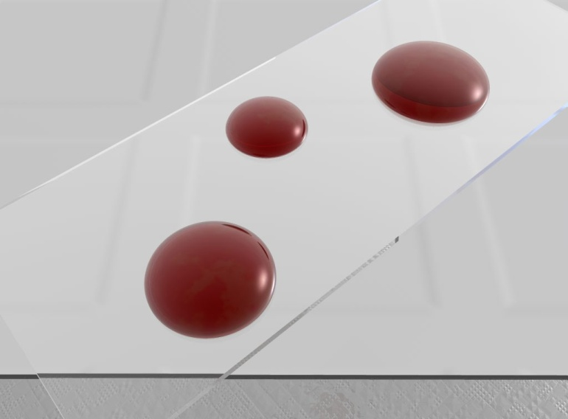
Common methods for parasitological diagnosis of malaria
The two methods common in use:
1: Light microscopy
2: Rapid diagnostic tests (RDTs).

Slide 22
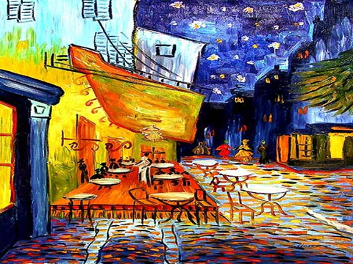

Slide 23
Microscopy is the gold standard for diagnosis of malaria
Parasite density
Species diagnosis
Monitoring response to treatment

Slide 24
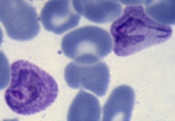
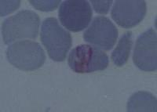
Laboratory diagnosis of malaria
Plasmodium falciparum
Plasmodium vivax
CCMOVBD
CCMOVBD
Plasmodium malariae
Plasmodium ovale
CCMOVBD
Malaria Tutorials, Wellcome Trust

Slide 25
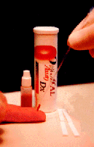
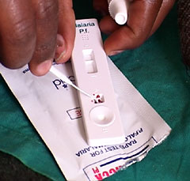
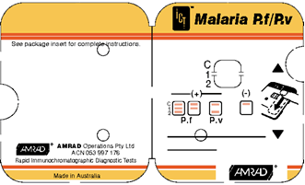
Laboratory diagnosis of malaria
Rapid diagnostic tests detect malaria antigens

Slide 26
Rapid diagnostic tests detect malaria antigens
Plastic cassette format of RDT

Slide 27
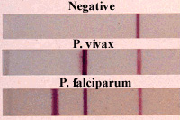
Rapid diagnostic tests detect malaria antigens

Slide 28
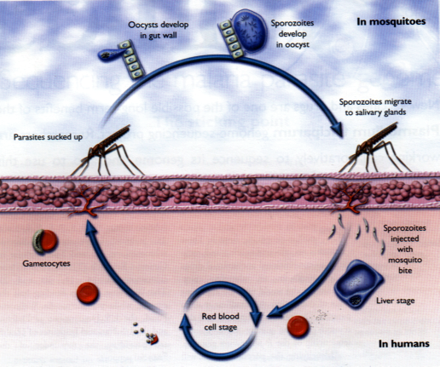
ACTION OF ANTIMALARIAL DRUG IN THE DIFFERENT LIFE STAGES OF THE MALARIA PARASITE
Sporontocides
Primaquine
Pyrimethamine
Proguanil
Tissue Schizontocides
Primaquine
Pyrimethamine
Tetracycline
Proguanil
Gametocyide
Primaquine
Anti-relapse (P.vivax)
primaquine
Blood Schizontocides
Chloroquine
Sulfadoxine/Pyrimethamine
Quinine
Artemisinins
Wellcome Trust (Modified)

