Slide 1
Intestinal Helminths Dr. Ibrahim Alkhalife

Slide 2
CLASSIFICATION OF PARASITES
PROTOZOA | HELMINTHS
Unicellular Single cell for all functions | Multicellular Specialized cells
1: Amoebae: move by pseudopodia 2: Flagellates: move by flagella 3: Ciliates: move by cilia 4: Apicomplexa (Sporozoa) tissue parasites | Round worms (Nematodes): - elongated, cylindrical, unsegmented. Flat worms: - Trematodes: leaf-like, unsegmented. - Cestodes: tape-like, segmented.

Slide 3
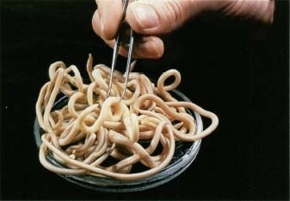
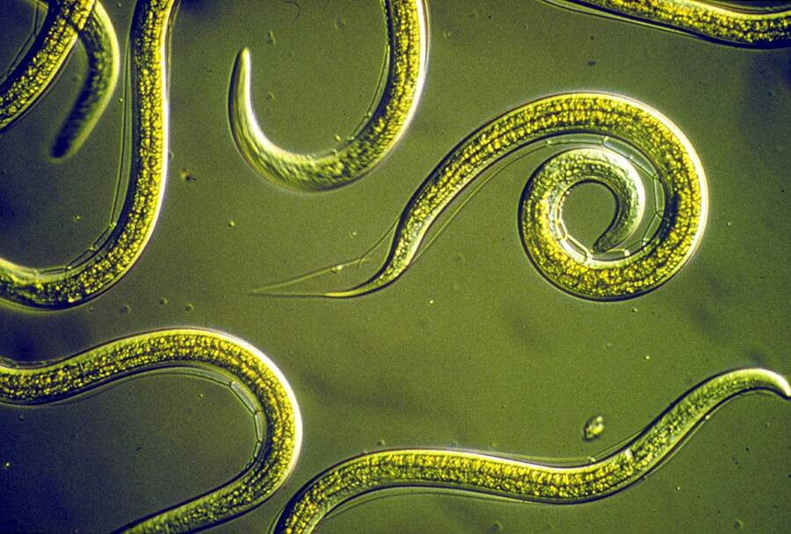
Nematodes: General features
Elongated worm, cylindrical, unsegmented and tapering at both ends.
Variable in size, measure <1 cm to about 100cm.
Sex separate and male is smaller than female

Slide 4
Nematodes: Location in the human body
Intestinal nematodes
Tissue nematodes

Slide 5
Nematodes: common intestinal infections
Enterobius (Oxyuris) vermicularis (Pinworm, seatworm, threadworm)
Trichuris trichiura (whipworm)
Ascaris lumbricoides (roundworm)
Ancylostoma duodenale & Necator americanus (hookworms)
Strongyloides stercoralis

Slide 6
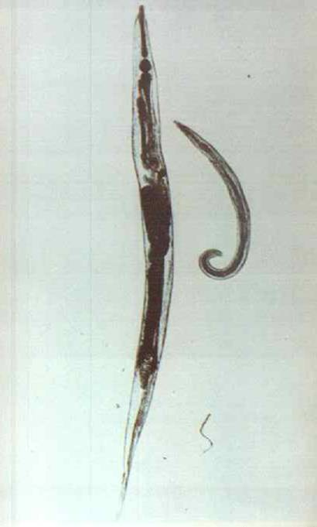
1- Enterobius vermicularis (THREAD WORM)
(Common names: Pin worm, seat worm(
Found all over the world but more common in temperate regions.
Children are more often evolved than adults, it tends to occur in groups living together such as families, army camps or nursery.
Adult worms are mainly located in lumen of cecum and the female migrate to rectum to deposit her eggs on perianal skin.

Slide 7
Direct human - human infection occurs mainly by swallowing the eggs.
Autoinfection occurs by contamination of the fingers.
It can be seen by naked eye as white thread ± 1cm.
Male is smaller than female ± 0.5cm, with coiled end.

Slide 8
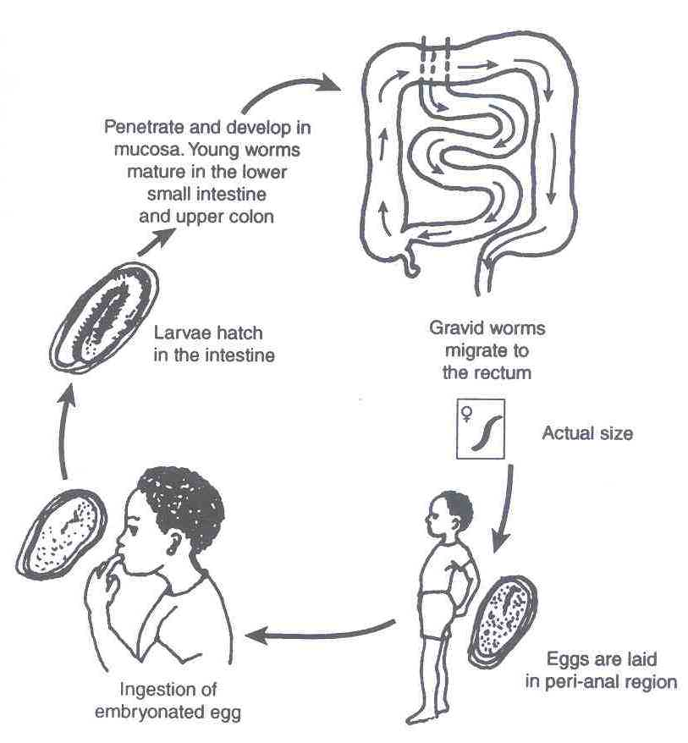
Enterobius vermicularis

Slide 9
Enterobius vermicularis (Oxyuris)
Pathology
Most infections are asymptomatic
Main clinical presentation pruritus ani which can be very troublesome and occurs more often during the night, persistent itching may lead to inflammation and secondary bacterial infection of the peri-anal region

Slide 10
Enterobius vermicularis (Oxyuris)
Infected children may suffer from emotional disturbance, insomnia, anorexia, loss of weight and loss of concentration and enuresis.
Ectopic enterobiasis occurs in infected adult female when invade vulva and vagina result in valvo-vagintis, salpingitis, also adult worm can lodge in the lumen of appendix cause appendicitis.

Slide 11
Enterobius vermicularis (Oxyuris)
DIAGNOSIS :
Unlike other intestinal Nematodes, the eggs are not usually found in feces. The best method is to look for them around the anus by taking an anal swab or by using
CELLULOSE ADHESIVE TAPE
the examination should be done before defecation or bathing.
Treatment
Albandazole or Mebendazole for whole family

Slide 12
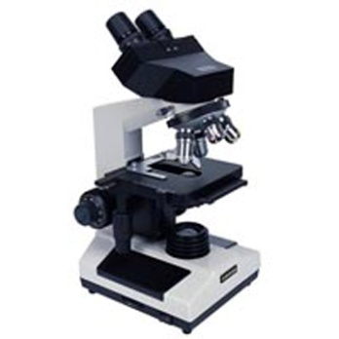
Enterobius vermicularis (Oxyuris)

Slide 13
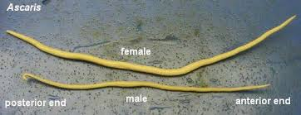
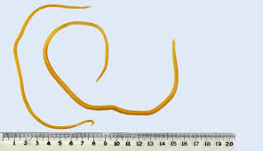
Ascaris lumbricoides (roundworm)

Slide 14
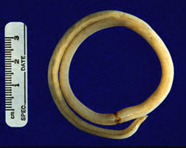
Ascaris lumbricoides (roundworm)
The commonest human helminths infection all over the world.
The large round worm which is normally located in the small intestine
Found in jejunum and upper part of ileum
Female ± 20 cm longer than male ± 10 cm
Feed on semi digested food.

Slide 15
Ascaris lumbricoides (roundworm)
Infective stage: embryonated egg
Diagnostic stage: unembryonated egg

Slide 16
Ascaris lumbricoides life cycle

Slide 17
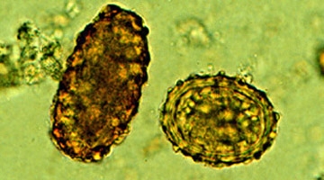
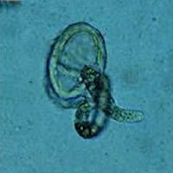
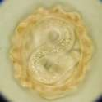
Ascaris eggs
Ascaris larva emerging from egg
Ascaris egg (embryonated)

Slide 18
Ascaris lumbricoides (roundworm)
Pathology:
1-Adult worm: (small intestine)
Light infection : asymptomatic
Heavy infection : intestinal obstruction
Migrating adult : to bile duct-jaundice
2-Larvae: Loeffler`s syndrome
Pneumonitis and broncho-spasm,
cough with bloody sputum, Eosinophilia, urticaria

Slide 19
Ascaris lumbricoides (roundworm)
Loeffler`s syndrome: Larvae in lung
pneumonia, cough, bloody sputum

Slide 20
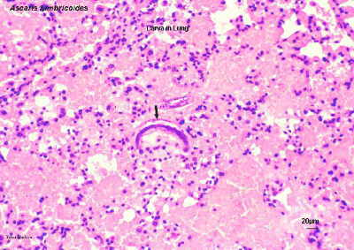
Ascaris lumbricoides (roundworm)
Ascaris larva in lung

Slide 21
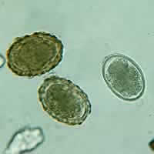
Ascaris lumbricoides (roundworm)
Diagnosis:
-eggs in stool.
-larvae in sputum.
-adult may pass with stool.
Treatment:
Albendazole or Mebendazole

Slide 22
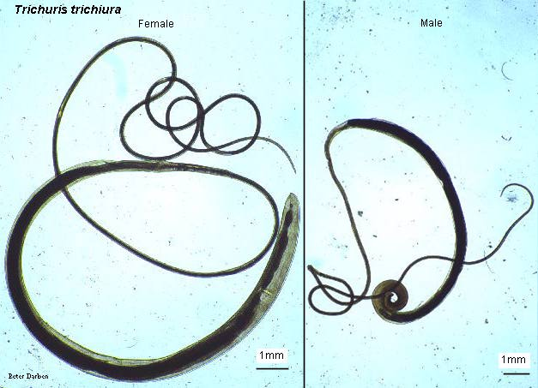
2-Trichuris trichiura (Whipworm)

Slide 24
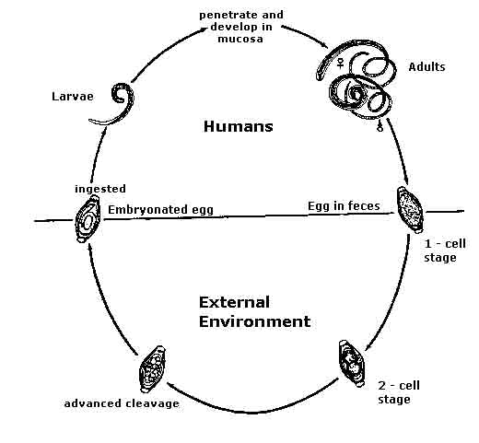
Trichuris trichiura
Infective stage: embryonated egg
Diagnostic stage:
egg in stool

Slide 25
Trichuris trichiura (whipworm)
World wide, common in poor sanitation
It coexists with Ascaris because of similar requirements (the eggs needs 3 weeks in the soil to be embryonated which is the infective stage).
Adult live in large intestine especially caecum and appendix
in heavy infection the whole length of large intestine affected.
Male and female worm have narrow anterior portion penetrate the intestinal mucosa

Slide 26
Trichuris trichiura (Whipworm)
Pathology
light infection: asymptomatic
heavy infection: abdominal pain, bloody diarrhea.
Rectal prolapse in children is a common complication.

Slide 27
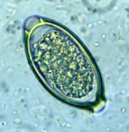
Trichuris trichiura (Whipworm)
Diagnosis: egg in stool characterized by its barrel shape with mucoid plugs at each pole.
Treatment: Albendazole.

Slide 28
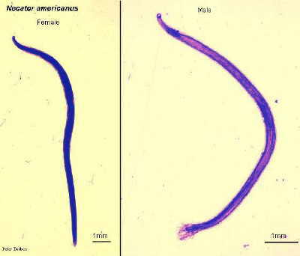
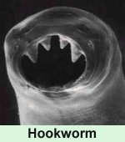
Hook worms
Ancylostoma dudenale & Necator americanus
Its buccal capsule (mouth) lined with hard hooks, triangular cutting plates and anticoagulant glands.

Slide 29
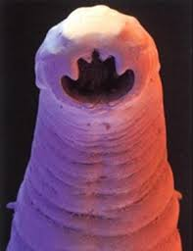
There are no specific symptoms or signs of hookworm infection
but they give rise to a combination of:
Intestinal inflammation
Progressive iron-deficiency anemia &
Protein deficiency

Slide 30
Filariform Larval (infective stage) invasion of the skin can produce a skin disease called:
cutaneous larva migrans (creeping eruption)
this is commonly caused by walking barefoot through areas contaminated with fecal matter.
Larva migrate through the vascular system to the lungs, and from there up the trachea, and are swallowed.
They then pass down the esophagus and enter the digestive system, finishing their journey in the small intestine where the larvae mature into adult worms.
They mate inside the host, females laying up to 30,000 eggs per day, which pass out in feces (diagnostic stage). The eggs need to be in soil for about one week to become FILARIFORM LARVA

Slide 31
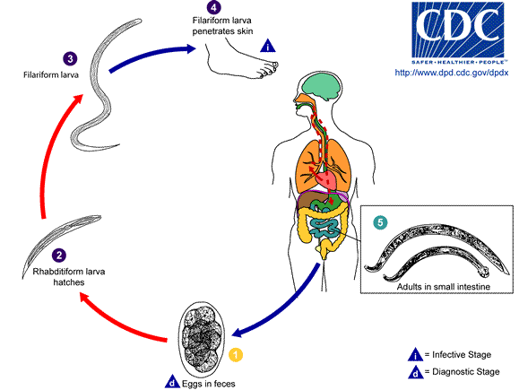
Life cycle of Hook worms

Slide 32
Hook worms
Pathology& clinical picture
- larvae:
At the site of entry of larvae intense itching (ground itch) and dermatitis.
Migration phase
cough with bloody sputum
pneumonitis and bronchitis but less sever than Ascaris, eosinophilia urticaria.
- Adult worm:
low worm burden (INFECTION): no symptoms.
Moderate to heavy burden:
Epigastric pain, vomiting, hemorrhagic enteritis.
Protein loss: hypo-proteinaemia edema.
Anemia: due to withdrawal of blood by parasites and hemorrhage from punctured sites lead to sever anemia = microcytic hypochromic anemia.

Slide 33
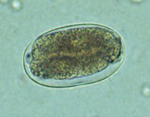
Hook worms
Diagnosis and treatment
Diagnosis:
-Eggs in stools;
-occult blood (+)
Treatment: Albendazol, Mebendazole

Slide 34
Strongyloides stercoralis
Widely distributed in tropical area at Asia, Africa & South America
Fatal dissemination in immuno-compromised host.
It is smallest pathogenic nematodes ± 2.5mm.
adult live membrane of duodenum, jejunum rarely mucous membrane of bronchus
Autoinfection is very important criteria

Slide 35
Strongyloides stercoralis life cycle
The parasite shows 3 different modes of development:
1-Direct development: The rhabditiform larva pass from stool and become directly a Filariform larva if the environment of the soil is suitable.
2-Indirect development: In external environment Rh. larva becomes free living adults, produce eggs, rhabditiform larva and Filariform larva (Infective stage).
3-AUTOINFECTION:
Internal: when the rhabditiform larva become a filariform larva in the intestine and penetrate the intestine
External: fecal contamination of skin –Rh larva > filariform penetrates the skin

Slide 36
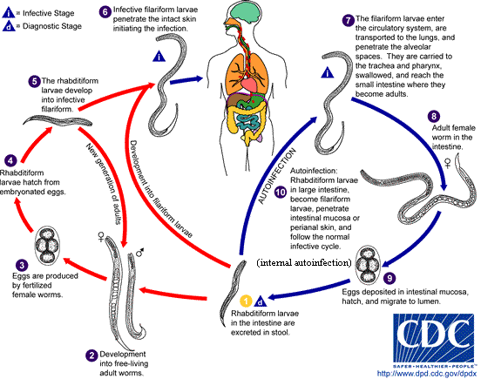
Strongyloides stercoralis
LIFE CYCLE

Slide 37
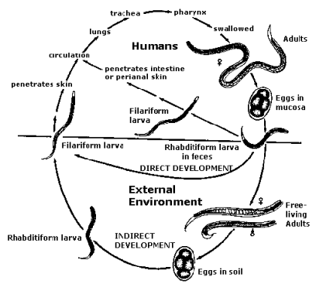

Slide 38
Strongyloides stercoralis
Pathology and clinical picture
Cuteneous little reaction on penetration.
sever dermatitis at perianal region in case of external autoinfection
Migration: pneumonitis during larval migration.
Intestinal: inflammation of upper intestinal mucosa, diarrhea, upper abdominal pain in the epigastria colicky in nature.
Disseminated strongyloidiasis: in patient with immunodeficiency, uncontrolled diarrhea –granulomatus changes –necrosis--perforation--peritonitis—death.

Slide 39
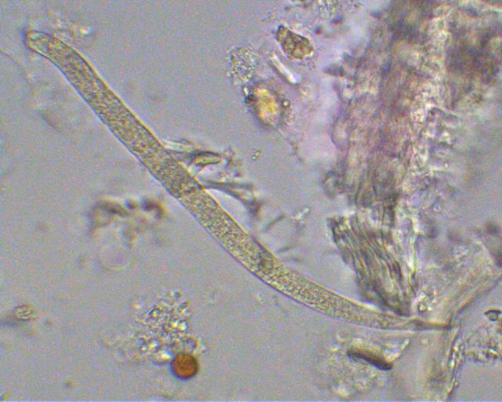
Strongyloides stercoralis
Diagnosis
rhabditiform larvae diagnostic stage in:
-Stool examination
-Duodenal aspirate
Treatment
Albendazole, Mebendazole

Slide 40
Common Tapeworm Infections
TAPEWORM
DISEASE
TRANSMISSION
OF INFECTION
LOCATION OF ADULT
IN HUMANS
LOCATION
OF LARVA
IN HUMANS
CLINICAL PICTURE
LAB.
DIAGNOSIS
Taenia saginata
taeniasis
ingestion of larva in undercooked
beef
Small
Intestine
not present
vague digestive disturbances
eggs or
proglottids
in stools
Taenia solium-
taeniasis
ingestion of larva in undercooked
pork
Small
Intestine
not present
vague digestive disturbances
eggs or
proglottids
in stools
ADULT
Taenia solium-
LARVA
(cysticercus cellulosae)
Cysticercosis
ingestion of egg
not present (except in
Autoinfection, small intestine)
sub-cutaneous
muscles
brain, eyes
depending on
locality:
from none to
epilepsy
X-ray, CT, MRI
Serology
Hymenolepis nana
hymenolepiais
ingestion of egg
Small
Intestine
Intestinal
Villi
Enteritis
diarrhoea
eggs in
stools
Echinochoccus
granulosus
hydatid disease
ingestion of egg
not present
Liver, lungs,
Bones etc
depending on
locality
X-ray, CT, US
Serology
Hydatid sand

Slide 41
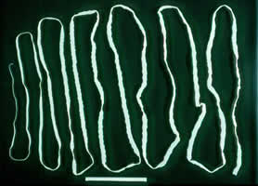
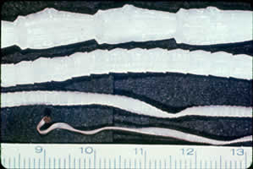
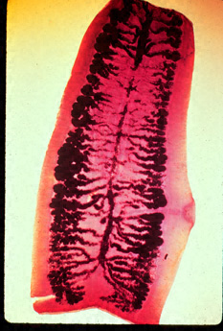
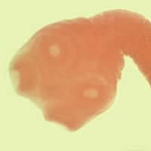
Taenia saginata

Slide 42
Taenia saginata
Is an obligatory parasite of man, the adult worm live in the SMALL INTESTINE
CATTLE become infected by ingesting grass contaminated with eggs or gravid segments which passed from human faeces. In the cattle the onchosphere hatches out go to circulation and transformed to cysticercus stage in the muscle known as CYSTICERCUS BOVIS
Man become infected by eating undercooked or improperly cooked beef, the adult worm lives in small intestine of man passing eggs and gravid proglottids to the environment.
The majority of cases are Asymptomatic, some patients have vague intestinal discomfort, vomiting and diarrhoea

Slide 43
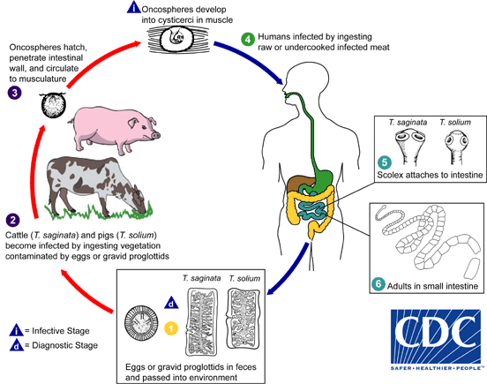
Life cycle of Taenia saginata

Slide 44
Taenia solium

Slide 45
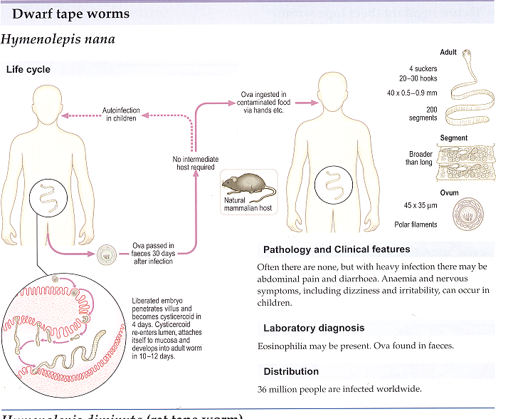

Slide 46
Hymenolepis nana

Slide 47
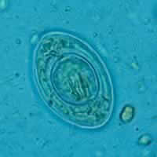
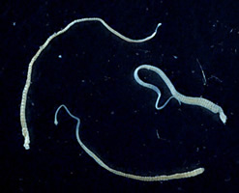
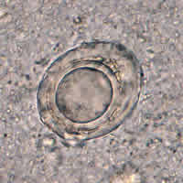
Hymenolepis nana

Slide 48
Echinococcus granulousus

Slide 49
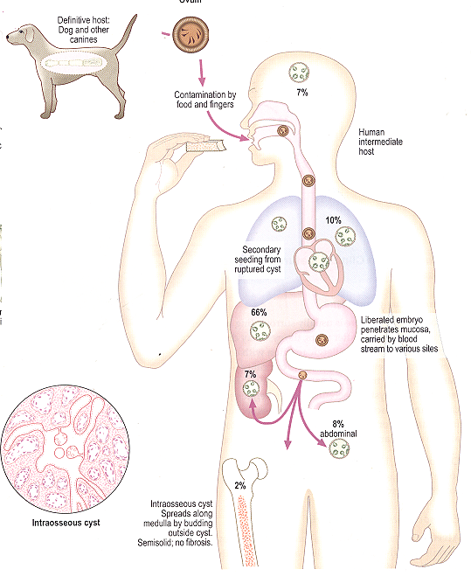
Location of hydatid cyst
Echinococcus granulosus

Slide 50
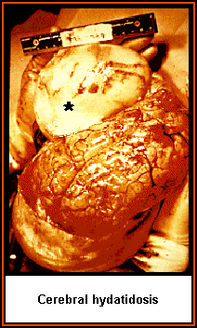
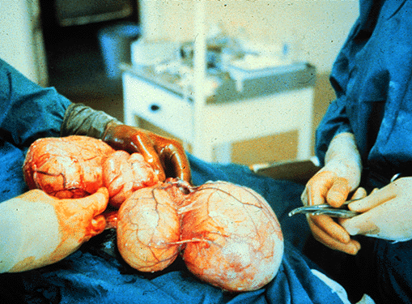
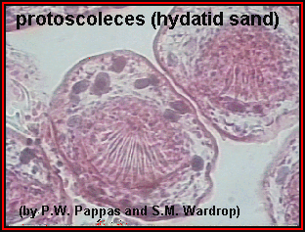
Hydatid cyst

Slide 51
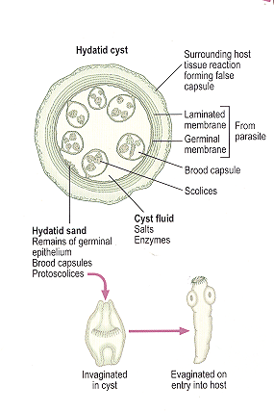
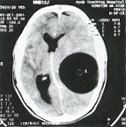
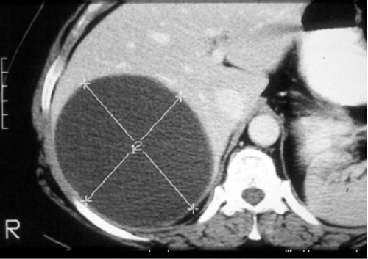
Hydatid cyst

Slide 52
Diagnosis of Hydatid cyst
Imaging: computed tomography (CT), magnetic resonance imaging (MRI) revealed a cystic swelling with smooth outline.
Microscopy: hydatid sand
Serologic tests; to detect specific antibodies

Slide 53
Treatment of Tapeworms
Intestinal stages: Praziquantel
Tissue stages (Hydatid, cysticersosis):
Depends on clinical condition: Surgical and/or Albendazole

