Slide 1
Haemoflagellates Leishmania Dr. Ibrahim Alkhalife

Slide 2
Leishmaniasis
a parasitic disease caused by the Leishmania parasite. This parasite typically lives in infected sand flies. You can contract leishmaniasis from a bite of an infected sand fly.
The sand flies that carry the parasite typically reside in tropical and subtropical environments. have occurred in areas of Asia, East Africa, and South America.

Slide 3
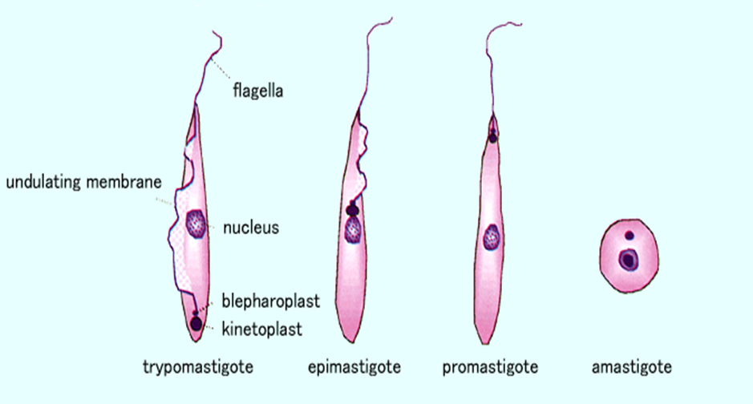
Different stages of Haemoflagellates

Slide 4
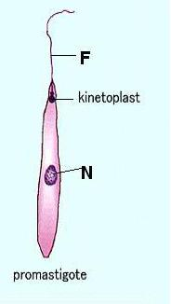
Promastigotes of Leishmania
Amastigote of Leishmania

Slide 5
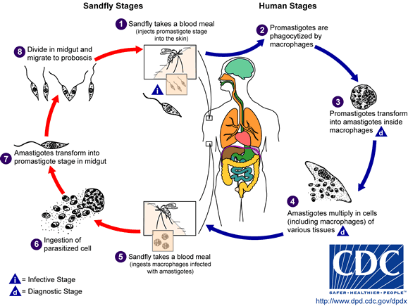
The life cycle of Leishmania

Slide 6
Leishmania Parasites and Diseases
Disease | SPECIES
Cutaneous leishmaniasis | Leishmania tropica* Leishmania major* Leishmania aethiopica Leishmania mexicana
Mucocutaneous leishmaniasis | Leishmania braziliensis
Visceral leishmaniasis | Leishmania donovani* Leishmania infantum* Leishmania chagasi
* Endemic in Saudi Arabia

Slide 7
What are the types of leishmaniasis?
Leishmaniasis comes in three forms: cutaneous, visceral, and mucocutaneous. Different species of the Leishmania parasite are associated with each form. Experts believe that there are about 20 Leishmania species that can transmit the disease to humans.
1. Cutaneous leishmaniasis
Cutaneous leishmaniasis causes ulcers on your skin. It’s the most common form of leishmaniasis. Treatment may not always be necessary depending on the person, but it can speed healing and prevent complications.
2. Mucocutaneous leishmaniasis
A rare form of the disease, mucocutaneous leishmaniasis is caused by the cutaneous form of the parasite and can occur several months after skin ulcers heal.

Slide 8
With this type of leishmaniasis, the parasites spread to your nose, throat, and mouth. This can lead to partial or complete destruction of the mucous membranes in those areas.
Although mucocutaneous leishmaniasis is usually considered a subset of cutaneous leishmaniasis, it’s more serious. It doesn’t heal on its own and always requires treatment.
3. Visceral leishmaniasis
Visceral leishmaniasis is sometimes known as systemic leishmaniasis or kala azar.
It usually occurs two to eight months after being bitten by a sand fly. It damages internal organs, such as your spleen and liver. It also affects your bone marrow, as well as your immune system through damage to these organs.
The condition is almost always fatal if it’s not treated.

Slide 9
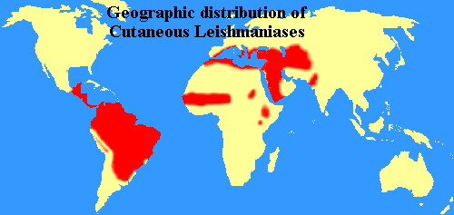

Slide 10
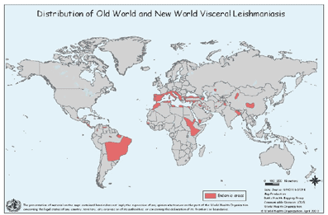
World distribution of Visceral Leishmaniasis

Slide 11
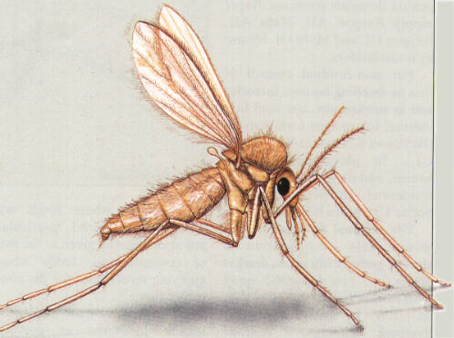
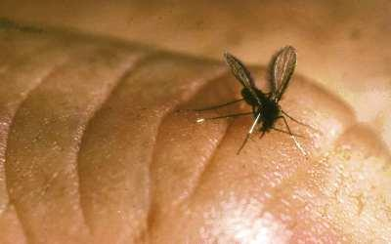
Sand fly

Slide 12
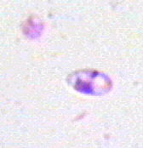
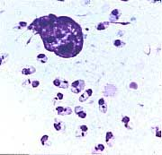
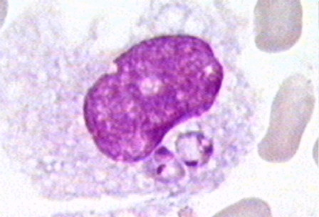
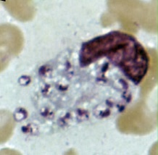
Amastigotes of Leishmania

Slide 13
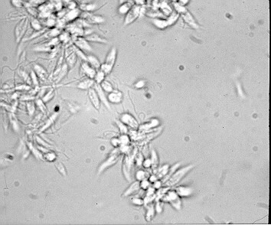
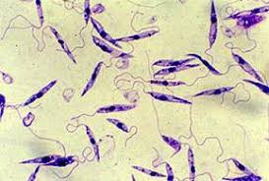
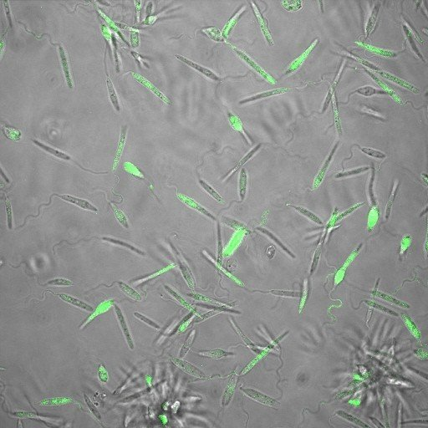
Promastigotes of Leishmania

Slide 14
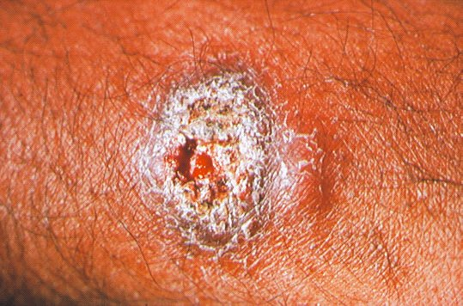
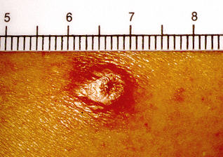
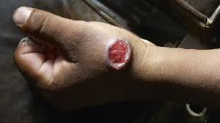
lesion of cutaneous lishmaniasis

Slide 15
Clinical types of cutaneous leishmaniasis
Leishmania major:
Zoonotic cutaneous leishmaniasis, wet lesions with severe reaction
Leishmania tropica:
Anthroponotic cutaneous leishmaniasis, dry lesions with minimal ulceration
Oriental sore (most common) classical self-limited ulcer

Slide 16
CUTANEOUS LISHMANIASIS THE COMMON TYPE
This starts as a painless papule on exposed parts of the body, generally the face.
The lesion ulcerates after a few months producing an ulcer with an indurate margin. In some cases the ulcer remains dry and heals readily (dry-type-lesion).
In some other cases the ulcer may spread with an inflammatory zone around, these known as (wet-type-lesion) which heal slowly.

Slide 17
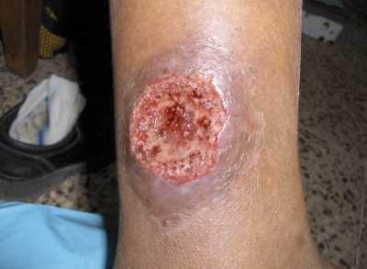
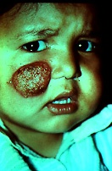
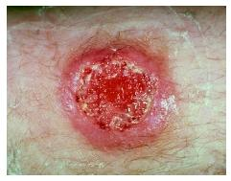

Slide 18
UNCOMMON TYPES OF CUTANEUS LISHMANIASIS
Diffuse cutaneous leishmaniasis (DCL):
Caused by L. aethiopica, diffuse nodular non-ulcerating lesions, seen in a part of Africa, people with low immunity to Leishmania antigens. Diffuse cutaneous (DCL), and consists of nodules and a thickening of the skin, generally without any ulceration, it needs numerous parasite.
Leishmaniasis recidiva (lupoid leishmaniasis):
Severe immunological reaction to leishmania antigen leading to persistent dry skin lesions, few parasites.

Slide 19
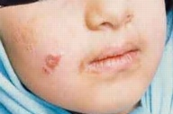
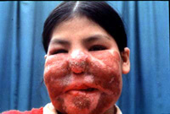
Diffuse cutaneous leishmaniasis (DCL)
Leishmaniasis recidiva

Slide 20
Mucocutaneous leishmaniasis
The lesion starts as a pustular swelling in the mouth or on the nostrils. The lesion may become ulcerative after many months and then extend into the naso- pharyngeal mucous membrane.
Secondary infection is very common with destruction of the nasal cartilage and the facial bone.

Slide 21
cutaneous & muco-cutaneous leishmaniasis
Diagnosis
The parasite can be isolated from the margin of the ulcer.
A diagnostic skin test, known as Leishmanin test
(Montenego Test), is useful.
Smear: Giemsa stain – microscopy for LD bodies (Leishman-Donovan bodies, amastigotes).
Skin biopsy: microscopy for LD bodies or culture in NNN medium for promastigotes.

Slide 22
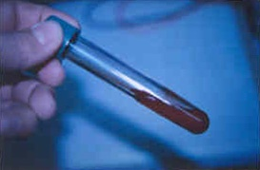
NNN medium

Slide 23
Visceral leishmaniasis
There are geographical variations.
The disease is called kala-azar
Leishmania infantum mainly affect children
Leishmania donovani mainly affects adults
The incubation period is usually 4-10 months.
The early symptoms are generally low grade fever with malaise and sweating.
In later stages, the fever becomes intermittent and their can be liver enlargement or spleen enlargement or hepatosplenomegally because of the hyperplasia of the lymphoid –macrophage system.

Slide 24
Presentation
Fever
Splenomegaly, hepatomegaly, hepatosplenomegaly
Weight loss
Anaemia
Epistaxis
Cough
Diarrhoea

Slide 25
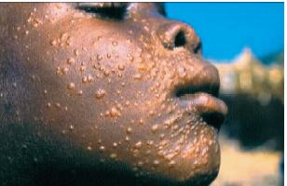
Untreated disease can be fatal
After recovery it might produce a condition called post kala-azar dermal leishmaniasis (PKDL)

Slide 26
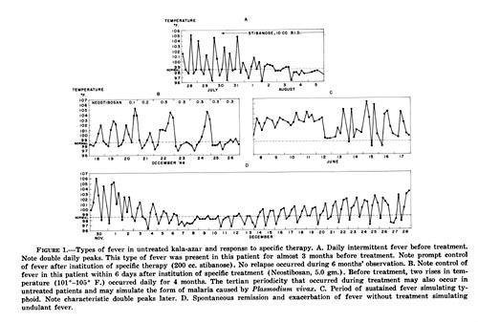
Fever 2 times a day due to kala-azar

Slide 27
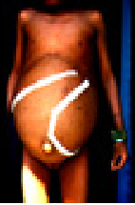
Hepatosplenomegaly in visceral leishmaniasis

Slide 28
Visceral leishmaniasis
Diagnosis
Parasitological diagnosis:
Bone marrow aspirate 1. microscopy (LD bodies)
Splenic aspirate 2. culture in NNN medium
(promastigotes)
Lymph node
Tissue biopsy

Slide 29
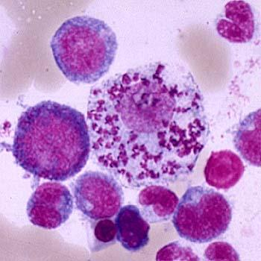
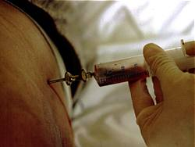
Bone marrow aspiration
Bone marrow amastigotes

Slide 30
(2) Immunological Diagnosis:
Specific serologic tests: Direct Agglutination Test (DAT), ELISA, IFAT
Skin test (leishmanin test) for survey of populations and follow-up after treatment.

Slide 31
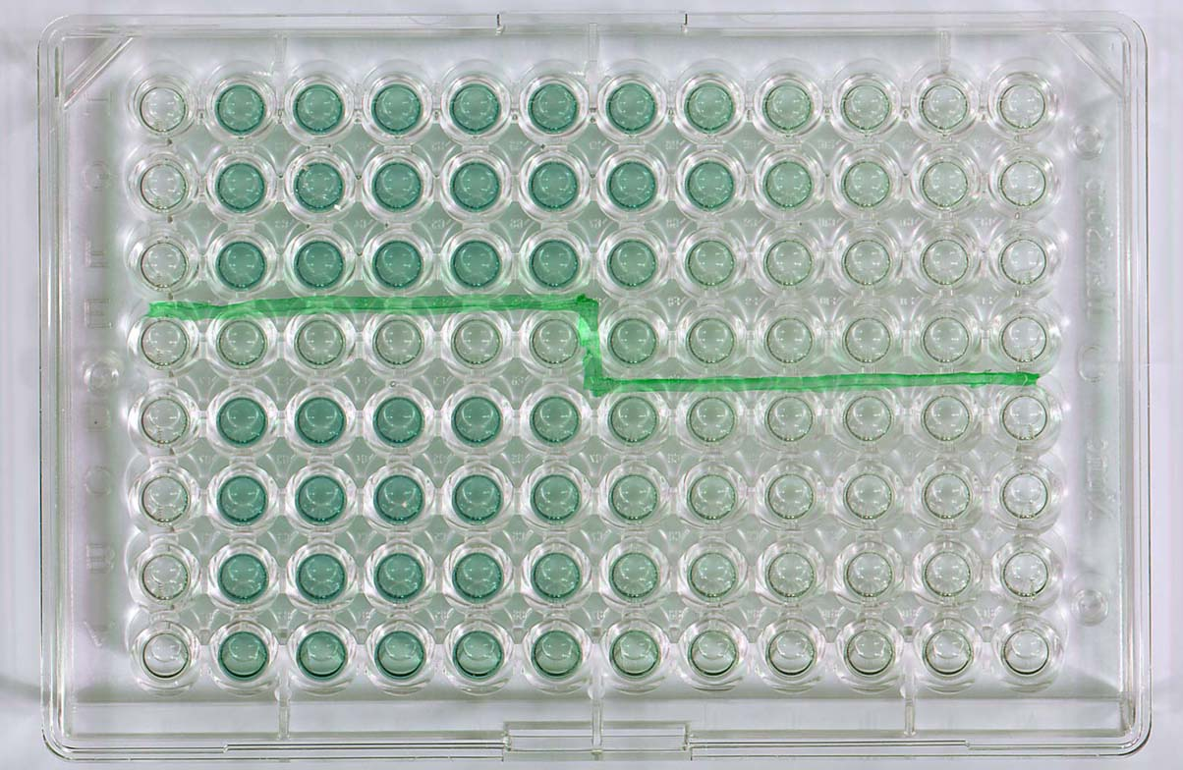
DAT test
ELISA test

Slide 32
Treatment
Antiparasitic drugs, such as amphotericin B (Ambisome), treat this condition. Your doctor may recommend other treatments based on the type of leishmaniasis you have.
Cutaneous leishmaniasis
Cutaneous ulcers will often heal without treatment. However, treatment can speed healing, reduce scarring, and decrease risk of further disease. Any skin ulcers that cause disfigurement may require plastic surgery.
Mucocutaneous leishmaniasis
These lesions don’t heal naturally. They always require treatment. Liposomal amphotericin B and paromomycin can treat mucocutaneous leishmaniasis.
Visceral leishmaniasis
Visceral disease always requires treatment. Several medications are available. Commonly used medicines include sodium stibogluconate (Pentostam), amphotericin B, paromomycin, and miltefosine (Impavido).

