Slide 1

The Trematodes

Slide 2
PROTOZOA | HELMINTHS
Unicellular Single cell for all functions | Multicellular Specialized cells
Amoebae: move by pseudopodia. 2. Flagellates: move by flagella. 3. Ciliates: move by cilia. 4. Apicomplexa (Sporozoa) tissue parasites. | Round worms (Nematodes) - elongated, cylindrical, unsegmented. Flat worms - Trematodes: leaf-like, unsegmented. - Cestodes (Tapeworms): tape-like, segmented.
CLASSIFICATION OF PARASITES

Slide 3
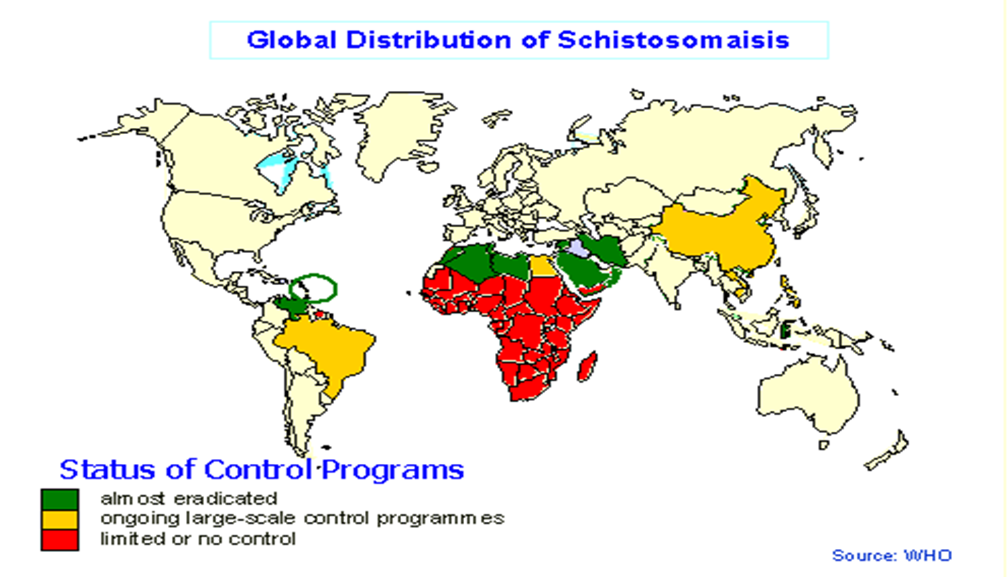
Blood Flukes
Schistosoma spp.

Slide 4




Slide 5
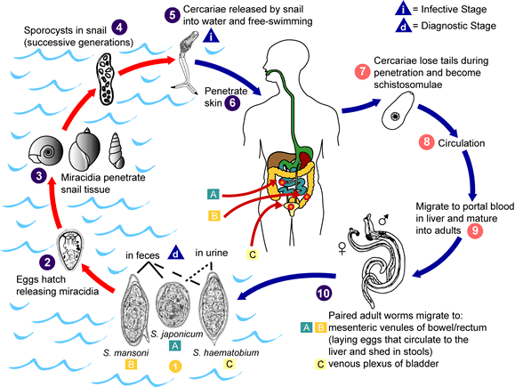
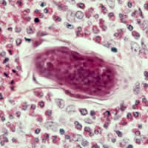
Life cycle of Schistosoma spp.

Slide 6
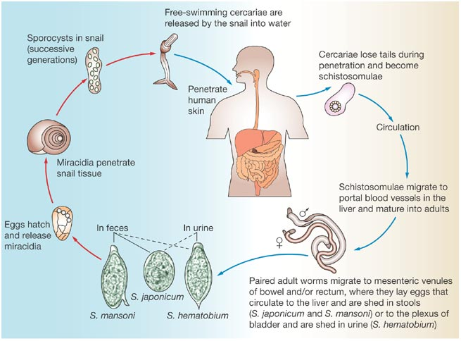
Schistosoma spp.
CERCARIA IS THE INFECTIVE STAGE.
Cercaria emerge from snail in the water and penetrate the skin of the human.
The cercaria is transformed into a schistosomula inside the host tissues.
The schistosomula first enters the systemic circulation and then finds its way into the portal circulation (S. mansoni & S. japonicum) worms mature in the mesenteric veins of the portal circulation, S. haematobium worms generally remain in the systemic circulation and mature in the blood vessels of the vesical plexus.
THE EGG IS THE DIAGNOSTIC STAGE. The eggs of S. mansoni & S. japonicum are passed mainly in stool and S. haematobium passed mainly in the urine.
PATHOLOGY:
The EGG is the main cause of pathology in schistosomiasis. Many eggs become stranded in the tissues or carried by the blood stream to other organs mainly the LIVER. The host reaction to the eggs may vary from small granulomas to extensive fibrosis. The extent of damage is generally related to the number of eggs present in the tissues.

Slide 7
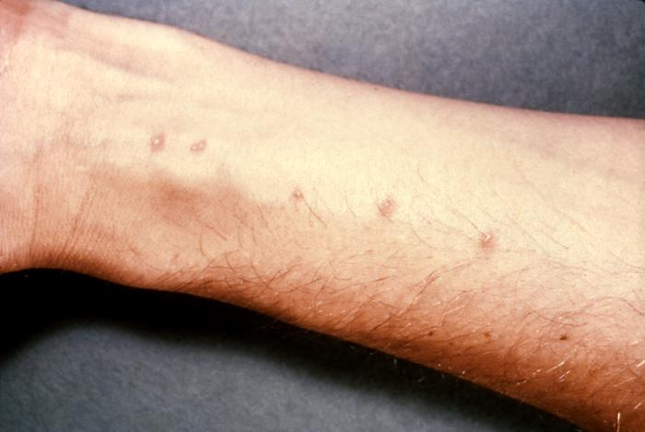
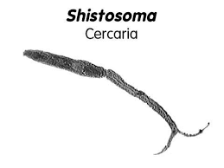
Schistosome dermatitis, or "swimmers itch” occurs when skin is penetrated by a free-swimming, fork-tailed infective cercaria. The dermatitis often develops 24 hours after exposure and last for 2 to 3 days and then spontaneously disappears.
Source: WikiMedia.

Slide 8
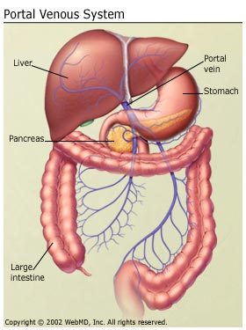
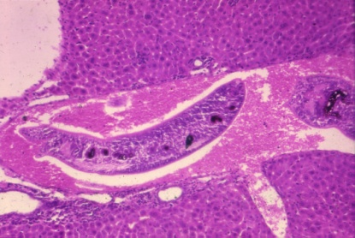
Developing Schistosome in liver:
S. mansoni & S. japonicum located mainly in mesenteric vein and its branches, the worm discharges EGGS, the eggs travel in 2 directions: 1- some eggs find their way into the lumen of the bowel and appear in the faeces, 2- other flow with blood stream in the portal circulation and enter the LIVER. Most of these eggs are trapped in the liver and give rise to pathology, again some of these eggs find their way through the liver tissue and enter the systemic circulation to another organ as brain, fibrosis of the liver caused from eggs settled in the liver may produce portal hypertension, which may lead to hepatomegaly, splenomegaly esophageal varices and ascites.

Slide 9
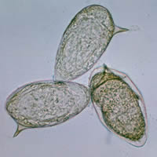
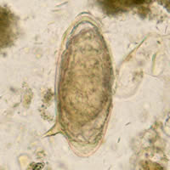
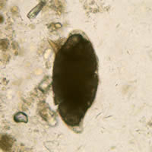
Eggs of Schistosoma mansoni with lateral spine

Slide 10
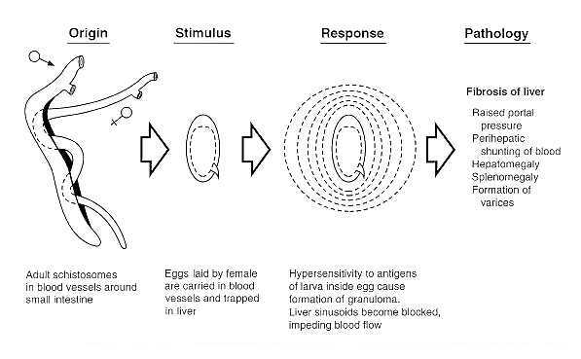

Slide 11
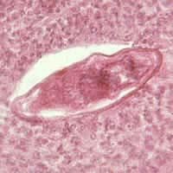
Eggs of Schistosoma mansoni in the liver and cellular reaction.

Slide 12
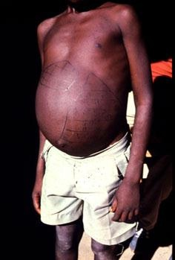
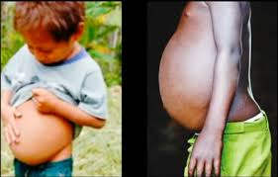
Hepatomegaly and splenomegaly with ascites.
HEPATOSPLENOMEGALY IN CHRONIC SCHISTOMAIASES

Slide 13
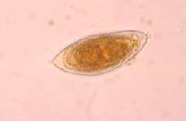
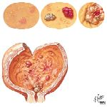
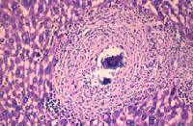
S. haematobium: The worm is located in the vesical venous plexus surrounding the urinary bladder. Many eggs are trapped in the wall of the bladder where they may give rise to calcification and granuloma formation. Constriction of the orifice of the ureter may produce kidney damage, hydronephrosis and cancer of the bladder.

Slide 14
Pathology of Schistosomiasis
Schistosoma haematobium
Causes urinary schistosomiasis
PREPATENT PERIOD 10-12 wks.
2. EGG DEPOSITION AND EXTRUSION:
  painless hematuria
  Inflammation of bladder and burning micturition
  CNS involvement (rare)
3. TISSUE PROLIFERATION AND REPAIR:
  Fibrosis, papillomata in the bladder and lower ureter leading to obstructive uropathy
  Periportal fibrosis
  Lung and CNS involvement
Schistosoma mansoni
Causes intestinal schistosomiasis
PREPATENT PERIOD 5-7 wks.
2. EGG DEPOSITION AND EXTRUSION:
  dysentery (blood and mucus in stools)
  hepatomegaly splenomegaly
  CNS involvement (rare)
3. TISSUE PROLIFERATION AND REPAIR:
  Fibrosis, Papillomata in intestine
  Periportal fibrosis, hematemesis
  Lung and CNS involvement

Slide 15
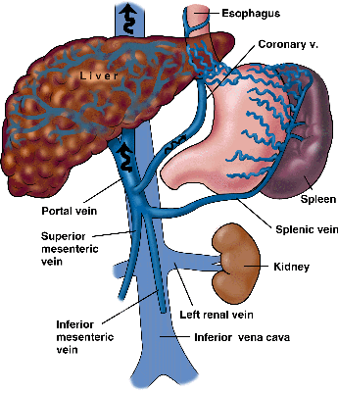
Portal hypertension in chronic schistosomiasis

Slide 16
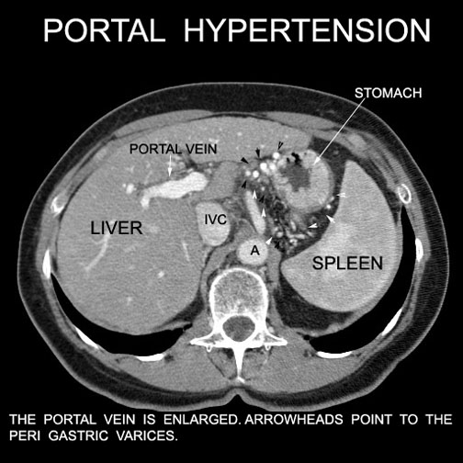

Slide 17
Diagnosis of Schistosomiasis
Schistosoma haematobium
Parasitological:
  Examination of urine
Immunological:
  Serological tests
Indirect:
  Radiological
  Cystoscopy
Schistosoma mansoni
Parasitological:
  Examination of stools
Immunological:
  Serological tests
Indirect:
  Radiological
  Endoscopy

Slide 18
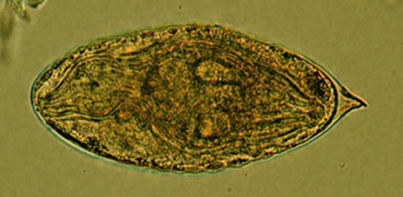
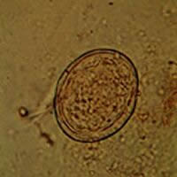
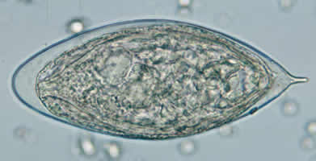
Egg of S. haematobium
Egg of S. japonicum
Egg of S. haematobium

Slide 19
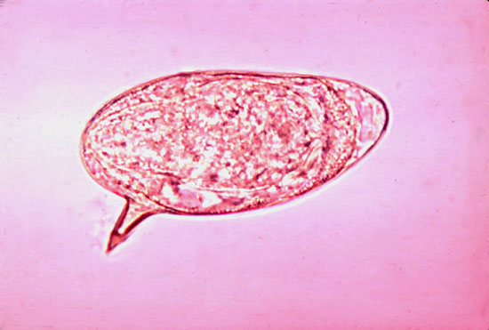
Egg of S. mansoni

Slide 20
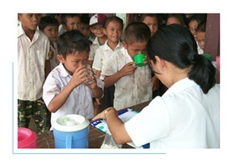
Drug of choice for schistosomiasis is
Praziquantel

Slide 21
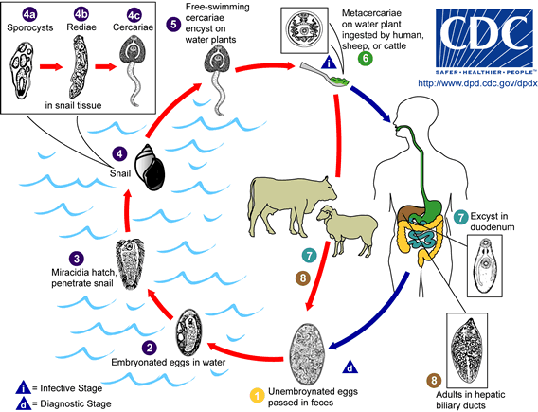
Life-cycle of Fasciola hepatica

Slide 22
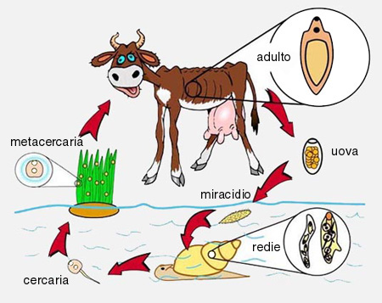
Life cycle of Fasciola hepatica

Slide 23
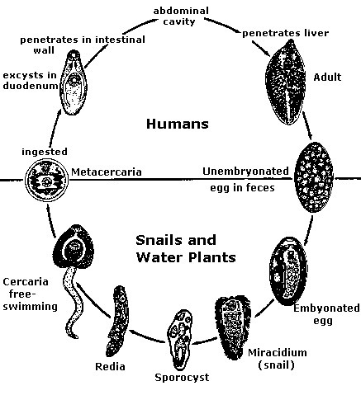

Slide 24
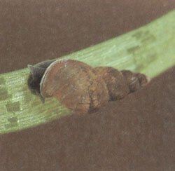
Snail
intermediate host of Fasciola hepatica

Slide 25
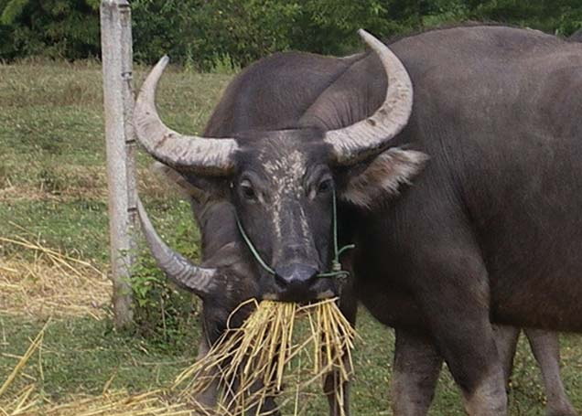

Slide 26
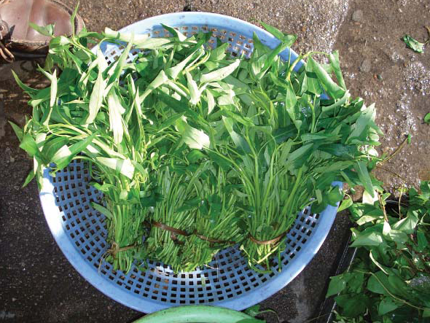

Watercress, one means of transmission of fascioliasis

Slide 27
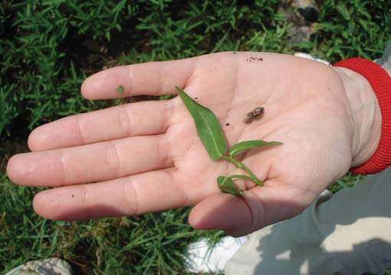

Slide 28
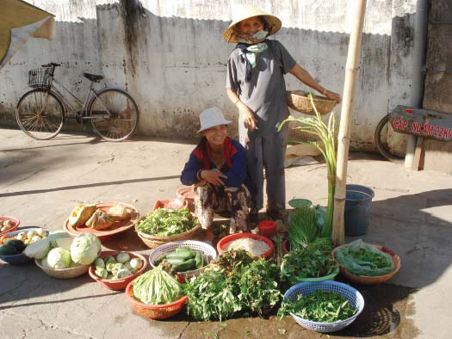

Slide 29
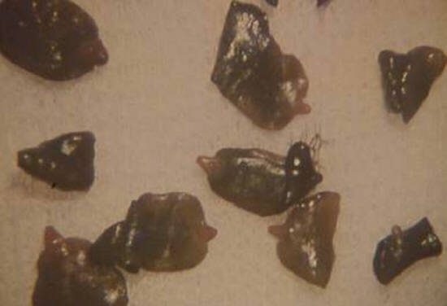
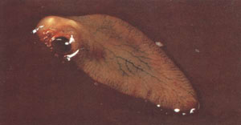
Fasciola hepatica
Fasciola hepatica

Slide 30
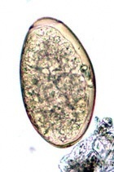
Egg of Fasciola hepatica

Slide 31
Fasciola hepatica
Pathology and clinical picture :
  True infection: occur when man accidentally ingests water plant (watercress) contaminated with METACERCARIA, the adult worm can causes mainly biliary colic with biliary obstruction, jaundice, generalized abdominal pain, cholecystitis.
  False infection: is when eggs are eaten in infected animal liver and passed in stools.
Diagnosis: eggs in stools or duodenal aspirate.
Treatment: Triclabendazole.

Slide 32
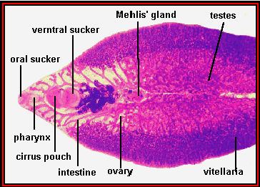
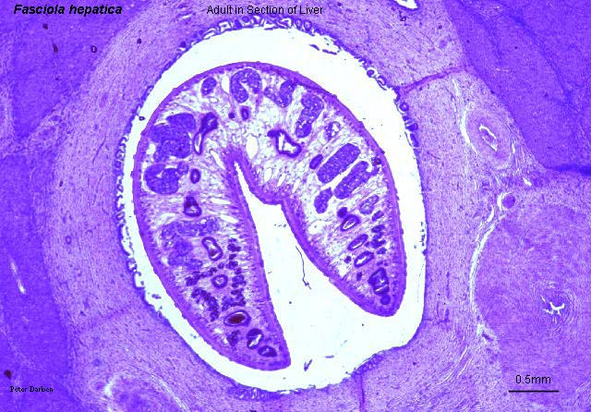
Fasciola hepatica adult
Fasciola hepatica in bile duct

Slide 33
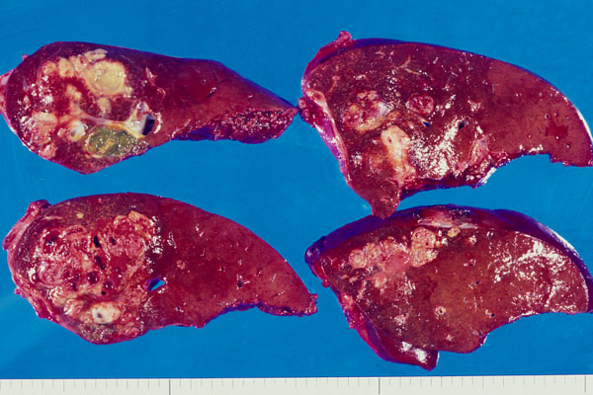
Sheep liver infected with Fasciola hepatica

Slide 34
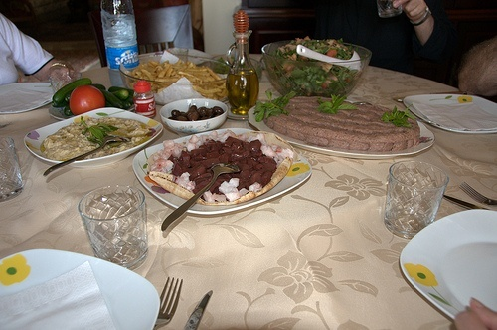
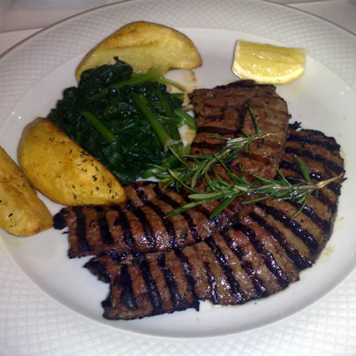
Fasciola hepatica: spurious infection (false infection) will not lead to liver infection only we can detect eggs in stool

Slide 35
TREATMENT Triclabendazole is the drug of choice to treat fascioliasis and is on the WHO list of essential medicines.
The correct dosage is calculated based on the person’s weight (10 mg/kg) and the tablets are given at one time.

