Slide 1
LECTURES
Gastro-esophageal reflux disease
Peptic Ulcer Disease
Pancreatitis
Cirrhosis
Cirrhosis
Cholecystitis
Tumors of liver and pancreas
Diarrhea
Malabsorption
Inflammatory bowel disease-1
Inflammatory bowel disease-2
Colonic polyps and carcinoma-1
Colonic polyps and carcinoma-2

Slide 2
8 LECTURES
Gastro-esophageal reflux disease
Peptic Ulcer Disease
Next lecture
Revision

Slide 3
Objectives
Upon completion of this lecture the students will :
Define gastroesophageal reflux disease
Understand the Pathophysiology of reflux esophagitis.
Know clinical features of reflux esophagitis
Describe the pathological features of reflux esophagitis
Know the complications of reflux esophagitis

Slide 4
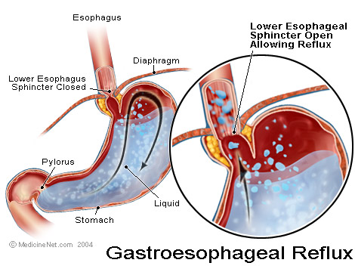
Figure 2 Anatomic radiographic landmarks of the lower esophageal sphincter (LES).

Slide 5
Gastroesophageal Reflux Disease (GERD)
Gastroesophageal reflux is a normal physiologic phenomenon experienced intermittently by most people, particularly after a meal.
Gastroesophageal reflux disease (GERD) occurs when the amount of gastric juice that refluxes into the esophagus exceeds the normal limit, causing symptoms with or without associated esophageal mucosal injury.

Slide 6
Physiologic vs Pathologic
Physiologic GERD
Postprandial
Short lived
Asymptomatic
No nocturnal symptomes
Pathologic GERD
Symptoms
Mucosal injury
Nocturnal symptomes
Notes:
--distinction between normal and GERD is blurred because some degree of reflux is physiologic is all folks
Physiologic—postprandially, short lived, asymptomatic, not during sleep
Pathologic—symptoms or mucosal injury and often with nocturnal symptoms

Slide 7
GERD Pathophysiology
Abnormal lower esophageal sphincter
or
Increase abdominal pressure

Slide 8
GERD Pathophysiology
Abnormal lower esophageal sphincter
Functional (frequent transient LES relaxation)
Mechanical (hypotensive LES)
Foods (eg, coffee, alcohol),
Medications (eg, calcium channel blockers),
Location .......... hiatal hernia (x ray show gas behind the heart)
or
B. Increase abdominal pressure
The most common cause of (GERD).
decrease the pressure of the LES.
obesity
Pregnancy
increased gastric volume

Slide 9
Pathophysiology
Primary barrier to gastroesophageal reflux is the lower esophageal sphincter
LES normally works in conjunction with the diaphragm
If barrier disrupted, acid goes from stomach to esophagus
Notes:
--At level of diaphragmatic hiatus—main deterrant to reflux
--disruption due to –review slide--multifactorial

Slide 10
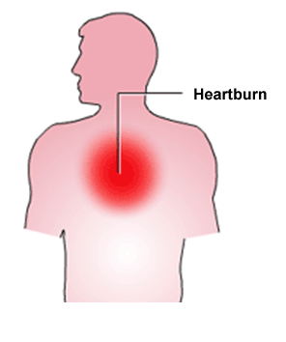
Clinical Manisfestations
Most common symptoms
Heartburn—retrosternal burning discomfort
Regurgitation—effortless return of gastric contents into the pharynx without nausea
Atypical symptoms….coughing, chest pain, and wheezing.
Notes:
--gerd related chest pain may mimic angina—squeezing/burning, substernal, radiates to back, neck, jaw, arms. Minutes to hours. After meals, awakens patient from sleep, exacerbated by emotional stress
--water brash—hypersalivation—heartburn and regurg of sour fluid or tasteless saliva into mouth
--globus—lump in throat irrespective of swallowing
--odynophagia—esophageal ulcer
--nausea—infrequent
--hrt burn 70-85%//regurg 60%//dysphagi 15-20%//angina 33%//asthma 15-20%

Slide 11
Diagnostic Evaluation
If classic symptoms of heartburn and regurgitation exist in the absence of “alarm symptoms” the diagnosis of GERD can be made clinically and treatment can be initiated
Notes:
--heartburn +/- regurgitation high specificity, low sensitivity

Slide 12
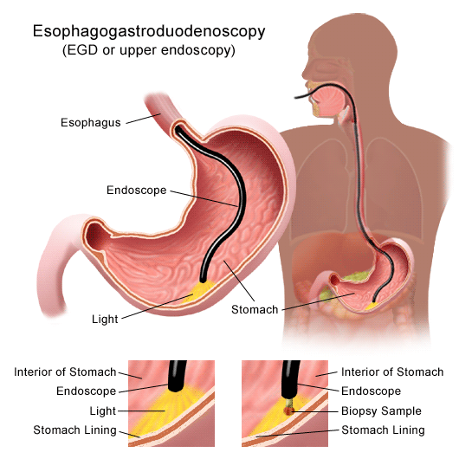
Esophagogastrodudenoscopy
Endoscopy (with biopsy if needed)
In patients with alarm signs/symptoms
Those who fail a medication trial
Notes:
--if trial of med did not work or if alarm symptoms or long term 5yrs need egd 1a evidence—dysphagia/early satiety/gi bleed/odynophagia/vomiting/wt loss/anemia
--50-70% of patient’s with gerd will have a neg egd.

Slide 13
Complications
Erosive esophagitis
Stricture
Barrett’s esophagus
Notes:
--dysphagia, odynophagia, early satiety, gi bleed, anemia, vomit, wt loss

Slide 14
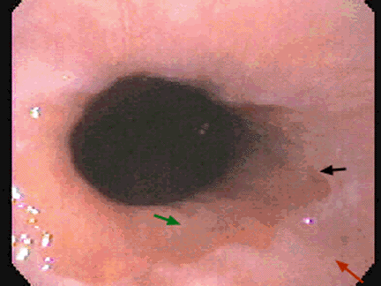
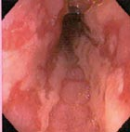
Complications
Erosive esophagitis
Responsible for 40-60% of GERD symptoms
Severity of symptoms often fail to match severity of erosive esophagitis
Notes:
--black arrow squamo-columnar jxn—Z-line
--Z-line has undulating smooth contours
--green arrow—gastric columnar epithelium above round black sphincter
--red arow—pink white esophageal squamous epithelium
--ulcerations in 2-7%

Slide 15
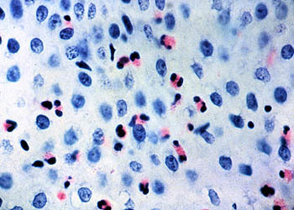
Esophagitis
Eosinophils and neutrophils
basal zone hyperplasia,
Elongation of lamina propria papillae

Slide 16
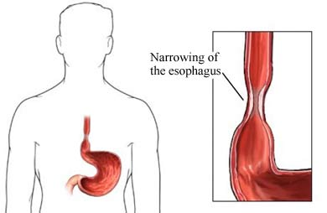
Complications
Esophageal stricture
Result of healing of erosive esophagitis
May need dilation
Notes:
4-20% of patients

Slide 17
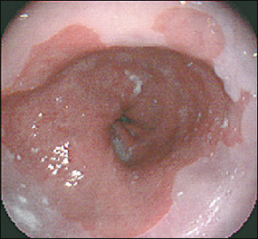
Complications
8-15%
Barrett’s Esophagus
Intestinal metaplasia of the esophagus
Associated with the development of adenocarcinoma
Notes:
--1950—Norman Barrett
--10-15%
--black arrow squamo-columnar jxn—Z-line
--Z-line has undulating smooth contours
--green arrow—gastric columnar epithelium above round black sphincter
--red arow—pink white esophageal squamous epithelium
--RFs—male, smoker, age, obese

Slide 18
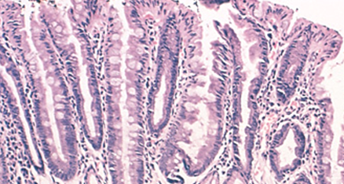
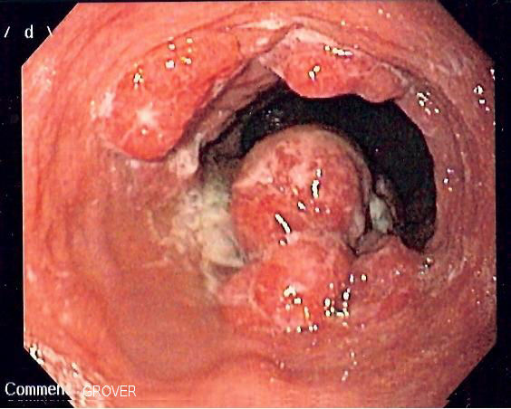
Complications
Barrett’s Esophagus
Acid damages lining of esophagus and causes esophagitis
Damaged area heals in a metaplastic process and abnormal columnar cells replace squamous cells
This specialized intestinal metaplasia can progress to dysplasia and adenocarcinoma
Many patients with Barrett’s are asymptomatic
Notes:
Adenoca with barretts 0.5%/yr--------without barretts 0.07%/yr

Slide 19
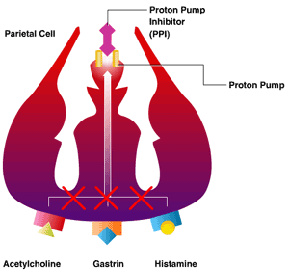
Treatment
H 2 receptor Blockers
Proton pump inhibitors
Antireflux surgery
Notes:
Once established h&p dx and no alarm symptoms can proceed with dx/therapeutic trial of tx.

Slide 20
Objectives
Define gastroesophageal reflux disease
Symptoms OR mucosal damage produced by the abnormal reflux of gastric contents into the esophagus
Physiologic vs. pathologic
Understand the Pathophysiology of reflux esophagitis.
Abnormal lower esophageal sphincter or increased abdominal pressure
Know clinical features of reflux esophagitis
Heartburn, Regurgitation
Atypical symptoms….coughing, chest pain, and wheezing
Describe the pathological features of reflux esophagitis
Eosinophils and neutrophils
Elongation of lamina propria papillae
basal zone hyperplasia
Know the complications of reflux esophagitis
Erosive esophagitis,
Stricture,
Barrett’s esophagus…………………………..dysplasia…………….adenocarcinoma

Slide 21
Gastro-esophageal reflux disease
Peptic Ulcer Disease

Slide 22
Objectives
Upon completion of this lecture the students will :
Understand the Pathophysiology of acute and chronic peptic ulcer
Know the possible causes of gastric and duodenal ulcers with emphasis on most common causes (H pylori and drugs)
Recognize the gross and microscopic features of peptic ulcer
Recognize the clinical features and consequences of acute and chronic peptic ulcer

Slide 23
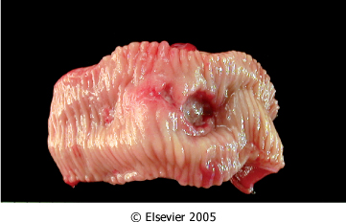
Ulcer
Ulcer: a breach in the mucosa of the alimentary tract extending through muscularis mucosa into submucosa or deeper.
Peptic ulcer
Stress ulcers (acute gastric ulcers)

Slide 24
Pathophysiology
Defensive Factors
Aggressive Factors

Slide 25
Pathophysiology
imbalance
Defensive Factors
Mucus
bicarbonate
Blood flow,
cell renewal
Prostaglandins
Phospholipid
Aggressive Factors
H. pylori
Drugs (NSAIDs)
Acid
pepsin
Bile salts
Defensive Factors
Aggressive Factors

Slide 26
Pathophysiology
imbalance
Defensive Factors
Mucus
bicarbonate
Blood flow,
cell renewal
Prostaglandins
Phospholipid
Aggressive Factors
H. pylori
Drugs (NSAIDs)
Acid
pepsin
Bile salts
Defensive Factors
Aggressive Factors

Slide 27
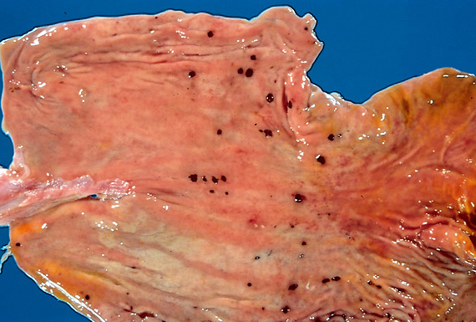
Acute peptic ulcers Pathophysiology
As part of an acute gastritis
As a complication of a severe stress response
As a result of extreme hyperacidity.

Slide 28
Acute peptic ulcers
Pathophysiology
As part of an acute gastritis (acute response to an irritant 'chemical' injury by drugs (NSAID) or alcohol
As a complication of a severe stress response (severe burns (Curling's ulcer), major trauma (cushing ulcer) or cerebrovascular accidents )
As a result of extreme hyperacidity (Zollinger-Ellison syndrome).

Slide 29
Chronic peptic ulcer Peptic Ulcer Disease Locations
May occur in any portion of the GI tract exposed to acidic gastric juices
98% located in first portion of duodenum or stomach, ratio = 4:1
Esophagus……. as a result of GERD or acid secretion by ectopic gastric mucosa.
Gastric mucosa within a Meckel diverticulum can result in peptic ulceration of adjacent mucosa.

Slide 30
Peptic Ulcer Disease Gastric ulcers
Pathophysiology
The mucosal defences against acid attack consist of:
Mucus-bicarbonate barrier
The surface epithelium.

Slide 31
Peptic Ulcer Disease Gastric ulcers
Pathophysiology
The mucosal defences against acid attack consist of:
Mucus-bicarbonate barrier
2. The surface epithelium.
Duodeno-gastric reflux ( bile )
NSAIDs (blocking the synthesis of the prostaglandins)
H. pylori infection, ( cytotoxins and ammonia)
Thus peptic ulcers in the stomach, breakdown of mucosal defence is much more important than excessive acid production.

Slide 32
Peptic Ulcer Disease Duodenal ulcers
Pathophysiology
Increased production of acid assumes more importance in the pathogenesis of duodenal ulceration
H. pylori-infected individuals secrete 2-6 times as much acid as non-infected controls
Helicobacter Pylori does not colonise normal duodenal epithelium
Helicobacter is involved in duodenal ulceration because there is gastric metaplasia in response to excess acid. Gastric metaplasia paves the way for colonisation by Helicobacter
+
=
Increased production of acid
Helicobacter P
Duodenal ulcers

Slide 33
Peptic Ulcer Disease Pathophysiology
Duodeno-gastric reflux ( bile )
Hyperacidity
Gastric
ulcers
H. pylori
Duodenal
ulcers
NSAIDs
H pylori infection of the pyloric antrum is present in nearly all patients with chronic duodenal ulcer and approximately 75% of patients with chronic gastric ulcer.
Although more than 70% of individuals with PUD are infected by H. pylori, fewer than 20% of H. pylori–infected individuals develop peptic ulcer.

Slide 34
Morphology
Gross
usually less than 20 mm in diameter but they may > 100 mm in diameter.
The classic peptic ulcer is a round to oval, sharply punched-out defect
In contrast, heaped-up margins are more characteristic of cancers
Microscopy
the base consists of necrotic tissue and polymorph exudate overlying inflamed granulation tissue which merges with mature fibrous (scar) tissue.

Slide 35
Clinical features
Epigastric pain (the most common symptom)
Gnawing or burning sensation
Occurs 2-3 hours after meals
Relieved by food or antacids
Patient awakens with pain at night.
Some present with complications such as iron deficiency anemia, frank hemorrhage, or perforation.

Slide 36
Therapy
Current therapies for PUD are aimed at
H. pylori eradication
Acid suppression
Proton pump inhibitors
H2 blockers

Slide 37
Objectives
Understand the Pathophysiology and etiology of acute and chronic peptic ulcer
Increase Aggressive Factors or dercrease Defensive Factors
Acute ulcers ……..acute gastritis , severe stress response, extreme hyperacidity
Chronic ulcer
Recognize the gross and microscopic features of peptic ulcer
The classic peptic ulcer is a round to oval, sharply punched-out defect
necrotic tissue and polymorph exudate overlying inflamed granulation tissue which merges with mature fibrous (scar) tissue.
Recognize the clinical features and consequences of acute and chronic peptic ulcer
Epigastric pain Gnawing or burning sensation
Some present with complications such as iron deficiency anemia, frank hemorrhage, or perforation
Gastric: H. pylori infection, NSAIDs , bile reflux
Duodenal: H. pylori infection , hyperacidity

