Slide 1
8 LECTURES
Gastro-esophageal reflux disease
Peptic Ulcer Disease
Diarrhea
Malabsorption
Inflammatory bowel disease-1
Inflammatory bowel disease-2
Colonic polyps and carcinoma-1
Colonic polyps and carcinoma-2

Slide 2
8 LECTURES
Diarrhea
Malabsorption

Slide 3
DIARREAHA

Slide 4
Objectives
Upon completion of this lecture the students should :
Understand the physiology of fluid in small intestine
Describe the pathophysiology and causes of various types of diarrhea ( Secretory, osmotic, Exudative, Motility-related )
Define acute diarrhea and enumerate its common causes
Define chronic diarrhea and enumerate its common causes

Slide 5
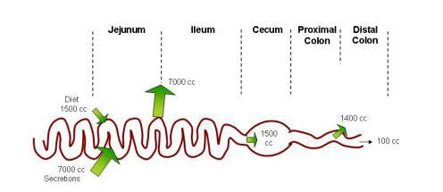
Physiology of Fluid and small intestine

Slide 6
DIARREAHA DEFINITION
World Health Organization
3 or more loose or liquid stools per day
Abnormally high fluid content of stool
> 200-300 gm/day

Slide 7
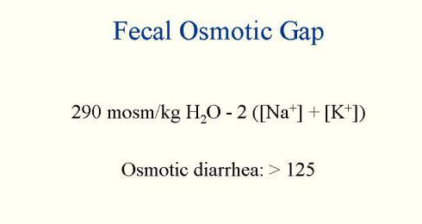
Fecal osmolarity
As stool leaves the colon, fecal osmolality is equal to the serum osmolality i.e. 290 mosm/kg.
Under normal circumstances, the major osmoles are Na⁺, K⁺, Cl–, and HCO₃–.

Slide 8
CLASSIFICATION
Acute …………….if 2 weeks,
Persistent ……. if 2 to 4 weeks,
Chronic ………..if 4 weeks in duration.

Slide 9
Why important?
The loss of fluids through diarrhea can cause dehydration and electrolyte imbalances
Easy to treat but if untreated, may lead to death especially in children

Slide 10
Why important?
More than 70 % of almost 11 million child deaths every year are attributable to 6 causes:
Diarrhea
Malaria
neonatal infection
Pneumonia
preterm delivery
lack of oxygen at birth.
UNICEF

Slide 11
Pathophysiology Categories of diarrhea
Secretory
Osmotic
Exudative (inflammatory )
Motility-related

Slide 12
Secretory
There is an increase in the active secretion
High stool output
Lack of response to fasting
Normal stool osmotic gap < 100 mOsm/kg
The most common cause of this type of diarrhea is a bacterial toxin ( E. coli , cholera) that stimulates the secretion of anions.
Also seen in Endocrine tumours

Slide 13
Osmotic
Excess amount of poorly absorbed substances that exert osmotic effect………water is drawn into the bowels……diarrhea
Stool output is usually not massive
Fasting improve the condition
Stool osmotic gap is high, > 125 mOsm/kg
Can be the result of
Malabsorption in which the nutrients are left in the lumen to pull in water e.g. lactose intolerance
2. osmotic laxatives.

Slide 14
Exudative (inflammatory )
Results from the outpouring of blood protein, or mucus from an inflamed or ulcerated mucosa
Presence of blood and pus in the stool.
Persists on fasting
Occurs with inflammatory bowel diseases, and invasive infections.

Slide 15
Motility-related
Caused by the rapid movement of food through the intestines (hypermotility).
Irritable bowel syndrome (IBS) – a motor disorder that causes abdominal pain and altered bowel habits with diarrhea predominating
Other causes:
Diabetic diarrhoea
hyperthyroid diarrhoea

Slide 16
Pathophysiology Categories of diarrhea
Secretory
Osmotic
Exudative (inflammatory )
Motility-related

Slide 17
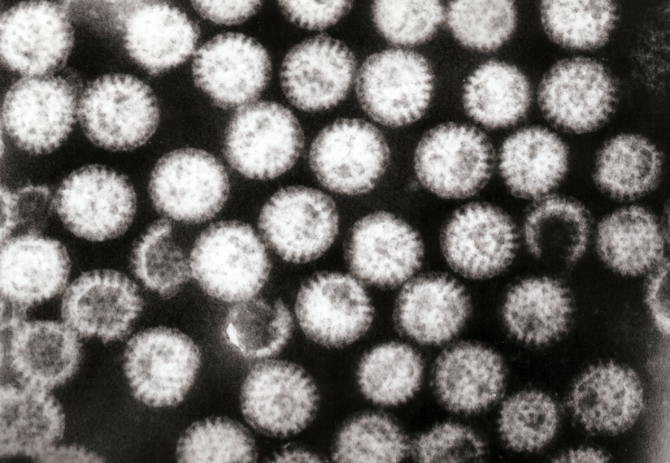
Aetiology Acute diarrhea?
Approximately 80% of acute diarrheas are due to infections (viruses, bacteria, helminths, and protozoa).
Viral gastroenteritis (viral infection of the stomach and the small intestine) is the most common cause of acute diarrhea worldwide.
Food poisoning
Drugs
Others
Rotavirus the cause of nearly 40% of hospitalizations from diarrhea in children under 5

Slide 18
Antibiotic-Associated Diarrheas
Diarrhea occurs in 20% of patients receiving broad-spectrum antibiotics; about 20% of these diarrheas are due to Clostridium difficile

Slide 19
Aetiology
Chronic diarrhea?
Infection ------------------ e.g.Giardia lamblia . AIDS often have chronic infections of their intestines that cause diarrhea.
Post-infectious. Following acute viral, bacterial or parasitic infections
Malabsorption
Inflammatory bowel disease (IBD)
Endocrine diseases.
Colon cancer
Irritable bowel syndrome.

Slide 20
Complications
Fluids ………………Dehydration
Electrolytes …………….. Electrolytes imbalance
Sodium bicarbonate……. Metabolic acidosis
If persistent ……Malnutrition

Slide 21
Tests useful in the evaluation of diarrhea
Acute diarrhea
Fecal leukocytes
present
not present
Inflammatory Diarrhea
Noninflammatory Diarrhea
Suggests a small bowel source
Or colon but without mucosal injury
Suggests colonic mucosa damage caused by invasion
shigellosis, salmonellosis, Campylobacter or Yersinia infection, amebiasis)
toxin (C difficile, E coli O157:H7).
Inflammatory bowel diseases

Slide 22
Chronic diarrhea
Infection
+
Stool analysis
Ova, parasites
-
Secretory or
Noninfectious
inflammatory diarrhea
-
Stool fat test
(normal <20%)
+
Malabsorption

Slide 23
Understand the physiology of fluid in small intestine
1.5 liter food
7 liters secretions and reabsorbed in small intestine
1.4 reabsorbed in large intestine
Describe the pathophysiology and causes of various types of diarrhea
Secretory Normal stool osmotic gap {bacterial toxin ( E. coli , cholera) Endocrine tumours}
osmotic, osmotic gap is high , {Malabsorption, osmotic laxatives}
Exudative, blood and pus in the stool, { inflammatory bowel diseases, and invasive infections}
Motility-related {Irritable bowel syndrome (IBS)}
Define acute diarrhea and enumerate its common causes
Less than 2 weeks
infections (viruses, bacteria, helminths, and protozoa). Food poisoning
Define chronic diarrhea and enumerate its common causes
More than one month
Infection, post Infection malabsorption, Inflammatory bowel disease (IBD), cancer

Slide 24
8 LECTURES
Diarrhea
Malabsorption

Slide 25
Objectives
Upon completion of this lecture the students will :
Understand that the malabsorption is caused by either abnormal digestion or small intestinal mucosa
Know that malabsorption can affect many organ systems ( alimentary tract, hematopoietic system, musculoskeletal system, endocrine system, epidermis, nervous system)
Concentrate on celiac disease and lactose intolerance as two examples of malabsoption syndrome.

Slide 26
Malabsorption Syndrome
Inability of the intestine to absorb nutrients adequately into the bloodstream.
Impairment can be of single or multiple nutrients depending on the abnormality.

Slide 27
Physiology
The main purpose of the gastrointestinal tract is to digests and absorbs nutrients (fat, carbohydrate, and protein), micronutrients (vitamins and trace minerals), water, and electrolytes.

Slide 28
Mechanisms and Causes of Malabsorption Syndrome
Inadequate digestion
Postgastrectomy
Deficiency of pancreatic lipase
Chronic pancreatitis
Cystic fibrosis
Pancreatic resection
Zollinger-Ellison syndrome
Deficient bile salt
Obstructive jaundice
Bacterial overgrowth
Stasis in blind loops, diverticula
Fistulas
Hypomotility states (diabetes)
Terminal ileal resection
Crohns' disease
Precipitation of bile salts (neomycin)
Primary mucosal abnormalities
Celiac disease
Tropical sprue
Whipple's disease
Amyloidosis
Radiation enteritis
Abetalipoproteinemia
Giardiasis
Inadequate small intestine
Intestinal resection
Crohn's disease
Mesenteric vascular disease with infarction
Jejunoileal bypass
Lymphatic obstruction
Intestinal lymphangiectasia
Malignant lymphoma
Macroglobulinemia
Many causes

Slide 29
Pathophysiology
Inadequate digestion
Or
Small intestine abnormalities
=
Malabsorption

Slide 30
Pathophysiology
Inadequate digestion
Stomach
Postgastrectomy
Pancrease
Deficiency of pancreatic lipase
Chronic pancreatitis
Cystic fibrosis
Pancreatic resection
Bile
Small intestine abnormalities
Obstructive jaundice
Terminal ileal resection
mucosa
Inadequate small intestine
Lymphatic obstruction

Slide 31
Pathophysiology
Inadequate digestion
Stomach
Pancrease
Bile
Celiac disease
Tropical sprue
Whipple's disease
Giardiasis
Small intestine abnormalities
mucosa
Intestinal resection
Crohn's disease
Inadequate small intestine
Lymphatic obstruction
Intestinal lymphangiectasia
Malignant lymphoma

Slide 32
Pathophysiology
Pancrease
Bile
mucosa

Slide 33
Malabsorption Syndrome Clinical features
There is increased fecal excretion of fat (steatorrhea) and the systemic effects of deficiency of vitamins, minerals, protein and carbohydrates.
Steatorrhea is passage of soft, yellowish, greasy stools containing an increased amount of fat.
Growth retardation, failure to thrive in children
Weight loss despite increased oral intake of nutrients.

Slide 34
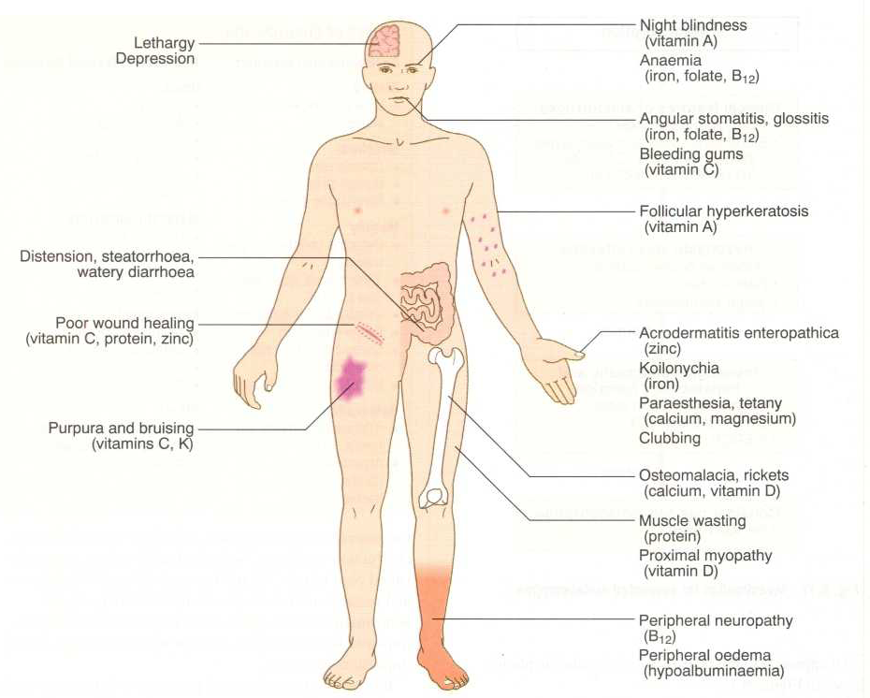
Clinical features

Slide 35
Malabsorption Syndrome Clinical features
Depend on the deficient nutrient
Protein
Musle wasting, Swelling or oedema
B₁₂, folic acid and iron deficiency
Anaemias
(fatigue and weakness)
vitamin D, calcium
Muscle cramp
Osteomalacia and osteoporosis
vitamin K and other coagulation factor
Bleeding tendencies

Slide 36
Diagnosis
There is no specific test for malabsorption.
Investigation is guided by symptoms and signs.
Fecal fat study to diagnose steatorrhoea
Blood tests
Stool studies
4. Endoscopy
Biopsy of small bowel

Slide 37
Malabsorption Syndrome Celiac disease
An immune reaction to gliadin fraction of the wheat protein gluten
Usually diagnosed in childhood – mid adult.
Patients have raised antibodies to gluten
Highly specific association with class II HLA (DQ2 or DQ8) and, to a lesser extent, DQ8 (haplotype DR-4).

Slide 38
Clinical features Celiac disease
Typical presentation GI symptoms that characteristically appear at age 9-24 months.
Symptoms begin at various times after the introduction of foods that contain gluten.
A relationship between the age of onset and the type of presentation;
Infants and toddlers….GI symptoms and failure to thrive
Childhood…………………minor GI symptoms, inadequate rate of weight gain,
Young adults……………anemia is the most common form of presentation.
Adults and elderly…...GI symptoms are more prevalent

Slide 39
Endoscopy
Normal
Celiac disease

Slide 40
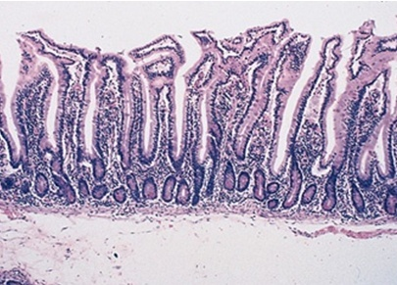
Celiac Disease
Normal
Histology
Mucosa is flattened with marked villous atrophy.
Crypt hyperplasia
Increased intraepithelial lymphocytosis

Slide 41
Celiac Disease
Diagnosis
Clinical documentations of malabsorption.
Stool ………. Fat
Serologic tests for celiac disease (namely the anti-TTG-IgA)
Small intestine biopsy demonstrate villous atrophy.
Improvement of symptom and mucosal histology on gluten withdrawal from diet.
wheat, barley, rye
Other grains, such as rice and corn flour, do not have such an effect.
rye
الشليم

Slide 42
Celiac Disease
Complications
Osteopenia , osteoporosis
Infertility in women
Short stature, delayed puberty, anemia,
Malignancies,[ intestinal T-cell lymphoma]
10 to 15% risk of developing GI lymphoma.

Slide 43
Lactose Intolerance

Slide 44
Lactose Intolerance Pathophysiology
lactase
Lactose
glucose + galactose
At the brush border of enterocytes
Lactose Intolerance
Low or absent activity of the enzyme lactase

Slide 45
Lactose Intolerance causes
Inherited lactase deficiency
Congenital lactase deficiency
Childhood-onset and adult-onset lactase deficiency
extremely rare
common
Genetically programmed progressive loss of the activity of the small intestinal enzyme lactase.
Gastroenteritis: Infectious diarrhea, particularly viral gastroenteritis in younger children, may damage the intestinal mucosa enough to reduce the quantity of the lactase enzyme.
Acquired lactase deficiency
Transient
Secondary lactase deficiency due to intestinal mucosal injury by an infectious, allergic, or inflammatory process

Slide 46
Clinical
Bloating, abdominal discomfort, and flatulence
……………1 hour to a few hours after ingestion of milk products

Slide 48
Lactose Intolerance Diagnosis
Empirical treatment with a lactose-free diet, which results in resolution of symptoms;
Hydrogen breath test

Slide 49
Hydrogen breath test .
An oral dose of lactose is administered
The sole source of H₂ is bacterial fermentation;
Unabsorbed lactose makes its way to colonic bacteria, resulting in excess breath H₂.
Increased exhaled H₂ after lactose ingestion suggests lactose malabsorption.

Slide 50
A 3-week trial of a diet that is free of milk and milk products is a satisfactory trial to diagnose lactose intolerance

Slide 51
Lactose Intolerance summary
Deficiency/absence of the enzyme lactase in the brush border of the intestinal mucosa → maldigestion and malabsorption of lactose
Unabsorbed lactose draws water in the intestinal lumen
In the colon, lactose is metabolized by bacteria to organic acid, CO2 and H2; acid is an irritant and exerts an osmotic effect
Causes diarrhea, gaseousness, bloating and abdominal cramps

Slide 52
Objectives
malabsorption = abnormal digestion or small intestinal mucosa
Know that malabsorption can affect many organ systems
alimentary tract,
hematopoietic system,
musculoskeletal system,
endocrine system,
Celiac disease
skin,
nervous system
Anaemia, Osteomalacia and osteoporosis Bleeding failure to thrive
Lactose Intolerance
immune reaction to gliadin fraction of the wheat protein gluten
Low or absent activity of the enzyme lactase
villous atrophy.
Crypt hyperplasia
Increased intraepithelial lymphocytosis
Lactose not absrbed
Lactose…….colon
In colon ….fermentation
Gases

