Slide 1
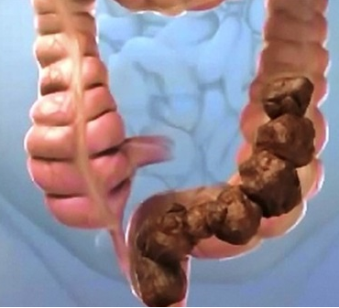
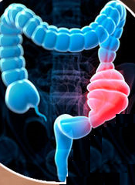
Constipation & IBS

Slide 2
Conistipation & IBS
Epidemiology
Constipation affects all age groups
The elderly are most susceptible
There is high incidence of females
Formula-fed baby are more likely to have constipation
Over 700 drugs have constipation as a side effect

Slide 3
Conistipation & IBS
ILOS
Classify Laxatives
Discuss the pharmacological properties of different classes of laxatives
Outline drugs used to treat irritable bowel syndrome

Slide 4
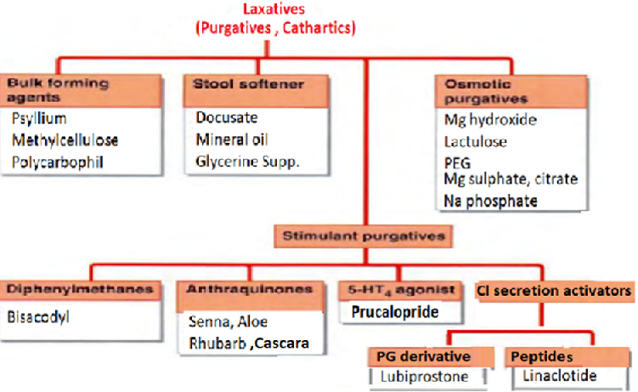
Classification

Slide 5
1-Bulk-forming laxatives
Indigestible hydrophilic colloids absorb water → distend the colon → promote peristalsis

Slide 6
Bulk-forming laxatives
Natural plant products
Psyllium,
Semisynthetic methylcellulose
Synthetic fibers
Polycarbophil
Digestion of plant fibers by bacteria→ bloating, flatus

Slide 7
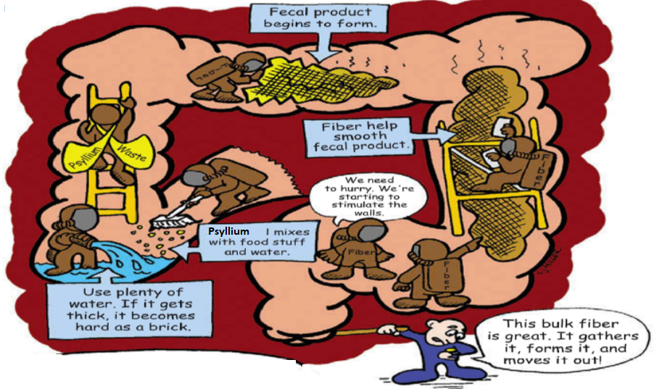
Psyllium

Slide 8
2-Stool softeners
Lower surface tension allowing water to interact with the stool
A-Docusate
Oral or enema
In hospitalized patients →↓constipation & straining

Slide 9
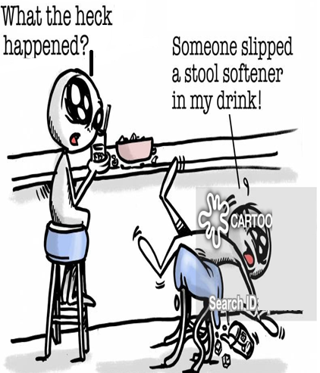
B-Glycerin suppositories
C-Mineral oil
Lubricate stool ↓ water absorption from the stool
To prevent fecal impaction in children & debilitated adults
Not palatable
Long- term use→ deficiency of fat- soluble vitamins

Slide 10
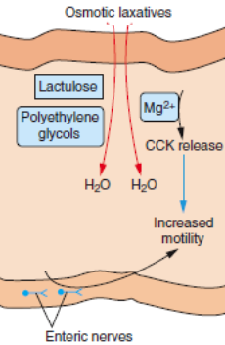
3-Osmotic laxatives
Soluble non absorbable compounds→↑ stool liquidity
Non- absorbable sugars & salts

Slide 11
Osmotic laxatives
A-Magnesium hydroxide
Used in acute & chronic constipation
Prolonged use in patients with renal insufficiency → hypermagnesemia
Mg salts contraindicated in kidney failure, heart block, neuromuscular block, CNS depression.

Slide 12
Osmotic laxatives
B- Lactulose
Chronic constipation
Metabolized by colonic bacteria severe flatus & cramps

Slide 13
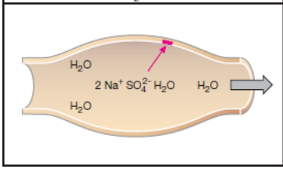
Osmotic laxatives
C-Magnesium sulphate & citrate
Severe purgative for acute constipation, cleanse the bowl
Patient should maintain adequate hydration
D-Sodium Phosphate
May cause hyperphosphatemia, hypernatremia, hypokalemia
Cardiac arrhythmias
Acute renal failure→ deposition of calcium phosphate “nephrocalcinosis”

Slide 14
E-Balanced polyethylene Glycol
Isotonic solution containing PEG, sodium sulphate, sodium chloride, sodium bicarbonate, potassium chloride
Safe for all patients
For optimal bowl cleansing1-2litres ingested rapidly over 1-2 hours on the evening before the procedure & 4-6h before the procedure
For chronic constipation PEG powder mixed with juice (no crams or flatus)

Slide 15
4-Stimulant laxatives
By stimulating enteric nervous system→↑bowl movement
Increase electrolyte & fluid secretion
In patients who are neurologically impaired
Bed- bound patients in long- term care facility

Slide 16
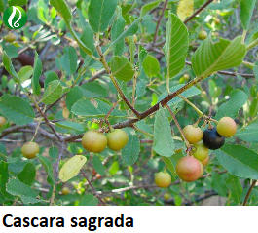
A-Anthraquinone derivatives
Occur naturally, poorly absorbed
Orally , bowl movement 6-12hrs. Rectally 2hrs
Prolonged use→ brown pigmentation of the colon “Melanosis coli”

Slide 17
B-Diphenomethane derivatives
Bisacodyl
Hydrolysed in the gut, absorbed, conjugated to glucouronic acid in the liver acid & secreted with bile
Oral administration is followed after 6-8 h by discharge of soft stool

Slide 18
C-Castor oil
Castor oil is obtained from the seeds of Ricinus communis
Oral administration of 10-30ml is followed by a discharge of watery stool within 0.5-3hrs.
Could be employed after oral ingestion of a toxin

Slide 19
Stimulant laxative dependence

Slide 20
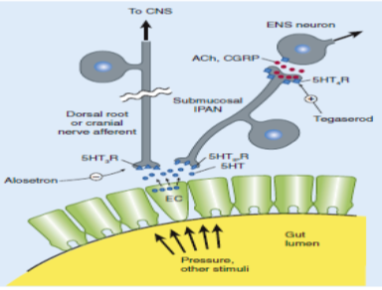
d-serotonin 5HT4-receptor agonists
Stimulation of 5HT 4 receptors→↑ release of neurotransmitters ↑ second order enteric neurons
Enteric neurons stimulates proximal bowel contraction & distal bowel relaxation
Prucalopride is used for chronic constipation in women

Slide 21
e-Chloride secretion activators
Lubiprostone used for chronic constipation & IBS-C
It stimulates type 2 chloride in the small intestine→↑Cl –fluid rich fluid,→ intestinal motility, shortens intestinal emptying
No loss of efficacy with long-term use
After discontinuation, constipation may return to pretreatment
Designated category C for pregnancy

Slide 22
e-Chloride secretion activators
Linaclotide stimule chloride sececretion through activation guanaylate cyclase C
Both agents are approved for chronic constipation & IBS-C.
Most common ADR is diarrhea

Slide 23
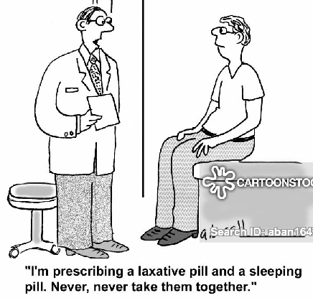
Opioid receptor antagonists
Acute & chronic treatment with opioids is accompanied with constipation
Methylnaltrexone & alivimopan are µ- receptor antagonist which don not cross the BBB
Methylnaltrexone is used in opioid induced constipation in patients receiving palliative care for advanced illness
Alvimopan is used for short term to shorten the period for post operative ileus

Slide 24
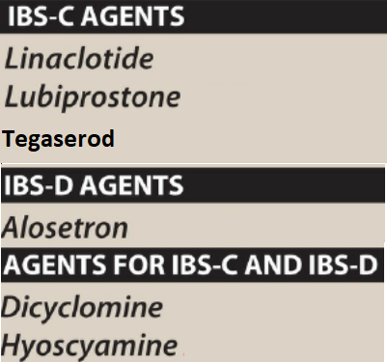
Drugs used for IBS
Idiopathic chronic relapsing disorder characterized by pain, bloating, distension, cramps with alteration in bowl habit
For patients with predominant diarrhea → antidiarrheal, loperamide
For patients with predominant constipation fibers are used , may cause bloating, osmotic ..milk of magnesia
For chronic abdominal pain low dose of tricyclic antidepressants

Slide 25
Antispasmodics (anticholinergics)
Dicyclomine & hyoscine
Inhibits muscarinic cholinergic receptors in enteric plexus & smooth muscle
Efficacy questionable

Slide 26
5ht3 –Receptor antagonists
5HT3 receptors in the GIT activate visceral afferent pain sensation
Inhibition of 5-HT3 receptors reduce nausea, bloating & pain
Alosetron 5-HT3 receptor antagonist used in patients with severe IBS with diarrhea
Rapidly absorbed from the GIT , 50-60% bioavailability, t½ 1.5h

Slide 27
5ht3 –Receptor antagonists
Undergoes extensive cytochrome P450 metabolism
It binds with high affinity & dissociate slowly from the receptor
ADRs: severe constipation, ischemic colitis
Use restricted in women with severe diarrhea- predominant IBS who have not responded to other therapies

Slide 28
Tegaserod
Stimulation of 5HT₄ of enteric nervous system of GIT → increases peristalsis.
Short term treatment of IBS-associated with constipation in women <55 years old with no history of heart problems.
Tegaserod has CVS side effects

Slide 29

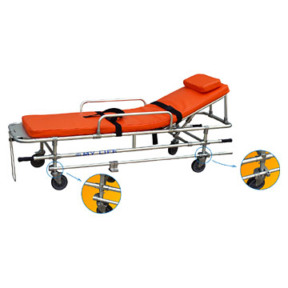
Case
A 70-year-old woman who was previously very active but whose mobility has recently been limited by osteoarthritis on the knees & hips sees her general practitioner because of a recent change in bowel habit from once daily to once every three days. Her current medication includes regular co-codamol (paracetamol + codeine) for her osteoarthritis , oxybutynine for urinary frequency, aluminuim hydroxide prn for dyspepsia, and bendrofluazide and verapamil for hypertension. Following bowel evacuation by a phosphate enema, proctoscopy & colonoscopy are reported as normal.
Notes:
<The patient is in early-stage parkinsonism,
most likely idiopathic (Parkinson’s disease).
Clinically, the disease is very mild and the
neurologist might consider not treating him at this
point, but because the micrographia interferes with
his work, the neurologist decides to prescribe
medication. Several drugs can be used to treat
early-onset parkinsonism.The most commonly used
are the dopamine receptor agonists (pramipexole,
ropinirole, pergolide; amantadine is also a
possibility, and some people get an acceptable
response to selegiline, the MAO inhibitor).
Levodopa–carbidopa could also be used; however,
most clinicians prefer to delay its use until
absolutely needed because of the adverse effects,
such as motor fluctuations and dyskinesias, that
accompany long-term use of levodopa.

Slide 30
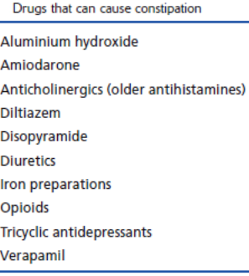
Case
1-What general approach should be employed to this patient?
2-What are the possible contributing causes of her constipation?
3-Which of these patient’s medications may contribute to her constipation?
4-What pharmacologic & non- pharmacologic approaches would be appropriate to this patient?

