Slide 1
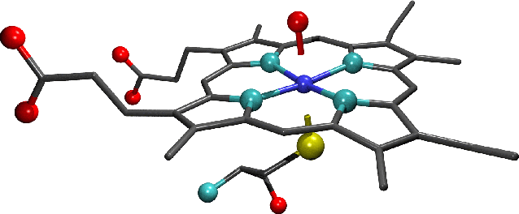
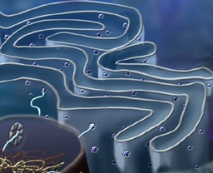
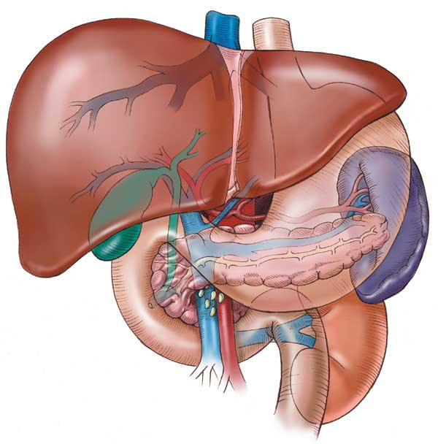
CYTOCHROME SYSTEM
&
DRUG METABOLISM
Dr. Mohammed Assiri
moassiri@ksu.edu.sa

Slide 2
&
CYTOCHROME SYSTEM
DRUG METABOLISM
Revise the aim & phases of drug metabolism
Define the role of cytochrome system in relation to drug metabolism
Expand on the nature, location, nomenclature, structure, distribution & function of CYT P450
Focus on its regulation; directly & indirectly, its induction & inhibition in relevance to drug interactions
Interpret molecular mechanism of interactions by CYTP450
Classify its different isoforms, their substrates, inducers & inhibitors
Delineate some of its genetic variations.

Slide 3
Where do drug biotransformations occur ?
RENAL Elimination
Being mostly lipophylic ➔ The liver subjects them to chemical transformation (METABOLISM) ➔ to become inactive & easily EXCRETED.
Polar product
Non-Polar product
Identified as foreign substances that body must get rid of
BILIARY Elimination
?
DRUG METABOLISM
Occurs mainly in the
“METABOLIC CLEARING HOUSE"

Slide 4
Inactive product
Active metabolite;
Similar to parent
More active than parent
A product with different effect
Toxic metabolite
“ Cytochrome P450“ “ CYT 450” Superfamily is the terminal rate limiting oxidase of this system
?
Phase II
Conjugation
Create a conjugation site
Phase I
OXIDATION /Reduction/Hydrolysis
Its enzymes are part of a cascade
➔ transfers electrons from molecular oxygen to oxidize the drugs
CYTOCHROME SYSTEM
DRUG METABOLISM

Slide 5
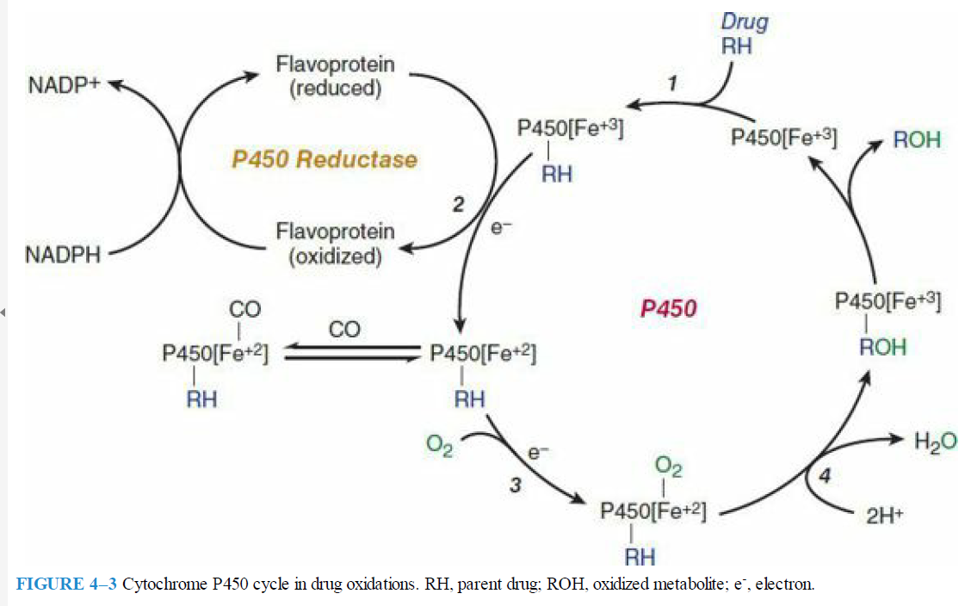

Slide 6
Cytochrome P450 cycle in drug oxidations

Slide 7
Microsomal drug oxidations require P450, P450 reductase, NADPH, & molecular oxygen
Briefly, oxidized (Fe3+) P450 combines with a drug substrate to form a binary complex (step 1). NADPH donates an electron to the flavoprotein P450 reductase, which in turn reduces the oxidized P450 drug complex (step 2).

Slide 8
A second electron is introduced from NADPH via the same P450 reductase, which serves to reduce molecular oxygen & to form an activated oxygen – P450-substrate complex (step 3).
This complex in turn transfers activated oxygen to the drug substrate to form the oxidized product (step 4).

Slide 9
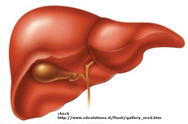
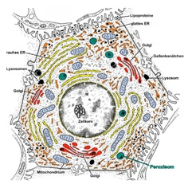
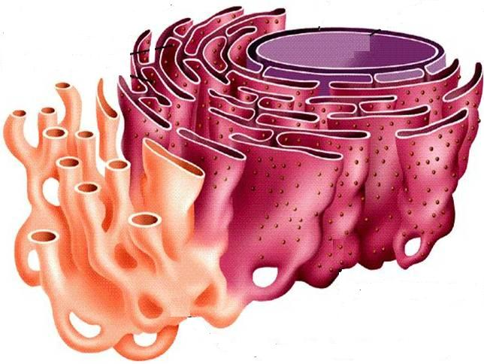
CYTOCHROME P450 FAMILY OF ENZYMES
They are located mainly attached to the smooth endoplasmic reticulum (SER) of hepatocytes.
“Cytochrome" = colored cells
They color the liver cells dark red as they contain iron
"P450“ absorbs a very characteristic wavelength (450 nm) of UV light when it is exposed to carbon monoxide.
They are isolated in the subcellular fraction termed the MICROSOMES
➔ Liver microsomal enzymes

Slide 10
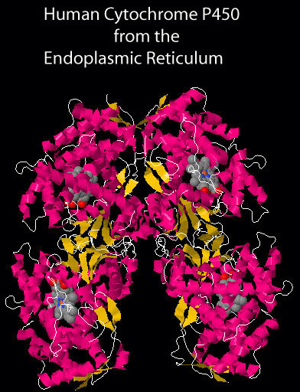
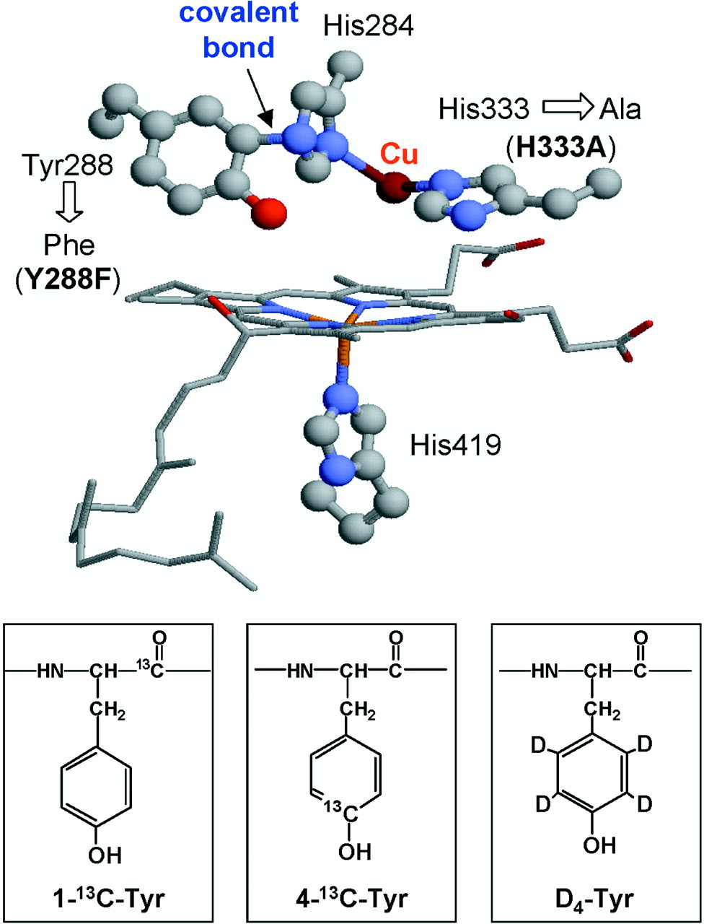
STRUCTURE
They are heme-containing isoenzymes
O₂
N₃
Cu
Fe
haem
DISTRIBUTION
Highly concentrated in hepatocytes
Enterocytes of the small intestine present their principal extra-hepatic source
Very small quantities in kidneys, lungs, & brain.

Slide 11
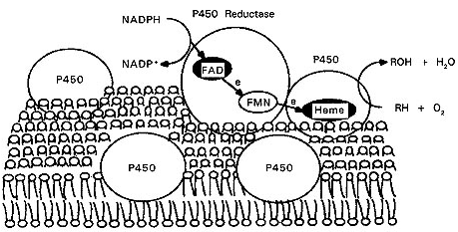
Function
Responsible for most of the OXIDATIVE METABOLISM of:
Endogenous substances: steroid hormones, prostaglandins, lipids, & fatty acids
Exogenous compounds: diet (food & beverages) / Drugs/ environmental xenobiotics.
Substrates
P450 Reductase
CYT P450 Oxidase

Slide 12
Regulation
Activation or Inactivation of the CYT P450 can be achieved either
A: Directly
B : Indirectly by expression or repression of its relevant genes by
activation or inhibition of the
responsible transcription factors
cyto
Activation or Inactivation can be
processed by any food, intrinsic products or extrinsic xenobiotics as drugs (usually the lipophylic) that have to be metabolized.

Slide 13
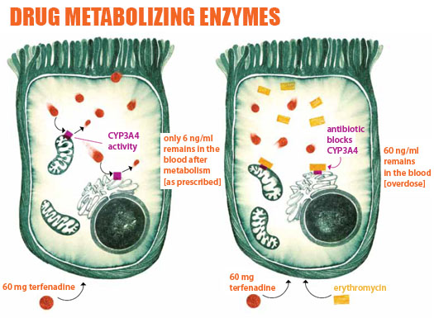
Regulation
When drugs play a role in regulation of the CYT P450 they are termed
Enzyme Inducers if Activate the enzyme
Enzyme Inhibitors if Inactivate the enzyme
PHARMACOKINETIC DRUG-DRUG INTERACTION
?

Slide 14
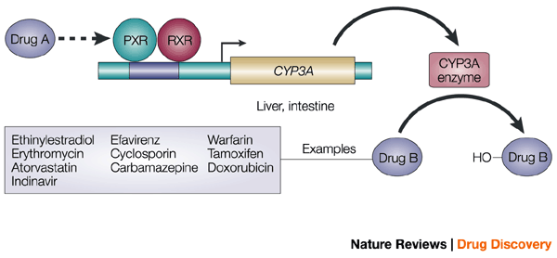
Molecular Basis Of Drug–drug Interaction
Regulation
The orphan nuclear receptor PXR is a TRANSCRIPTION FACTOR that regulates the expression of the CYP P450 genes.
If Drug A is INDUCER  it binds & activates PXR  which translocates into nucleus dimerize with RXR  the heterodiamer PXR / RXR will induce EXPRESSION of CYT P450 isoenzymes to metabolism of Drug B
If Drug A is an INHIBITOR, its binding will prevent activation  REPRESSION of CYT P450 isoenzymes   metabolism of Drug B
PXR, pregnane X receptor
RXR, retinoid X receptor.

Slide 15
Outcome Of Drug-drug Interactions Mediated By CYT P450
Regulation
IN RELATION TO ENZ INDUCERS
 metabolism of the inducer +  its pharmacological action.
Tolerance or complete nullification
 metabolism of co-administered drugs
◉ EFFICACY
IN RELATION TO ENZ INHIBITORS
/ Retard metabolism & excretion of inhibitor & co-administered drugs
 / prolong action of the inhibitor & co-administered drugs.
TOXCICITY

Slide 16
Classification
CYT P450 has been classified into
Families designated by Numbers
Sub families designated by Letters
Distribution of
different CYP isoforms
in the liver.

Slide 17
Major Contributor to Phase I Metabolism

Slide 18
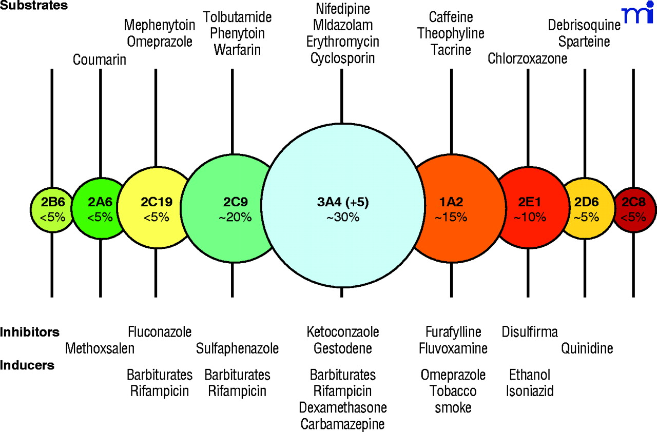
Substrate
Inhibitors
Disulfiram
Inducers

Slide 19
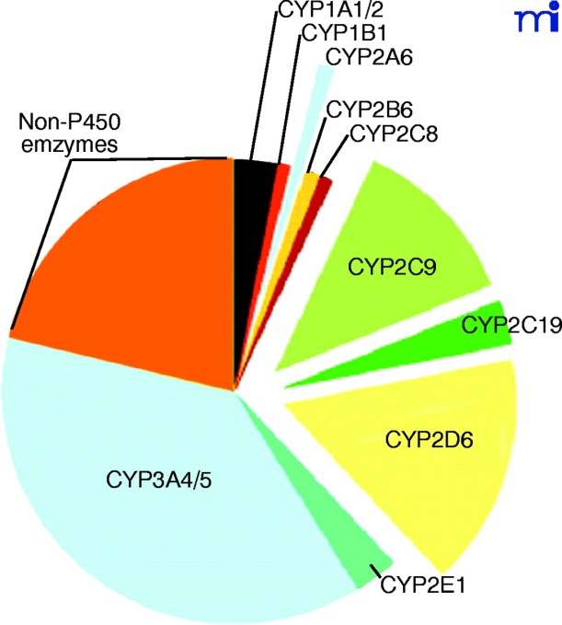
Ritonavir
Cytochrome P450 3A4

Slide 20
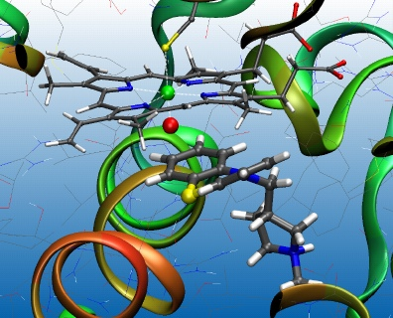
Cytochrome P450 2D6

Slide 21
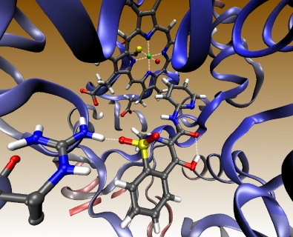
Cytochrome P450 2C9

Slide 22
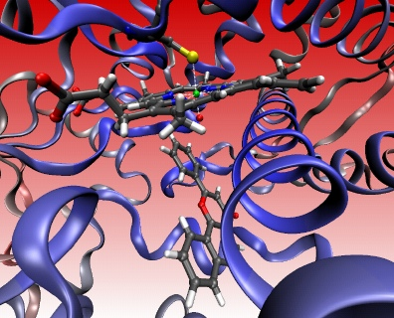
Cytochrome P450 1A2

Slide 23
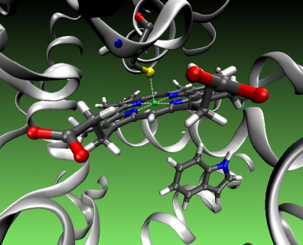
Cytochrome P450 2C 19

Slide 24
CYT P450 3A4
Substrates
Immunosuppressants (Cyclosporine)
Azole Antifungals (Fluconazole)
Antibiotics (Erythromycin, Clarithromycin)
Ca channel blockers (Amlodepine, Verapamil)
Statins (Atorvastatin)
Cancer Chemotherapy
(Cyclophosphamide, Tamoxifen)
Non-Sedating Antihistamines (Astemizole)
Benzodiazepines (Midazolam, Clonazepam).
Inhibitors
Ritonavir
Cimetidine
Chlorampheni-col
Nefazodone
Grape Fruits
Inducers
Phenytoin
Carbamazepine
Barbiturates
Rifampicin
Dexamethazone
Progestins

Slide 25
“A 50 years old, patient was treated for the last 3 years by the hypocholestrolemic agent; atorvastatin. Yesterday he began to complain of severe muscle pains, weakness & reddish discoloration of urine
He receives daily multivitamins & his lab results last week, proved that he has become diabetic, for which he was prescribed metformin. He was also started on a course of fluconazole for a concomitant fungal infection.
From drug history, the diagnosis of his current state was likely rhabdo-myositis (severe musculoskeletal toxicity) & was verified by the lab finding of severe elevation in creatinine phosphokinase. “
Which one of the following drug-drug interaction on CYT 3A4 is the likely cause of his current state?
Metformin + Atorvastatin
Atorvastatin + Fluconazole
Metformin + Fluconazole
Fluconazole+ Multivitamins

Slide 26
Genetic Variation
Genetic polymorphisms in CYT P450 isoenzymes have been observed & are reasons behind the ALTERED RESPONSE to drug therapy
CYP2D6
This isoenzyme has the most frequent polymorphisms in all CYT P450
When polymorphism occurs   metabolizing capacity of CYP2D6
i.e. those who exhibit the polymorphism become poor metabolizers:
1. Metabolism of some neuroleptics, tricyclic antidepressants, antianginal agents (perhexiline), antiarrhythmics (propafenone & metoprolol) is suppressed  so side effects & toxicity develop. i.e.
Neuropathy after therapeutic doses of perhexiline
Bradycardia & arrhythmias on therapeutic dose of propafenone or metoprolol
2. The pro-drugs cannot be converted to their therapeutically active metabolite; e.g poor analgesia with codeine & tramadol because they are not transformed into active forms.

Slide 27
Genetic Variation
CYP2C9.
Warfarin, phenytoin, & tolbutamide are examples of drugs with narrow therapeutic index that are metabolized by CYP2C9.
Clearance of these drugs is impaired in genetic variation of the enzyme
CYP2C19
Polymorphism in CYP2C19 shows increased & prolonged action of its substrates as omeprazole
This has been an advantage as in those variants   cure rates in peptic ulcer patient with Helicobacter pylori.
Benefit

Slide 28
G
O
O
D
L
U
C
K
CYTOCHROME SYSTEM
&
DRUG METABOLISM

