Slide 1
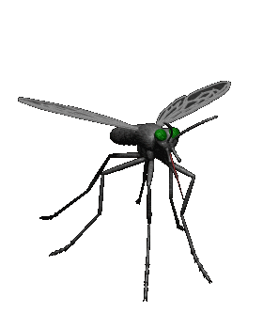
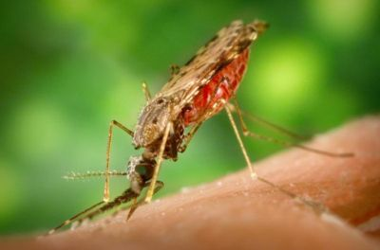
Antimalarial drugs
Malaria causes 900,000 deaths annually
Resistance developed to chloroquine, mefloquine, quinine, atovaquone, pyrimethamine/sulfadoxin
Chloroquine, primaquine,1946-1947
Mefloquine, halofantrine, lumefantrine, 1967-1970
Cost To Develop One New Drug Is $2.6 Billion
Vaccination?

Slide 2
Antimalarial drugs
ilos
Classify the main antimalarial drugs depending on their goal of therapy
Detail the pharmacokinetics & dynamics of main drugs used to treat attack or prevent relapses
State the WHO therapeutic strategy for treatment
Hint on the CDC recommendations for prophylaxis in travelers to endemic areas

Slide 3
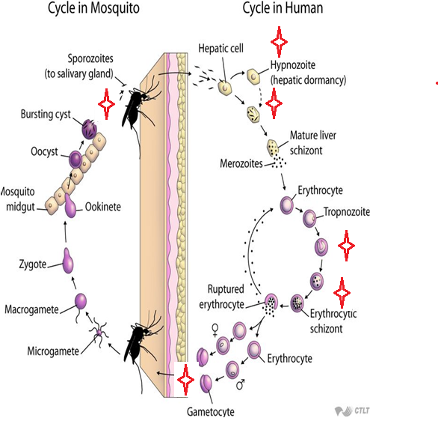
Cycle & Drugs site
of action
Causal
prophylaxis
Radical
cure
Clinical
cure
Supressive
prophylaxis
Sporozoitocides
Gametocides

Slide 4
Antimalarial drugs
Therapeutic classification
Causal prophylaxis
Destroys parasite in liver cells & prevent invasion of erythrocytes
Primaquine
Supressive prophylaxis
Suppresses the erythrocytic phase & thus attack of malaria fever
Chloroquine, mefloquine, doxycycline

Slide 5
Antimalarial drugs
Therapeutic classification
Radical cure
Clinical cure (erythrocytic schizonicide)
Used to terminate an episode of malarial fever
Eradicate all forms of vivax from the body
Suppressive drug + hypnozoitocidal
Fast acting high efficacy
Destroys gametocytes & prevent transmission
Chloroquine, quinine against vivax
Gametocidal
Chloroquine, quinine, mefloquine, artemisinin
Primaquine, all species
Slow acting low efficacy
Pyrimethamine, proguanil, sulfonamides
Destroys sporozoites
Proguanil, pyrimethamine
Sprozoitocides

Slide 6
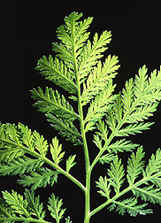
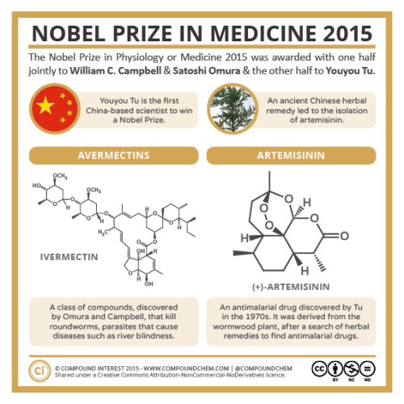
artemesinin
  Artemisinin is the active principle of the plant Artemisia annua(qinghaosu)
  Fast acting blood Schizontocide
Affect all forms including multi-drug resistant P. falciparum
  Short duration of action
  High recrudescence rate
  Poorly soluble in water & oil, can only be used orally

Slide 7
pharmaokinetics
Rapidly biotransformed in liver into dihydroartesimininactive metabolite
Artemisinin ,artesunate, artemether are prodrugs
Derivatives are rapidly absorbed orally
Widely distributed
t½ artemisinin  4hrs / artesunate  45min / artemether 4-11hrs
Artesunate (water-soluble; oral, IV, IM, rectal administration)
Artemether (lipid-soluble; oral, IM, and rectal administration)
Dihydroartemisinin (water-soluble; oral administration)
Induce its own CYP-mediated metabolism→ ↑ clearance 5 fold

Slide 8
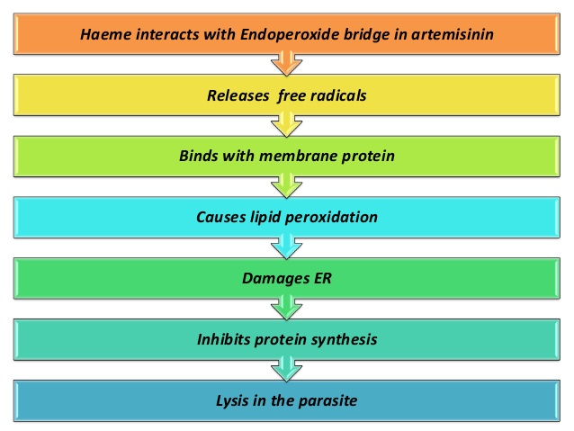
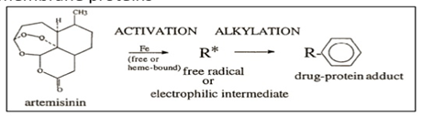
artemesinin
mechanism
They have endoperoxide bridges that are cleaved by haem iron to yield carbon- centered free radicals, that will
Alkylate membranes of parasite’s food vacuole and mitochondria no energy
Irreversibly bind & inhibit sarco-endoplasmic reticulum Ca²⁺-ATPase of the
parasite, thereby inhibiting its growth
Inhibiting formation of transport vesicles no food vacuoles

Slide 9
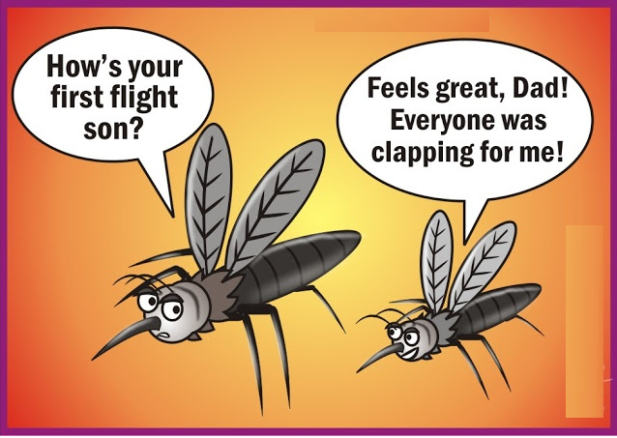
artemesinin
adrs
Transient heart block
↓Neutrophil count
Brief episodes of fever
Resistance  was reported recently in Cambodia- Thailand border

Slide 10
artemesinin
Clinical uses
Because artemisinin derivatives have short t½ , (1) monotherapy should be extended beyond disappearance of parasite to prevent recrudescence or (2) by combining the drug with long- acting antimalarial drug
preparations
Artesunate IV or IM preparations for severe complicated cases as cerebral malaria (24h) followed by complete course of ACT

Slide 11
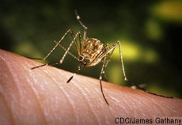
artemesinin
preparations
Artemisinin-based combination therapies (ACTs):
  Artemether + lumefantrine
  Artemether + amodiaquine
  Artemether + mefloquine
  Artemether + sulfadoxine- pyrimethamine

Slide 12
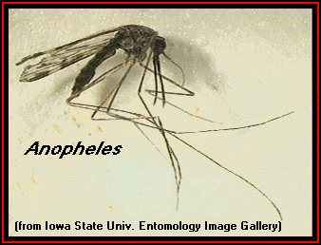
Antimalarial drugs
chloroquine
Potent blood Schizontocide
Active against all forms of the schizonts (exception is chloroquine-resistant P.f. & P.v.)
No activity against tissue schizonts
  Gametocide:-Against all species except P. falciparum

Slide 13
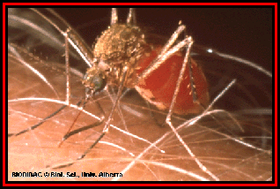
chloroquine
pharmacokinetics
  Rapidly & completely absorbed from the GIT
  Has high volume of distribution(100-1000l/kg)
  Concentrated into parasitized RBCs
  Released slowly from tissues
  Metabolized in the liver
  Excreted in the urine 70% unchanged
  Initial t½ =2-3days & terminal t ½=1-2months

Slide 14
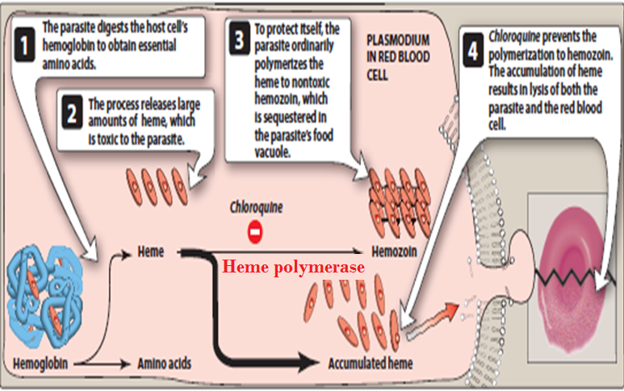
chloroquine
Mechanism of action
Malaria Parasite digest host cell’s Hb to obtain amino acids
Heme is released  Toxic
So parasite detoxifies it by heme polymerase  Hemozoin (NonToxic) & traps it in food vacuole

Slide 15

chloroquine
adrs
1. Mild headache and visual disturbances
2. Gastro-intestinal upsets; Nausea, vomiting
3. Pruritus, urticaria.
Prolonged therapy
Ocular toxicity: Loss of accommodation, lenticular opacity, retinopathy
Ototoxicity
Weight loss
Bolus injection→ hypotension & dysrrhythmias
Safe in pregnancy

Slide 16
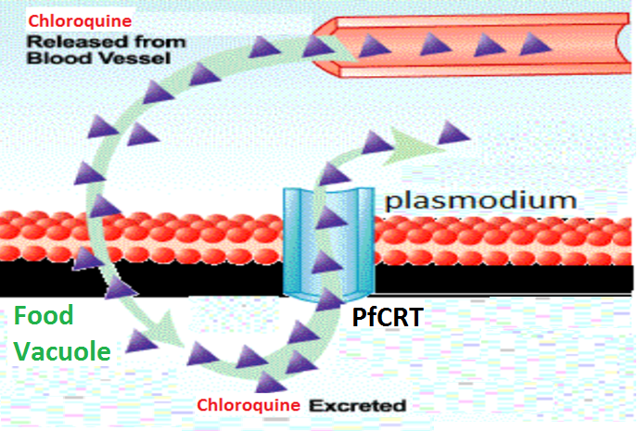
chloroquine
resistance
Resistance against the drug develops as a result of mutation of the chloroquine resistance transporter (PfCRT)
PfCRT enhances the efflux of chloroquine from the food vacuole

Slide 17
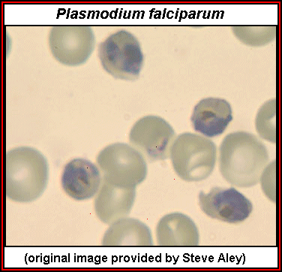
chloroquin
Therapeutic uses
Used to eradicate blood schizonts of Plasmodium
Hepatic amoebiasis
Rheumatoid arthritis

Slide 18
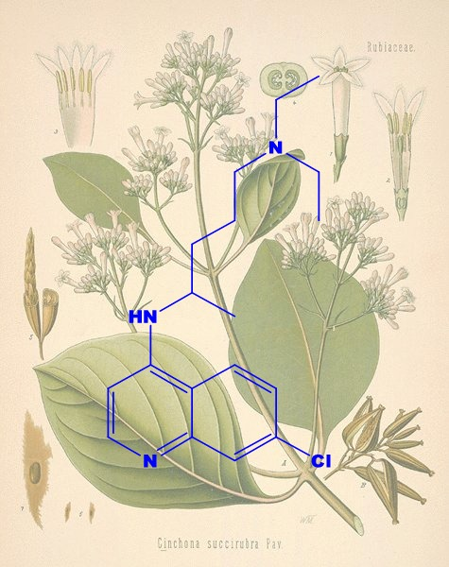
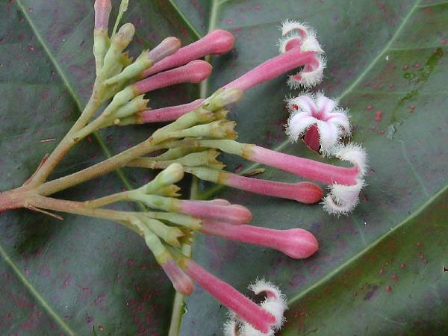
QUININE
  The main alkaloid in cinchona bark
  Potent blood Schizontocide of all malarial parasites & weak gametocide for vivax & ovale
  Depresses the myocardium, reduce excitability & conductivity
  Mild analgesic, antipyretic, stimulation of uterine smooth muscle, curaremimetic effect

Slide 19
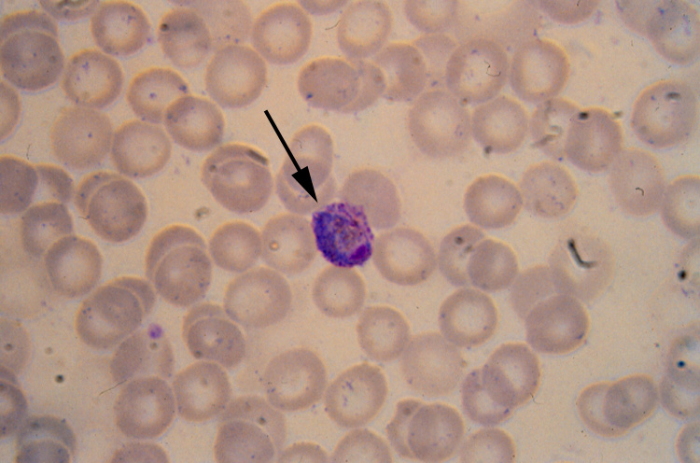
QUININE
pharmacokinetics
  Rapidly & completely absorbed from the GIT
  Peaks after 1-3 hours
  Metabolized in the liver & excreted in urine
  5-20% excreted in the urine unchanged
  t½ = 10 hrs but longer in sever falciparum infection(18hrs)
  Administered: orally in a 7 day course
  or by slow IV for severe P. falciparum infection

Slide 20
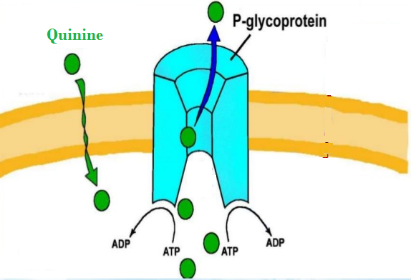
quinine
mechanism
Same as chloroquine
Mechanism of resistance
Like chloroquine by mutation of chloroquine resistance transporter, also increased expression of P-glycoprotein transporter

Slide 21
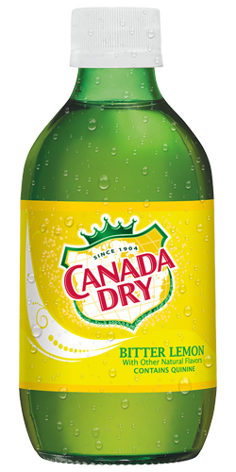
quinine
adrs
With therapeutic dose  poor compliance  bitter taste.
Higher doses 
  Cinchonism  (tinnitus, deafness, headaches, nausea & visual disturbances)
  Abdominal pain & diarrhea
  Hypotension & arrhythmias, hypoglycemia
Rashes, fever, hypersensitivity reactions
  Blood dyscarasis; anaemia, thrombocytopenic purpura & hypoprothrombinaemia
  Blackwater fever, a fatal condition in which acute haemolytic
  anaemia is associated with renal failure
IV  neurotoxicity  tremor of the lips and
limbs, delirium, fits, stimulation followed by
depression of respiration & coma
Safe in pregnancy

Slide 22
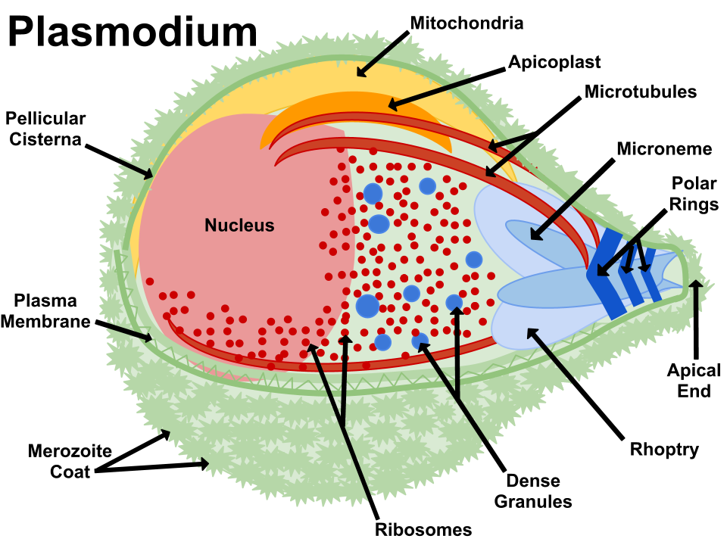
quinine
contraindications
Prolonged QT Interval
Glucose-6-Phosphate Dehydrogenase Deficiency
Myasthenia Gravis
Hypersensitivity
Optic Neuritis, auditory problems
Dose should be reduced in renal insufficiency

Slide 23
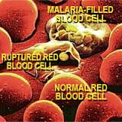
quinine
Clinical uses
Parenteral treatment of severe falciparum malaria
Oral treatment of falciparum malaria
Nocturnal leg cramps??

Slide 24
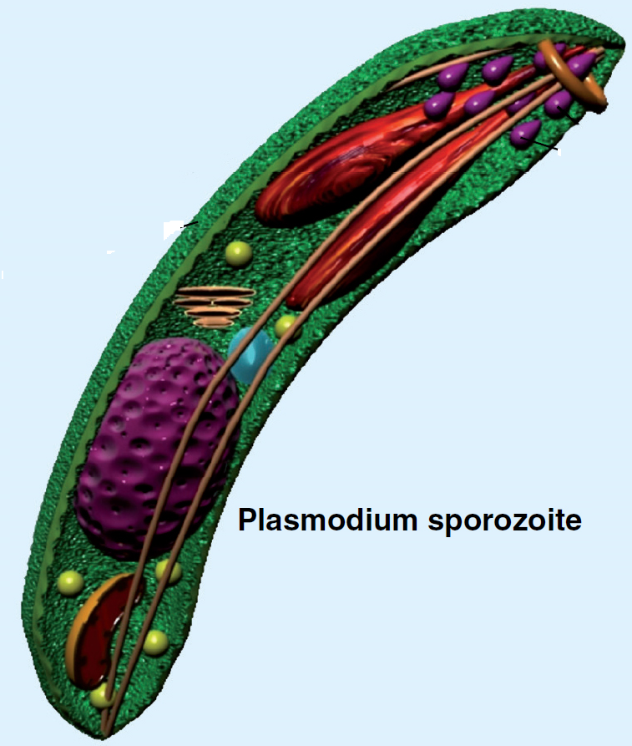
quinine
Drug interactions
Antacids: Antacids containing aluminum &/or
magnesium may delay or decrease absorption of quinine
Mefloquine
Quinine can raise plasma levels of warfarin and digoxin

Slide 25
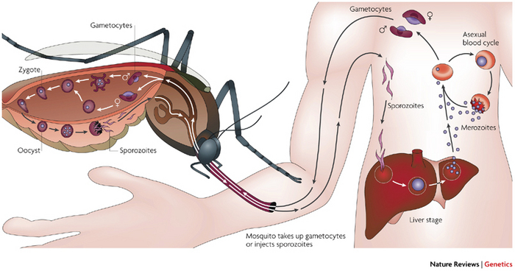
primaquine
  Hypnozoitocides  against liver hypnozoites & gametocytocide
Radical cure of P. ovale & P. vivax
Prevent spread of all forms
pharmacokinetics
  Well absorbed orally
Rapidly metabolized to etaquine & tafenoquine  more active
t½  3-6h

Slide 26
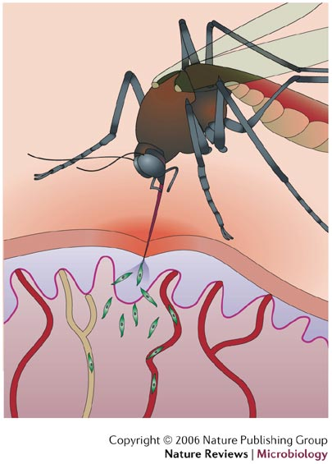
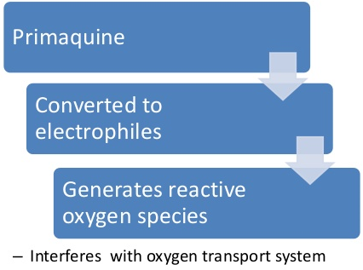
primaquine
mechanism
Not well understood. It may be acting by:-
Generating ROS  can damage lipids, proteins & nucleic acids
Interfering with the electron transport in the parasite  no energy
Inhibiting formation of transport vesicles no food vacuoles
Resistance;  Rare when primaquine & chloroquine are combined

Slide 27
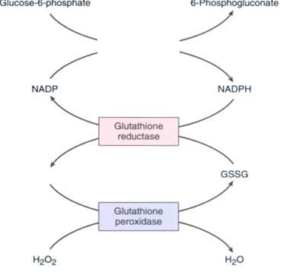
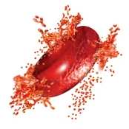
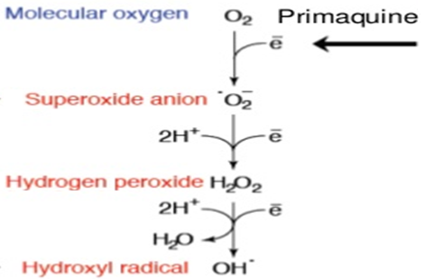
primaquine
adrs
At regular doses  patients with G-6-PD deficiency  hemolytic anemia.
Oxidation of primaqune produces free radicals
G6PD
Free radicals will cause oxidative damage of RBCs →Hemolysis
At larger doses 
Epigastric distress & abdominal cramps.
H2O2 oxidizes GSH
Mild anemia, cyanosis & methemoglobinemia
GSH
Severe methemoglobinemia  rarely in patients with deficiency of NADH methemoglobin reductase.
Maintains integrity of RBCs
Granulocytopenia & agranulocytosis  rare

Slide 28
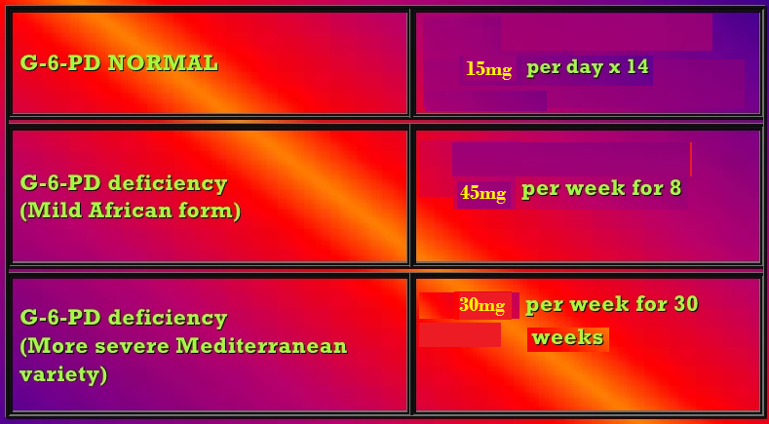
Antimalarial drugs
primaquine
Clinical uses
Radical cure of relapsing malaria, 15mg/day for 14 days
In falciparum malaria: a single dose (45mg) to kill gametes & cut down transmission
Should be avoided in pregnancy(the fetus is relatively G6PD-deficient and thus at risk of hemolysis)& G6PD deficiency patients

Slide 29
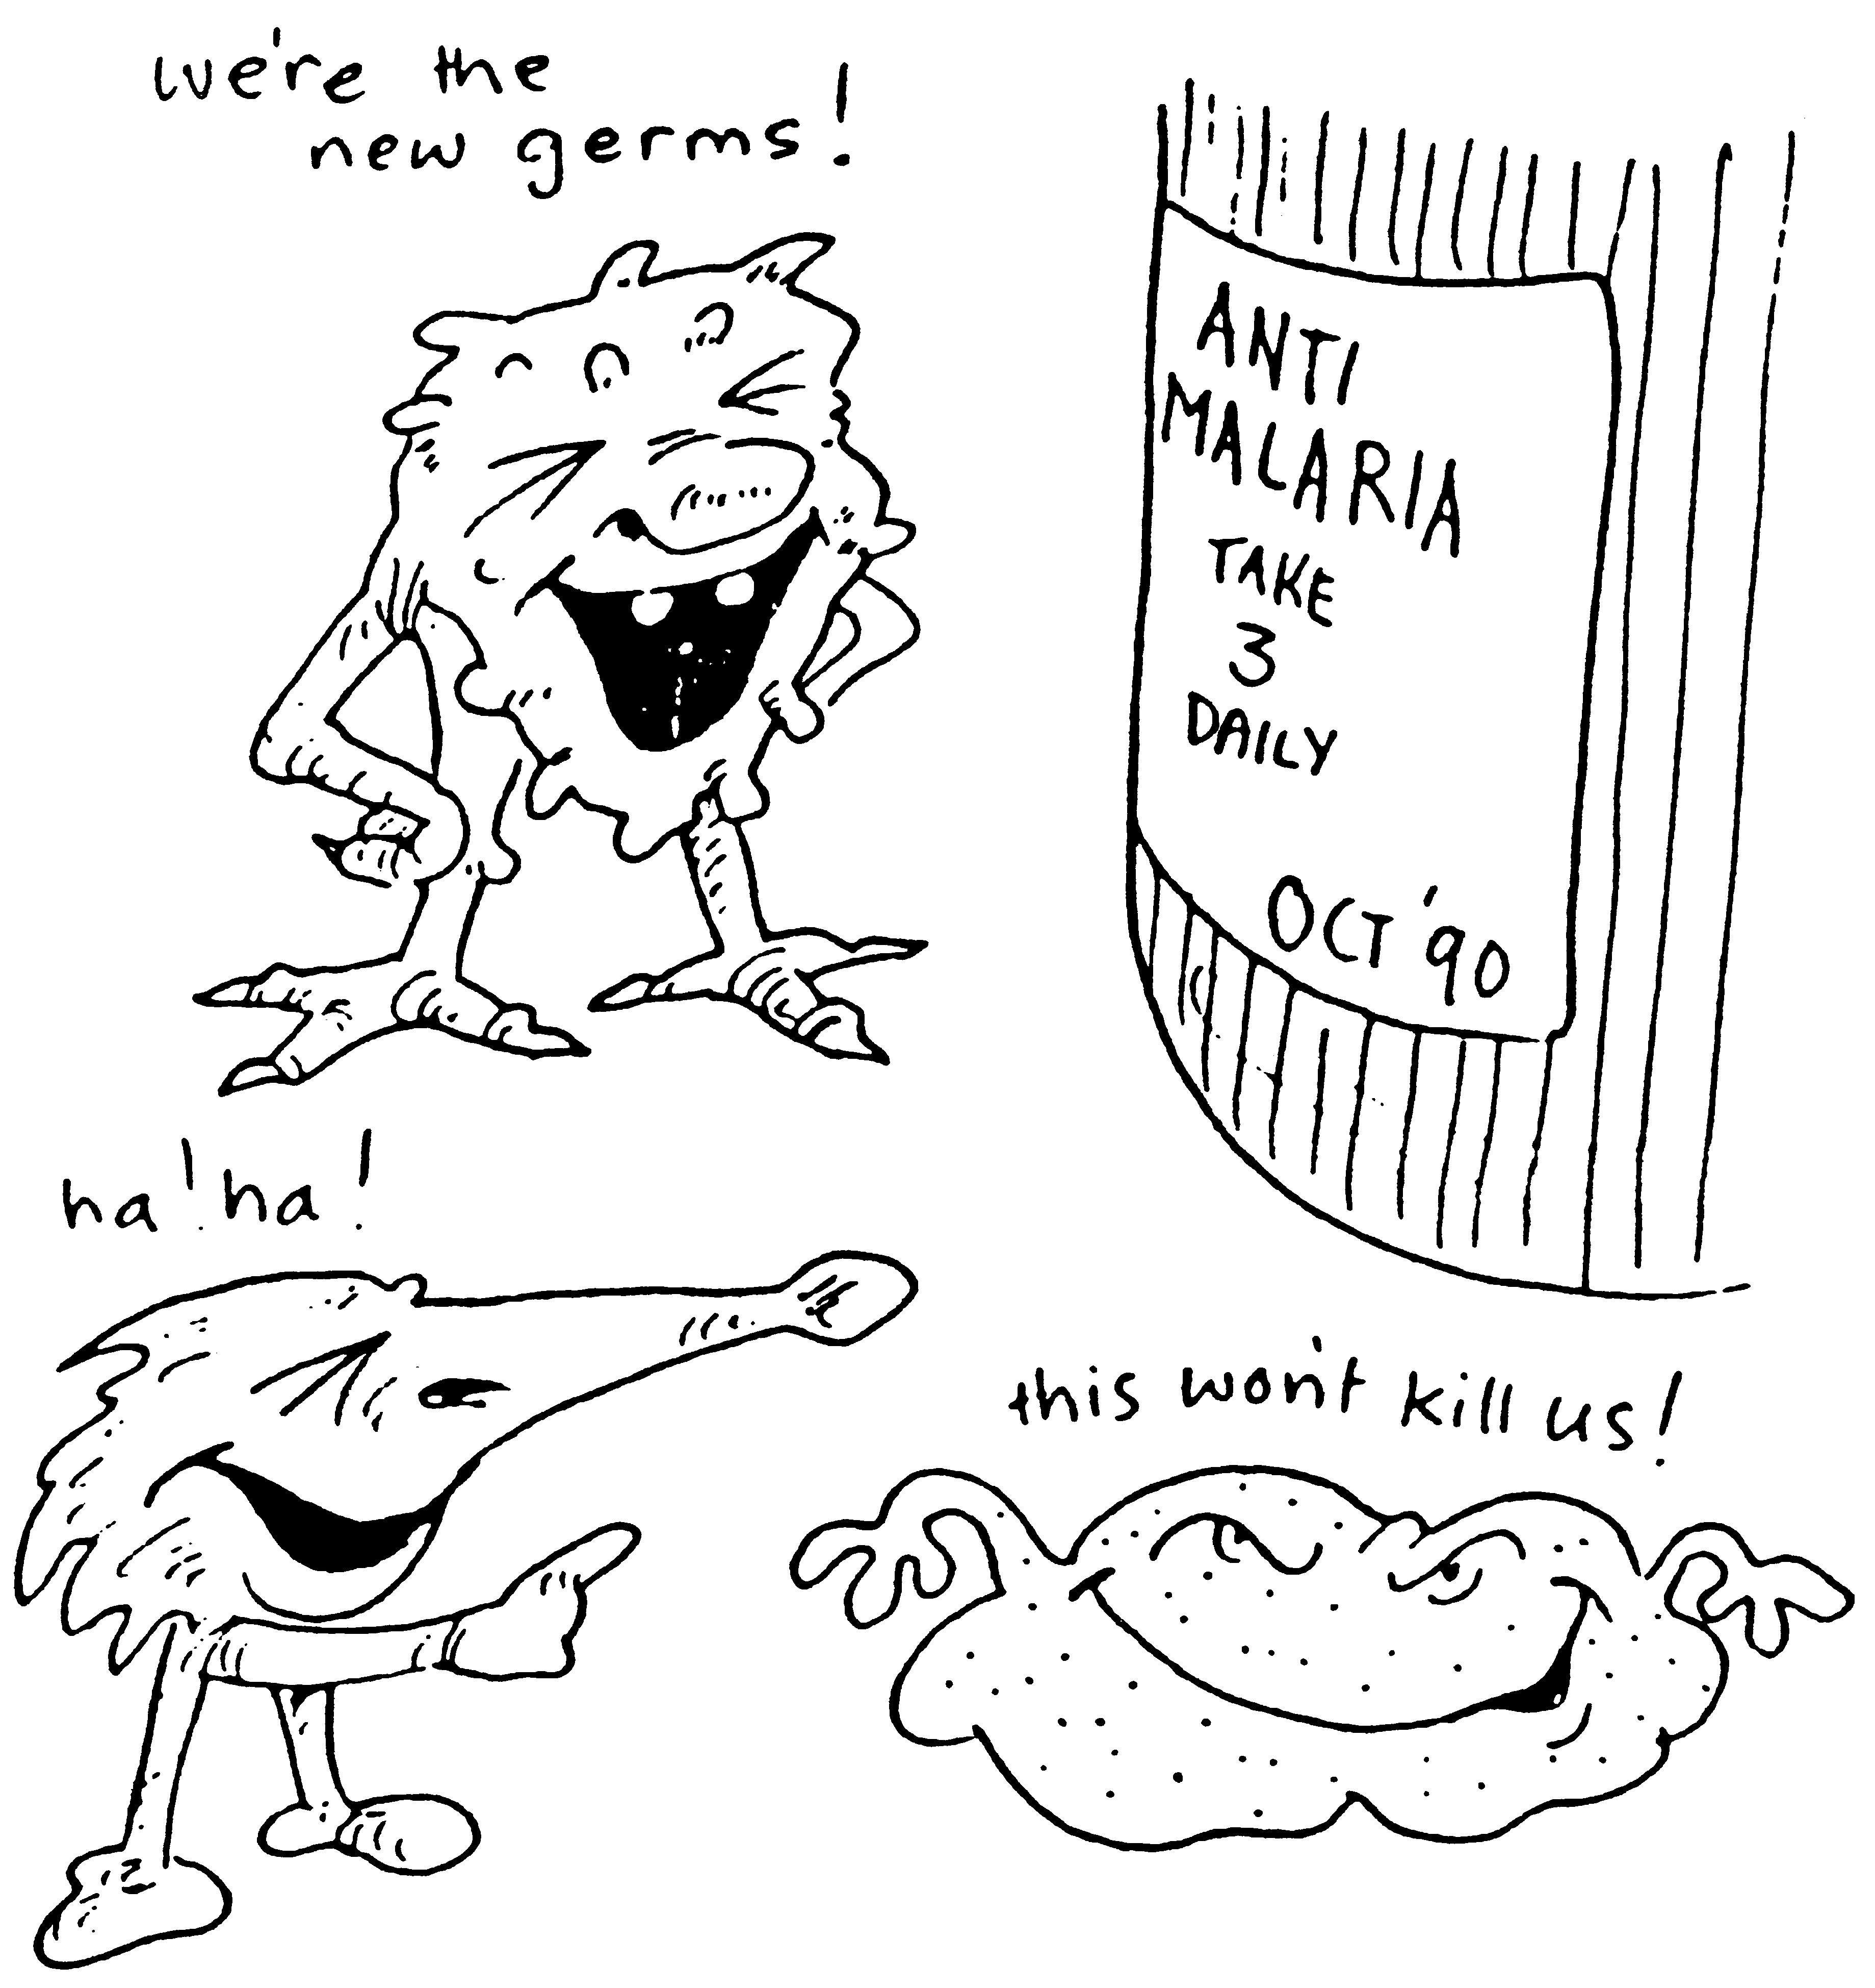
Who treatment guidelines
In vivax
In falicparum
All show Resistance
sensitive
Chloroquine for 3 days followed by Primaquine for 14 days
uncomplicated
ACT
resistant
ACT / 3 days followed by Primaquine for 14 days
complicated
IV Artesunate for 24 hrs followed by ACT
Or Artemether + [Clindamycin / doxycyline]
Or Quinine + [Clindamycin / doxycyline]

Slide 30
Who treatment guidelines
In falicparum
Special risk groups
Pregnancy; 1st trimester
Quinine + Clindamycin (7 days)
Pregnancy; 2nd & 3rd trimester
Lactating women
Infants & young children
ACT

Slide 31
Prophylaxis in travellers
Cdc recomendations
Chloroquine
Areas without resistant P falciparum
Mefloquine
Areas with chloroquine-resistant P falciparum
Doxycycline
Areas with multidrug-resistant P falciparum
Begin 1-2 weeks before departure (except for doxycycline 2 days) & continue for 4 weeks after leaving the endemic area

