Slide 1
Pancreatic Secretion
(Chapter 65; Pages 825-827; Guyton & Hall)
Prof. Mohammed Alzoghaibi
zzoghaibi@gmail.com
0506338400

Slide 2
Required Textbook
Guyton & Hall
Textbook of Medical Physiology
Thirteenth Edition
Published by Saunders Elsevier
2016

Slide 3
Pancreatic Secretion (Exocrine)
Objectives:
1. Functional Anatomy
2. Major components of pancreatic juice and their physiologic roles
3. Cellular mechanisms of bicarbonate secretion
4. Cellular mechanisms of enzyme secretion
5. Activation of pancreatic enzymes
6. Hormonal & neural regulation of pancreatic secretion
7. Potentiation of the secretory response

Slide 4
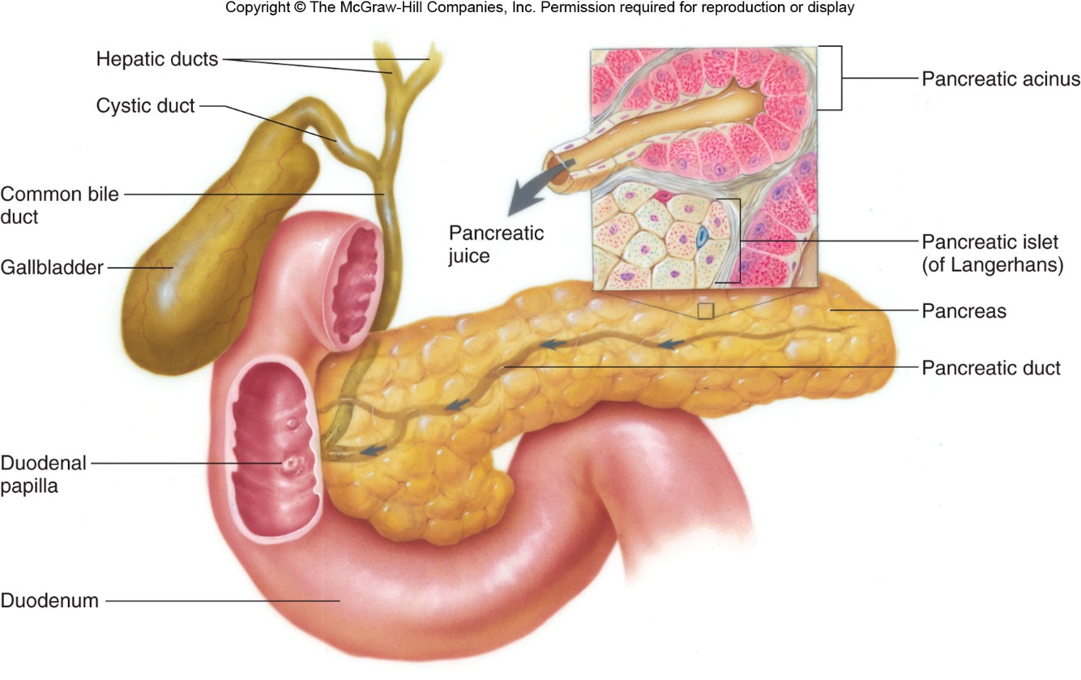
Functional Anatomy
The pancreas, which lies parallel to and beneath the stomach is a large compound gland with most of its internal structure similar to that of the salivary glands

Slide 5
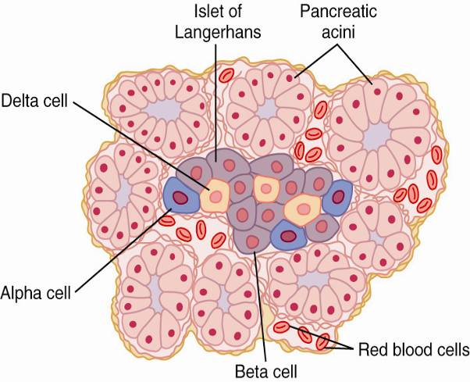
Islet of Langerhans in the pancreas.
The pancreas, in addition to its digestive functions, secretes two important hormones:
1. Insulin (Beta cells; 60%).
2. Glucagon (Alpha cells; ~25%).
that are crucial for normal regulation of glucose, lipid, and protein metabolism.
Also Somatostatin is secreted by delta cells (form ~10% of islets’s cells).
Figure 79-1. Copyright 2011, WB Saunders Elsevier, All Rights Reserved

Slide 6
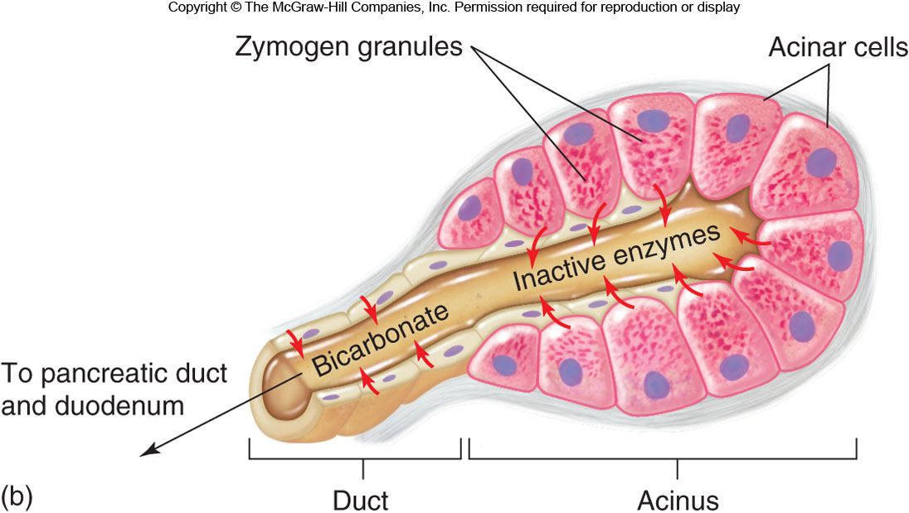
Functional Anatomy (cont.)
The pancreatic digestive enzymes are secreted by pancreatic acini, and large volumes of sodium bicarbonate solution are secreted by the small ductules and larger ducts leading from the acini.
Pancreatic juice is secreted in response to the presence of chyme in the upper portions of the small intestine.

Slide 7
Pancreatic Secretion
The major functions of pancreatic secretion:
To neutralize the acids in the duodenal chyme to optimum range (pH= 7.0-8.0) for activity of pancreatic enzymes.
To prevent damage to duodenal mucosa by acid & pepsin.
To produce enzymes involved in the digestion of dietary carbohydrate, fat, and protein.

Slide 8
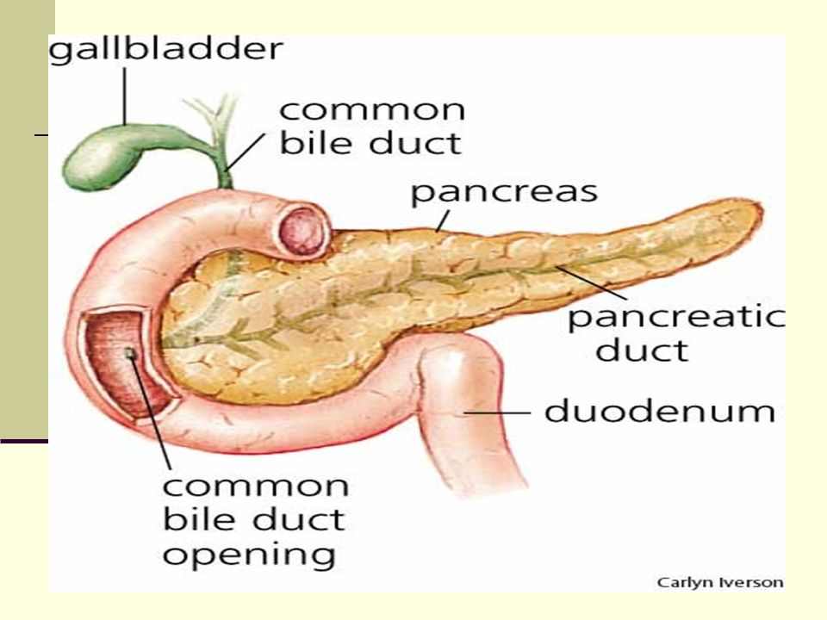
Flow of Pancreatic Secretion into Duodenum
The combined product of enzymes and NaCO₃ flows through a long pancreatic duct.
Pancreatic duct joins the hepatic duct immediately before it empties into the duodenum through the papilla of Vater, surrounded by the sphincter of Oddi.

Slide 9
Pancreatic secretion (continued)
Pancreatic secretions contain many enzymes for digesting proteins, carbohydrates, and fats, and large quantities of HCO₃ ions.
The most important pancreatic enzymes for digesting proteins are:
Trypsin.
Chymotrypsin.
Carboxypolypeptidase.
Trypsin and chymotrypsin split whole and partially digested proteins into peptides of various sizes but do not cause release of individual amino acids.
Carboxypolypeptidase splits some peptides into individual amino acids, thus completing digestion of some proteins to amino acids.

Slide 10
Pancreatic Enzymes (continued)
When first synthesized in the pancreatic cells, the proteolytic digestive enzymes are in the inactive forms:
1. Trypsinogen
2. Chymotrypsinogen
3. Procarboxypolypeptidase
These enzymes become activated only after they are secreted into the intestinal tract.
1. Trypsinogen is activated by:
● Enteropeptidase (enterokinase), an enzyme secreted by the intestinal mucosa when chyme comes in contact with the mucosa.
● Trypsinogen can be autocatalytically activated by trypsin formed from previously secreted trypsinogen.
2 & 3. Chymotrypsinogen and procarboxypolypeptidase are activated by trypsin to form chymotrypsin and carboxypolypeptidase.

Slide 11
Trypsin Inhibitor
Secretion of Trypsin Inhibitor Prevents Digestion of the Pancreas Itself.
● Proteolytic enzymes of the pancreatic juice do not become activated until after they have been secreted into the intestine because the trypsin and the other enzymes would digest the pancreas itself.
● The same cells that secrete proteolytic enzymes into the acini of the pancreas secrete another substance called trypsin inhibitor, which is formed in the cytoplasm of the glandular cells, and it prevents activation of trypsin both inside the secretory cells and in the acini and ducts of the pancreas.
● Because trypsin activates the other pancreatic proteolytic enzymes, therefore trypsin inhibitor prevents activation of the other enzymes as well.

Slide 12
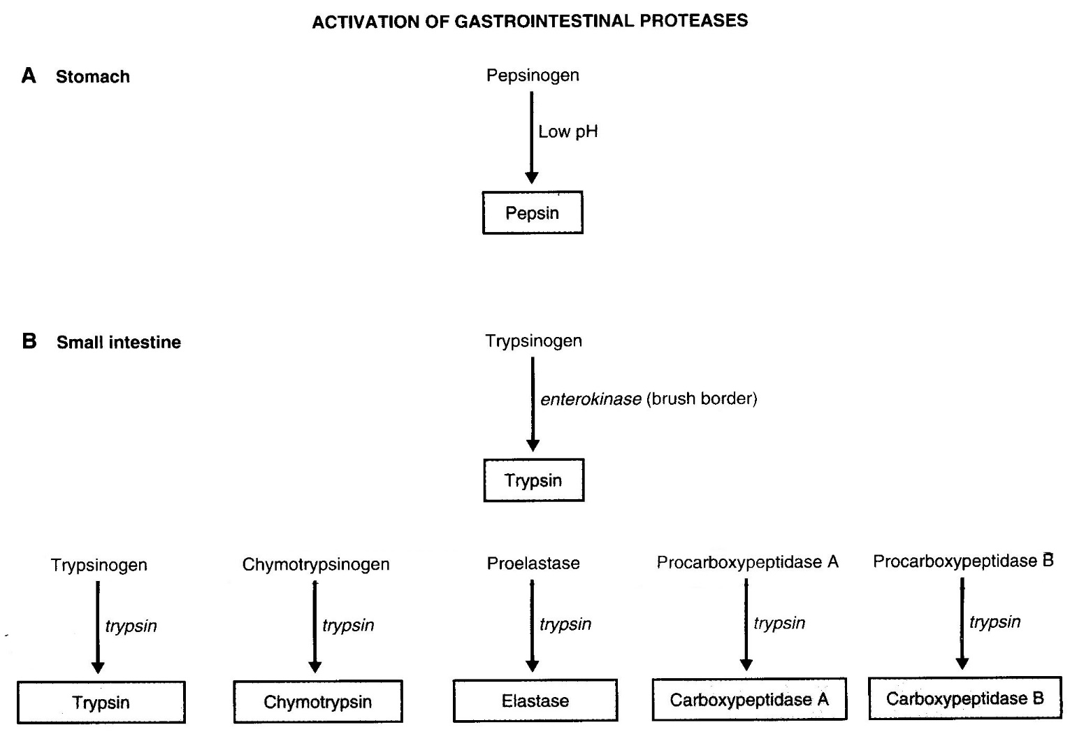
Activation of Trypsinogen in duodenal Lumen

Slide 13
Pancreatic secretion (continued)
The pancreatic enzyme for digesting carbohydrates is pancreatic amylase, which hydrolyzes starches, glycogen, and most other carbohydrates (except cellulose) to form mostly disaccharides and a few tri-saccharides.

Slide 14
Pancreatic secretion (continued)
The main enzymes for fat digestion are:
Pancreatic lipase
(2) Cholesterol esterase
(3) Phospholipase

Slide 15
Characteristics of Pancreatic Enzymes
Enzyme
Specific Hydrolytic Activity
Proteolytic
Endopeptidases
Trypsin(ogen)
Chymotrypsin(ogen)
(Pro)elastase
Exopeptidase
(Pro)carboxypeptidase
Amylolytic
α-Amylase
Lipases
Lipase
(Pro)phospholipase A₂
Carboxylester hydrolase
(cholesterol esterase)
Nucleolytic
Ribonuclease
Deoxyribonuclease
The suffix –ogen or prefix pro- indicates the enzyme is secreted in an inactive form.

Slide 16
Pancreatic secretions are rich in bicarbonate ions
The pancreas secrets about 1 L/day of HCO3 –rich fluid from the epithelial cells of the ductules and ducts.
The osmolarity of pancreatic fluid is equal to that of plasma.
HCO3 concentration increases with increasing secretion rate.

Slide 17
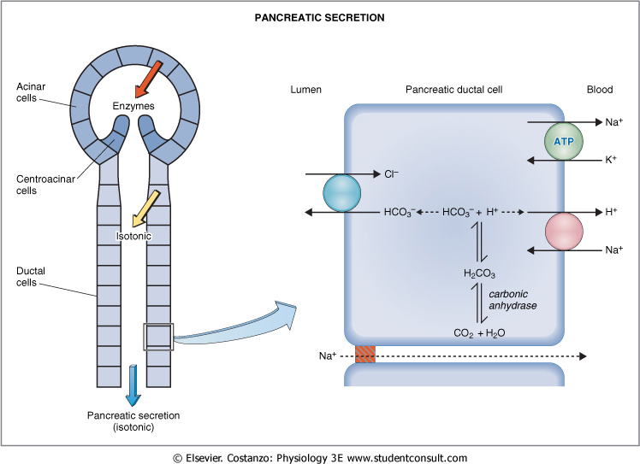
Secretion of Isosmotic Sodium Bicarbonate Solution.

Slide 18
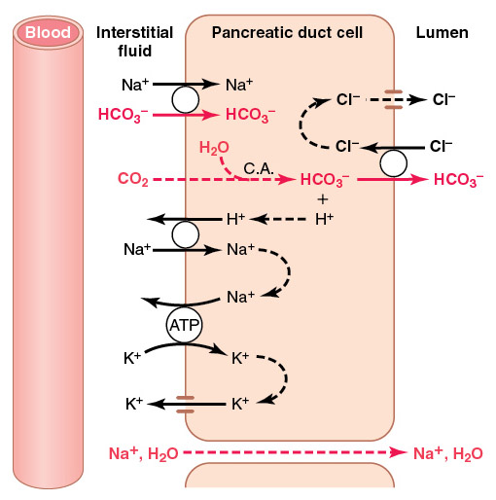
Mechanism of HCO₃⁻ Secretion From Pancreatic Ductal cell
CO₂ and H₂O combine in ductal cells to form H₂CO₃
H₂CO₃ dissociated into H⁺ and HCO₃⁻
H⁺ is transported into blood by Na⁺-H⁺ exchanger at basolateral membrane of ductal cells
HCO₃⁻ is secreted into pancreatic juice by Cl⁻-HCO₃⁻ exchanger at apical membrane of ductal cells
Absorption of H⁺ causes acidification of pancreatic venous blood

Slide 19
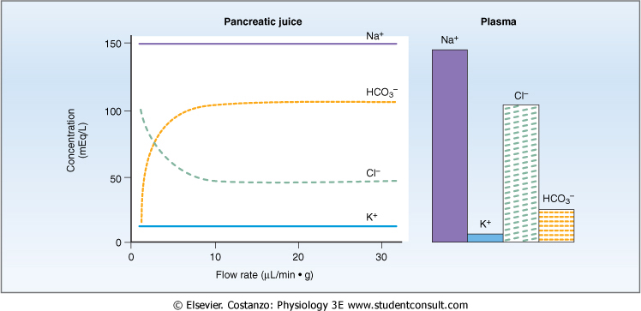
Flow Rate and pancreatic secretion

Slide 20
Pancreatic Secretion is Under Neural and Hormonal Control
Parasympathetic stimulation (through Ach on acinar cells) results in an increase in enzyme secretion-fluid and HCO₃⁻.
Secretin tends to stimulate a HCO₃⁻ rich secretion by activating ductal cells.
CCK stimulates a marked increase in enzyme secretion by stimulating the acinar cells.
Pancreatic secretion normally results from the combined effects of the multiple basic stimuli, not from one alone (potentiate each other).

Slide 21
Stimuli for Pancreatic Secretion
Acetylcholine: released from the parasympathetic vagus nerve endings and from other cholinergic nerves in the enteric nervous system.
Cholecystokinin: secreted by the duodenal and upper jejunal mucosa (I cells) when food enters the small intestine.
Secretin: also secreted by the duodenal and jejunal mucosa (S cells) when highly acidic chyme enters the small intestine.
Acetylcholine and cholecystokinin stimulate the acinar cells of the pancreas, causing production of large quantities of pancreatic digestive enzymes but relatively small quantities of water and electrolytes to go with the enzymes.
Secretin, in contrast to the first two basic stimuli, stimulates secretion of large quantities of H₂O and NaHCO₃ solution by the pancreatic ductal epithelium.

Slide 22
Stimuli for Pancreatic Secretion (continued)
Secretin Stimulates Secretion of Copious Quantities of Bicarbonate Ions—Neutralization of Acidic Stomach Chyme.
● Secretin is present in an inactive form, prosecretin (in S cells in the mucosa of the duodenum and jejunum).
● When acid chyme with pH less than 4.5-5.0 enters the duodenum from the stomach, it causes duodenal mucosal release and activation of secretin, which is then absorbed into the blood.
● Secretin causes the pancreas to secrete large quantities of fluid containing a high concentration of HCO₃⁻ (up to 145 mEq/L = ~5X normal) but a low concentration of Cl⁻.
HCl + NaHCO₃ → NaCl + H₂CO₃
H₂CO₃ dissociates into CO₂ and H₂O.

Slide 23
Stimuli for Pancreatic Secretion (continued)
Cholecystokinin—Its Contribution to Control of Digestive Enzyme Secretion by the Pancreas.
● The presence of food in the upper small intestine causes cholecystokinin to be released from the I cells in the mucosa of the duodenum and upper jejunum.
● Release of cholecystokinin results especially from the presence of proteoses and peptones (products of partial protein digestion) and long-chain fatty acids in the chyme.
● Cholecystokinin, like secretin, passes by way of the blood to the pancreas and causes secretion of pancreatic digestive enzymes by the acinar cells.
● This effect is similar to that caused by vagal stimulation but even more pronounced, accounting for 70-80% of the total secretion of the pancreatic digestive enzymes after a meal.

Slide 24
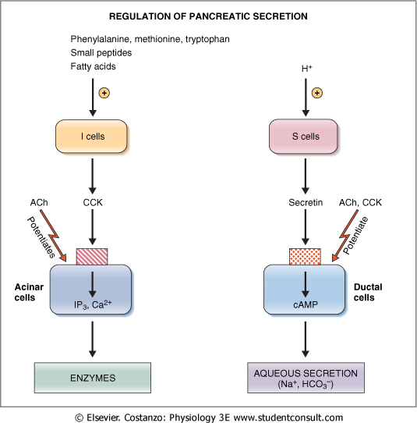
Regulation of Pancreatic Secretion

Slide 25
Multiplicative or Potentiation Effects of Different Pancreatic Secretion Stimuli
● When all different stimuli of pancreatic secretion (acetylcholine, cholecystokinin, and secretin) occur at once, then the total secretion is far greater than the sum of the secretions caused by each stimulus separately. The stimuli are said to “multiply” or “potentiate” one another.
● Usually, pancreatic secretions are the result of multiple stimuli rather than one stimulus.

Slide 26
Pancreatic secretion is phasic
Mediators | Stimulus | Phase
Release of Ach by the vagal nerve | Smell, taste, chewing and swallowing | Cephalic phase
Release of Ach by the vagal nerve | Protein, gastric distention | Gastric phase
Mainly in response to Secretin | Acid in chyme, fatty acids | Intestinal phase

Slide 27
The End

