Slide 1
The Large Intestine
Prof. Mohammed Alzoghaibi
mzoghaibi@ksu.edu.sa
zzoghaibi@gmail.com
0506338400

Slide 2
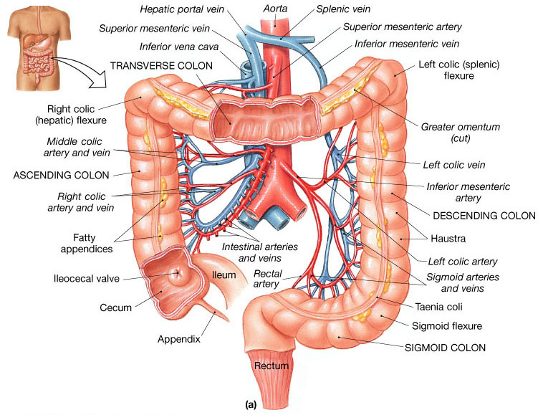
The areas of the colon are:
Ascending
Transverse
Descending
Sigmoid
Rectum
Anal canal

Slide 3
Functions of the Large Intestine
Reabsorb water and compact material into feces.
Absorb vitamins produced by bacteria.
Store fecal matter prior to defecation.

Slide 4
Secretions of the Large Intestine
Mucus Secretion:
The mucosa of the large intestine has many crypts of Lieberkühn.
Absence of villi.
The epithelial cells contain almost no enzymes.
Presence of goblet cells that secrete mucus (provides an adherent medium for holding fecal matter together).
Stimulation of the pelvic nerves from the spinal cord can cause marked increase in mucus secretion. This occurs along with increase in peristaltic motility of the colon.
During extreme parasympathetic stimulation, so much mucus can be secreted into the large intestine that the person has a bowel movement of ropy mucus as often as every 30 minutes; this mucus often contains little or no fecal material.

Slide 5
Absorption in the Large Intestine: Formation of Feces
Most of the absorption in the large intestine occurs in the proximal one half of the colon, giving this portion the name absorbing colon, whereas the distal colon functions principally for feces storage until a propitious time for feces excretion and is therefore called the storage colon.

Slide 6
Absorption and Secretion of Electrolytes and Water
The large intestine can absorb a maximum of 5 to 8 liters of fluid and electrolytes each day.
The mucosa, like that of the small intestine, has a high capability for active absorption of sodium, Cl and water.
It secretes bicarbonate ions.

Slide 7
Absorption and Secretion of Electrolytes and Water
Reabsorption in the large intestine includes:
Water
Vitamins – K, biotin, and B₅
Organic wastes – Urobilinogens and Sterobilinogens
Bile salts
Toxins

Slide 8
Bacterial Action in the Colon (normal flora):
Colon bacilli bacteria are capable of digesting small amounts of cellulose.
Vitamin K, vitamin B12, thiamine, and various gases can be formed by bacteria.
The bacteria-formed vitamin K is especially important because the amount of this vitamin in the daily ingested foods is normally insufficient to maintain adequate blood coagulation.

Slide 9
Bacterial Action in the Colon (normal flora):
Deconjugation and decarboxylation of bile salts: Break down of bile pigments to produce stercobilinogen.
Decarboxylation of some AA to produce amine and histamine. The amines are excreted in feces and are responsible for its smell.
Break down of Urea by bacterial urease to ammonia. Most ammonia is absorbed and reconverted into Urea by liver.
Fermentation of undigested oligo- saccharides producing gases.
Note: chronic disruption of the normal flora in the large intestine leads to bruising and excessive bleeding.

Slide 10
The physiology of different colon regions

Slide 11
The physiology of different colon regions
The ascending colon is specialized for processing chyme delivered from the terminal ileum:
When rediolabeled chyme is instilled (put gradually) into cecum, half of the instilled volume empties from ascending colon in 87 min.
This period is short in comparison with the transverse colon.
The ascending colon is not the primary site of storage, mixing and removal of water.

Slide 12
The physiology of different colon regions
The transverse colon is specialized for the storage and dehydration of feces:
The labeled material is retained for about 24 hrs.
The transverse colon is the primary site for the removal of water and electrolytes and the storage of feces.

Slide 13
The physiology of different colon regions
The descending colon is a conduit between the transverse and sigmoid colon
Labeled feces begin to accumulate in the sigmoid colon about 24 hours after the label is instilled in the cecum
This region has the neural program for power propulsion (mass movement) that is involved in defecation reflex.

Slide 14
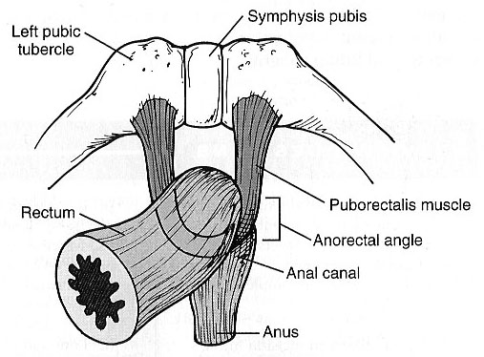
The physiology of different colon regions
The physiology of the rectosigmoid region, anal canal, and pelvic floor musculature maintains fecal continence (the ability to voluntarily control urinary and fecal discharge).
The sigmoid and rectum are reservoirs with a capacity of up to 500mL.
The puborectalis muscle and external anal sphincter comprise a functional unit that maintain continence.
Fibers of puborectalis join behind the anorectum and pass around it to form a U-shaped sling (physiological valve).

Slide 15
Sensory innervation and continence
Mechanoreceptors in the rectum detect distention and supply the ENS.
The anal canal in the region of the skin is innervated by somatosensory nerves that transmit signals to CNS.
This region has sensory receptors of pain, temperature and touch.
Contraction of internal anal sphincter and puborectalis muscle blocks the passage of feces and maintains continence with small volumes in the rectum.

Slide 16
Motility in the Large Intestine
The proximal half of the colon is concerned with absorption and the distal half with storage.
The transit of small labeled markers through the large intestine occurs in 36-48 hrs.
Movements of the colon:
Mixing movements (Haustrations)
Propulsive movements (Mass Movements)

Slide 17
Motility in the Large Intestine
Mixing movements (Haustrations):
Ring-like contractions (about 2.5 cm) of the circular muscle divide the colon into pockets called haustra.
The contracting segment and receiving segment on either side remain in their respective state for longer periods.
In addition, there is uniform repetition of the haustra along the colon.
Net forward propulsion occurs when sequential migration of haustra occurs along the length of the bowel.

Slide 18
Motility in the Large Intestine
Propulsive movements (Mass Movements):
The motor events in the transverse and descending colon.
May be triggered by the increased delivery of ileal chyme into ascending colon following a meal (gastrocolic reflex).
Irritants, e.g., castor oil, threatening agents such as parasites and toxins can initiate mass movement
Start at the middle of transverse colon and is preceded by relaxation of the circular muscle and the downstream disappearance of haustral contractions.

Slide 19
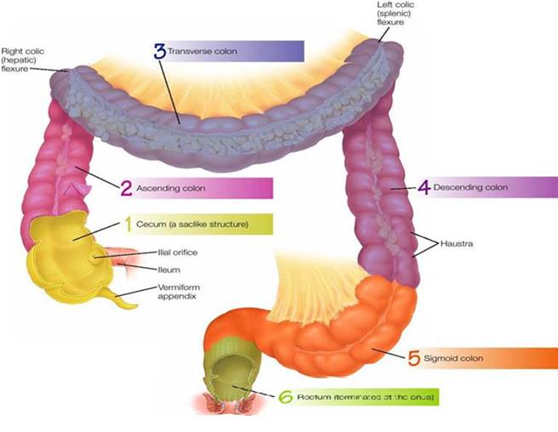
Motility in the Large Intestine
Antiperistalsis
It starts at the junction of ascending and transverse colon and traveling towards the cecum.
It mixes contents and help water absorption.

Slide 20
The Rectum
Last portion of the digestive tract.
Terminates at the anal canal.
Internal and external anal sphincters.

Slide 21
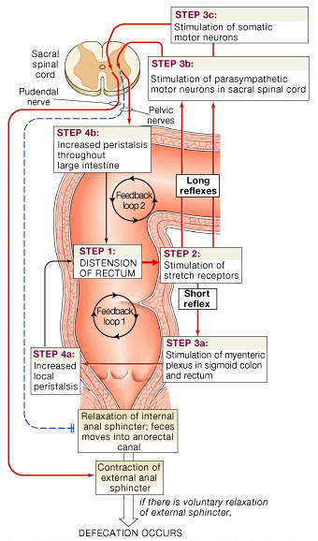
Defecation Reflex:
Distension of the rectum.
Stimulation of the stretch receptors in the rectum.
A. Short reflex: Stimulation of myenteric plexus in sigmoid colon and rectum.
B. long reflex: stimulation of parasympathetic motor neurons in sacral spinal cord.
C. stimulation of somatic motor neurons.
Result in: increased local peristalsis. Relaxation of internal anal sphincter and contraction of external anal sphincter.

Slide 22
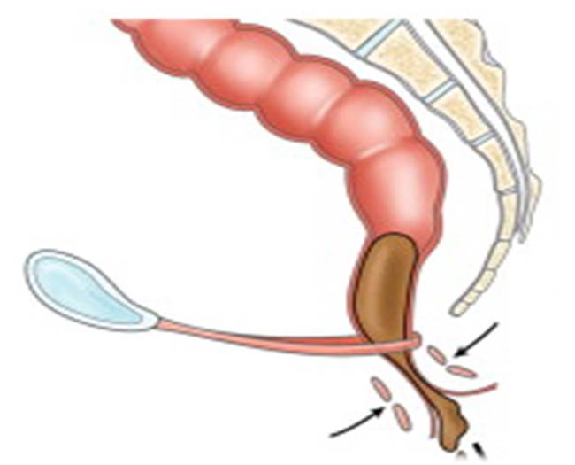
Fecal Incontinence
The spinal reflex of defecation operates without interference from higher centers.
Causes:
In infants (physiological).
Spinal cord lesion.
Weakness of IAS and EAS.
Weakness of pulborectalis.
Altered rectal or anal sensation.
Diarrheal conditions.
Diminished rectal capacity.

Slide 23
The End

