Slide 1
Physiology of Bile Salts and Enterohepatic Circulation
Chapter : 64; pages: 783-786
Prof. Mohammed Alzoghaibi
zzoghaibi@gmail.com
0506338400

Slide 2
Learning Objectives
Liver Digestive Functions
Physiologic Anatomy of Biliary Secretion
The Components of Bile
What is the bile acid ? What are the types of the bile acid?
Storing and Concentrating Bile in the Gallbladder
Function of Bile Salts in Fat Digestion and Absorption
Enterohepatic Circulation of Bile Salts
The mechanisms of bile reabsorption back into hepatocytes

Slide 3
The Liver
The liver is the largest internal organ in the body, constituting about 2.5% of an adult’s body weight.
Receives 25% of the cardiac output via the hepatic portal vein and hepatic artery.
Takes up, stores, and distributes nutrients and vitamins.
Plays an important role in maintaining blood glucose levels.
Regulates the circulating blood lipids by the amount of very low–density lipoproteins (LDL) it secretes.
Synthesizes many of the circulating plasma proteins.
Takes up numerous toxic compounds and drugs from the portal circulation.
Performs important endocrine functions.
Serves as an excretory organ for bile pigments, cholesterol, and drugs.

Slide 4
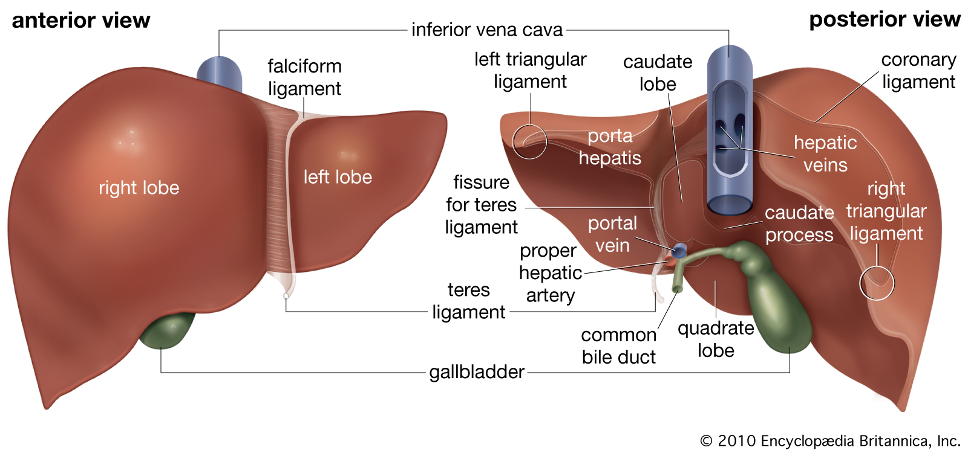
The Anatomy of the Liver

Slide 5
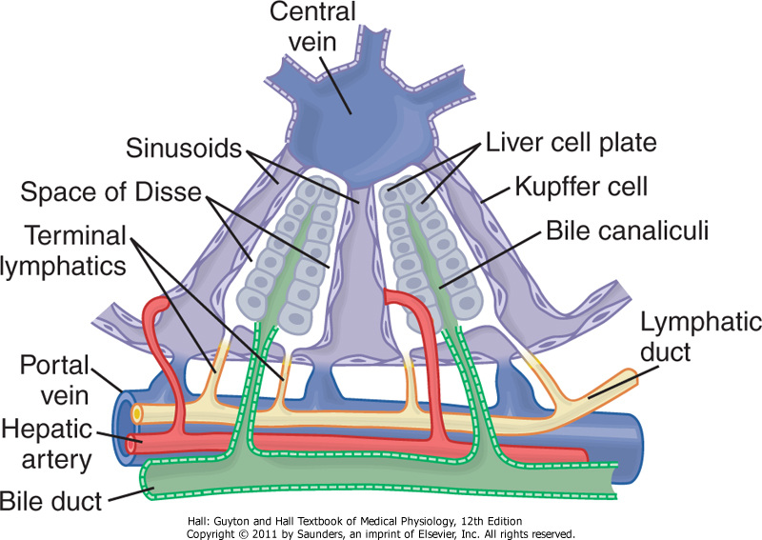
Bile Canaliculi & Ducts

Slide 6
The main digestive function of the liver
The main digestive function of the liver is the secretion of bile (normally 600-1000 ml/day)
Bile serves two important functions:
It plays an important role in fat digestion and absorption by the following:
emulsifying the large fat particles of the food into minute particles.
they aid in absorption of the digested fat end products through the intestinal mucosal membrane, via micelles formation.
bile serves as a means for excretion of waste products from the blood. These include especially bilirubin, an end product of hemoglobin destruction.

Slide 7
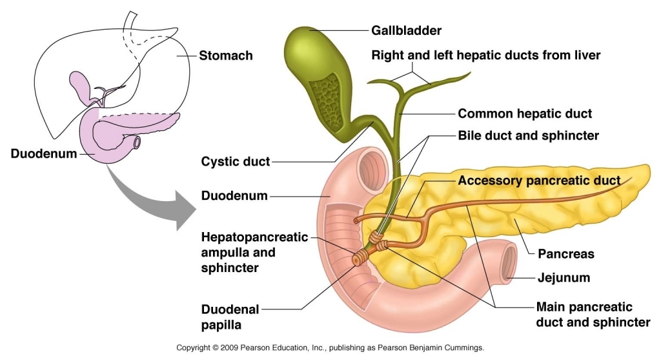
The Gallbladder

Slide 8
Gallbladder Bile Differs From Hepatic Bile
Bile is secreted in two stages:
The initial portion is secreted by the hepatocytes. It is secreted into bile canaliculi that originate between the hepatic cells.
Hepatic Bile: Isotonic secretion, with high Na⁺, Cl⁻ and HCO₃ and low K⁺ and Ca²⁺.
(2) The bile flows in the canaliculi toward the hepatic duct and common bile duct. From these the bile either empties directly into the duodenum or is diverted for minutes up to several hours through the cystic duct into the gallbladder (this is the second portion of liver secretion which is added to the initial bile). Gallbladder bile: high Bile acid anion and Ca²⁺ ; but low Na⁺ , Cl⁻ , HCO₃ and H₂O.

Slide 9
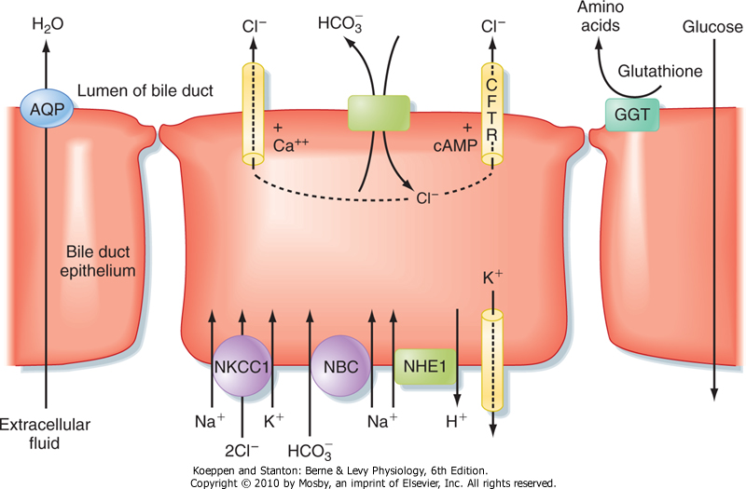
The major transport processes of cholangiocytes that secrete an alkaline-rich fluid
Active reabsorption of Glucose and A.A. to prevent bacterial growth.
Hepatic Bile: Isotonic secretion, with high Na⁺, Cl⁻ and HCO₃ and low K⁺ and Ca²⁺.

Slide 10
Storing and Concentrating Bile in the Gallbladder
Bile is secreted continually by the liver cells and then normally stored in the gallbladder until needed in the duodenum (gallbladder can hold 30 to 60 mL).
Gallbladder concentrates the bile, which has the bile salts, cholesterol, lecithin, and bilirubin during every 12 hours of bile secretion (usually about 450 mL) because water, Na, Cl, and most other small electrolytes are continually absorbed through the gallbladder mucosa by active transport of sodium, and this is followed by secondary absorption of chloride ions, water, and most other diffusible constituents.
Bile is normally concentrated in this way about 5-fold, but it can be concentrated up to a maximum of 20-fold.

Slide 11
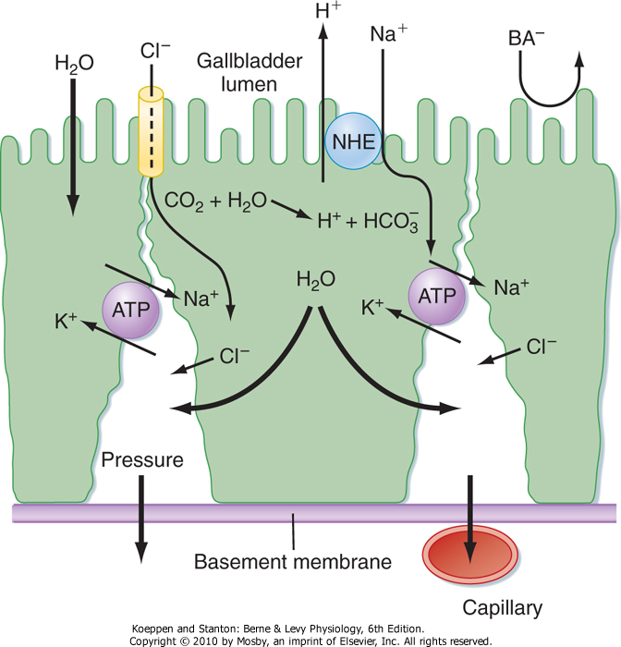
Concentration of Bile During Storage in The Gallbladder
Gallbladder bile: high Bile acid anion and Ca²⁺ ; but low Na⁺ , Cl⁻, HCO₃ and H₂O.
CFTR: Cystic fibrosis transmembrane conductance regulator (chloride channel).
The tight junctions have low permeability, they resist the passage of Bile Acid anions (BA) out of the lumen.

Slide 12
What Are The Components of Bile?
The components of bile are:
Bile acids (bile salts)
Cholesterol
Phospholipids (Lecithin), phosphatidylcholine
Bile pigments
Ions and water

Slide 13
Regulation of Bile Secretion
Bile secretion is primarily regulated by a feedback mechanism, with secondary hormonal and neural controls.
The major determinant of bile acid synthesis is its concentration in hepatic portal blood (feedback control).
CCK, Secretin and estrogen (hormonal control).
Parasympathetic and sympathetic nerves supply the biliary system. Parasympathetic (vagal) stimulation results in contraction of the gallbladder and relaxation of the sphincter of Oddi, as well as increased bile formation. Bilateral vagotomy results in reduced bile secretion after a meal, suggesting that the parasympathetic nervous system plays a role in mediating bile secretion.
By contrast, stimulation of the sympathetic nervous system results in reduced bile secretion and relaxation of the gallbladder.

Slide 14
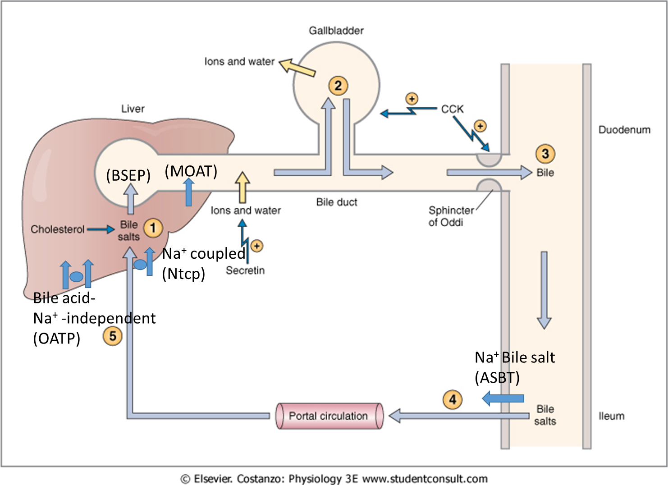
Secretion and enterohepatic circulation of bile salts
Bile salt export pump (BSEP)
Bile acid-Na⁺independent (OATP)
Bile salt-Na⁺ coupled (Ntcp)
Multiple organic anion transporter (MOAT)
Apical Na⁺ dependent Bile salt transporter (ASBT)

Slide 15
1.The hepatocytes of the liver continuously synthesize and secrete the constituents of bile (Step 1).
2. The components of bile are the bile salts, cholesterol, phospholipids, bile pigments, ions, and water. Bile flows out of the liver through the bile ducts and fills the gallbladder, where it is stored (Step 2). The gallbladder then concentrates the bile salts by absorption of water and ions.
3. When chyme reaches the small intestine, CCK is secreted. CCK has two separate but coordinated actions on the biliary system: It stimulates contraction of the gallbladder and relaxation of the sphincter of Oddi, causing stored bile to flow from the gallbladder into the lumen of the duodenum (Step 3). In the small intestine, the bile salts emulsify and solubilize dietary lipids.
4. When lipid absorption is complete, the bile salts are recirculated to the liver via the enterohepatic circulation (Step 4).
5. The steps involved in the enterohepatic circulation include absorption of bile salts from the ileum into the portal circulation, delivery back to the liver, and extraction of bile salts from the portal blood by the hepatocytes (Step 5)

Slide 16
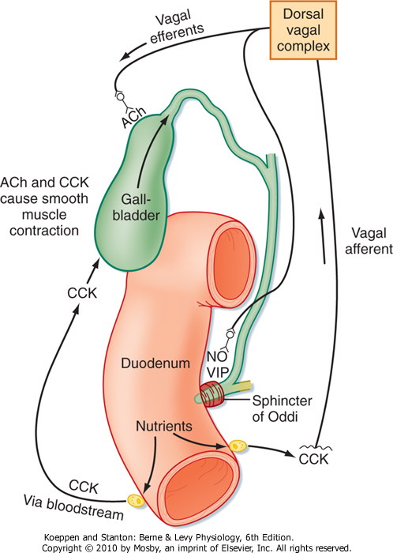
Neurohumoral control of gallbladder contraction and biliary secretion

Slide 17
What is the bile acid ? What are the types of the bile acid?

Slide 18
Bile Acids Are Formed in the Liver From Cholesterol
Bile acids are formed in the liver from cholesterol. During the conversion, hydroxyl groups (by 7 α- hydroxylase) and a carboxyl group are added to the steroid nucleus.
Bile acids are classified as primary or secondary. The hepatocytes synthesize the primary bile acids (by C 27- dehydroxylase), which include cholic acid and chenodeoxycholic acid. Bile acids are secreted as conjugates of taurine or glycine. When bile enters the GI tract, bacteria present in the lumen act on the primary bile acids and convert them to secondary bile acids by dehydroxylation. Cholic acid is converted to deoxycholic acid and chenodeoxycholic acid to lithocholic acid, which is cytotoxic and can be sulfated by the liver if it presents in high concentration.

Slide 19
Bile Acids Are Formed in the Liver From Cholesterol (continued)
At a neutral pH, the bile acids are mostly ionized and are referred to as bile salts. Conjugated bile acids ionize more readily than the unconjugated bile acids and, thus, usually exist as salts of various cations (e.g., sodium glycocholate).
The conjugation biochemical reaction decreases the pKa of the compound and make it more ionized.
Bile salts are much more polar than bile acids and have greater difficulty penetrating cell membranes. Consequently, the small intestine absorbs bile salts much more poorly than bile acids. This property of bile salts is important because they play an integral role in the intestinal absorption of lipid. Therefore, it is important that the small intestine absorb bile salts only after all of the lipid has been absorbed.

Slide 20
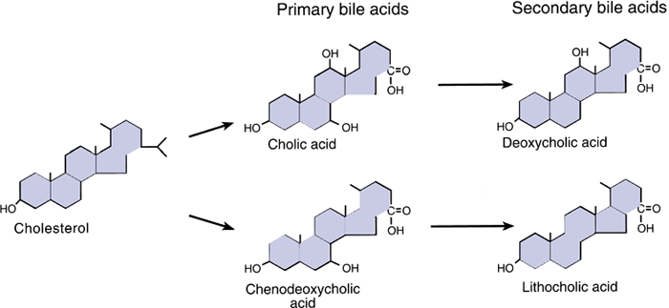
Function of Bile Salts in Fat Digestion and Absorption
Figure 26.13: Bile acids are formed from cholesterol in the liver. Bile acids are conjugated with the amino acid, glycine, and taurine (which is an organic compound available in animal tissue) in the liver. At neutral pH, the bile acids are mostly ionized and referred to as bile salts.
RHOADES AND BELL: Medical Physiology: Principles for Clinical Medicine, 3rd Edition. Page: 510; Lippincott Williams & Wilkins, all right reserved.

Slide 21
Role of Bile Salts to Accelerate Fat Digestion Formation of Micelles
Bile salts have the ability to form micelles, (each bile salt molecule is composed of a sterol nucleus that is fat-soluble and a polar group that is water-soluble
Micelles are small spherical, cylindrical globules 3 to 6 nm in diameter composed of 20 to 40 molecules of bile salt.
The polar groups are (-) charged, they allow the entire micelle globule to dissolve in the water of the digestive fluids and to remain in stable solution.
The micelles act as a transport medium to carry the monoglycerides and free fatty acids to the brush borders of the intestinal epithelial cells.

Slide 22
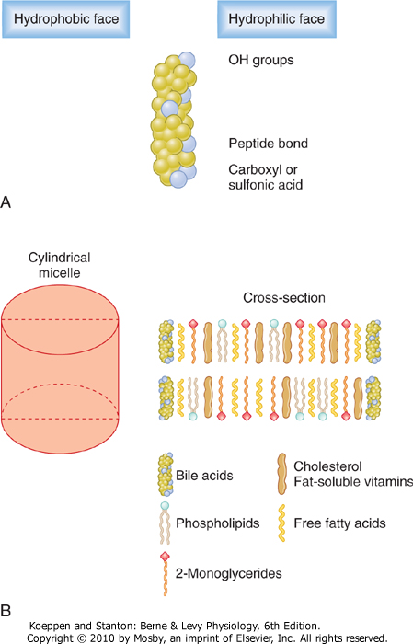
Micelles Formation

Slide 23
Functions of Bile Salts in Fat Digestion and Absorption
They have a detergent action (emulsifying) on the fat particles in the food which decreases the surface tension of the particles.
They help in the absorption of fatty acids, monoglycerides, cholesterol, and other lipids from the intestinal tract.

Slide 24
Other Functions of Bile Salts
Bile salts are essential for absorption of fat soluble vitamins (A, D, E and K).
In the liver, bile salts are important for stimulating bile secretion and flow (choleretic action). They also take part in the formation of micelles which render cholesterol soluble in bile.

Slide 25
Enterohepatic Circulation (Portal circulation) of Bile Salts

Slide 26
Enterohepatic Circulation of Bile Salts. Bile Salts Are Recycled Between the Small Intestine and the Liver
The enterohepatic circulation of bile salts is the recycling of bile salts between the small intestine and the liver.
The total amount of bile acids in the body, primary or secondary, conjugated or free, at any time is defined as the total bile acid pool.
In healthy people, the bile acid pool ranges from 2 to 4 g. The enterohepatic circulation of bile acids in this pool is physiologically extremely important. By cycling several times during a meal, a relatively small bile acid pool can provide the body with sufficient amounts of bile salts to promote lipid absorption. In a light eater, the bile acid pool may circulate three to five (3-5) times a day; in a heavy eater, it may circulate 14 to 16 times a day.

Slide 27
Enterohepatic Circulation of Bile Salts. Bile Salts Are Recycled Between the Small Intestine and the Liver (cont.)
The intestine is normally extremely efficient in absorbing the bile salts by carriers located in the distal ileum. Inflammation of the ileum can lead to their malabsorption and result in the loss of large quantities of bile salts in the feces e.g., inflammatory bowel diseases (Crohn’s disease an Ulcerative Colitis). Depending on the severity of illness, malabsorption of fat may result in steatorrhea (fat in stool) because bile salt pool was depleted following the ileal inflammation or resectioning. Presence of bile salt in the colonic lumen will activate Cl secretion, Na and water will follow Cl into the intestinal lumen, producing secretory diarrhea.

Slide 28
The Enterohepatic circulation recycles bile salts between the small intestine and the liver (cont.)
Bile salts or bile acids in the intestine lumen are absorbed via four pathways into portal circulation (enterohepatic circulation):
Passive diffusion
An active carrier-mediated process (Apical Na⁺ dependent Bile salt transporter (ASBT).
De-conjugation and/or transforming of bile salts to bile acids (by bacteria)
Transforming the primary bile acids to secondary bile acids (by bacteria)

Slide 29
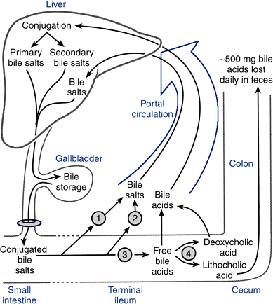
The Enterohepatic circulation recycles bile salts between the small intestine and the liver (cont.)
Figure 26.16 Bile salts are recycled.
RHOADES AND BELL: Medical Physiology: Principles for Clinical Medicine, 3rd Edition. Page: 511; Lippincott Williams & Wilkins, all right reserved.

Slide 30
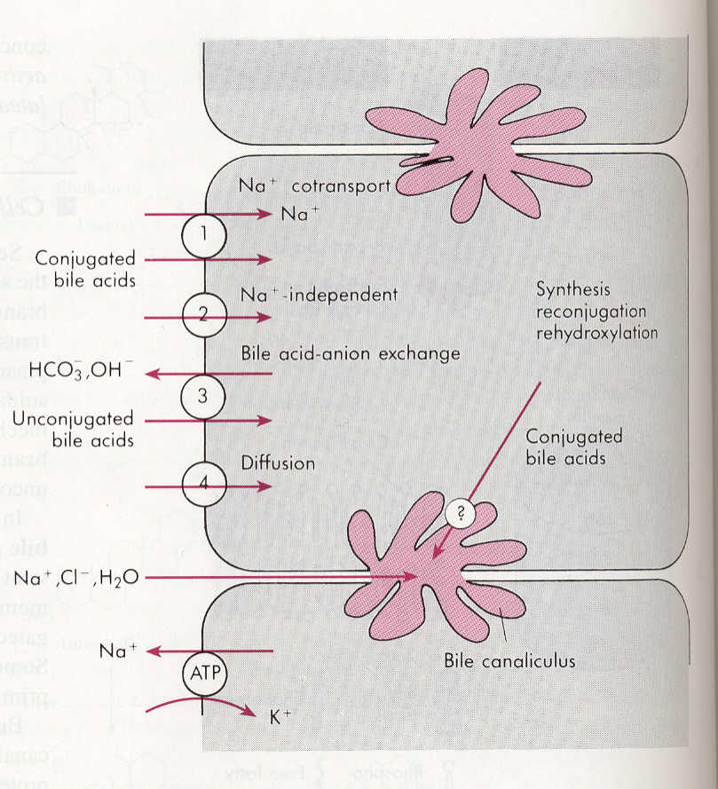
Absorption of bile acids or bile salt back into hepatocytes
Bile salts or bile acids in the portal circulation are absorbed via four pathways into hepatocytes:
An active carrier-mediated process: conjugated bile acids-Na co-transport (Bile salt-Na⁺ coupled (Ntcp).
Na-independent pathway (Bile acid-Na⁺independent (OATP).
Bile acid-HCO3 or Bile acid-OH exchange.
Passive diffusion (very little).

Slide 31
The End

