Slide 1
Anatomy of salivary gland
Gastrointestinal block-Anatomy-Lecture 2
Editing file

Slide 2
Objectives
Color guide :
Only in boys slides in Green
Only in girls slides in Purple
important in Red
Notes in Grey
At the end of the lecture, students should be able to:
Describe the anatomy of the parotid gland: position, shape, structures within it ,innervation and parotid duct.
Describe the anatomy of the submandibular and sublingual salivary glands: location, shape, parts, ducts and innervation of the glands.

Slide 3
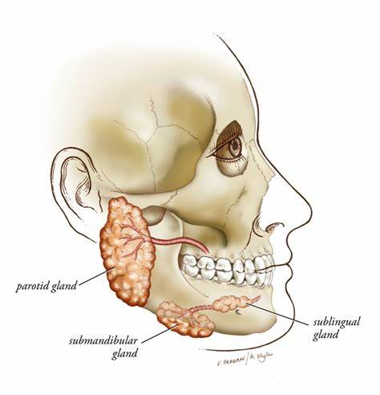
Introduction
Salivary glands are exocrine glands, that produce saliva.
There are 3 large named pairs of salivary glands and multiple minute unnamed glands in the submucosa of the oral cavity (lips, palate & under surface of the tongue).
The 3 named glands
Parotid
Submandibular
Sublingual
Produces a serous, watery secretion.
Produces a mixed serous & mucous secretion.
Secrets saliva that is predominantly mucous in character.

Slide 4
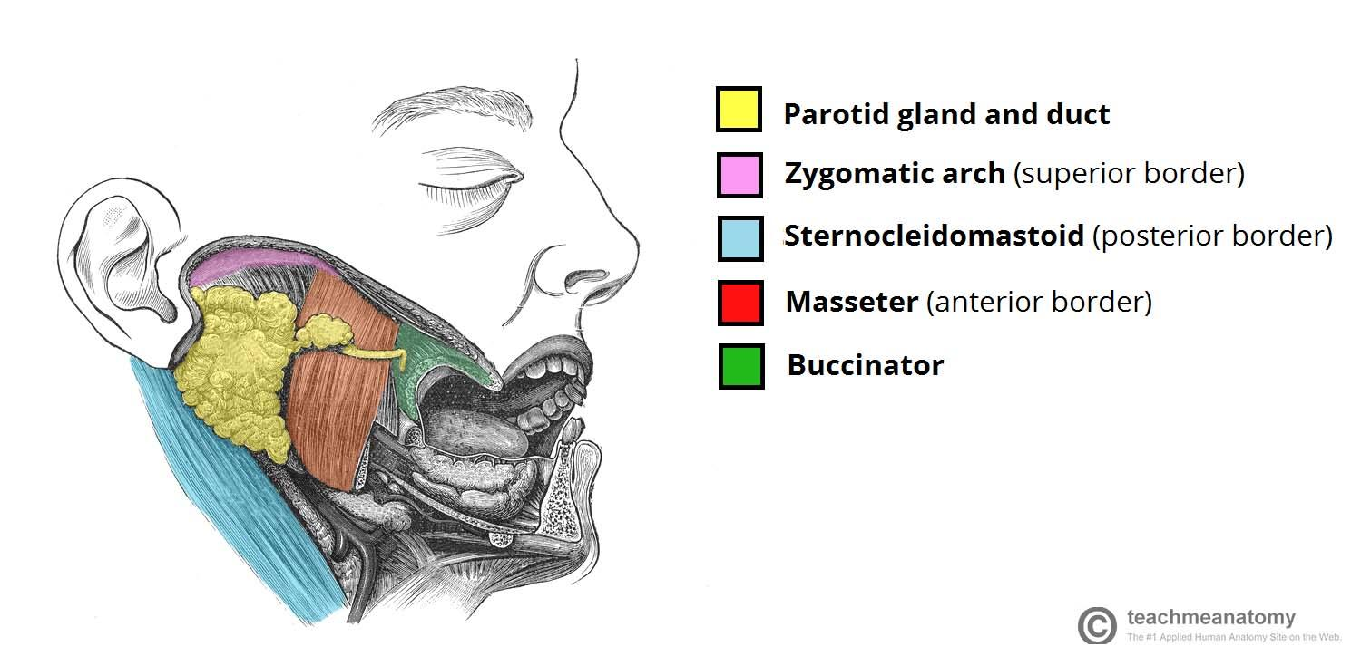
Parotid gland
Capsule
-Tight, derived from deep cervical fascia of the neck. -The gland is divided into superficial & deep parts, by the facial nerve fibers.
Shape
-Triangular. -Apex: behind angle of the mandible. -Base: directed upward just below the zygomatic arch, external auditory meatus & temporomandibular joint.
Position
-Anteriorly: Wedged between mandibular ramus & masseter. -Posteriorly: Mastoid process & sternomastoid muscle.
Nerve supply
-Parasympathetic: from inferior salivary nucleus (of glossopharyngeal nerve) to tympanic nerve to tympanic plexus to lesser petrosal to otic ganglion. -postganglionic fibers from otic ganglion runs in the auriculotemporal nerve. -Sympathetic: from plexus around external carotid artery.
Largest salivary gland.
Formed entirely of serous acini.
Has an Accessory part: A small part that is separated from the main gland.
Blood supply:
Arterial supply: external carotid artery & its branches.
Venous drainage: retromandibular vein.
Lymphatic drainage: parotid (preauricular) & thence to upper group of deep cervical lymph nodes.
Base
Apex

Slide 5
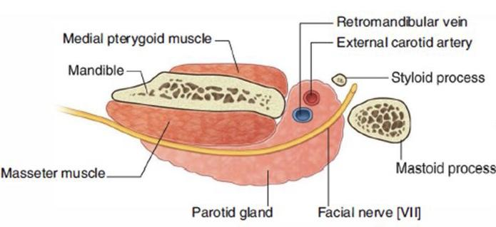
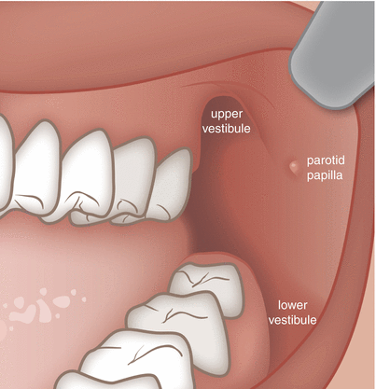
Structures within the parotid gland
(From superficial to deep)
1
Facial nerve
It is the most superficial structure, it divides the gland into superficial & deep parts. It gives two Branches before it enters the gland and five branches within the parotid:
1- Temporal
2- Zygomatic
3- Buccal
4- Mandibular
5- Cervical
2
Retromandibular vein
Intermediate in position, formed by the union of maxillary & superficial temporal veins. Before it leaves the gland it is divided into anterior & posterior branches.
3
External carotid artery
Most deep, It is divided into maxillary and superficial temporal arteries.
Parotid duct:
5 cm long ,Runs on the masseter muscle , Passes thru buccal pad of fat o Pierces the buccinators muscle
It opens into the vestibule of the mouth on a small papilla, opposite the upper second molar (maxillary) tooth.
MUMPS
is a viral disease caused by the mumps virus. Initial signs and symptoms often include fever, muscle pain, headache, poor appetite, and feeling tired. This is then usually followed by painful swelling of one or both parotid gland About two to three out of every 10 adolescent or adult men who have mumps may experience painful swelling of the testicles.

Slide 6
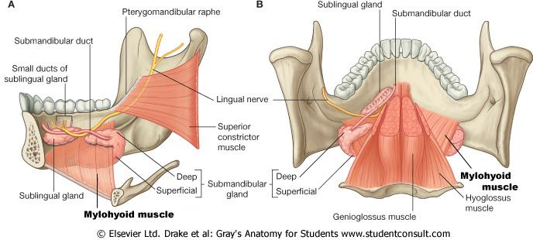
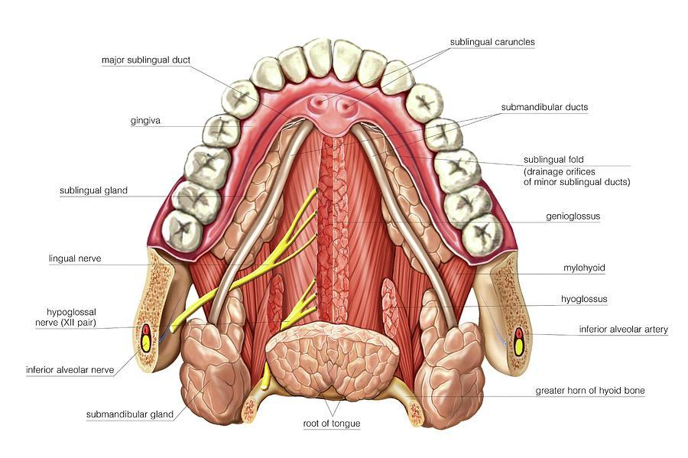
Submandibular gland & Sublingual gland
Submandibular gland
Location | Parts
Located deep to the body of the mandible | -Large Superficial part -Small deep part both parts continuate around the mylohyoid muscle
Sublingual gland
Location
-Almond shape -the smallest of the three salivary glands. -It lies below the mucous membrane of the floor of mouth, close to the midline.
Submandibular & sublingual glands
-Arterial supply: Facial artery -Venous drainage: Facial vein. -Lymph drainage: Submandibular lymph nodes. sublingual glands : lingual vessels & branches from submental (facial vessels) | -Parasympathetic: secretomotor supply is from superior salivary nucleus (of the facial nerve) to chorda tympani and lingual nerve to the submandibular ganglion. -Postganglionic fibers reach the submandibular & sublingual glands running in lingual nerve either directly or along the duct.

Slide 7
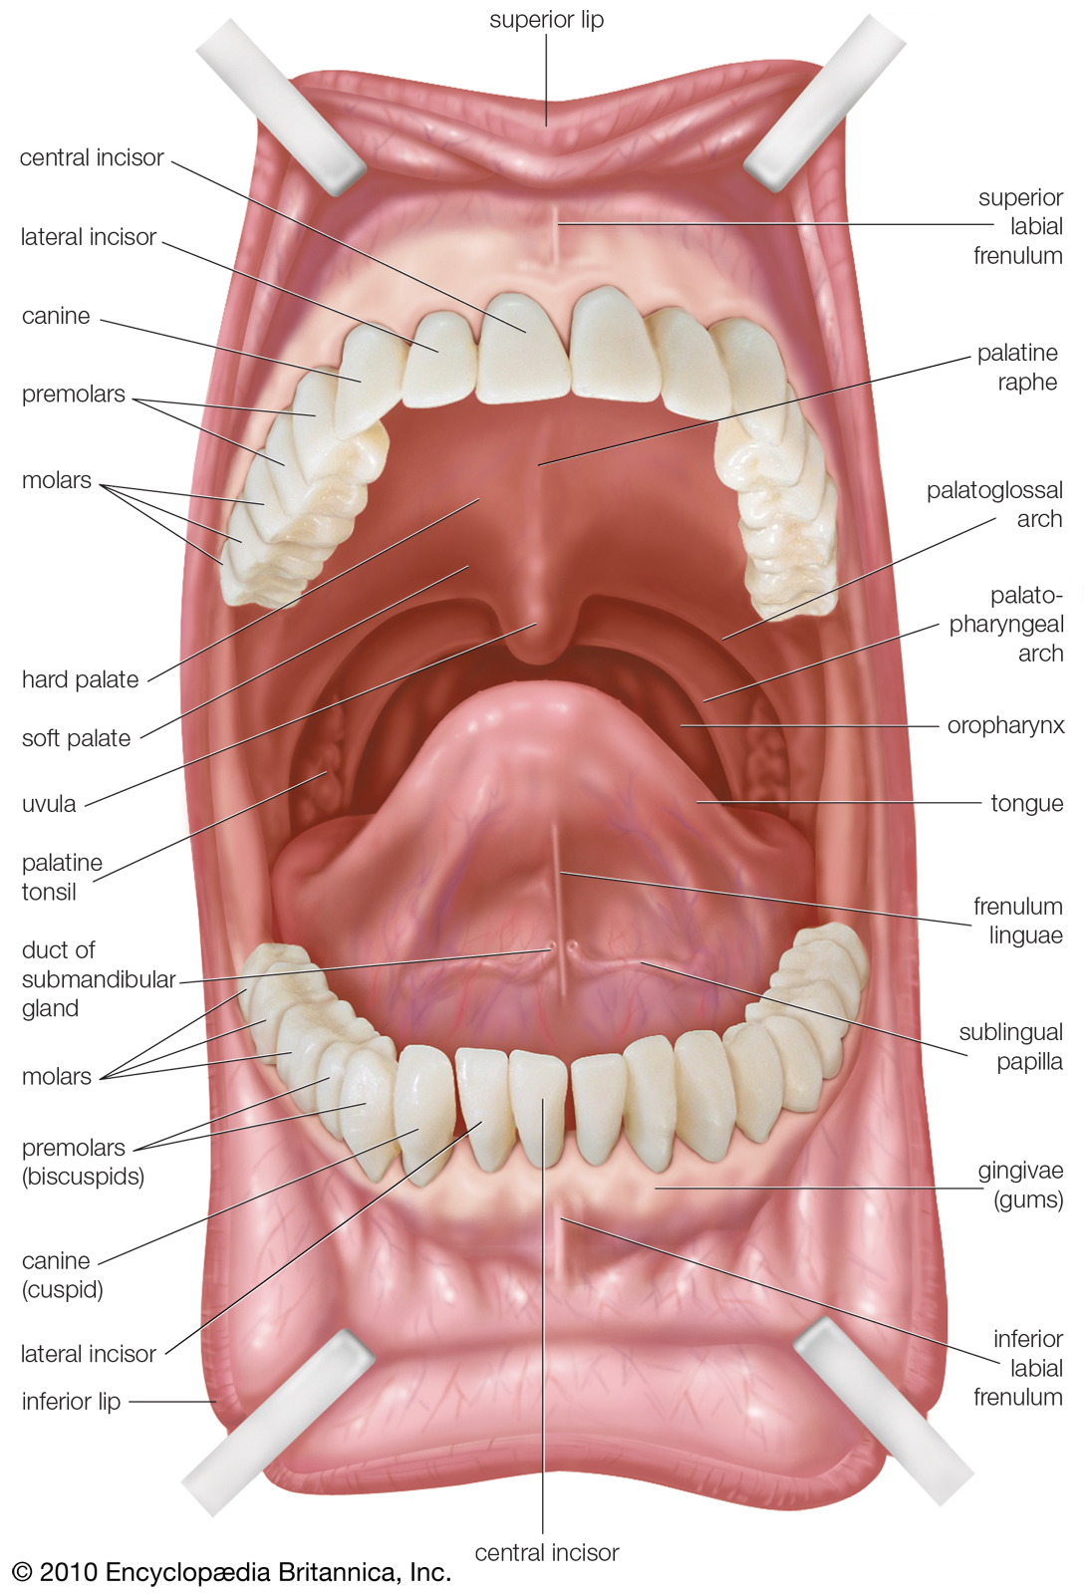
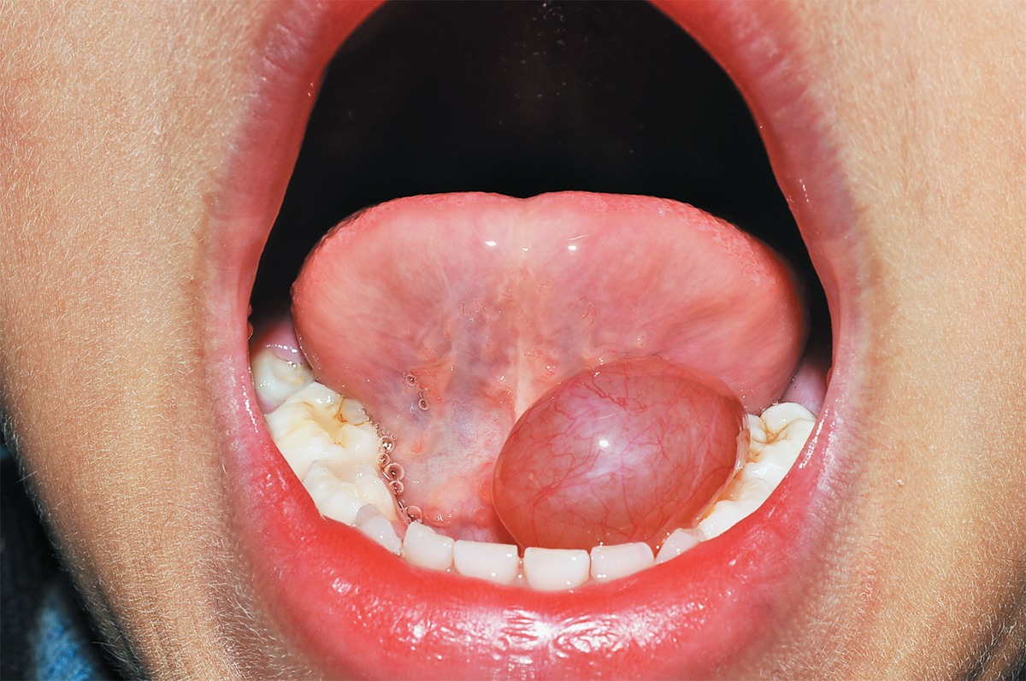
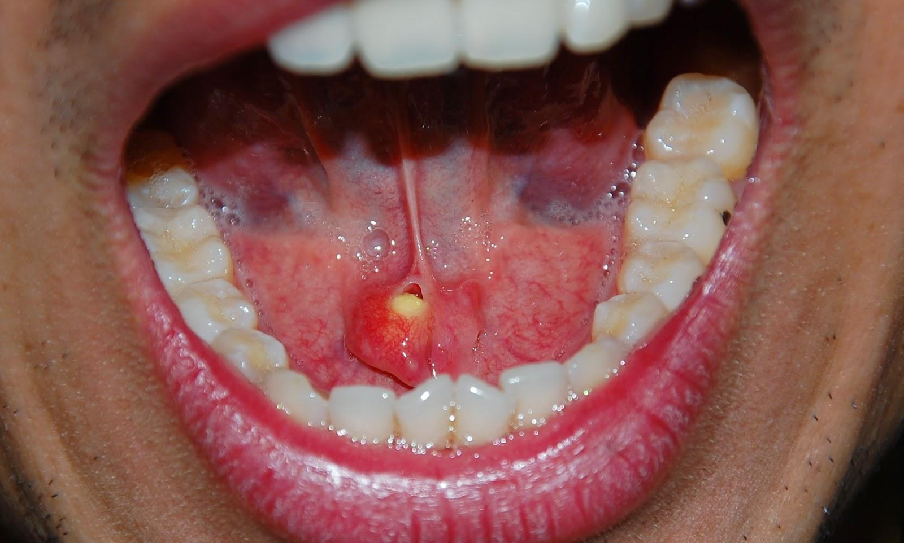
Sublingual duct & Submandibular duct:
Sublingual duct:
The sublingual ducts are 8 to 20 in number & Most open into the summit of the sublingual fold, but a few may open into the submandibular duct.
Ranula
is a mucus extravasation cyst.
Involved sublingual gland Found on the floor of the mouth
Submandibular duct:
The duct emerges from the deep part of the gland, and it passes forward along the side of the tongue, under the mucous membrane of the floor of the mouth & It is crossed laterally by the lingual nerve.
It opens on the summit of a small sublingual papilla, which lies at the side of the frenulum of the tongue & saliva can usually be seen emerging from the orifice of the duct.
clinically, it is important to remember that the submandibular duct can be palpated through the floor of the mouth alongside the tongue.
Ranula
Calculus formation
The submandibular duct is a common site of calculus formation.
The presence of a tense swelling below the body of the mandible, which is greatest before or during a meal and is reduced in size or absent between meals, is diagnostic of the condition.
Examination of the floor of the mouth will reveal absence of ejection of saliva from the orifice of the duct of the affected gland.
Frequently, the stone can be palpated in the duct, which lies below the mucous membrane of the floor of the mouth.
Calculus formation

Slide 8
QUIZ
Q1 | Q2 | Q3 | Q4 | Q5 | Q6 | Q7 | Q8
A | C | B | B | A | B | D | C
Q1: which of the following is anterior to the parotid gland:
A. Masseter muscle
B. Sternomastoid muscle
C. Zygomatic arch
D. None of the above
Q2: the apex of the parotid gland is: A. Direct upward below the external auditory meatus
B. Directed upward below the zygomatic arch
C. Behind the angle of the mandible
D. Directed upward below the temporomandibular joint.
Q3: the most superficial structure in the parotid gland is:
A. Lingual nerve
B. Facial nerve
C. External carotid artery
D. Retromandibular vein
Q4: which of the following is CORRECT about the submandibular gland:
A. The submandibular duct arise from the superficial part of the gland
B. The gland is located deep to the body of mandible
C. The gland has large deep part and small superficial part
D. The submandibular duct is crossed laterally by the facial nerve
Q5: Most sublingual ducts open into the:
A. Sublingual fold
B. Frenulum of the tongue
C.Submandibular duct
D. Papilla in vestibule
Q6: Most common site for calculus formation:
A. Parotid duct
B. Submandibular duct
C. Palatine gland
D. Sublingual duct
Q7: Parotid gland postganglionic parasympathetic supply runs in the:
A. Lingual nerve
B. Chorda tympani
C. Tympanic nerve
D. Auriculotemporal nerve
Q8: Sublingual & submandibular parasympathetic supply originate from:
A. Inferior salivary nucleus
B. Nucleus solitarius
C. Superior salivary nucleus
D. Facial nucleus

Slide 9
Members board
Team leaders
Abdulrahman Shadid
Ateen Almutairi
Boys team:
Mohammed Al-huqbani
Salman Alagla
Ziyad Al-jofan
Ali Aldawood
Khalid Nagshabandi
Sameh nuser
Abdullah Basamh
Alwaleed Alsaleh
Mohaned Makkawi
Abdullah Alghamdi
Girls team :
Ajeed Al Rashoud
‏Taif Alotaibi
‏Noura Al Turki
‏Amirah Al-Zahrani
‏Alhanouf Al-haluli
‏Sara Al-Abdulkarem
‏Renad Al Haqbani
‏Nouf Al Humaidhi
Jude Al Khalifah
Nouf Al Hussaini
Rema Al Mutawa
Maha Al Nahdi
Razan Al zohaifi
Ghalia Alnufaei
Contact us:
Editing file

