Slide 1
Oral Cavity, Palate And Tongue
Gastrointestinal block-Anatomy-Lecture 2
Editing file

Slide 2
Objectives
Color guide :
Only in boys slides in Green
Only in girls slides in Purple
important in Red
Notes in Grey
At the end of the lecture, students should be able to:
Describe the anatomy of the oral cavity, (boundaries, parts, nerve supply).
Describe the anatomy of the palate, (parts, muscles, nerve & blood supply).
Describe the anatomy of the tongue, (structure, muscles, motor and sensory nerve, blood supply and lymphatic drainage).

Slide 3
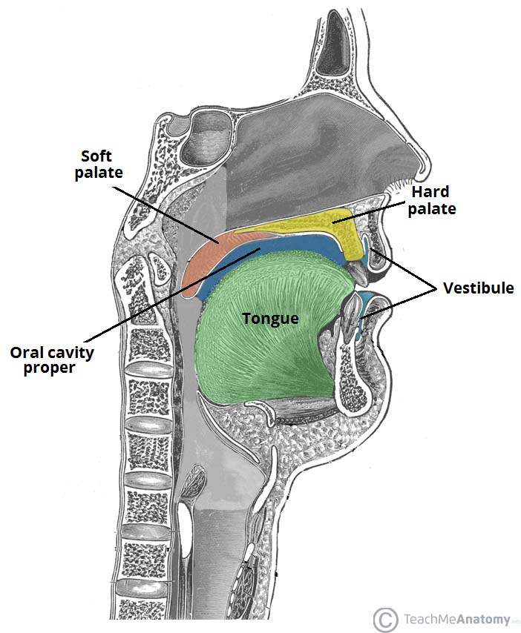
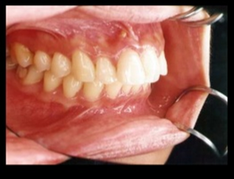
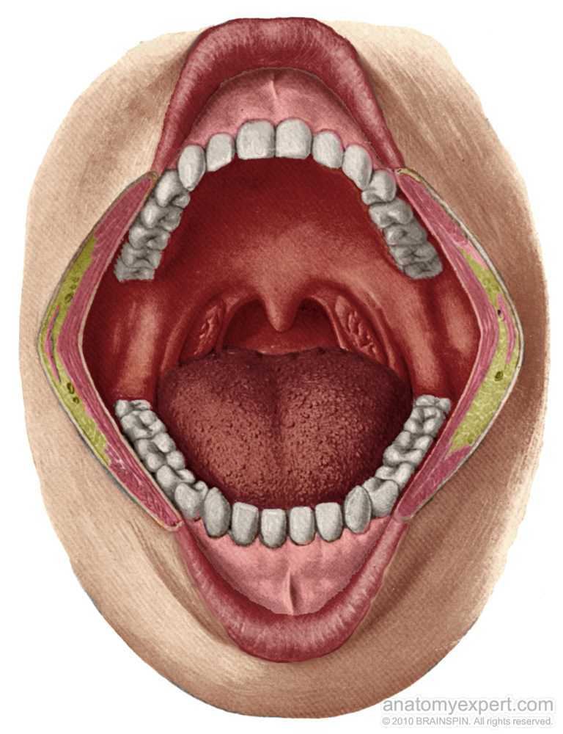
Oral Cavity
The mouth extends from lips to oropharyngeal isthmus (the junction between mouth & the pharynx).
Is bounded: Above by the soft palate and the palatoglossal folds, Below by the dorsum of the tongue.
it divided into
Vestibule:
It’s lies between gums & teeth internally and, Lips & cheeks externally.
It is a slit-like space that communicates with the exterior through the oral fissure.
When the jaws are closed, it communicates with the mouth proper behind the last molar tooth.
The cheek forms the lateral wall of the vestibule and is made up of the buccinator muscle, which is covered by skin and lined by mucous membrane.
Opposite the upper second molar tooth, there is a small papilla on the mucous membrane, marking the opening of the parotid duct.
Mouth cavity proper:
Which lies within the alveolar arches, gums, and teeth
has a:
Roof: which is formed by the hard & soft palate.
Floor: which is formed by the anterior 2/3 of the tongue, (oral or palatine part of the tongue).
Oropharyngeal isthmus

Slide 4
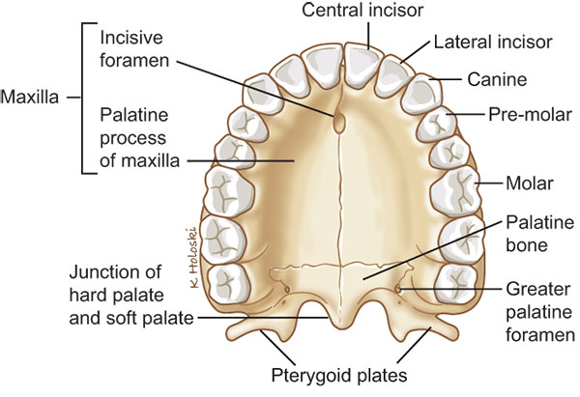
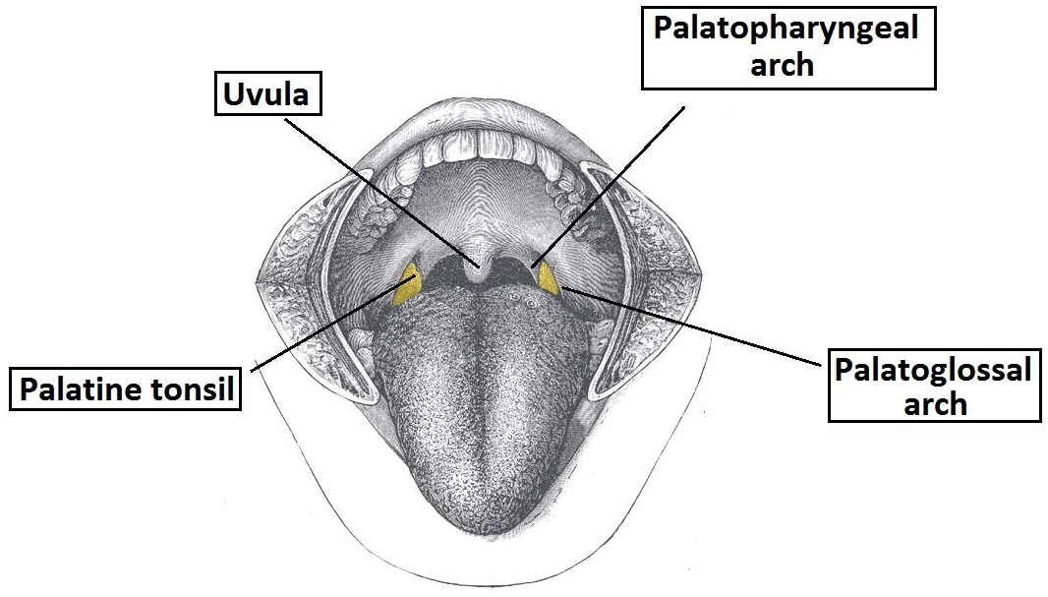
Palate
It forms the roof of the mouth and divided into two parts:
The Hard (Bony) palate in front.
is formed by (4 bones) separated by cruciform suture:
2 Palatine processes of the maxillae anteriorly
2 Horizontal plates of palatine bones posteriorly
It is Bounded Laterally by the alveolar arches of the maxilla.
The under surface of the hard palate is covered with mucoperiosteum. It possesses a median elevated ridge. On either side of the ridge the mucous membrane shows transverse corrugations
The hard palate forms the floor of the nasal cavities.
The Soft palate behind.
it is a mobile fold formed of a bag of mucous membrane filled with striated muscles.
It is attached to the posterior border of the hard palate.
Its free posterior border is a conical projection called the uvula.
Composed of
Sensory Innervation
Blood supply
Mucous membrane: covers its upper & lower surfaces.
Palatine aponeurosis: is a fibrous sheet attached to the posterior border of the hard palate, It is the expanded tendon of the tensor palatini.
Muscles.
Nerves and vessels.
Maxillary nerve through:
Greater and Lesser palatine nerve from maxillary nerve enter the palate through greater and lesser palatine foramina. (also the vessels)
Nasopalatine nerve is a branch of the maxillary nerve enters the palate through the incisive foramen. (also the vessels).
Glossopharyngeal nerve.
Greater & lesser palatine branches of the maxillary artery.
Ascending palatine branch of the facial artery.
Ascending pharyngeal branch of the external carotid artery.

Slide 5
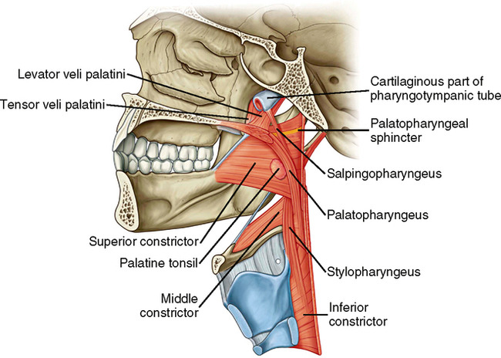
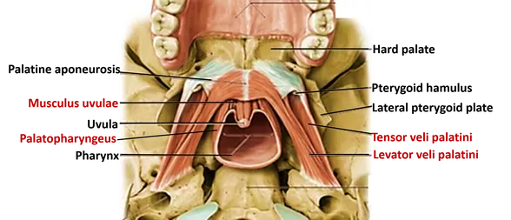
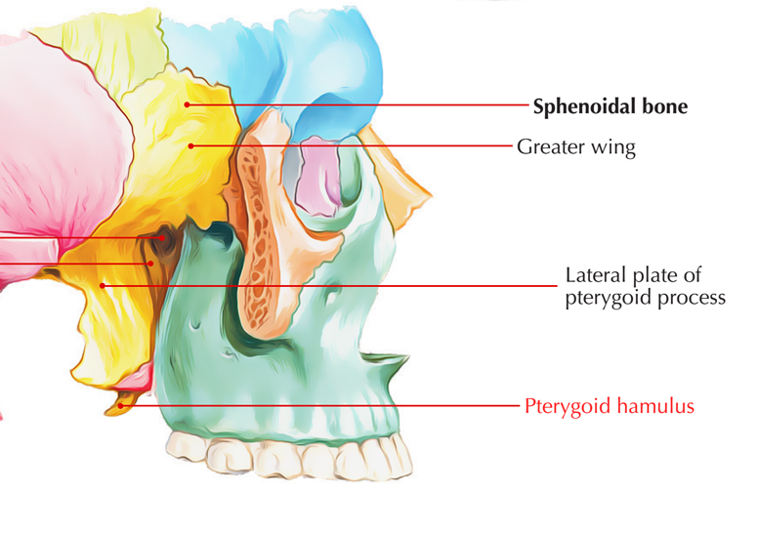
Palate: Muscle of the soft palate
Muscle (Pair) | Origin* | Insertion* | Nerve supply | Action
Tensor veli palatini | Spine of sphenoid, auditory tube | With muscle of other side, forms palatine aponeurosis | Nerve to medial ptetygoid from mandibular n. | When muscles contract: tightened and Tenses the soft palate
Levator veli palatini | Petrous part of temporal bone, auditory tube | Palatine aponeurosis | Pharyngeal plexus Formed by branches from glossopharyngeal nerve vagus nerve cranial part of accessory nerve superior cervical ganglion sympathetic fibers | Raises soft palate
Palato-glossus | Palatine aponeurosis | Side of tongue |  | Pulls root of tongue upward and backward, narrows oropharyngeal isthmus
Palato-pharyngeus | Palatine aponeurosis | Posterior border of thyroid cartilage |  | Elevates wall of pharynx, pulls palato-phatyngeal folds medially
Musculus uvulae | Posterior border of hard palate | Mucous membrane of uvula |  | Elevates uvula (can be tested by saying ‘Ah’, normally uvula moves backward in the middle line, if it deviated to a side. that inducat a lesion in the nerve supply in the opposite side )
The muscle fibers of the tensor palatini converge as they descend from their origin to form a narrow tendon, which turns medially around the pterygoid hamulus.
*Males’ doctor said origin and insertion are not important

Slide 6
Palate : Movement of the soft palate
Closure occurs during the production of explosive consonants in speech and swallowing.
Soft palate is raised by the contraction of the levator veli palatini and Palatopharyngeus.
become tenes by Tensor veli palatini
The palatopharyngeus muscles on both sides also contract so that the palatopharyngeal arches are pulled medially, like side curtains.
By this means the nasal part of the pharynx is closed off from its oral part
1
3
2
At the same time, the posterior (superior) wall of the pharynx is pulled forward.
4
Pharyngeal isthmus: (It is the communicating between nasal and oral parts of the pharynx) It is closed by raising the soft palate upward.

Slide 7
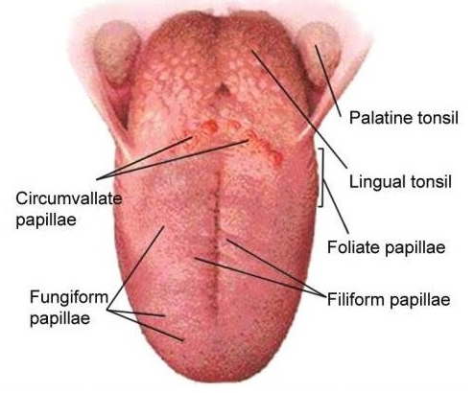
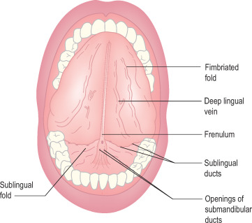
Tongue:
1
is a mass of striated muscle covered with mucous membrane.
2
Its anterior 2/3 lies in the mouth, and its posterior 1/3 lies in the pharynx.
3
Muscles attach the tongue to :
styloid process & soft palate above
mandible & the hyoid bone below
The tongue is divided into right & left halves by a median fibrous septum.
4
Upper surface
Can be divided by The sulcus terminalis V-shaped sulcus. into
Anterior 2/3 or oral part and Posterior 1/3 or pharyngeal part
The apex of the sulcus projects backward and is marked by a small pit, the foramen cecum. It’s an embryologic remnant which marks the site of the upper end of the thyroglossal duct
Three types of papillae are present on the upper surface of the anterior two thirds of the tongue:
filiform papillae
fungiform papillae
vallate papillae.
The mucous membrane covering the posterior third of the tongue is devoid of papillae but has a nodular irregular surface caused by the presence of underlying lymph nodules, the lingual tonsil. The posterior third has no papillae.
inferior surface
The mucous membrane on the inferior surface of the tongue is smooth and is reflected from the tongue to the floor of the mouth.
In the midline, the undersurface of the tongue is connected to the floor of the mouth by a fold of mucous membrane, the frenulum of tongue. (Tongue-tie is a condition where tongue movement is restricted due to a short frenulum, baby may have difficulties breastfeeding and speaking.)
On the lateral side of the frenulum, the deep lingual vein can be seen through the mucous membrane.
Lateral to the lingual vein, the mucous membrane forms a serrated fold called the fimbriated fold.

Slide 8
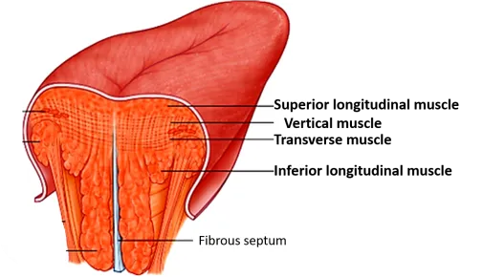
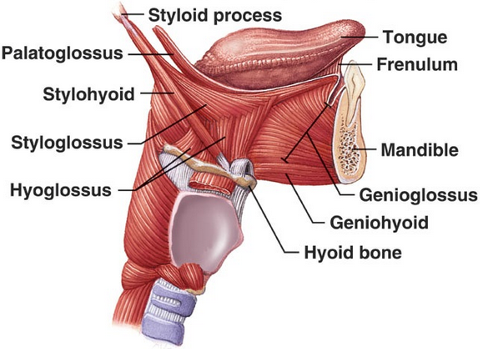
Tongue: Muscles
Muscle (Pair) | Origin* | Insertion* | Nerve supply | Action
Intrinsic Muscles: are not attached to bone
Superior & inferior Longitudinal Transverse Vertical | Median septum and submucosa | Mucous membrane | Hypoglossal nerve | Alter the shape of the tongue while it lies within the mouth.
Extrinsic Muscles: are attached to bones and soft palate
Genioglossus | Superior genial spine of mandible | Blends with other muscles of tongue | Hypoglossal nerve | Protrudes apex of tongue through mouth
Hyoglossus | Body and greater cornu of hyoid bone |  |  | Depresses tongue
Styloglossus | Styloid process of temporal bone |  |  | Draws tongue upward and backward
Palato-glossus | Palatine aponeurosis | Side of tongue | Pharyngeal plexus | Pulls root of tongue upward and backward,narrows oropharyngeal isthmus
*Males’ doctor said origin and insertion are not important

Slide 9
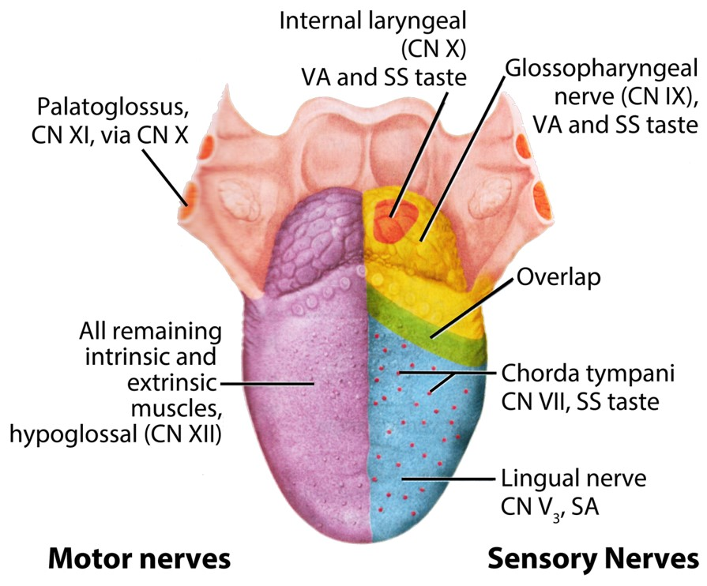
Tongue Supply :
Blood supply
Venous drainage
Lymphatic drainage
It is supplied by:
lingual artery, from external carotid artery. its branch: Deep lingual artery, sublingual artery and dorsal lingual arteries
Tonsillar branch of the facial artery,
Ascending pharyngeal artery.
The veins drain into the internal jugular vein
The tip of the tongue drain into submental lymph nodes
The remainder of the anterior 2/3 drain into
submandibular lymph nodes
deep cervical lymph nodes.
Posterior 1/3 drain into deep cervical lymph nodes.
Sensory Innervation
Part | General Sensation (from mucous membrane) | Taste Sensation (from taste buds)
Anterior 2/3 | Lingual nerve. (branch of the 5th CN) | Chorda Tympani of the (Facial) nerve. EXCEPT the vallate papillae
Posterior 1/3 | Glossopharyngeal nerve. | Glossopharyngeal nerve. (including the vallate papillae)
Roots of the tongue and epiglottis | Vagus nerve | Vagus nerve

Slide 10
QUIZ
Q1 | Q2 | Q3 | Q4 | Q5 | Q6 | Q7 | Q8
D | C | C | D | A | C | A | A
Q1: Which of the following muscles is NOT innervated by the hypoglossal nerve?
A. genioglossus
B. hyoglossus
C. styloglossus
D. palatoglossus
Q2: Which one of the following is not part of Pharyngeal plexus : A. glossopharyngeal nerve B. vagus nerve
C. Abducent nerve D. superior cervical ganglion
Q3:Which of these is correct
A. 7th CN carries only, taste sensation from the Anterior half of the tongue
B. 9th CN carries only, taste sensation from the posterior third of the tongue.
C. 5th CN carries only general sensation from the anterior two-thirds of the tongue
D. 9th CN carries general & taste sensation from the posterior half of the tongue
Q4: which muscle of these forms the palatine aponeurosis
A. Tensor tympani
B. Levator veli palatini
C. Palato-pharyngeus
D. Tensor palatini
Q5: The tip of the tongue drain into…………….lymph nodes
A. submental
B. submandibular
C. deep cervical lymph
D. neek
Q6: Opening of the parotid duct located in A. Opposite the lower second molar tooth B. Opposite the upper last molar tooth C. Opposite the upper second molar tooth D. There is no opening :(
Q7: Nasopalatine nerves enters the palate through
A. incisive foramen
B. cecum foramen
C. greater palatine foramen
D. lesser palatine foramen
Q8: vallate papillae is innervated by
A. glossopharyngeal nerve
B. vagus nerve
C. Lingual nerve branch of the 5th CN
D. Facial nerve

Slide 11
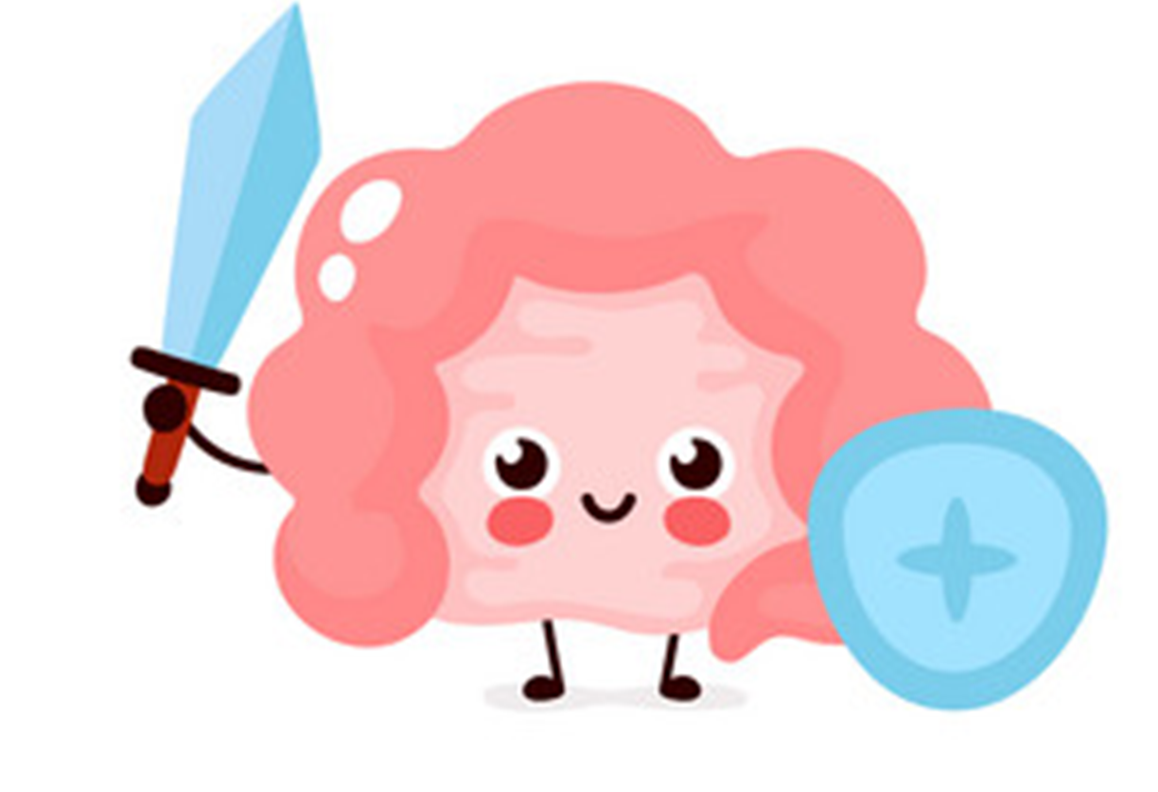
Members board
Team leaders
Abdulrahman Shadid
Ateen Almutairi
Boys team:
Mohammed Al-huqbani
Salman Alagla
Ziyad Al-jofan
Ali Aldawood
Khalid Nagshabandi
Sameh nuser
Abdullah Basamh
Alwaleed Alsaleh
Mohaned Makkawi
Abdullah Alghamdi
Girls team :
Ajeed Al Rashoud
‏Taif Alotaibi
‏Noura Al Turki
‏Amirah Al-Zahrani
‏Alhanouf Al-haluli
‏Sara Al-Abdulkarem
‏Renad Al Haqbani
‏Nouf Al Humaidhi
Jude Al Khalifah
Nouf Al Hussaini
Danah Al Halees
Rema Al Mutawa
Maha Al Nahdi
Razan Al zohaifi
Ghalia Alnufaei
Contact us:
Editing file

