Slide 1
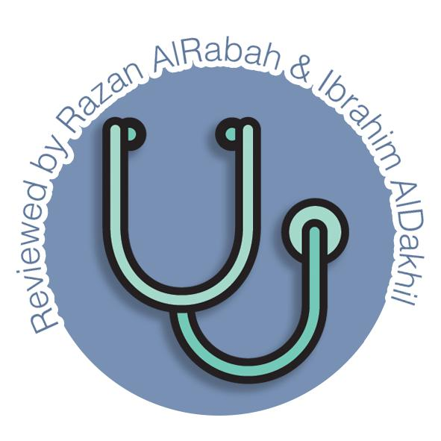
Esophagus And Stomach
Gastrointestinal block-Anatomy-Lecture 3
Editing file

Slide 2
Objectives
Color guide :
Only in boys slides in Green
Only in girls slides in Purple
important in Red
Notes in Grey
At the end of the lecture, students should be able to:
Describe the anatomy of the esophagus; extent, length, parts, strictures, relations, blood & nerve supply and lymphatic.
Describe the anatomy of the stomach; location, shape, parts, relations, blood & nerve supply and lymphatic.

Slide 3
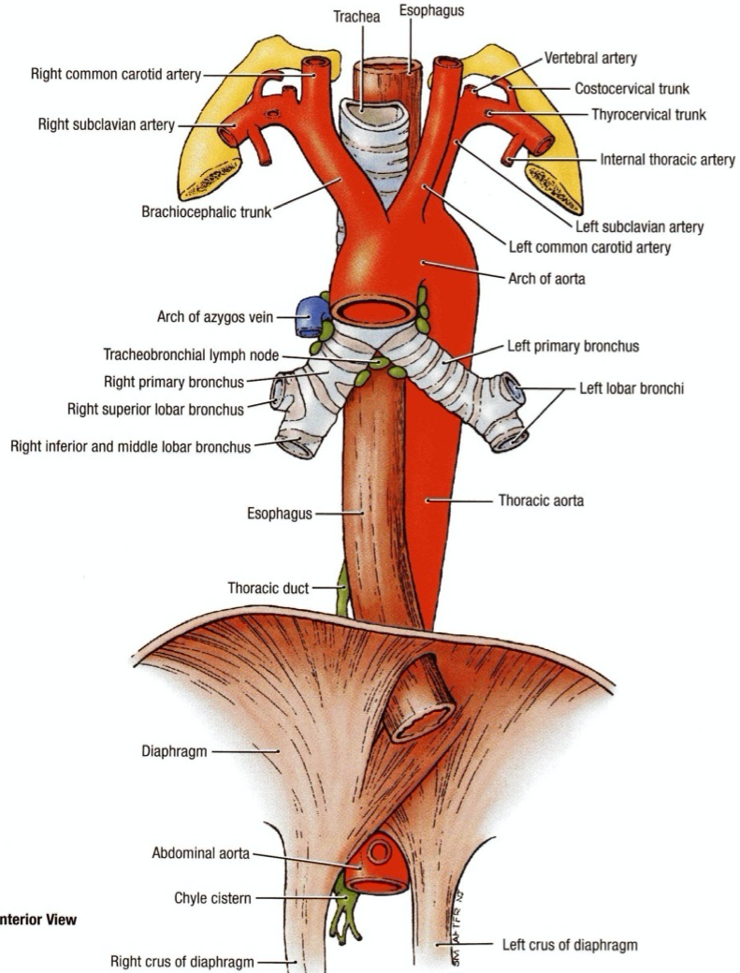
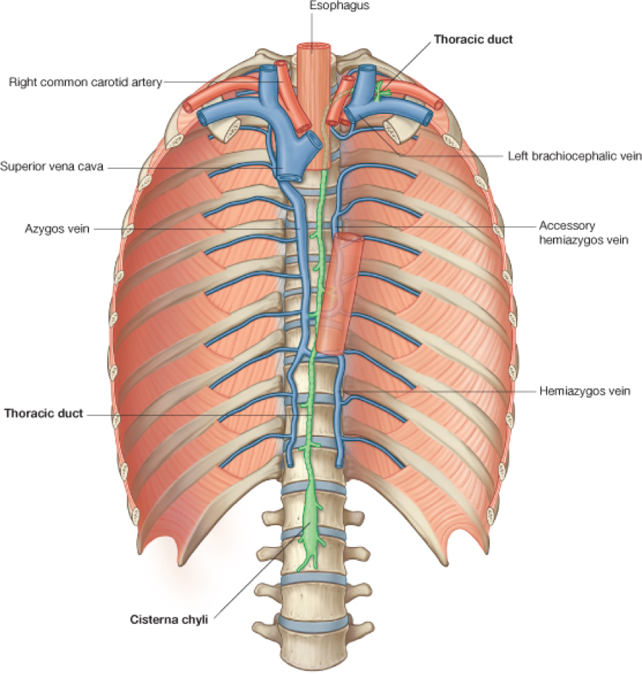
Esophagus
It is a tubular structure about 25 cm long and is divided into three parts
Extends from C6 (end of pharynx) → In the thoracic part it bends to the left but at the level of the sternal angle, aortic arch and left main bronchus push it again to the midline → Until it pierces diaphragm at T10 → Crosses the diaphragm for 1.3 cm to join the stomach in the abdomen = (end in the level of T11)
1
Cervical
2
Thoracic
3
Abdominal
Relations
Anterior:
Trachea
Recurrent laryngeal nerves
Posterior:
Vertebral column
Lateral:
Lobes of Thyroid gland
Relations
Anterior:
Trachea
Left Recurrent laryngeal nerve
Posterior:
Bodies of Thoracic Vertebrae
Azygos vein
Right posterior intercostal arteries
Lateral:
Right: - Left:
Relations
Anterior:
Left lobe of the liver
Posterior:
Left crus of the diaphragm
•Fibers from the right crus form a sling around the esophagus
•At the opening of the diaphragm it’s accompanied by:
Two vagi
Left gastric vessels
Lymphatic vessels
Left principal bronchus
Left atrium and pericardium
Thoracic Duct
Descending Thoracic aorta (end only)
Right Mediastinum pleura
Terminal end of azygos vein
Left Mediastinum pleura
Aortic arch
Left subclavian artery
Thoracic duct

Slide 4
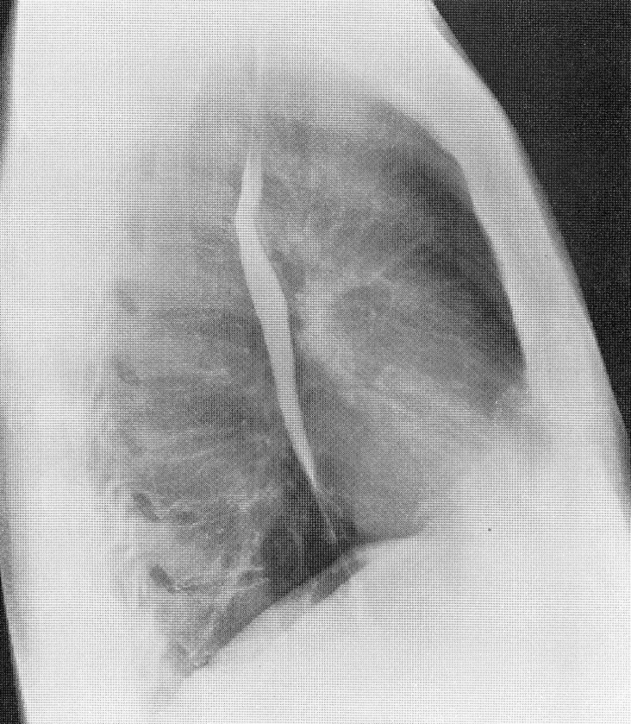
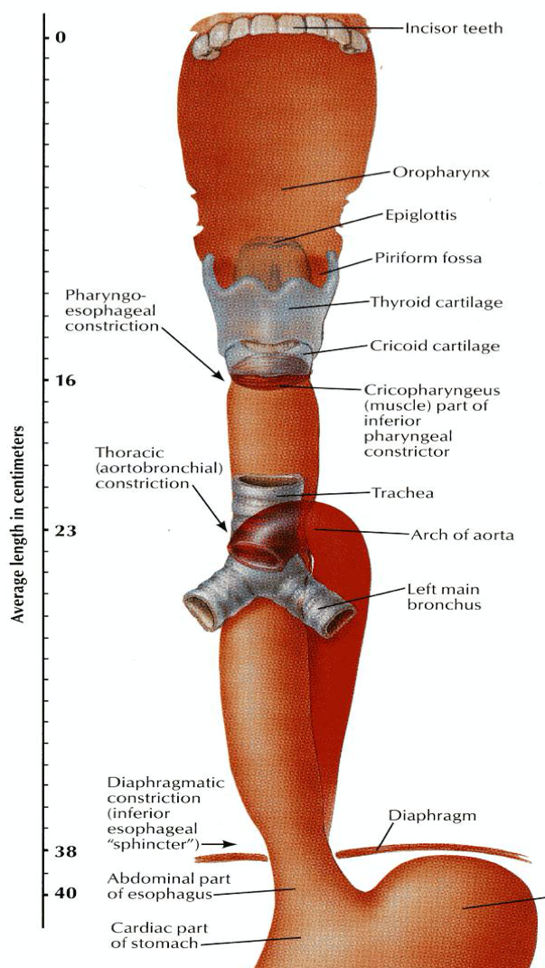
Clinical Aspects: Esophagus
There’s a close relationship between the esophagus and left atrium.
A barium swallow will help physicians assess the size of the left atrium (Dilation) in case of heart failure or long standing mitral stenosis
1. They might cause difficulties in passing a gastroscope
2. In case of swallowing of caustic liquids (mostly in children), this is where the burning is the worst and strictures develop.
3. Esophageal strictures are common place for esophageal carcinoma
The importance of this scale is that when a doctor inserts the gastroscope, they can know where the levels of constriction is so they can move the gastroscope with caution
The esophagus has 3 anatomic constrictions:
First one (16 cm):
Located at the junction with the pharynx
Second one (23 cm):
Located at the crossing with the aortic arch and left main bronchus
Third one (38 cm)
Located at the junction with the stomach
Clinical
Importance
Constrictions

Slide 5
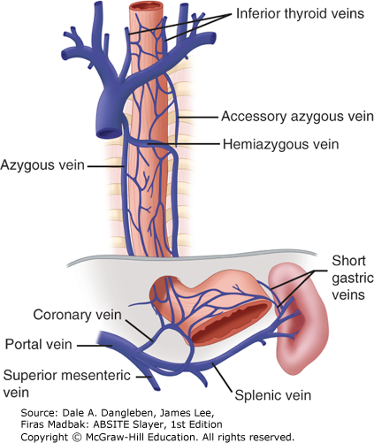
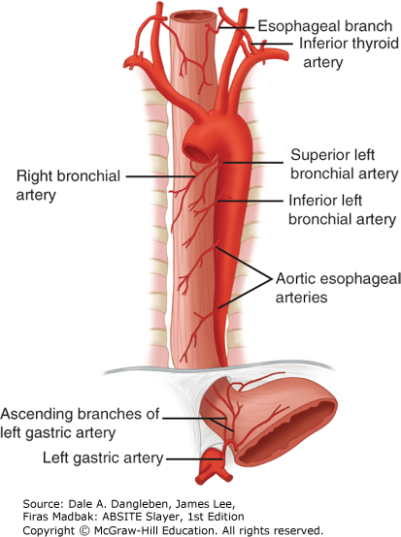
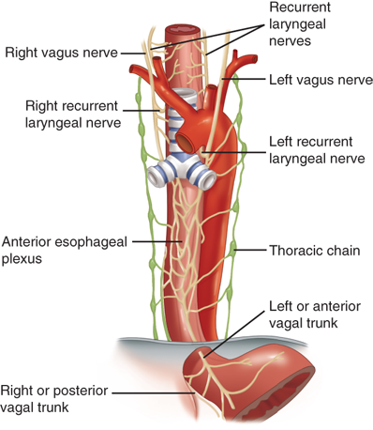
Esophagus Supply
Arterial Supply
Venous Drainage
Upper third: inferior thyroid artery.
Middle third: thoracic aorta.
Lower third: left gastric artery.
Upper third: inferior thyroid veins.(drains into IJV)
Middle third: azygos veins. (drains into SVC)
The lower third: left gastric vein (portal vein tributary)
Nerve Supply
Upper third: Deep cervical nodes
Middle third: Superior and inferior mediastinal nodes
Lower third: Celiac nodes
Sympathetic: sympathetic trunks
Parasympathetic: Vagus nerves
- Left vagus becomes anterior to the
esophagus.
- Right vagus becomes posterior to the
esophagus.
Below the inferior root of the lungs the vagus nerve joins the sympathetic trunk to form the esophageal plexus
Lymph Drainage

Slide 6
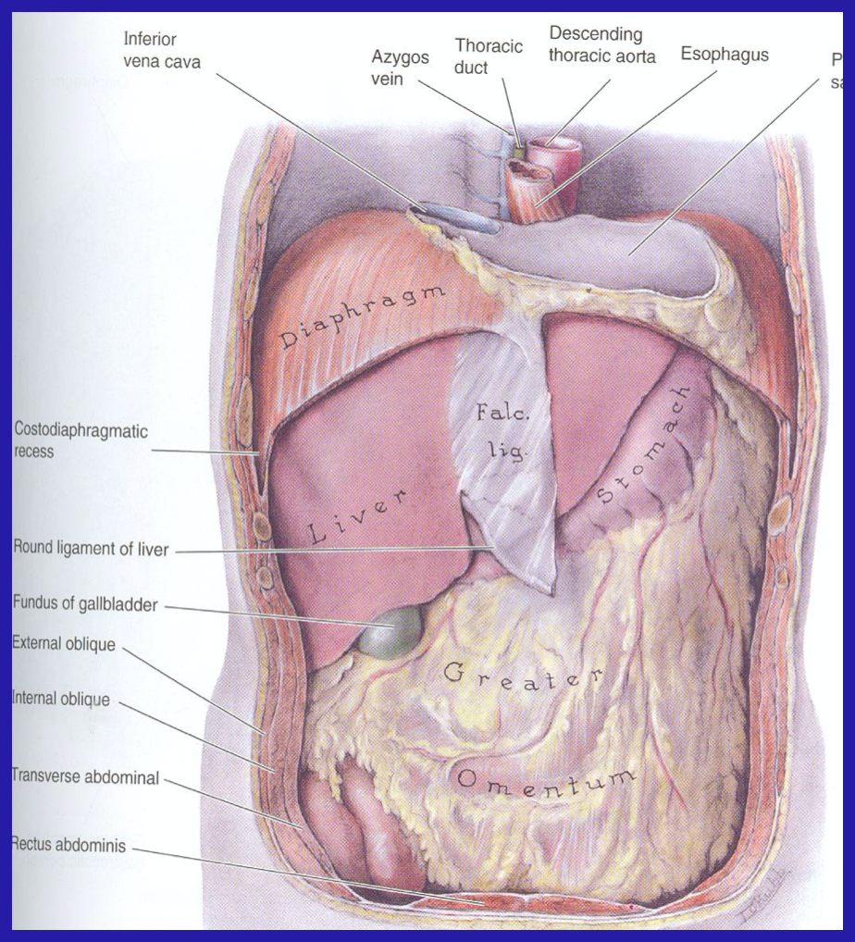
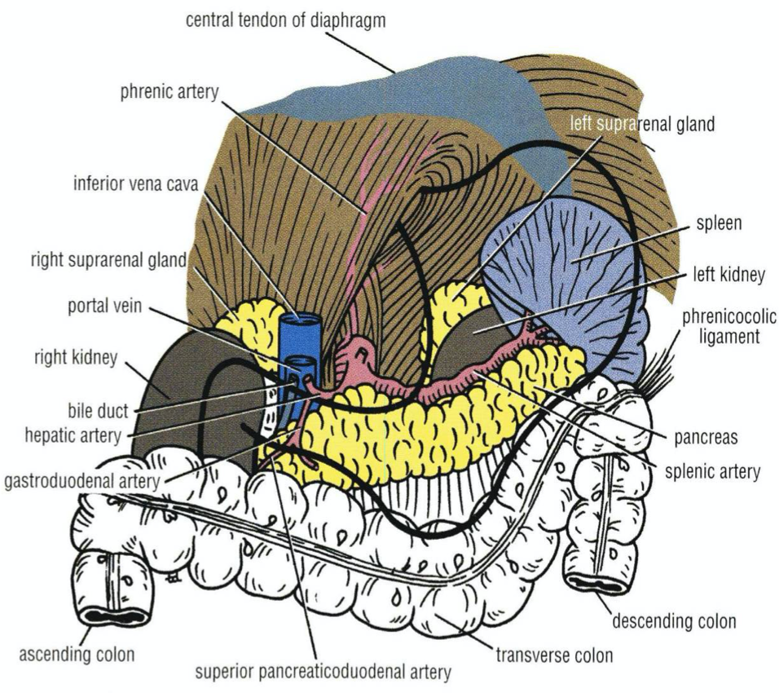
Stomach
It is the most dilated part of the alimentary canal and roughly resembles the letter “J”.
It is located in the upper part of the abdomen.
It extends from beneath the left coastal region into the epigastric and umbilical regions
Much of the stomach is protected by the lower ribs
Relations
Anterior | Posterior (Stomach bed)
Anterior abdominal wall Left costal margin Base of the left pleura Base of the left lung Diaphragm Left lobe of the liver | Left crus of diaphragm Left suprarenal gland Part of left kidney Spleen Splenic artery Pancreas Transverse colon and mesocolon Lesser sac
All structures on the posterior aspect are separated from the stomach by the peritoneum of lesser sac except the spleen which is separated by the greater sac

Slide 7
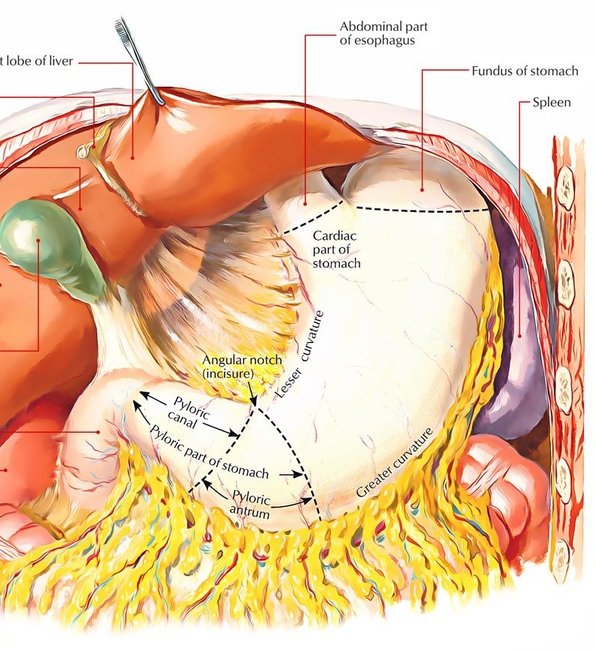
Stomach Parts
2 Orifices
2 Borders
2 Surfaces
3 Parts
Pylorus Formation
1) Cardiac Orifice
Gastro-esophageal sphincter (physiological)
Consist of circular smooth muscles under vagal and hormonal control
lies opposite to the left seventh costal cartilage 2.5 cm from the sternum
Prevents esophageal reflux (regurgitation)
2) Pyloric Orifice
1) Lesser curvature
Right border
Extends from the cardiac orifice to the pylorus.
Attached to the liver by lesser omentum (gastrohepatic ligament)
2) Greater curvature
Left border
Extends from the cardiac orifice to the pylorus.
At upper part it’s attached to the spleen by gastrosplenic ligament
At lower part it’s attached to the transverse colon by greater omentum
1) Anterior surface (anterosuperior)
2) Posterior surface (posteroinferior)
1) Fundus
Dome shaped part that is full of gases
Located to the left of the cardiac orifice at the left 5th intercostal space just below the apex of the heart
2) Body
Extends from Fundus to incisura angularis
Incisura angularis is a constant notch on the lesser curvature
3) Pylorus
Tubular part of stomach lies in the transpyloric plane L1 (1 cm) to the right of the midline
Made of:
1) Pyloric Antrum
Extends from incisura angularis to the pylorus
2) Pyloric canal
cavity of the pylorus
3) Pyloric Sphincter
Thick muscular End

Slide 8
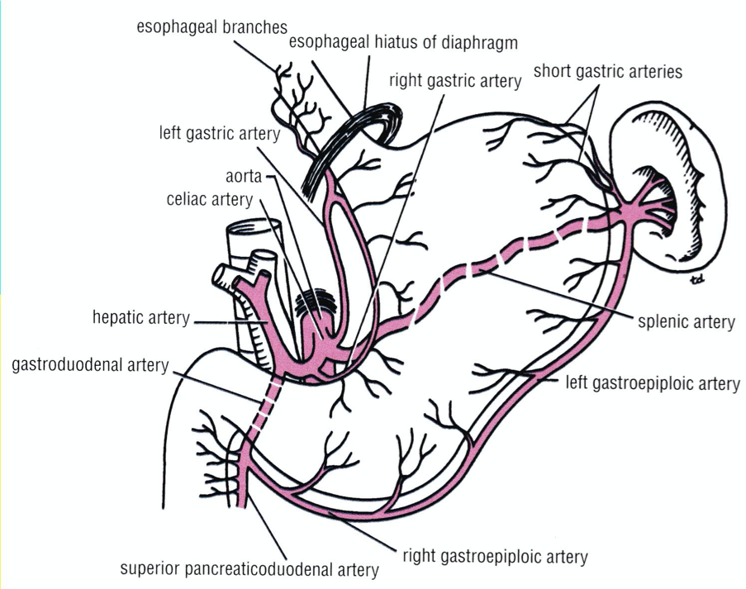
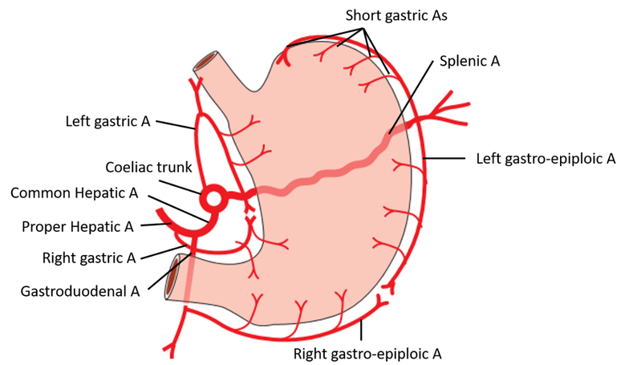
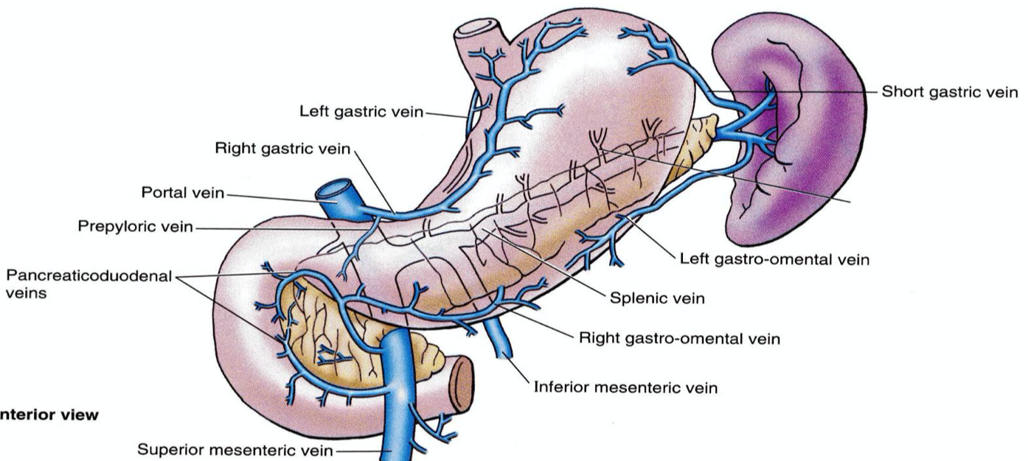
Stomach Supply
(5)
Arterial Supply (5)
Venous Drainage (5)
Runs on:
Lesser curvature:
Right gastric (hepatic artery of celiac)
Left gastric (a branch of celiac artery)
Greater curvature:
Right gastroepiploic (from gastroduodenal artery of hepatic)
Gastrosplenic ligament:
Short gastric arteries and Left gastroepiploic (from splenic artery)
Corresponds to the arteries and all of them drain in the portal vein
Right and left gastric drain directly into the portal vein
Short gastric and left gastroepiploic veins drain into the splenic vein
Right gastroepiploic vein drain into the superior mesenteric vein

Slide 9
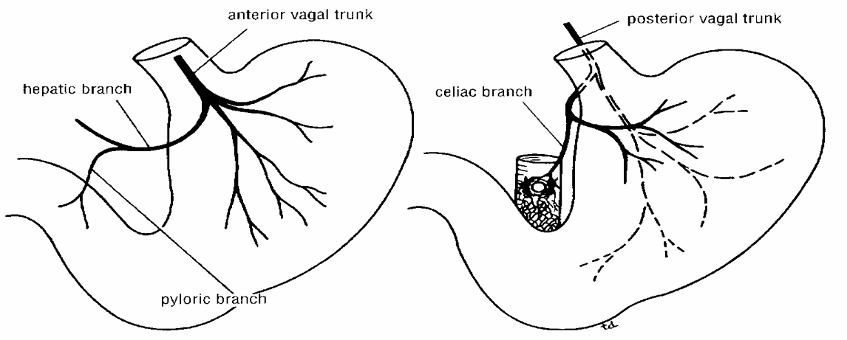
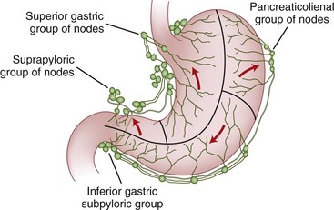
Stomach Supply
Nerve supply
Lymphatic drainage
Sympathetic: derived from celiac plexus
Parasympathetic: from both Vagus nerves
Anterior vagal trunk: Formed from the left vagus, supplies the anterior surface of the stomach and gives a hepatic branch that gives a branch to pyloric
Posterior vagal trunk :Formed from the right vagus supplies the posterior surface of the stomach and gives a branch to the celiac and superior mesenteric plexuses
The lymph vessels Follow the arteries and drain first into:
Left and right gastric nodes
Left and right gastroepiploic nodes
Short gastric nodes
Ultimately they drain into the celiac nodes

Slide 10
QUIZ
Q1 | Q2 | Q3 | Q4 | Q5 | Q6 | Q7 | Q8
C | C | A | B | C | A | B | A
Q1: At which level does the esophagus ends ?
A. T8
B. T10
C. T11
D. C6
Q2: Which of the following is a lateral relation of the cervical Esophagus? A. Trachea B. Aortic arch
C. Lobes of thyroid gland D. Pericardium
Q3: Which of the following is a direct branch of the celiac artery?
A. Left gastric artery
B. Right gastric artery
C. Short gastric artery
D. Right gastroepiploic artery
Q4: barium swallow will help to assess which of the following?
A. left ventricle dilation
B. left atrial dilation
C. RIght atrial dilation
D. Right ventricle dilation
Q5: Which one is from the posterior relations of the stomach :
A. Anterior abdominal wall
B. Diaphragm
C. Left crus of diaphragm
D. Base of the left pleura
Q6: The Lesser curvature is attached to which of the following?
A. liver by gastrohepatic ligament B. liver by gastrosplenic ligament C. Colon by lesser omentum D. Colon by gastrosplenic ligament
Q7: The Fundus of the stomach is located at which level?
A.4th intercostal space just below the apex of the heart
B. 5th intercostal space just below the apex of the heart
C. 5th intercostal space just above the apex of the heart
D. 6th intercostal space just above the apex of the heart
Q8: Second esophageal constriction is located at which of the following?
A. at the crossing with the aortic arch and left main bronchus
B. at the junction with the stomach
C. at the junction with the pharynx
D. at the junction with the Larynx

Slide 11
Members board
Team leaders
Abdulrahman Shadid
Ateen Almutairi
Boys team:
Mohammed Al-huqbani
Salman Alagla
Ziyad Al-jofan
Ali Aldawood
Khalid Nagshabandi
Sameh nuser
Abdullah Basamh
Alwaleed Alsaleh
Mohaned Makkawi
Abdullah Alghamdi
Girls team :
Ajeed Al Rashoud
‏Taif Alotaibi
‏Noura Al Turki
‏Amirah Al-Zahrani
‏Alhanouf Al-haluli
‏Sara Al-Abdulkarem
‏Renad Al Haqbani
‏Nouf Al Humaidhi
Jude Al Khalifah
Nouf Al Hussaini
Danah Al Halees
Rema Al Mutawa
Maha Al Nahdi
Razan Al zohaifi
Ghalia Alnufaei
Contact us:
Editing file

