Slide 1
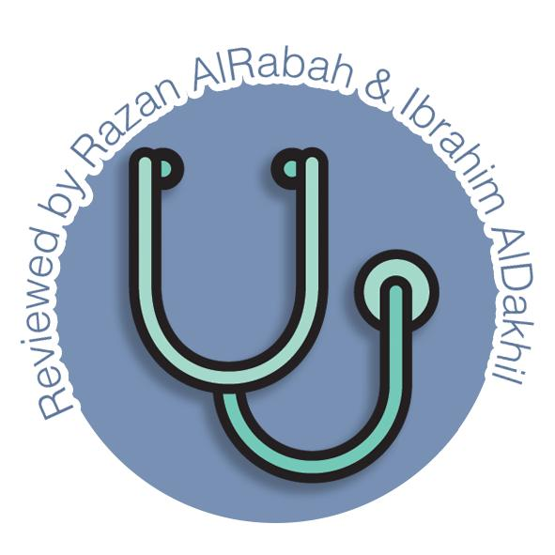
Pancreas & Biliary System
Gastrointestinal block-Anatomy-Lecture 4
Editing file

Slide 2
Objectives
Color guide :
Only in boys slides in Green
Only in girls slides in Purple
important in Red
Notes in Grey
At the end of the lecture, students should be able to:
Describe the location, surface anatomy, parts, relations & peritoneal reflection of the pancreas and gallbladder.
Describe blood supply, nerve supply and lymphatic drainage of pancreas and gallbladder.
Describe Course of each of common hepatic, cystic and common bile duct and pancreatic ducts

Slide 3
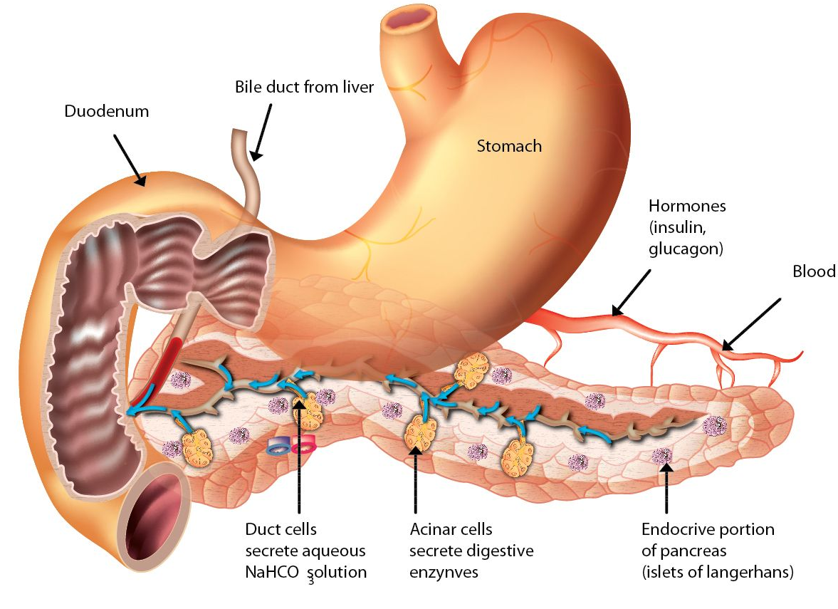
Pancreas
Location
Located in Epigastrium & Left upper quadrant (left hypochondriac) of abdomen behind the stomach. in front of spleen (from concavity of the duodenum to the hilum of spleen opposite the level of T12– L3 vertebrae).
12–15 cm ,6-10 inch in length and 60-100 gram in weight.
soft, lobulated elongated gland
The greater part is Retroperitoneal behind the lesser sac.
“J”-shaped or RETORT shaped
Lies across the posterior abdominal wall in a transverse/oblique directions at the transpyloric plane (L1 vertebra) (except the tail it lies at the level of T12)
has exocrine and endocrine functions.
Exocrine component
makes and secretes digestive enzymes into the intestine (Exocrine pancreas)
comprise more than 95% of the pancreatic mass
Endocrine component
makes and secretes hormones (insulin, glucagon, somatostatin)
control energy metabolism and storage throughout the body (Endocrine pancreas Islet's of Langerhans).
comprise 1-2% of pancreatic mass

Slide 4
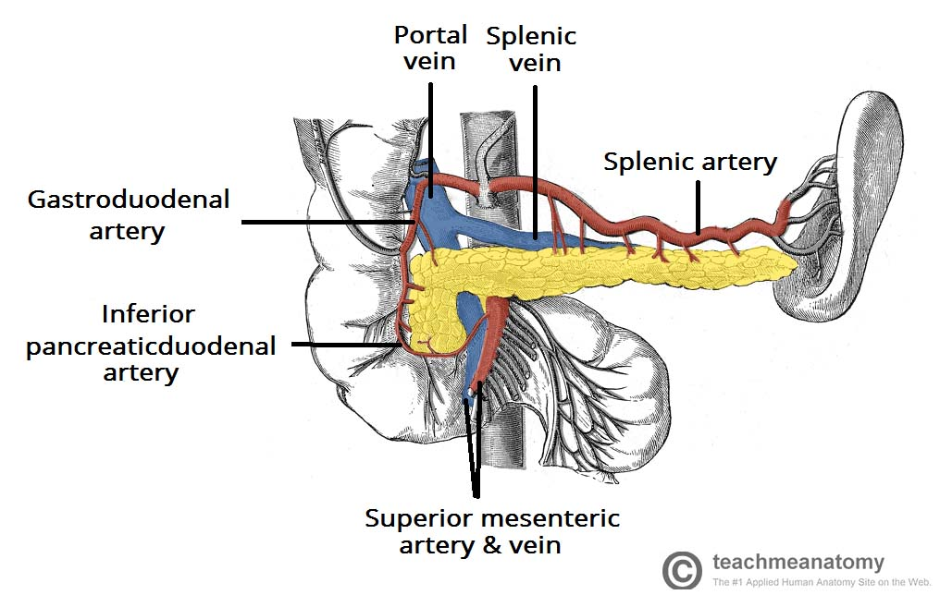
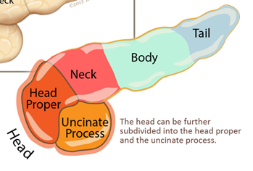
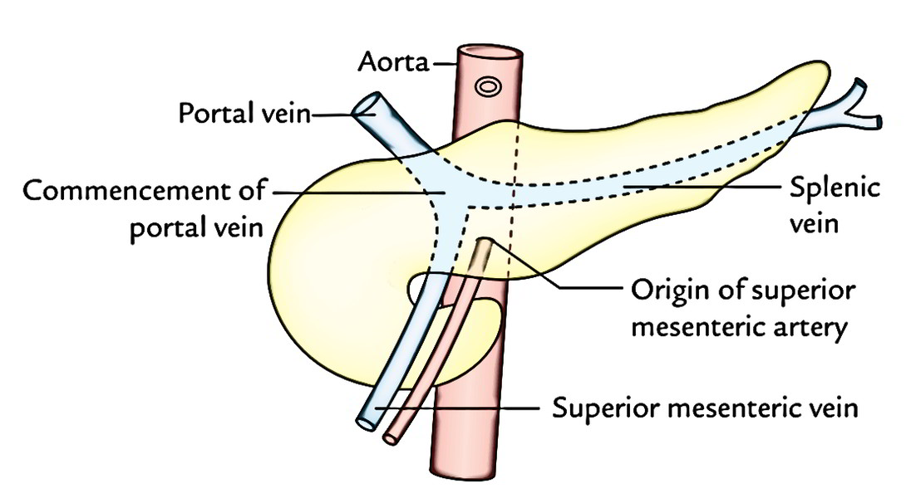
Pancreas Parts
1
Head
2
Neck
3
Body
4
Tail
Head
enlarged, disc-shaped right end of the pancreas
lies in the concavity of the C-shaped duodenal loop in front of the L2 vertebra.
Related to the 2nd and 3rd portions of the duodenum on the right & continues with the neck on the left.
Anterior surface is related from above downward to:
The gastroduodenal artery, Transverse colon, root of the transverse mesocolon & jejunum
Posterior surface is related to:
Inferior vena cava, left renal vein, bile duct & right crus of diaphragm
Includes uncinate process (part extending to the left behind the superior mesenteric vessels).
Uncinate process is related to:
anteriorly to superior mesenteric vessels
posteriorly to the abdominal aorta
CLINICAL ANATOMY: Carcinoma of the head of pancreas : common ,Compresses the bile duct leading to persistent obstructive jaundice May press the portal vein or may involve the stomach due to close vicinity of these structures to the head of pancreas
Neck
The constricted portion connecting the head & body.
narrow band of pancreatic tissue that lies in front of origin of superior mesenteric artery and the confluence of the portal vein (made of union of splenic & superior mesenteric veins)
Its antero-superior surface supports the pylorus of the stomach.
The superior mesenteric vessels emerge from its inferior border.

Slide 5
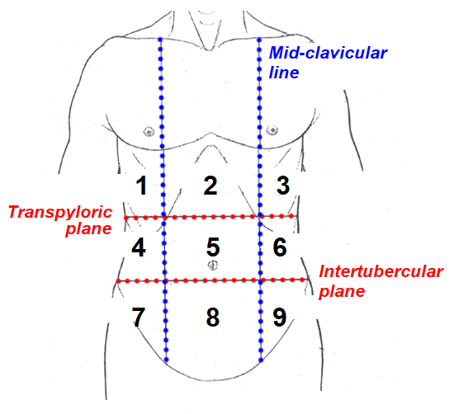
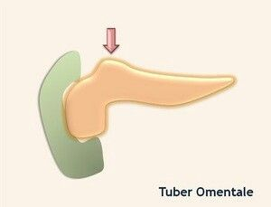
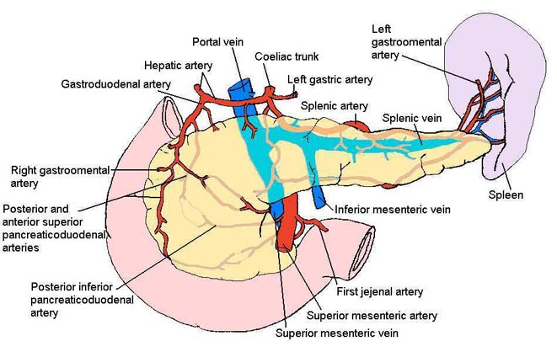
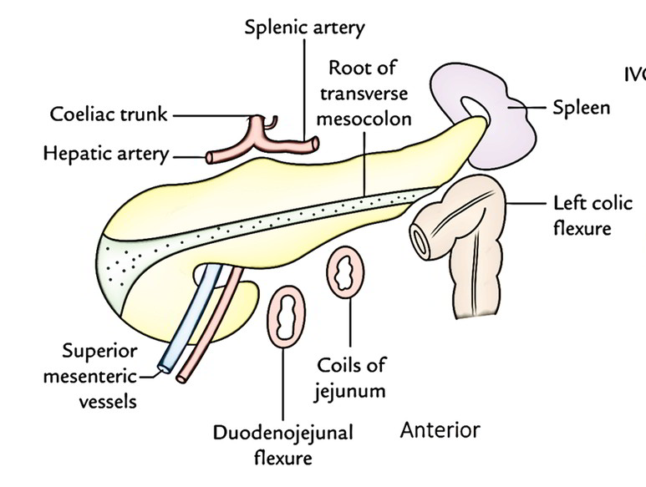
Pancreas Parts
1
Head
2
Neck
3
Body
4
Tail
Body
It runs upward and to the left.
lies in front of the vertebral column at or just below the transpyloric plane.
One process: Tuber omentale (a part of the body projects above the lesser curvature of the stomach and comes in contact with the lesser omentum across the lesser sac).
It is triangular in cross section.
The splenic vein is embedded in its posterior surface.
The splenic artery runs over its upper border
Tail
Narrow, short segment, ending at the splenic hilum.
It is mobile unlike the other major retroperitoneal parts of the gland
contains the largest number of islets of Langerhans
Lies in the splenicorenal (lienorenal) ligament (may get injured during splenectomy or nephrectomy), at the level of the T12 vertebra.
Anteriorly, related to splenic flexure of colon.

Slide 6
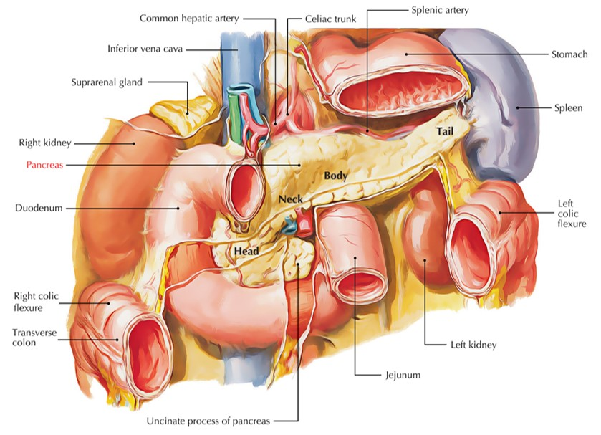
Pancreas relations
From Right to Left (from head to tail)
Bile duct.
portal vein
splenic veins.
inferior vena cava.
aorta.
origin of superior mesenteric artery.
Left psoas muscle.
left adrenal gland,
left renal vessels .
upper ⅓ of left kidney.
Hilum of the spleen.
Posterior relations (11)
Stomach separated by lesser sac.
Transverse colon.
transverse mesocolon.
Anterior relations (3)

Slide 7
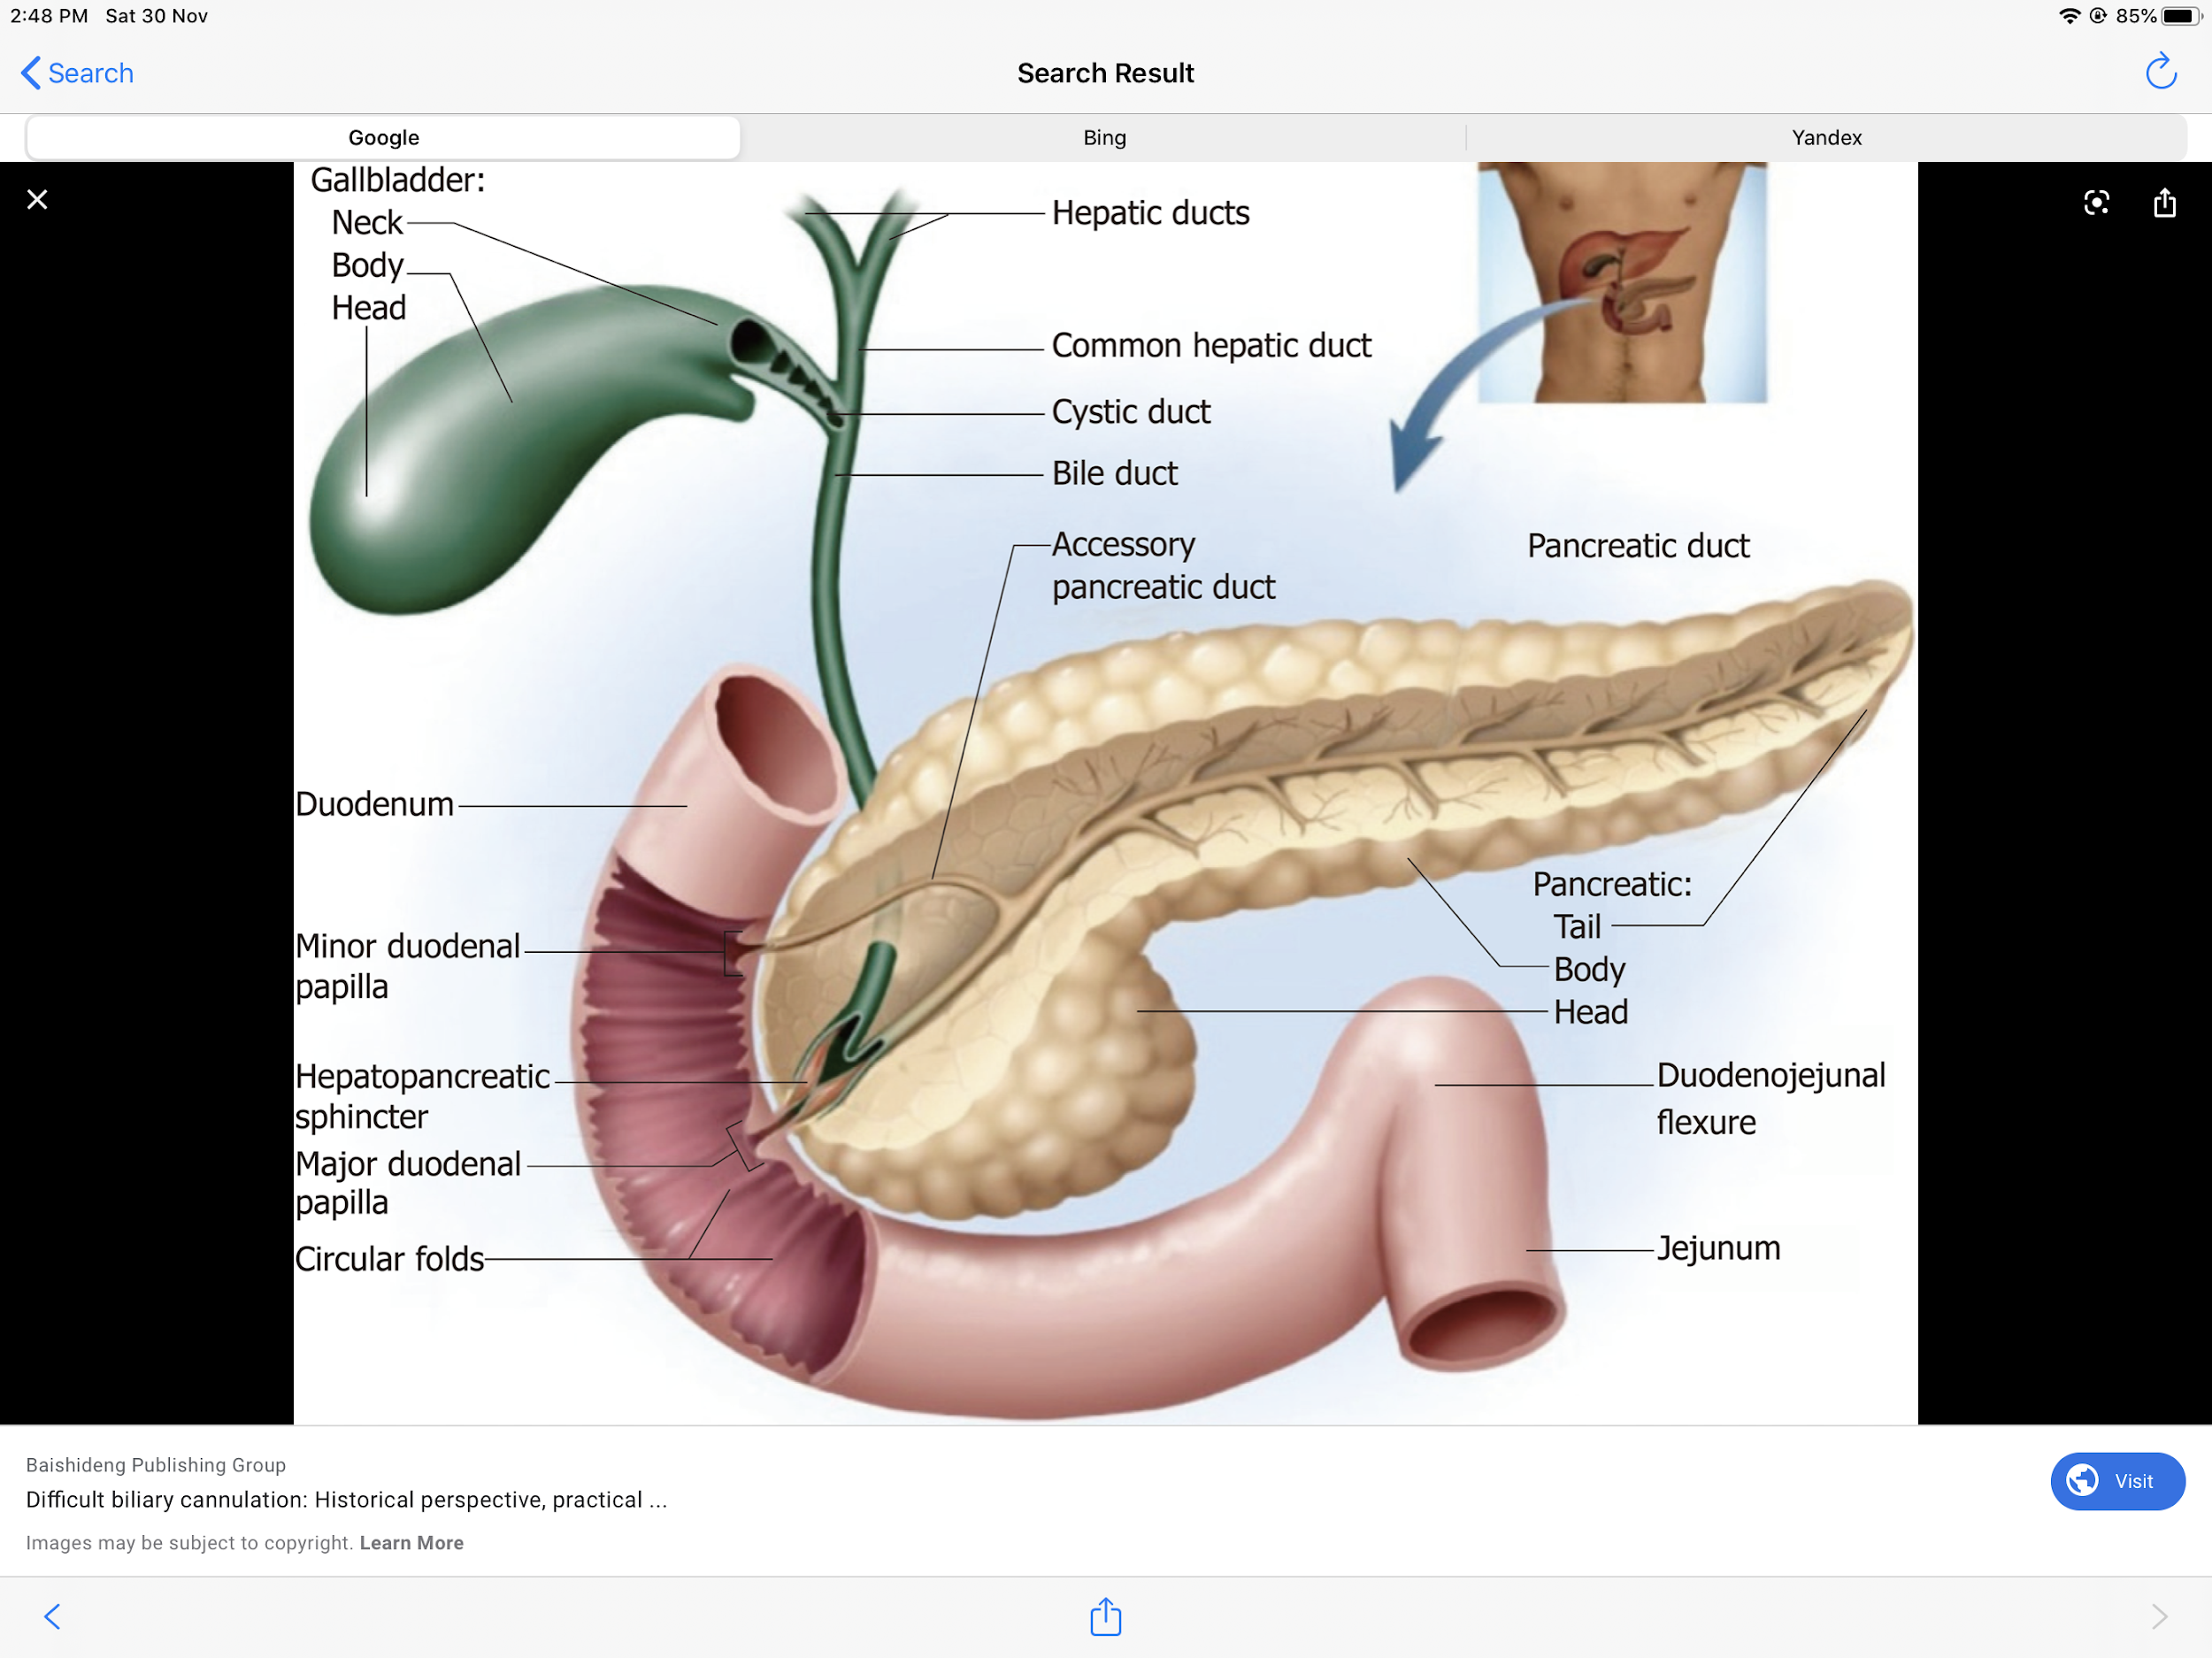
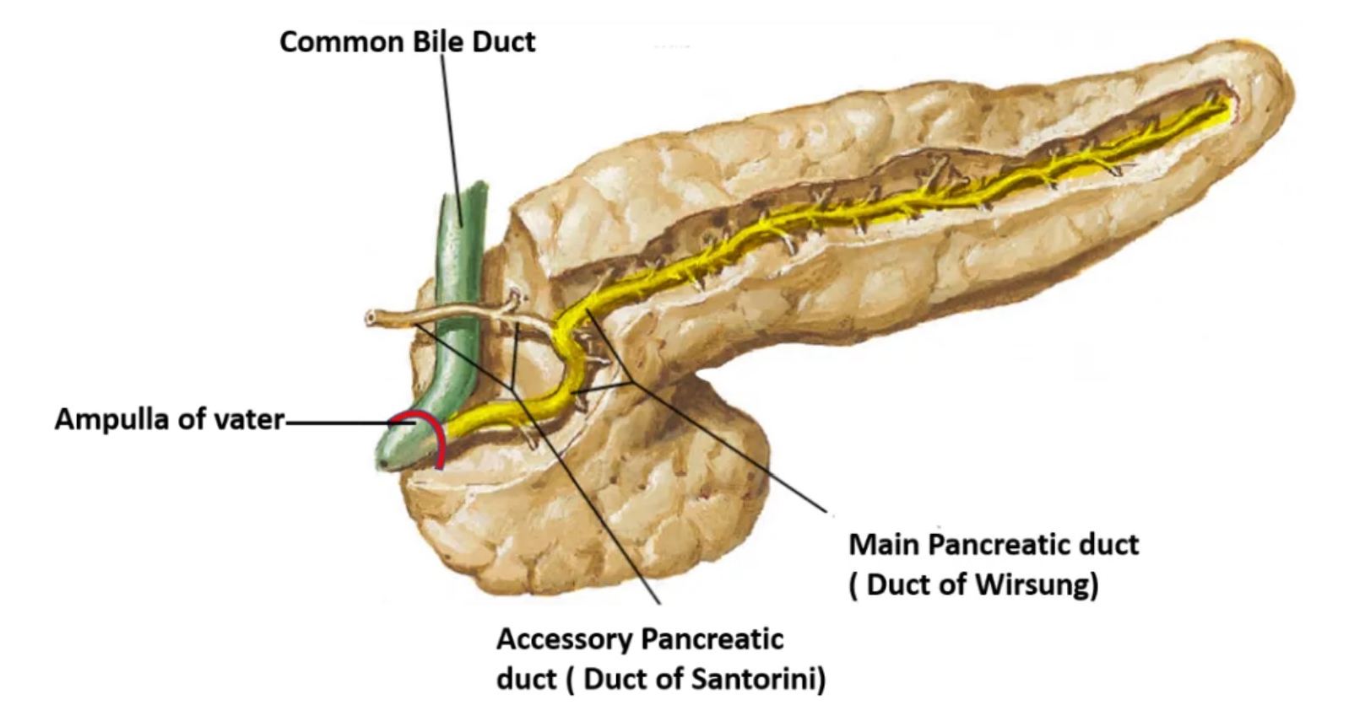
Pancreatic Ducts
2 ducts
Main duct (of Wirsung)
Accessory duct (of Santorini)
runs the entire length of pancreas beginning from the tail.
It receives many tributaries from tail, body, neck, inferior portion of head & uncinate process except upper portion of the head.
Joins common bile duct & together they open into a small hepatopancreatic ampulla (Ampulla of Vater) in 2nd part of the duodenal wall.
The ampulla opens into the lumen of the duodenum by means of a small Papilla, (Major duodenal papilla). 8-10 cm distal to the pylorus.
drains superior portion of the head.
It empties separately into 2nd portion of duodenum at (minor duodenal papilla). about 2–3 cm above the opening of main pancreatic duct (6–8 cm distal to pylorus).
CLINICAL ANATOMY : Acute pancreatitis
acute inflammation of the pancreas
Occurs due to obstruction of pancreatic duct, ingestion of alcohol, viral infections (mumps), or trauma
serious condition because activated pancreatic enzymes leak into the substance of pancreas and initiates the autodigestion of the gland
Clinically, it presents as very severe pain in the epigastric region radiating to the back, fever, nausea, and vomiting

Slide 8
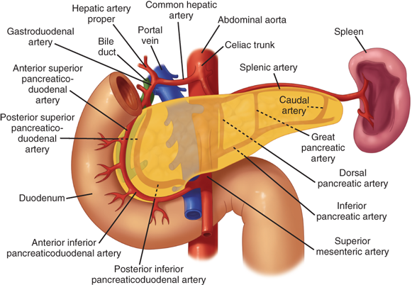
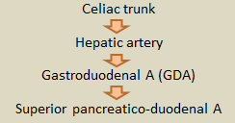
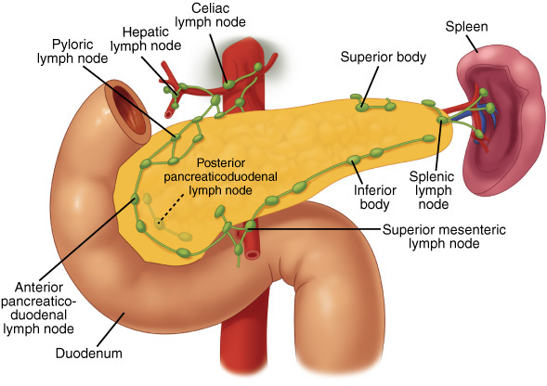
Pancreas supply
Arteries
Veins
Head & neck
Head & neck
Supplied by branches from:
Celiac trunk through hepatic artery through gastroduodenal artery (GDA) through Superior pancreaticoduodenal artery
Superior mesenteric artery through Inferior pancreaticoduodenal artery
Drained by: anterior and posterior venous arcades that form the superior & inferior pancreaticoduodenal veins which follow the corresponding arteries.
Body & tail
Body & tail
Drained by splenic vein, which is a tributary of portal vein
Splenic artery (main artery) through 8-10 branches
Innervation
Lymphatic Drainage
Sympathetic
Rich network that drains into:
pyloric nodes
hepatic nodes
splenic nodes
Ultimately the efferent vessels drain into:
celiac lymph nodes
superior mesenteric lymph nodes.
from the thoracic splanchnic nerves.
have a predominantly inhibitory effect
Parasympathetic
from the vagus.
stimulate both exocrine and endocrine secretions

Slide 9
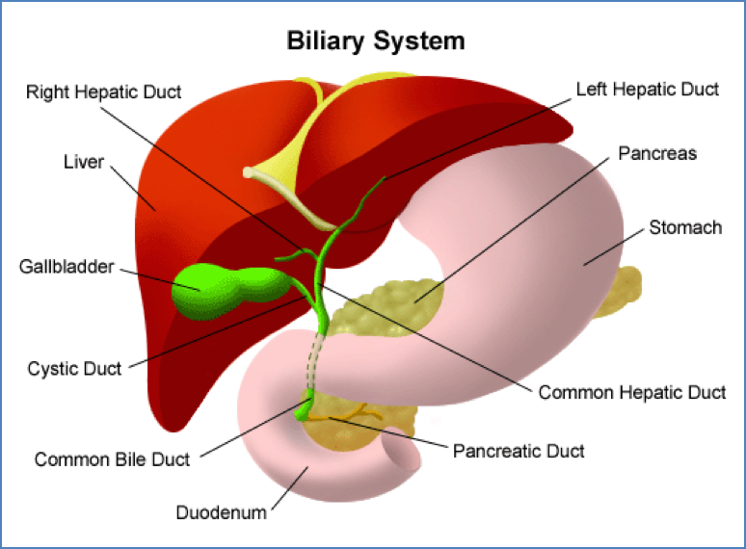
Biliary system
It consists of the ducts and organs (bile ducts, liver & gallbladder)
involved in the production, storage & transportation of bile
Bile is secreted by the liver cells at a constant rate of about 40 ml per hour.
When digestion is not taking place, the sphincter of Oddi remains closed and the bile is stored and concentrated in the gallbladder; later, it is delivered to the duodenum.
Bile duct
Consists of:
is about 1.5 in. (4 cm) long • descends within the free margin of the lesser omentum.
is joined on the right side by the cystic duct from the gallbladder to form the common bile duct
The smallest tributaries of the bile ducts; situated in the portal canals of the liver Receives bile from the hepatocytes
5
Common hepatic duct
1
Bile canaliculi
join one another to form progressively larger ducts and, eventually, at the porta hepatis, form the right and left hepatic ducts
2
Interlobular ducts
6
Cystic duct
3
Intrahepatic ducts
7
Common bile duct (Bile duct)
right drains the right lobe of the liver
left drains the left lobe, the caudate lobe, & quadrate lobe.
After a short course, the hepatic ducts unite to form the common hepatic duct
4
Right and left hepatic ducts

Slide 10
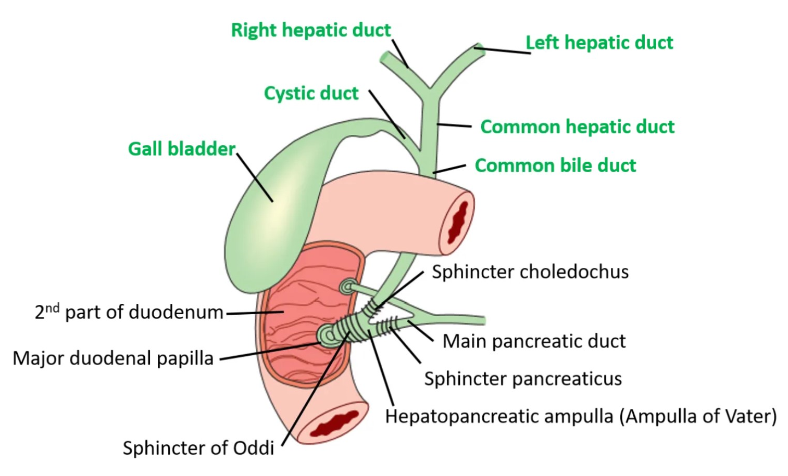
Biliary system
6
Cystic duct
The cystic duct is about 1.5 in. (3.8 cm) long
connects the neck of the gallbladder to the common hepatic duct to form the bile duct.
It is usually somewhat S-shaped and descends for a variable distance in the right free margin of the lesser omentum
The mucous membrane of the cystic duct is raised to form a spiral fold that is continuous with a similar fold in the neck of the gallbladder.
The fold is commonly known as the “spiral valve.” which is keep the lumen constantly open.
7
Common bile duct (Bile duct)
It is about 3 inches (8 cm) long.
Course:
First it lies in the right free margin of the lesser omentum.
Then it runs behind the first part of the duodenum.
Lastly it lies in a groove on the posterior surface of the head of the pancreas. (cancer of the head of the pancreas will press on the bile duct which results in blockage of bile passage through it, bile will go back in the opposite direction causing Jaundice) Here, the bile duct comes into contact with the main pancreatic duct
ends below by piercing the medial wall of the second part of the duodenum about halfway down its length
It is usually joined by the main pancreatic duct, and together they open into a small ampulla in the duodenal wall, called the hepatopancreatic ampulla (ampulla of Vater).
The ampulla opens into the lumen of the duodenum by means of a small papilla, the major duodenal papilla.
The terminal parts of both ducts and the ampulla are surrounded by circular muscle, known as the sphincter of the hepatopancreatic ampulla (sphincter of Oddi).
Occasionally, the bile and pancreatic ducts open separately into the duodenum.
Passage of the bile:
In storage : common hepatic duct to cystic duct then gallbladder.
After fatty meal: gallbladder to cystic duct then bile duct

Slide 11
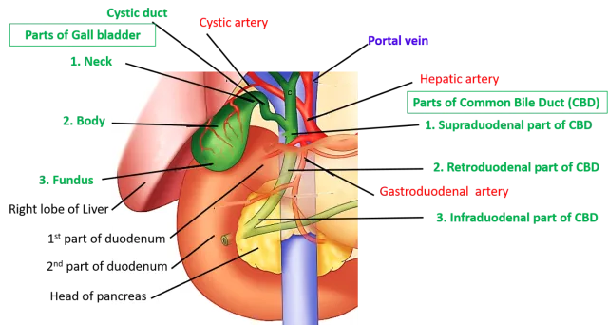
Biliary system
Gallbladder
A pear-shaped sac lying on the undersurface of the liver.
It has a capacity of 30 to 50 ml , it stores bile, which is concentrated by absorbing water.
It’s divided into:
Fundus | Body | Neck
is rounded and projects below the inferior margin of the liver, where it comes in contact with the anterior abdominal wall at the level of the tip of the ninth right costal cartilage. (as surface anatomy) | Is lie in contact with the visceral surface of the liver and is directed upward, backward, and to the left. | It becomes continuous with the cystic duct, which turns into the lesser omentum, joins the common hepatic duct, to form the bile duct
The peritoneum completely surrounds the fundus of the gallbladder and binds the body and neck to the visceral surface of the liver.
Relations
Function
Anteriorly | Posteriorly | concentrates & stores bile selectively absorbs bile salts keeps the bile acid excretes cholesterol secretes mucus. To aid in these functions, the mucous membrane is thrown into permanent folds that unite with each other, giving the surface a honeycombed appearance. When the bile is secreted by the liver cells, it contains water , salts, and acids, so after it arrives to the gallbladder. which is absorbs the water and salts, and keeps the acids unchanged. At the same time its wall secretes mucus and cholesterol. The longer the bile stays in the gallbladder the more it secretes mucus and cholesterol (which may lead to the formation of stones)
anterior abdominal wall and the inferior surface of the liver. | The transverse colon and the first and second parts of the duodenum
1
2
3
4
5

Slide 12
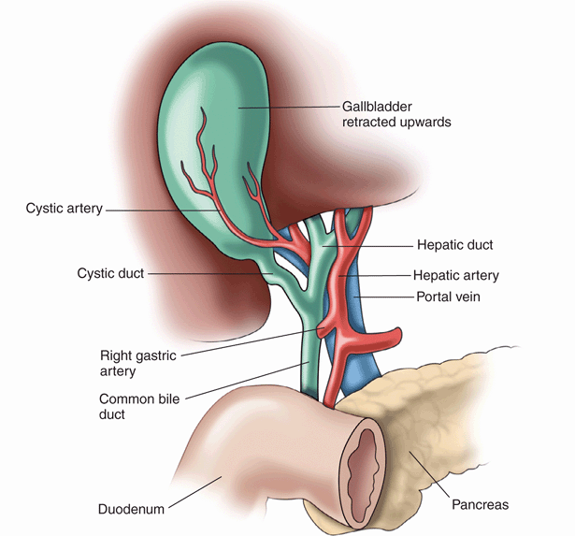
Biliary system
Gallbladder
Blood
supply
venous
drainage
Nerve supply
Cystic artery, branch of the right hepatic artery.
The cystic vein drains directly into the portal vein.
Several small arteries and veins run between the liver and gallbladder.
Sympathetic and parasympathetic vagal fibers form the celiac plexus.
The gallbladder contracts in response to the hormone cholecystokinin (CCK), which is produced by the mucous membrane of the duodenum on the arrival of fatty food from the stomach.
Lymphatic Drainage
The lymph drains into a cystic lymph node situated near the neck of the gallbladder.
From here, the lymph vessels pass to the hepatic nodes along the course of the hepatic artery and then to the celiac nodes.

Slide 13
QUIZ
Q1 | Q2 | Q3 | Q4 | Q5 | Q6 | Q7 | Q8
B | C | A | D | A | A | A | B
Q1: The tail of the pancreas lies at the level of:
A. T10
B. T12
C. L1
D. L2
Q2: Which of the following has an anterior relation to the pancreas
A. Splenic vein B. Bile duct
C. Transverse mesocolon D. Left psoas muscle
Q3: which one of the following lymph nodes the pancreatic vessels ultimately drain into:
A. Superior mesenteric
B. Hepatic
C. Splenic
D. Pyloric
Q4: Which one of the following is true about the head of the pancreas:
A. Its antero-superior surface supports the pylorus of the stomach
B. It is triangular in cross section
C. Anteriorly, related to splenic flexure of colon
D. Includes uncinate process
Q5: Anterior abdominal wall is in contact with fundus of gallbladder at level of ?
A. the Tip of the Right Ninth costal cartilage.
B. the Tip of the Right Eighth costal cartilage.
C. the Tip of the Right Second costal cartilage.
D. the Tip of the Left Ninth costal cartilage.
Q6: the wall of gallbladder secretes: A. Mucus B. Water C. Acids D. C&B
Q7: The smallest interlobular tributaries of the bile ducts are receive from?
A.bile canaliculi.
B. Intrahepatic ducts
C. Common bile duct
D. None of the above
Q8: the common bile duct comes into contact with:
A. Common hepatic duct
B. Main Pancreatic duct
C. Cystic duct
D. Right hepatic duct

Slide 14
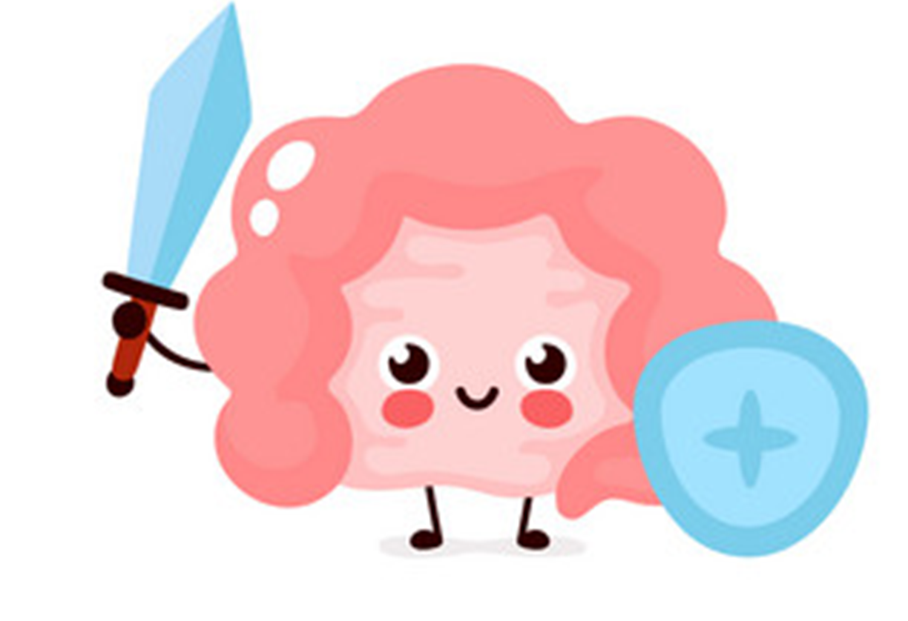
Members board
Team leaders
Abdulrahman Shadid
Ateen Almutairi
Boys team:
Mohammed Al-huqbani
Salman Alagla
Ziyad Al-jofan
Ali Aldawood
Khalid Nagshabandi
Sameh nuser
Abdullah Basamh
Alwaleed Alsaleh
Mohaned Makkawi
Abdullah Alghamdi
Girls team :
Ajeed Al Rashoud
‏Taif Alotaibi
‏Noura Al Turki
‏Amirah Al-Zahrani
‏Alhanouf Al-haluli
‏Sara Al-Abdulkarem
‏Renad Al Haqbani
‏Nouf Al Humaidhi
Jude Al Khalifah
Nouf Al Hussaini
Danah Al Halees
Rema Al Mutawa
Maha Al Nahdi
Razan Al zohaifi
Ghalia Alnufaei
Contact us:
Editing file

