Slide 1
The Omentum
Gastrointestinal block-Anatomy-Lecture 5
Editing file

Slide 2
Objectives
Color guide :
Only in boys slides in Green
Only in girls slides in Purple
important in Red
Notes in Grey
At the end of the lecture, students should be able to:
Brief knowledge about peritoneum as a thin serous membrane and its main parts; parietal and visceral.
The peritonial cavity and its parts the greater sac and the lesser sac (Omental bursa).
The omentum, as one of the peritonial folds
The greater omentum ,its extends, and contents.
The lesser omentum, its boundaries, and contents
The Omental bursa, its boundaries.
The Epiploic foramen, its boundaries.

Slide 3
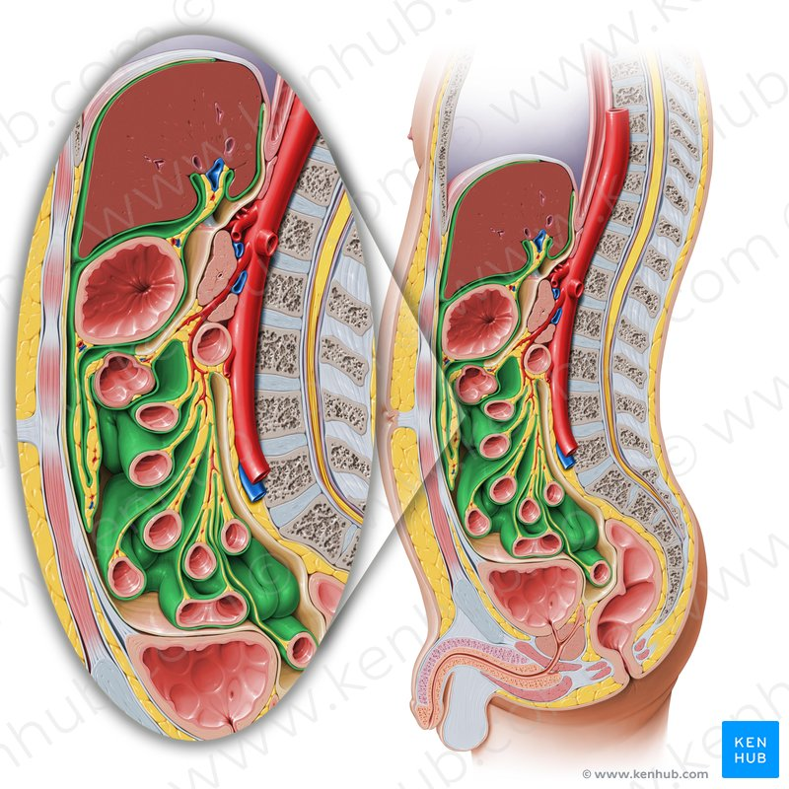
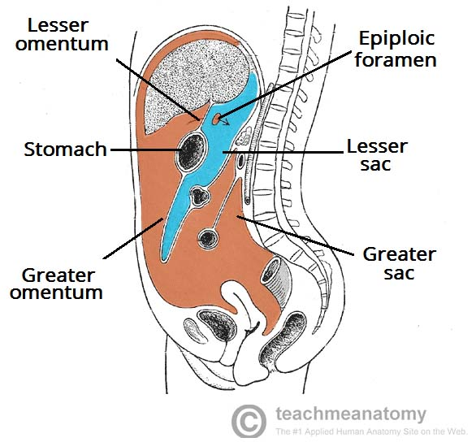
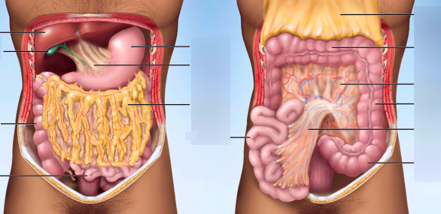
The Peritoneum
It is a thin serous membrane
Lining the wall of the abdominal and pelvic cavities, (the parietal peritoneum).
Covering the existing organs, (the visceral peritoneum).
The potential space between the two layers is the peritoneal cavity.
The peritoneal cavity is the largest one in the body.
Divisions of the peritoneal cavity :
Greater sac:extends from diaphragm down to the pelvis.
Lesser sac: lies behind the stomach.
Both cavities are interconnected through the epiploic foramen.
1
2
3
4
In male : the peritoneum is a closed sac .
In female : the sac is not completely closed because it communicates with the exterior through the uterine tubes, uterus and vagina.
T types of peritoneal folds :
Omenta.
Mesenteries.
peritoneal Ligaments.
all permit blood, lymph vessels, and nerves to reach the viscera
Omenta Mesenteries

Slide 4
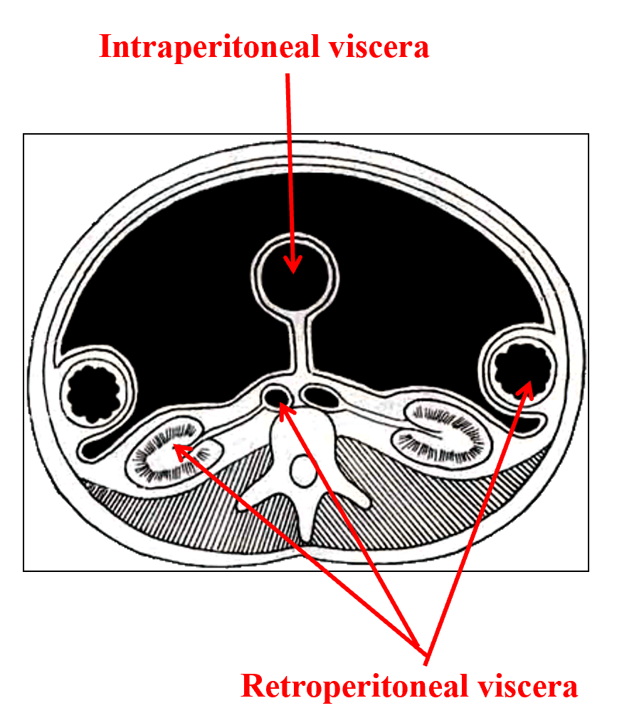
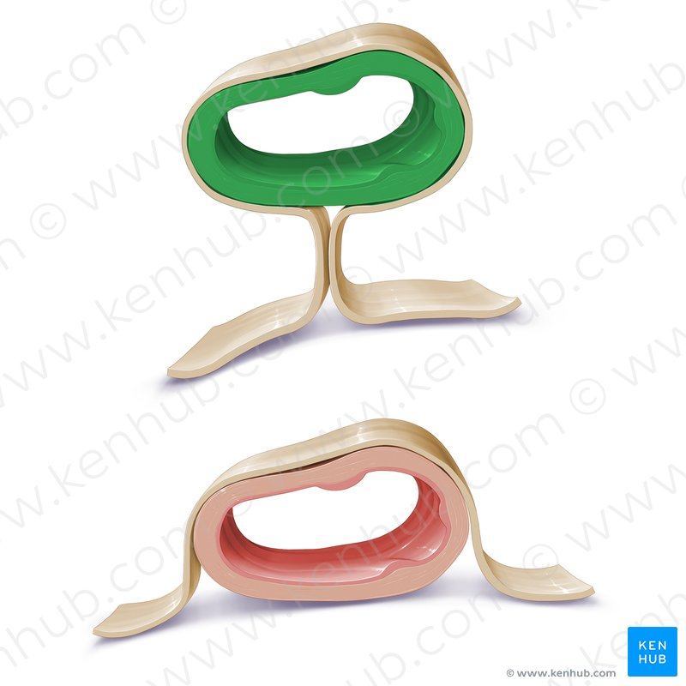
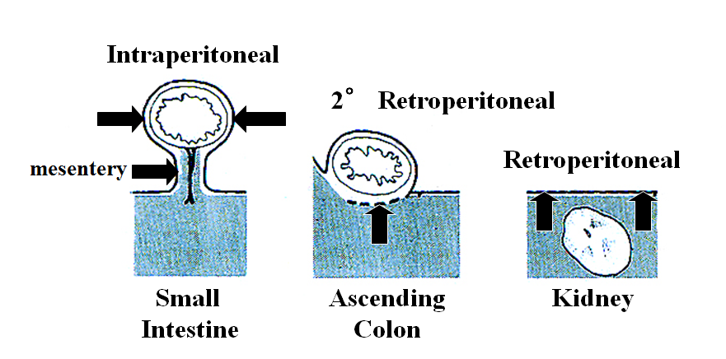
Intraperitoneal and retroperitoneal structure:
describe the relationship between various organs and their peritoneal covering.
Intraperitoneal | Retroperitoneal
Is entirely surrounded by the visceral peritoneum and has a supporting mesentery : Stomach 1st Part Of Duodenum Liver Gallbladder Spleen Jejunum Ileum Transverse Colon Sigmoid Colon Uterus Ovaries | Structure that lies behind the parietal peritoneum or partially covered by the peritoneum and has no supporting mesentery. Primary retroperitoneal organs: Aorta Inferior Vena Cava Kidneys Suprarenal Glands Urinary Bladder Vagina Rectum. Secondary retroperitoneal organs: develop in mesenteries, but get pushed against the body wall (parietal peritoneum) during growth so that only half of their surface is covered by peritoneum : Pancreas Duodenum Ascending Colon Descending Colon.
2

Slide 5
Omenta
Two layered fold of peritoneum connecting the stomach to another viscus.
 | The lesser omentum | The greater omentum The largest peritoneal fold, with cribriform appearance,
Attaches | the lesser curvature of the stomach to the liver. | the greater curvature of the stomach to the transverse colon.
Course | (1) It is continuous with the two layers of peritoneum which cover the anterior & posterior surfaces of stomach and 1st part of the duodenum. (2) Ascend as a double fold to the porta hepatis of liver, and (3) fissure for ligamentum venosum | It consists of a double sheet of peritoneum, folded on itself so that it is made up of four layers (2 anterior ,2 posterior). (1) The two layers which descend from the greater curve of the stomach and commencement of the duodenum, pass downward in front of the small intestines, then (2)turn upon themselves, and (3) ascend to the transverse colon, where they separate and enclose it.
Left Border | To the left of porta hepatis it is carried to the diaphragm. | continuous with the gastrosplenic ligament.
Right Border | is a free margin; constitutes the anterior boundary of the epiploic foramen | extends as far as the commencement of the duodenum.
Content | Close to the right free margin, are the hepatic artery, common bile duct, portal vein, lymphatics, and hepatic plexus At the attachment to the stomach, run the right and left gastric vessels. | Adipose tissue. Right & left gastroepiploic vessels and The anastomosis between them Lymph nodes
3
2
1
1
2
3
The lesser omentum
right border
left border
The greater omentum
right border
left border
L
L
R
R

Slide 6
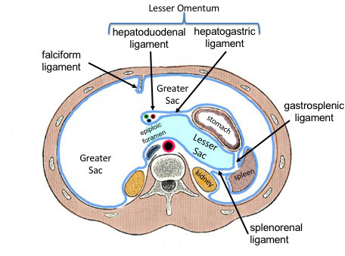
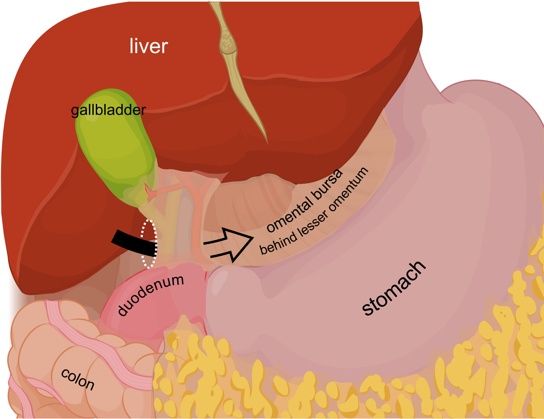
Omental bursa (lesser sac)
It is a part of the peritoneal cavity behind the stomach. it Boundaries :
Anterior wall
Posterior wall
*from above to downward
*from below upward
caudate lobe of the liver
posterior two layers of the greater omentum
lesser omentum
transverse colon
ascending layer of the transverse mesocolon
back of the stomach
upper surface of the pancreas
anterior two layers of the greater omentum.
upper end of the left kidney suprarenal gland
Epiploic foramen: it is the communication between the greater and lesser sacs .
In front | Behind | Above (roof) | Below (floor)
free border of the lesser omentum, with its contents between its two layers: hepatic artery common bile duct portal vein | peritoneum covering the inferior vena cava. | peritoneum on the caudate process of the liver. | peritoneum covering of the commencement of the duodenum hepatic artery, before ascending between the two layers of the lesser omentum.

Slide 7
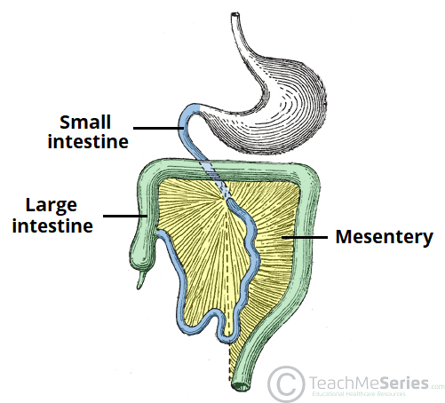
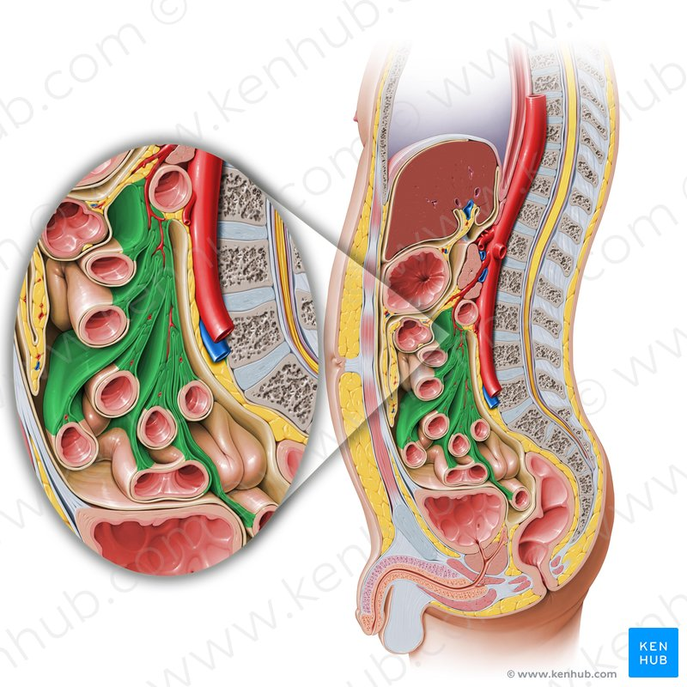
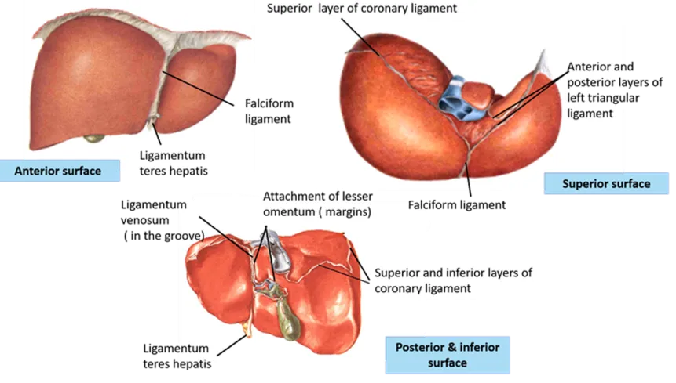
Mesentery and Ligaments
Mesentery
Ligaments
Two-layered folds of peritoneum that attach solid viscera to the abdominal wall and diaphragm
its doubling up of visceral peritoneum and connecting viscera to the viscera or the abdominal wall
Ligaments of liver:
Two-layered fold of peritoneum suspends the small intestine from the posterior abdominal wall
its doubling up of visceral peritoneum and wrapping around an organ, then attaches it to posterior abdominal
Broad and a fan-shaped
Intestinal border: folded, 7cm long
Root of mesentery:
15 cm long
Directed obliquely from duodenojejunal flexure at the level of left side of L2 to the ileocecal junction in the right iliac fossa at the level of right sacroiliac joint.
1
Falciform of liver
2
Coronary ligament
3
Left and right triangular ligaments
4
Ligamentum teres

Slide 8
Nerve supply of peritoneum
The parietal peritoneum lining the anterior abdominal wall is supplied by:
Thoracic nerves T7-12 (Lower 6 intercostal nerves) and L 1 (iliohypogastric nerve)
The central part of the diaphragmatic peritoneum is supplied by
phrenic nerves, C3,4,and 5
Peripheral part of the diaphragmatic peritoneum supplied by
intercostal nerves T7-11
pelvic wall by
obturator nerve L2,3,and 4
Clinical point :
it sensitive to: pain.temperature,touch and pressure.
Abdominal pain originating from the parietal peritoneum is therefore of the somatic type, it is usually severe, and can be accurately localized
Supplied by autonomic afferent nerves that supply the viscera or traveling in the mesenteries.
Clinical point :
its sensitive only to stretch and tearing.
The visceral peritoneum, including the mesenteries, It is due to Stretch caused by over distension of a viscus and pulling on a mesentery that gives rise to the sensation of pain.
leading to poorly localized, poorly characterized pain. (dull, cramping, aching)
Peritoneal Dialysis:
Because the peritoneum is a semi permeable membrane :
It allows transfer of substances across itself. It has been made use of in patients with acute renal insufficiency.
Visceral peritoneum
parietal peritoneum

Slide 9
QUIZ
Q1 | Q2 | Q3 | Q4 | Q5 | Q6 | Q7 | Q8
A | A | A | C | D | C | A | B
Q1: Which one of the following arteries pass along the free margin of the lesser omentum?
A. Hepatic
B. Gastroduodenal
C. Left gastric
D. Right gastric
Q2: : The peritoneal cavity behind the stomach is A. Lesser sac B. Greater sac
C. Greater omentum D. Lesser omentum
Q3: Which artery lies between the 2 fold of greater omentum?
A. Left gastroepiploic artery
B. gastroduodenal artery
C. cystic artery
D. Left gastric artery
Q4: Which of the following structures lies anteriorly to the omental bursa?
A. anterior of the stomach
B. Upper right border of the kidney
C. caudate lobe of the liver
D. Pancreas
Q5: Which one of the following parts of large intestine has a mesentery?
A. Ascending colon
B. Descending colon
C. Rectum
D. Sigmoid
Q6: Which one is completely covered with peritoneum? A. Descending colon B. Ascending colon C. Transverse colon D. Rectum
Q7: Which one of the following is the anterior relation of the epiploic foramen?
A. Lesser omentum
B. Greater omentum
C. Greater sac
D. Lesser sac
Q8: the left Border of the greater omentum ?
A. to the left of porta hepatis it is carried to the diaphragm.
B. continuous with the gastrosplenic ligament.
C. is a free margin; constitutes the anterior boundary of the epiploic foramen
D. extends as far as the commencement of the duodenum.

Slide 10
Members board
Team leaders
Abdulrahman Shadid
Ateen Almutairi
Boys team:
Mohammed Al-huqbani
Salman Alagla
Ziyad Al-jofan
Ali Aldawood
Khalid Nagshabandi
Sameh nuser
Abdullah Basamh
Alwaleed Alsaleh
Mohaned Makkawi
Abdullah Alghamdi
Girls team :
Ajeed Al Rashoud
‏Taif Alotaibi
‏Noura Al Turki
‏Amirah Al-Zahrani
‏Alhanouf Al-haluli
‏Sara Al-Abdulkarem
‏Renad Al Haqbani
‏Nouf Al Humaidhi
Jude Al Khalifah
Nouf Al Hussaini
Danah Al Halees
Rema Al Mutawa
Maha Al Nahdi
Razan Al zohaifi
Ghalia Alnufaei
Contact us:
Editing file

