Slide 1
Small & Large Intestine
Gastrointestinal block-Anatomy-Lecture 6,7
Editing file

Slide 2
Objectives
Color guide :
Only in boys slides in Green
Only in girls slides in Purple
important in Red
Notes in Grey
At the end of the lecture, students should be able to:
List the different parts of small intestine.
Describe the anatomy of duodenum, jejunum & ileum regarding:
(the shape, length, site of beginning & termination, peritoneal covering, arterial supply & lymphatic drainage)
Differentiate between each part of duodenum regarding the length, level & relations.
Differentiate between the jejunum & ileum regarding the characteristic anatomical features of each of them.
List the different parts of large intestine.
List the characteristic features of colon.
Describe the anatomy of different parts of large intestine regarding:
(the surface anatomy, peritoneal covering, relations, arterial & nerve supply)

Slide 3
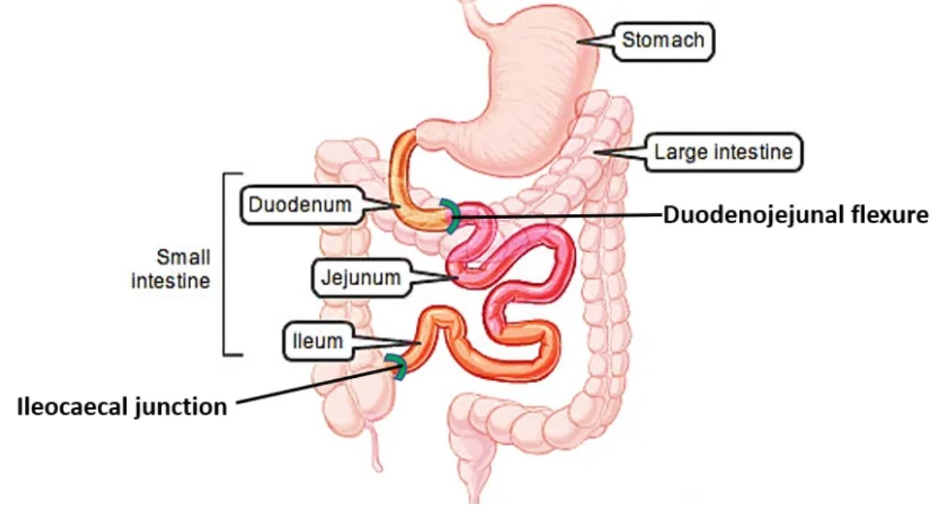
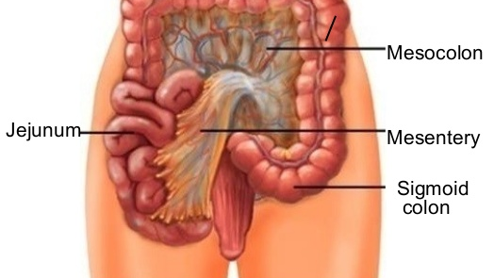
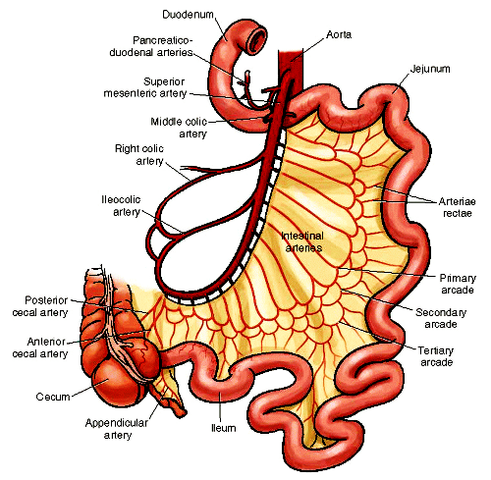
Small intestine
The small intestine divided into :
Parts | Fixed Part (No Mesentery): Duodenum* | Free (Movable) Part (With Mesentery): Jejunum & Ileum
Shape | C-shaped loop | coiled tube
Length | 10 inches | 6 meters (20 feet)
Beginning | At pyloro-duodenal junction | at duodeno-jejunal flexure
Termination | At duodeno-jejunal flexure | at ileo-ceacal flexure
Peritoneal Covering | Retroperitoneal | mesentery of small intestine
Divisions | 4 parts | ---------
Embryological origin | Foregut (above bile duct opening in 2nd part )& Midgut (below bile duct opening in 2nd part) So 2nd part has double origin and double supply | Midgut
Arterial Supply | Coeliac (artery of foregut) Superior Mesenteric (artery of midgut) | Superior mesenteric
Lymphatic Drainage | Coeliac & Superior Mesenteric | Superior mesenteric
Transverse Colon separates the stomach/liver from the jejunum/ileum
* 1st inch of 1st part has an omentum with the stomach

Slide 4
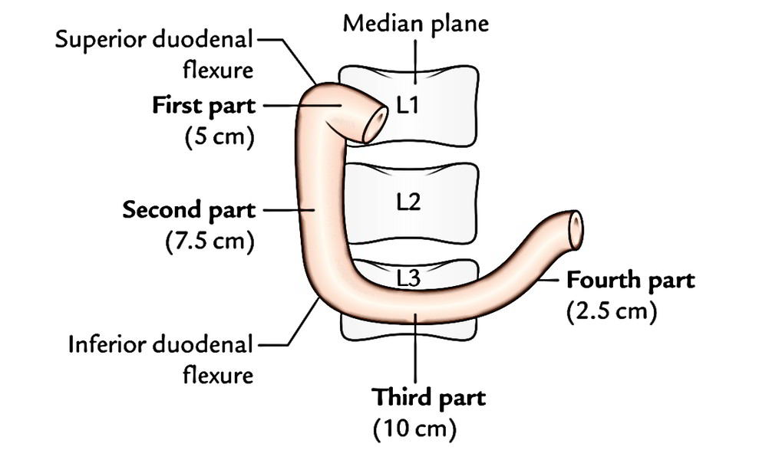
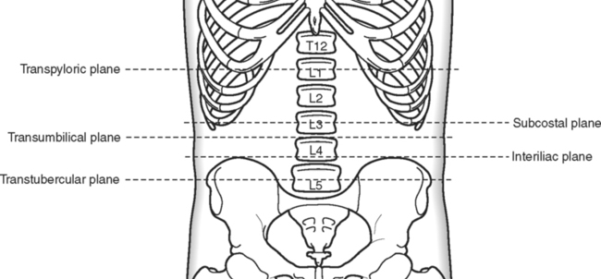
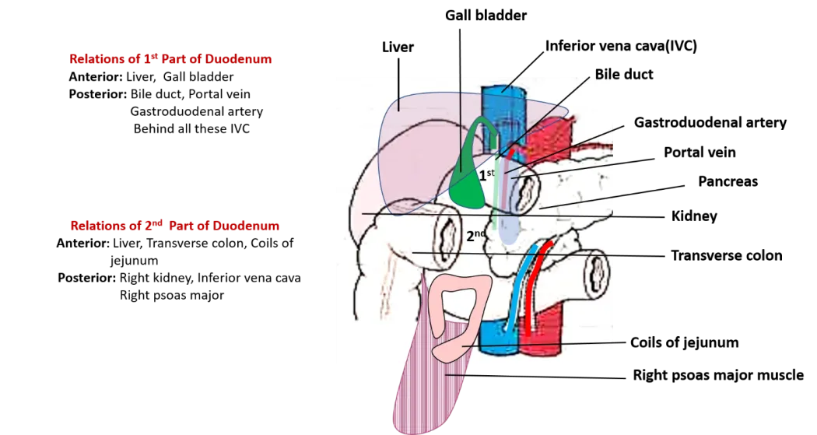
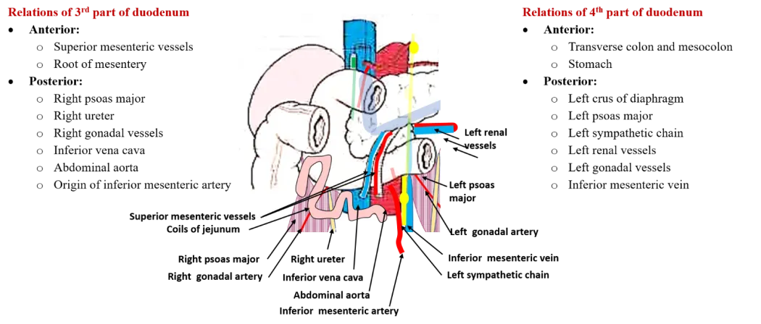
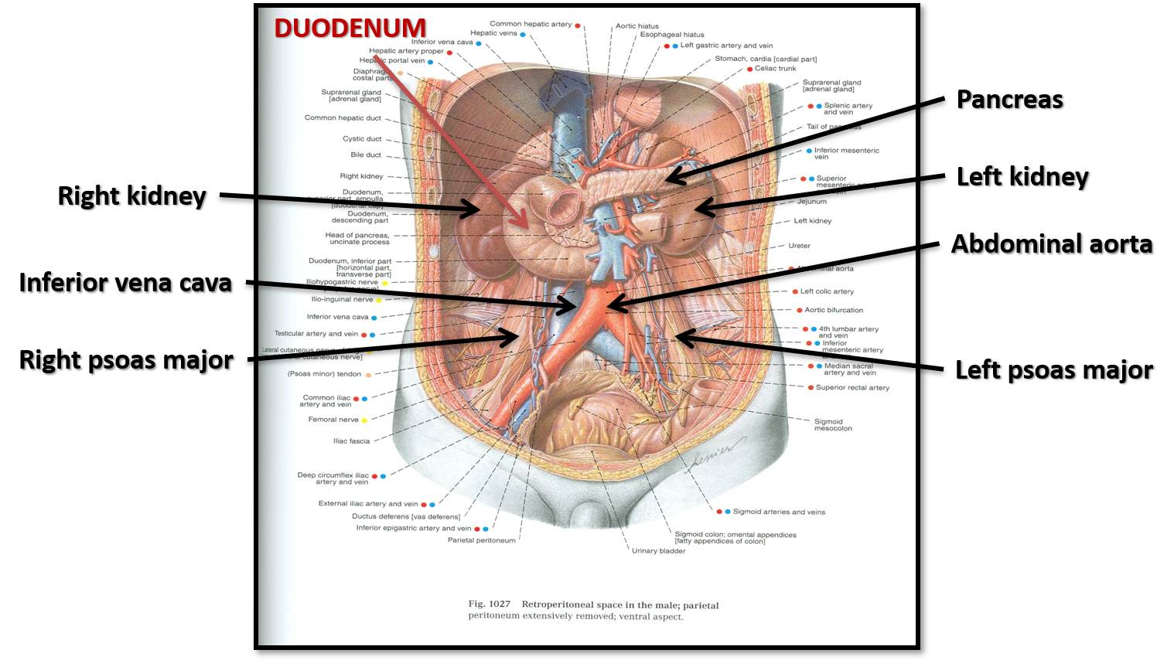
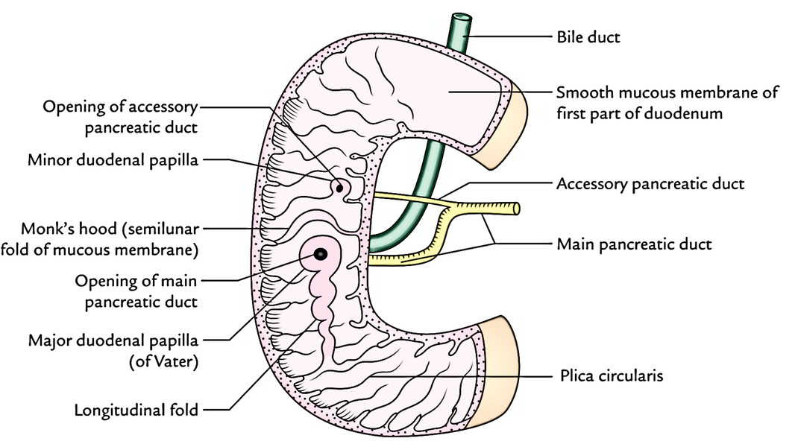
Duodenum parts
Part | 1st Part ( Superior ) | 2nd Part (Descending) | 3rd Part (Horizontal) | 4th Part (Ascending)
Length | 2 inches | 3 inches | 4 inches | 1 inch
Level | L1 (Transpyloric Plane) | Descends from L1 to L3 | L3 (Subcostal Plane) | Ascends from L3 to L2
Anterior Relations | Liver | 1) Liver 2) Transverse Colon 3) Small Intestine | 1) Small intestine 2) Superior mesenteric vessels | Small intestine
Posterior Relations | 1) Bile duct 2) Gastroduodenal artery* 3) Portal Vein 4) Neck of pancreas | Right Kidney | 1) Right psoas major 2) Inferior vena cava 3) Abdominal aorta 4) Inferior mesenteric vessels | Left psoas major
Medial Relations | - | head of Pancreas | - | -
Lateral Relations | - | Right Colic Flexure | - | -
1
4
2
3
Opening of accessory pancreatic duct One inch higher), on summit of minor duodenal papilla
Common opening of bile duct & main pancreatic duct On summit of major duodenal papilla (vater) the bile duct could be obstructed in case of head of pancreas carcinoma
Openings of the 2nd part
*if there is an ulcer in the duodenum, Gastroduodenal artery will be the source of bleeding

Slide 5
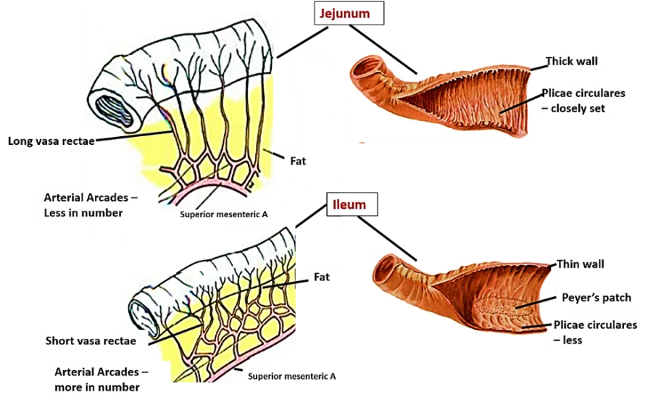
Comparison Between Jejunum & Ileum
 | Jejunum | Ileum
Length | Shorter (Proximal 2/5) | Longer (Distal 3/5)
Diameter | Wider | Narrower
Wall | Thicker (More Plicae Circulares) | Thinner (Less Plica Circulares)
Appearance | Dark Red (More Vascular) | Light Red (Less Vascular)
Vessels | Less Arcades (Long Terminal Branches) | More Arcades (Short Terminal Branches)
Mesenteric Fat | Small Amount away from Intestinal Border | Large Amount Near Intestinal Border
Lymphoid Tissue | Few Aggregations | Numerous Aggregations (Peyer’s Patches)
The absorption happen in Jejunum more, so it need to be wider and thicker to increase the surface area of absorption, also it need to be more vascular to facilitate moving of substance to the circulation
While Ileum is longer and thinner, so it need more fat in around to support it and this fat need supply, so it will be hard for the blood to reach the illem so the vessels need to be More Arcades to penetrate the fat and supply it. As result of that the blood that reach the ileum will be less so its less vascular

Slide 6
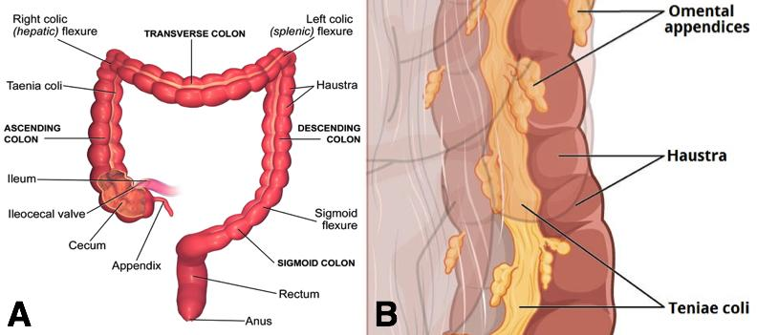
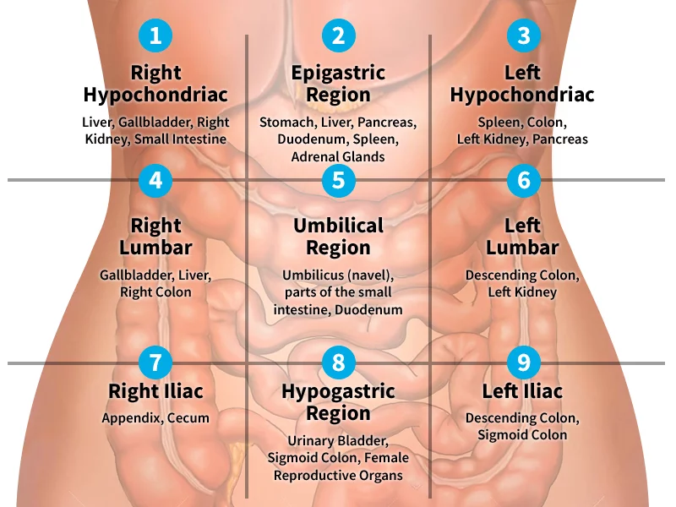
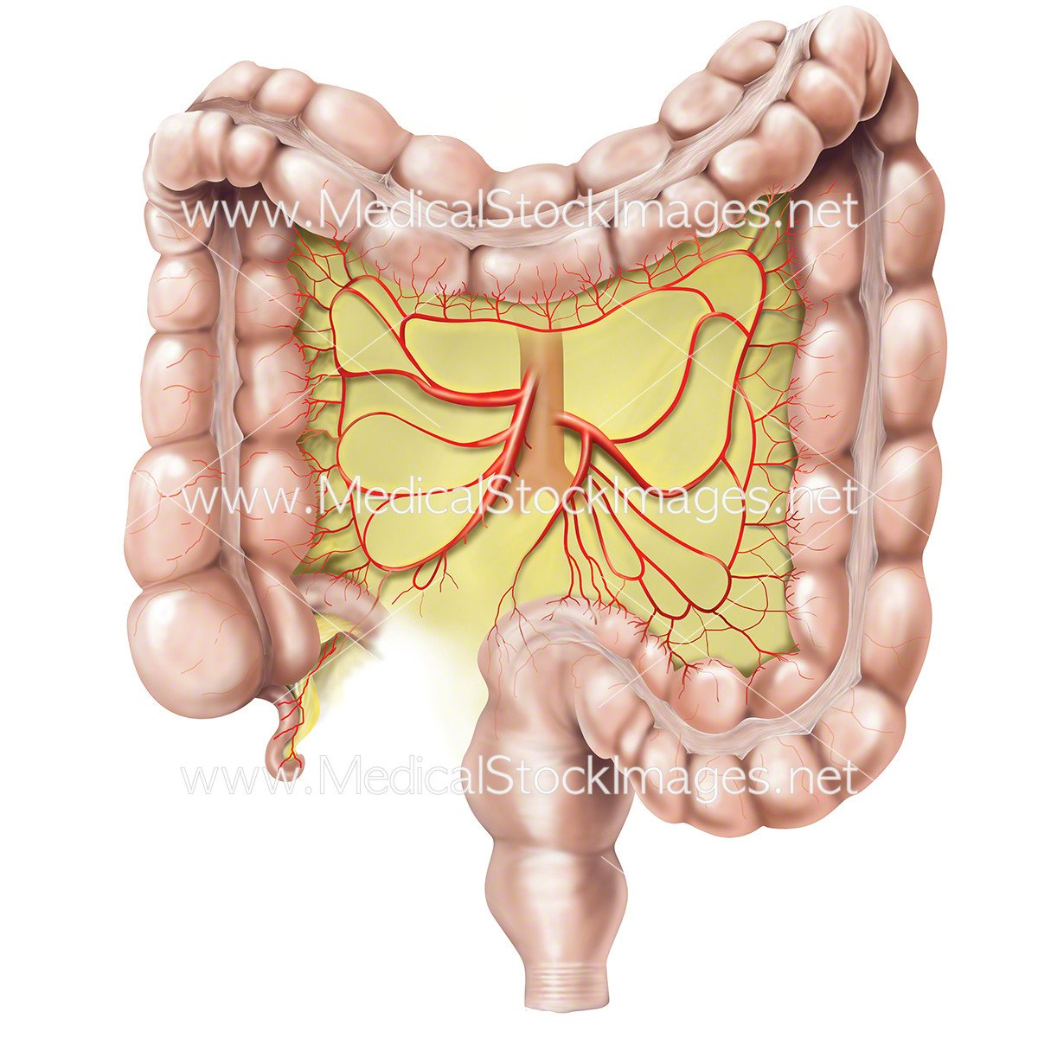
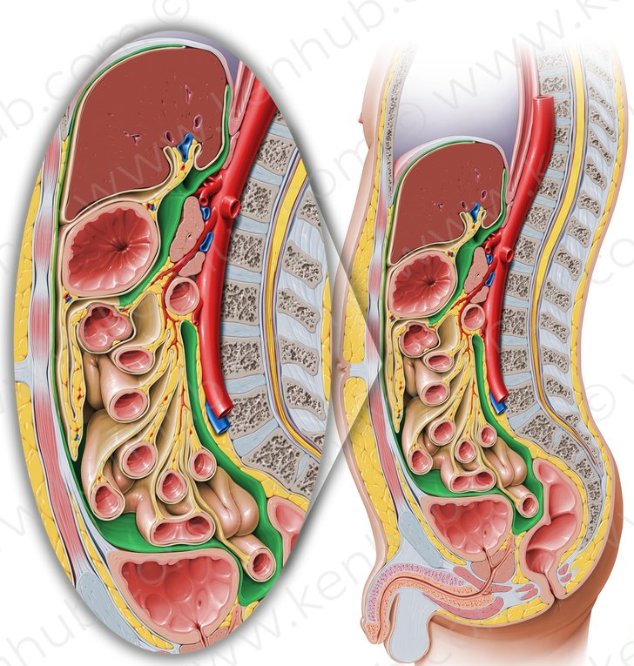
Large Intestine
Parts of Large Intestine
Characteristics of COLON
Peritoneal covering
In Abdomen
Taeniae coli
Parts With Mesentery
- cecum (in right iliac region )
- appendix (in right iliac region )
- Ascending Colon (in right lumbar region )
- Transverse Colon (in 4,5,6 regions )
- descending Colon (in left lumbar, iliac regions )
3 longitudinal muscle bands
1. Transverse colon (transverse mesocolon)
2. Sigmoid colon (sigmoid mesocolon)
3. Appendix (mesoappendix)
4. Cecum (could be without) (see slide 8)
Sacculations (Haustra)
Because the Taeniae coli are shorter
than large intestine
Retroperitoneal Parts
In pelvis
Epiploic Appendices
1. Ascending colon
2. Descending colon
3. Upper ⅔ of rectum
-sigmoid Colon (in left iliac, hypogastric regions )
-rectum (in right iliac region )
Short peritoneal folds filled with fat
In peritoneum
NOTE:THESE CHARACTERISTICS ARE NOT FOUND IN RECTUM & ANAL CANAL
Parts Devoid Of
Peritoneal Covering
-anal Canal
1. Lower ⅓ of rectum 2. Anal canal
Rectum
Anal canal

Slide 7
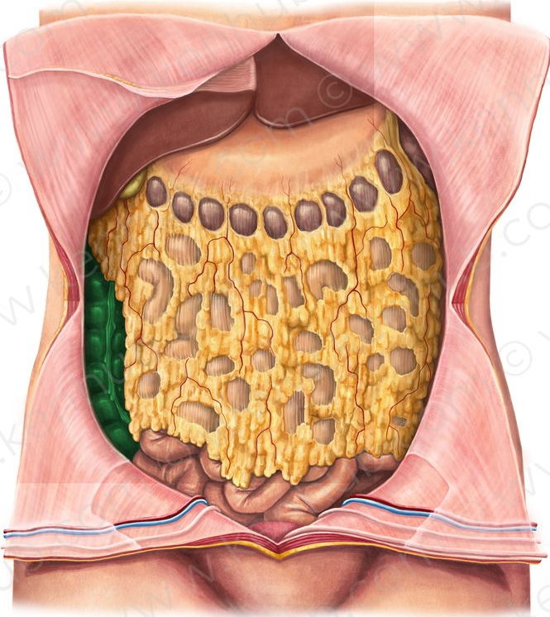
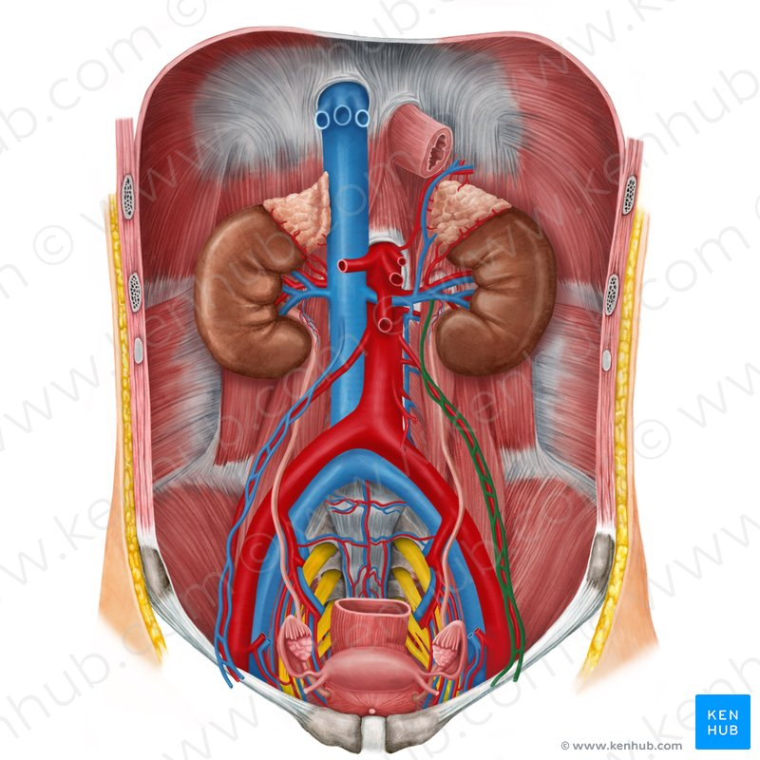
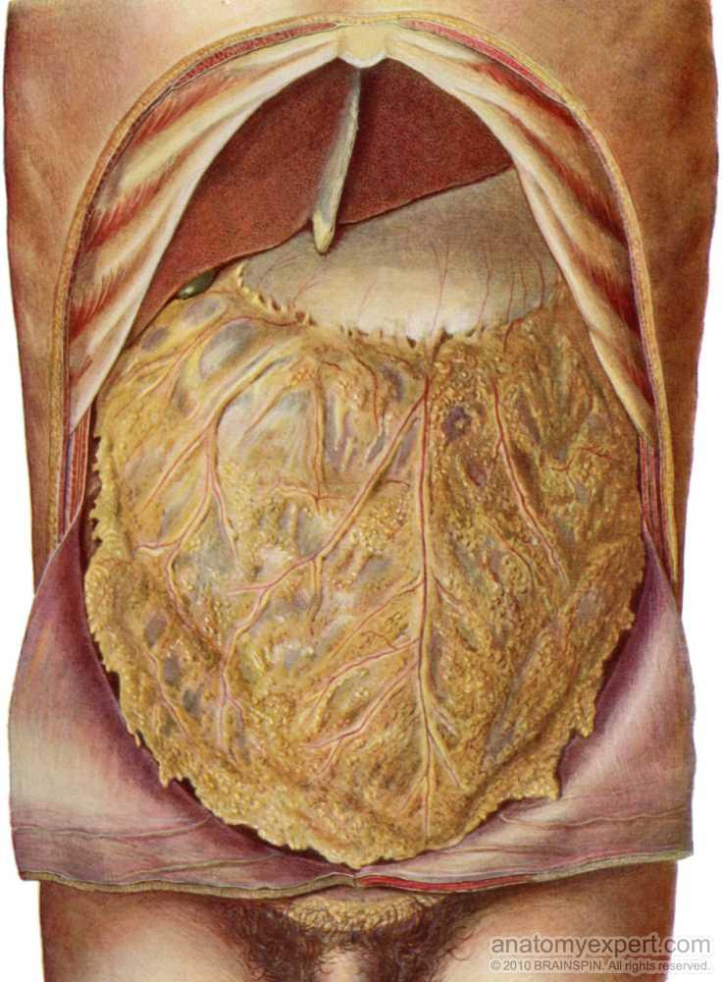
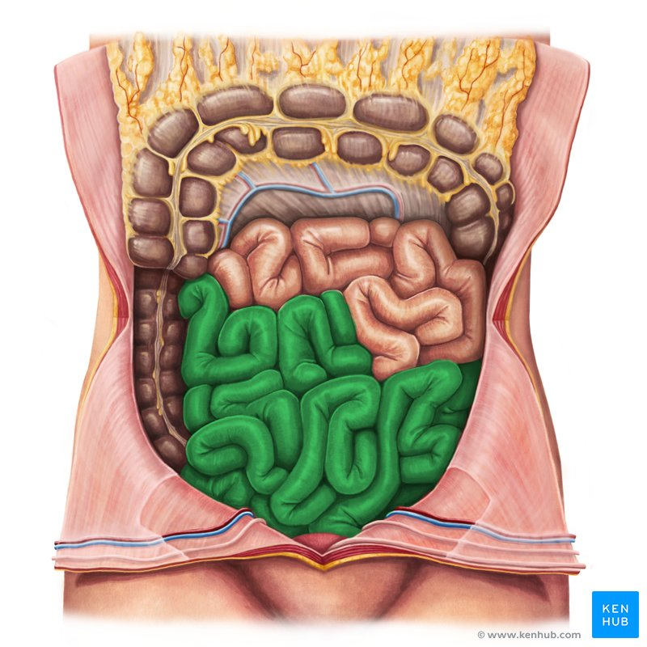
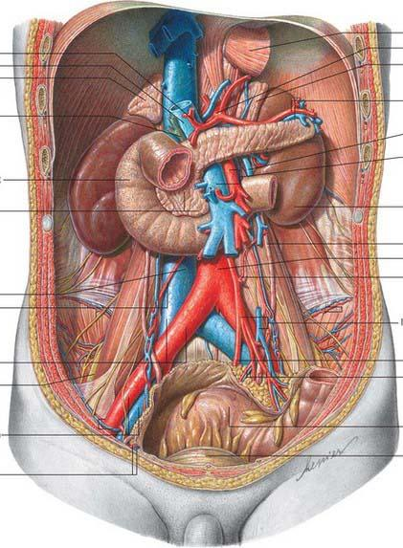
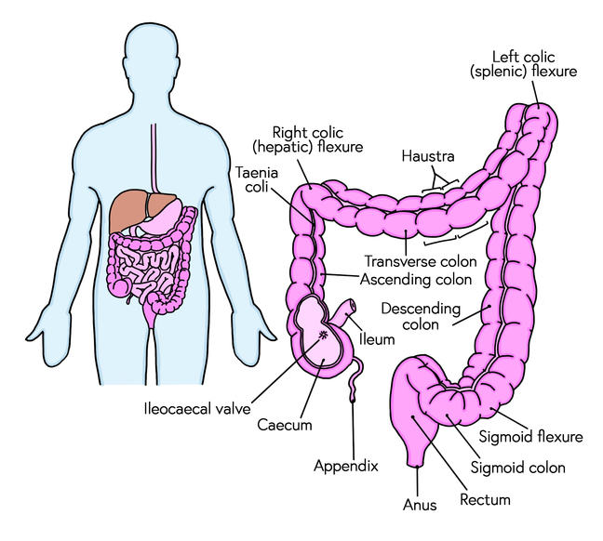
Cecum–ascending & Descending Colons
Transverse Colon
Colic Flexures
1
Parts | Cecum | Ascending colon | Descending colon
Anterior Relations | 1-Greater omentum 2-Coils of small intestine 3-Anterior abdominal wall
Posterior Relations | Right Psoas major Right Iliacus Nerves: (all right)* Iliohypogastric Ilioinguinal | Right Iliacus Right Quadratus lumborum Right kidney. Nerves: (all right)* lateral cutaneous of thigh ,Femoral,Genitofemoral | Left Iliacus Left Quadratus lumborum Left kidney. Left Psoas major Nerves: (all left)* Iliohypogastric ,Ilioinguinal, lateral cutaneous of thigh Femoral, Genitofemoral;
1
Coils of small intestine
kidney
Quadratus lumborum
Iliacus
Psoas major
2
Anterior Relations | Posterior Relations | Superior Relation | Inferior Relation
1-greater omentum 2-anterior abdominal wall | 1-2nd part of duodenum 2-pancreas 3-superior mesenteric vessels | 1-liver 2-gallbladder 3-stomach | 1-coils of small intestine
Anterior
Superior
Inferior
Posterior
3
Hepatic flexure (right colic flexure): position: lower(liver push it down) + angle: wider
Splenic flexure (left colic flexure): Position: higher + Angle: more acute
*from the picture in the lecture

Slide 8
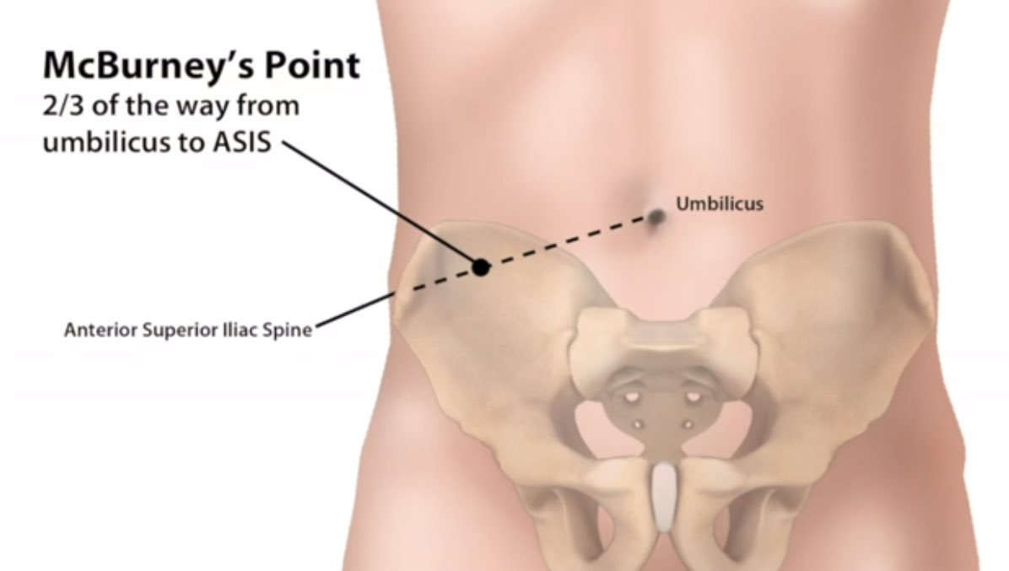
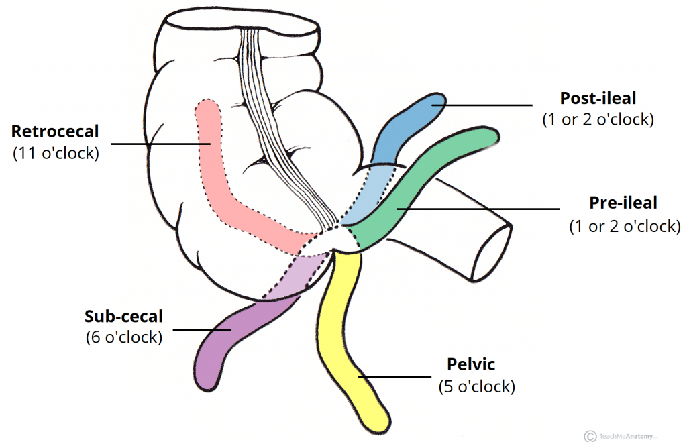
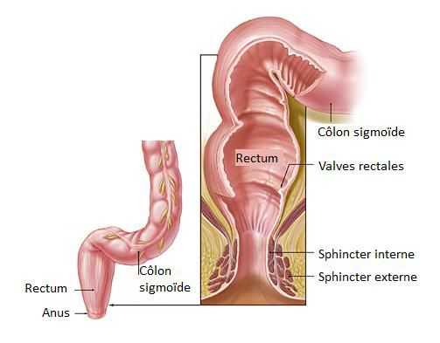
Appendix
Rectum
4
5
Surface anatomy | the base of appendix is marked by Mc’Burney’s point: A point at the junction of lateral ⅓ & medial ⅔ of a line traced from right anterior superior iliac spine to umbilicus
Opening | At posteromedial aspect of cecum, 1 inch below ileo-cecal junction
Positions | 1.Retrocecal:(most common) 2.Pelvic 3.Subcecal 4.Preilieal 5.Postileal:(least common) if the appendix in any position rather than (1) the cecum will be without mesentery
Beginning
as a continuation of sigmoid colon at level of S3
Termination
continues as anal canal, one inch below & in front of tip of coccyx. Its end is dilated to form the rectal ampulla.
Length
13 cm(5 inches)
Relations of Rectum in Pelvis
Males Anterior : 1.Posterior surfaces of urinary bladder 2.Seminal vesicles 3.Prostate gland | Females Anterior : 1.posterior wall of vagina
Posterior: 1.Sacral plexus 2.Sacrum 3.Coccyx
Vs.
Rectum
Relations of Rectum in Pelvis

Slide 9
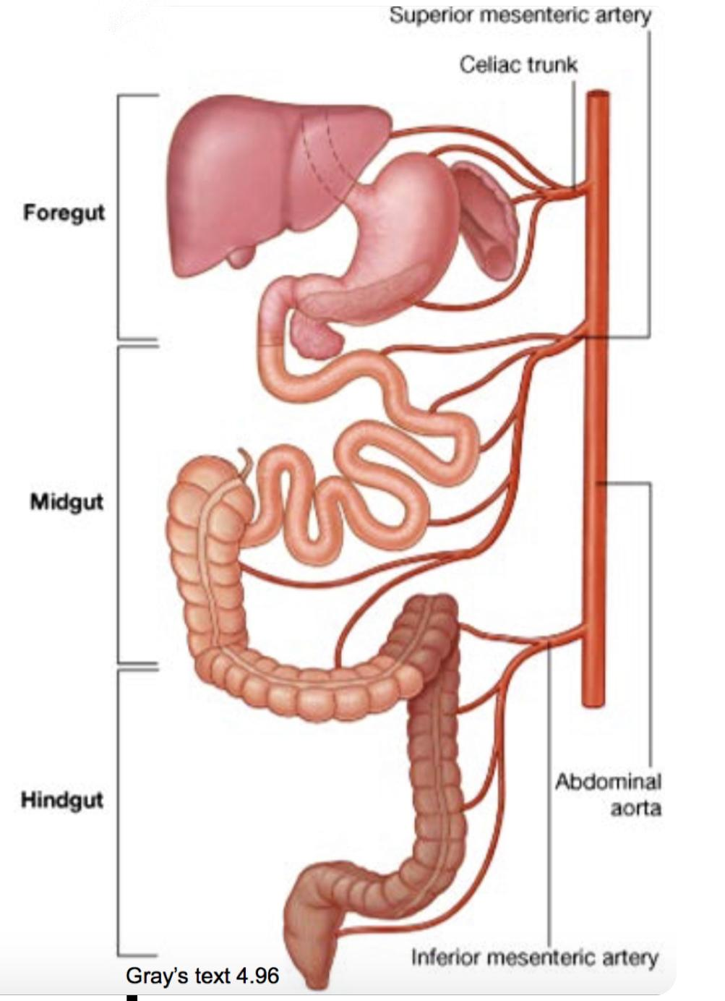
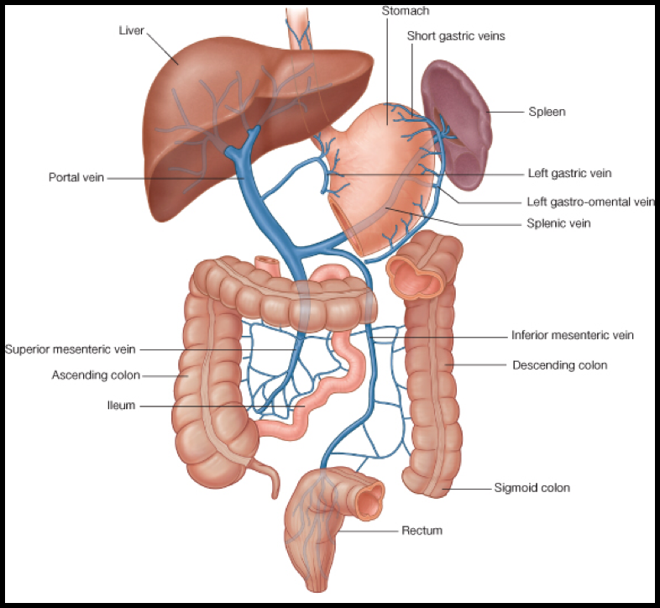
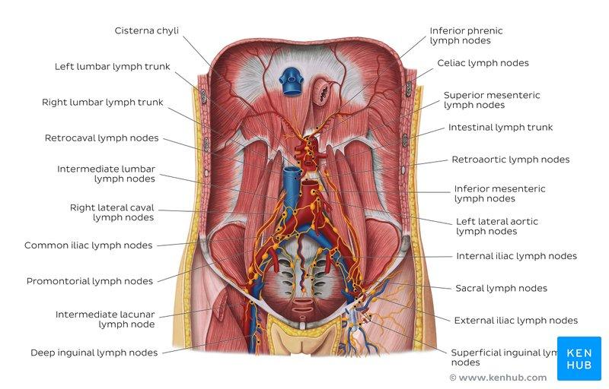
Relation between embryological origin of GIT & Supply
Arterial Supply
3-Hindgut (endoderm):
Inferior mesenteric artery
Left ⅓ of transverse colon, descending colon, sigmoid colon, rectum, upper part of anal canal
1-Foregut:
celiac trunk
Includes Stomach ,liver, gallbladder, pancreas, spleen, upper part of duodenum until major duodenal ampulla
2-Midgut (endoderm) :
Superior mesenteric artery
Includes the Rest of duodenum ,jejunum, ileum, cecum,appendix, ascending colon, right ⅔ of transverse colon
4-Ectoderm:
inferior rectal artery
Lower part of anal canal
Venous Drainage
Lymph drainage of GIT
Nerve Supply
Veins draining gut form the portal circulation
All veins finally end into portal vein which enters the liver
The lymph vessels follow the arteries.
Ultimately, all the lymph is collected at the Preaortic lymph nodes (Superior & Inferior mesenteric).
Midgut (endoderm) : Autonomic nerve supply :Sympathetic + Vagus nerve
Hindgut (endoderm) Autonomic nerve supply :Sympathetic + pelvic splanchnic nerves (S2,S3,S4)
ectoderm(lower ⅓ of anal canal) Somatic nerve supply :inferior rectal (branch of pudendal nerve)

Slide 10
QUIZ 1
Q1 | Q2 | Q3 | Q4 | Q5 | Q6 | Q7 | Q8
D | C | C | B | A | B | D | B
Q1: The duodenum originates from the …….
A. Foregut
B. Midgut
C. Hindgut
D. A&B
Q2: Which of the following could be injured in case of perforated duodenal ulcer? A. Right kidney B. Right colic flexure C. Gastroduodenal artery D. Inferior mesenteric vessels
Q3: if there is a stone in gallbladder ,Which part of intestine initially receives the stone?
A. cecum
B. ascending colon
C. 2nd part of duodenum
D. 3rd part of duodenum
Q4: Which of the following lies anterior to the third part of duodenum?
A. Right psoas major
B. Small Intestine
C. Ureter
D. Bile duct
Q5: What part of the duodenum lies in the transpyloric plane?
A. 1st
B. 2nd
C. 3rd
D. 4th
Q6: the length of the Jejunum & Ileum is A. 6 inches B. 6 meter
C. 10 meter D. 10 inches
Q7: :Which one of these contains numerous aggregation of Lymphoid Tissue ?
A. Jejunum
B. Stomach
C. duodenum
D. ileum
Q8: Which ONE of the following lies behind the 3rd part of the duodenum?
A. inferior mesenteric vein
B. inferior mesenteric artery
C. superior mesenteric artery
D. Gastroduodenal artery

Slide 11
QUIZ 2
Q1 | Q2 | Q3 | Q4 | Q5 | Q6 | Q7 | Q8
B | C | A | C | C | B | A | D
Q1: where does the rectum begin?
A. At s3 as continuation of cecum
B. At s3 as continuation of sigmoid colon
C. At L3 as continuation of cecum
D. At L3 as continuation of sigmoid colon
Q2: which one of the following structures found in pelvis? A. Anal canal
B. Descending colon
C.sigmoid colon
D.appendix
Q3: which one of the following structures marked by Mc’Burney’s point?
A. Base of appendix
B. Apex of appendix
C. Beginning of cecum
D. Termination of cecum
Q4: the innervation of inferior part of anal canal is :
A. Autonomic,by vagus nerve
B. Somatic, by pudendal nerve
C. Somatic ,by inferior rectal nerve
D. Autonomic, by pelvic splanchnic nerve
Q5: One of the superior relations to transverse colon is
A. Coils of small intestine
B. Anterior abdominal wall
C. Gallbladder
D. Right kidney
Q6: if superior mesenteric artery and vagus nerve injured. Which part of colon will be affected?
A. Ascending and descending B. Ascending and transverse C. Descending and sigmoid D. Descending and transverse
Q7: Appendix opens at posteromedial aspect of cecum, ……below ileocecal junction
A. 1 inch
B. 5 inches
C. 3 inches
D. 2 inches
Q8: One of anterior relations of rectum in males is
A. Vagina
B. Sacral plexus
C. Sacrum
D. Posterior surfaces of urinary bladder

Slide 12
Members board
Team leaders
Abdulrahman Shadid
Ateen Almutairi
Boys team:
Mohammed Al-huqbani
Salman Alagla
Ziyad Al-jofan
Ali Aldawood
Khalid Nagshabandi
Sameh nuser
Abdullah Basamh
Alwaleed Alsaleh
Mohaned Makkawi
Abdullah Alghamdi
Girls team :
Ajeed Al Rashoud
‏Taif Alotaibi
‏Noura Al Turki
‏Amirah Al-Zahrani
‏Alhanouf Al-haluli
‏Sara Al-Abdulkarem
‏Renad Al Haqbani
‏Nouf Al Humaidhi
Jude Al Khalifah
Nouf Al Hussaini
Danah Al Halees
Rema Al Mutawa
Maha Al Nahdi
Razan Al zohaifi
Ghalia Alnufaei
Contact us:
Editing file

