Slide 1
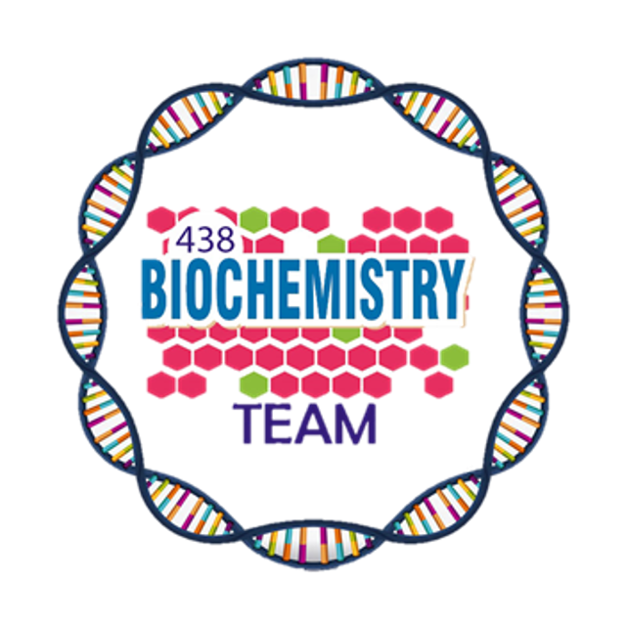
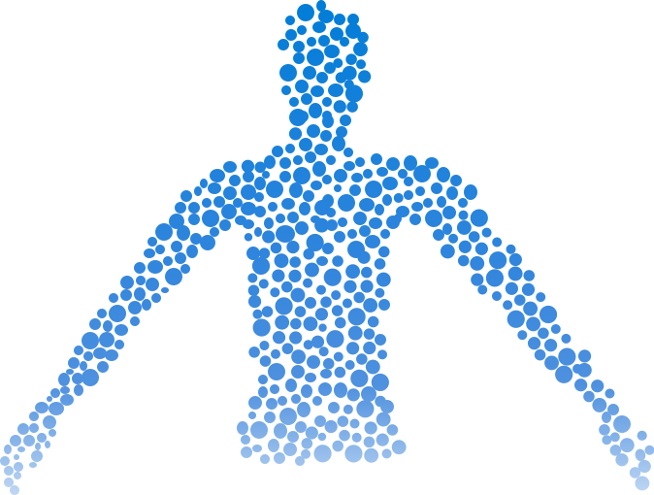
Role of salivary glands and stomach in digestion
Color Index:
Main Topic
Main content
Important
Drs’ notes
Extra info
Editing File
Biochemistry teamwork 438 - Gastrointestinal & Nutrition Block

Slide 2
Objectives:
Understand the principle and importance of digestion of dietary foodstuffs
Understand the role of salivary glands in digestion
Understand the role of stomach in digestion
And…..

Slide 3
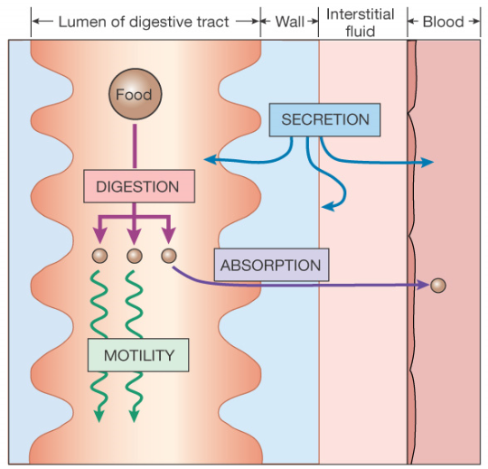
background
End Products of Digestion:
Carbohydrates
Monosaccharides
Most of dietary foodstuffs are ingested in the form that cannot be readily absorbed from the digestive tract
Digestion:The breakdown of the naturally occurring foodstuffs into smaller, easily absorbable forms.
Triacylglycerols (TAG)
Fatty acids &
monoacylglycerols
Proteins
Amino acids
Processes of the digestive system
Role of Salivary Glands in Digestion:
Digestion:
Motility
Secretion
Mechanical effects:
e.g., mastication
They secrete saliva
saliva:
Absorption
Elimination
Enzymatic effects:
Digestive enzymes (Hydrolases)
Acts as lubricant
1
Contains salivary α-amylase
2
Contains lingual lipase
3

Slide 4
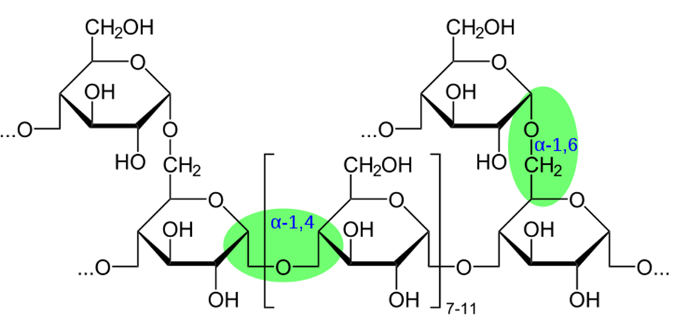
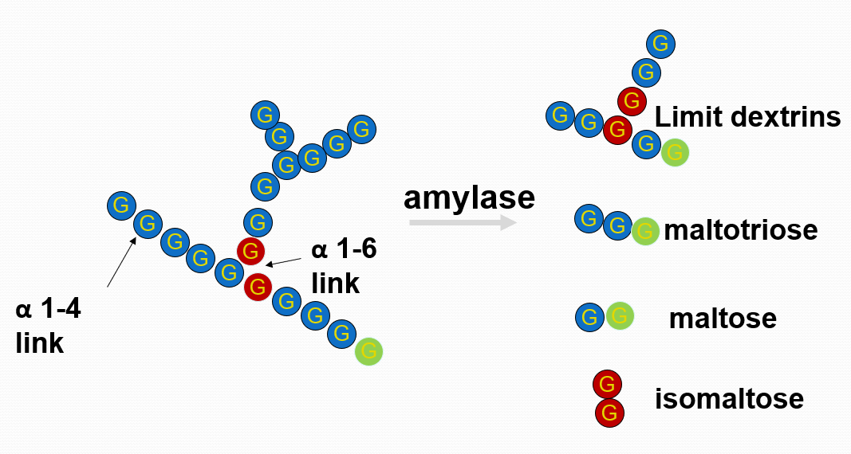
Salivary α-Amylase
Substrates:
Starch and glycogen
Optimum pH:
6.6-6.8
Hydrolyzes:
α(1,4) glycosidic bonds
Secreted by:
Parotid glands
Produces:
Short Oligosaccharides
Simple sugars
Disaccharides
Digestion
Pre-stomach¹ –Salivary amylase :
α 1-4 endoglycosidase²
α-Amylase does not breaks the branching bond
↓
Final products
↑
α-Amylase breaks the main bond
α 1-6 bond
Dr. note: no structures this is just for your understanding
¹in the mouth
²Its called (endo) because it only breaks the middle bonds not the peripheral ones

Slide 5
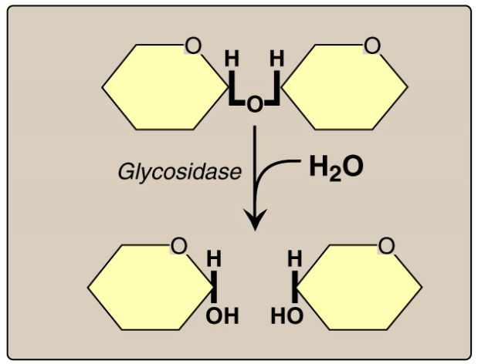
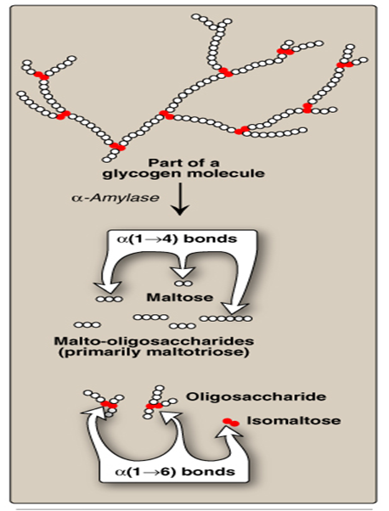
Effect of α-Amylase on Glycogen
Hydrolysis of α(1,4) Glycosidic Bonds
Mixture of short oligosaccharides (both branched & unbranched)
Hydrolysis of:
α(1,4) glycosidic bonds
Products:
Disaccharides: Maltose and isomaltose
Its digestive action on the polysaccharides is of little significance because of the short time during which the enzyme can act on the food in the mouth
Salivary amylase is inactivated by the acidity of stomach (The enzyme is inactivated at pH 4.0 or less)
Salivary α-amylase does not hydrolyze: α(1,6) glycosidic bonds (The branch points of starch and glycogen)
Salivary α-amylase cannot act on: β(1,4) glycosidic bonds of cellulose
Salivary α-amylase does not hydrolyze: disaccharides

Slide 6
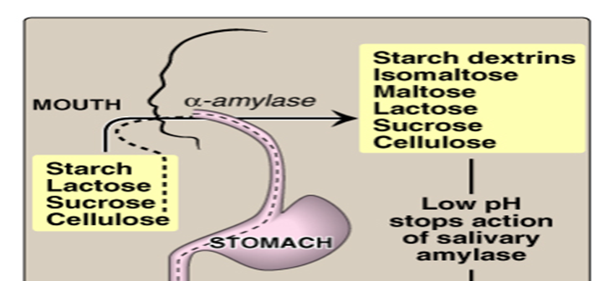
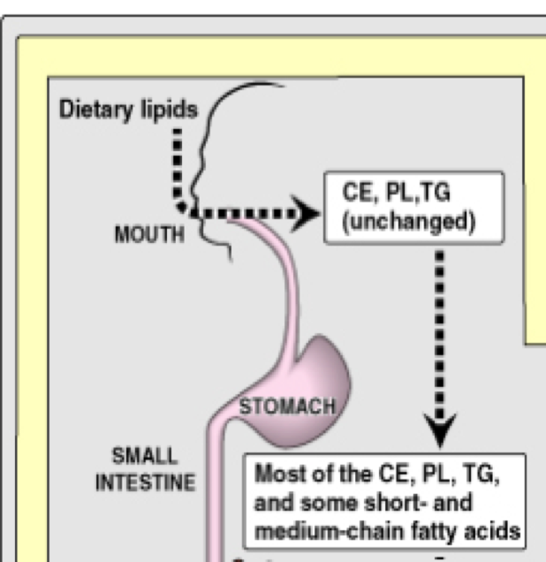
Digestion of Carbohydrates in the Mouth
Role of Stomach in Digestion
No further digestion of carbohydrates
Lipid digestion begins by lingual and gastric lipases
Protein digestion begins by pepsin and rennin
Lingual Lipase
Digestion of Lipids in Stomach
Secreted by the dorsal surface of the tongue (Ebner’s glands)
In adults
VS
In neonates and infants
Acts in the stomach for the digestion of TAG
no significant effects because of lack of emulsification that occurs in duodenum
digestion of milk TAG and production of short- and medium-chain fatty acids
Produces fatty acids and monoacylglycerols
Its role is of little significance in adult humans

Slide 7
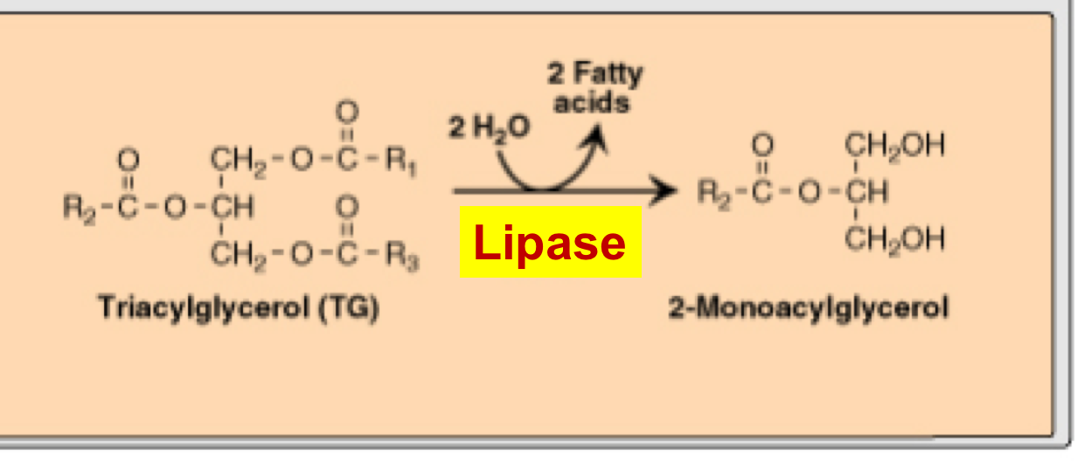
Lingual and Gastric Lipases (Acid-Stable Lipases)
They are important in:
Substrate
End product
Role
Neonates and infants
for the digestion of TAG of milk
TAG molecules, containing
medium- and short-chain fatty acids; such as found in milk fat
2-monoacylglycerols and fatty acids
both lipases role in lipid digestion is
of little significance in adult human
(The lipids in the stomach is not yet emulsified,
Emulsification occurs in duodenum)
Because it has low amount of lipids
Patients with pancreatic insufficiency
1
It has very little significance although it breaks lipids down to very small molecules, because lipids need another process which is called (emulsification) which basically means that the molecule will take more surface area so the enzyme will act easily on the molecule.
Because there is absence of pancreatic lipase
Lingual and Gastric Lipases (Acid-Stable Lipases)
(Acid-Stable Lipases)
2
TAG’s are broken down by lipase
to 2 fatty acids
and 1 (2*-monoacylglycerol)
*the number 2 is due to the location of carbon bonded to
TAG’s are broken down by lipase
to 2 fatty acids
and 1 (2*-monoacylglycerol)
*the number 2 is due to the location of carbon bonded to
Target substrate for acid-stable lipases is TAG containing:
as short- or medium-chain fatty acids
Target substrate for acid-stable lipases is TAG containing:
as short- or medium-chain fatty acids

Slide 8
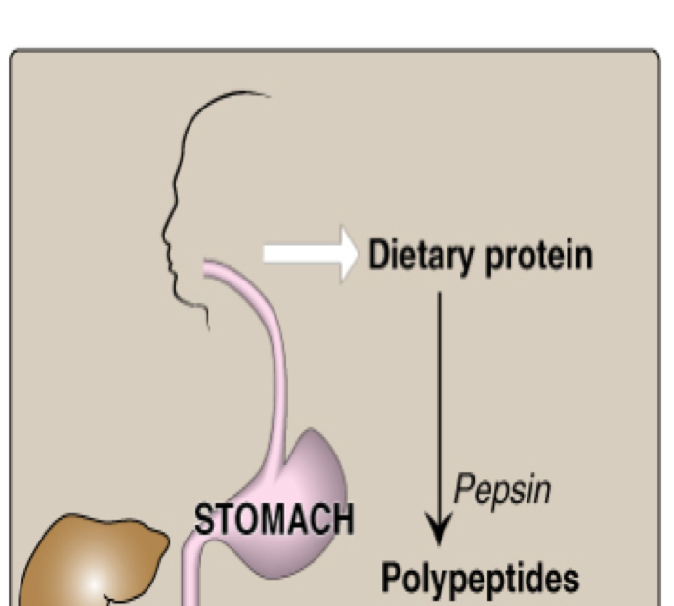
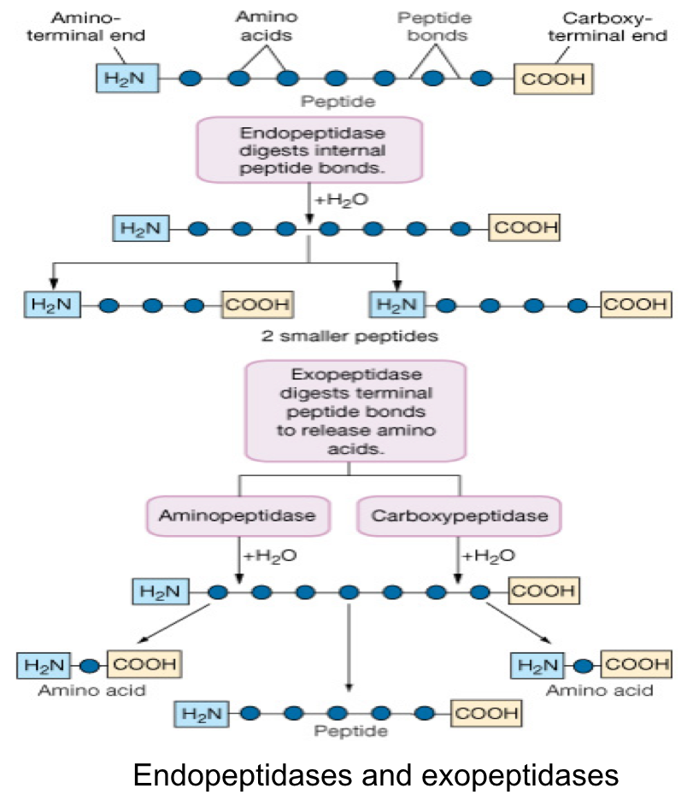
Digestion of Dietary Proteins in Stomach
Pepsin :
Cleaves proteins into polypeptides
HCL :
Denatures proteins
Activates pepsin
Rennin :
Formation of milk clot*
*To make it stay in the stomach for longer time so that pepsin have enough time to act on it
Pepsin
Rennin
Endopeptidase ( breaks the middle bond)
Exopeptidase ( breaks the periphery bonds )
Don’t mix it with renin
chief cells of stomach as
inactive proenzyme, pepsinogen
Secreted
by
chief cells of stomach in neonates and infants
denatured dietary proteins (by HCl)
Substrate
Casein of milk (in the presence of calcium)
Smaller polypeptides
End product
Paracasein with the formation of milk clot
*Cleaves the inner parts in the protein
Effect : It prevents rapid passage of milk
from stomach, allowing more time for
action of pepsin on milk proteins
Acid-stable, endopeptidase*.
Activated by HCl and autocatalytically by pepsin.

Slide 9
Take Home Messages
Digestion involves both mechanical and enzymatic processes
Digestion makes dietary foodstuffs readily absorbable by the digestive tract
Salivary α-amylase is of limited, but initial effect on digestion of starch and glycogen in the mouth
Salivary α-amylase converts starch and glycogen into short, branched oligosaccharides
Limited digestion of TAG begins in the stomach by both lingual and gastric lipases producing 2-monoacylglycerols and fatty acids
Digestion of proteins begins in the stomach by pepsin producing smaller polypeptides
In neonates and infants, digestion of milk occurs in stomach by:
Acid-stable lipases for digestion of milk fat Rennin and pepsin for digestion of milk proteins

Slide 10
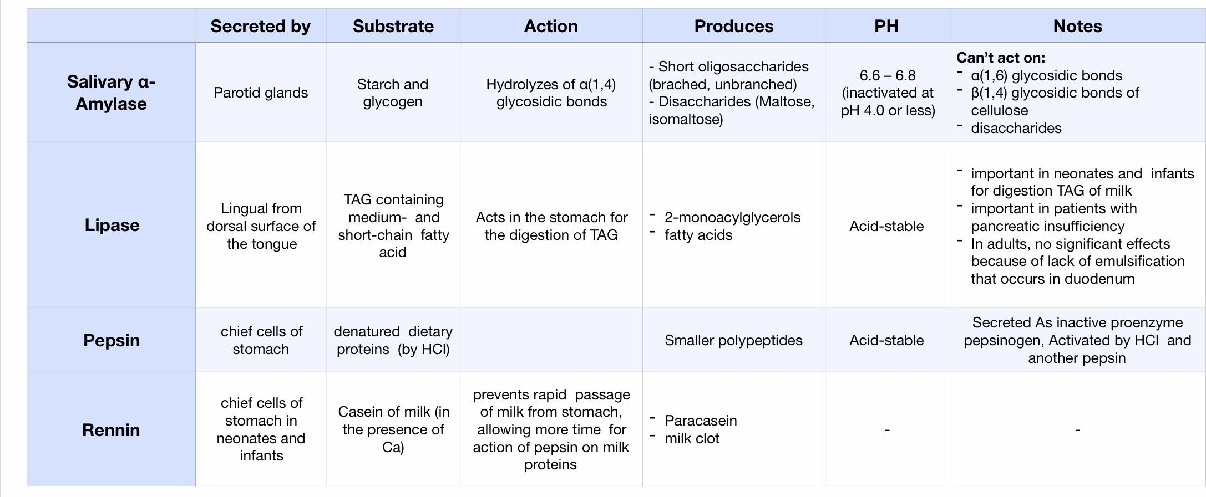
Summary
Special thanks to Dimah Alarifi #med437

Slide 11
Quiz
MCQs :
Q1: which of the following does α-Amylase hydrolyse?
A) α(1,6) Glycosidic bond B) β(1,4) glycosidic bonds of cellulose
C) α(1,4) Glycosidic Bond D) Disaccharides
Q2: which of the following Produces fatty acids and monoacylglycerols?
A) salivary Amylase B) lingual lipase C) pepsin D) rennin
Q3: which of the following is not produced by Hydrolysis of α(1,4) glycosidic bond?
A) glucose B) maltose C) isomaltose D) short oligosaccharides
Q4: why lipases are of little significance in lipid digestion in adults?
A) Emulsification occurs in duodenum B) lipids are more complex in adults C) changes in pH D) none
Q5: Rennin acts on casein in the presence of
A) Phosphate B) Calcium C) sodium D) potassium
Q6: What is the most important enzyme for milk digestion in neonates?
A) Colipase B) Phospholipase A2 C) Gastric lipase D) Amylase
SAQs :
Q1: why is the salivary Amylase is not active in the stomach?
Q2: why pepsin isn’t denatured by HCl like most of the proteins?
Q3: TAG’s are broken down by…. to...
Q4: compare between rennin and pepsin regarding their secretion, substrate and end product
MCQs Answer key:
1) C 2) B 3) A 4) A 5) B 6) C
SAQs Answer key:
Because the stomach is the acidity is higher (Acidic ph 4.0) while salivary Amylase optimum ph is 6.6-6.8
Because it is acid stable
Lipase, to 2 fatty acids and 1 2-monoacylglycerol
8th Slide

Slide 12
Team members
There is no elevator to success, you have to take the stairs
Girls Team:
Boys Team:
Ajeed Al-Rashoud
Alwateen Albalawi
Amira AlDakhilallah
Arwa Al Emam
Deema Almaziad
Ghaliah Alnufaei
Haifa Alwaily
Leena Alnassar
Lama Aldakhil
Lamiss Alzahrani
Nouf Alhumaidhi
Noura Alturki
Sarah Alkhalife
Shahd Alsalamah
Taif Alotaibi
Abdulrahman Bedaiwi
Alkassem Binobaid
Khayyal Alderaan
Mashal Abaalkhail
Naif Alsolais
Omar Alyabis
Omar Saeed
Omar Odeh
Rayyan Almousa
Yazen Bajeaifer
Team Leaders
We hear you
Lina Alosaimi
Mohannad Alqarni

