Slide 1
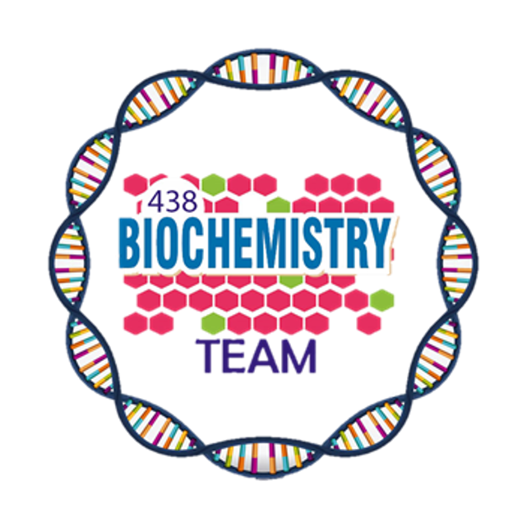
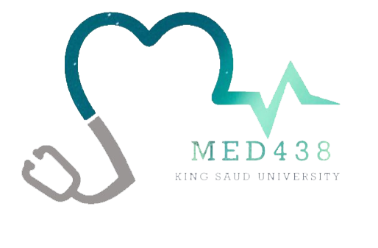
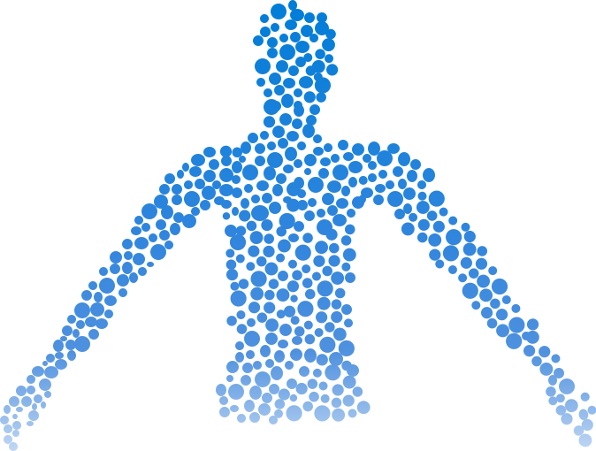
Bile Acids & Salts
Objectives:
Structure of primary bile acids and salts
Enterohepatic circulation
Structure of secondary bile acids and salts
Malabsorption syndrome
Functions of bile salts
Cholelithiasis
Color Index:
Main Topic
Main content
Important
Drs’ notes
Extra info
Editing File
Biochemistry teamwork 438 - Gastrointestinal & Nutrition Block

Slide 2
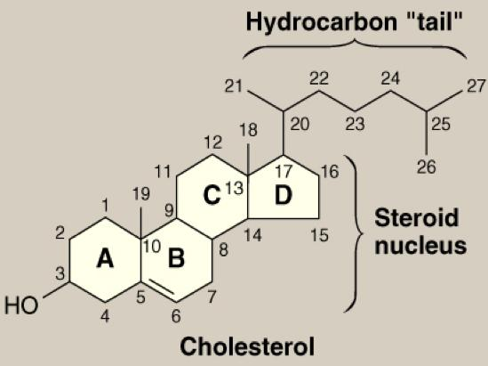
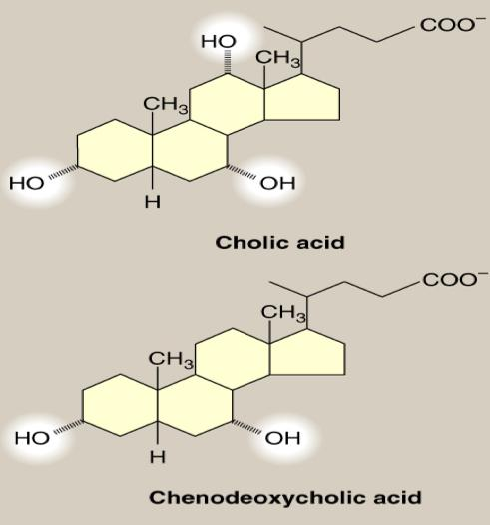
Cholesterol & Primary Bile Acids
Cholesterol
Primary Bile Acids
1
Amphipathic¹
Has 24 carbon atoms with COOH at side chain.
It’s synthesized from Cholesterol by removing 3C, and adding Hydroxyl groups:
- Cholic acid → Has 3 OH (2 were added)
- Chenodeoxycholic→ Has 2 OH (1 was added)
Has 27 carbons atoms.
Parent steroid compound.
Precursor of bile acids and salts
2
Will be discussed in next slide
Have both hydrophilic and hydrophobic parts.

Slide 3
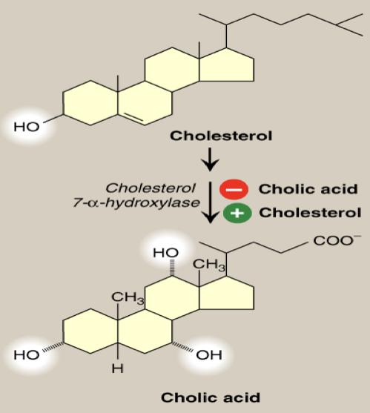
Hepatic Synthesis of Bile Acids
The rate-limiting step is catalyzed by: Cholesterol 7- α-hydroxylase.¹
Up-regulated by | Down-regulated by
Cholesterol “Enzyme induction” Explanation: If we have too much of the precursor (Cholesterol) it will INDUCE the synthesis of the enzyme and increase bile acids | End products (bile acids) “Enzyme repression” Explanation: If we have too much of the product(bile acids) it will REPRESS the synthesis of the enzyme and inhibit the synthesis of bile acids.
EXTRA but IMPORTANT for understanding (most will be repeated in next slide): So now that we’ve synthesized the bile acids we will convert them into bile salts. But before we begin, What’s the difference between bile acid and bile salts?
Simply before the bile acids leave the liver, they are conjugated to a molecule of either glycine or taurine, by an amide bond between the carboxyl group of the bile acid and the amino group of the added compound. Addition of glycine or taurine results in the presence of a carboxyl group with a lower pKa (from glycine) or a sulfonate group (from taurine), both of which are fully ionized (negatively charged) at physiologic pH, thus, the conjugated forms are called bile salts
Adds hydroxyl group at carbon 7 of the steroid nucleus.

Slide 4
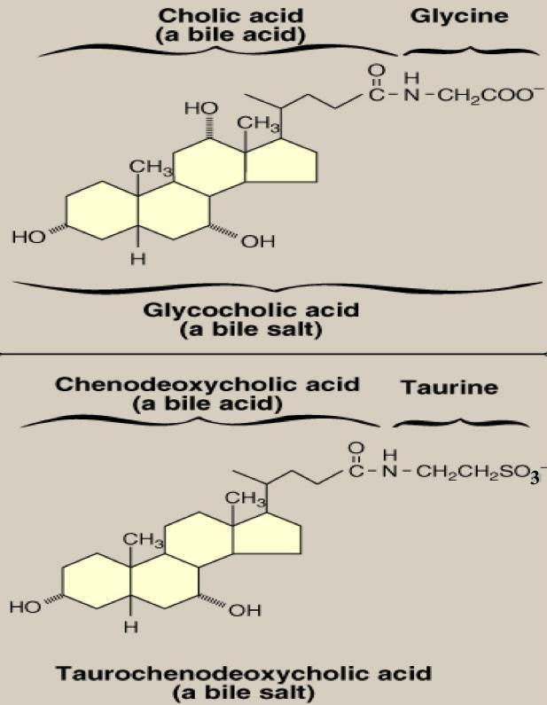
Primary Bile Acids & Salts
BILE ACIDS
BILE SALTS
Conjugated with glycine or taurine
Cholic acid
Chenodeoxycholic acid
Glycocholic & Taurocholic
Glycochenodeoxycholic & Taurochenodeoxycholic
Conjugated with glycine or taurine
Bile Salts
(Conjugated bile acids)
3
Addition of glycine or taurine forming an amide bond between them and the bile acids, results in the presence of fully ionized groups at pH 7.0:
COOH of glycine
SO3 of taurine
( Hence, its name as bile salts e.g., Sodium or potassium glycocholate )
The ratio of glycine to taurine forms in the bile is 3:1
Bile salts are more effective detergent than bile acids
Only bile salts, but not acids, found in bile
After the addition of glycine or taurine they will now form bile salts in combination with Na or K resulting in Sodium or Potassium Glycocholate,
Sodium or Potassium Taurochenodeoxycholate

Slide 5
Secondary bile acids & Enterohepatic circulation
Enterohepatic circulation:
Explanation: Bile salts secreted into the intestine are efficiently reabsorbed and reused. The liver converts both primary and secondary bile acids into bile salts by conjugation with glycine or taurine, and secretes them into the bile. The mixture of bile acids and bile salts is absorbed primarily in the ileum via a Na+ -bile salt cotransporter. They are actively transported out of the ileal mucosal cells into the portal blood, and are efficiently taken up by the hepatocytes via an isoform of the cotransporter. The continuous process of secretion of bile salts into the bile, their passage through the duodenum where some are converted to bile acids, their uptake in the ileum, and subsequent return to the liver as a mixture of bile acids and salts is termed the enterohepatic circulation
Secondary bile acids:
Bile salts
Glyco- or Tauro-cholate - Chenodeoxycholate
Intestinal bacteria
Glycine
Deconjugation
Taurine
1º Bile acids
Cholic acid - Chenodeoxycholic
Intestinal bacteria
OH
Bacterial 7α-dehydroxylation
2º Bile acids
Deoxycholic acid - Lithocholic
Cholestyramine:
Bile acid sequestrants.
Binds to bile acids in the gut, prevent their reabsorption, and so promote their excretion.
It is used in the treatment of hypercholesterolemia¹
1- Because the removal of bile acids relieves the inhibition on bile acid synthesis in the liver, thereby diverting additional cholesterol into that pathway.
Dietary fibers:
It binds to bile acids, increasing their excretion.

Slide 6
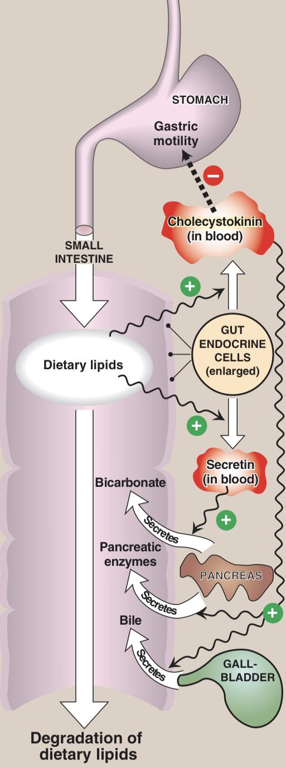
Hormonal Control of Bile Secretion
Bile¹ secretion:
Stimulus | Undigested lipids and partially digested proteins in duodenum.
Hormone from gut cells | Cholecystokinin (CCK)
Responses | 1- Secretion of pancreatic enzymes 2- Bile secretion 3- Slow release of gastric contents
Explanation: Cells in the mucosa of the lower duodenum and jejunum produce a small peptide hormone, cholecystokinin (CCK), in response to the presence of lipids and partially digested proteins entering these regions of the upper small intestine. CCK acts on the gallbladder (causing it to contract and release bile), and on the exocrine cells of the pancreas (causing them to release digestive enzymes). It also decreases gastric motility, resulting in a slower release of gastric contents into the small intestine. Other intestinal cells produce another small peptide hormone, secretin, in response to the low pH of the chyme entering the intestine. Secretin causes the pancreas and the liver to release a solution rich in bicarbonate that helps neutralize the pH of the intestinal contents, bringing them to the appropriate pH for digestive activity by pancreatic enzymes.
Hormonal control of lipid digestion in the small intestine.
Functions of Bile Salts:
Important for cholesterol excretion:
1- As metabolic products of cholesterol .
2- Solubilizer of cholesterol in bile.
Emulsifying factors for dietary lipids,
a prerequisite step for efficient lipid digestion.
01
02
03
Cofactor for pancreatic lipase and PLA2
04
Facilitate intestinal lipid absorption by
formation of mixed micelle
Don’t mix it with bile salts which is a COMPONENT of Bile, so we can say that Bile is a mixture of bile salts, phospholipids, and free cholesterol.
Emulsification and Absorption Will be explained in next slide..

Slide 7
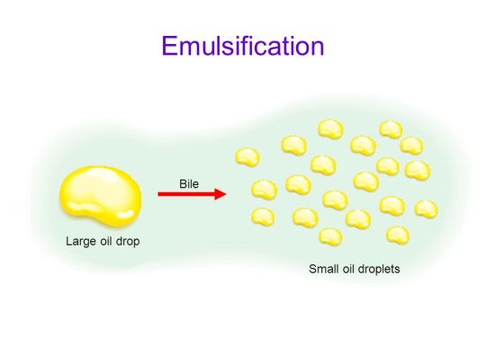
Functions of bile salts cont.
Emulsification
Absorption of Lipids
Emulsification of dietary fat occurs in duodenum.
Emulsification increases the surface area of lipid droplets, therefore the digestive enzymes can effectively act.
Has 2 Mechanisms:
Lipids require Mixed micelles to get absorbed.
What are Mixed micelles?
Disc-shaped clusters of amphipathic lipids.Arranged with their hydrophobic groups on the inside and their hydrophilic groups on the outside.
What are they formed of?
1
Mechanical mixing by peristalsis.
2
Detergent effect of bile salts.
1
Bile salts
Free fatty acids(Long-chain), Free cholesterol and 2-monoacylglycerol.
Bile salts interact with lipid particles and aqueous duodenal contents, stabilizing the particles as they become smaller, and preventing them from coalescing.
2
End products of lipid digestion
3
Fat-soluble vitamins (A,D,E and K)
Note that Short- and medium-chain fatty acids do not require mixed micelle for absorption by intestinal cells.

Slide 8
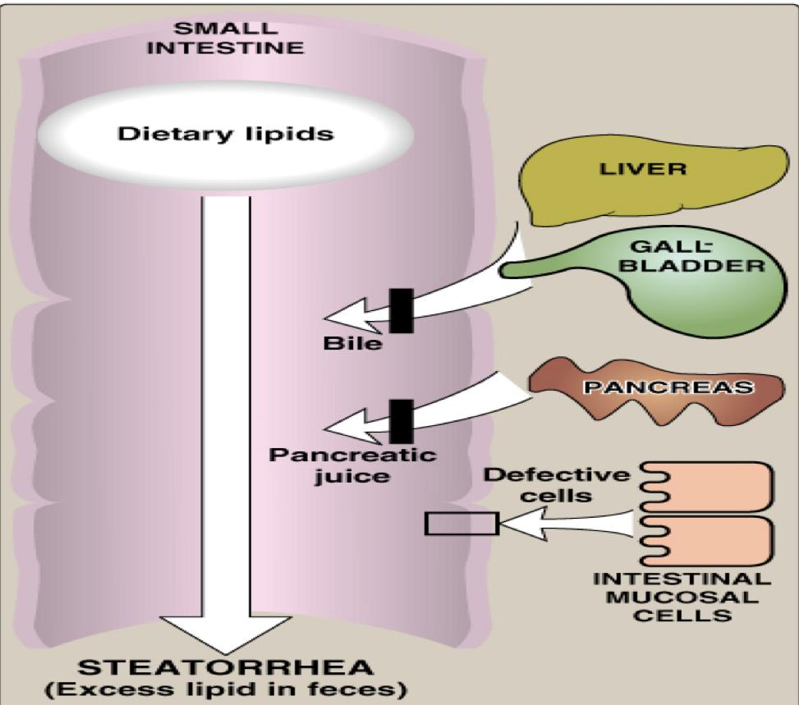
Malabsorption and Cholelithiasis
Malabsorption/ Maldigestion of lipids
Cholelithiasis¹
Cholesterol Gallstone² Diseases
Causes:
Decreased bile salts in bile:
Biliary tract obstruction(Interferes with enterohepatic circulation)
Hepatic dysfunction(Decrease synthesis)
Increased biliary cholesterol excretion.
Treatment: shock wave, Bile acid replacement therapy(not very effective cuz there's high chance of recurrence), surgical (majority)
Decreased bile secretion by:
Liver diseases: (Decrease synthesis)
e.g. Hepatitis or cirrhosis
Gallbladder diseases: (Obstruction)
e.g. Gallstones
1
Malabsorption of lipids
2
1- the formation of gallstones.
2- If there's any disturbance between bile acid and cholesterol then the bile which contain the cholesterol will accumulate and stay in the bile which cause the formation of stones

Slide 9
Summary
Click here for a cool pic from Kaplan
Synthesis of Primary bile acids: | Cholesterol(27C) → Primary bile acids(24C) (Chenodeoxycholic, Cholic acid) Rate limiting step is catalyzed by: Cholesterol 7- α-hydroxylase Induced by: Cholesterol Inhibited by: Bile acids
Synthesis of Bile salts: | Primary bile acids → Bile salts (Glycocholic & Taurocholic Or Glycochenodeoxycholic & Taurochenodeoxycholic) Synthesized by Conjugation with glycine or taurine resulting in the presence of fully ionized groups at pH 7. Note that Only bile salts, but not acids, found in bile.
Synthesis of Secondary bile acids: | Bile salts → Primary bile acid → Secondary bile acids(Deoxycholic acid, Lithocholic) 1- Converted by intestinal bacteria, End products: Primary bile acids, By products: Glycine and taurine. 2- Converted by intestinal bacteria. End products: Secondary bile acids, By products: OH.
Enterohepatic circulation: | Cholestyramine: Bile acid sequestrants, binds to bile acids in the gut, prevent their reabsorption, and so promote their excretion. It is used in the treatment of hypercholesterolemia Dietary fibers: It binds to bile acids, increasing their excretion.
Hormonal control of Bile secretion: CCK | Stimulus: Undigested lipids and partially digested proteins in duodenum. Responses: 1- Secretion of pancreatic enzymes, 2- Bile secretion, 3- Slow release of gastric contents.
Functions of bile salts: | 1- Important for cholesterol excretion, 2- Emulsification of fat, 3- Cofactor for pancreatic lipase and PLA2, 4- Facilitate lipid absorption.
1
2

Slide 10
Quiz
MCQs :
Q1: Which of the following is the precursor for Primary bile acids?
a) Proteins b) Cholesterol c) Carbohydrates d) Bilirubin
Q2: Which of the following enzymes is responsible for the formation of Primary Bile acids?
a) Cholesterol 7-⍶- hydroxylase b) 7-⍶- carboxylase
c) 7-⍶- Dehydroxylase d) amylase
Q3: Which of the following is true regarding cholestyramine?
a) Prevents bile acids reabsorption b) Promotes bile acids reabsorption c) Prevents bile acids excretion d) None of the above
Q4: Which of the following is found in bile?
a) Bile acids b) Carbohydrates c) Bile salts d) Hemoglobin
Q5: Which of the following is a secondary bile acid?
a) Glycochenodeoxycholic b) Cholic acid
c) Taurocholic d) Lithocholic
Q6: Which of the following substance enhances the synthesis of bile acids?
a) Bile acids b) Proteins c) Vitamin A d) Cholesterol
SAQs :
Q1: Mention 3 functions for bile salts.
Q2: What are the mechanisms of emulsification?
Q3: What are the components of micelles?
Q4: What hormone controls the secretion of bile? Its effects?
MCQs Answer key:
1) B 2) A 3) A 4) C 5) D 6) D
SAQs Answer key:
1- Important for cholesterol excretion(1- As metabolic products of cholesterol .2- Solubilizer of cholesterol in bile.)
2-Emulsifying factors for dietary lipids, a prerequisite step for efficient lipid Digestion.
3- Cofactor for pancreatic lipase and PLA2
1- Mechanical mixing by peristalsis.
2- Detergent effect of bile salts.
Bile salts, End products of lipid digestion, Fat-soluble vitamins.
CCK, Responds by 1- Secretion of pancreatic enzymes, 2- Bile secretion, 3- Slow release of gastric contents.

Slide 11
Team members
A Bird in the Hand is Worth Two in the Bush.
Girls Team:
Boys Team:
Ajeed Al-Rashoud
Alwateen Albalawi
Amira AlDakhilallah
Arwa Al Emam
Deema Almaziad
Ghaliah Alnufaei
Haifa Alwaily
Leena Alnassar
Lama Aldakhil
Lamiss Alzahrani
Nouf Alhumaidhi
Noura Alturki
Sarah Alkhalife
Shahd Alsalamah
Taif Alotaibi
Abdulrahman Bedaiwi
Alkassem Binobaid
Khayyal Alderaan
Mashal Abaalkhail
Naif Alsolais
Omar Alyabis
Omar Saeed
Omar Odeh
Rayyan Almousa
Yazen Bajeaifer
Team Leaders
We hear you
Lina Alosaimi
Mohannad Alqarni

