Slide 1
G6PD
Color Index:
Main Topic
Main content
Important
Drs’ notes
Extra info
Editing File
Biochemistry teamwork 438 - Gastrointestinal & Nutrition Block

Slide 2
Objectives:
Overview:
Explain the biochemical basis of G6PD deficiency anemia
G6PD deficiency hemolytic anemia
Recognize the precipitating factors for G6PD deficiency anemia
Biochemical basis of G6PD deficiency hemolytic anemia
Different classes of G6PD deficiency hemolytic anemia
Classify various classes of G6PD deficiency anemia (variant enzymes)
Diagnosis of G6PD deficiency hemolytic anemia
Describe the diagnostic methods for G6PD deficiency anemia

Slide 3
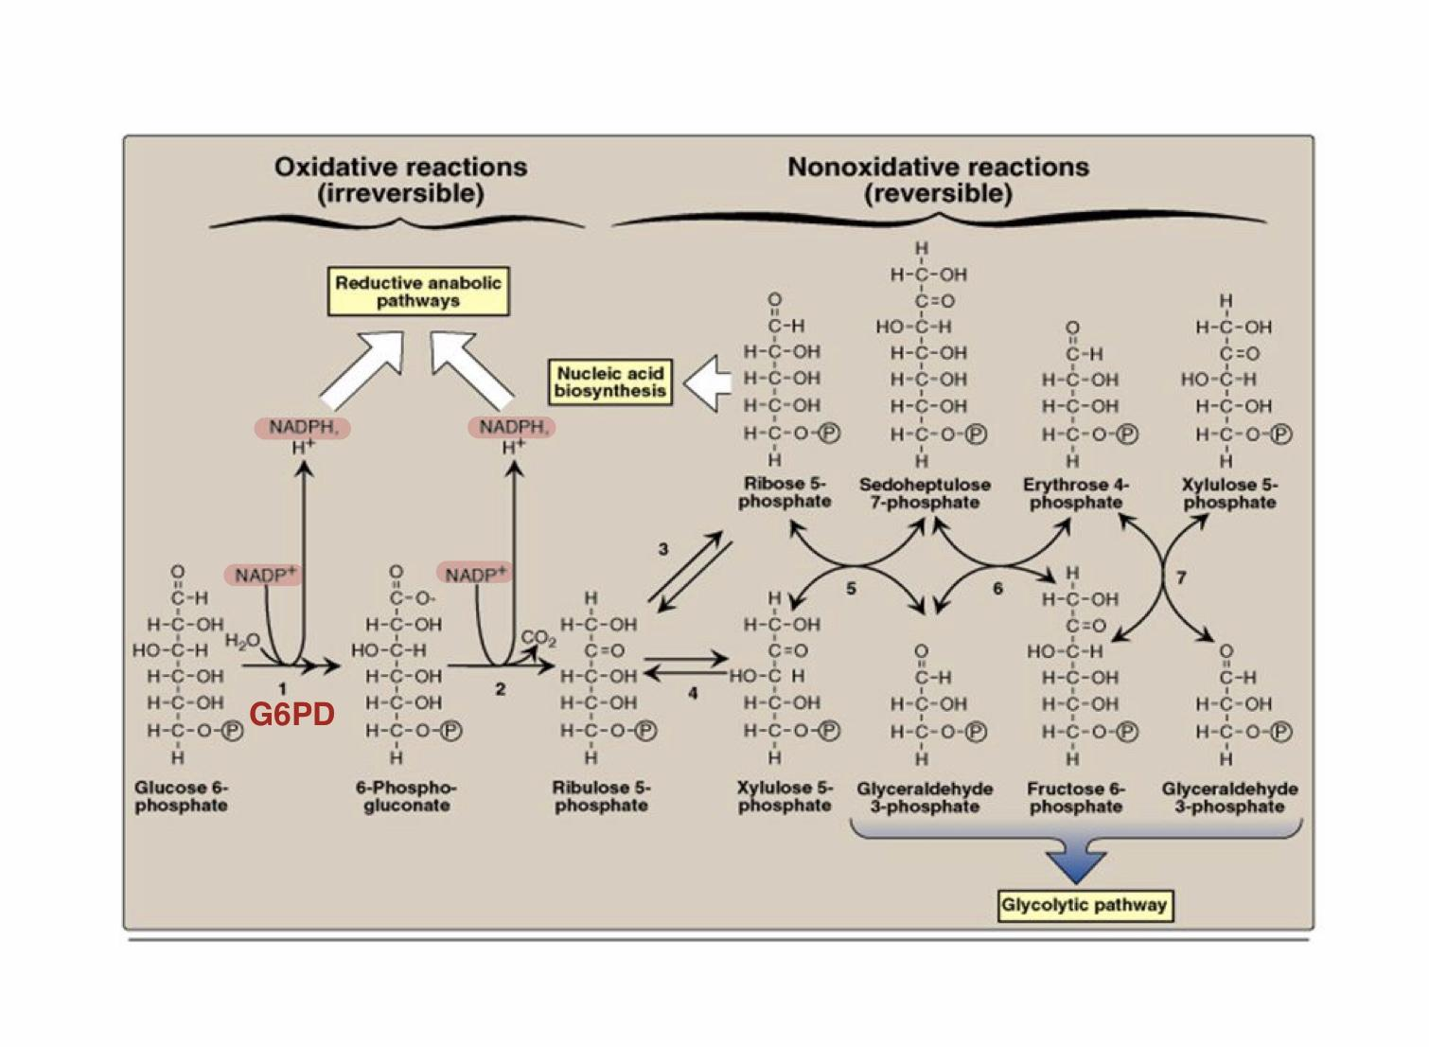
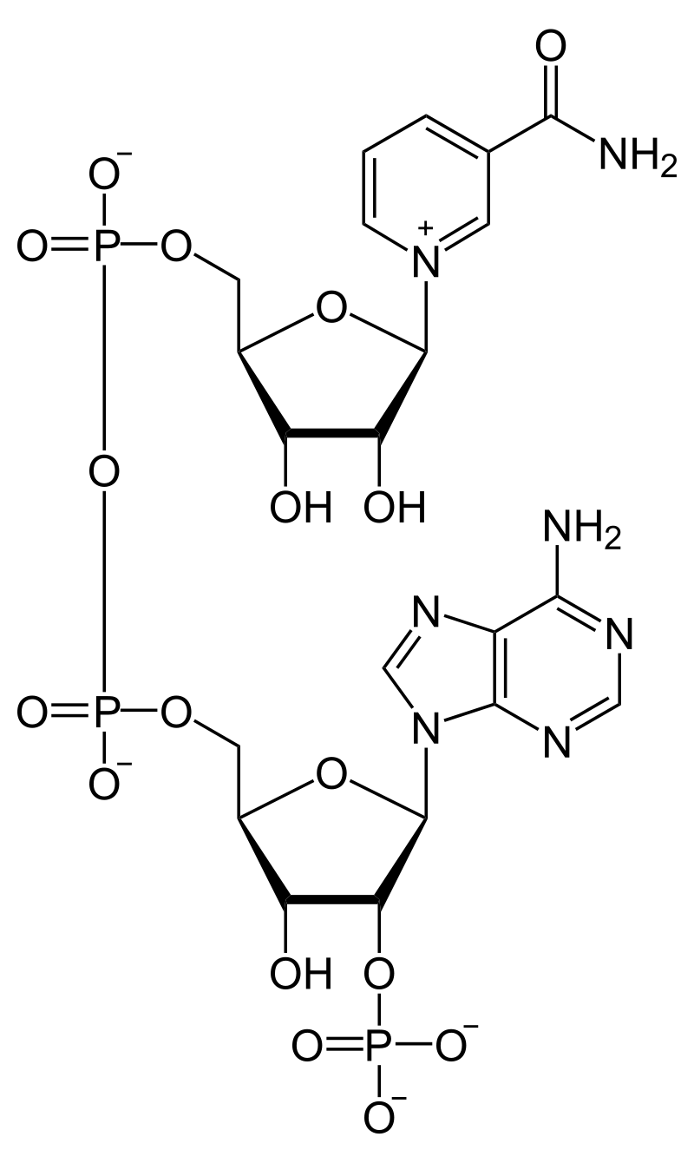
Background
An alternative oxidative pathway for glucose
Major pathway for NADPH production
NADPH
Uses of NADPH
Hexose monophosphate pathway (HMP) or Pentose Phosphate Pathway (PPP)
1
Reductive biosynthesis e.g , fatty acid biosynthesis
2
Antioxidant (part of glutathione system)
No ATP production
Produces ribose-5-phosphate for nucleotide synthesis
3
Oxygen-dependent phagocytosis by WBCs
4
Synthesis of nitric oxide (NO)
PPP
For illustration
NADPH

Slide 4
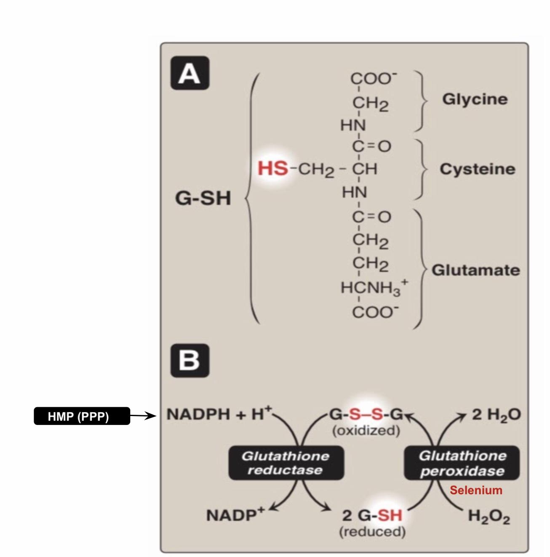
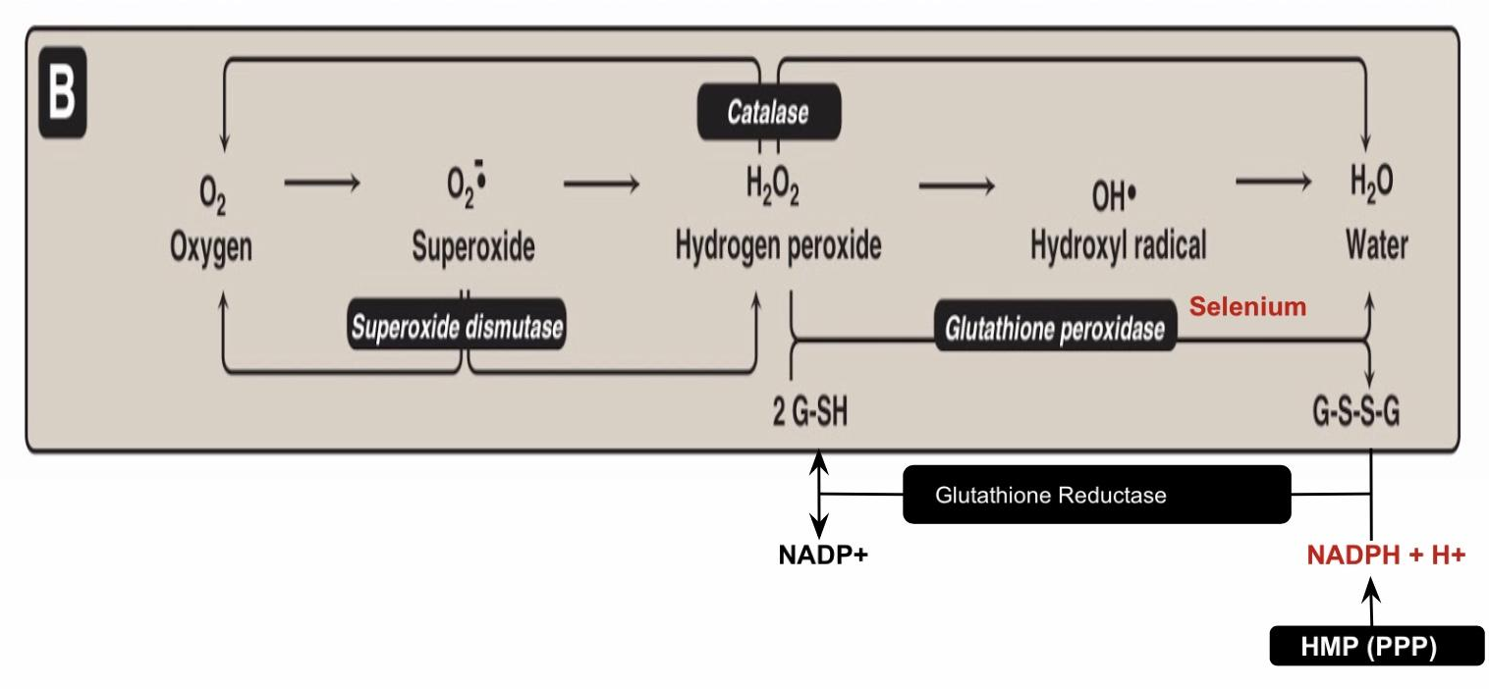
Background
Reactive Oxygen Species (ROS)
Glutathione System
-Oxygen-derived Free radicals: e.g., Superoxide and hydroxyl
-radicals Non-free radical: Hydrogen peroxide
Oxidative Stress:
Imbalance between oxidant production and antioxidant mechanisms
Antioxidant Mechanisms
Oxidative damage to
Oxidative stress and diseases
1- DNA
2- Proteins
3- Lipids (unsaturated fatty acids)
1- Inflammatory conditions e.g., Rheumatoid arthritis Atherosclerosis and coronary heart diseases
2- Obesity
3- Cancers
4- G6PD deficiency hemolytic anemia

Slide 5
G6PD Deficiency Hemolytic Anemia
Inherited X-linked recessive disease
Most common enzyme-related hemolytic anemia
Highest prevalence: Middle East, Tropical Africa Asia and Mediterranean
~400 different mutations affect G6PD gene, but only some can cause clinical hemolytic anemia
G6PD deficient patients have increased resistance to infestation by falciparum malaria

Slide 6
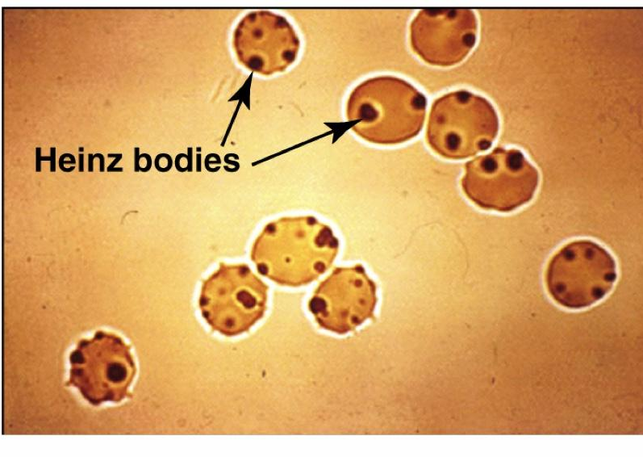
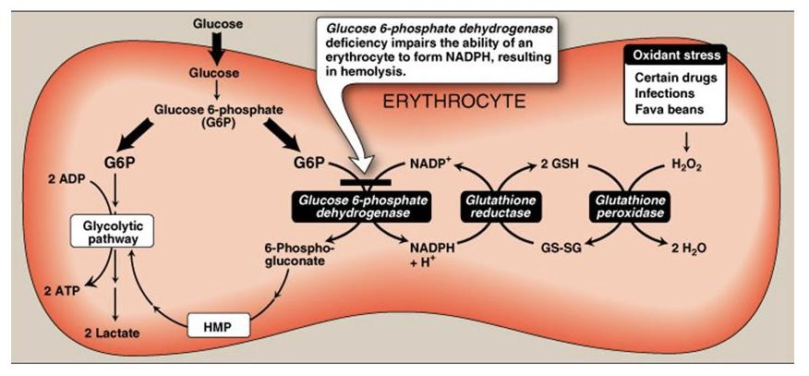
Biochemical Basis of G6PD Deficiency Hemolytic Anemia
Oxidation of sulfhydryl (SH) groups of proteins inside RBCs causes protein denaturation and formation of insoluble masses (Heinz bodies) that attach to RBCs membranes
-G6PD convert G6P to 6-phosphogluconate and make NADPH So if I don't have this enzyme “G6PD” I will not have NADPH and I will not have reduced glutathione thus I can not convert hydrogen peroxide“H2O2” to H2O
-Accumulation of H2O2 will cause oxidative stress that will damage the proteins and this include the cell membrane of the RBCs which is protein leading to hemolysis
Al though G6PD deficiency affects all cells,
it is most severe in RBCs …… Why?
Other cells have other sources for NADPH production:
e.g., Malic enzyme that converts malate into pyruvate

Slide 7
Precipitating factors for G6PD deficiency hemolytic anemia
G6PD deficient patient will develop hemolytic attack upon:
1
2
3
Intake of oxidant drugs (AAA):
Antibiotics e.g : sulfa preparation
Antimalarial e.g : Primaquine
Antipyretics
Exposure to infection
Ingestion of fava beans
(favism , mediterranean variant )
Chronic nonspherocytic anemia:
Hemolytic attack in absence of precipitating factors .
( severe form due to class I mutation )
Different classes of G6PD Deficiency Hemolytic Anemia
I
(very severe)
II
(Severe: mediterranean)
III
(Moderate: G6PD A-)
IV
(Normal)
This classification is based on the residual enzyme activity (Least in class I, and Highest in class IV)

Slide 8
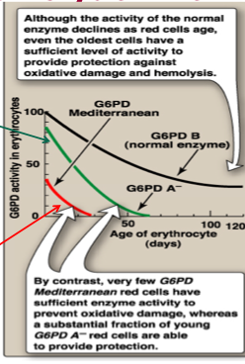
Variant Enzymes of G6PD Deficiency Hemolytic Anemia
Diagnosis of G6PD deficiency hemolytic anemia
Diagnosis of hemolytic anemia
Screening
G6PD A-(class III)
Moderate, young RBCs contain enzymatic activity. Unstable enzyme, but kinetically normal
Complete Blood Count (CBC) & reticulocytic count
Qualitative assessment of G6PD enzymatic activity (UV-based test)
Confirmatory test:
Molecular test:
G6PD Mediterranean(II)
Enzyme with decreased stability Resulting in decreased activity (severe). Affect all RBCs
(both young and old)
Quantitative measurement of G6PD enzymatic activity
Detection of G6PD gene mutation

Slide 9
Take Home Messages
G6PD deficiency impairs the ability of cells to form NADPH.
RBCs are particularly affected because they do not have other sources of NADPH.
NADPH is essential for the antioxidant activity of Glutathione peroxidase/reductase system
G6PD deficiency is an X-linked disease characterized by hemolytic anemia.
The precipitating factors of hemolysis includes administration of oxidant drugs, ingestion of fava
beans or severe infections.
G6PD deficiency is classified according to the residual activity of the G6PD
Class I variant (the most severe) class is associated with chronic nonspherocytic hemolytic anemia.

Slide 10
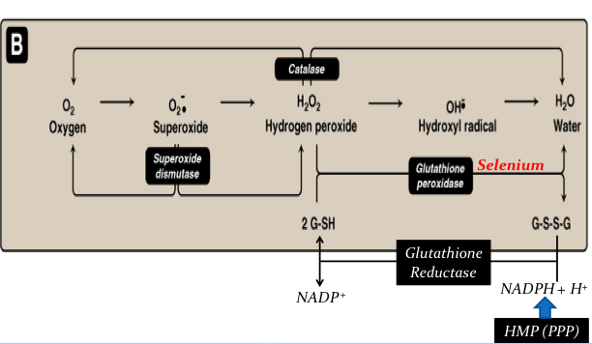
Summary
Hexose monophosphate pathway (HMP) or Pentose Phosphate Pathway (PPP)
Major pathway for NADPH production
Uses of NADPH:
1)Reductive biosynthesis e.g., fatty acid biosynthesis
2)Oxygen-dependent phagocytosis by WBCs
3)Antioxidant (part of glutathione system)
4)Synthesis of nitric oxide (NO)
G6PD converts G6P to 6-phosphogluconate and makes NADPH
When G6PD is deficient their will be no production of NADPH
So I will have no reduced glutathione
Thus I cannot convert H₂O₂ to H₂O
Accumulation of H₂O₂ causes oxidative stress and damage to proteins
Gg
Screening
Complete blood count
Diagnosis of G6PD deficiency hemolytic anemia
Molecular test
Confirmatory test

Slide 11
Quiz
MCQs:
Q1: which one is not one of the uses of NADPH
a) part of glutathione system b) synthesis of NO
c) Biosynthesis of fatty acid d) non-oxygen dependent phagocytosis
Q2: while glutathione reductase converts GSSG to 2GSH —— will also be converted to ——.
a) NADP+,NADPH+H+ b) NADPH+H+,NADP+
c) NADPH+,H+ d) NADPH+H+,NADPH+
Q3: which one of the following is true about G6PD deficiency hemolytic anemia?
a) Inherited x link dominant disease
b) Almost all mutations of the gene for G6PD cause hemolytic anemia c) Increase resistant infestation to falciparum malaria
Q4: The moderate state of G6PD deficiency is classified as class:
a) 2 b) 3 c) 1 d) 4
Q5: For the diagnosis of G6PD deficiency,the confirmatory test is by
a) Qualitative assessment of G6PD enzymatic activity
b) CBC
c) Detection of G6PD gene mutation
d) Quantitative measurement of G6PD enzymatic activity
SAQs :
Q1: List 3 uses of NADPH
Q2: Give 2 examples of ROS free radicals and non free radicals
Q3: Which class of G6PD deficiency effects all RBC
Q4: Oxidation of SH groups of proteins inside RBC causes denaturation and formation of insoluble masses known as:
MCQs Answer key:
1) D 2)B 3) C 4) B 5) D
SAQs Answer key:
Antioxidants,reductive biosynthesis,synthesis of NO
Free radical:superoxide ,hydroxyl. Non free radicals hydrogen peroxide
Second class
Hienz bodies

Slide 12
Team members
اللهم لا سهلا الا ماجعلته سهلا وأنت تجعل الحزن اذا شئت سهلا
Girls Team:
Boys Team:
Ajeed Al-Rashoud
Alwateen Albalawi
Amira AlDakhilallah
Arwa Al Emam
Deema Almaziad
Ghaliah Alnufaei
Haifa Alwaily
Leena Alnassar
Lama Aldakhil
Lamiss Alzahrani
Nouf Alhumaidhi
Noura Alturki
Sarah Alkhalife
Shahd Alsalamah
Taif Alotaibi
Abdulrahman Bedaiwi
Alkassem Binobaid
Khayyal Alderaan
Mashal Abaalkhail
Naif Alsolais
Omar Alyabis
Omar Saeed
Omar Odeh
Rayyan Almousa
Yazen Bajeaifer
Team Leaders
We hear you
Lina Alosaimi
Mohannad Alqarni

