Slide 1
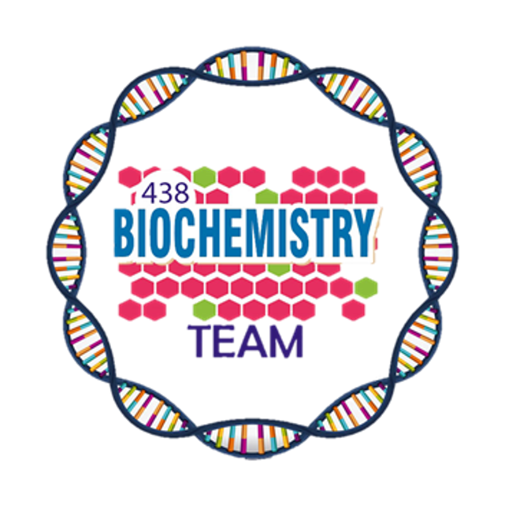
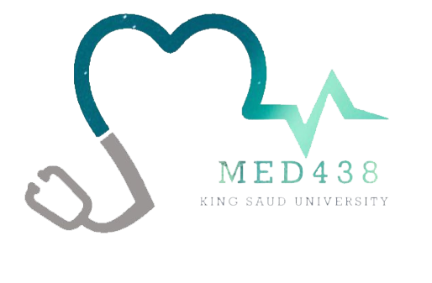
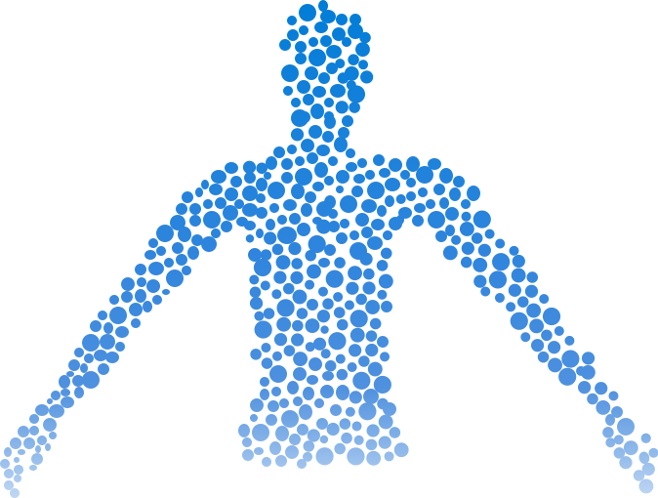
Urea Cycle
Color Index:
Main Topic
Main content
Important
Drs’ notes
Extra info
Editing File
Biochemistry teamwork 438 - Gastrointestinal & Nutrition Block

Slide 2
Objectives:
Understand the reactions for removal of α-amino group of amino acids and formation of ammonia
Identify the importance of blood transport of ammonia to the liver in the form of glutamine/alanine
Understand the importance of conversion of ammonia into urea by the liver through urea cycle
Identify the causes (hereditary & acquired), clinical manifestations and management of hyperammonemia
Background:
Unlike glucose and fatty acids, amino acids are not stored by the body.
Degradation of amino acids involves:
Removal of α-amino group ¹ → Ammonia (NH₃)
Remaining carbon skeleton → Energy metabolism
Amino acids in excess of biosynthetic needs are degraded.
Sources of amino acid in the body:
Diet
Protein turnover
Biosynthesis such as nonessential amino acid
If the body want to degrade the amino acid, it has to remove the amino group in the form of “ammonia”, but because the ammonia is toxic we also have to get rid of it. To get rid of it: body must transport it first to the liver, then in the liver the ammonia will be converted to “urea” and then excreted.
Amino group, protects the amino acid from being metabolized. Remove it involves two reactions: Transamination & Deamination

Slide 3
Amino Acid Degradation (α-amino group)
First:
“Removal of α-amino group of amino acids & formation of ammonia”
Second:
“Blood transport of ammonia
into liver”
Transamination to Glutamate.
(Except in the Muscles → to Alanine)
Oxidative deamination of Glutamate
Amino groups of amino acids are funneled to “Glutamate” by: transamination reactions with
α-ketoglutarate. Because Glutamate is unique & It is the only amino acid that undergoes rapid oxidative deamination.
Oxidative deamination of glutamate will release NH₃ and re-generate α-ketoglutarate & NADH.
In the form of Glutamine¹ (most tissue)
In the form of Alanine (muscle²)
Ammonia is produced by all tissues and the main disposal is via formation of urea in liver.
Blood level of NH₃ must be kept very low. otherwise, hyperammonemia and CNS toxicity will occur (NH₃ is toxic to CNS).
To solve this problem, NH₃ is transported from peripheral tissues to the liver via formation of:
Glutamine (most tissues)
Alanine (muscle)
Dibasic amino acid, the only transporter of glutamate molecules from other tissues to liver.
Because the ﬁnal product of anaerobic metabolism is pyruvate which is a main component of alanine.

Slide 4
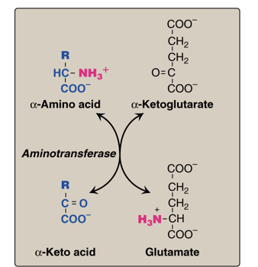
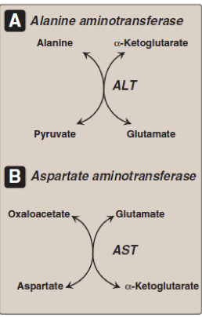
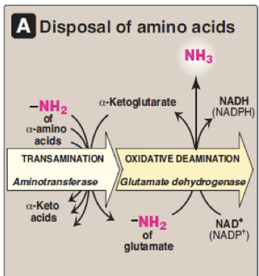
The First Step:
(Removal of α-amino group of amino acids & formation of ammonia)
Transamination: The amino group is transferred from the α-amino acid to α-Ketoglutarate (acceptor of amino groups) by Aminotransferase with the help of PLP, forming glutamate & α-keto acid “Note that the reaction is bidirectional”.
Two common examples for this reaction is transamination of alanine and aspartate:
The amino group is transferred from the alanine to the α-Ketoglutarate
(acceptor of amino groups) by ALT with the help of PLP, forming glutamate & pyruvate.
The amino group is transferred from the aspartate to α-Ketoglutarate (acceptor of amino groups) by AST with the help of PLP, forming glutamate & oxaloacetate. “Note that the reaction can go in the other direction where the amino group is transferred from glutamate to oxaloacetate forming aspartate which is needed for urea cycle”.
To remove the amino group from glutamate, it undergoes deamination. Deamination: involves reducing NAD to NADH (gains H) and oxidising glutamate to α-Ketoglutarate by the enzyme glutamate dehydrogenase. The reaction is called oxidation- reduction reaction. This result in the removal of ammonia, and the regeneration of α-Ketoglutarate.
❶
01
A.
B.
PLP : Pyridoxal phosphate, a coenzyme that is derived from vitamin B6.
Transamination by : ALT & AST.
❷
02
Oxidative deamination
Summary : Transamination is done in tissue, while Deamination in liver.
It’s important to know the names of these reactions, their substrates, enzymes and products.

Slide 5
The Second Step:
(Blood transport of ammonia into liver)
From most peripheral tissues:
Most tissues
Release of ammonia from glutamine and alanine in the liver:
NH₃ is transported Into the liver through forming glutamine by glutamine synthetase¹.
❶
Glutamine
converted into glutamate by glutaminase.
❶
❷
Alanine
will give its amino group to α-ketoglutarate to form glutamate by ALT.
❸
From the muscle:
First, NH₃ will be transferred into α-ketoglutarate to form glutamate.
Then, glutamate will give its amino group to pyruvate to form alanine by ALT .
Therefore, NH₃ is transported from muscle into the liver through forming alanine.
❷
❸
Glutamate
is converted into α-ketoglutarate and releasing NH₃ by glutamate dehydrogenase².
Muscle
In summary:
Blood transport of NH₃ from peripheral tissues (in the form of glutamine and from the muscles in the form of alanine ) into the liver.
The release of NH₃ black in the liver to start the urea cycle.
Turn glutamate into glutamine ”glutamic acid” by adding ammonia Requires ATP “any synthetase requires ATP”.
Deamination process.

Slide 6
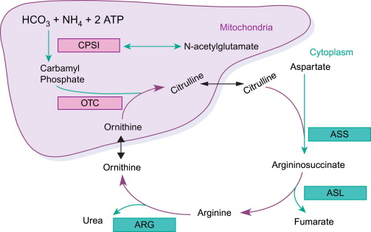
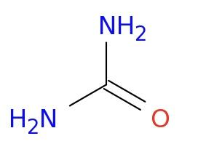
Urea Cycle
It's occurs in the liver
Urea
is transported in the blood to the kidney for excretion in urine.
is the major form for disposal of amino groups derived from amino acids.
One nitrogen of Urea is from NH3 (Ammonia) and the other nitrogen is from aspartate (2N from aspartate).
Carbamoyl Phosphate Synthetase I (CPSI)^{1M}
5
enzymes of urea cycle:
Ornithine Transcarbamylase (OCT/OTC)^{2M}
Argininosuccinate Synthase (ASS)^{C}
(M) mitochondria
(C) cytoplasm
Rate limiting enzyme, needs N-acetyl glutamate to be activated.
“activator” When I eat more protein, I will have More arginine and more glutamate, which will increases n acetyl glutamate, which in turn increases the production of urea.
Alternative name: Ornithine carbamoyltransferase that's why we call it “OCT”Could also be called (OTC) MOST COMMON.
Present only in the liver, this is why the urea cycle happens only in the liver.
Argininosuccinate Lyase (ASL)^{C}
Arginase (ARG)^{3C}

Slide 7
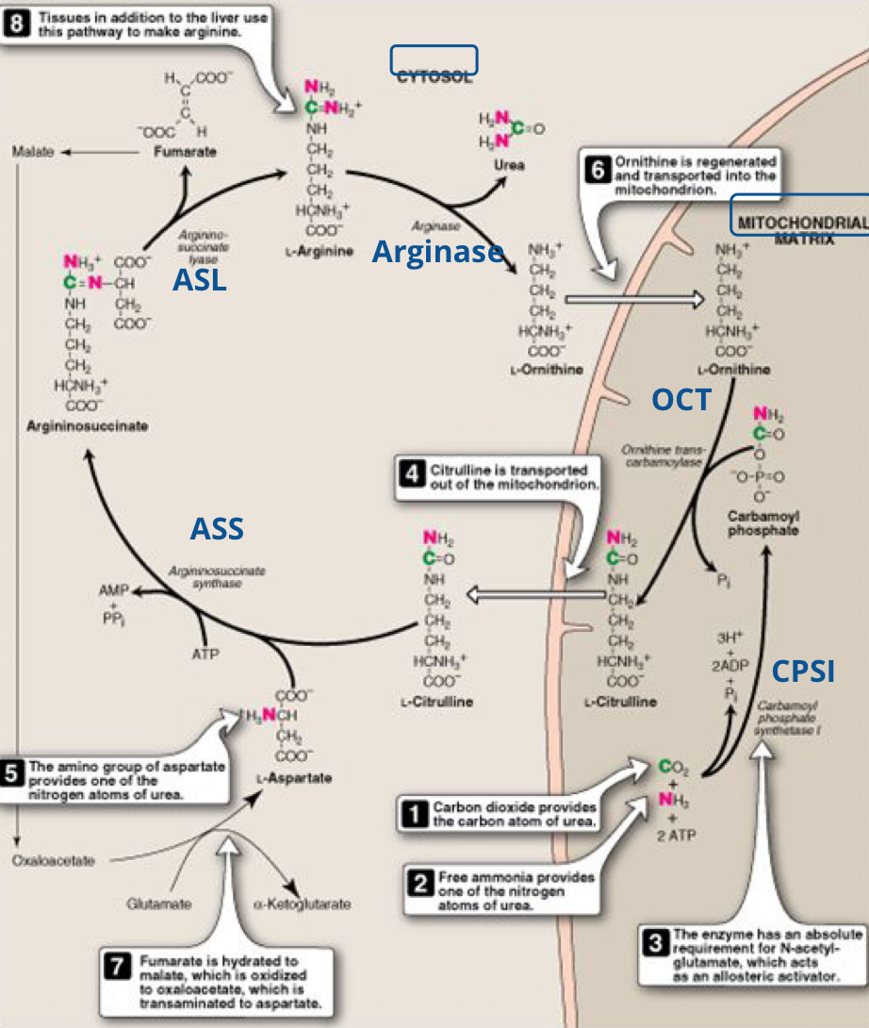
Urea Cycle
Female doctor note: “knowing the enzymes is extremely important but understanding the cycle is for yourself”.
Cytosol
437 notes:
The ammonia in the presence of ATP & CO2 will create the Urea backbone with the use of Carbamoyl phosphate synthetase I Enzyme in the presence of N-Acetylglutamate as an activator will convert it to Carbamoyl Phosphate.
Carbamoyl Phosphate in the presence of Ornithine and OTC Enzyme (Ornithine transcarbamylase) will convert it to Citrulline.
Citrulline will leave the mitochondria to go to the cytosol where a nitrogen group will be added to it from aspartate by Argininosuccinate synthase which will convert it to Argininosuccinate.
Argininosuccinate will be converted to arginine by Argininosuccinate lyase.
Arginine will be converted to Ornithine by Arginase. This is the MOST IMPORTANT step as it will lead to the release of urea & The cycle precursor ( The Ornithine ).
Ornithine will leave the cytosol to go the mitochondria to start another Cycle.
Mitochondrial Matrix
Arginase
ASL
OTC
ASS
CPSI

Slide 8
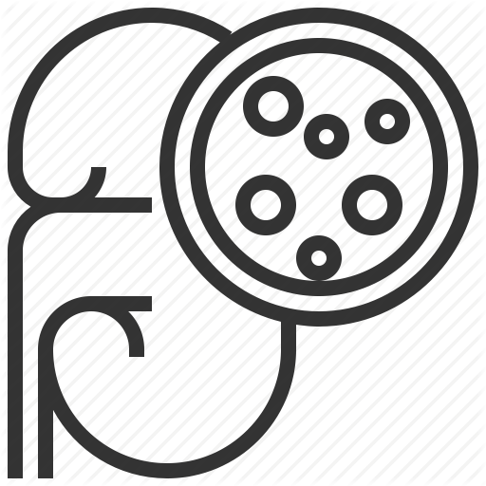
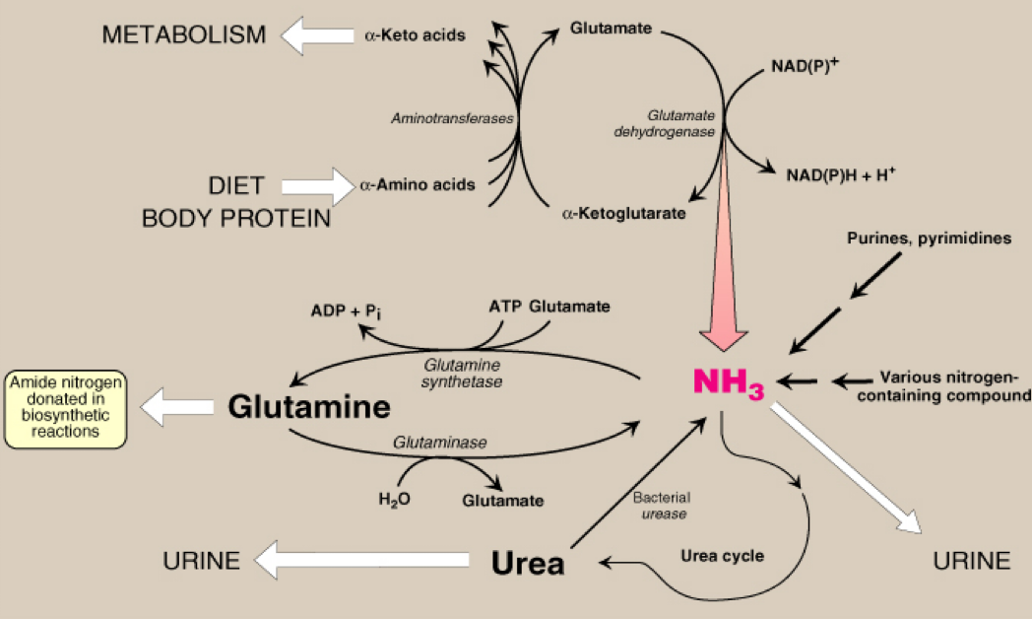
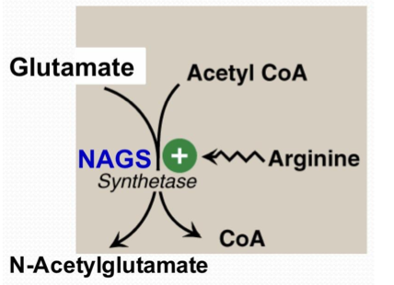
Urea Cycle: Regulation
Blood
Kidneys and excreted in Urine
Rate-limiting enzyme of urea cycle:
Urea
Urease
Carbamoyl phosphate synthetase I (CPSI)
Intestine
NH₃ + CO₂
From normal flora
Allosteric activator of CPSI:
Lost in feces
Reabsorbed into blood
N-Acetylglutamate
The action of intestinal Urease to form NH3 is clinically signiﬁcant in renal failure:
N-Acetylglutamate is synthesized by:
N-Acetylglutamate synthetase (NAGS) in presence of arginine
NH₃
blood level
Renal Failure
Urea to
intestine
Urease
Blood Urea
(acquired hyperammonemia)
NAGS deficiency is efficiently treated with
Carbaglue → a CPS1 activator
“I’m not going to waste my time here it's just summary”
Sources & Fate of ammonia
Normal blood level of ammonia: 5-50µmol/L

Slide 9
Hyperammonemia
Acquired hyperammonemia:
Inherited hyperammonemia:
Liver disease
Acute: Viral hepatitis or hepatotoxic
Chronic: Cirrhosis by hepatitis or alcoholism
Genetic deficiencies of any of the 5 enzymes of
urea cycle or the activator enzyme for CPSI:
CPSI, OTC, ASS, ASL, arginase or NAGS
1
2
Renal failure
Ornithine transcarbamylase deficiency:
X-linked recessive
Most common of congenital hyperammonemia
Marked decrease of citrulline and arginine
Others: Autosomal recessive
Tremors
Vomiting and cerebral edema
“Not that important”
Clinical Presentation
Convulsions
Lethargy and somnolence
Coma and death

Slide 10
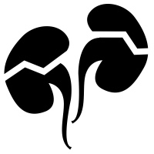
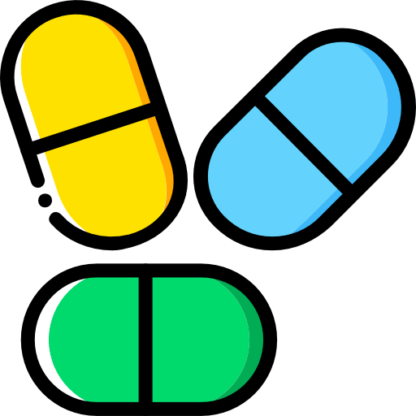
Hyperammonemia cont.
Management:
Drugs of treatment:
Protein restriction
01
Drugs that scavenge ammonia by creating an alternate pathway to excrete N 2- precursors:
I.V. Sodium phenylacetate & sodium benzoate (Ammonul)
Oral sodium phenylbutyrate (Buphenyl)
I.V. Arginine: for all UCDs except UCD due to arginase deﬁciency (argininemia)
Volume repletion to maintain renal function
○ Use 10% dextrose in water but limit the use of normal saline
Sodium phenylbutyrate (Buphenyl):
Prodrug that is converted to phenylacetate.
Phenylacetate condenses with glutamine (in blood) forming phenylacetylglutamine that is excreted in urine.
Ammonia removal by hemodialysis & or drugs
Avoid drugs that increase protein catabolism (eg, glucocorticoids) or inhibit urea synthesis (eg, valproic acid), or have direct hepatotoxicity
02
Activators to CPSI (Carglumic acid ‘Carbaglu’):
For hyperammonemia due to NAGS deﬁciency

Slide 11
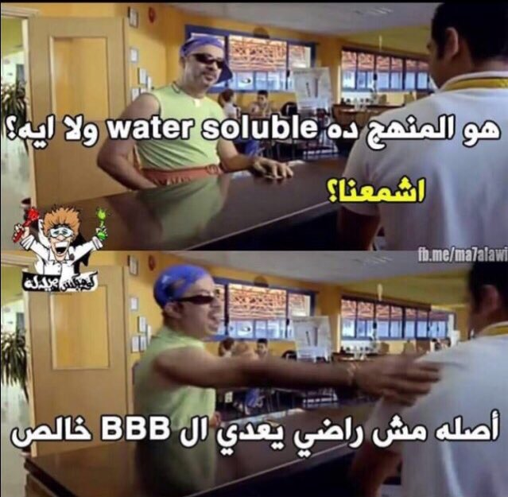
Summary
❶ Removal of α-amino group, formation of ammonia
Transamination: By ALT & AST. Amino groups of amino acids are funneled to glutamate by transamination reactions with α-ketoglutarate. Oxidative deamination: in liver By Glutamate dehydrogenase. The glutamate will release NH₃ & Regenerate α-ketoglutarate.
❷ Transport of NH₃ from peripheral tissues into the liver
Glutamine (from most tissues to liver). Glutamine formed by glutamine synthetase. Alanine (from muscles to liver).
❸ Release of ammonia from glutamine and alanine in the liver
Glutamine is converted back into glutamate by glutaminase. Alanine will give its amino group to α-ketoglutarate to form glutamate by ALT. Glutamate is converted into α-ketoglutarate and releasing NH₃ by glutamate dehydrogenase.
Enzymes of urea
Carbamoyl Phosphate synthetase (CPSI)
Ornithine Transcarbamylase (OTC)
Argininosuccinate Synthase (ASS)
Argininosuccinate Lyase (ASL)
Arginase
Regulation of urea cycle
RATE-LIMITING ENZYME of urea cycle: (CPSI).
Allosteric activator of CPSI: (N-Acetylglutamate).
N-Acetylglutamate is synthesized by:
N-Acetylglutamate synthetase (NAGS) in presence of arginine.
Treatment of NAGS deﬁciency:
(Carbaglu, CPS1 activator).
Urea Cycle
Fate of urea
To the kidneys (Mostly) excreted in urine.
To the intestine by urease gives NH ₃ (lost in feces or reabsorbed into blood + CO₂ ).
Hyperammonemia
Acquired (liver diseases – Renal failure).
Inherited (all the enzymes are autosomal recessive except OTC which is X-linked recessive).
Treatment: Oral sodium phenylbutyrate (Buphenyl) a Prodrug that is converted to phenylacetate.

Slide 12
Quiz
MCQs :
Q1: Blood transport of ammonia into liver in form of:
a) Glutamate (in most tissues) b) Glutamine (in most tissues) c) Alanin (in muscle) d) Both b & c
Q2: Glutamine is converted into glutamate by:
a) Glutamine synthetase b) Glutaminase
c) Glutamate dehydrogenase d) ALT
Q3: Which one of the following is the rate limiting enzyme of urea cycle?
a) Arginase b) CPSI
c) OCT d) Argininosuccinate Lyase
Q4: What is the allosteric activator enzyme of urea?
a) NAGS b) Carbaglue c) N-Acetylglutamate d) CPS1
Q5: Which one of the following enzymes is X linked recessive
a) Arginase b) OCT
c) NAGS d) Argininosuccinate synthase
Q6: Which drugs work as activator for CPSI, can be used in case of hyperammonemia due to NAGS deficiency?
a) Carglumic acid b) Buphenyl c) Sodium phenylacetate d) I.V. Arginine
SAQs :
Q1: What are the products of oxidative deamination reaction of glutamate?
Q2: Explain the steps of releasing ammonia from glutamine and alanine in the liver.
Q3: 35 y.o patient was diagnosed with hyperammonemia, which drugs he must avoid it?
Q4: How can Sodium phenylbutyrate (Buphenyl) treat hyperammonemia?
MCQs Answer key:
1) D 2) B 3) B 4)A 5) B 6) A
SAQs Answer key:
NH₃ ”ammonia”, α-ketoglutarate and NADH “NADPH”.
Glutamine is converted into glutamate by glutaminase. Alanine will give its amino group to α-ketoglutarate to form glutamate by ALT. Glutamate is converted into α-ketoglutarate and releasing NH₃ by glutamate dehydrogenase.
Valproic acid and glucocorticoids.
It’s a prodrug that converted to phenylacetate. Phenylacetate then condenses with glutamine (in blood) forming phenylacetylglutamine that is excreted in urine. (scavenge ammonia by creating an alternate pathway)

Slide 13
Team members
Do something today that your future self will thank you for
Girls Team:
Boys Team:
Ajeed Al-Rashoud
Alwateen Albalawi
Amira AlDakhilallah
Arwa Al Emam
Deema Almaziad
Ghaliah Alnufaei
Haifa Alwaily
Leena Alnassar
Lama Aldakhil
Lamiss Alzahrani Nouf Alhumaidhi Noura Alturki
Sarah Alkhalife
Shahd Alsalamah
Taif Alotaibi
Abdulrahman Bedaiwi
Alkassem Binobaid
Khayyal Alderaan
Mashal Abaalkhail
Naif Alsolais
Omar Alyabis
Omar Saeed
Omar Odeh
Rayyan Almousa
Yazen Bajeaifer
Team Leaders
We hear you
Lina Alosaimi
Mohannad Alqarni

