Slide 1
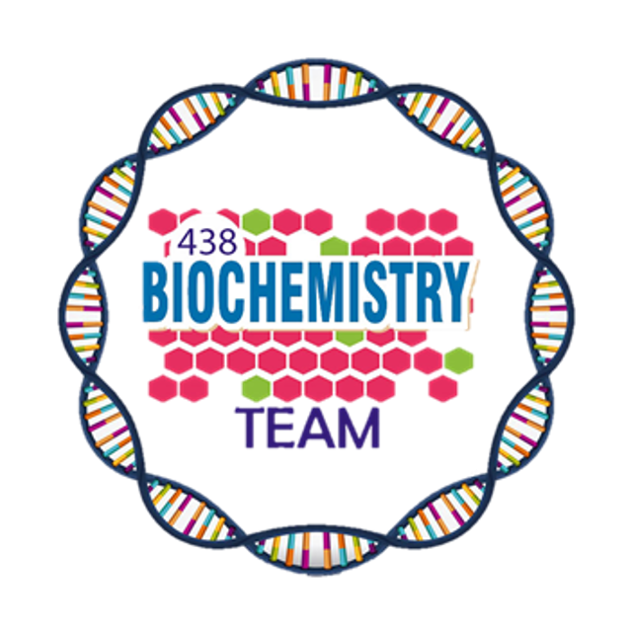
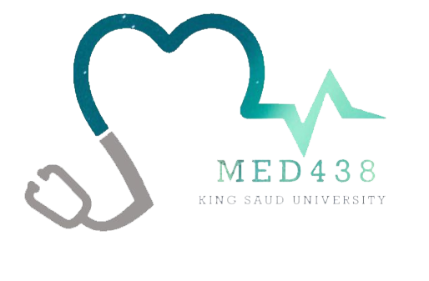
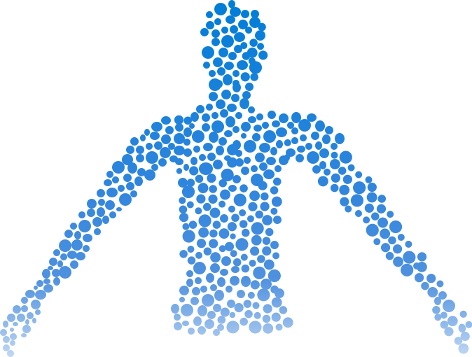
Structure & Function of Hemoglobin
Color Index:
Main Topic
Main content
Important
Drs’ notes
Extra info
Editing File
Biochemistry teamwork 438 - Gastrointestinal & Nutrition Block

Slide 2
Objectives:
The structure and function of hemoglobin.
The factors affecting oxygen binding to hemoglobin.
Examples of normal and abnormal hemoglobin structures.

Slide 3
Hemoglobin (Hb)
Oxygen transport function
Contains heme as prosthetic group
A hemeprotein found only in red blood cells
Heme reversibly binds to oxygen
A complex of protoporphyrin IX + ferrous (Fe²⁺)
The heme group:
The iron molecule must be in the ferrous state (Fe²⁺) When the Heme group contains ferrous iron, the iron is able to bind to 6 molecules:
○ 4 Pyrrole nitrogens of the porphyrin ring
○ 1 Histidine of the globin chain
○ 1 Molecular O₂ 3+
In case the iron was in the ferric state (Fe³⁺), it can only make five bonds, so it cannot bind to oxygen. This is the case in Met-hemoglobin. “Abnormal hemoglobin”
Fe²⁺ is present in the center of the heme
Fe²⁺ binds to four nitrogen atoms of the porphyrin ring
Forms two additional bonds with:
Oxygen
Histidine residue of globin chain

Slide 4
Types of Hb
Normal
Abnormal:
Unable to transport O² due to abnormal structure
Form | Chain composition | Fraction of total hemoglobin
HbA | α₂β₂ | 90%
HbF | α₂γ₂ (Gamma) | < 2%
HbA₂ | α₂δ₂ (Delta) | 2% - 5%
HbA_{1c} | α₂β₂-glucose | 3% - 9%
1- Carboxy Hb
CO replaces O₂ and binds 220X tighter than O₂ (in smokers)
2- Met Hb
Contains oxidized Fe³⁺ (~2%) that cannot carry O₂
3- Sulf Hb
Forms due to high sulfur levels in blood (irreversible reaction)

Slide 5
Hemoglobin A (HbA)
Major Hb in adults
Composed of four polypeptide chains:
Two α and two β chains
Contains two dimers of αβ subunits¹
Held together by non-covalent interactions²
1- A dimer is made of one α and one β chains.
2- The bond between the two subunits in one dimer is called an intradimer bond
-The bond between the 2 dimers are called interdimer bonds
-The intradimer bonds are much stronger than the interdimer bonds, which allows the movement of the 2 dimers
Each chain is a subunit with a heme group in the center that carries oxygen
A Hb molecule contains 4 heme groups and carries 4 molecules of O₂
VS
- a molecule made by the shunt in the pathway of glycolysis in the RBCs. This molecule binds to the deoxy form of Hb and stabilizes it, allows the release of O₂.
- In case of deficiency of DPG, the Hb can bind to oxygen but can't release it, resulting in the trapping of O₂ in the Hb
T-form of Hb
R-form of Hb
→ The deoxy form of Hb
→ Taut form
→ The movement of dimers is constrained
→ Low-oxygen-affinity form
→ The oxygenated form of Hb
→ Relaxed form
→ The dimers have more freedom of movement
→ High-oxygen-affinity form

Slide 6
Hemoglobin function
Carries O₂ from the lungs to tissues
Carries CO₂ from tissues back to the lungs
Normal level (g/dL):
: 14-16 (g/dL)¹
:13-15 (g/dL)²
Factors affecting oxygen binding
1
3
pO₂ (partial oxygen pressure)
pCO₂ (partial carbon dioxide pressure)
2
4
pH of the environment
Availability of 2,3-bisphosphoglycerate
1- in smokers the Hemoglobin level could be physiologically higher due to adaptation mechanisms.
2- the decreased level in female due to the menstrual period

Slide 7
Oxygen Dissociation Curve (ODC)
The curve is sigmoidal¹
Indicates cooperation of subunits in O₂ binding
Binding of O₂ to one heme group increases O₂ affinity of others
Heme-heme interaction²
Percent Saturation depends on how many O₂ molecules are bound to Hb, for example Hb bound to one O₂ molecule is 25% saturated, if 2 molecules it is 50% saturated and so on.
we have different degrees of saturation.
As we shift to the right the affinity to O₂ decreases.
P₅₀:
Indicates affinity of Hb to O_{2.}
P₅₀ (mmHg): the pressure at which Hb is 50% saturated with O₂
The affinity:
May come as SAQ alhuwaykan way (;
fast unloading of O₂
slow unloading of O₂
Low
High
Dr.kurdy said “For you in the future If you asked to read a graph:
1- you have to define what you see in the X and Y axis and the scale
2- explain the normal then explain the abnormal”
Lung pO₂
100 mmHb saturation 100%
1- The shape of the curve has a lag phase and a steep phase which indicates the presence of cooperative binding.
2- Happens when the binding of the first O₂ molecule facilitates the binding of the second molecule “makes it faster”. And the binding of the first and second facilitates the third and so on.
Tissue pO₂
40 mmHb saturation reduces
Hence O₂ is delivered to tissues

Slide 8
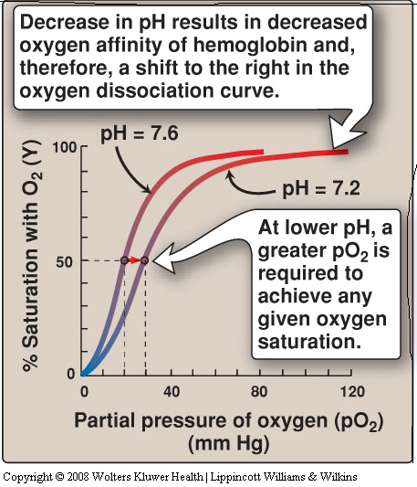
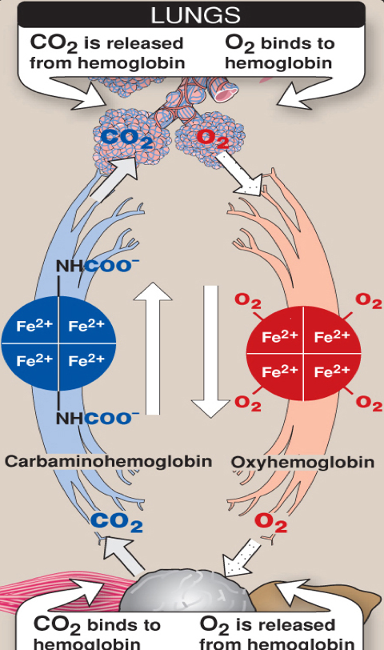
The Bohr effect
It is the shift of the ODC “oxygen dissociation curve” to the right in response to an increase in pCO₂ or a decrease in pH.
It describes the Eﬀect of ph and pCO₂ on:
1. Oxygenation of Hb in the lungs.
2. Deoxygenation in tissues.
The result of Bohr effect is unloading O₂ inside the tissues and taking CO₂ outside.
Also BPG has the same result to unload O₂ inside the tissues.

Slide 9
The Bohr effect
In the lungs
Protons are released and react with HCO3- to form CO₂ gas
CO₂ + H₂O ↔ H₂CO₃ ↔ HCO₃₋ + H⁺
The proton-poor Hb now (in the lungs) has greater affinity for O₂.
The Bohr effect removes insoluble CO₂ from bloodstream and Produces soluble bicarbonate.
Tissues have lower pH (acidic) than lungs Due to proton generation (two reactions):
CO₂ + H₂O ↔ H₂CO₃ ↔ HCO₃₋ + H⁺
Protons reduce O₂ affinity of Hb Causing easier O₂ release into the tissues.
The free Hb binds to two protons.
→
→
In the tissues

Slide 10
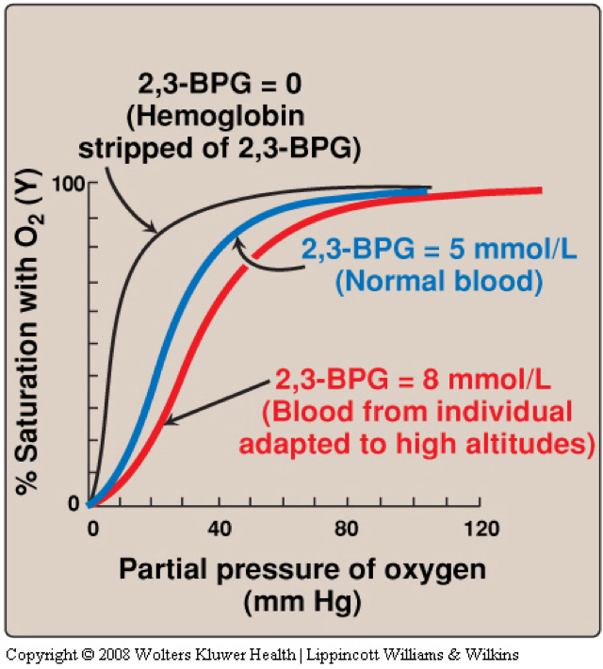
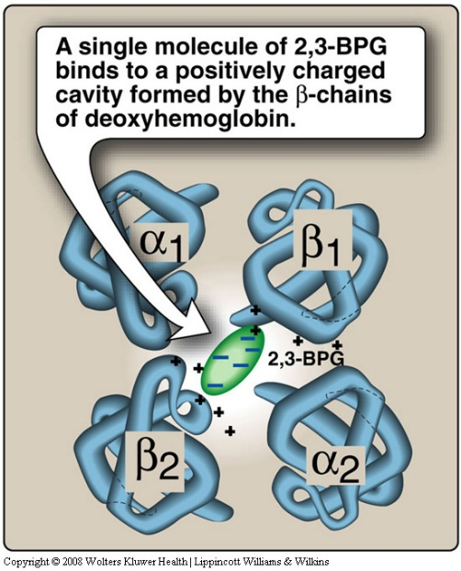
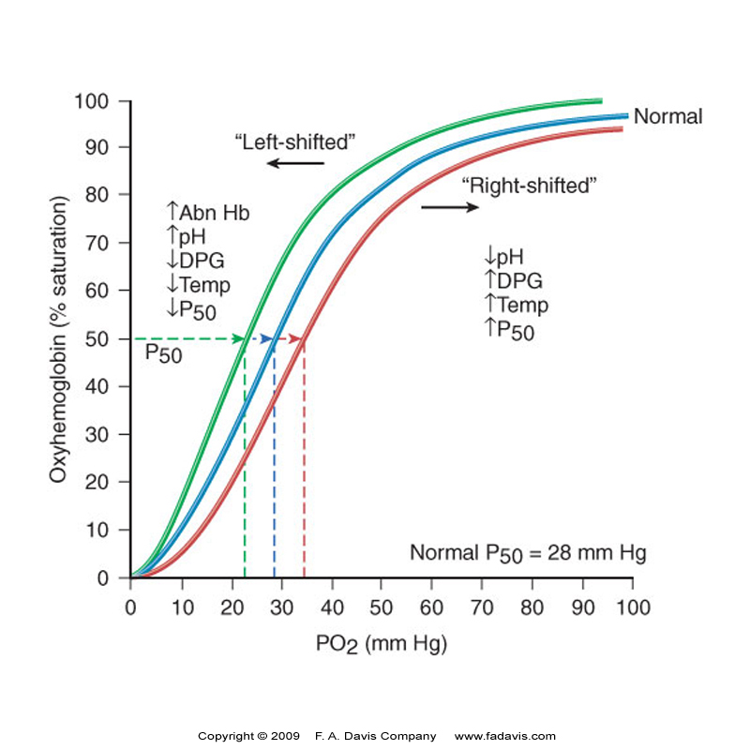
Availability of 2,3 bisphosphoglycerate (BPG/DPG)
High altitude and O₂ affinity
In hypoxia and high altitude:
In the tissues
BPG Binds to deoxy-hb and stabilizes the T-form.
In the lungs
2,3 BPG levels↑
↓O₂ affinity of Hb
↑O₂ delivery to tissues
When oxygen binds to Hb, BPG is released.
High O2 affinity
High O2 affinity is due to:
Alkalosis
High levels of HbF
Multiple transfusion of 2,3 DPG-depleted blood¹
At high altitude:
↑RBC number
↑Hb conc.
↑2,3 BPG
1- Dr.kurdy: A blood unit can withstand for about 90 days, because it has anticoagulants, but these anticoagulants can cause depletion of the normal amount of DPG, which means this blood unit may has a partially depleted amount of DPG, thus deficiency of DPG, so it can’t do its job and it needs time to compensate that loss.

Slide 11
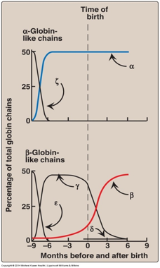
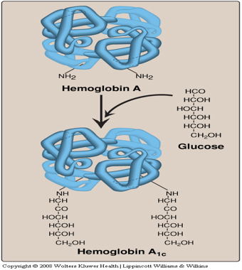
Other hemoglobin forms
Types | HbF | HbA₂ | HbA_{1c}
Structure (All Tetramer) | two α and two (gamma) γ chains | two α and two (delta) δ globin chains | Two α and two β -Glucose
Found | Major hemoglobin found in the fetus and newborn. | Appears shortly before birth. | high in patients with diabetes mellitus.
Deference | ● Higher affinity for O₂ than HbA ● Transfers O₂ from maternal to fetal circulation across placenta | Constitutes ~2% of total Hb | ● it’s HbA undergoes non-enzymatic glycosylation ● Glycosylation depends on plasma glucose levels
اذا فيه كلمة افضل لأنها ما اعجبتني
<———-

Slide 12
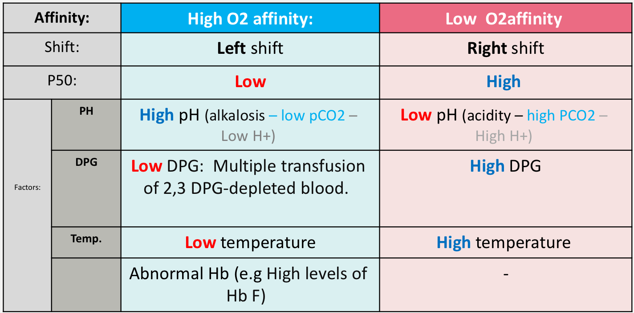
Summary
A hemeprotein found only in red blood cells
Fe²⁺ is present in the center of the heme
The heme group
A complex of protoporphyrin IX and ferrous iron (Fe²⁺)
Oxygen transport function
Hemoglobin
Fe²⁺ binds to four nitrogen atoms of the porphyrin ring
Contains heme as prosthetic group
Oxygen
Forms two additional bonds with
بكمل الباقي
Heme reversibly binds to oxygen
Histidine residue of globin chain

Slide 13
Quiz
MCQs :
Q1: The movement of dimers is constrained in which type of Hb:
a) Relaxed form b) High-oxygen-affinity form c) T form d) B&C
Q2: A type of Hb composed of α₂γ₂:
a) HbA₂ b) HbF c) HbA d) HbA_{1C}
Q3: The bond connect the two dimers is:
a) Ionic bond b) Covalent bond c) Non-covalent d) A&C
Q4: Shifting of the ODC “oxygen dissociation curve” to the right means?
a) pH ↓ b) DPG ↓ c) PCO₂ ↓ d) None of them
Q5: Ali patient with hypoxia went to visit his uncle in Abha, what do you expect to find?
a) BPG ↓ b) O₂ delivery to tissues ↓ c) O₂ affinity ↓ d) A&C
Q6: Which one of the following statements concerning the binding of oxygen by hemoglobin is correct?
a) The Bohr effect results in a lower affinity for oxygen at higher pH values.
b) Carbon dioxide increases the oxygen affinity of hemoglobin by binding to the C-terminal groups of the polypeptide chains.
c) The oxygen affinity of hemoglobin increases as the percentage saturation
increases.
d) The hemoglobin tetramer binds four molecules of 2,3-bisphosphoglycerate.
SAQs :
Q1: In ODC what happen if the curve shift to the lift?
Q2: The bond between two dimers are broken in which state?
Q3: What happen to your blood at high altitude?
Q4: What are the factors affecting O₂ binding?
MCQs Answer key:
1) C 2) B 3) D 4) A 5) C 6) C
SAQs Answer key:
The affinity of Hemoglobin to the O₂ molecule increases
Oxygenated state.
↑RBC number, ↑Hb conc., ↑2,3 BPG
pO₂, PH of the environment, pCO₂, availability of 2,3-bisphosphoglycerate

Slide 14
Team members
Don’t study because you need to, study because knowledge is power and they can never take it away from you.
Girls Team:
Boys Team:
Ajeed Al-Rashoud
Alwateen Albalawi
Amira AlDakhilallah
Arwa Al Emam
Deema Almaziad
Ghaliah Alnufaei
Haifa Alwaily
Leena Alnassar
Lama Aldakhil
Lamiss Alzahrani
Nouf Alhumaidhi
Noura Alturki
Sarah Alkhalife
Shahd Alsalamah
Taif Alotaibi
Abdulrahman Bedaiwi
Alkassem Binobaid
Khayyal Alderaan
Mashal Abaalkhail
Naif Alsolais
Omar Alyabis
Omar Saeed
Omar Odeh
Rayyan Almousa
Yazen Bajeaifer
Very secret lecture reviewer
Team Leaders
We hear you
Lina Alosaimi
Mohannad Alqarni

