Slide 1
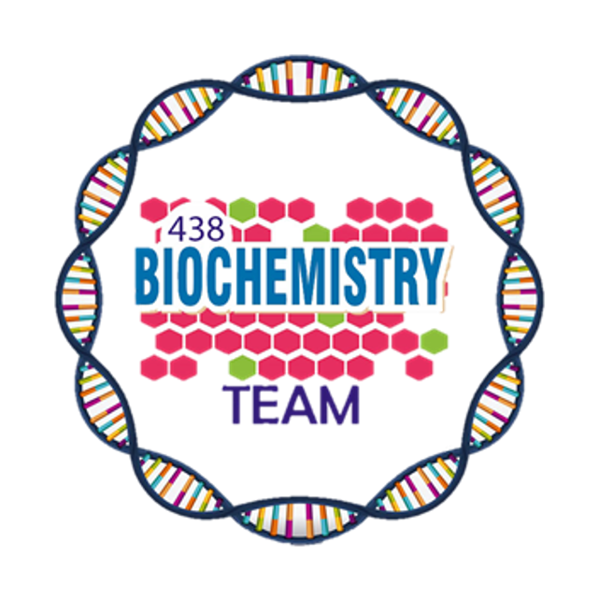
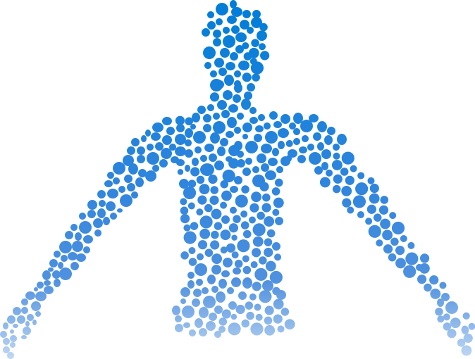
Biochemical aspects of digestion of lipids
Color Index:
Main Topic
Main content
Important
Drs’ notes
Extra info
Editing File
Biochemistry teamwork 438 - Gastrointestinal & Nutrition Block

Slide 2
Overview:
Dietary lipid: organs and enzymes
Objectives:
Lipid digestion in the stomach and intestine
Understand the process of digestion of dietary lipids including, the organs involved, the enzymes required, and the end products.
Lipid degradation by the pancreatic enzymes
Pancreatic insufficiency
Study the synthesis, secretion and fate of chylomicron
Control of lipid digestion
Lipid absorption, re-synthesis and secretion
Understand the clinical manifestations of diseases that involve defective lipid digestion and/or absorption (indigestion and malabsorption syndrome)
Lipid malabsorption
Use of dietary lipid by the tissues

Slide 3
Dietary lipids
Organs and Enzymes
Dietary lipids intake is ~81 g/day
Triacylglycerol is >90%
Stomach ¹
Small intestine
Lingual lipase
Lipase / Co-lipase ²
The remainder includes:
• Cholesterol
• Cholesterol ester
• Phospholipids
• Glycolipids
• Free fatty acids
Gastric lipase
Cholesterol esterase
Phospholipase A2
Lysophospholipase
1-carbohydrates digestion starts in the mouth but lipid digestion starts from the stomach
2-co-lipase activates lipase enzyme

Slide 4
Dietary lipids
Lipid digestion
Stomach
Small intestine
Catalyzed by an acid-stable lipase (lingual lipase)
Triacylglycerols ¹ (TAGs) are hydrolyzed by the lipases secreted:
- Under the tongue and gastric mucosa
Acid lipases are important for lipid (milk fat) digestion in neonates and patients with pancreatic insufficiency.
Emulsification²:
Occurs in the duodenum
Increases surface area of lipid droplets
To maximize the effect of digestive enzymes
Two mechanisms ³:
Detergent properties of bile salts in the bile (Bile salts emulsify dietary lipid particles)
Mechanical mixing by peristalsis
1- Not all , only short & medium Fatty acids ” that have 12 or less carbons” - Most of dietary fatty acids are long chain fatty acids, so the contribution of these enzymes is minimal | 2-Emulsification is a process that forms a liquid, known as an emulsion, containing very small droplets of fat or oil suspended in a fluid | 3- Enzyme > hydrophilic. Lipids > hydrophobic .. so, how do they come in contact with each other? By two mechanisms: - When peristaltic movement mixes the fat and the fluid together, the fat particles break up and become smaller. - The bile also separates and keeps the small particles of lipid separated by its detergent physical properties, Which allows the enzymes to work with more surface area.

Slide 5
Lipid degradation by pancreatic enzymes
TAG degradation:
Cholesteryl ester degradation:
Performed by pancreatic lipase, colipase ¹
Hydrolyzed by cholesterol esterase
1
1
Removes fatty acids at C1 and C3
Produces cholesterol + FFAs
2
2
Leaving 2-monoacyglycerol ⁴ and free fatty acids
(FFAs) ²
3
Pancreatic lipase :
Found in high conc. in pancreatic secretion
(2-3% of total proteins)
Inhibited by Orlistat, an antiobesity drug ³
1- co-lipase is activated by trypsin when needed.
2- The free fatty acids which have been removed from 1st & 3rd C .
3- The drug inhibits the degradation of lipid by inhibiting pancreatic lipase thus decreasing lipid absorption and body weight
4- Number 2 refers to the location of the attachment

Slide 6
Digestion of Phospholipids (PL)by Phospholipase A2 & Lysophospholipase
Two enzymes are responsible for digestion of phospholipids,
- Phospholipase A2
- Lysophospholipase
How do they work?
- Phospholipase A2 removes one fatty acid from the phospholipid and we get lysophospholipid
- Lysophospholipase acts on lysophospholipids to give us glycerophosphoryl base which can be excreted
Example of phospholipid digestion:
- Phosphatidylcholine → Lysophosphatidylcholine →choline
437 Team

Slide 7
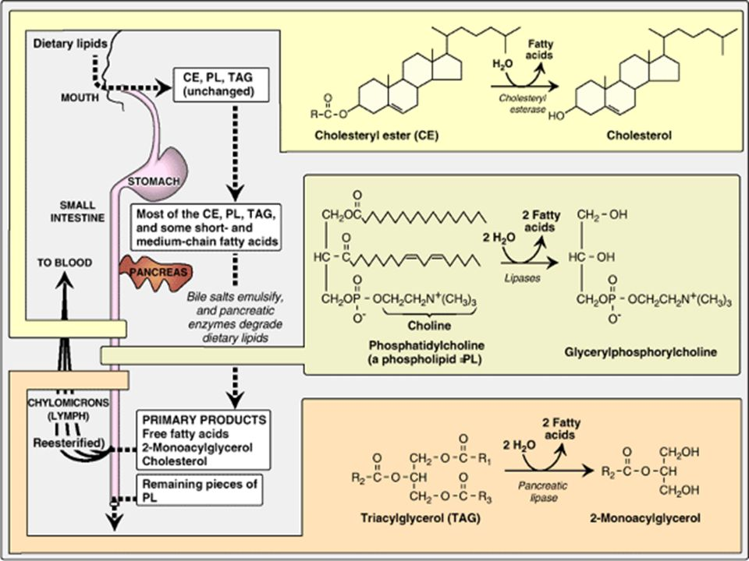
Overview of Lipid Digestion
After Ingestion of dietary lipids:
- In the mouth→ Unchanged.
- In the stomach: some of the short, medium chain fatty acids are removed by lingual and gastric lipases, the remaining are the same
- The undigested long chain fatty acids reach the small intestine, Bile salts are released from the gallbladder to emulsify the lipids, then the
pancreatic enzymes work on them.
- Pancreas also secretes bicarbonate to neutralize the chyme, because the pancreatic enzymes cannot work in an acidic media.
- End product [primary products]: free fatty acids, 2-monoacylglycerol, cholesterol.
- The end product molecules are taken into the enterocytes by mixed micelles “discussed in another slide” , then they will be synthesized to
complexes again :to TAG, which is carried by chylomicrons.
- Chylomicrons carry dietary TAGs in the blood.
- The presence of lipids in the GIT stimulates the secretion of and for the glands to secrete them.
10
437 Team

Slide 8
Pancreatic insufficiency in cystic fibrosis (CF)
1
6
Treatment: enzyme and fat-soluble vitamin
supplementation
CF is due to genetic mutations in CFTR
(transmembrane conductance regulator protein)
2
5
Functions as chloride channel on epithelium
Pancreatic enzymes are unable to reach the intestine
3
4
Defective CFTR causes:
Decreased hydration in pancreas thickens the
pancreatic secretions
Decreased secretion of chloride
Increased reabsorption of sodium and water

Slide 9
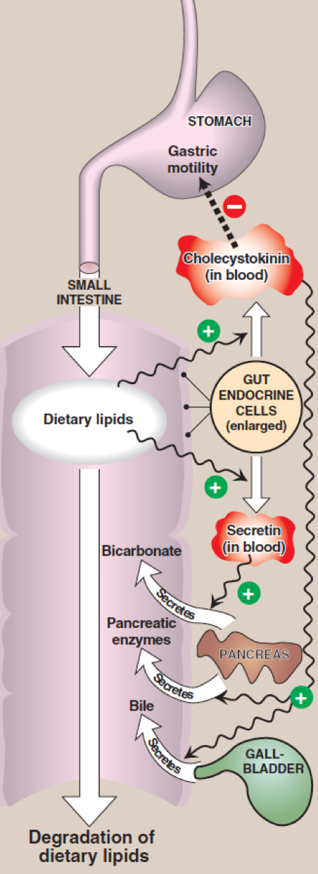
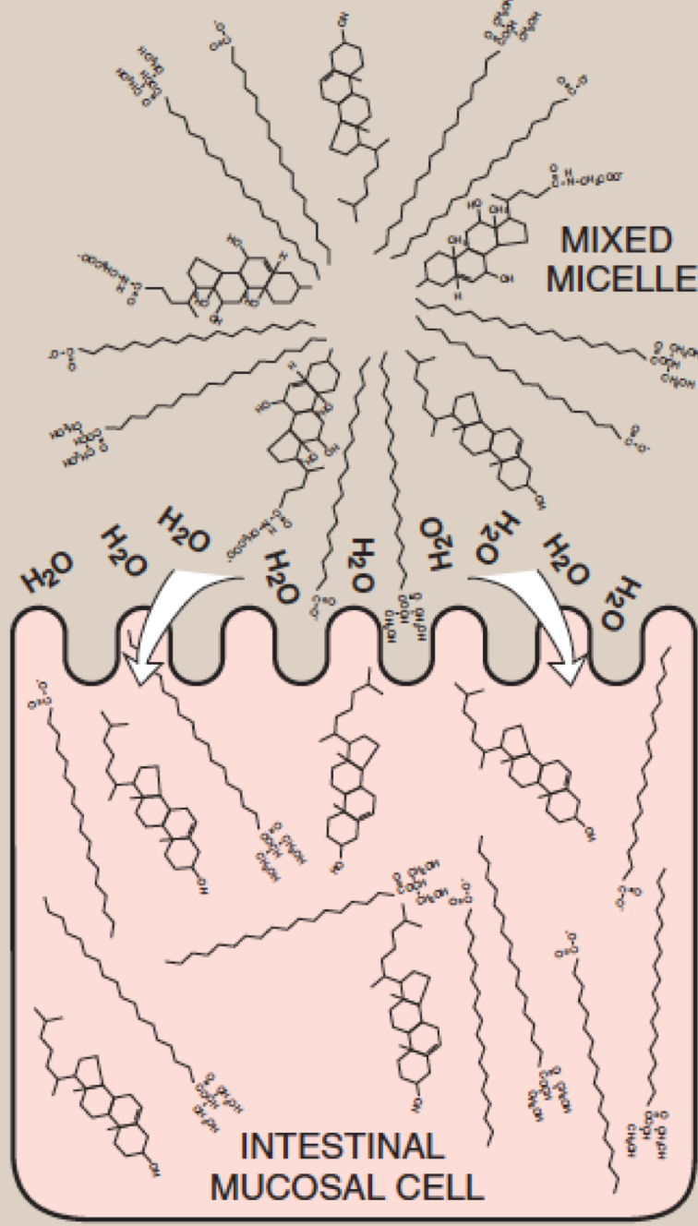
Control of lipid digestion
Lipid absorption by enterocytes
Controlled by hormones:
Cholecystokinin (CCK) | Secretin
Acts on gallbladder to release bile | Low pH stimulates its secretion
Acts on pancreas to release enzymes | Acts on pancreas to release bicarbonate and acts on liver to release bile To Neutralizes the pH of the contents before entering the small intestine
Decreases gastric motility (slow release of gastric contents)
Products of lipid digestion (FFAs, free cholesterol,
2-monoacylglycerol. ) combine with bile salts
and fat-soluble vitamins
They form mixed micelles (disk-
shaped particles)
1
2
3
Short and medium
chain length
fatty acids are absorbed directly
Absorbed by brush
border membrane of enterocytes
4
Mixed micelles are hydrophobic inside and hydrophilic outside
Intestinal mucosal cells have a thin water layer, which will attract the hydrophilic outer portion of the micelles for absorption

Slide 10
Resynthesis of TAG / Cholesteryl esters
Digested lipids absorbed by enterocytes migrate to endoplasmic reticulum for complex lipid biosynthesis
Fatty acids
activated to acyl CoA form
2-Monoacyglycerols
TAGs
The whole picture is important.
Newly synthesized TAG and cholesterol ester are packaged as lipid droplets surrounded by thin layer of:
1
2
3
Apolipoprotein B-48 (apo B-48)
Phospholipids
Free cholesterol

Slide 11
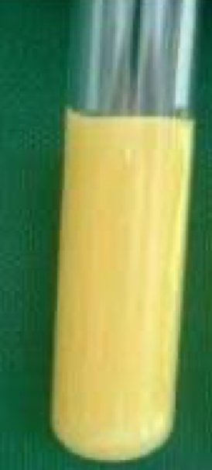
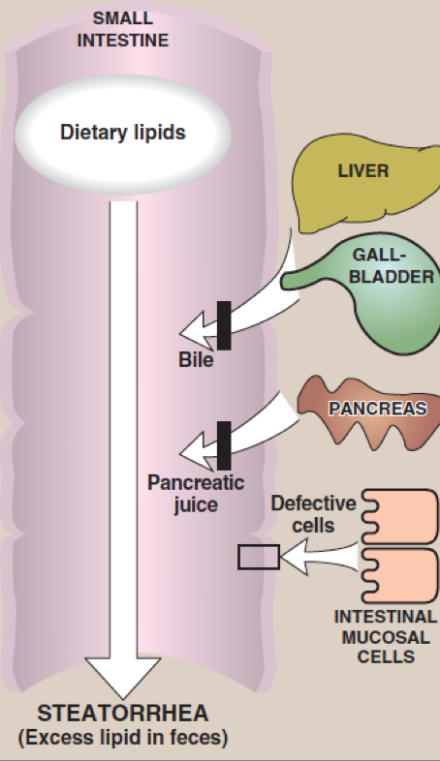
Secretion of chylomicrons by enterocytes
By exocytosis into lymphatic vessels
around villi of small intestine
(lacteals)which enter into systemic
circulation
Serum becomes milky after a fatty
meal
chyle
Once chyme reaches the intestine its called chyle , and chyle contains some undigested lipids , those lipids are gonna stimulate the release of CCK hormone.
Lipid malabsorption
Increased excretion of
lipids, fat-soluble vitamins
and essential FAs in the
feces
1
Due to defects in lipid digestion or absorption
2
Can be caused by CF
(cystic fibrosis) or
shortened bowel
3

Slide 12
Take Home Messages
Lipid digestion begins in stomach
Emulsification of lipids occurs in duodenum,
helped by peristalsis and bile salts
Intestinal digestion of lipids by pancreatic
enzymes
Lipid absorption by mixed micelles
Re-synthesis of TAGs, cholesterol ester and PLs
inside the intestinal mucosal cells
Assembly and secretion of chylomicrons into
lymphatic lacteals and then into systemic circulation

Slide 13
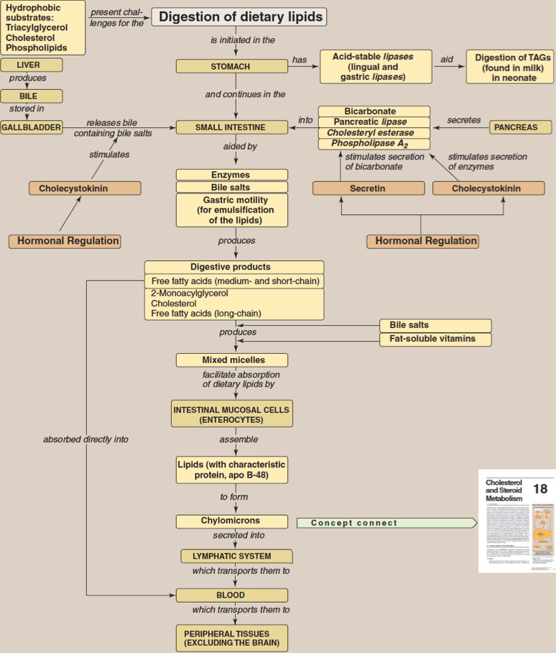
Summary
Lipid digestion
TAG by pancreatic lipase, colipase →
2-monoacyglycerol and free fatty acids
(FFAs)
Stomach
Cholesteryl ester by cholesteryl esterase → cholesterol + FFAs
Small intestine ( by pancreatic enzymes)
Phospholipid by phospholipase A2 → lysophospholipid
TAG are degraded by gastric & lingual lipase
Lysophospholipid by lysophospholipase → glycerophoshpryl base
Summary
lipid digestion Controlled by
Lipid malabsorption
Cholecystokinin (CCK)
Increased excretion of lipids, fat-soluble vitamins and essential FAs in the feces
Due to defects in lipid digestion or absorption
Secretin
Lipid absorption by enterocytes
Resynthesis of TAG
Short and medium chain length fatty acids are absorbed directly
1-Fatty acids
2-activated to acyl CoA form
3- 2-Monoacyglycerols
4-TAGs

Slide 14
Quiz
MCQs
Q1: 2-monoacyglycerol and free fatty acids is the product of degradation of:
A)Cholesteryl esters B)Phospholipids C) proteins D) TAG
Q2: Orlistat is an anti obesity drug that acts on which of the following pancreatic enzymes?
A)Lipase B)Lysophospholipase C)Phospholipase A D)Esterase
Q3: A 9-year old girl , known to have cystic fibrosis was presented in pediatric clinic complaining of distention and diarrhea with passing of foul smelling stools over the past week , which of the following explains her condition?
A) increased gastric motility B) Increased secretion of CCK C) Pancreatic insufficiency D) Decreased reabsorption of water
Q4: Mixed micelles are classified as :
A)Hydrophilic B)hydrophobic C)Amphipathic D)fat soluble
Q5:which of the following is a primary Apolipoprotein contributed in the synthesis of chylomicrons?
A)APOE B)APO B100 C)APO B48 D)APOC
Q6: which one of the following types of fatty acids absorbed directly ?
A)Short B)Medium C)Long D) A & B
SAQs :
Q1:Mention the two mechanisms for emulsification.
Q2:Explain how Cholesteryl esters get degraded and what are the products ?
Q3: what are the hormones that control the lipid digestion and where do they act on ?
Q4:What are the enzymes involved in the resynthesis of TAG ?
MCQs Answer key:
1) D 2) A 3) C 4) C 5) C 6) D
SAQs Answer key:
1)A-Detergent properties of bile salts in the bile (Bile salts emulsify dietary lipid particles)
B-Mechanical mixing by peristalsis
2) Cholesteryl ester by cholesteryl esterase → cholesterol + FFAs
3)Slide 9
4)Acyl CoA:monoacylglycerol acyltransferase & Acyl CoA:diacylglycerol acyltransferase.

Slide 15
Team members
The flower doesn't dream of the bee, it blossoms and the bee comes.
Girls Team:
Boys Team:
Ajeed Al-Rashoud
Alwateen Albalawi
Amirah Aldakhilallah
Arwa Al Emam
Deema Almaziad
Ghaliah Alnufaei
Haifa Alwaily
Leena Alnassar
Lama Aldakhil
Lamiss Alzahrani
Nouf Alhumaidhi
Noura Alturki
Sarah Alkhalife
Shahd Alsalamah
Taif Alotaibi
Abdulrahman Bedaiwi
Alkassem Binobaid
Khayyal Alderaan
Mashal Abaalkhail
Naif Alsolais
Omar Alyabis
Omar Saeed
Omar Odeh
Rayyan Almousa
Yazen Bajeaifer
Team Leaders
We hear you
Lina Alosaimi
Mohannad Alqarni

