Slide 1
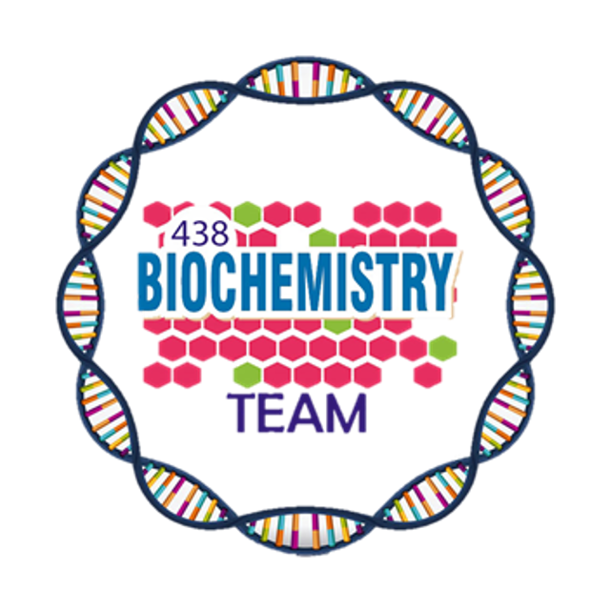
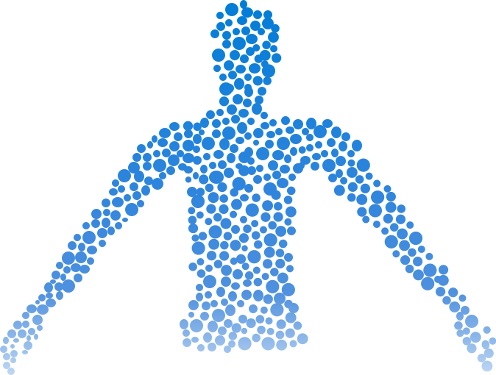
Biochemical Aspects of Digestion of Proteins and Carbohydrates
Color Index:
Main Topic
Main content
Important
Drs’ notes
Extra info
Editing File
Biochemistry teamwork 438 - Gastrointestinal & Nutrition Block

Slide 2
Objectives:
Understand the overall process of dietary proteins’ and carbohydrates’ digestion, the organs involved, the enzymes required, and the end products
Implement the basic science knowledge of the process of proteins & carbohydrates digestion to understand the clinical manifestations of diseases that involve defective proteins’ or carbohydrates’ digestion &/or absorption.
Protein Digestion:
Dietary protein constitute 70-100 g/day.
Protein are too large to be absorbed by the intestine.
Small intestine only absorb amino acids
They must be hydrolyzed to their constituent amino acids to be absorbed
Dr notes: so proteins have to be degraded except maternal antibodies they are directly absorbed found in breast milk

Slide 3
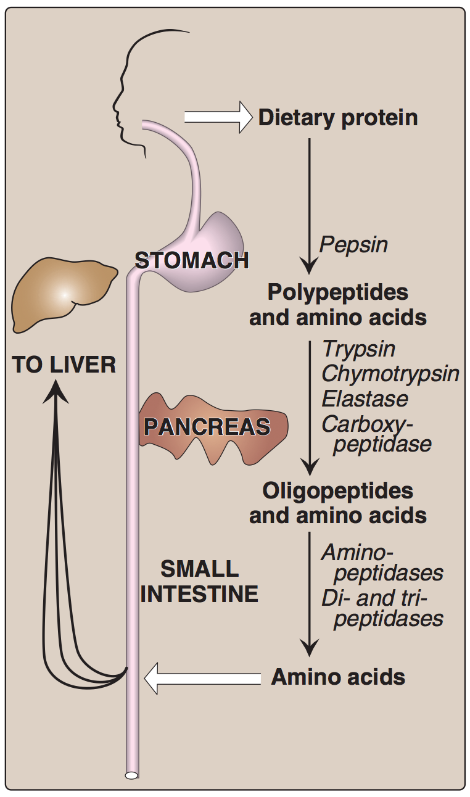
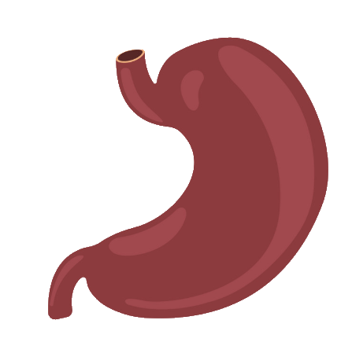
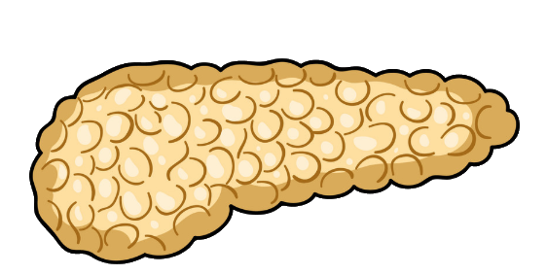
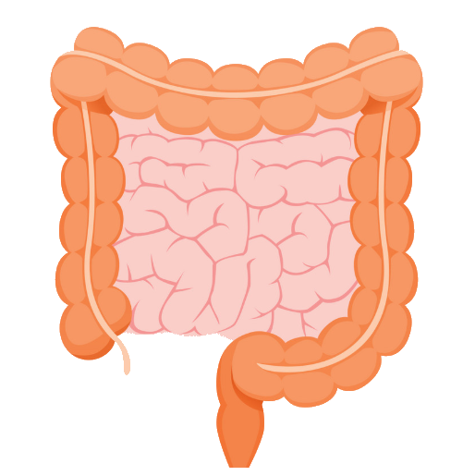
The Source of Proteolytic Enzymes Responsible for Degrading Dietary Proteins
1- Digestion of Proteins By Gastric Secretion
The gastric juice contains 2 components important for protein digestion:
Hydrochloric acid.
Pepsin.
Digesting agent | Description
Hydrochloric acid | Kills some bacteria Denatures protein → denatured proteins are more susceptible to hydrolysis by proteases.
Pepsin | Acid-stable Endopeptidase Secreted as inactive zymogen (pepsinogen) Pepsinogen is activated by: 1. hydrochloric acid 2. pepsin, i.e. autocatalysis Protein digestion by stomach → Polypeptides + few free amino acids
The stomach
The pancreas
The small intestine
3. it activates pepsin enzyme by converting pepsinogen to pepsin
HCL is responsible for the denaturation of The proteins.
Protein digestion starts in the stomach and ends in the small intestine
Denaturation is: Return the ready structure protein into it primary structure by breaking all the bonds except the peptide and some of the disulfide bonds.
It’s very important to know the enzymes that are Endo/Exopeptidase.
Endopeptidase: Enzyme that catalyze the bonds that located in the middle.
Exopeptidase: Enzyme that catalyze the terminal C-N bonds.

Slide 4
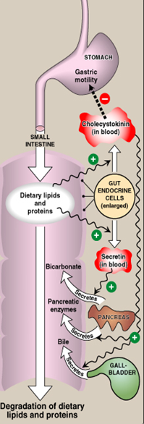
2- Digestion of Proteins in Small Intestine
Hormonal Control of Digestion in Small Intestine:
1- By pancreatic enzymes
1
Cholecystokinin (CCK)
2- By intestinal aminopeptidase
1. Secretion of pancreatic enzymes.
2. Bile secretion.
3. Slow release of gastric contents.
The digestion in small intestine is hormonally controlled.
Two small peptide hormones are released from cells of the upper part of small intestine:
2
Secretin
Release of watery solution rich in bicarbonate by pancreas.
1. Cholecystokinin (CCK)
2. Secretin
Further details in the next slide.

Slide 5
The Gut Hormones
The gut hormones | Stimulus for secretion | Effects
Cholecystokinin (CCK) | The presence of partially digested proteins (& lipids) in the upper small intestine. | 1. Stimulates the release of pancreatic digestive enzymes 2. Stimulates the contraction of the gallbladder & release of bile (bile is used for lipids) 3. Decreases gastric motility → slower release of gastric contents into the small intestine (to give more time for the digestion)
Secretine | Low pH of the chyme entering the intestine | Stimulates the pancreas to release a watery solution rich in bicarbonate to neutralize the pH of the intestinal contents (to reach the optimum pH for digestive activity by pancreatic enzymes)

Slide 6
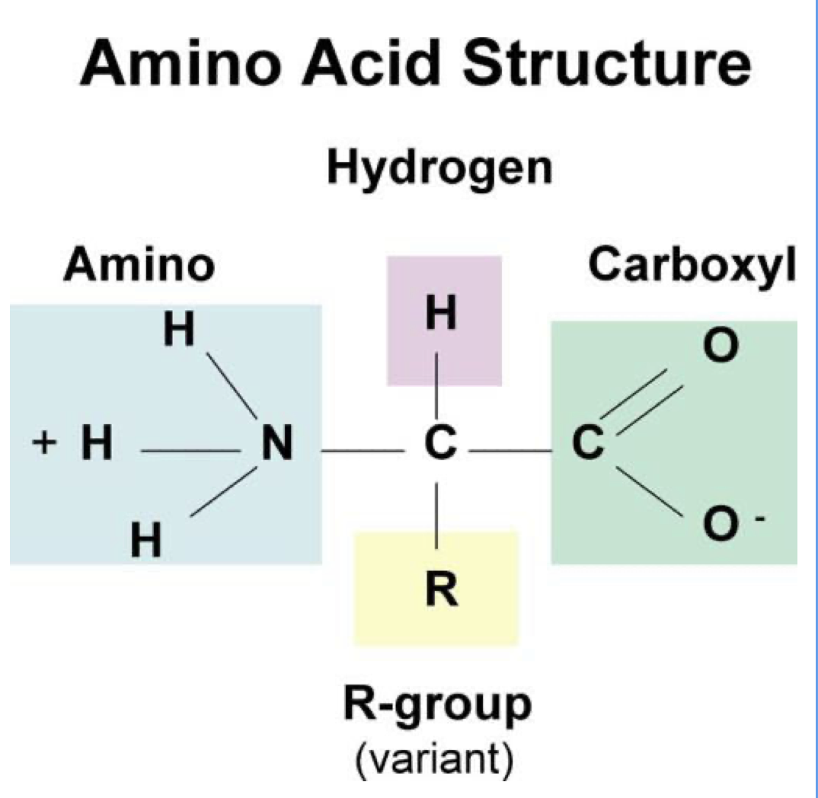
Pancreatic enzymes for digestion of proteins
A. Digestion by pancreatic enzymes:
In proteins, we have two terminals:
1) N-terminals: containing amino acids.
2) C-terminals: containing carboxyl group.
-Carboxypeptidases break the C-terminals and has two types A,B; they differ by amino acid they prefer to break
-aminopeptidase break N-terminal
1
The pancreatic secretion contains a group of pancreatic proteases
2
Each of these enzymes has different specificity for the cleavage sites
Ex:trypsin always cleaves after arginine and lysine
3
These proteases are synthesized and secreted as inactive zymogens
Pancreatic enzymes:
Zymogen | Active enzyme | Activating enzyme
Trypsinogen | Trypsin (endopeptidase) | 1- Enteropeptidase 2- Trypsin (autocatalysis)
Chymotrypsinogen | Chymotrypsin (endopeptidase) | Trypsin
Proelastase | Elastase (endopeptidase) | Trypsin
Procarboxypeptidases | Carboxypeptidases (exopeptidases) | Trypsin

Slide 7
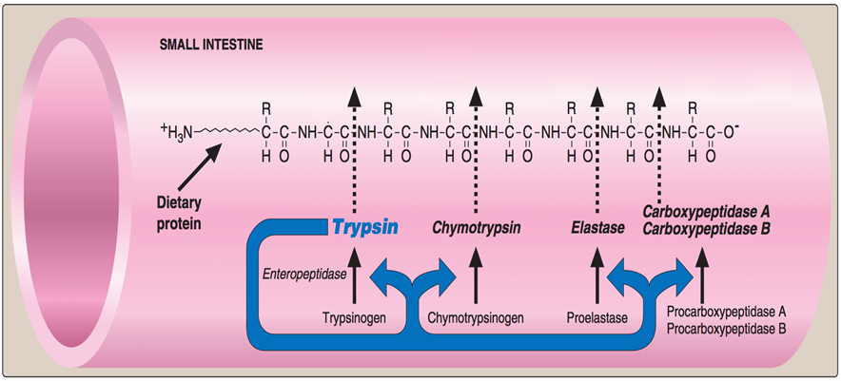
Pancreatic enzymes continued
Enteropeptidase: Converts trypsinogen to trypsin
(So two enzymes form by autocatalysis: pepsin,trypsin)
Trypsin then activates all the other pancreatic zymogens (including itself)
(The conversion is initiated by this enzyme)
Enteropeptidase is an enzyme synthesized by, and present on the luminal surface of intestinal mucosal cells of the brush border membrane.
Trypsin starts a cascade because it can activate all other pancreatic enzymes. Every protease is specific for different active site, polypeptides are their substrates and their products are oligopeptides and amino acids.

Slide 8
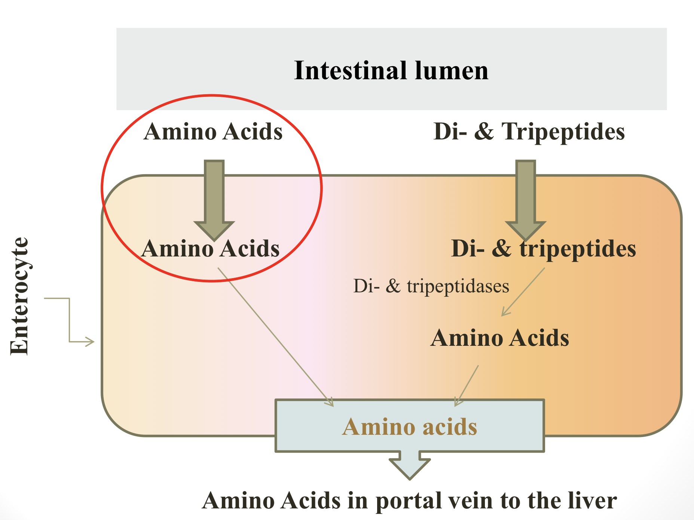
2- Digestion of Proteins in Small Intestine: Continued…
B. Digestion by intestinal aminopeptidase, which break the N-terminals of proteins → giving a lot of amino acids.
Oligopeptides that result from the action of pancreatic proteases are cleaved into free amino acids and smaller peptides (di- & tri- peptides)
by intestinal aminopeptidase (an exopeptidase on the luminal surface of the intestine)
Absorption of digested proteins
By sodium dependent transporter
(Active)
By proton co-transporter
( non-active)
Released into blood by facilitated diffusion.
Di & tripeptidase is an enzyme that converts the di and tri amino acids → mono amino acid

Slide 9
Genetic Errors in Amino Acids Transport
Cystinuria
About the disease: | Is one of the most common genetic error of amino acid transport
Example of: | Inherited disorder in the transport of certain amino acids
Affects: | The transport of Cystine and dibasic amino acids (COLA)
Organs affected: | Small intestine and the kidney
Clinically: | Cystine and dibasic amino acids appear in the urine
 | There is kidney stones formation because they’re not absorbed
Treatment: | Oral hydration (drinking lots of water) is an important part of Treatment (to prevent kidney stones formation)
Cystine
Lysin
Remember:cystine is made up of dimer of 2 cysteine by a disulfide bond
Ornithine
Arginine

Slide 10
Abnormalities of Protein Digestion
1
2
3
Pancreatic insufficiency, e.g., chronic pancreatitis, cystic fibrosis, surgical removal of the pancreas.
Incomplete digestion & absorption of lipids & proteins
Abnormal appearance of lipids (steatorrhea) & undigested proteins in the feces
Celiac Disease (Celiac sprue)
Definition:
A disease of malabsorption resulting from immune-mediated damage to the villi of the small intestine in response to ingestion of gluten.
mechanism of celiac disease: when gluten is degraded it forms gliadin, so the antibodies attack the gliadin causing inflammatory responses causing damage to the villi
A protein found in wheat, rye, and barley

Slide 11
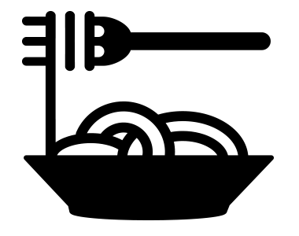
Biochemical Aspects of Digestion
of Dietary Carbohydrates

Slide 12
Carbohydrates Digestion
Carbohydrates digestion is rapid:
Generally completed by the time the gastric contents reach the junction of the duodenum & jejunum.
Sites for digestion of dietary carbohydrates:
Mouth
Intestinal lumen
Dietary Carbohydrates Mainly:
Polysaccharides:
(Digested by breaking the glycosidic bonds)
Oligosaccharides
Disaccharides:
1- Sucrose=glu+fru
Starch from plant origin
Glycogen from animal origin
Cellulose from plant origin
2- Lactose=glu+galact
Contains β (1→4) bonds(humans don’t have the enzyme to break the bond,so cellulose is not digested)
Monosaccharides: Little amounts
3- Maltose=glu+glu
Contain α (1→4) & α (1→6) bonds( the branch form)

Slide 13
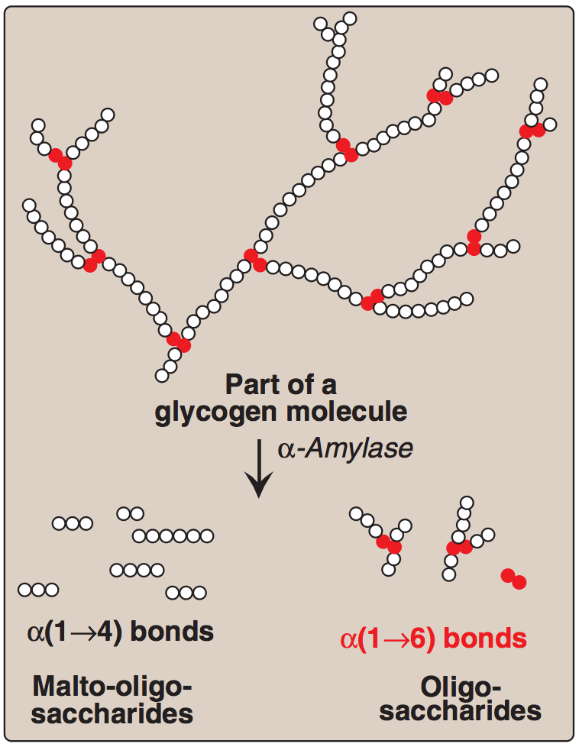
Enzymes for Digestion of Dietary Carbohydrates
α-amylase
(Both salivary & pancreatic).
Disaccharidases (Intestinal)
Isomaltase & α(1,6) glucosidase (Intestinal)
*
Substrate: Polysaccharides
Substrate: Disaccharides
Substrate: Branch points of oligo- and di-saccharides
No dietary carbohydrate digestion occurs in the stomach.
(the high acidity of the stomach inactivates the salivary α–amylase)
Pancreatic α–amylase continues the process of starch & glycogen digestion in the small intestine. (Secreted by pancreas and works in small intestine)
*In blood both,but salivary is so low so it’s referred as pancreatic
A branch point every 8-10 amino acids
Effects of a-amylase on Glycogen
Hydrolysis of:
α(1,4) glycosidic bonds
Products:
Mixture of short oligosaccharides (both branched & unbranched)
Disaccharides: Maltose and isomaltose

Slide 14
Serum level of α-amylases
Normal level in serum: 25 -125 U/L
The clinical significance of rising circulating levels of α-amylase activity:
Units/L
Its level starts to rise within few hours.
Diagnosis of acute pancreatitis:
(damage of pancreatic cells → release & activation of the
intracellular enzymes into the blood)
Reaches a peak within 12-72 hours.
The significant in using serum a-amylase level test:
1)cheap;lipase is more expensive
2)easy
3)has certain pattern
Then returns to normal within few days. Usually 5 days

Slide 15
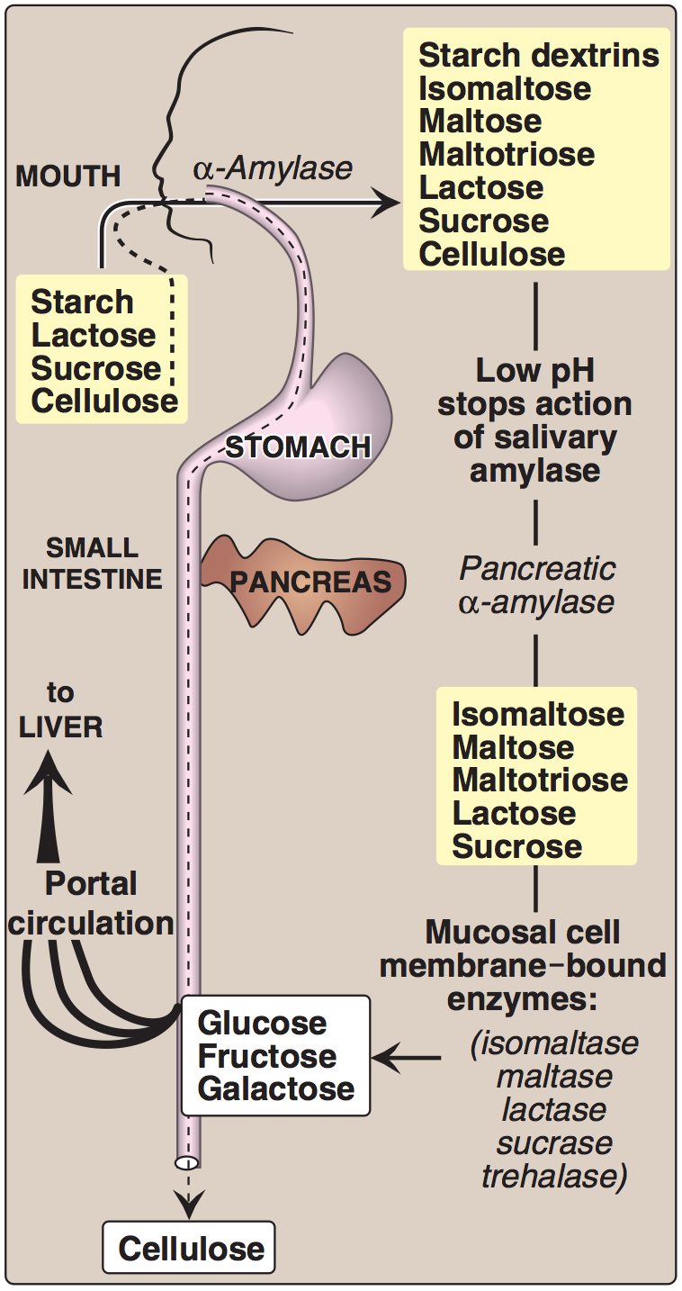
Final Digestion of Carbohydrates
By Intestinal Enzymes in The Small Intestine
Enzyme | Source | Location of their action
Disaccharidases | Secreted by & remain associated with the luminal side of the brush border membranes of the intestinal mucosal cells | the mucosal lining of the jejunum.
α(1,6) Glucosidase (for branched oligosaccharides)
Intestinal Disaccharidases:
Enzyme | Substrate | Product
Isomaltase | Isomaltose | 2 Glucose
Maltase | Maltose | 2 Glucose
Sucrase | Sucrose | Glucose & Fructose
Lactase (β-galactosidase) | Lactose (From milk) | Glucose & Galactose
Dietary cellulose cannot be digested due to the absence of enzyme that can cleave β(1-4) bonds. It passes through the GIT largely intact.
Despite that, it has several beneficial effects.
(increases motility and treat constipation)

Slide 16
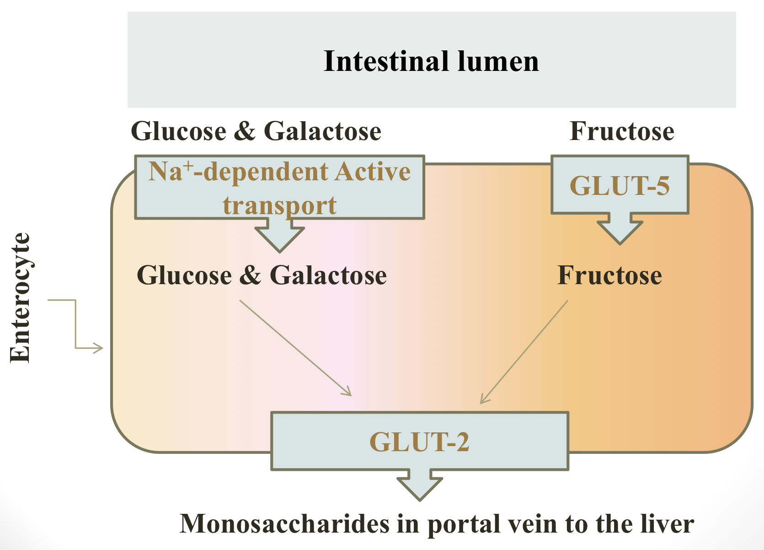
Absorption of Monosaccharides
by Intestinal Mucosal Cells
Location: Duodenum & upper jejunum.
Insulin: is NOT required for the uptake of glucose by intestinal cells.
1. Facilitated diffusion (GLUT-mediated)
Different monosaccharides have different mechanisms of absorption:
Sodium independent
Active transport (Energy-dependent): Co-transport with Na⁺
Absorption of Digested Carbohydrates
Sodium dependent
GLUT : Transports all monosaccharides into the bloodstream.
Fructose enters the enterocytes by GLUT-5
Example of cells that need insulin for uptake of glucose is muscle cells

Slide 17
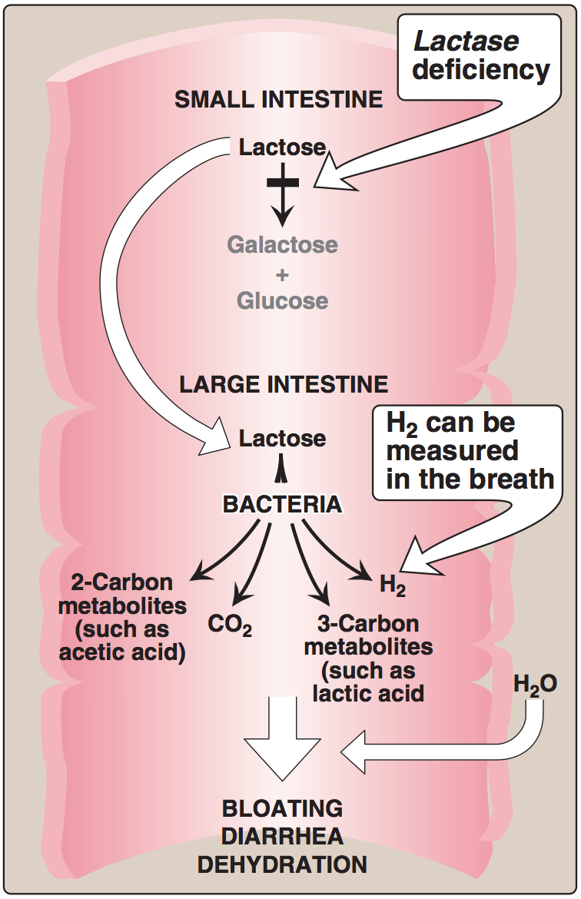
Abnormal Digestion of Disaccharides (e.g. of lactose)
Lactase (β-galactosidase) deficiency
Lactose intolerance
(Lactase deficiency)
Undigested carbohydrate in large intestine
Osmotic diarrhea.
Bacterial fermentation of the undigested compounds in the large intestine
Summary:when there is lactase deficiency lactose will accumulate in the large intestine and the normal bacteria in the large intestine will feed on lactose causing release of carbon dioxide and carbon metabolites and water will enter the large intestine causing osmotic diarrhea
CO₂, H₂ gas
Abdominal cramps, diarrhea & distension (flatulence)

Slide 18
Take Home Messages
Digestion of Dietary Proteins
Proteolytic enzymes responsible for digestion of dietary proteins are produced by the stomach, the pancreas & the small intestine.
The digestion of proteins in the stomach is the result of the action of HCl and pepsin.
Pancreatic proteases are, like pepsin, synthesized and secreted as inactive zymogens.
The intestinal digestion of proteins occurs in the small intestine’s lumen, on the luminal surface of the small intestine, and is completed intracellularly to produce free amino acids.
In pancreatic insufficiency, the digestion and absorption of fat & protein is incomplete → steatorrhea & appearance of undigested proteins in the feces.

Slide 19
Take Home Messages
Digestion of Dietary Carbohydrates
Salivary α-amylase acts on dietary glycogen & starch in the mouth.
Pancreatic α-amylase continues the process of polysaccharide digestion in small intestine.
The final digestive processes of carbohydrates into monosaccharides occur at the mucosal lining of the small intestine by disaccharidases & α(1,6) glucosidase.
Dietary cellulose cannot be digested due to the absence of enzyme that can cleaveβ (1-4) bonds, so it passes through the GIT largely intact. Despite that, it has several beneficial effects.
Absorption of the monosaccharides requires specific transporters (GLUTs).
Lactose intolerance is due to deficiency of lactase enzyme and causes abdominal cramps, diarrhea & flatulence

Slide 20
Summary
Diseases related to protein digestion
Genetic errors of amino acid transport | Abnormalities of protein digestion
Cystinuria | Pancreatic insufficiency | Celiac disease
Most common genetic error of amino acid transport. Inherited disorder. Affects the transport of Cystine and dibasic amino acids. Affects kidney and small intestine. Cystine and dibasic appear in the urine. Kidney stones formation. Kidney stones formation treated by hydration. Oral hydration is an important of treatment. | Such as in: chronic pancreatitis, cystic fibrosis, and removal of pancreas. Leads to Incomplete digestion and absorption of lipids and proteins because of lack of pancreatic enzymes . Which lead to Abnormal appearance of lipids (steatorrhea) & undigested proteins in feces. | It is a disease of malabsorption resulting from immune-mediated damage to the villi of the small intestine in response to ingestion of gluten. Gluten is a protein found in wheat, rye, and barley.

Slide 21
Summary
Absorption of monosaccharides:
Occurs in duodenum and jejunum.
No insulin required for re-uptake of glucose by intestinal cells
Two Mechanisms of absorption:
Facilitated diffusion (GLUT-mediated). such as in fructose.
Active transport (Energy-dependent): Co-transport with Na+. such as in glucose and galactose.
Lactose intolerance (Lactase deficiency): Lactase (β-galactosidase) deficiency → Undigested carbohydrate in large intestine → osmotic diarrhea.
Bacterial fermentation of the undigested compounds in the large intestine → CO₂, H₂ gas → abdominal cramps, diarrhea & distension (flatulence)
Intestinal Disaccharides
Enzyme | Substrate | Product
Isomaltase | Isomaltose | 2 glucose
Maltase | Maltose | 2 glucose
Sucrase | Sucrose | Glucose and fructose
Lactase | Lactose | Glucose and galactose

Slide 22
Quiz
MCQs :
Q1: Which one of the following considered as a normal level of α-amylases in serum?
a) 5 U/L b) 50 U/L c) 500 U/L d) 5000 U/L
Q2: Lactose considered as?
a) Polysaccharides b) Oligosaccharides
c) Disaccharides d) Monosaccharides
Q3: α-amylase works which one of the following?
a) Polysaccharides b) Oligosaccharides
c) Disaccharides d) Monosaccharides
Q4: Which of the following is not an endopeptidase?
a) Trypsin b) Chymotrypsin
c) Elastase d) Enteropeptidase
Q5: Which of the following is not wrong about Secretin?
a) Contract the gallbladder b) Release a watery solution c) Slow the release of gastric contents d) A&B
Q6: Which of the following is an genetic error in amino acid transport?
a) Cystinuria b) Chronic pancreatitis c) Celiac sprue d) Lactose intolerance
SAQs :
Q1: What is the Sites for digestion of dietary carbohydrates?
Q2: What are the deficient amino acids in cystinuria?
Q3: Where does the absorption of monosaccharides occur?
Q4: Mention two hormones that control the digestion of proteins in small intestine.
MCQs Answer key:
1) B 2) C 3) A 4) D 5) B 6) A
SAQs Answer key:
The mouth, The intestinal lumen
1- Cystine 2- Ornithine 3- Lysine 4- Arginine
Duodenum & Upper jejunum
1- Cholecystokinin (CCK), 2- Secretin

Slide 23
Team members
Persistence is very important. you should not give up UNLESS you are forced to give up.
Elon Musk.
Girls Team:
Boys Team:
Ajeed Al-Rashoud
Alwateen Albalawi
Amira AlDakhilallah
Arwa Al Emam
Deema Almaziad
Ghaliah Alnufaei
Haifa Alwaily
Leena Alnassar
Lama Aldakhil
Lamiss Alzahrani
Nouf Alhumaidhi
Noura Alturki
Sarah Alkhalife
Shahd Alsalamah
Taif Alotaibi
Abdulrahman Bedaiwi
Alkassem Binobaid
Khayyal Alderaan
Mashal Abaalkhail
Naif Alsolais
Omar Alyabis
Omar Saeed
Omar Odeh
Rayyan Almousa
Yazen Bajeaifer
Team Leaders
We hear you
Lina Alosaimi
Mohannad Alqarni

