Slide 1
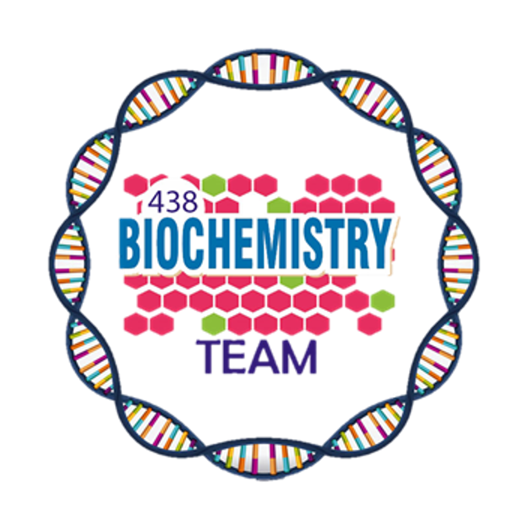
Nutritional Requirements
Color Index:
Main Topic
Main content
Important
Drs’ notes
Extra info
Editing File
Biochemistry teamwork 438 - Gastrointestinal & Nutrition Block

Slide 2
Overview:
Objectives:
What is nutrition?
Assessment of malnutrition
Understand the basic terms of nutritional requirements that are important for establishing intake of a nutrient in a population.
Dietary reference intakes (DRIs)
Understand the food pyramid that recommends daily serving size from each food group for vegetarians and non-vegetarians.
Estimated Average Requirement (EAR)
Identify dietary guidelines and goals that are necessary for good health
Recommended Dietary Allowance (RDA)
Adequate Intake (AI)
Discuss energy requirement in humans including basic energy expenditure and the factors that affect it.
Acceptable Macronutrient Distribution Ranges (ADMR)
Know about total parenteral nutrition (TPN) and its applications
The Food Pyramid: dietary guidelines and goals
Energy requirement and expenditure in humans
Total parenteral nutrition (TPN)

Slide 3
Nutrition
What is nutrition?
Assessment of malnutrition
Composition and quantity of food intake by living organisms
malnutrition in humans measured by
Biochemical utilization of food
Dietary intake studies: identify people with deficient diets
Human nutrition is divided into three areas:
Undernutrition (nutrient deficiency)
Overnutrition (excessive nutrient intake)
Optimal nutrition (balanced nutrient intake)
Biochemical studies: identify subclinical nutritional deficiencies
Ex: vitamin D test to detect deficiency
Clinical symptoms: identify clinical nutritional deficiencies

Slide 4
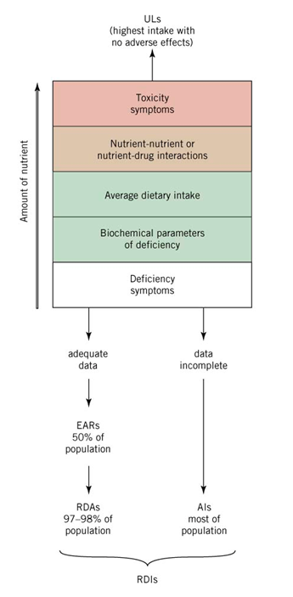
Dietary reference intake
Dietary reference intake (DRI)
quantitative estimates of nutrient intakes required to prevent deficiencies and maintain optimal health in population Recommended by: Food and Nutrition Board of the National Research Council, USA
DRI standards
estimated average requirement (EAR) | recommended dietary allowance (RDA) | adequate intake (AI) | tolerable upper intake level (UL)
the amount of nutrient intake estimated to meet the nutritional requirement of half of health individuals 50% in an age and gender group | the amount of nutrient intake that is sufficient to meet the nutritional requirement of nearly all healthy individuals 97-98% in a group RDA is two SD above EAR RDA = EAR + 2 SD | it is used instead of EAR and RDA if a nutrient is considered essential but the experimental data are inadequate for determining EAR and RDA it covers the nutritional requirement of all individuals in a group with approximation due to insufficient data | the highest level of daily nutrient intake that has no adverse effects of toxicity in almost all individuals
Dietary Reference Intakes (DRIs)
SD : standard deviation
Doctor said that we have to know all the definitions , numbers and calculations
Somehow this lecture made it out of فجب - Very Secret Lecture Reviewer

Slide 5
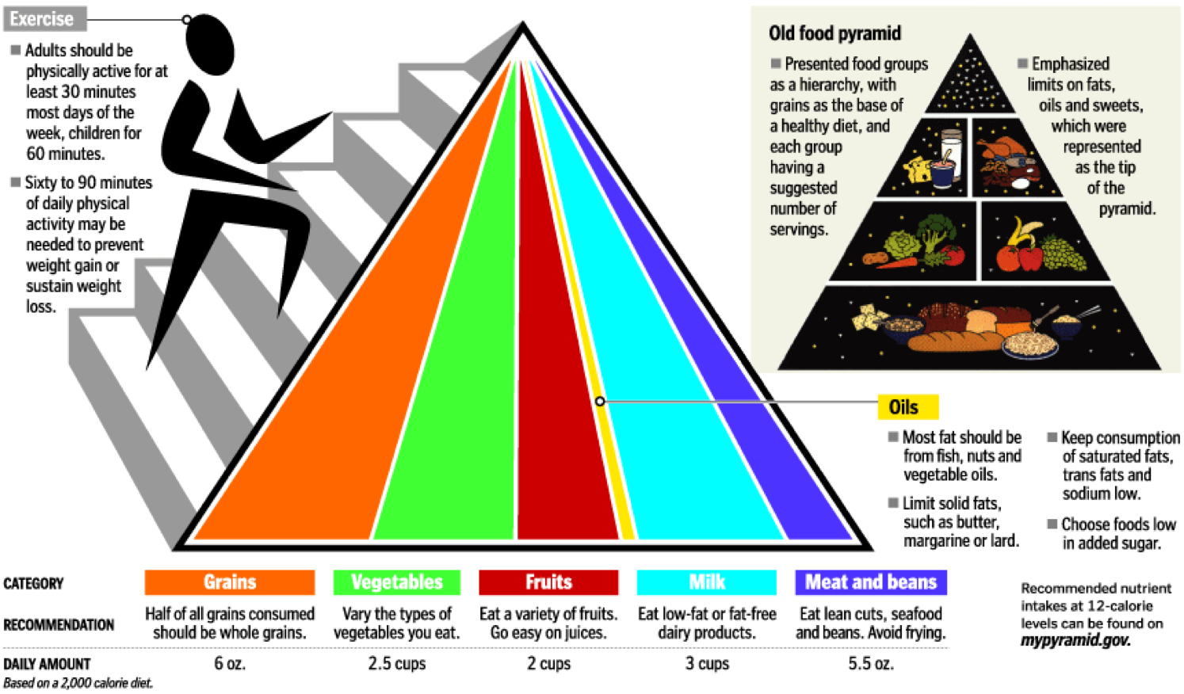
I hope u guys aced ur CNS, now let’s ace this one too- Very Secret Lecture Reviewer
acceptable macronutrient distribution ranges (AMDR)
range of adequate intake of a macronutrient associated with reduced risk of chronic diseases | AMDR for adult (% of total calories) carbohydrates : 45-65% Fats : 20-35% Proteins : 10-35% Fibers : >25 g
Fibers has no calories but it's important for utilization of food
Food pyramid
Public educational tool established in 1992
Recommends size of daily servings
Pyramid shape
Fats, oils and sweets have small serving size
Dr note: You don't have to memorize anything from this pic

Slide 6
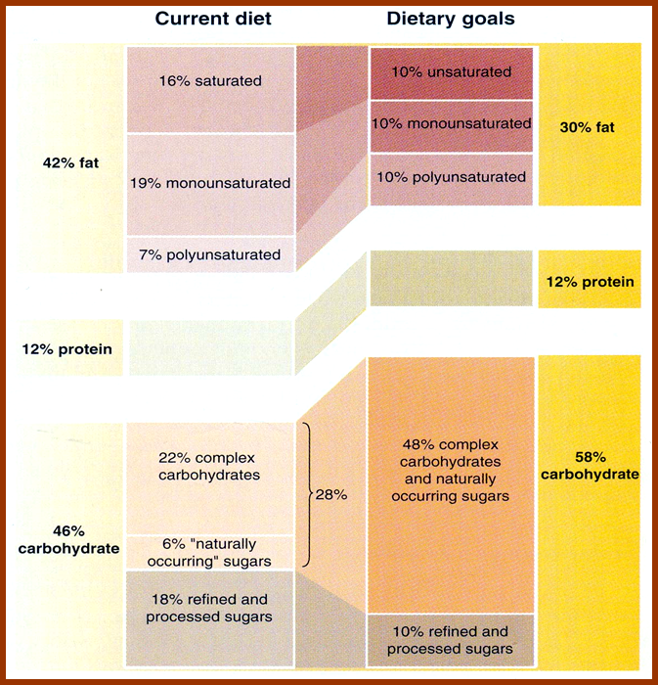
Dietary guidelines and goals
You don't need to memorize numbers in this pic
Dietary guidelines and goals
Consume a variety of foods from the basic food groups
Control calorie intake to manage body weight
Be physically active everyday
Choose fats and CHOs wisely for good health
Increase daily intake of fruits, vegetables, whole grains, and non-fat or low-fat milk and milk products
Choose and prepare foods with little salt

Slide 7
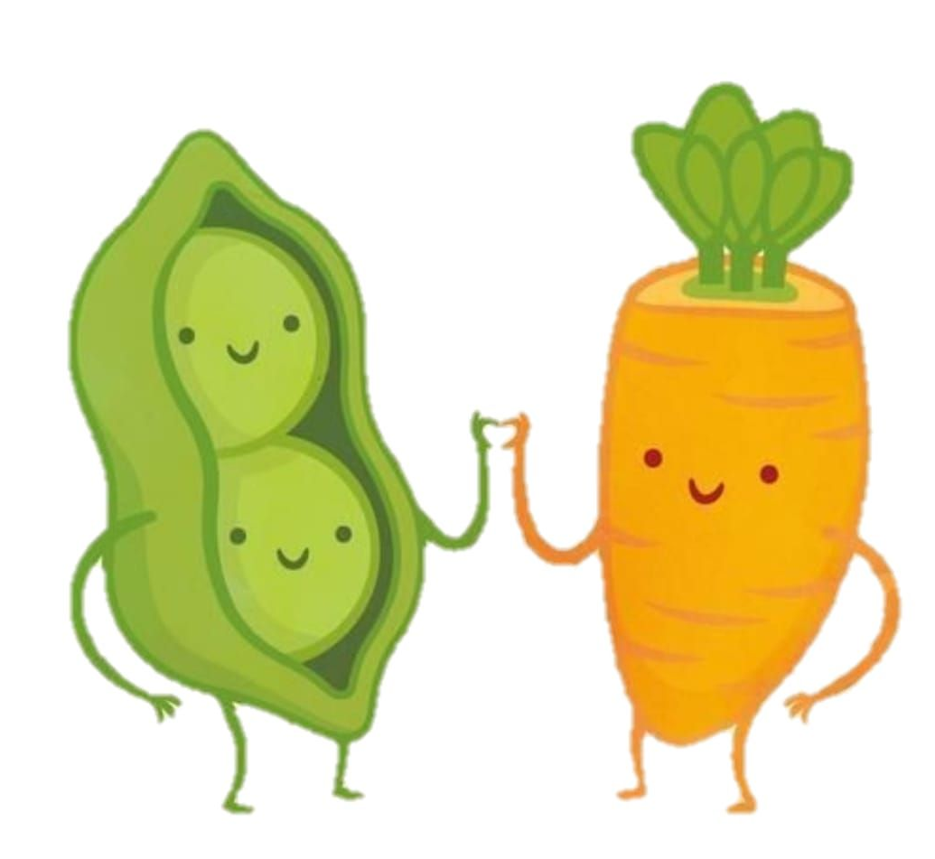
Energy requirement in humans
Vegetarians
It is The dietary energy intake required to maintain energy balance in a healthy individual
Energy balance is maintained by calorie intake and energy expenditure
Energy content of food is measured in calories or kilocalories (heat energy)
nutrient intake
chronic disease
Lower intake of iron, calcium and vitamin D
Long-term vegans may develop megaloblastic anemia due to vitamin B₁₂ deficiency
Most consume enough protein
Lower in total dietary fat
Lower Body Mass Index (BMI)
Lower death rate from ischemic heart disease
Lower blood pressure
Lower cancer rates compared to non-vegetarians
Sex | Age | Weight (Kg) | Avg. Energy Needs (Kcal)
Men | 23-50 | 70 | Up to 2900
Women | 23-50 | 55 | Up to 2200
Pregnant | - | - | +300
Lactating | - | - | +500
Don’t mind him^ u guys are doing a great job -VSLR

Slide 8
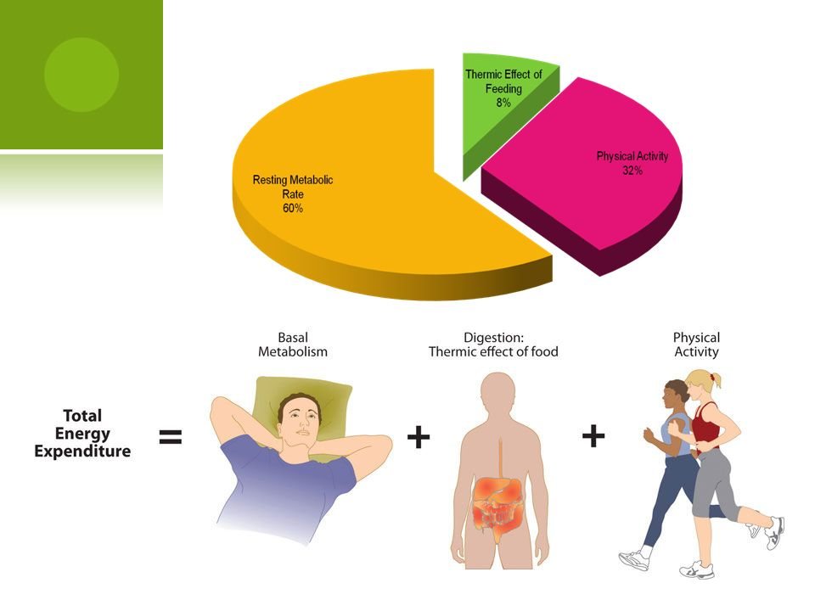
Basic energy expenditure depends on:
1
Resting metabolic rate (RMR):
Energy expense at rest
Required for normal body function
Depends on age, sex, growth, body surface area, fever, fasting, stress
Men: 1800 kcal
Women: 1300 kcal
2
Physical activity
Sedentary person: 30-50% above RMR
Active person: 100%+ above RMR
3
Thermic effect of food
Heat produced by the body due to food digestion and absorption
5-10% of total energy expenditure
Total Parenteral Nutrition (TPN)
Definition
A type of exogenous nutrition in which terminally-ill patients are provided with all essential nutrients intravenously or through tube feeding
Indications
TPN is particularly indicated in severe inflammatory bowel disease, coma, cachexia, prolonged ileus¹ and extensive burns
How its done
Nutrients are pumped into a large central vein to allow rapid dilution of the solution (3 L / 24 hr)
*Tube feeding is only provided to patients whose GI tract is intact and supports this type of nutrition
Standard composition of TPN feed (24 hr requirement)
Glucose: 1000 kcal
Electrolytes, trace elements, vitamins: present
Volume: 3 liters
Energy content: 2000 kcal
Nitrogen: 12–14 g
Fat: 900 kcal
remember
Individual nutritional requirements of patients may vary
Continuous biochemical, hematological and immunological monitoring of patient on TPN is required
1. Loss of movement in a part of intestine

Slide 9
Take Home Messages
Basic standards of nutritional requirements are important for malnutrition assessment
Establishing these standards is essential for a population in order to avoid disease and maintain good health
Committees of American and Canadian experts organized by the Food and Nutrition Board of National Academy of Sciences have established Dietary Reference intakes (DRIs).
The DRIs replace and expand on the recommended Dietary Allowances (RDA)

Slide 10
Summary
Nutritional Requirements
Assessment of malnutrition:
Dietary intake studies
Biochemical studies
Clinical symptoms
Dietary guidelines & goals
Energy requirement in humans
The dietary energy intake required to maintain energy balance in a healthy individual
DRI
estimated average requirement (EAR)
recommended dietary allowance (RDA)
adequate intake (AI)
tolerable upper intake level (UL)
Vegetarians
Low iron,calcium,V D
Megaloblastic anemia
Low BP & cancer rates
Basic energy expenditure
-Resting metabolic rate (RMR):
Energy expense at rest Required for normal body function
-Physical activity
-Thermic effect: body produces heat d/t digestion & absorption
acceptable macronutrient distribution ranges (AMDR)
carbohydrates : 45-65%
Fats : 20-35%
Proteins : 10-35%
Fibers : >25 g
Food pyramid
Total Parenteral Nutrition (TPN)
-route of administration: I.V , tube feeding
-Indications: IBD, coma, cachexia, prolonged ileus and extensive burns

Slide 11
Quiz
MCQs :
Q1: If a nutrient is considered essential but the experimental data are inadequate for determining EAR and RDA we use:
a) Adequate intake (AI) b) Tolerable upper intake level (UL)
c) AMDR d) None of them
Q2: AMDR for adult regarding the fibers:
a) 20% b) >20 g c) <20 g d) >20%
Q3: Biochemical studies identify :
a) Clinical nutritional deficiencies b) People with deficient diets
c) Subclinical nutritional deficiencies d) B & C
Q4: What type of anemia vegans may develop?
a) Sideroblastic b) Normocytic c) Megaloblastic d) Hemolytic
Q5: Energy balance maintained by:
a) Energy expenditure b) Fats c) Calorie intake d) Carbohydrates
Q6: Which of the following is determined by EAR + 2 SD?
a) Adequate intake b) Tolerable upper intake level
c) Estimated average requirement d) Recommended dietary allowance
SAQs :
Q1: Mention two Dietary reference intake standards.
Q2: Define dietary reference intake.
Q3: What does the energy expenditure depends on?
Q4: Define total parenteral nutrition.
MCQs Answer key:
1) A 2) B 3) C 4) C 5) A&C 6) D
SAQs Answer key:
estimated average requirement (EAR), recommended dietary allowance (RDA), adequate intake (AI), tolerable upper intake level (UL)
quantitative estimates of nutrient intakes required to prevent deficiencies and maintain optimal health in population
Resting metabolic rate , physical activity and thermic effect
A type of exogenous nutrition in which terminally-ill patients are provided with all essential nutrients intravenously or through tube feeding

Slide 12
Team members
You may see me struggle but you will never see me quit.
Girls Team:
Boys Team:
Ajeed Al-Rashoud
Alwateen Albalawi
Amira AlDakhilallah
Arwa Al Emam
Deema Almaziad
Ghaliah Alnufaei
Haifa Alwaily
Leena Alnassar
Lama Aldakhil
Lamiss Alzahrani
Nouf Alhumaidhi
Noura Alturki
Sarah Alkhalife
Shahd Alsalamah
Taif Alotaibi
Abdulrahman Bedaiwi
Alkassem Binobaid
Khayyal Alderaan
Mashal Abaalkhail
Naif Alsolais
Omar Alyabis
Omar Saeed
Omar Odeh
Rayyan Almousa
Yazen Bajeaifer
VSLR *chuckles*
Team Leaders
We hear you
Lina Alosaimi
Mohannad Alqarni

