Slide 1
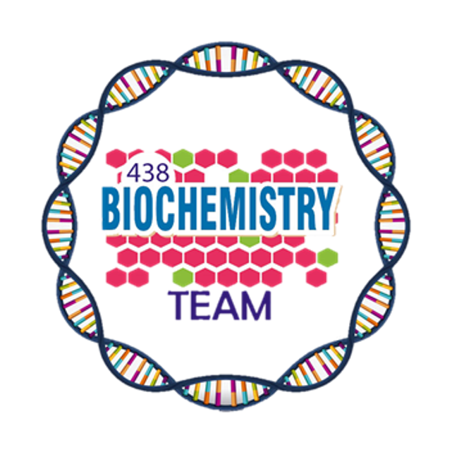
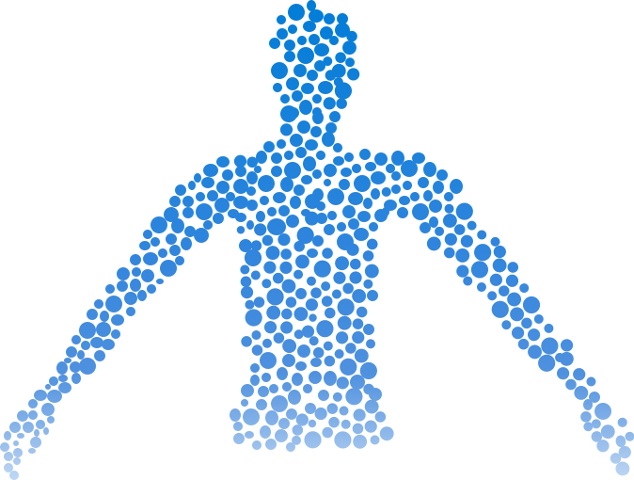
Macro & Micronutrients
Color Index:
Main Topic
Main content
Important
Drs’ notes
Extra info
Editing File
Biochemistry teamwork 438 - Gastrointestinal & Nutrition Block

Slide 2
Objectives:
Understand the nutritional importance of dietary macro and micronutrients.
Identify major dietary sources and RDAs of macro and micronutrients.
Evaluate the nutritional quality of proteins, the types of dietary carbohydrates, fibers and fats and their benefits.
Discuss the role of macronutrients in causing diseases or conditions such as nitrogen imbalance, diabetes, obesity, atherosclerosis and heart disease.
Understand the functions of micronutrients and the diseases due to their deficiencies.
Overview:
What are macro and micronutrients?
Types.
Functions are important.
Functions.
We will not ask you about sources in the exam.
We might ask you about RDA of macronutrients not micro.
Sources and RDAs.
Diseases and conditions due to their deficiency.
diseases are important.

Slide 3
Macro and Micro Nutrients
Nutrients needed by the body in large amounts (proteins, fats, carbohydrate).
They provide energy and building blocks for proteins, fats and carbohydrate.
Nutrients needed by the body in small amounts (vitamins, minerals and trace elements).
Required for maintaining normal health and preventing various diseases.
They do not provide energy.
Macronutrients
Micronutrients
Energy Content of Food
Acceptable macronutrient distribution range (AMDR)
Adequate intake of macronutrient to prevent the risk of disease
Body obtain energy as ATP.
ATP is used for all body function.
AMDR for adults:
CHOs: 45-65%
Proteins: 10-35%
Fats: 20-35%
Fibers > 25 g
The energy content of food is measured in calories (kilocalories).
One calorie: The heat required to raise the temperature of 1gram of water by 1ºC:
proteins → 4 kcal/g
Carbohydrate → 4 kcal/g
Fats → 9 kcal/g

Slide 4
Nutritional Importance of Proteins
Proteins supply amino acids and amino nitrogen to the body.¹
Essential amino acids:
Body can’t synthesize, must be supplied in the diet.
Phenylalanine, Valine, Tryptophan, Threonine, Isoleucine, Methionine, Histidine, Arginine¹, Leucin, Lysine.
“PVT TIM HALL”
amino acids
Non-Essential amino acids:
body can synthesize.
1. No longer considered as an essential, it's a conditionally essential amino acid.
Except in the preterm infants where they can't synthesize them due to the lack of enzymes.
Nutritional Quality of Proteins
A measure of protein ability to provide the essential amino acids required for tissue maintenance
1
Measured in PDCAAS units (Digestibility-Corrected Amino Acid Scoring)
2
High value indicate more digestibility and high quality (maximum score 1.0)²
3
Proteins from animal sources: (0.82 – 1.0)
4
Proteins from plant sources: (0.4)³
5
1: Main importance of proteins is providing essential amino acids to the body and they provide amino nitrogen to maintain normal nitrogen balance.
2: protein score = 1 this mean the protein can provide all essential amino acids.
3: this why vegetarians are usually amino acid deficient, however when combined with different types of food it gets higher.

Slide 5
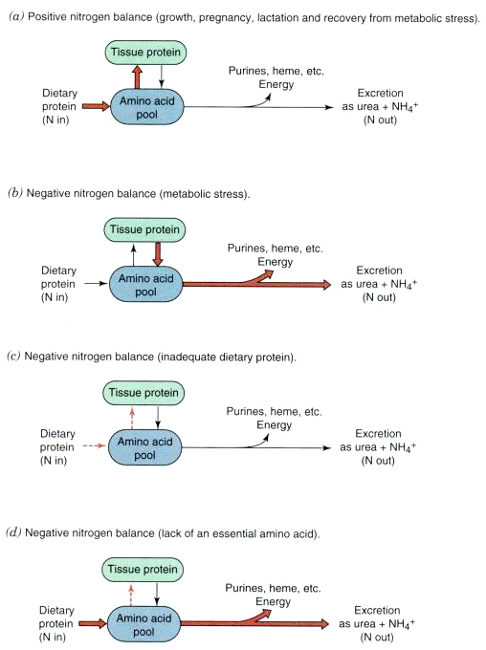
Sources and RDA¹ of Proteins:
Sources and RDA:
Meat, poultry, fish, milk, wheat,
Corn, beans, nuts.
RDA (g/kg body weight):
Normal adults: 0.8
Athletes: 1.0
Pregnancy/lactation: up to 30
Children: 2.0
Nitrogen Balance
A
Normal Nitrogen Balance
In a healthy person, nitrogen intake = nitrogen loss.
Negative Nitrogen Balance
When nitrogen intake < loss.
Occurs in burns, trauma, illness² and metabolic stress.
B
Positive Nitrogen Balance
Nitrogen intake > loss.
Occurs in growth, pregnancy, lactation and recovery of illness²
C
Description of the picture:
A positive nitrogen balance where intake is more than loss.
B: normal nitrogen intake but metabolic stress causes breakdown of tissue protein increasing its loss.
C: inadequate dietary protein cause decrease in protein intake and synthesis with normal nitrogen excretion (nitrogen loss is more than intake).
D: increase protein intake, decrease in synthesis and and increase in excretion (this happen when the body is supplied by proteins NOT required by the body so, the body will excrete the unwanted proteins.
- the nitrogen excreted in the form of urea+ NH4 (ammonium).
D
1. recommended dietary allowance
2.during illness you will be deficient in protein but during recovery you will need more proteins shifting the nitrogen balance from negative to positive nitrogen balance

Slide 6
Protein–Energy Malnutrition
Malnutrition: A condition or disease caused by not eating enough food or not eating a balanced diet.
Malnutrition is due to inadequate intake of proteins or energy.
two conditions:
 | Marasmus | Kwashiorkor
Cause | Inadequate energy intake with adequate protein intake. | Inadequate proteins intake with adequate energy intake.
Age and food intake | 1– 3 years Mother’s milk is supplemented with food (cereals) deficient in calories | After Weaning¹(at about 1 year) Diet mainly contain CHOs
Symptoms | Arrested growth Extreme muscle wasting Weakness Weight loss No edema or changes in plasma proteins | edema² Distended abdomen Diarrhea Dermatitis / thin hair enlarged fatty liver Low plasma albumin
1.When breast feeding stop.
2.Due to protein deficiency.

Slide 7
Carbohydrates
Types in diet:
Simple CHO : sucrose, fructose, lactose, corn syrup.
Complex CHOs: whole grains, pasta, wheat, starch.
Their major role in diet is energy production
RDA: 130 g/day for adults and children
Protein–Sparing Effect
CHOs intake above RDA:
- cause weight gain or obesity due to increase fat storage in adipose tissue
Dietary protein requirements and CHOs¹ diet are related to each other
CHOs have protein sparing effect:
They inhibit gluconeogenesis from amino acids.
That way amino acids are used for repair and maintenance of tissue protein.
CHOs intake below RDA:
- More protein will be metabolized
- More gluconeogenesis
1.CHOs prevent you from losing muscle mass HOW? When there is CHOs deficiency the body will use amino acids derived from the muscles for gluconeogenesis causing loss of the muscle mass.

Slide 8
Dietary Fibers
Fats in Diet
A concentrated source of energy (9kcal/g).
The Component of food that can’t be broken down by human digestive enzymes. Gives no energy ( no calories)
RDA (g/day): : 38, : 25
Supply essential fatty acids such as:
linoleic and linolenic acids.
Provide phospholipids for membrane function.
03
Lower serum LDL levels²
Reduce constipation
RDA (g/day): total fats: 65, saturated: 20
Benefits
Source of Fat-soluble vitamins (A,K,E,D) and help in their absorption.
Slows gastric emptying (long term glucose control in patient with diabetes mellitus)¹
Excessive fat intake can cause:
Atherosclerosis/heart disease.
Obesity.
Reduce exposure of gut to carcinogens.
promote feeling of fullness
1.The fibers binds with glucose and slow down glucose absorption and help to improve blood sugar level
2.How? Bile acid are made of cholesterol, fiber bind with bile acid thus they are not reabsorbed to the liver and excreted with fiber.

Slide 9
Essential Fatty Acids
Two essential fatty acids :
α-Linolenic acid (ω-3 fatty acid)
Linoleic acid (ω-6 fatty acid)
Deficiency causes:
Scaly skin, Dermatitis, Reduced growth (most common in infants)
Omega 3:
the double bond starts at C number 3 from terminal (C16).
20:5, n-3 :it has 20 C, 5 double bonds so it’s more unsaturated than omega 6.
Found in fish oil.
Omega 6:
Double bond start at C number 6 from terminal (C13).
20:4, n-6: has 20 C, 4 double bond so, it’s less unsaturated than omega 3.
Found in seed oil
Used for eicosanoid synthesis which appear to have cardioprotective effects:
↓ Blood Clotting
↓ Blood pressure
Omega-6 Fatty Acid
Nuts
Avocado
Olives
Soybeans
Oils (sesame, cottonseed, corn oil)
Sources
Effect
Plasma cholesterol
LDL
HDL¹
1.Undesirable effect

Slide 10
Omega-3 Fatty Acid
Mainly found in cold water ocean fish such as: albacore, mackerel, salmon, sardines, tuna and white fish
Play an important role as:
1- structural membrane lipids
2- Modulator of omega-6 fatty acid metabolism
A
B
Sources:
Plants
Fish oil containing docosahexaenoic acid (DHA) and eicosapentaenoic acid (EPA)
Effect:
Suppress cardiac arrhythmia
Little effect on LDL and HDL levels
↓ serum triglycerides
↓ tendency to thrombosis
↓ risk of cardiovascular mortality
↓ blood pressure
C
D
Recommendation for Omega-3 Fatty Acid Intake
American heart association guidelines
1
2
3
Patients without coronary heart disease (CHD):
Patient with CHD
Patient who need to lower triglycerides (fats)
Fatty fish twice a week
Include oils and foods rich in α-linolenic acid (flaxseed, canola and soybean oil; flaxseed and walnuts
1gm of EPA+DHA per day from fatty fish
EPA+DHA supplements
2-4 grams of EPA+DHA per day

Slide 11
Trans Fatty Acids
Unsaturated fatty acids, behaving more like saturated fatty acids in the body:
↑ serum LDL (but not HDL)
risk of CVD CardioVascular Disease
Not found in plants (animals only)
Formed during hydrogenation of liquid vegetable oil
Found in baked food: cookies, cakes,deep-fried foods
Vitamins
Organic compounds present in small quantities in different types of food
Help in various biochemical processes in cell
Important for growth and good health
Essential
Noncaloric
Required in very small amounts
Vitamins - Classiﬁed Based on Solubility
Fat -soluble Vitamins | Water-soluble Vitamins
A,D,E and K | Ascorbic acid (vitamin C), Thiamin (vitamin B₁), Riboﬂavin (vitamin B₂),Niacin (vitamin B₃), Pyridoxine (vitamin B₆ ),Biotin, Pantothenic acid, Folate, Cobalamin (vitamin B₁₂)

Slide 12
Vitamin E
May have a role in fertility and anti-aging effect
Antioxidant¹: prevents oxidation of cell components by molecular oxygen and free radicals
a-Tocopherol is the most active form in the body
Sources and RDA (mg/day)
Vegetable Oil, nuts, seeds, vegetables
Adults: 15, Children: 7
Anemia due to oxidative damage to RBCs
Neurological problems
Deficiency
Defective lipid absorption
Male infertility
(Mostly observed in premature infants)
1.Becoming stable free radical

Slide 13
Vitamin B₁
Coenzyme for transketolase and oxidative decarboxylation reactions
In thiamin deficiency, the activity of these two dehydrogenases is decreased
Functions of Vitamin B₁ (Thiamin)
Active form: Thiamin pyrophosphate (TPP)
Causing: Low ATP production and defective cellular function
Sources and RDA (mg/day)
Plants, cereals, meat
Adults: 1.2, Children: 0.6
Disorders of vitamin B1 (Thiamin) Deficiency:
Beriberi
Wernicke-Korsakoff syndrome
A type of chronic peripheral neuritis due to severe thiamin deficiency causes weakness, neuropathy, disorderly thinking, paralysis
Common in alcoholics due to defective intestinal absorption of thiamin or dietary insufficiency
Thiamin has a role in nerve conduction
Causes apathy, loss of memory
Neuropathy affects glial cells (astrocytes) of the brain and spinal cord causing neuron death

Slide 14
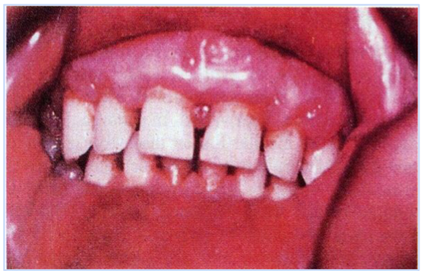
Vitamin C
Helps in the maturation of RBCs
Increases iron absorption
Promotes wound healing
Functions of Vitamin C
Helps in dentine, intercellular matrix and collagen formation
Stimulates phagocytic action of leukocytes
Powerful antioxidant (prevents some cancers)
Reduces risk of cataract formation
Sources and RDA (mg/day)
Citrus Fruits, tomatoes, melon, peppers
Men: 90, Women: 75, Children: 15-25
Scurvy
Deficiency → Scurvy:
Gums become painful, swollen and spongy
Abnormal collagen production
The pulp is separated and the teeth are lost
Scorbutic gums in vitamin C deﬁciency. Gums are swollen, ulcerated, and bleeding due to vitamin C-induced defects in oral epithelial basement membranes and periodontal collagen ﬁber synthesis.

Slide 15
Minerals and Trace Elements
Microminerals (<100 mg/day)
Iron
Macrominerals (>100 mg/day)
Iodine
Copper
Calcium
Phosphorous
Manganese
Zinc
Sodium
Cobalt
Potassium
Molybdenum
Chloride
Selenium
Magnesium
Fluoride
Chromium
Silicon

Slide 16
Iron
Part of hemoglobin, myoglobin, cytochromes electron transport chain
Body stores iron as ferritin, hemosiderin and transferrin
Functions of iron
Oxygen transport and metabolism
Adult women have much lower iron storage than men
Sources and RDA (mg/day)
Heme iron: Animal products (meat, liver), 25% absorption
Nonheme iron: Plants (spinach, beans), 5% absorption
Men: 8, Women: 18, Children: 7-15
Iron Deficiency
Iron deficiency anemia
(Is the most common)
Hemosiderosis (iron overload disorder)
Due to iron excess (toxicity)
Growing children, pregnant, lactating and
menstruating women need more iron
Hemosiderin (Iron stored in complex with ferritin
protein in liver and spleen)
Occurs in persons receiving repeated blood
transfusions

Slide 17
Take Home Messages
Macro and micronutrients are essential
for energy and maintaining good health.
Various diseases are associated either with malnutrition or excessive intake of these nutrients.

Slide 18
Summary
Essential (body can’t synthesis)
amino acids
Non-Essential (body can synthesis)
Normal Nitrogen Balance
In a healthy person, the nitrogen intake is equal to to nitrogen loss
Marasmus
Cause
Inadequate intake of energy with adequate protein intake
Negative Nitrogen Balance
When nitrogen loss is more than intake
Kwashiorkor
Positive Nitrogen Balance
Nitrogen intake is more than loss
Cause
Inadequate intake of proteins with adequate energy intake
Dietary fibers:
Two essential fatty acids:
α-Linolenic acid (ω-3 fatty acid)
Linoleic acid (ω-6 fatty acid)
Lower serum LDL levels
Reduce constipation
Benefits
Slows gastric emptying (long term glucose control in patient with diabetes mellitus)
Reduce exposure of gut to carcinogens.
promote feeling of fullness

Slide 19
Summary
Vitamins - Classiﬁed Based on solubility
Omega-6 fatty acid
Fat -soluble Vitamins
A,D,E and K
Sources:
Nuts.
Avocado.
Olives.
Soybeans.
Oils (sesame, cottonseed, corn oil).
Effect :
Plasma cholesterol.
LDL.
HDL¹
Water-soluble Vitamins
Ascorbic acid (vitamin C), Thiamin (vitamin B1), (vitamin B2), (vitamin B3), (vitamin B6 ), (vitamin B12)
Omega-3-fatty acid
Vitamin B1 (Thiamin)
Sources:
Plants
Fish oil containing docosahexaenoic acid (DHA) and eicosapentaenoic acid (EPA).
Effect :
Suppress cardiac arrhythmia.
Little effect on LDL and HDL levels.
↓ serum triglycerides.
↓ tendency to thrombosis.
↓ risk of cardiovascular mortality.
↓ blood pressure
Disorders of vitamin B1 (Thiamin) Deficiency:
Beriberi: A type of chronic peripheral neuritis due to severe thiamin deficiency causes weakness, neuropathy, disorderly thinking, paralysis
Wernicke-Korsakoff syndrome:
Common in alcoholics due to defective intestinal absorption of thiamin or dietary insufficiency
Iron
Functions
Oxygen transport and metabolism
Part of hemoglobin, myoglobin, cytochromes
Body stores iron as ferritin, hemosiderin and transferrin
Adult women have much lower iron storage than men
Vitamin E
Deficiency: (mostly observed in premature infants)
1- Defective lipid absorption
2- Anemia due to oxidative damage to RBCs
3- Neurological problems
4- Male infertility
Vitamin C
Deﬁciency causes scurvy :
Abnormal collagen production
● Gums become painful, swollen and spongy
● The pulp is separated and the teeth are lost
Iron Deficiency → Hemosiderosis
↓
Iron deﬁciency anemia

Slide 20
Quiz
MCQs :
Q1: Inadequate protein intake with adequate energy intake describe which of the following condition:
A) Marasmus B) Korsakoff C) Kwashiorkor D) Scurvy
Q2: Which of the following cause decrease of LDL level?
A) Proteins B) Dietary fibers C) Omega 3 D) B,C
Q3: Which of the following is a fat soluble vitamin?
A) Vitamin C B) Vitamin B C) Vitamin E D) Folate
Q4: Wernicke-Korsakoff syndrome is due to deficiency in which of the following enzymes?
A) Vitamin B12 B) Vitamin C C) Vitamin A D) Vitamin B1
Q5: Regarding micronutrients which of the following is correct?
A) Provide energy B) Needed large amounts
C) Don’t provide energy D) A,B
Q6: Vitamin E Deficiency will lead to?
A) Defective lipid absorption B) Beriberi
C) Scurvy D) Wernicke-Korsakoff syndrome
Q7: Body store iron as?
A) Ferritin B) Transferrin C) Hemosiderin D) All of them
SAQs :
Q1: Mention two Effects and Sources of omega 3 fatty acid.
Q2: Explain how carbohydrates deficiency can affect proteins.
Q3: What is the cause of Kwashiorkor and mention three symptoms of this condition?
Q4: Enumerate two functions of Vitamin C and mention the disorder caused when it’s deficient?
MCQs Answer key:
1) C 2) B 3) C 4) D 5) C 6) A 7) D
SAQs Answer key:
Sources:1- Plants. 2-Fish oil containing DHA and EPA. Effects: 1- Suppress cardiac arrhythmia. 2-lower BP.
CHOs have protein sparing effect and their dificnct cause increase protein metabolization and gluconeogenesis using proteins.
Inadequate protein intake with adequate energy intake. 1-Edema. 2-Diarrhea. 3-Dermatitis.
1- increase iron absorption 2- promote wound healing
scurvy

Slide 21
Team members
(من سلك طريقًا يلتمس فيه علمًا، سهّل الله به طريقًا إلى الجنة)
Girls Team:
Boys Team:
Ajeed Al-Rashoud
Alwateen Albalawi
Amira AlDakhilallah
Arwa Al Emam
Deema Almaziad
Ghaliah Alnufaei
Haifa Alwaily
Leena Alnassar
Lama Aldakhil
Lamiss Alzahrani
Nouf Alhumaidhi
Noura Alturki
Sarah Alkhalife
Shahd Alsalamah
Taif Alotaibi
Abdulrahman Bedaiwi
Alkassem Binobaid
Khayyal Alderaan
Mashal Abaalkhail
Naif Alsolais
Omar Alyabis
Omar Saeed
Omar Odeh
Rayyan Almousa
Yazen Bajeaifer
Team Leaders
We hear you
Lina Alosaimi
Mohannad Alqarni

