Slide 1
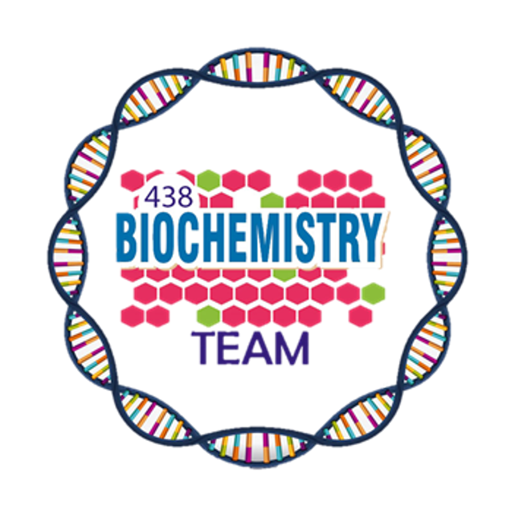
Plasma Proteins
Color Index:
Main Topic
Main content
Important
Drs’ notes
Extra info
Editing File
Biochemistry teamwork 438 - Gastrointestinal & Nutrition Block

Slide 2
Objectives:
Identify types and various functions of plasma proteins.
Discuss the role of plasma proteins in the diagnosis of diseases and conditions.
Interpret the normal and abnormal electrophoretic patterns of plasma proteins.
Identify the role positive and negative acute phase proteins in various diseases.
Overview:
Functions and characteristics of plasma proteins
Measurement of plasma proteins and diagnosis of diseases
Electrophoretic patterns of plasma proteins
Acute phase proteins

Slide 3
1
Plasma contains >300 different proteins
Content
Here
A normal adult contains ~70 g/L of pps
Many pathological conditions affect the level of plasma proteins
5
2
Plasma Proteins
(PPS)
Some are produced in other sites (e.g. immunoglobulins are produced by plasma B cells)
Mostly synthesized in the liver
4
3
Plasma Proteins FUNCTIONS
Maintain plasma oncotic pressure
Defense
Clotting and fibrinolysis
Transport
Albumin
prealbumin
globulins
Albumin
Immunoglobulin
complements
Thrombin
plasmin
1
3
4
2

Slide 4
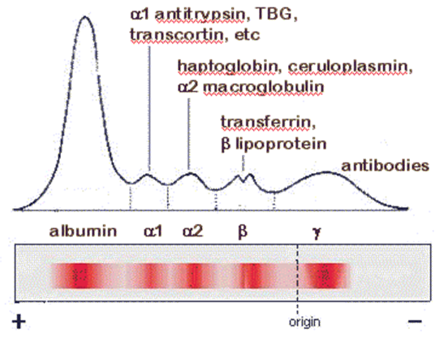
Normal Pattern of Plasma Protein Electrophoresis
60% → albumin
20% → γ globulin
1- Quantitative measurement of a specific protein:
Chemical or immunological reactions
Comes 1st (fastest) cause it has the smallest size
Measurement of Plasma Proteins
Comes last (slowlest) cause it’s the largest
2- Semiquantitative measurement by electrophoresis:
Proteins are separated by their electrical charge in electrophoresis
Five separate bands of proteins are observed
These bands change in disease
The Test separates the proteins in the blood based on their Electrical charge & Molecular weight

Slide 5
Types of Plasma Proteins
1
Prealbumin
2
Albumin
3
γ- Globulins
α₁-Globulins:
a₁-Antitrypsin
α-fetoprotein
α₂-Globulins:
Ceruloplasmin
Haptoglobin
β-Globulins:
CRP
Transferrin
β2-microglobulin
4
5
6
Prealbumin (Transthyretin):
Information
Migrates faster than albumin in electrophoresis Separated by immunoelectrophoresis Short half-life (2 days)
Function
A transport protein for: 1- Thyroid hormone 2- Retinol (vitamin A)
Lowered levels in:
liver disease, nephrotic syndrome, acute phase inflammatory response malnutrition
It is NOT an albumin precursor, it's a completely different protein that doesn't show bands in electrophoresis because it’s small

Slide 6
Albumin
1- Most abundant plasma protein (~40 g/L) in normal adult.
2- Synthesized in the liver as preproalbumin and secreted as albumin.
3- Half-life in plasma: 20 days
4- Decreases rapidly in injury, infection and surgery.
Functions
Abnormalities
1- Maintains oncotic pressure:
–The osmotic pressure exerted by plasma proteins that pulls water into the circulatory system.
–Maintains fluid distribution in and outside cells and plasma volume.
2- 80% of plasma oncotic pressure is maintained by albumin.
3- A non-specific carrier of: hormones, calcium, free fatty acids, drugs, etc.
4- Tissue cells can take up albumin by pinocytosis where it is hydrolyzed to amino acids.
5- Useful in treatment of liver diseases, hemorrhage, shock and burns.
1- Hypoalbuminemia:
Causes:
1- Decreased albumin synthesis (liver cirrhosis, malnutrition)
2- Increased losses of albumin:
-Increased catabolism in infections
-Excessive excretion by the kidneys
(nephrotic syndrome)
-Excessive loss in bowel (bleeding)
-Severe burns (plasma loss in the absence of skin barrier
Effects:
1- Edema due to low oncotic pressure
-Albumin level drops in liver disease causing low oncotic pressure
-Fluid moves into the interstitial spaces causing edema
2- Reduced transport of drugs and other substances in plasma
3- Reduced protein-bound calcium
- Total plasma calcium level drops
- Ionized calcium level may remain normal
2-Hyperalbuminemia:
1- No clinical conditions are known that cause the liver to produce large amounts of albumin.
2- The only cause of hyperalbuminemia
is dehydration.

Slide 7
a₁-Antitrypsin
Information
Function
Genetic definciny
Synthesized by the liver and macrophages.
Over 30 types are known.
The most common is M type.
1- An acute-phase protein that inhibits proteases.
2- Proteases are produced endogenously and from leukocytes and bacteria.
Digestive enzymes (trypsin, chymotrypsin)
Other proteases (elastase, thrombin)
3- Infection leads to protease release from bacteria and from leukocytes.
1- Synthesis of the defective a₁-Antitrypsin occurs in the liver but it cannot secrete the protein.
2- a₁-Antitrypsin accumulates in hepatocytes and is deficient in plasma.
Laboratory Diagnosis:
Clinical Consequences of a₁-Antitrypsin Deficiency:
Lack of a₁-globulin band in protein electrophoresis.
Quantitative measurement of a₁-Antitrypsin by:
Radial immunodiffusion, isoelectric focusing or nephelometry
Neonatal jaundice with evidence of cholestasis
Childhood liver cirrhosis
Pulmonary emphysema in young adults

Slide 8
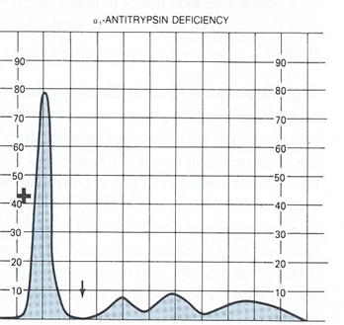
1
2
Picture 1 shows a normal Serum Electrophoresis Pattern
Pictures 2 shows a₁-Antitrypsin\a₁-globulin is gone. which means the patient has no a₁-Antitrypsin

Slide 9
Plasma protein | Information/Function | Abnormality
α-Fetoprotein (AFP) | -Synthesized in the developing embryo and fetus by the parenchymal cells of the liver. -AFP levels decrease gradually during intra-uterine life and reach adult levels at birth. -Function is unknown but it may protect fetus from immunologic attack by the mother & no known physiological function in adult. | -Elevated maternal AFP levels are associated with:  Neural tube defect, anencephaly -Decreased maternal AFP levels areassociated with: Increased risk of Down’s syndrome -AFP is a tumor marker for: Hepatoma and testicular cancer.
Ceruloplasmin | -Synthesized by the liver & contains >90% of serum copper. -An oxidoreductase that inactivates ROS causing tissue damage in acute phase response. -Important for iron absorption from the intestine. | -Wilson’s disease: Due to low plasma levels of ceruloplasmin, copper is accumulated in the liver and brain.
Haptoglobin | -Synthesized by the liver & binds to free hemoglobin to form complexes that are metabolized in the reticuloendothelial system (RES). -Limits iron loss by preventing Hb loss from kidneys (recycling) | -Plasma level decreases during hemolysis.
Transferrin | -A major iron-transport protein in plasma 30% saturated with iron & Iron deficiency results in increased hepatic synthesis. -A negative acute phase protein¹. | -Plasma level drops in: Malnutrition, liver disease, inflammation, malignancy.
β2–Microglobulin | -A component of human leukocyte antigen (HLA) & present on the surface of lymphocytes and most nucleated cells. -Filtered by the renal glomeruli due to its small size but most (>99%) is reabsorbed. | -Elevated serum levels are found in: severe inflammation (infections, SLE, and rheumatoid arthritis) -May be a tumor marker for: Leukemia, lymphomas, multiple myeloma.
C-Reactive Protein (CRP) | -A Positive acute-phase protein synthesized by the liver & Important for phagocytosis.  | -High plasma levels are found in many inflammatory conditions such as rheumatoid arthritis. -A marker for ischemic heart disease. it's ultra sensitive CRP
1.Acute phase proteins will be discussed in the next slides

Slide 10
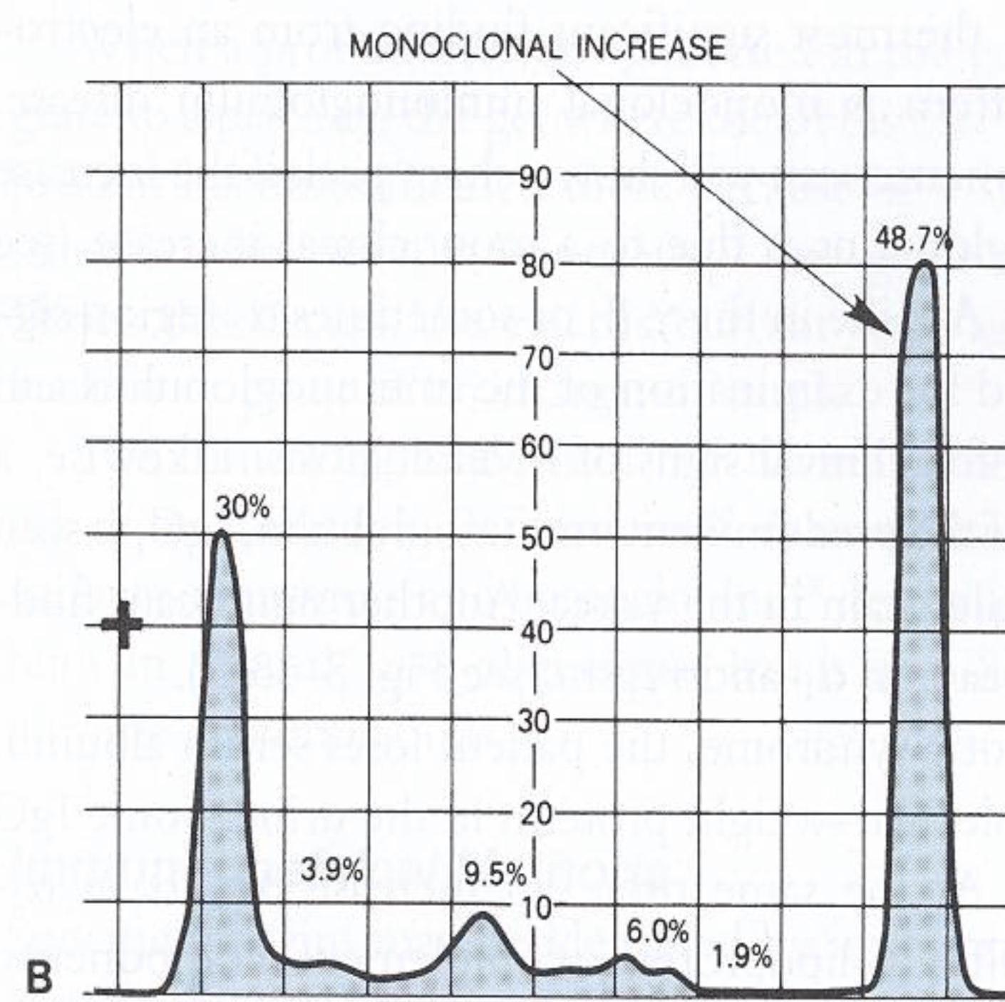
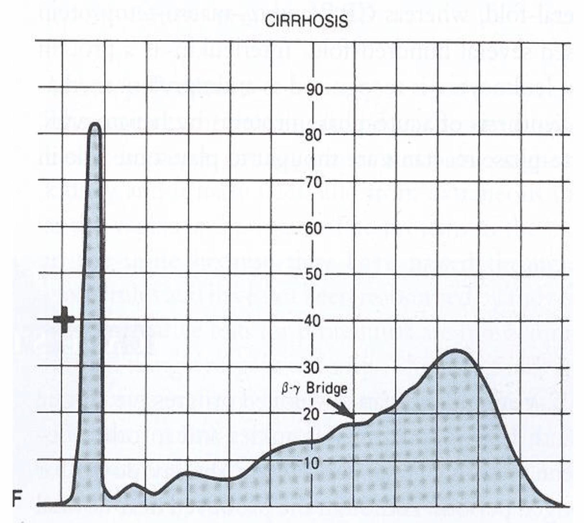
Hypergammaglobulinemia
01
Monoclonal Hypergammaglobulinemia
02
Polyclonal Hypergammaglobulinemia
Stimulation of many clones of B cells produce a wide range of antibodies.
γ-globulin band appears large in electophoresis.
Clinical conditions: acute and chronic infections, autoimmune diseases, chronic liver diseases.
Proliferation of a single B-cell clone produces a single type of Ig.
Appears as a separate dense band (paraprotein or M band) in electrophoresis.
Paraproteins are characteristic of malignant B-cell proliferation.
Clinical condition: multiple myeloma.
3M: Monoclonal - M band - Multiple myeloma

Slide 11
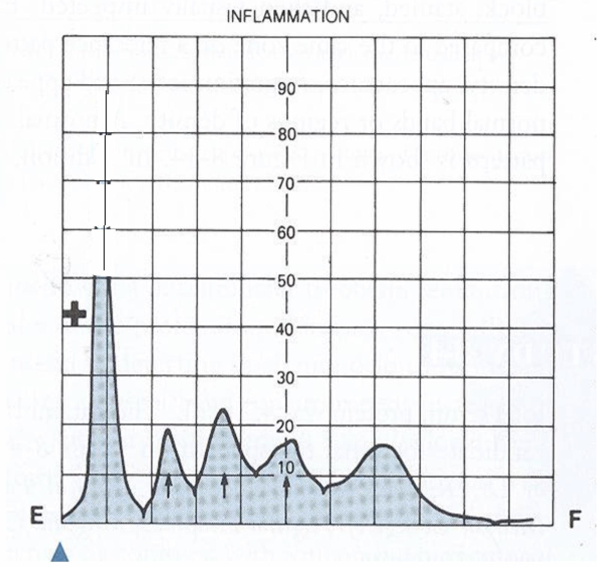
Positive acute phase proteins
-Plasma protein levels increase in: Infection, inflammation, malignancy, trauma, surgery.
-These proteins are called acute phase reactants & synthesized due to body’s response to injury.
-Examples: α1-Antitypsin, haptoglobin, ceruloplasmin, fibrinogen, C-reactive protein.
Mediators that cause these proteins to increase after injury are:
Cytokines (IL-1, IL-6), tumor necrosis factors α and β, interferons, platelet activating factor.
Mediators functions:
1. Bind to polysaccharides in bacterial walls.
2. Activate complement system.
3. Stimulate phagocytosis.
Negative acute phase proteins
-These are proteins which decrease in inflammation: Albumin, prealbumin, transferrin
-They’re mediated by inflammatory response via cytokines and hormones.
-Reason for the decrease in synthesis of these proteins is:
to save amino acids for positive acute phase proteins.
Dr’s note: Acute phase inflammatory response is the first response that you will have within 24 hours of an acute insult/infection. Your body will try to fight the insult by synthesizing certain proteins in increased amounts (positive proteins), while decreasing the amounts of other proteins (negative proteins).

Slide 12
Take Home Messages
Plasma proteins play essential roles in a number of cellular functions.
They possess diagnostic significance in identifying various pathological conditions.
Summary
Plasma proteins
Functions | Abnormal levels of proteins | Proteins used as markers
1.transport: (albumin/prealbumin/globulin) 2.maintain plasma oncotic pressure: (albumin) 3.Defense: (Immunoglobulins and complement) 4.Clotting and fibrinolysis: (Thrombin and plasmin) | 1. Prealbumin: decreased level in liver disease, nephrotic syndrome, acute phase inflammatory response, malnutrition. 2. Albumin: Decreased in liver cirrhosis, malnutrition, Increased losses of albumin (such as severe burn/bleeding). While it’s increased in dehydration. 3. α1-Antitrypsin: decreased levels lead to neonatal jaundice / childhood liver cirrhosis / pulmonary emphysema. 4. α-fetoprotein: increased level associates with neural tube defect and anencephaly while decreased level associates with Down syndrome. 5. Ceruloplasmin: decreased level in Wilson’s disease. 6. Haptoglobin: decreased during hemolysis. 7. CRP: increased in inflammatory conditions such as rheumatoid arthritis 8. Transferrin: decreased in Malnutrition, liver disease, inflammation, malignancy. 9. β2-microglobulin: increased levels / overproduction in inflammatory diseases. 10. γ- Globulins: increased level result in hypergammaglobulinemia. | 1. AFP is a tumor marker for Hepatoma and testicular cancer. 2. β2-microglobulin may be a tumor marker for Leukemia, lymphomas, multiple myeloma. 3. CRP is a marker for ischemic heart disease.

Slide 13
Quiz
MCQs :
Q1: Which of the following is a tumor marker for hepatoma:
a) C-Reactive protein b) a-fetoprotein c) β2–Microglobulin d) Haptoglobin
Q2: Which of the following is a negative acute phase protein:
a) Transferrin b) Haptoglobin c) C-Reactive protein d) Fibrinogen
Q3: Decreased maternal AFP is associated with:
a) Lymphoma b) Anencephaly c) Wilson’s disease d) Down syndrome
Q4: Which of the following is a clinical consequences of a₁-Antitrypsin Deficiency:
a) Adulthood liver cirrhosis b) Pulmonary emphysema c) Renal failure d) ischemic heart disease
Q5: Which of the following causes Hyperalbuminemia:
a) Increase kidney secretion b) Severe burns c) Dehydration d) Increase catabolism in infection
Q6: Which of the following is true regarding CRP?
a) Important for phagocytosis b) Synthesized by kidney c) Marker for heart failure d) All of them
MCQs Answer key:
1) B 2) A 3) D 4) B 5) C 6) A

Slide 14
Quiz
SAQs :
Q1: What kind of measurement does this graph indicates?
Q2: What kind of abnormality does the RED arrow indicates? Explain.
Q3: List TWO clinical consequences of this abnormality.
Q4: List THREE negative acute phase proteins.
Q5: List THREE mediators that cause positive acute phase proteins to increase after injury.
SAQs Answer key:
Semiquantitative measurement by plasma protein electrophoresis.
Indicate a₁-antitrypsin deficiency, because there’s lack of a₁-globulin band in the graph.
Childhood liver cirrhosis - Pulmonary emphysema in young adults.
Albumin, prealbumin, transferrin.
Cytokines (IL-1, IL-6), tumor necrosis factors α and β , interferons, platelet activating factor.

Slide 15
Team members
You Will Never Have This Day Again, So Make It Count
Girls Team:
Boys Team:
Ajeed Al-Rashoud
Alwateen Albalawi
Amira AlDakhilallah
Arwa Al Emam
Deema Almaziad
Ghaliah Alnufaei
Haifa Alwaily
Leena Alnassar
Lama Aldakhil
Lamiss Alzahrani
Nouf Alhumaidhi
Noura Alturki
Sarah Alkhalife
Shahd Alsalamah
Taif Alotaibi
Abdulrahman Bedaiwi
Alkassem Binobaid
Khayyal Alderaan
Mashal Abaalkhail
Naif Alsolais
Omar Alyabis
Omar Saeed
Omar Odeh
Rayyan Almousa
Yazen Bajeaifer
Team Leaders
We hear you
Lina Alosaimi
Mohannad Alqarni

