Slide 1
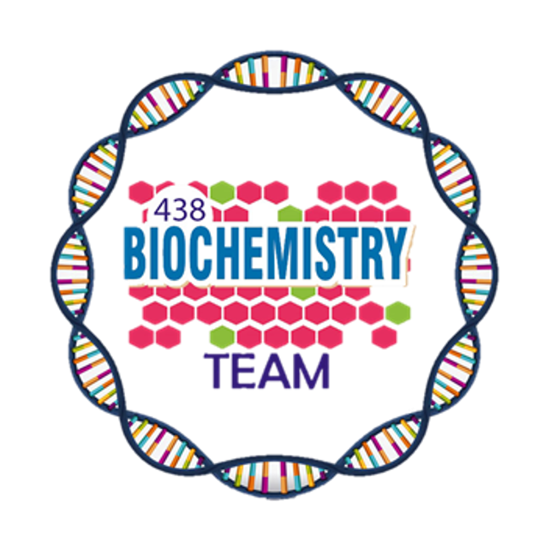
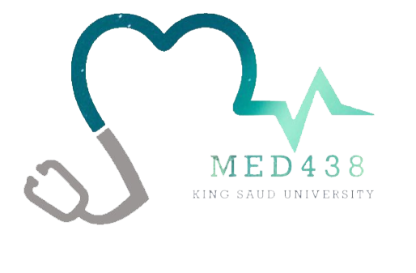
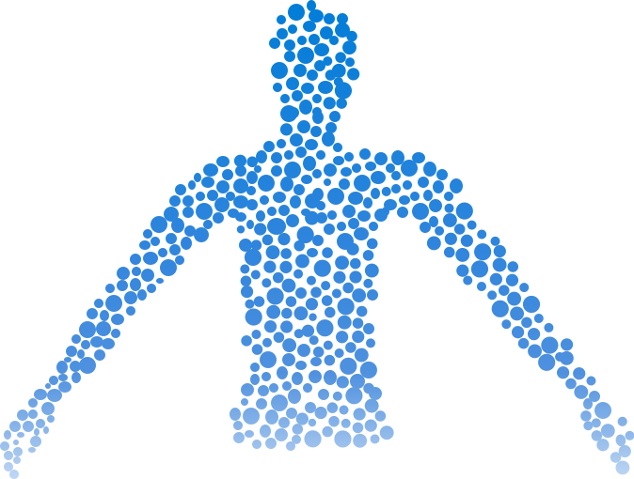
Vitamin K
Color Index:
Main Topic
Main content
Important
Drs’ notes
Extra info
Editing File
Biochemistry teamwork 438 - Gastrointestinal & Nutrition Block

Slide 2
Objectives:
Identify the types and sources of vitamin K
Understand the role of vitamin K in blood Coagulation
Recognize the importance of g-carboxylation of glutamic acid in coagulation proteins
Understand the role of anticoagulant drugs in affecting vitamin K function
Discuss the causes and disorders of vitamin K deficiency
Overview:
Types, chemistry and sources of vitamin K
Sources and daily requirements
Functions:
Deficiency and disorders
- Synthesis of γ-carboxyglutamate in:
- Prothrombin and blood clotting factors
- Interaction of prothrombin with platelets
- Osteocalcin
- Protein C and S (anticoagulant proteins)
Clinical manifestations

Slide 3
Types and Sources
Vitamin K₁
(Phylloquinone)
Chemistry
Infant (0-1 year): 2-2.5
Children (1-8): 30-55
Upper limit: Not established
RDA for Vitamin K (mg/day)
Men (19+): 120
Occurs in several forms:
Vitamin K₂
(Menaquinone)
Chemistry
Pregnancy / lactation: 90
Women (19+): 90
Vitamin K₃
(Menadione)
Chemistry
Dietary sources:
01
Phylloquinone: Green leafy vegetables
Cabbage, kale, spinach,
egg yolk, liver
02
Menaquinone: Intestinal bacteria
Intestinal bacterial synthesis meets the daily requirement of vitamin K even without dietary supplement
03
Menadione¹: Synthetic form
A precursor of menaquinone (look at the chemistry for both of them)
Cabbage
Kale
Spinach
1- No more use as supplement, because of ↑ in toxicity and now we use phylloquinone for supplementation

Slide 4
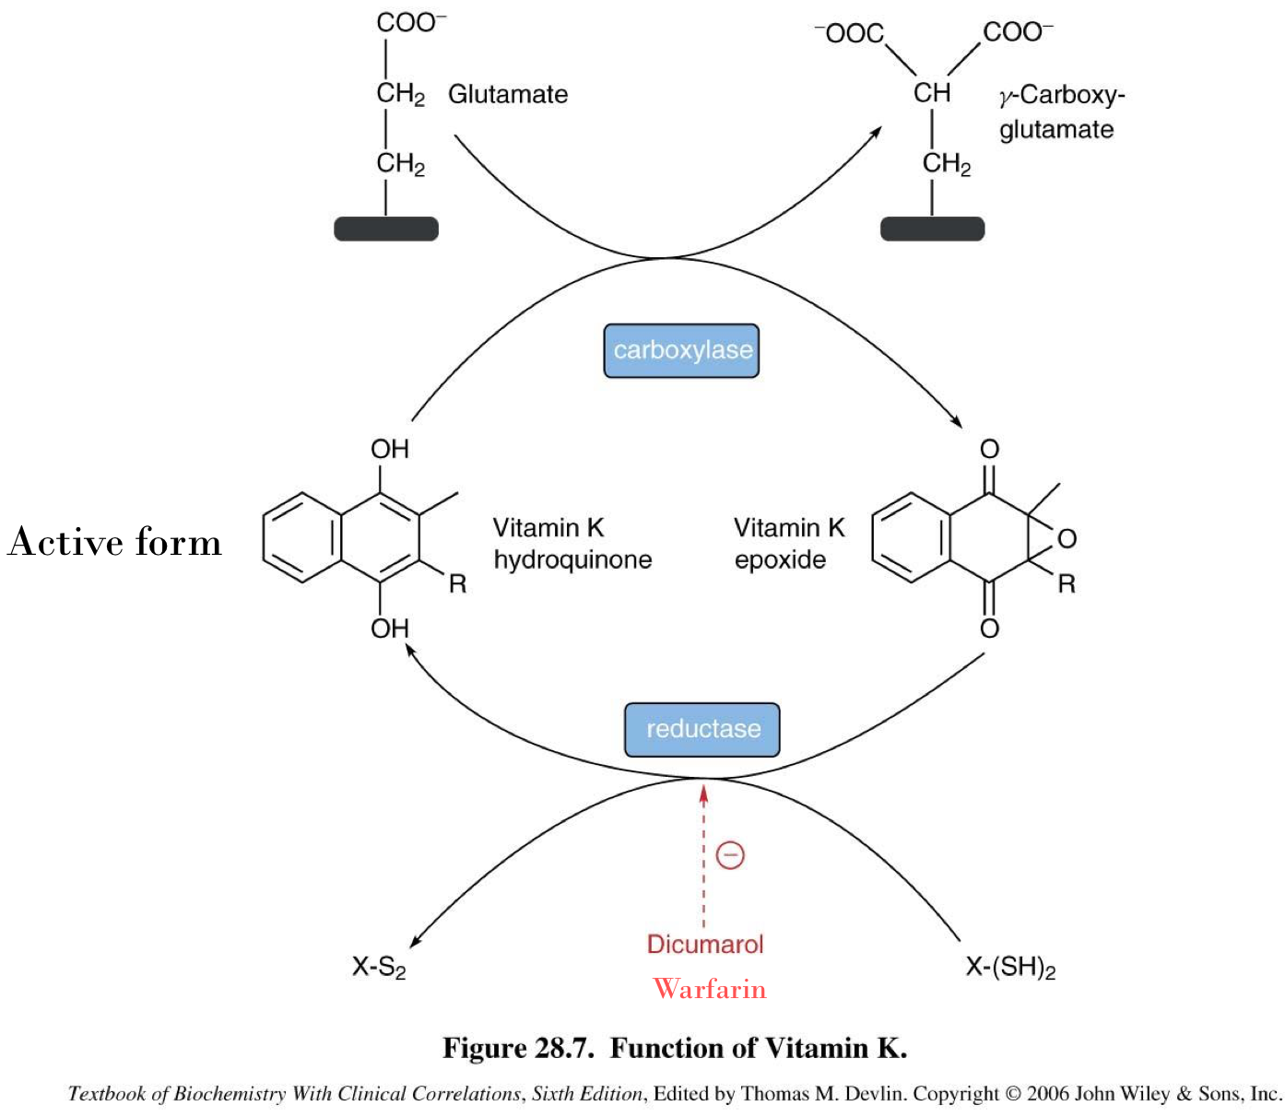
Functions of Vitamin K
Coenzyme for the synthesis of prothrombin and blood clotting factors in the liver
Prothrombin¹ and clotting factors are protein in nature.
Synthesis of prothrombin¹, clotting factors II, VII, IX, X require carboxylation of their glutamic acid (Glu) residue.
Mature prothrombin and clotting factors contain g-carboxyglutamate (Gla) after carboxylation reaction.
Vitamin K is essential for the carboxylase enzyme involved.
Dihydroquinone form of vitamin K is essential for this reaction.
Adds carboxylic acid group
of Vit k
Block the activation of Vit k
“competitive inhibitors of reductase”
- If Vit K is in it’s epoxide form and can’t get back to it’s hydroquinone form → decrease clotting factors and increase prothrombin time.
- Quinone form epoxide isn’t active so even vit K needs to get activated by being reduced again into hydroquinone “active form” with the help of the enzyme reductase.
- Carboxylase enzyme is also called epoxidase since it turns vit k to epoxide form.
1- Prothrombin = coagulation factor II

Slide 5
Analogs of Vitamin K
Anticoagulant drugs: warfarin and dicoumarol (Structural analogs of vitamin K)
They inhibit the activation of vitamin K to hydroquinone form (inhibiting the reductase enzyme)
Prothrombin and clotting factors are not carboxylated
Hence blood coagulation time increases upon injury
Carboxylation of glutamate requires vitamin K
The process is inhibited by warfarin

Slide 6
Functions of Vitamin K
Prothrombin – platelet interaction:
Carboxylated prothrombin contains
two carboxylate groups (COO–)
1
These groups bind to Ca2+, forming
prothrombin-calcium complex
2
The complex then binds to phospholipids on the surface of platelets (important for blood clotting)
3
Converting prothrombin to thrombin and initiating clot formation
4
Prothrombin > Thrombin > Clot formation
So the calcium works as a bridge between the clotting factors and membrane of platelets

Slide 7
Functions of Vitamin K
Synthesis of γ-carboxyglutamate in osteocalcin:
Osteocalcin
(Also called Bone Gla Protein “BGP”)
is a bone turnover protein
Involved in bone formation, mineralization and resorption
1
2
3
The binding mechanism is similar to
that of prothrombin-platelet binding
γ-Carboxyglutamate is required for osteocalcin binding to hydroxyapatite
(a calcium mineral) in the bone
4
The exact function is unknown but it was noticed that Vit K deﬁciency → decrease γ-carboxyglutamate (carboxylated osteocalcin) → Osteoporosis and another thing that vit K deficiency lead to decrease ca absorption so ca increase in circulation and lead to calcification in arteries and soft tissue which increase risk of CVD

Slide 8
Deficiency of Vitamin K
Deficiencies are rare: Vitamin k is synthesized by intestinal bacteria (normal flora) and stored in the liver
Causes of vit K deficiency:
Lipid malabsorption can lead to vitamin K deficiency “because it is a fat soluble vitamin”
Prolonged antibiotic therapy → killing normal flora → Vit K deficiency Especially in marginally malnourished individuals
(e.g. debilitated geriatric patients)
Some second-generation cephalosporin drugs cause this condition due to warfarin-like effects
(antibiotics given with vit. K)
Gastrointestinal infections with diarrhea → loss of normal flora → Vit K deficiency
Deficiency most common in newborn infants
Newborns lack intestinal flora
Human milk can provide only 1/5th vitamin K
Supplements are given intramuscularly at birth
Affects of Vit K deficiency:
Hypoprothrombinemia:
↑ blood coagulation time
Bone growth and mineralization

Slide 9
Clinical Manifestations of the Deficiency
Toxicity of Vitamin K
01
Prolonged supplementation of large doses of menadione can cause:
Hemolytic anemia
Jaundice
Mucus membrane hemorrhage
Hemorrhagic disease
of the newborn
Bruising tendency, ecchymotic patches (bleeding underneath the skin)
Due to toxic effects on RBC membrane
02
Post-traumatic bleeding / internal bleeding
Prolonged prothrombin time

Slide 10
Take Home Messages
Vitamin K is essential for blood coagulation process
It mediates the process by γ-carboxylation of glutamic acid residues of prothrombin and coagulation factors

Slide 11
Summary
Vitamin K
Types
Function
Deficiency
Clinical Manifestations
Toxicity
Coenzyme for the synthesis of proteins in the liver: Prothrombin and Blood clotting factors by carboxylation of (Glu) into (Gla) which needs dihydroquinone form of Vit K.
Warfarin inhibits reductase (no dihydroquinone formation)
- Lipid malabsorption
- 2nd Gen cephalosporins (given antibiotic + vit k due to warfarin-like effects)
- Prolonged antibiotic therapy
- GI Infections with diarrhea
- last two destroy normal flora → Vit k deficiency because Vit k is synthesized by intestinal bacteria (normal flora)
- Mucus membrane hemorrhage
- Hemorrhagic disease of the newborn
- Bruising tendency, ecchymotic patches (bleeding underneath the skin)
- Post-traumatic bleeding/internal bleeding
- Prolonged prothrombin time
Prolonged large intake of menadione for a long time > toxic effects on the RBC membrane which leads to:
- Hemolytic anemia
- Jaundice
K1 (Phylloquinone)
K2 (Menaquinone)
K3 (Menadione)
Synthesis of (Gla) γ-carboxyglutamate for osteocalcin to bind with hydroxyapatite.
Carboxylated Prothrombin + Ca2+ > phospholipids on surface of platelets:
(Important for clotting)

Slide 12
Quiz
MCQs :
Q1: All factors and proteins in blood clotting are synthesized in
a) Pancreas b) Liver c) Kidney d) Spleen
Q2: The form of vitamin K that is required for activation of clotting factors is:
a) Menaquinone b) Menadione c) Phylloquinone d) Hydroquinone
Q3: Which of the following is type of vitamin K is produced by the intestinal bacteria?
a) Phylloquinone b) Menaquinone c) Menadione d) Hydroquinone
Q4: The clotting factor that is synthesized by vitamin k is:
a) VI b) V c) XII d) IX
Q5: Which one of the following can be inhibited by Dicumarol?
a) Glutamate b) Vit K Epoxide
c) Vit K hydroquinone d) γ-Crboxy-glutamate
Q6: What type of malabsorption could lead to vitamin K deficiency?
a) Lipid malabsorption b) Protein malabsorption
c) Carbohydrate malabsorption d) B & C
SAQs :
Q1: Mention the dietary sources of Vitamin K
Q2: A patient on warfarin get injured by a car accident, he is on risk of:
Q3: Write 3 causes of Vit K deficiency
Q4: Prolonged supplementation of large doses of Menadione can lead to:
MCQs Answer key:
1) B 2) D 3) B 4) D 5) C 6) A
SAQs Answer key:
Cabbage, kale, spinach, egg yolk, liver
Increasing of blood coagulation time.
Prolonged antibiotic therapy , lipid malabsorption , destroy the bacterial flora
Hemolytic anemia, Jaundice

Slide 13
Team members
Learn from yesterday,live for today,hope for tomorrow,The important thing is not to stop questioning
Girls Team:
Boys Team:
Ajeed Al-Rashoud
Alwateen Albalawi
Amira AlDakhilallah
Arwa Al Emam
Deema Almaziad
Ghaliah Alnufaei
Haifa Alwaily
Leena Alnassar
Lama Aldakhil
Lamiss Alzahrani
Nouf Alhumaidhi
Noura Alturki
Sarah Alkhalife
Shahd Alsalamah
Taif Alotaibi
Abdulrahman Bedaiwi
Alkassem Binobaid
Khayyal Alderaan
Mashal Abaalkhail
Naif Alsolais
Omar Alyabis
Omar Saeed
Omar Odeh
Rayyan Almousa
Yazen Bajeaifer
Team Leaders
We hear you
Lina Alosaimi
Mohannad Alqarni

