Slide 1
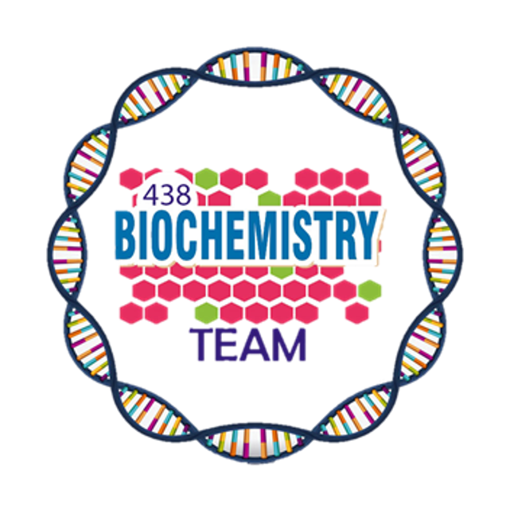
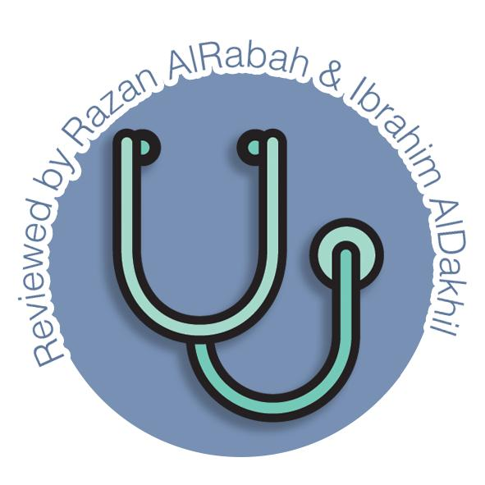
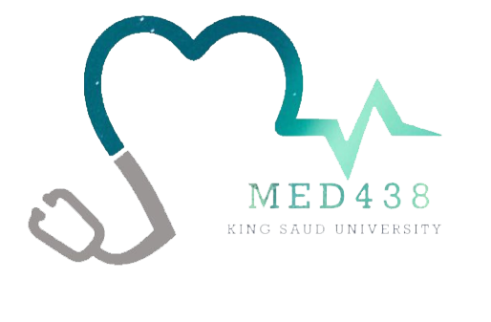
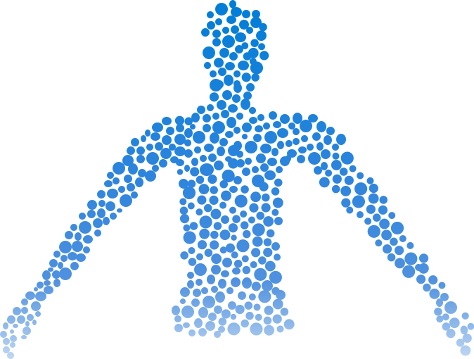
Liver Function
Color Index:
Main Topic
Main content
Important
Drs’ notes
Extra info
Editing File
Biochemistry teamwork 438 - Gastrointestinal & Nutrition Block

Slide 2
Objectives:
Understand the major metabolic functions of the liver and causes of liver dysfunction.
Discuss markers of liver function tests such as liver enzymes, bilirubin, albumin and prothrombin time that can diagnose hepatic injury and assess hepatic function.
And…..

Slide 3
the Liver
Major Metabolic Functions
Examples of dysfunction
Synthetic
Detoxification & excretion
Storage
Production
Hepatocellular disease
Cholestasis
(obstruction of bile flow)
Triglycerides
Bilirubin
Vitamins
Bile salts
Hepatitis
Steatosis
(fatty liver)
A.
D.
E.
K.
B₁₂.
Helps in digestion.
Cholesterol
Cholesterol
Cirrhosis
Jaundice
Lipoproteins
Drug metabolites
Liver cancer
Genetic Disorders
Plasma proteins
Urea cycle
Albumin.
Globulins.
Ammonia → urea
Hemochromatosis (iron storage).

Slide 4
Liver Function Tests (LFTs)
Noninvasive methods for screening of liver dysfunction.
1
Help in identifying general types of disorder
2
Assess severity & allow prediction of outcome
3
Disease & treatment follow up
Classification
Markers of hepatic injury Mild or severe / acute or chronic |  | Markers of liver dysfunction
Hepatocellular | Cholestasis Or biliary obstruction | Serum bilirubin total (direct & indirect) & conjugated
Alanine aminotransferase (ALT) | Alkaline phosphatase (ALP) ¹ Infiltrative disease.² | Urine bile salts and urobilinogen
Aspartate aminotransferase (AST) | γ-glutamyltransferase (GGT) ³ | Protein Total. Serum albumin . Albumin/globulin ratio. Synthetic function
 | Bilirubin Impaired conjugation .. | Prothrombin Time Synthetic function
 | Bile acids
Related to the bones but was found in the membrane in hepatocytes
Infiltrative disease in which the liver is invaded or replaced by non-hepatic substance such as neoplasm.
important for detection of alcohol/ drug abuse

Slide 5
Liver Function Tests (LFTs)
Normal values don’t always indicate
absence of disease
Limitations
Asymptomatic people may have abnormal
results
Liver has a very large reserve capacity
Diagnosis should be based on clinical examination¹
Bilirubin
Serum levels
Normal | 0.2 – 0.8 mg/dL
Unconjugated (indirect) | 0.2 – 0.7 mg/dL
Conjugated (direct) | 0.1 – 0.4 mg/dL
Latent jaundice | > 1 mg/dL less than 2 mg/dL
Jaundice | > 2 mg/dL
Jaundice
Pre-hepatic (Hemolytic) | 1- Abnormal RBCs 2- Antibodies 3- Drugs & toxins 4- Hemoglobinopathies (thalessemia) 5- Gilbert’s syndrome ² 6- Crigler-Najjar syndrome ²
Hepatic (Hepatocellular) | 1- Viral hepatitis 2- toxic hepatitis 3- intrahepatic cholestasis
Post-hepatic | 1- Extrahepatic cholestasis 2- gallstones 3- tumors of the bile duct 4- carcinoma of the apex of pancreas
A byproduct of RBC breakdown
The yellowish pigment in jaundice
High levels are observed in :
1
Gallstones
acute & chronic hepatitis
2
Remember that these tests aren’t sensitive nor specific for liver disease
Varying degrees of deficiency of bilirubin UDP-glucuronosyltransferase result in Crigler-Najjar I and II and Gilbert syndrome, with Crigler- Najjar I being the most severe.
Jaundice
Pre-hepatic
(Hemolytic)
Hepatic
(Hepatocellular)
Post-hepatic

Slide 6
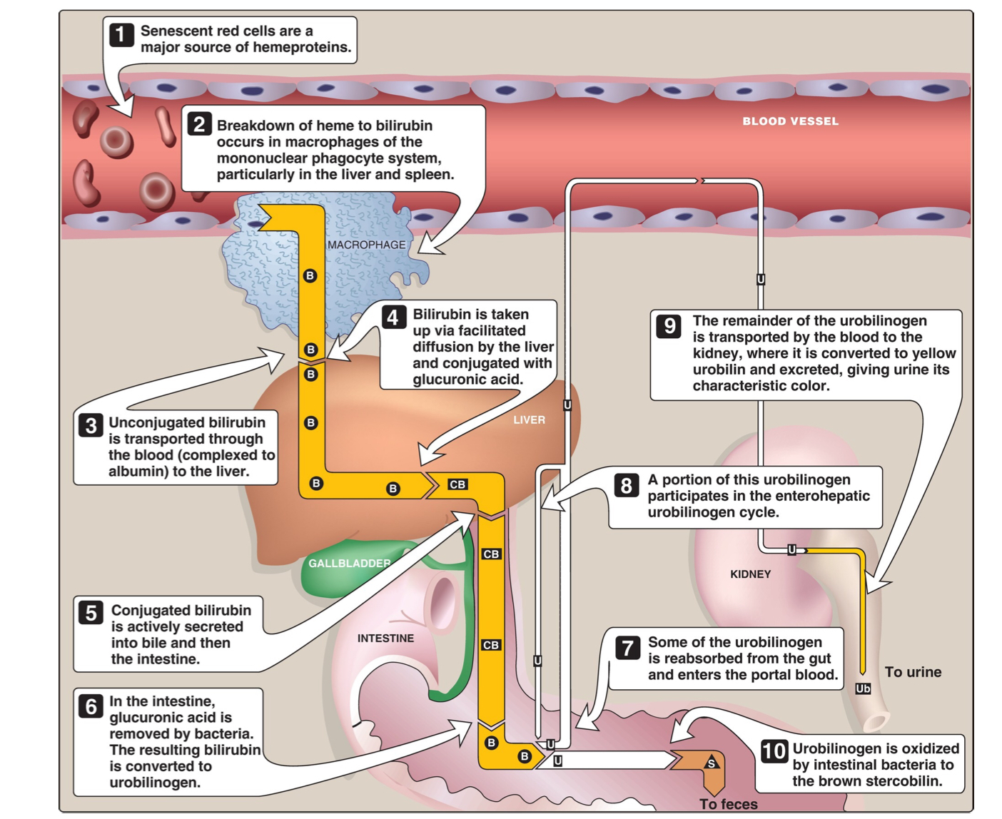
Explanation
1- Rupture of RBCs lead to release of heme
2- Heme is converted to biliverdin catalyzed by microsomal heme oxygenase which is reduced to bilirubin
3- bilirubin is complexed with albumin and released at entrance to the liver (unconjugated bilirubin).
4- Bilirubin is conjugated with UPD-glucuronic acid.
5- Conjugated bilirubin is secreted into bile and then into the intestine.
6- Bacteria utilize glucuronic acid so it remove it from bilirubin converting it into urobilinogen.
Fate of urobilinogen:
7- Some enter the portal circulation where:
8- Returns back to the liver.
9- filtered by the kidney as urobilin
10- majority is excreted with feces as stercobilin (gives the feces its characteristic color)

Slide 7
Markers for liver dysfunction
Marker | Urobilinogen | Bile salts | Serum albumin | Serum globulin | Prothrombin time
Normal levels | Most are metabolised in the large intestine, but a fraction is excreted in the urine: less than 4 mg/day | Normally not found in urine | 3.5 - 5 g/dL (measured from the serum) | 2.5-4.5 g/dL
Features |  | Obstruction of biliary passages → leakage of bile salts into the circulation → excretion in urine | -The most abundant protein synthesized by the liver -Synthesis depends on the extent of functioning liver cell mass - Longer half life: 20 days | - α and β globulins are mainly synthesized in the liver - They constitute immunoglobulins (antibodies) | - Synthesized by the liver - Half life = 6 hours → indicates present function of the liver (an early marker)
In disease |  | Excreted in urine | Low in all chronic liver diseases | High serum γ-globulins in chronic hepatitis & cirrhosis: IgG: autoimmune hepatitis IgA: alcoholic liver disease | It is prolonged only when the liver loses more than 80% of its reserve capacity
Notes | Measured from urine |  | Albumin to globulin (A/G) ratio: - Normally: 1.2/1 - 1.5 /1 (1.2-1.5 albumin molecules for every 1 globulin) - Hypoalbuminemia: globulin levels increase as a compensation |  | - Vit. K also causes prolonged PT - Vit K intake does not affect PT in liver disease

Slide 8
Markers for hepatocellular injury
Marker | Aspartate aminotransferase (AST) | Alanine aminotransferase (ALT)
Normal levels | 8-20 U/L | Male: 13-35 Female: 10 - 30
Features | Marker for hepatocellular damage | - More liver-specific than AST - Appears in plasma many days before clinical signs appear - Obese but otherwise normal individuals may have elevated ALT levels
In disease | High serum levels are observed in: Chronic hepatitis Cirrhosis Liver cancer | Minor elevations (50 - 100 U/L): cirrhosis hepatitis C non-alcoholic steatohepatitis (NASH) Moderate elevations (100 - 300 U/L): alcoholic hepatitis High serum levels (300 - 1000 U/L): acute hepatitis
Notes | Not very specific for liver disease; could be used as a marker for diseases in organs such as the heart, the brain, the kidney, skeletal muscles, bones | - If both AST + ALT were high → liver disease - If AST levels were much higher than ALT → could indicate basal muscle damage since it’s also present in cardiac + skeletal muscles

Slide 9
Markers of cholestasis
Marker | Alkaline phosphatase (ALP) | Ɣ Glutamyltransferase (GGT)
Normal levels | 40 - 125 U/L | 10 - 30 U/L
Features | - Non-specific marker of liver disease - Produced by bone osteoblasts (for bone calcification) + placenta¹ - Present on hepatocyte membrane | - Used for glutathione synthesis - Highly sensitive for alcohol abuse; it is increased in alcoholics despite normal liver function tests
In disease | Minor elevations observed in: infective hepatitis alcoholic hepatitis hepatitis hepatocellular carcinoma High elevations observed in: Extrahepatic obstruction (obstructive jaundice) Intrahepatic cholestasis Very high levels observed in: Bone diseases² | Moderate elevations observed in: Infective hepatitis Prostate cancers High in alcoholics
Notes | 1. Could be high in pregnancy 2. Elevated alone, without GGT indicates bones disease → ALP + GGT are always measured together to indicate liver obstruction | Alcohol leads to liver damage and affects many parameters. However, since GGT is very sensitive to alcohol, it becomes elevated earlier than other enzymes

Slide 10
Take Home Messages
LFTs help detect liver injury and function
LFTs do have some limitations
Done studying? Let’s see if your memory is still working!!
*issa joke*
CLICK ON ME!!

Slide 11
Summary
Serum levels:
Latent jaundice: > 1 mg/dL
Jaundice: > 2 mg/dL
Hepatic jaundice: viral hepatitis; toxic hepatitis; intrahepatic cholestasis
Bilirubin/ Jaundice
Prehepatic jaundice: abnormal RBCs; antibodies; drugs & toxins; Thalassemia; Gilbert’s syndrome; Crigler-Najjar syndrome
Post-hepatic jaundice: extrahepatic cholestasis; gallstones; tumors of bile duct; carcinoma of the pancreas
Marker | Bilirubin | Bile salts | Serum albumin | Serum globulin | Prothrombin time | AST | ALT | ALP | GGT
Change |  | Excreted in urine |  |  | Prolonged
Disease | - Gallstones - Acute & chronic hepatitis | Biliary passage obstruction | All chronic liver diseases | Chronic hepatitis & cirrhosis: - IgG: autoimmune hepatitis - IgA: alcoholic liver disease | When the liver loses more than 80% of its reserve capacity | - Chronic hepatitis - Cirrhosis - Liver cancer | - Minor: cirrhosis, hepatitis C, NASH - Moderate: alcoholic hepatitis - Severe: acute hepatitis | - Minor: infective hepatitis, alcoholic hepatitis, hepatitis, hepatocellular carcinoma - Moderate: extrahepatic obstruction, intrahepatic cholestasis - Severe: bone diseases | Moderate: infective hepatitis, prostate cancer High in alcoholics

Slide 12
Quiz
MCQs :
Q1: A patient presents with jaundice, abdominal pain, and nausea. Clinical laboratory results show increase in serum conjugated bilirubin, presence of urinary bilirubin but absence of urine urobilinogen. What is the most likely cause of the jaundice?
a) Decreased hepatic conjugation b) Decreased hepatic uptake
c) Decreased secretion of bile into the intestine d) Increased hemolysis
Q2: In post hepatic jaundice, ALT levels rise markedly.
a) True b) False
Q3: _________ is responsible for the yellow coloring in jaundice.
a) bilirubin b) urobilinogen c) urobilin d) stercobilin
Q4: Which of the following LFTs is more specific?
a) ALT b) Serum bilirubin c) alpha fetoprotein d) AST
Q5: Which of the following is produced in the bones?
a) GGT b) ALP c) Prothrombin d) AST
Q6: Which of the following markers indicate present liver function?
a) Serum albumin b) Prothrombin time c) GGT d) ALP
SAQs :
Q1: Name 3 markers related to cholestasis:
Q2: list the causes of pre hepatic , hepatic & post hepatic jaundice .
Q3: what do we observe when bilirubin serum is elevated ?
Q4: Name 3 markers observed in alcoholic liver disease:
MCQs Answer key:
1) C 2) B 3) A 4) A 5) B 6) B
SAQs Answer key:
Alkaline phosphatase (ALP) - γ-glutamyltransferase (GGT) - bilirubin
Slide 5
Gallstones , acute & chronic hepatitis
Serum globulin, ALP, ALT, GGT

Slide 13
Team members
. "Opportunities don't happen. You create them."
-- Chris Grosser
Girls Team:
Boys Team:
Ajeed Al-Rashoud
Alwateen Albalawi
Amira AlDakhilallah
Arwa Al Emam
Deema Almaziad
Ghaliah Alnufaei
Haifa AlWaily
Leena Alnassar
Lama Aldakhil
Lamiss Alzahrani
Nouf Alhumaidhi
Noura Alturki
Sarah Alkhalife
Shahd Alsalamah
Taif Alotaibi
Abdulrahman Bedaiwi
Alkassem Binobaid
Khayyal Alderaan
Mashal Abaalkhail
Naif Alsolais
Omar Alyabis
Omar Saeed
Omar Odeh
Rayyan Almousa
Yazen Bajeaifer
Team Leaders
We hear you
Lina Alosaimi
Mohannad Alqarni

