Slide 1
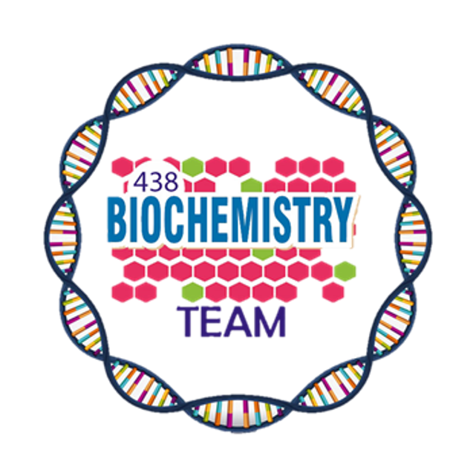
Summary

Slide 2
Role of Salivary Glands and Stomach in Digestion
What is the enzyme that breaks down TAG’s? And what are the products?
The enzyme: Lipase
The products: 2 fatty acids and 1 (2-monoacylglycerol)
Why lingual and gastric lipases have very minimal effects in normal adults in comparison to pancreatic lipases?
The lipids in the stomach is not yet emulsified, Emulsification occurs in duodenum
Alpha amylase breaks which bond ?
α (1,4) glycosidic bonds → products : mixture of oligosaccharides ( branched , unbranched ) and Disaccharides ( Maltose and isomaltose )
But CAN NOT break α (1,6) glycosidic bonds , β (1,4) glycosidic bonds of cellulose, or disaccharides.
Lingual and gastric lipases are important in specific conditions , mention them .
Neonates and infants, Patients with pancreatic insufficiency because there is absence of pancreatic lipase
Where is the lingual lipase secreted?
Secreted by the dorsal surface of tongue ( Ebner’s glands)
Compare between rennin and pepsin regarding their secretion, substrate and end product
 | Pepsin | Rennin
Secretion | chief cells of stomach
Substrate | denatured dietary proteins (by HCl) | Casein of milk (in the presence of calcium)
Product | Smaller polypeptides | Paracasein with the formation of milk clot
2

Slide 3
Structure & Function of Hemoglobin
What does the heme group consist of.
A complex of protoporphyrin IX + ferrous (Fe2+)
1- Fe2+ presents in the center of the heme.
2- Fe2+ binds to four nitrogen atoms of the porphyrin ring.
Forms two additional bonds with: Oxygen And Histidine residue of globin chain
What is the four normal types of Hb and what is the chain composition of it.
1- HbA > α₂β₂
2- HbF > α₂γ₂
3- HbA₂ > α₂δ₂
4- HbA_{1c} > α₂β₂-glucose
What is the four normal types of Hb, and describe its abnormality.
1- Carboxy Hb : CO replaces O
2- Met Hb : Contains oxidized Fe3+
3- Sulf Hb : irreversible forms due to high sulfur levels in blood
How many oxygen atoms a Hb molecule can carry?
8 atoms of oxygen = 4 molecules of oxygen
If asked about a heme group capacity:
2 atoms of oxygen = 1 molecule of oxygen
What is the the strongest bond among the bonds present between the dimers and the subunits in hemoglobin?
The Intradimer (between α and β subunits) is stronger than interdimer bond (between two dimers) = weak ionic and hydrogen bonds (non-covalent)
What is the deference between T-form and R-form of Hb?
What is the Factors affecting oxygen binding.
1- pO₂ (partial oxygen pressure)
2- pH of the environment
3- pCO₂(partial carbon dioxide pressure)
4- Availability of 2,3-bisphosphoglycerate
What does the graph represent?
Oxygen Dissociation Curve (ODC)
What does the X axis represent?
The partial pressure of oxygen (pO₂)
What does the Y axis represent?
% of saturation with O₂
Why does the curve look sigmoidal?
It indicates cooperation of subunits in O₂ which in turn increases O₂ affinity
of others (Heme-heme interaction)
Define P₅₀
the pressure at which Hb is 50% saturated with O₂
T-form of Hb
VS
R-form of Hb
→ The deoxy form of Hb
→ Taut form
→ The movement of dimers is constrained
→ Low-oxygen-affinity form
→ Contains 2,3-bisphosphoglycerate
→ The oxygenated form of Hb
→ Relaxed form
→ The dimers have more freedom of movement
→ High-oxygen-affinity form
3

Slide 4
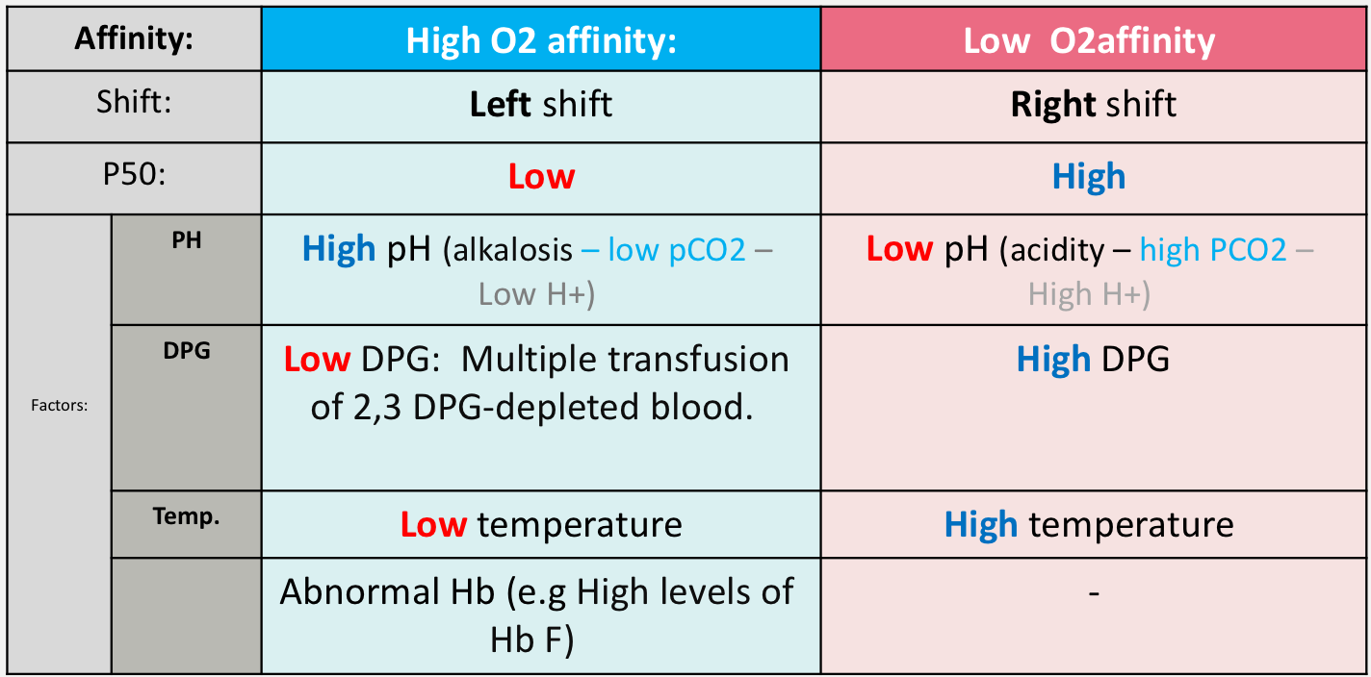
Structure & Function of Hemoglobin cont.
Define The bohr effect.
It is the shift of the ODC “oxygen dissociation curve” to the right in response to an increase in pCO₂ or a decrease in pH.
What does it describe?
Oxygenation of Hb in the lungs. 2. Deoxygenation in tissues.
The Bohr effect removes ……………….. from bloodstream and Produces …………………...
insoluble CO₂ - soluble bicarbonate.
Why do Tissues have lower pH (acidic) than lungs?
Due to proton generation.
Describe the relation between high altitude and (BPG + O₂ affinity)
High O2 affinity is due to:
1- Alkalosis
2- high levels of HbF
3- multiple transfusion of 2,3 DPG-depleted blood.
Fill the two tables below
At high altitude:
↑RBC number
↑Hb conc.
↑2,3 BPG
↓O₂ affinity of Hb
↑O₂ delivery to tissues
Types | HbF | HbA₂ | HbA_{1c}
Structure (All Tetramer) | two α and two (gamma) γ chains | two α and two (delta) δ globin chains | Two α and two β -Glucose
Found | Major hemoglobin found in the fetus and newborn. | Appears shortly before birth. | high in patients with diabetes mellitus.
difference | ● Higher affinity for O₂ than HbA ● Transfers O₂ from maternal to fetal circulation across placenta | Constitutes ~2% of total Hb | ● it’s HbA undergoes non-enzymatic glycosylation ● Glycosylation depends on plasma glucose levels
3

Slide 5
Biochemical Aspects of Digestion of Lipids
Where does lipid digestion occur?
In the stomach by : lingual and gastric lipases
In the small intestine by :Pancreatic lipase & Co lipas , cholesterol esterase, phospolipase A2, lysophospholipase
Explain the pathway of TAG degradation:
TAG is degraded by lipase producing 2-monoacylglycerol and 2 fatty acids
Explain the pathway of Cholesteryl ester degradation:
Degraded by cholesterol esterase producing cholesterol + FFAs
How are phospholipids converted to glycerolphosphoryl base and what is the fate of the product?
First: phospholipids are converted by phospholipids A2 into lysophospholipid
Second: lysophospholipids are converted by lysophopholipase into glycerolphosphoryl base
It can be excreted in feces, degraded or reabsorbed
What are the end products of lipid digestion?
2-monoacylglycerol , free fatty acids, cholesterol and glycerolphosphoryl base
How does cystic fibrosis affect lipid digestion?
In CF there’s a mutation in CFTR gene which functions as chloride channel on epithelium. When it’s defected it will lead to decreased secretion of chloride and increase water and sodium reabsorption. Due to that there will be decreased hydration in pancreatic thickness and secretions thus the enzymes won’t be able to reach the small intestine.
What are the hormones that control the lipid digestion and where do they act on ?
What are the types of fatty acids absorbed directly ?
Short and medium chain length fatty acids
List the steps of resynthesis of TAG ?
List the components of chylomicron ?
1- Newly synthesized TAG 2- cholesterol ester 3- Phospholipids.
4- Apolipoprotein B-48 (apo B-48) 5-free cholesterol
How is chylomicrons secreted ?
By exocytosis into lymphatic vessels around lacteals which enter into systemic circulation
What happens if lipid malabsorption occurs?
Increased excretion of fat soluble vitamins and essential fatty acids in feces (Steatorrhea)
Cholecystokinin (CCK) | Secretin
Acts on gallbladder to release bile | Low pH stimulates its secretion
Acts on pancreas to release enzymes | Acts on pancreas to release bicarbonate and acts on liver to release bile To Neutralizes the pH of the contents before entering the small intestine
Decreases gastric motility (slow release of gastric contents)
Fatty acids
activated to acyl CoA form
2-Monoacyglycerols
TAGs
4

Slide 6
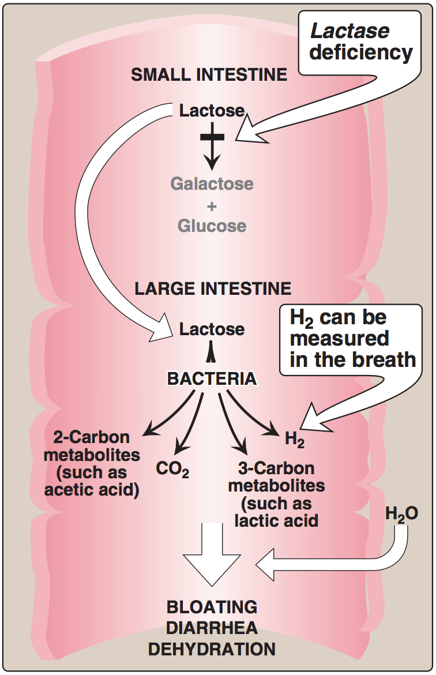
Biochemical Aspects of Digestion of Proteins and Carbohydrates
What are the effects of Cholecystokinin? And secretine?
cholecystokinin:
Release of pancreatic digestive enzyme
Contract of the gallbladder and release of bile
Decrease gastric motility leading to slower release of gastric contents.
Secretine:
Release watery solution rich in bicarbonate to neutralize the pH of small intestine
List Four pancreatic enzymes that play role in protein digestion.
Trypsin
Elastase
Chymotrypsin
Carboxypeptidase
*keep in mind that there is also intestinal aminopeptidase that digest oligopeptidase and cleave them into di and tri peptidases
The pancreatic enzymes are zymogens , what activates them?
Enteropeptidase activate trypsinogen into trypsin or autocatalytically
And then trypsin activate the rest of the enzymes
What are the affected amino acid in Cystinuria?
1- Cystine
2- Ornithine
3- Arginine
4- Lysine
What are the affected organs in Cystinuria?
Small intestine and kidneys
Where are the sites of carbohydrate digestion?
in mouth and intestinal lumen
What is the normal level of serum alpha amylase and what is the clinical significance of its rising levels in circulation?
NORMAL LEVEL : 25-125 U/L
The clinical significance: Diagnosis of acute pancreatitis
Explain what happens if someone is lactose intolerant according to the figure.
when someones has lactase deficiency, lactose will accumulate in the large intestine and the normal bacteria in the large intestine will feed on lactose causing release of carbon dioxide and carbon metabolites leading to abdominal cramps & distension as well as water will enter the large intestine causing osmotic diarrhea .
5

Slide 7
Nutritional Requirements
What is nutrition?
Composition and quantity of food intake by living organisms
Or
Biochemical utilization of food
List three ways to assess malnutrition.
1- Dietary intake studies: identify people with deficient diets
2- Biochemical studies: identify subclinical nutritional deficiencies
3-Clinical symptoms: identify clinical nutritional deficiencies
Dietary reference intake.
Dietary reference intake (DRI)
quantitative estimates of nutrient intakes required to prevent deficiencies and maintain optimal health in population Recommended by: Food and Nutrition Board of the National Research Council, USA
DRI standards
estimated average requirement (EAR) | recommended dietary allowance (RDA) | adequate intake (AI) | tolerable upper intake level (UL)
the amount of nutrient intake estimated to meet the nutritional requirement of half of health individuals 50% in an age and gender group | the amount of nutrient intake that is sufficient to meet the nutritional requirement of nearly all healthy individuals 97-98% in a group RDA is two SD above EAR RDA = EAR + 2 SD | it is used instead of EAR and RDA if a nutrient is considered essential but the experimental data are inadequate for determining EAR and RDA it covers the nutritional requirement of all individuals in a group with approximation due to insufficient data | the highest level of daily nutrient intake that has no adverse effects of toxicity in almost all individuals
List the ADMR for adults.
List nutrients intake for vegetarians.
carbohydrates : 45-65%
Fats : 20-35%
Proteins : 10-35%
Fibers : >25 g
They have lower intake of iron , calcium and vitamin D.
They may develop megaloblastic anemia due to vit B12 deficiency.
They have lower dietary fat
Enumerate 3 points that basic expenditure depends on?
1- Resting metabolic rate (60%) 2- Physical activity (30%) 3- Thermic effect of food (10%)
What is the definition of total parenteral nutrition? And mention its indications.
A type of exogenous nutrition in which terminally-ill patients are provided with all essential nutrients intravenously or through tube feeding.
indications :
Severe inflammatory bowel disease , coma , cachexia , prolonged ileus and extensive burns
6

Slide 8
Macro & Micronutrients
Enumerate three effects for each of the following:
1- Dietary fibers
- Reduce constipation - ↓ LDL levels - Reduce exposure of gut to carcinogens.
2- Omega 6 fatty acids:
- ↓Plasma cholesterol - ↓ LDL levels - ↓ HDL.
3- Omega 3 fatty acid:
- ↓ serum triglyceride - ↓ BP - ↓ tendency to thrombosis.
Explain the effect of carbohydrate on proteins.
- CHO have protein sparing effect by inhibiting gluconeogenesis from amino acids and amino acids are used for repair and maintenance of tissues.
What is the cause of:
- Marasmus
· Inadequate energy intake with adequate protein intake
- Kwashiorkor
· Inadequate protein intake with adequate energy intake
- Negative Nitrogen Balance
· Nitrogen intake < loss (burns, trauma and illness & metabolic stress)
- Positive Nitrogen Balance
· Nitrogen intake > loss (pregnancy, lactation and growth).
Do CHO have protein sparing effect if yes mention them?
-yes , They inhibit gluconeogenesis from amino acids.
What is the function of vitamin E ?
Antioxidant: prevents oxidation of cell components by molecular oxygen & free radicals
Its deficiency may lead to ?
1-Neurological problems 2-Male infertility
3-Defective Lipid absorption 4-Anemia due to oxidative damage
Vitamin B1 (Thiamin)
-name 2 disorder of vitamin B1 (thiamine) deﬁciency and give quick explanation?
Vitamin C
enumerate the function of Vitamin C & mention the disorder caused when it’s deficient?
Function: Powerful antioxidant (prevents some cancers) , Helps in dentine, intercellular matrix and collagen formation , Increases iron absorption through conversion of ferric to ferrous , Helps in the maturation of RBCs , Promotes wound healing , Stimulates phagocytic action of leukocytes, Reduces risk of cataract formation
Deﬁciency causes scurvy , Abnormal collagen production , Gums become painful, swollen and spongy , The pulp is separated and the teeth are lost.
Iron deficiency
Hemosiderosis (iron overload disorder) / Iron deﬁciency anemia
Beriberi:
A type of chronic peripheral neuritis due to severe thiamin deﬁciency causes weakness, neuropathy, disorderly thinking, paralysis Thiamin has a role in nerve conduction Neuropathy aﬀects glial cells (astrocytes) of the brain and spinal cord causing neuron death .
Wernicke-Korsakoﬀ syndrome:
Common in alcoholics due to defective intestinal absorption of thiamin or dietary insuﬃciency Causes apathy, loss of memory.
7

Slide 9
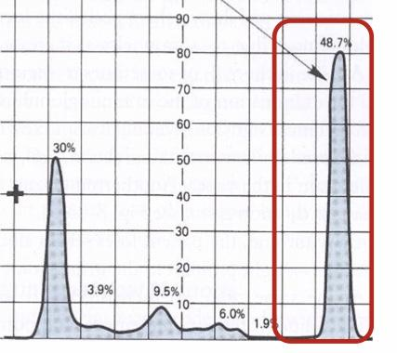
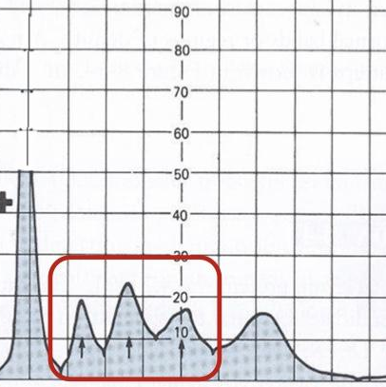
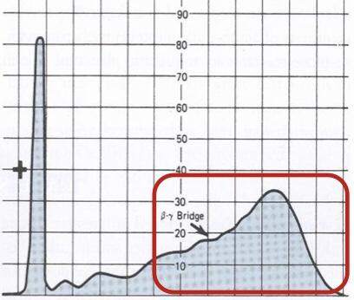
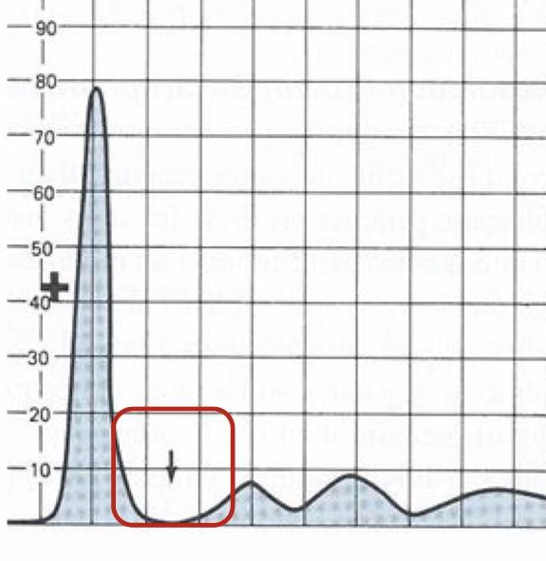
Plasma Proteins
List 4 functions of plasma proteins with the proteins responsible for each of them:
1. Transport - albumin & prealbumin & globulin.
2. Maintain plasma oncotic pressure - albumin.
3. Defense - immunoglobulins & complement.
4. Clotting and fibrinolysis - thrombin & plasmin.
List 3 types of B-Globulins:
1. CRP.
2. Transferrin.
3. β2-microglobulin.
List 3 functions of albumin:
1. Maintains oncotic pressure.
2. Non-specific carrier of: hormones, calcium, free fatty acids, drugs, etc.
3. Useful in treatment of liver diseases, hemorrhage, shock and burns.
List 3 causes & effects of hypoalbuminemia:
Causes: 1. Severe burns.
2. Decreased albumin synthesis (liver cirrhosis).
3. Excessive loss in bowel (bleeding).
List 3 proteins that are used as markers with one clinical condition for each of them:
1. β2-microglobulin - tumor marker for leukemia, lymphomas and multiple myeloma.
2. a-fetoprotein (AFP) - tumor marker for hepatoma and testicular cancer.
3. CRP - sensitive marker for ischemic heart disease.
Look at the following graphs and answer the questions:
A- What kind of measurement does these graphs indicate?
Semiquantitative measurement by plasma protein electrophoresis.
B-
C-
D-
E-
Effects: 1. Edema.
2. Reduced transport of drugs.
3. Reduced protein-bound calcium.
What kind of abnormality does the RED box indicates?
Proliferation of a single B-cell clone (paraprotein or M band)
What is the name of this abnormality?
Monoclonal Hypergammaglobulinemia.
What is the most likely clinical condition?
Multiple myeloma.
What kind of abnormality does the RED box indicates?
Increase in plasma protein levels due to infection, inflammation, malignancy,trauma..etc
List THREE positive acute phase proteins?
α1-antitrypsin, haptoglobin and ceruloplasmin.
List THREE mediators that cause positive acute phase proteins to increase after injury?
Cytokines (IL-1, IL-6), tumor necrosis factors α and β , interferons.
List THREE negative acute phase proteins.
Albumin, prealbumin, transferrin.
What is the reason for the decrease in synthesis of these proteins?
to save amino acids for positive acute phase proteins.
What kind of abnormality does the RED box indicates?
Proliferation of a many B-cell clone (γ-globulin band)
What is the name of this abnormality?
Polyclonal Hypergammaglobulinemia.
What is the most likely clinical condition?
chronic liver disease or autoimmune disease.
What kind of abnormality does the RED box indicates?
lack of a1-globulin band.
What is the name of this abnormality?
a1-antitrypsin deficiency.
List THREE clinical consequences of this abnormality?
Childhood liver cirrhosis - Pulmonary emphysema in young adults - Neonatal jaundice.
What kind of functions would be absent due to this abnormality?
Inhibition of proteases that are produced from leukocytes and bacteria during infection.
8

Slide 10
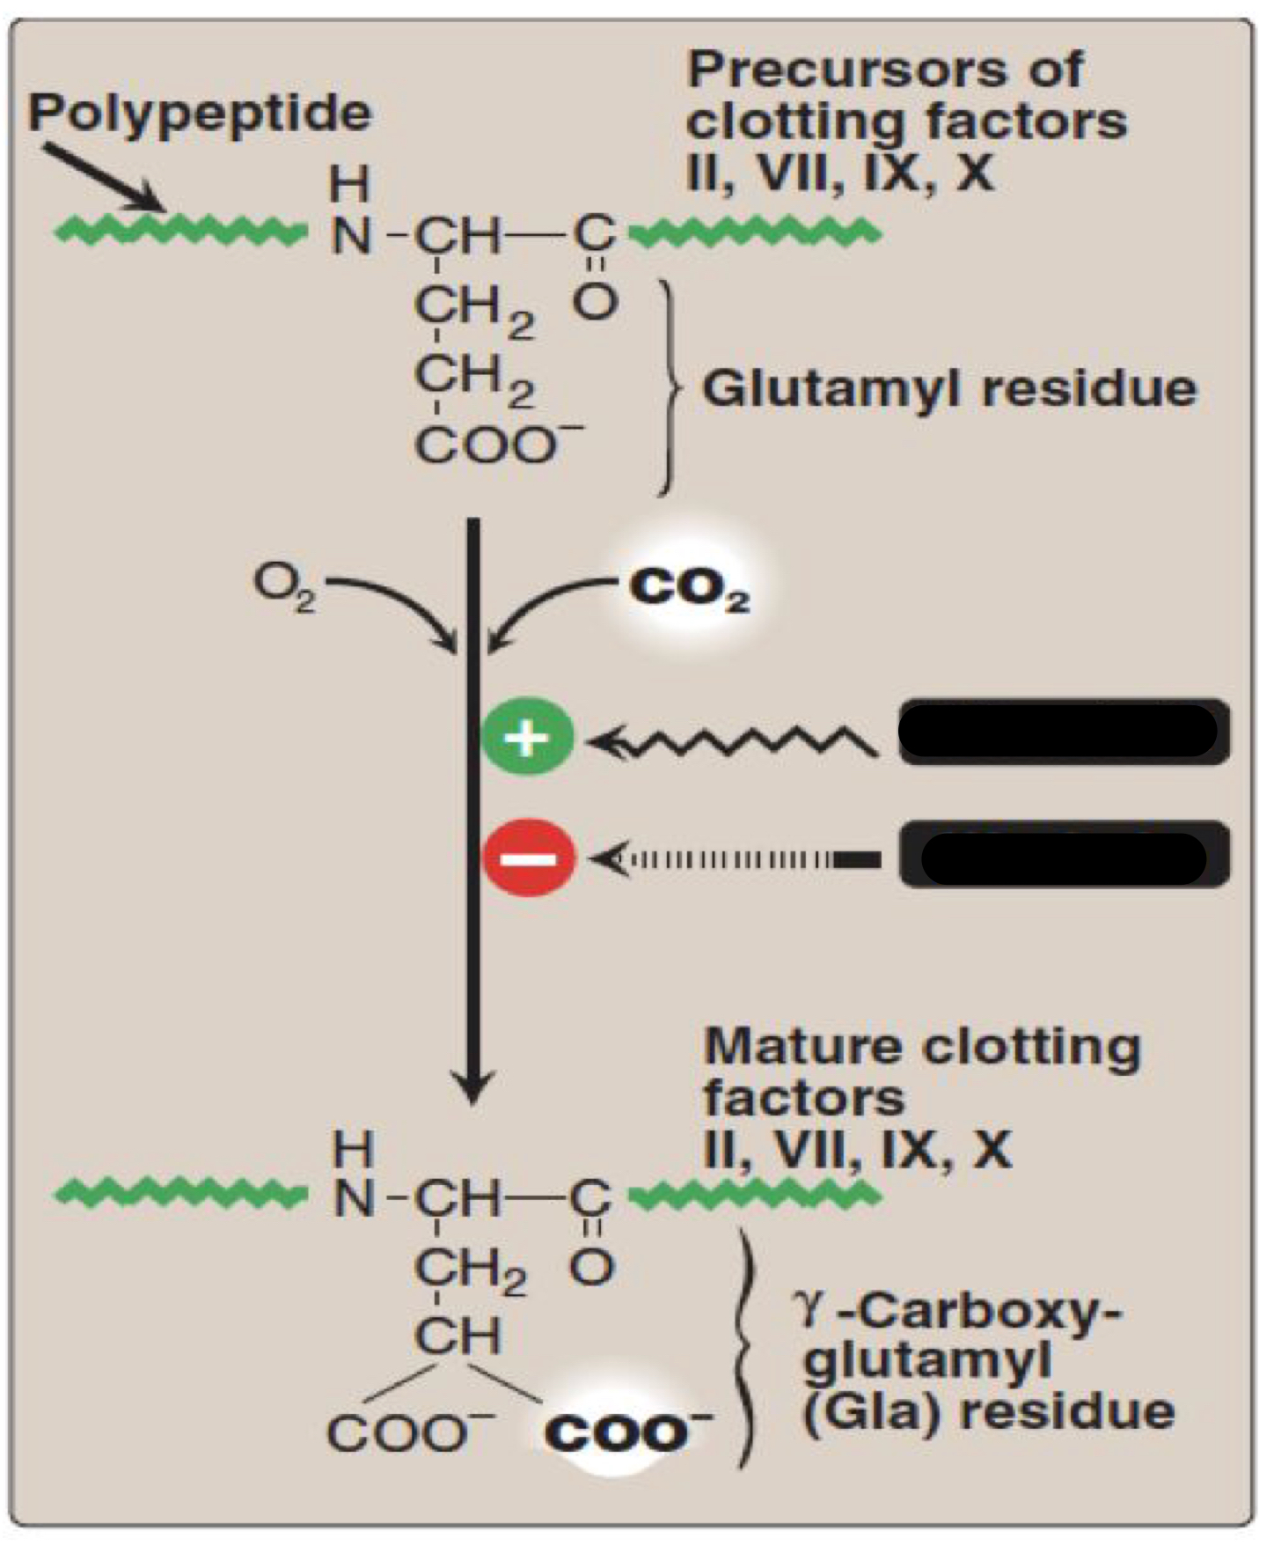
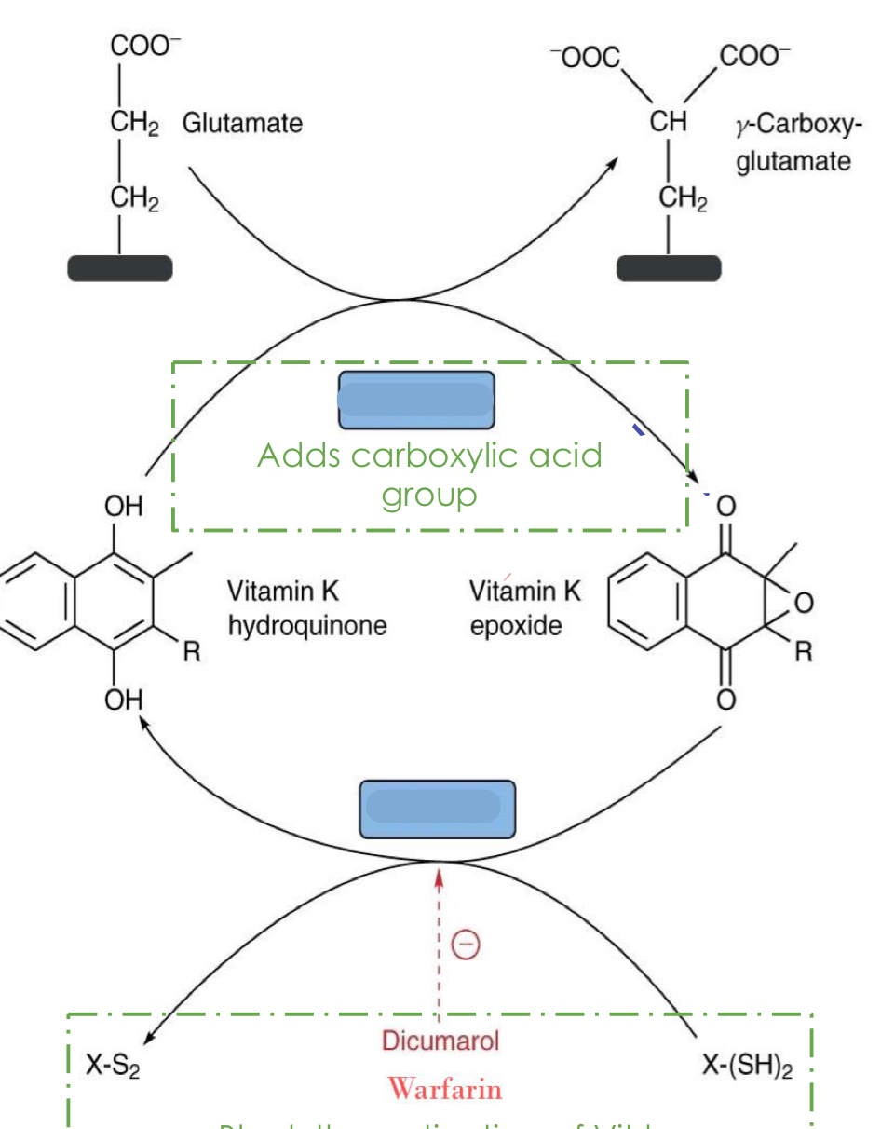
Vitamin K
Enumerate 3 forms of vit k:
Vit k1 : Phylloquinone
Vit k2 : Menaquinone
Vit k3 : Menadione
Which clotting factors require vit k for their synthesis?
Synthesis of prothrombin, clotting factors II, VII, IX, X require carboxylation of their glutamic acid (Glu) residue.
Fill the blank boxes in the following pictures:
3
1
1: vit k
2: warfarin
3: carboxylase
4: reductase
2
4
Explain the effect of anticoagulant drugs.
They inhibit the activation of vit K to hydroquinone form (inhibiting reductase enzyme) thus prothrombin and clotting factors are not carboxylated which will increase the injury time
What are the functions of vitamin K ?
1) prothrombin - platelet interaction 2) synthesis of gamma-carboxyglutamate in osteocalcin
Enumerate 2 causes for vit k deficiency :
Lipid malabsorption can lead to vitamin K deficiency “because it is a fat soluble vitamin”
Prolonged antibiotic therapy → killing normal flora → Vit K deficiency
Why Vit k deficiency is common in newborns ?
Newborns lack intestinal flora and human milk can provide only 1/5th vitamin K
Enumerate the clinical manifestations of Vit K deficiency.
Mucus membrane hemorrhage, bruising tendency, prolonged thrombin time,
post traumatic bleeding/internal bleeding, hemorrhagic disease of the newborn
Toxicity of vit K leads to ?
Hemolytic anemia 2) jaundice
9

Slide 11
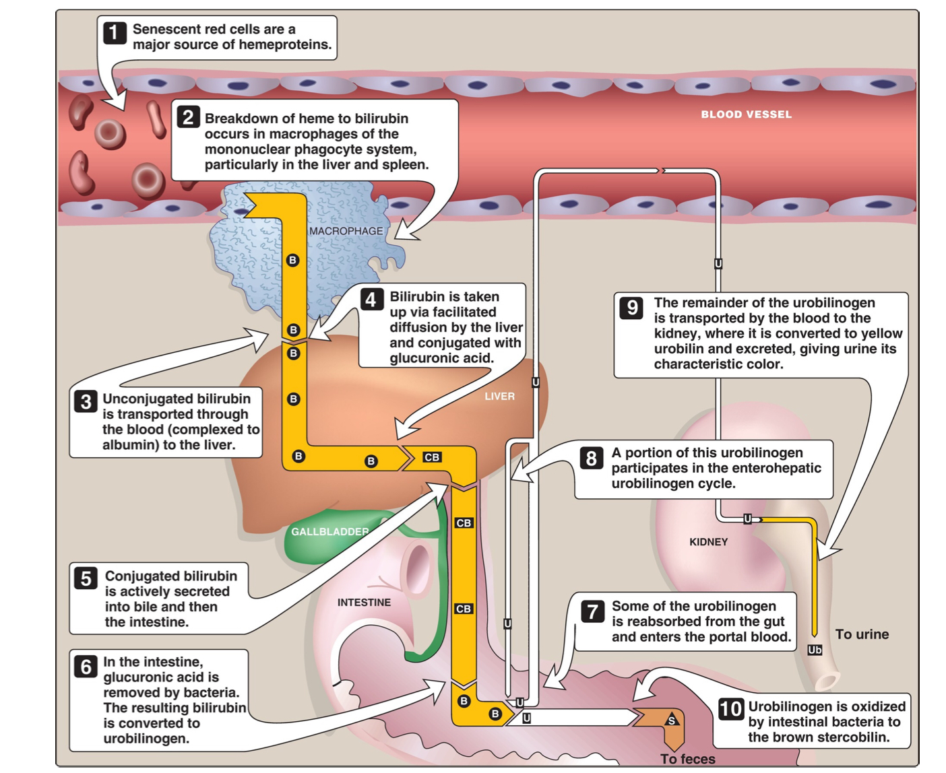
Liver Function Tests
List 2 markers of hepatocellular injury
Alanine aminotransferase (ALT)
Aspartate aminotransferase (AST)
List 2 Markers of cholestasis
Alkaline phosphatase (ALP)
gamma-glutamyltransferase (GGT)
List 2 Limitations of Liver function tests
Normal LFT values do not always indicate absence of liver disease because Liver a has very large reserve capacity
Asymptomatic people may have abnormal LFT results (Diagnosis should be based on clinical examination)
fill in the missing parts in the figure below
Enumerate 4 causes of prehepatic jaundice
Abnormal red cells
antibodies
drugs and toxins
Hemoglobinopathies (thalassemia)
Gilbert’s syndrome
Crigler-Najjar syndrome
Enumerate 3 causes of hepatic (hepatocellular) jaundice
Viral hepatitis
Toxic hepatitis
intrahepatic cholestasis
Give 4 causes of post-hepatic jaundice
Extrahepatic cholestasis
gallstones
tumors of the bile duct
carcinoma of pancreas
10

Slide 12
Liver Function Tests
List 4 Major Metabolic Functions of the Liver
1. Synthetic Function
▫ Plasma proteins (albumin, globulins) ▫cholesterol ▫triglycerides ▫lipoproteins
2. Detoxification and excretion
▫ Ammonia → urea (urea cycle) ▫bilirubin ▫cholesterol ▫drug metabolites
3. Storage:
▫ Vitamins (A, K, E, D, B12)
4. Production of bile salts
List 4 examples of liver dysfunction
Hepatocellular disease
Cholestasis (obstruction of bile flow)
Cirrhosis
Hepatitis
Jaundice
Liver cancer
Steatosis (fatty liver)
Genetic Disorders: Hemochromatosis (iron storage)
List 4 indications for liver function tests
identifying general types of disorder
Assess severity and allow prediction of outcome
Disease and treatment follow up
List 4 Markers of liver dysfunction
Total and conjugated serum bilirubin
bile salts and urobilinogen in urine
Total protein
Serum albumin
albumin/globulin ratio
Prothrombin Time
A patient is diagnosed with alcoholic liver disease (ALD). List 3 markers used in diagnosis.
GGT, ALP, ALT, Serum globulin IgA
List 2 diseases in which AST is elevated?
Chronic hepatitis, Cirrhosis, liver cancer
List one condition in which there is:
Minor ALP elevations: alcoholic hepatitis
High ALP elevations: intrahepatic cholestasis
Drawing break!!
10

Slide 13
Bile Acids & Salts
Mention 2 examples of Primary bile acids.
Cholic acid (3 OH), Chenodeoxycholic (2 OH)
What’s the enzyme catalyzing the rate limiting step in hepatic synthesis of bile acids, and how is it regulated?
Cholesterol 7-alpha-hydroxylase.
Up-regulated by: Cholesterol
Down-regulated by: Bile acids
How are Primary Bile acids converted to Bile salts?
By the addition of glycine or taurine forming an amide bond between them and the bile acids.
Mention 4 examples of Bile salts.
Glycocholic, Taurocholic, Glycochenodeoxycholic and Taurochenodeoxycholic.
Mention 2 examples of Secondary Bile acids.
Deoxycholic acid and Lithocholic
Mention 1 example of bile acid sequestrant and its MOA.
Name: Cholestyramine,
MOA: Binds to bile acids in the gut, prevent their reabsorption, and so promote their excretion.
(Note: It’s used for Hypercholesterolemia)
What hormone controls the secretion of bile?
Fill the table:
Mention 4 functions of Bile salts.
1- Important for cholesterol excretion:
- As metabolic products of cholesterol . - Solubilizer of cholesterol in bile.
2- Emulsifying factors for dietary lipids, a prerequisite step for efficient lipid digestion.
3- Facilitate intestinal lipid absorption by formation of mixed micelle
4- Cofactor for pancreatic lipase and PLA2.
What are the components of micelles?
Bile salts, Fat soluble vitamins and End products of lipid digestion (Long chain FFAs, Free cholesterol, 2-monoacylglycerol)
What are the mechanisms of emulsification?
1- Mechanical mixing by peristalsis, 2- Detergent effect of bile salts
Name of hormone | Cholecystokinin (CCK)
Stimulus | Undigested lipids and partially digested proteins in duodenum
Responses | 1- Secretion of pancreatic enzymes. 2- Bile secretion. 3- Slow release of gastric contents
11

Slide 14
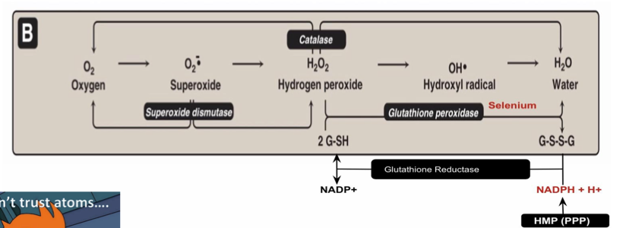
G6PD
What’s the major pathway for NADPH production
hexose monophosphate pathway (HMP) or pentose phosphate pathway (ppp)
List four main uses of NADPH
Reductive biosynthesis e.g, fatty acid biosynthesis
Antioxidant (part of glutathione system)
Oxygen-dependent phagocytosis by WBCs
Synthesis of nitric oxide (NO)
Fill in the blanks
Answer:
1- Glutathione reductase
2- NADPH+ H+
1
2
Explain the mechanism of G6PD and what will it’s deficiency lead to
G6PD convert G6P TO 6-phosphogluconate and make NADPH so if I don’t have this enzyme “G6PD”I will not have NADPH and I will not have reduced glutathione thus I cannot convert hydrogen peroxide “H202” to H2O
- Accumulation of H2O2 will cause oxidative stress that will damage the proteins and this include the cell membrane of the RBC which is protein leading to hemolysis
Although G6PD deﬁciency affects all cells, it is most severe in RBCs …… Why?
Because Other cells have other sources for NADPH production:
e.g., Malic enzyme that converts malate into pyruvate
Enumerate 4 methods of diagnosing G6PD deficiency hemolytic anemia
Diagnosis of hemolytic anemia: CBC
Screening: Qualitative assessment of G6PD enzymatic activity
Confirmatory test: Quantitative measurement ofG6PD enzyme activity
Molecular test: Detection of G6PD gene mutation
12

Slide 15
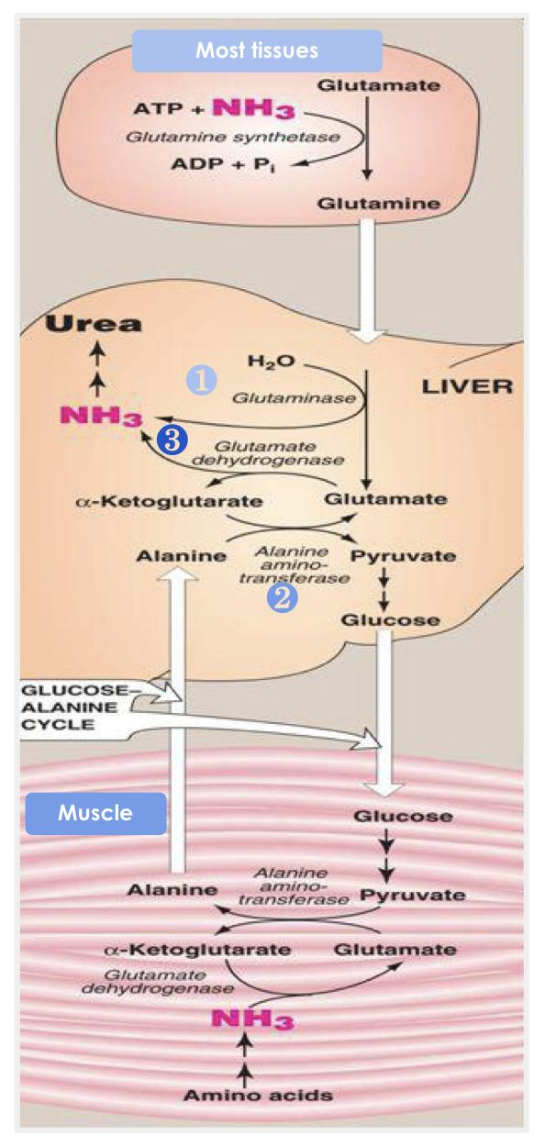
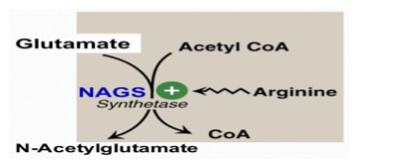
Urea Cycle
Compare between “Transamination reaction“ of alanine & aspartate.
Mention the enzyme & results of “Oxidative deamination reaction” of glutamate
Enzyme: Glutamate dehydrogenase.
results: removal of ammonia, regeneration of α-Ketoglutarate, reducing NAD to NADH.
Explain the steps of releasing ammonia from glutamine and alanine in the liver.
Glutamine is converted back into glutamate by glutaminase.
Alanine will give its amino group to α-ketoglutarate to form glutamate by ALT.
Glutamate is converted into α-ketoglutarate and releasing NH3 by glutamate dehydrogenase.
Amino group transferring | Enzymes | Products
from the α-amino acid to α-Ketoglutarate | Alanine amino transferase with the help of PLP (Pyridoxal phosphate) | glutamate & pyruvate
aspartate to α-Ketoglutarate | Aspartate amino transferase with the help of PLP | glutamate & oxaloacetate
Enumerate the 5 enzymes involved in urea cycle?
Carbamoyl Phosphate Synthetase I (CPSI)
Ornithine Transcarbamylase (OCT/OTC)
Argininosuccinate Synthase (ASS)
Argininosuccinate Lyase (ASL)
Arginase (ARG)
Which one is the Allosteric activator of CPSI?
N-Acetylglutamate
What is the role of urease enzyme?
Converting urea into NH3 and CO2
Which amino acid helping in synthesized of N-acetylglutamate?
Arginine
Give an example of drug used in management of hyperammonemia?
sodium phenylbutyrate (Buphenyl)
13

Slide 16
Big dreams take time, dedication, blood, sweat, tears and years
☆
This magnificent work was done by the team members:
Ajeed Al-Rashoud
Alwateen Albalawi
Amira AlDakhilallah
Arwa Al Emam
Deema Almaziad
Ghaliah Alnufaei
Haifa Alwaily
Leena Alnassar
Lama Aldakhil
Lamiss Alzahrani
Nouf Alhumaidhi
Noura Alturki
Sarah Alkhalife
Shahd Alsalamah
Taif Alotaibi
Alkassem Binobaid
Khayyal Alderaan
Mashal Abaalkhail
Naif Alsolais
Omar Alyabis
Omar Saeed
Omar Odeh
Rayyan Almousa
Yazen Bajeaifer
Team leaders:
Lina Alosaimi Mohannad Alqarni

