Slide 1
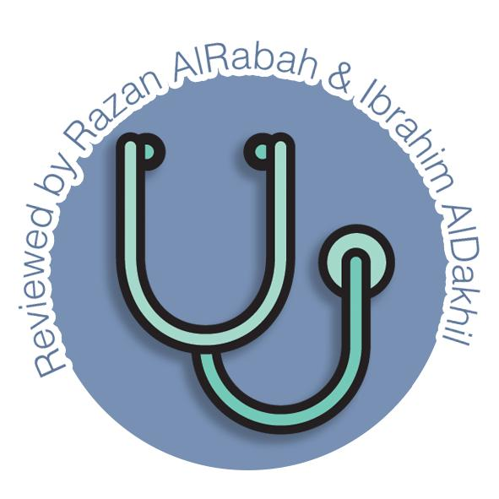
Development of pancreas and Small Intestine
Gastrointestinal block-Embryology
Editing file

Slide 2
Objectives
Color guide :
Only in boys slides in Green
Only in girls slides in Purple
important in Red
Notes in Grey
At the end of the lecture, students should be able to:
Describe the development of the duodenum.
Describe the development of the pancreas.
Describe the development of the small intestine.
Identify the congenital anomalies of the duodenum, pancreas, and the small intestine :
Congenital omphalocele.
Umbilical hernia.
Meckel’s diverticulum.

Slide 3
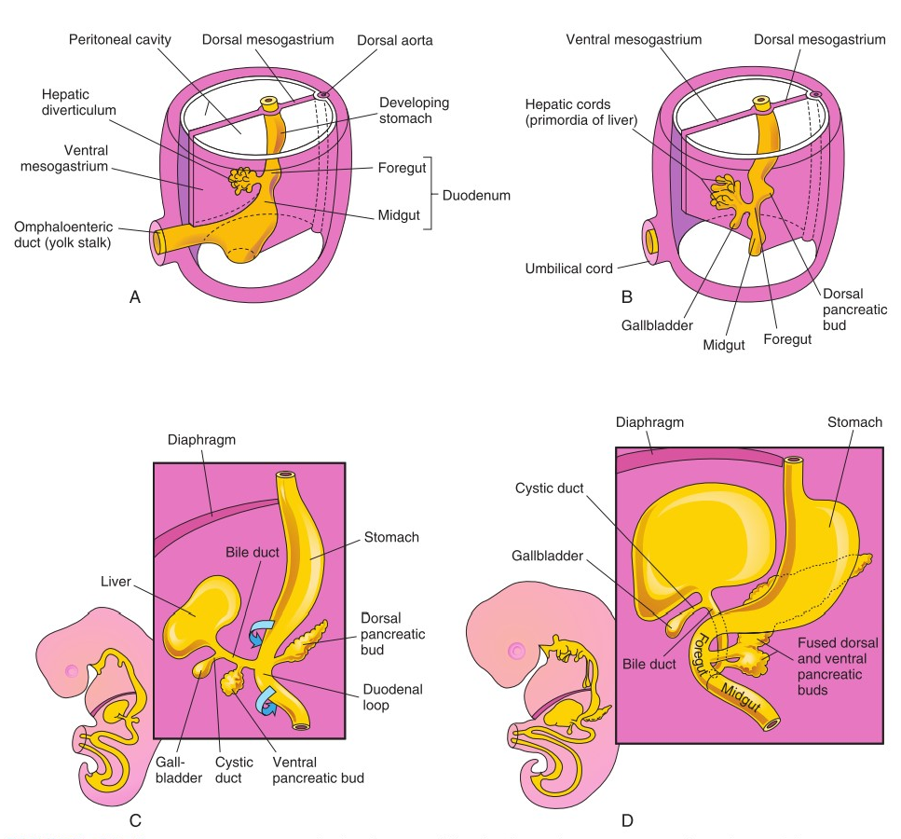
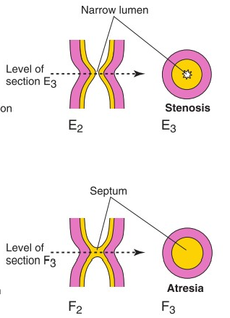
Development Of The Duodenum
Early in the 4 th week
the duodenum develops from the endoderm of primordial gut of :
Caudal part of foregut.
Cranial part of midgut
Splanchnic mesoderm.
The junction of the 2 parts of the gut lies just below or distal to the origin of bile duct
Stages in the development of duodenum, liver, biliary ducts and pancreas (A-D).
The duodenal loop is formed and projected ventrally, forming a C- shaped loop (C).
The duodenal loop is rotated with the stomach to the right and comes to lie on the posterior abdominal wall retroperitoneally with the developing pancreas.
The duodenum is the most fixed part of small intestine and has no mesentery, only partially covered by peritoneum
4th week
5th week
During 5th & 6th weeks
The lumen of the duodenum is temporarily obliterated(disappear) because of proliferation of its epithelial cells.
Normally degeneration of epithelial cells occurs, so the duodenum normally becomes recanalized (opening the canal ) by the end of the embryonic period.
Congenital anomalies happen in this stage
Duodenal stenosis: results from incomplete recanalization of duodenum.
Duodenal atresia: results from failure of recanalization leading to complete occlusion of the duodenal lumen, (autosomal recessive inheritance ).
5th week
6th week
Anomalies
Normal

Slide 4
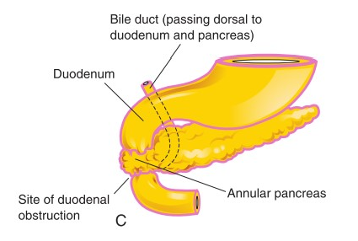
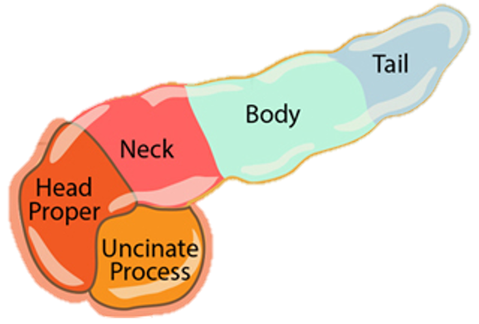
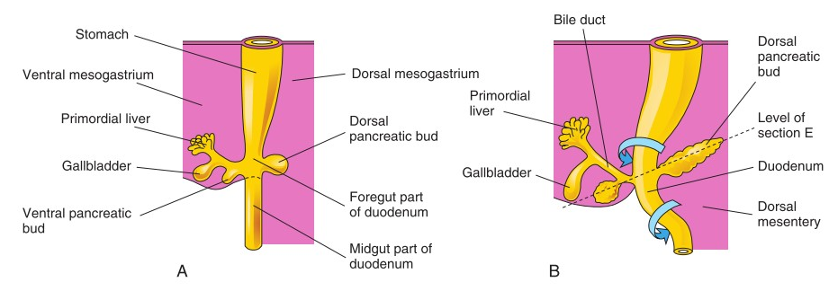
Development Of The Pancreas
it develops from 2 buds arising from the endoderm of the caudal part of foregut : (start in the 4th week)
A ventral pancreatic bud (VPB): which develops from the proximal end of hepatic diverticulum (forms the liver & gallbladder).
A dorsal pancreatic bud (DPB): which develops from dorsal wall of duodenum slightly cranial to the ventral bud.(Most of pancreas is derived from it)
When the duodenum rotates to the right and becomes C-shaped, the VPB moves dorsally to lie below and behind the DPB.
Later the 2 buds fused together and lying in the dorsal mesentery.
The main pancreatic duct is formed from :
The duct of the ventral bud.
The distal part of duct of dorsal bud.
The accessory pancreatic duct is derived from :
Proximal part of duct of dorsal bud.
The parenchyma of pancreas is derived from the endoderm of pancreatic buds.
Pancreatic islets develops from parenchymatous pancreatic tissue.
Insulin secretion begins at 5th month of pregnancy.
Pancreatic buds
Congenital anomalies
The Pancreas
Pancreatic ducts
The VPB forms :
Uncinate process.
Inferior part of head of pancreas
The DPB forms :
Upper part of of head.
Neck.
Body
Tail
Accessory pancreatic tissue: located in the wall of the stomach or duodenum.
Anular pancreas; a thin flat band of pancreatic tissue surrounding the second part of the duodenum, causing duodenal obstruction.

Slide 5
Development Of Small Intestine
5 stages Of Development
Distal part of the duodenum (proximal part of duodenum is developed from caudal part of foregut)
Jejunum
Upper part of the ileum.
Derivatives of cranial part of the midgut loop
Lower portion of ileum.
Cecum & appendix.
Ascending colon + proximal 2/3 of transverse colon.
Derivatives of the caudal part of midgut loop
So, the small intestine is developed from :
Caudal part of foregut.
All midgut.(supplied by superior mesenteric artery (artery of midgut).
01
02
03
04
05
Pre-herniation stage.
Stage of physiological umbilical hernia.
Stage of rotation of midgut loop.
Stage of reduction of umbilical hernia.
Stage of fixation of various parts of intestine.

Slide 6
Development Of Small Intestine : 5 stages
Stage 1 and 2 Development Of Midgut Loop | Stage 3 Rotation Of The Midgut Loop
Beginning Of 6th Week The midgut elongates to form a ventral U-shaped midgut loop. Midgut loop communicates with the yolk sac by vitelline duct or yolk stalk. As a result of rapidly growing liver, kidneys & gut ,the abdominal cavity is temporarily too small to contain the developing rapidly growing intestinal loop. So ,Midgut loop projects into the umbilical cord this is called physiological umbilical herniation (begins at 6th week.). | Midgut loop has a cranial limb & a caudal limb. Midgut loop rotates around the axis of the superior mesenteric artery. Midgut loop rotates first 90 degrees to bring the cranial limb to the right and caudal limb to left during the physiological hernia. The cranial limb of midgut loop elongates to form the intestinal coiled loops (jejunum & ileum). after reduction of physiological hernia it rotates to about 180 degrees. so the total counterclockwise rotation is 270 degrees

Slide 7
Development Of Small Intestine : 5 stages
Stage 4 Return Of Midgut To Abdomen | Stage 5 Fixation Of Various Parts Of Intestines
During 10th Week the intestines return to the abdomen due to regression of liver & kidneys + expansion of abdominal cavity. It is called reduction of physiological midgut hernia. Rotation is completed and the coiled intestinal loops lie in their final position in the left side. The caecum (cecal bud) at first lies below the liver, but later it descends to lie in the right iliac fossa. | The mesentery of jejunoileal loops is at first continuous with The mesentery ascending colon. When the mesentery of ascending colon fuses with the posterior abdominal wall, the mesentery of small intestine becomes fan-shaped and acquires a new line of attachment that passes from duodenojejunal junction to the ileocecal junction. The enlarged colon presses the duodenum & pancreas against the posterior abdominal wall. Most of duodenal mesentery is absorbed, so most of duodenum ( except for about the first 2.5 cm derived from foregut) & pancreas become retroperitoneal.
Before Fixation
After Fixation

Slide 8
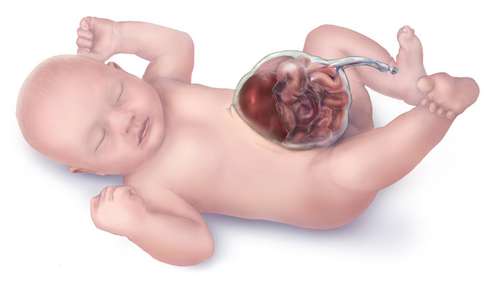
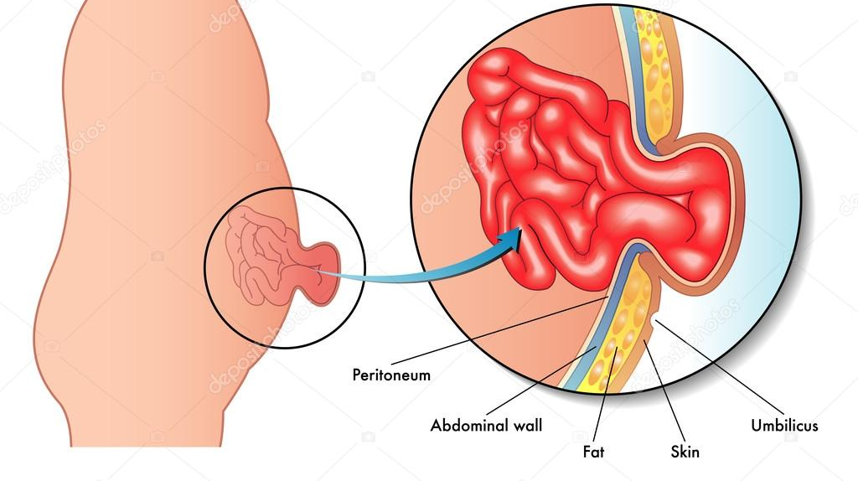
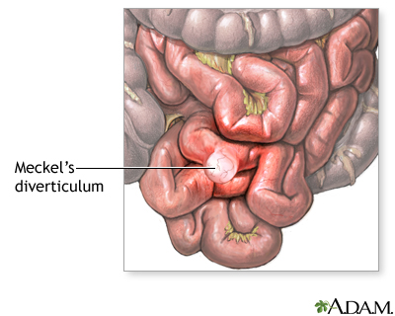
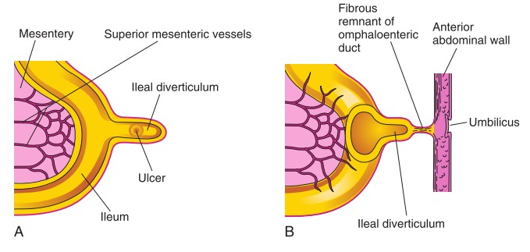
Congenital anomalies of the small intestine
Congenital Omphalocele
It is a persistence of herniation of abdominal contents into proximal part of umbilical cord due to failure of reduction of physiological hernia to abdominal cavity at 10th week.
occurs in intestines in 1 of 5000 births – liver & intestines occurs in 1 of 10,000 births.
accompanied by small abdominal cavity.
hernial sac is covered by the epithelium of the umbilical cord/ the amnion.
Immediate surgical repair is required.
Congenital Umbilical Hernia
The intestines return to abdominal cavity at 10th week, but herniated through an imperfectly closed umbilicus
common type of hernia.
herniated contents are usually the greater omentum & small intestine.
hernial sac is covered by skin & subcutaneous tissue.
protrudes during crying, straining or coughing and can
easily reduced through fibrous ring at umbilicus. and at age of 3-5 years surgery is performed
Ileal (Meckel’s) Diverticulum
It is one of the most common(more in males) anomalies of the digestive tract, present in about 2% -4% of people.
It is a small pouch from the ileum
may contain small patches of gastric & pancreatic tissues causing ulceration, bleeding or even perforation.
It is the remnant of proximal part non-obliterated part of yolk stalk (or vitelline duct).
It arises from antimesenteric border of ileum, 1/2 meter from ileocecal junction.
It is sometimes becomes inflamed and causes symptoms that mimic appendicitis.
It may be connected to the umbilicus by a fibrous cord, and the middle portion forms a cyst or may remain patent forming the fistula so, faecal matter is carried through the duct into umbilicus.

Slide 9
QUIZ
Q1 | Q2 | Q3 | Q4 | Q5 | Q6 | Q7 | Q8
B | A | C | B | B | A | D | B
Q1: Most of pancreas is derived from ?
A. A ventral pancreatic bud
B. A dorsal pancreatic bud
C. main pancreatic duct
D. accessory pancreatic duct
Q2: Insulin secretion begins at: A. 5th month of pregnancy B. 4th month of pregnancy
C. after born D in 24 week of pregnancy
Q3: the total rotation Of The Midgut Loop during the physiological hernia is
A. 200 degrees
B. 180 degrees
C. 90 degrees
D. 270 degrees
Q4: if a baby was born with Omphalocele what will be the covering of the herniated sac?
A. subcutaneous tissue
B. the amnion.
C. skin
D. Epithelium of the umbilicus
Q5: The most of the small intestine develop from
A. Caudal part of foregut
B. midgut
C. foregut
D. hindgut
Q6: physiological umbilical herniation happen at A.in the beginning of week 6 B. in the beginning of week 7 C. in the last of week 7 D. in the week 5
Q7: Anular pancreas; a flat band of pancreatic tissue surrounding ……..
A. the Uncinate process
B. the second part of the Jejunum
C. the first part of the duodenum
D. the second part of the duodenum
Q8: the Duodenal atresia is a ……………... disease
A. X-linked dominant
B. autosomal recessive
C. Autosomal dominant
D. Y-linked

Slide 10
Members board
Team leaders
Abdulrahman Shadid
Ateen Almutairi
Boys team:
Mohammed Al-huqbani
Salman Alagla
Ziyad Al-jofan
Ali Aldawood
Khalid Nagshabandi
Sameh nuser
Abdullah Basamh
Alwaleed Alsaleh
Mohaned Makkawi
Abdullah Alghamdi
Girls team :
Ajeed Al Rashoud
‏Taif Alotaibi
‏Noura Al Turki
‏Amirah Al-Zahrani
‏Alhanouf Al-haluli
‏Sara Al-Abdulkarem
‏Renad Al Haqbani
‏Nouf Al Humaidhi
Jude Al Khalifah
Nouf Al Hussaini
Danah Al Halees
Rema Al Mutawa
Maha Al Nahdi
Razan Al zohaifi
Ghalia Alnufaei
Contact us:
Editing file

