Slide 1
| Anemia
Hematology
438 teamwork
Color index:
Red: Important
Gray: Extra, notes
Editing file

Slide 2
| objectives
To understand the normal control of erythropoiesis
To understand the pathophysiology of anemia
To recognize the general features of anemia
To understand the basis of anemia classification
To understand iron metabolism
To understand how iron deficiency
To understand anemia of chronic disease may arise and how to manage it.

Slide 3
| Hemoglobin
It’s the protein molecule in RBC that carries O₂ from the lungs to the body's tissues and returns CO₂ from the tissues back to the lungs.
Also maintains the shape of RBC.
| Hemoglobin structure
β
α
Globin chain
2α and 2β
ββ
O₂
O₂
Fe⁺⁺
Fe⁺⁺
Haem
coordination complex consisting of = an iron ion (which oxygen binds to) + ringlike organic compound known as porphyrin.
α
β
Fe⁺⁺
Fe⁺⁺
Porphyrin ring
Iron atom
Ferrous state
O₂
O₂

Slide 4
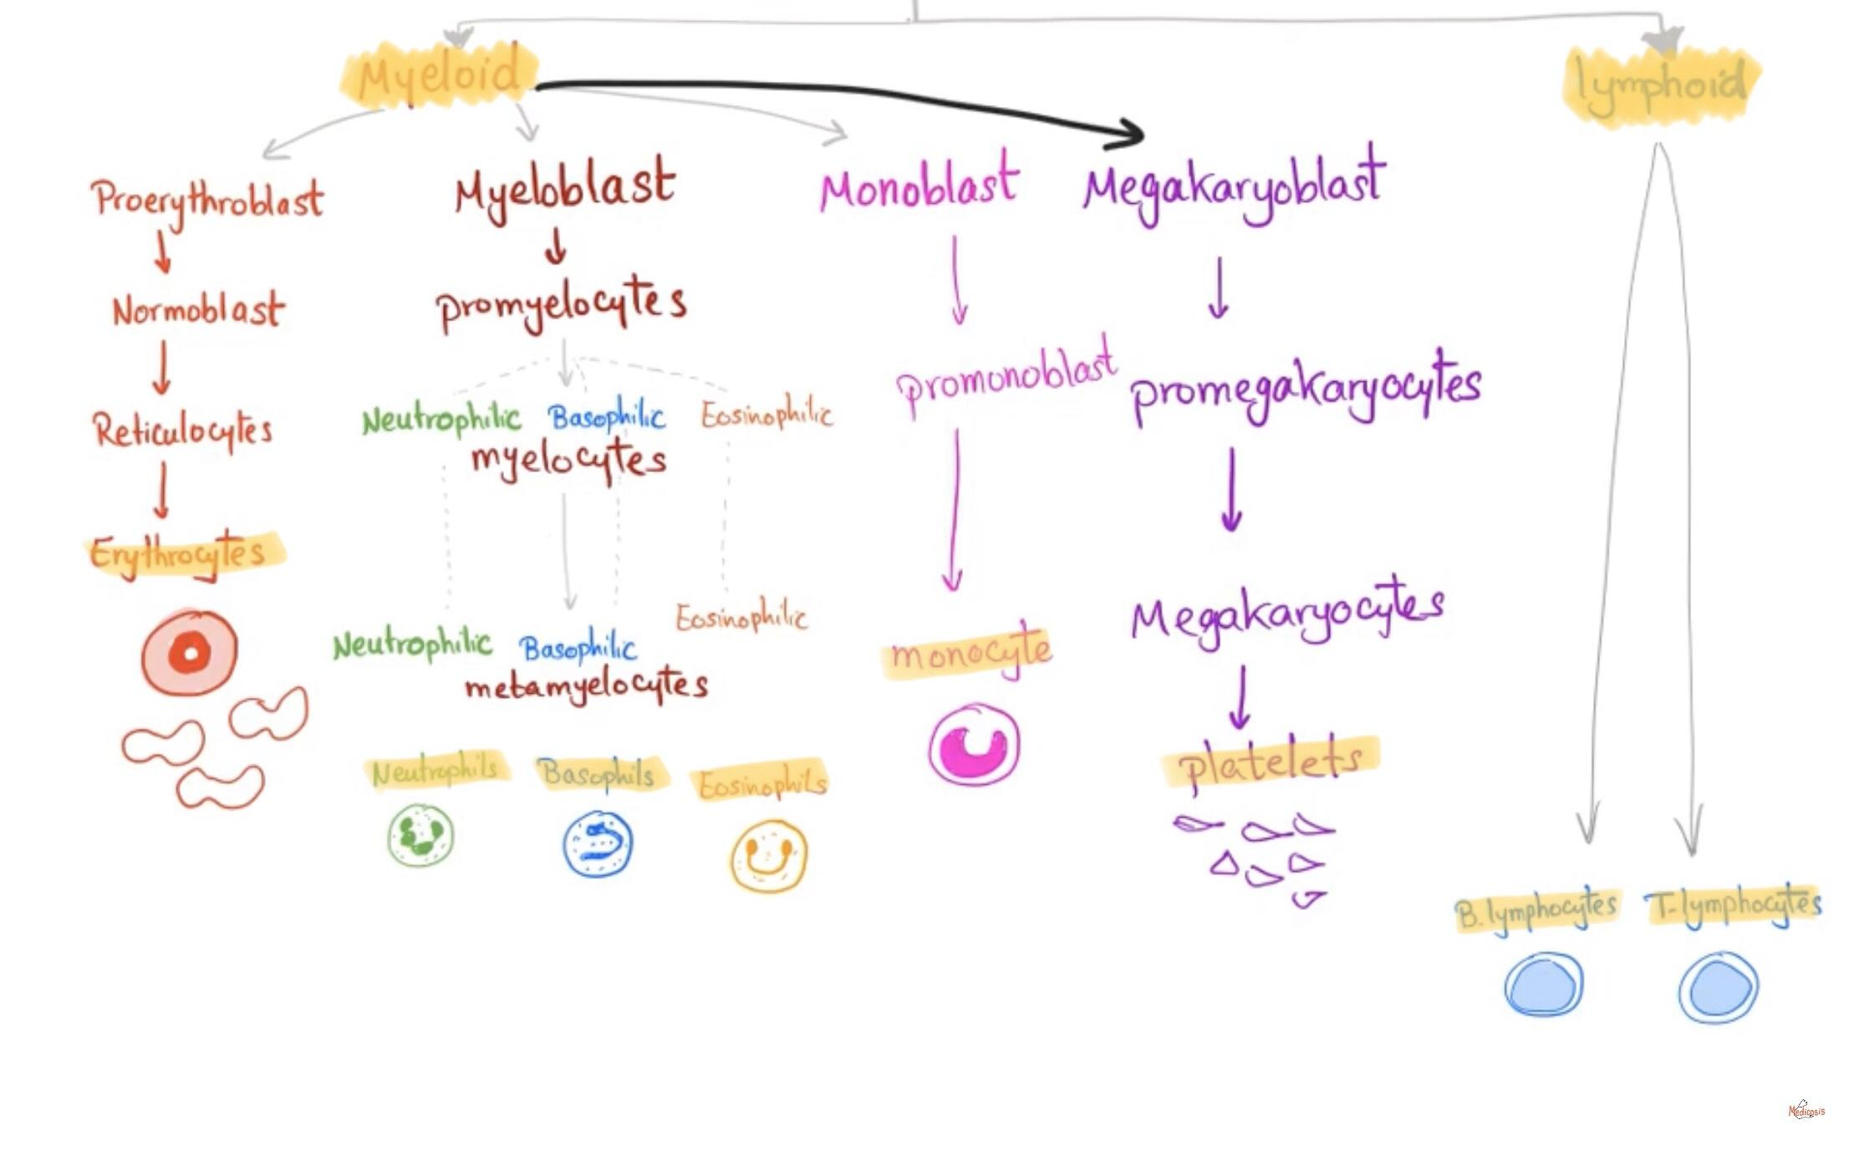
وش حذفتوا؟
| Hematopoiesis
(formation of blood cells in bone marrow)
ββ
Origin of hematopoietic stem cells is: mesenchymal hemangioblast
Lymphoid lineages
HSC
HSC
Other myeloid lineages
Myeloid SC
Erythroid precursors are the mothers of RBC *not ready yet*
Erythroid precursor
this pic is just for your understanding (just read the highlighted points).
only ready red blood cells gets out of the bone marrow to the circulation.
Erythroid precursor
transcription factor meaning: a molecule that is capable of changing (increase or decrease) the gene expression in a cell (which is responsible of cell differentiation) by altering the gene transcription.
Hematopoietic stem cell: | Transcriptional Factor
the mother of all blood cells. | these are specific for erythrocytes
Self renewal | Erythropoietin
Cell differentiation | GATA1
if there is any abnormality in these two characters of hematopoietic stem cell it will give many diseases like cancer.
- Erythropoietin is a hormone controlling the RBC formation.
- 90% synthesized in kidney .
- 10% synthesized in liver.

Slide 5
| Erythropoiesis
(RBC formation)
The “Bone Marrow” is the major site with the need of:
Cell
Name | Erythroblast | Basophilic Normoblast | Intermediate Normoblast | Late Normoblast | Reticulocyte | Erythrocyte
Cells under microscope:
Folic acid
Vit B₁₂
Cell
Name | Erythroblast | Basophilic Normoblast | Intermediate Normoblast | Late Normoblast | Reticulocyte | Erythrocyte
Synthesis of Hb¹ | + | ++ | +++ | ++ | + | -
Iron “Ferrous”
Erythropoietin
Amino acids
minerals
other regulatory factors
| Normal Ranges²
Indices | Female | Male
Hemoglobin(g/dL)³ | 11.5-15.5 | 13.5-17.5
Hematocrit (PCV) (%) | 36-48 | 40-52
Red Cell Count (×10¹²) | 3.9-5.6 | 4.5-6.5
Mean Cell Volume (MCV) (fL)⁴ | 80-95
Mean Cell Hemoglobin (MCH) (pg)⁵ | 30-35
HCT
Hematocrit
MCV
Microcytic
Normocytic
Macrocytic
Hb
MCH
Hypochromic
Normochromic
normally the central ⅓ of RBC is pale

Slide 6
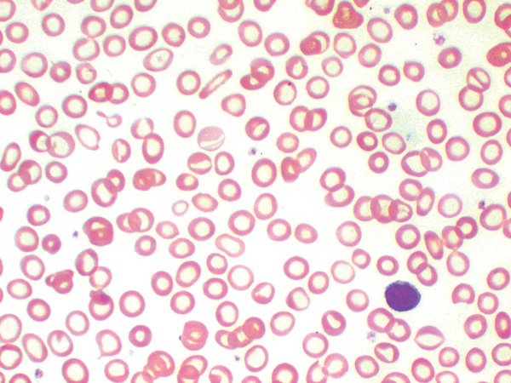
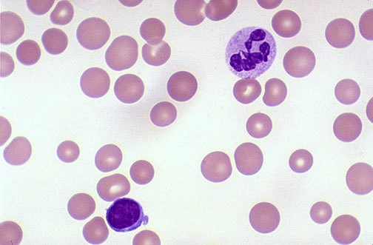
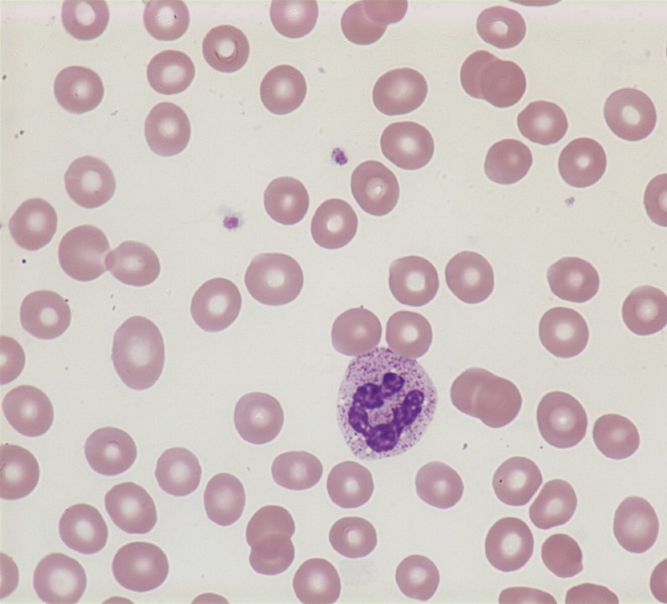
| Anemia
An (without) -aemia (blood)
Reduction of Hb concentration below the normal range for the age and gender
Leading to decreased O₂ carrying capacity of blood and thus O₂ availability to tissues (hypoxia)
| Classification of Anemia
Hypochromic microcytic anemia
Macrocytic anemia
Normocytic normochromic anemia
Disruption in Hb
Disruption of DNA synthesis
Megaloblastic anemia:
B₁₂ def.
Folate def.
MDS⁶
reduction in RBC count
-Porphyrin defect. Sideroblastic anemia
-Iron deficiency. Iron def. anemia
-Globin chain defect. Thalassemia
- Blood loss Acute bleeding
- Hemolysis Autoimmune, enzymopathy, membranopathy, sickle cell anemia and mechanical⁷
- RBC production BM failure, anemia of chronic disease⁸
BM failure causes:⁹
Chemotherapy, aplastic anemia¹⁰ and malignancy¹¹
poor diet or absorption problems.
protein chain abnormality

Slide 7
01
02
03
Speed of onset:
Severity:
Age:
| Clinical features¹²
Presence or absence of clinical feature depends on:
• Rapidly progressive anemia causes more symptoms than slow onset anemia due to lack of compensatory mechanisms:
(cardiovascular system, BM¹³ & O₂ dissociation curve)
• Mild anemia: no symptoms usually
• Symptoms appear if Hb less than 9g/dL
• Elderly tolerate anemia less than young patients due to incompetence of compensatory mechanisms.
Lethargy
Weakness
Pallor
01
Related to anemia
Dizziness
Headache
General features of anemia
Related to compensatory mechanism
Palpitation
Cardiac failure
02
of heart
Angina
01
Spoon nail with iron deficiency
Specific Features
02
Leg ulcers with sickle cell anemia
Specific signs are associated with particular types of anemia
03
Jaundice with hemolytic anemia
Bone deformities in thalassemia major
04

Slide 8
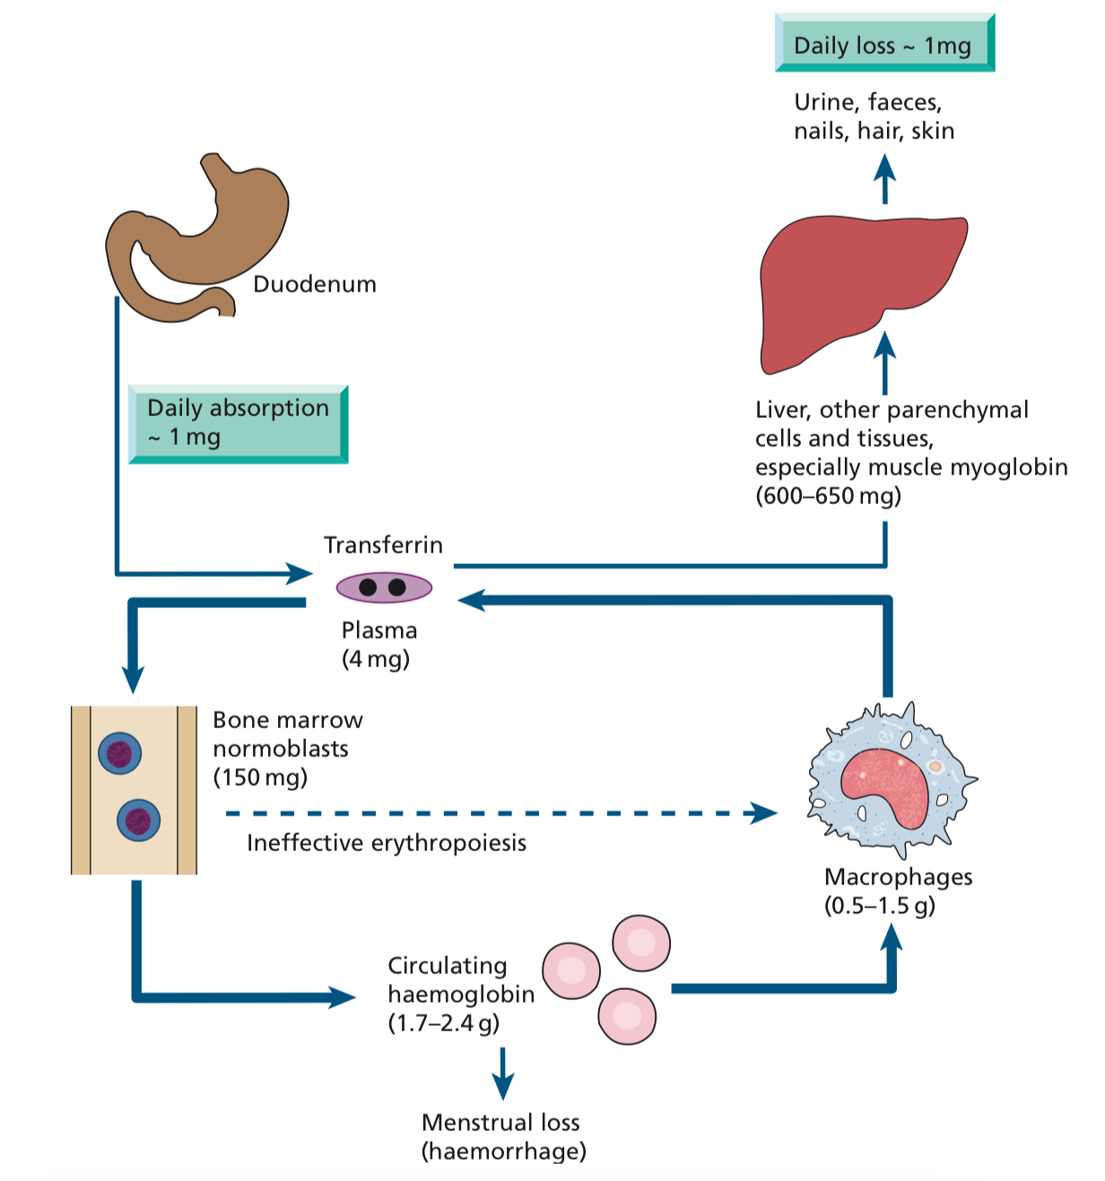
Pathoma
Iron is consumed in heme (meat-derived) and non-heme (vegetable-derived) forms.
Absorption occurs in the duodenum. Enterocytes have heme & non-heme (DMT1) transporters; the heme form is more readily absorbed
Enterocytes transport iron across the cell membrane into blood via ferroportin
Transferrin transports iron in the blood & delivers it to liver & bone marrow macrophages for storage
Stored intracellular iron is bound to ferritin, which prevents iron from forming free radicals via the Fenton reaction
| Iron Deficiency Anemia
Iron is among the abundant minerals on earth (6%).
Iron deficiency is the most common disorder ( 24%).
01
Limited absorption ability
Only 5-10% of taken iron will be absorbed
Inorganic iron can not be absorbed easily
Caused by:
02
Excess loss due to hemorrhage¹⁴
Explanation
Iron in your body:
*(in a 70kg man the total body iron is about 4g).
*(1 mg is the daily absorbed iron).
*(1mg is daily lost through urine, faeces, nails, hair, skin ) other than bleeding and menstrual loss will increase the loss of iron.
*(1.7-2.4 g circulating as a part of Hb on the RBC) THE largest amount of iron is here.
*(0.5-1.5 g within macrophages) macrophages stores a large amount of iron.
*(600-650 mg is stored in: liver, other parenchymal cells and tissues (especially muscle myoglobin).
.
Storage forms:
Ferritin, Haemosiderin
1
2b
1- iron is absorbed in Duodenum.
2- Transferrin is a carrier protein, each carries 2 molecules of iron in the form (FERRIC) through circulation to:
A- bone marrow (where Hb is synthesized especially in normoblast)
b- to be stored in liver or muscle myoglobin.
3- phagocytosis by macrophages happens to RBC when:
A- RBC lifespan reaches the end (120 days)
B- when ineffectively formed erythrocytes leaves the bone marrow.
4- iron is stored in liver, muscle and macrophages (BM).
5- iron released from stores when body needed and carried again by transferrin to go to bone marrow.
2
2a
3

Slide 9
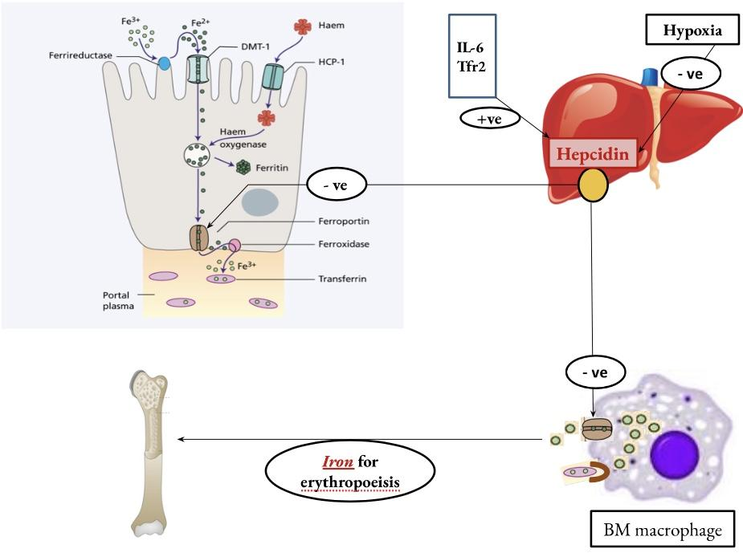
| Iron Deficiency Anemia
Explanation
1- iron absorption is controlled by the hormone hepcidin (synthesized in liver only) 2- the release of this hormone is controlled by
a- IL₆ and Tfr₂ (increase the release of hepcidin)
b- Hypoxia (decrease the release of hepcidin).
3- this hormone is inversely proportional to iron absorption:
High hepcidin = low absorption of Iron.
Low hepcidin = high absorption of Iron.
4- there are many spots controlling the process of iron absorption to prevent iron overload.
5- iron enters the duodenum cells when it gets converted to the ferrous state by the enzyme ferrireductase, then it gets out to circulation in the ferric state by the enzyme ferroxidase so, it can be carried in circulation by transferrin.
6- this hormone blocks ferroportin (the gate of iron to the circulation located in macrophages and duodenum cells).
436 team notes:
(Hepcidin controls Ferroportin by negative feedback control.
Inorganic (non-heme) Iron needs to one additional step to be absorbed which is conversion of the Fe³⁺ form (Ferric iron) which is non-absorbable form to the Fe²⁺ form (Ferrous Iron) which is absorbable form by ferrireductase enzyme).
Pathoma:
Why hepcidin cause decrease in iron levels?
Hepcidin sequesters iron in storage sites by:
1- limiting iron transfer from macrophages to erythroid precursors
2- suppressing erythropoietin (EPO) production; aim is to prevent bacteria from accessing iron, which is necessary for their survival (as hepcidin is an inflammatory protein hence its effects)

Slide 10
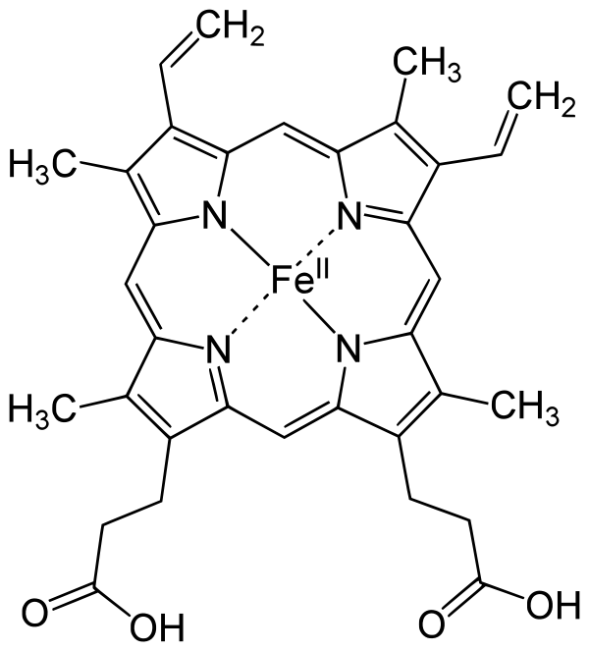
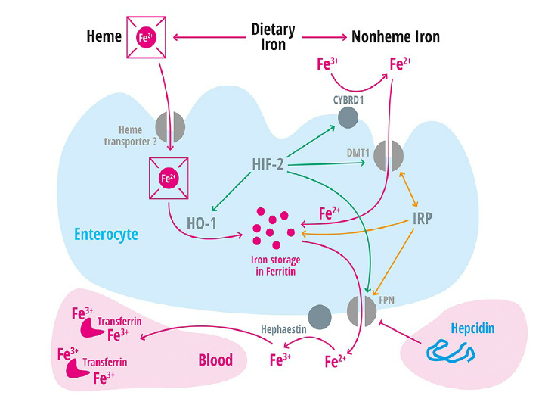
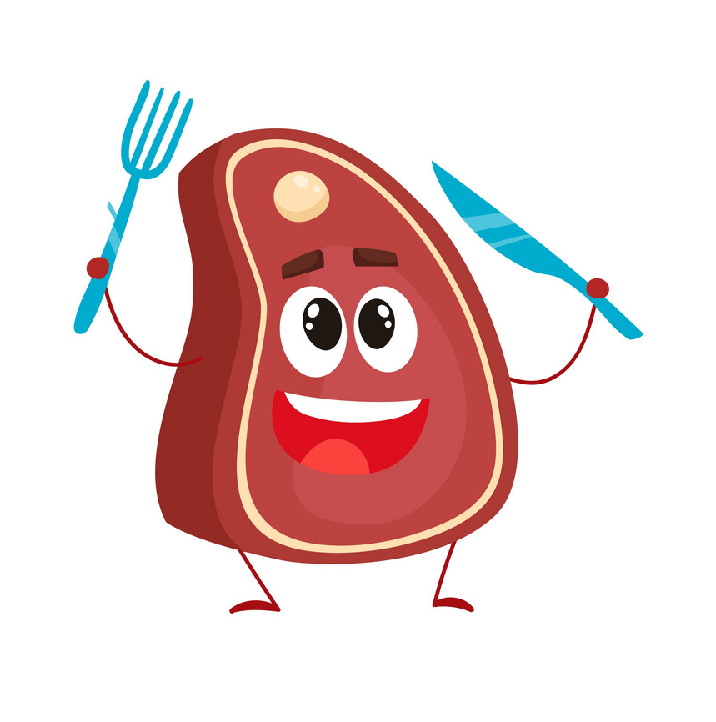
| Iron Absorption
| Factors affecting absorption
Body Iron status:
01
Increased demands (iron def., pregnancy) Low iron in stores High iron absorption
Iron overload Full iron stores Low iron absorption
Favoring absorption
Heam iron¹⁵ Ferrous Iron (Fe²⁺) Acid Iron def. Pregnancy Hemochromatosis¹⁶ Solubilizing agent (sugar)
02
Content and form of dietary iron:
More iron
Heam iron More absorption
Ferrous iron
Reducing absorption
Inorganic iron¹⁷ Ferric iron Fe³⁺ Alkalines Iron overload Tea Increased hepcidin Precipitating agent (phenol)
03
Balance between dietary enhancers & Inhibitory factors:
Enhancers:
Meat (haem iron)
Fruit (Vitamin C)
Sugar (Solubilizing agent)
Acids
Inhibitors:
Dairy foods (calcium)
High fiber foods (phytate)
Coffee & tea (polyphenols)
Anti -Acids
Body Iron status:
Content and form of dietary iron:
Balance between dietary enhancers & Inhibitory factors:
Factors affecting absorption:
Enhancers | Inhibitors
Meat (haem iron) Fruit (Vitamin C) Sugar (Solubilizing agent) Acids | Dairy foods (calcium) High fiber foods (phytate) Coffee & tea (polyphenoles) Anti -Acids
Favoring absorption | Reducing absorption
Heam iron Ferrous Iron (Fe++) Acid Iron def. Pregnancy Hemochromatosis Solubilizing agent (sugar) | Inorganic iron Ferric iron Fe+++ Alkalines Iron overload Tea Increased hepcidin Precipitating agent (phenol)

Slide 11
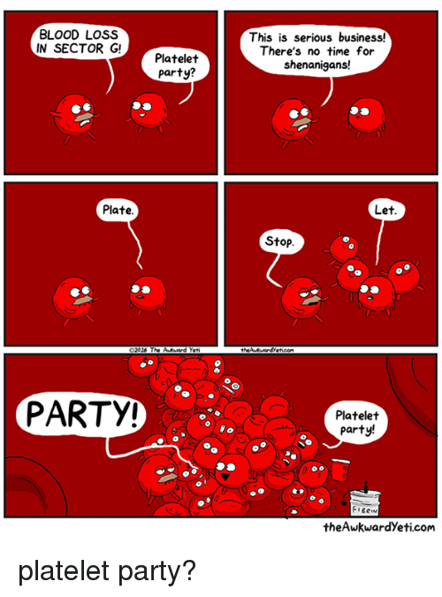
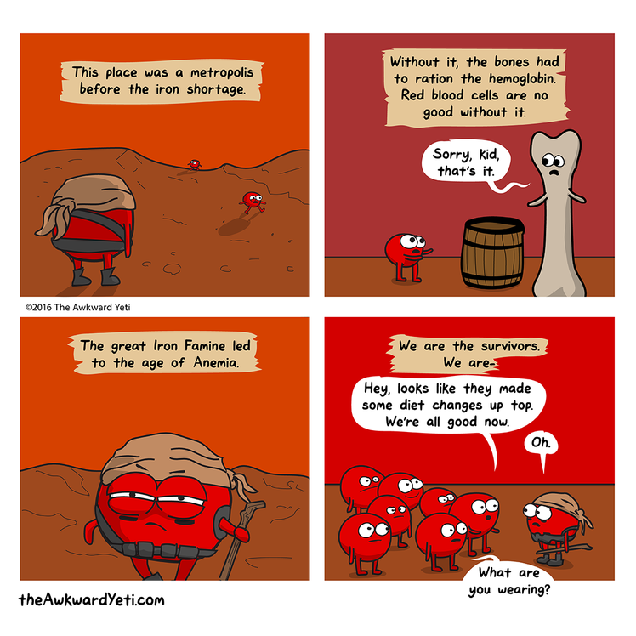
01
03
Chronic blood loss:
Malabsorption:
Causes of IDA
02
04
Increased demands:
Poor diet:
• GIT Bleeding: peptic ulcer, esophageal varices , hookworm & cancer
• Uterine bleeding
• Hematuria
• Enteropathy
• Gastrectomy
• Immaturity
• Growth
• Pregnancy
• EPO therapy
• Rare as the only cause (rule out other causes)
Erythropoietin

Slide 12
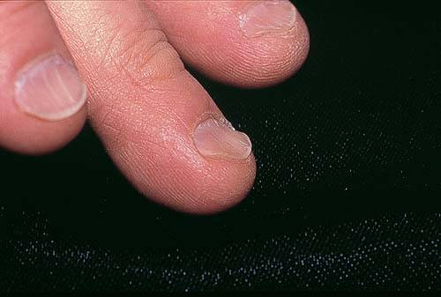
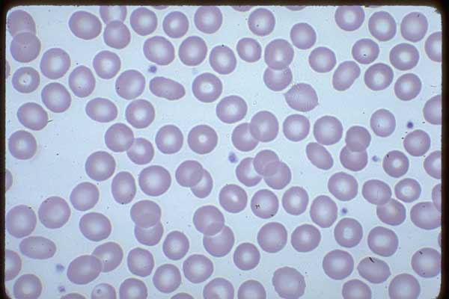
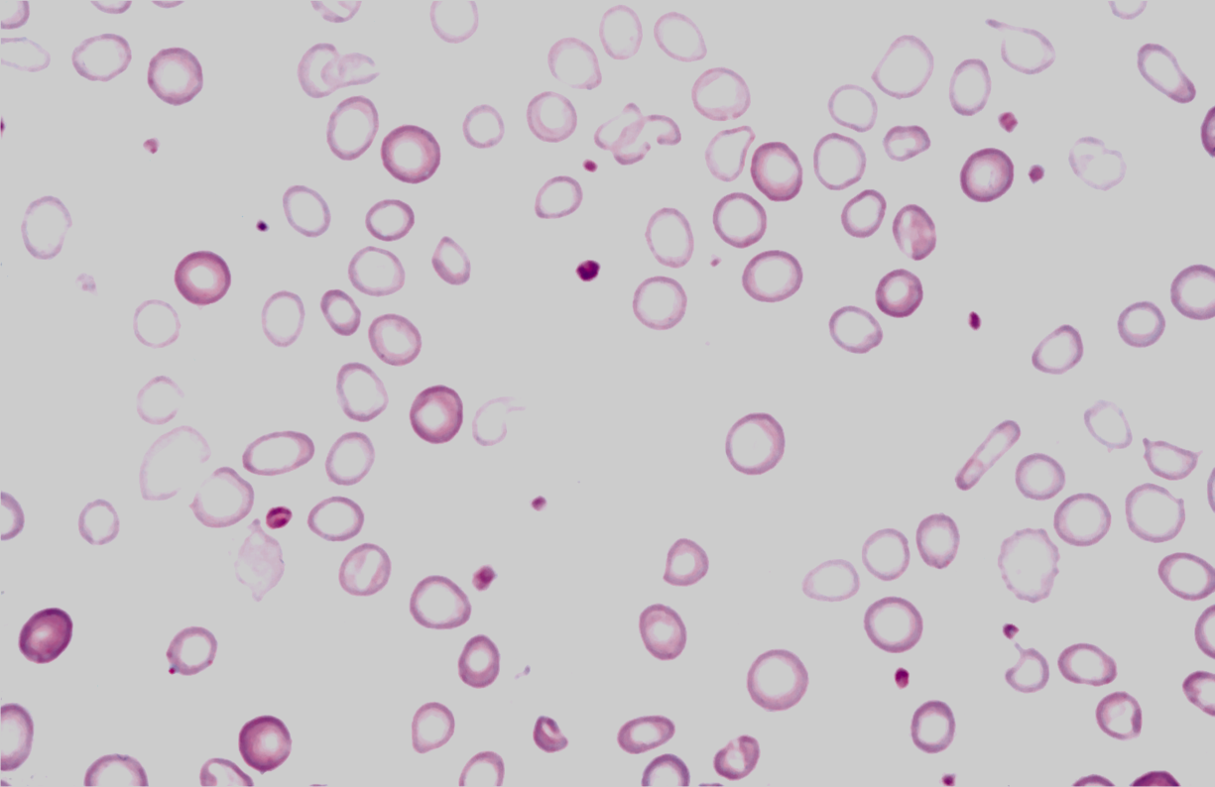
كنها زحمة
:) :(
| Investigation
| Signs and symptoms of IDA
Koilonychia
(spoon-shaped nails)
02
Microcytic hypochromic anemia
03
BM Iron stain (Perl’s stain)
Beside symptoms and signs of anaemia +/- bleeding, patients present with:
01
Iron Studies
Angular stomatitis and/or glossitis
Dysphagia due to pharyngeal web¹⁹ (Plummer-Vinson syndrome)
Thalassemia
Normal
IDA
with:
•Anisocytosis
( variation in size)
• Poikilocytosis
(variation in shape)
The gold standard but invasive procedure
| Development of IDA
Low TIBC*
high TIBC*
High Serum Iron
High Serum ferritin
High Transferrin saturation
 | Normal | Pre-latent | Latent | Iron def. anemia
Stores | Normal | Low | Low | Low
MCV/MCH¹⁸ | Normal | Normal | Low | Low
Hemoglobin | Normal | Normal | Normal | Low
Low Serum Iron
Low Serum ferritin
Low Transferrin saturation
Normal
IDA: reduced or absent iron stores (hemosiderin)
Normal
Green/blue color = iron
we say it is IDA when we see signs of anemia on top of these results
No green granules in cytoplasm
IDA
+Signs of anemia
*TIBC : total iron binding capacity of transferrin
Pathoma:
Total iron-binding capacity: measure of transferrin molecules in the blood

Slide 13
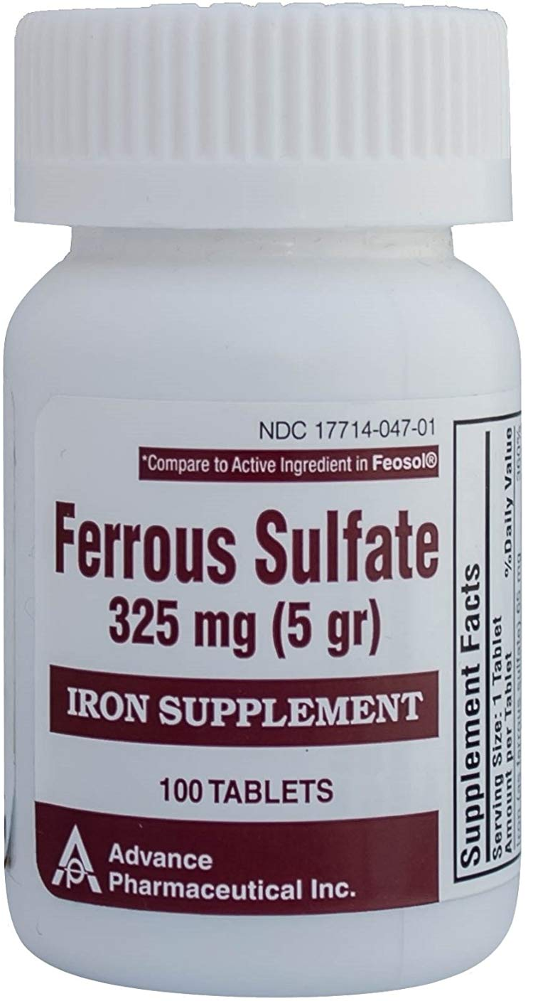
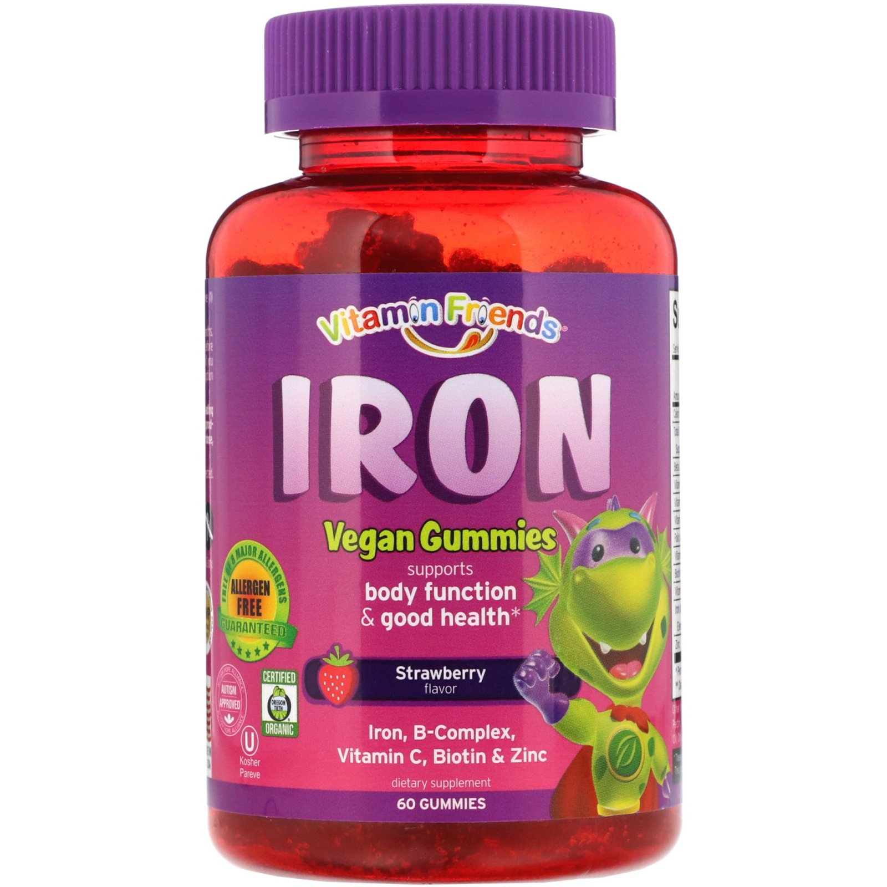
| Iron Deficiency Anemia (treatment & prevention)
Treatment of IDA
PREVENTION OF IDA
Dietary modification
Meat is better source than vegetables.
Treat the underlying cause
Food fortification (with ferrous sulphate)
GIT disturbances ,staining of teeth & metallic taste.
Iron replacement therapy:
-Oral :( Ferrous Sulphate OD for 6 months)
-Intravenous:( Ferric sucrose OD for 6 months)
Iron supplementation
For high risk groups.
Hb should rise 2g/dL every 3 weeks
Oral Ferrous Sulphate
Intravenous Ferric sucrose
Iron supplement

Slide 14
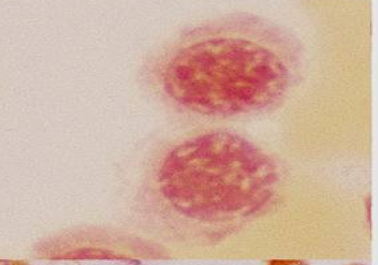
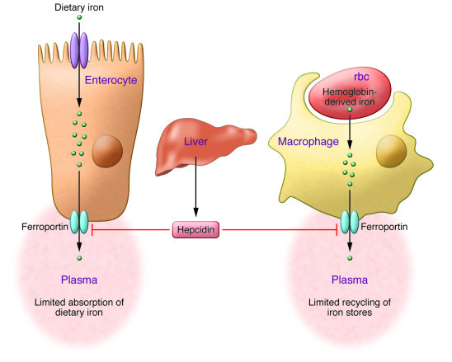
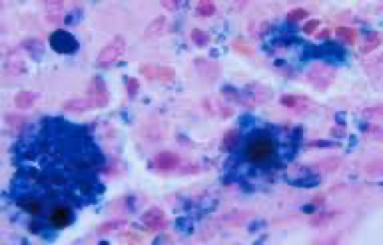
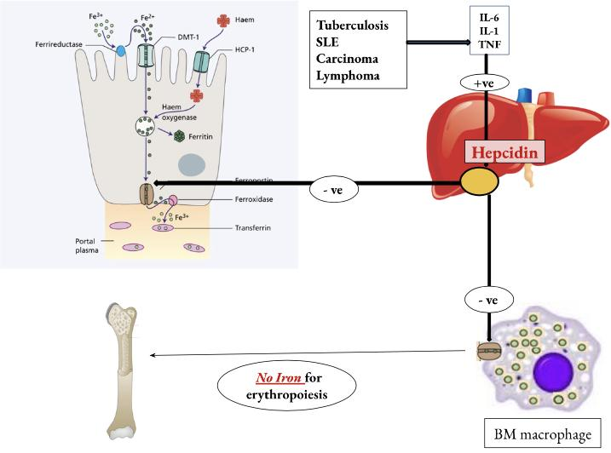
Fe⁺³
Fe⁺²
Ferri reductase
Tb
SLE
Carcinoma
Lymphoma
BM
IL-6
IL-1
TNF
+ve
-ve
-ve
No Iron for erythropoiesis
ريما هذي السلايداه سيئة سيئة وزححححمممممة
استخدمي اشكال ثانية
| Anemia of chronic disease
Normochromic normocytic (usually) anemia caused by:
decreased release of iron from iron stores due to raised serum Hepcidin.
Associated with
Associated with
01
Chronic infection including HIV, malaria, TB.
02
Tissue necrosis
03
Malignancy: carcinoma, lymphoma.
04
Chronic inflammations
Chronic infection including HIV, malaria
Malignancy
Tissue necrosis
Chronic inflammations
Explanation
Chronic diseases like TB, SLE, carcinoma and lymphoma released a lot of IL-6, IL-1 and TNF these are responsible of the high hepcidin levels which is in turn prevents the release of iron from the stores, so there is NO iron for erythropoiesis.
Features of anemia of chronic disease
Features of anemia of chronic disease:
Management:
Treat the underlying cause
Iron replacement +/- EPO
Normocytic normochromic or mildly microcytic anaemia
Low serum iron and TIBC
Normocytic normochromic or mildly microcytic anaemia
Normal or high serum ferritin ( acute phase reactant)
Normal or high serum ferritin
( acute phase reactant)
1
3
Low serum iron and TIBC
High haemosiderin in macrophages but low in normoblasts
High haemosiderin in macrophages but low in normoblasts
2
4

Slide 15
Features of anemia of chronic disease:
Normocytic normochromic or mildly microcytic anaemia
Normal or high serum ferritin ( acute phase reactant)
1
3
2
Low serum iron and TIBC
4
High haemosiderin in macrophages but low in normoblasts
Management:
Treat the underlying cause
Iron replacement +/- EPO
| Features of anemia of chronic disease
04
03
02
High haemosiderin in macrophages but low in normoblasts
01
Normal or high serum ferritin ( acute phase reactant)
Low serum iron and TIBC
Normocytic normochromic or mildly microcytic anaemia
| Management
Treat the underlying cause
Iron replacement +/- EPO
1
2

Slide 16
1- Hb is synthesized in all immature stages but Not in the mature erythrocyte
2- Normal range in CBC depends on (a- sex b-age).
3- Hemoglobin determines the (severity) of anemia.
4- MCV determines the (class) of anemia
5- MCH hypo/normochromic (يحدد نسبة التصبغ)
6- MDS is a malignant hematological disorder called myelodysplastic syndrome
7- mechanical hemolysis likes abnormal heart valves
8- Anemia of chronic disease is a type of anemia that affects people who have conditions that cause inflammation.
9- BM failure is characterized by inability to produce RBC
10 - Aplastic anemia is characterized by bone marrow shutdown
11- Malignancy is very important cause in BM failure especially when metastasis to bone marrow happens
12- If anemia is mild or has developed over a long period of time, there may not be any noticeable symptoms
13-cellularity of bone marrow will increase as a compensatory mechanism if there is enough time (slow onset anemia)
14- Hemorrhages can be due to uterine bleeding, heavy menstrual period…
15- Heam Iron is organic iron like in: red meat (favoring absorption)
16- Hemochromatosis is a congenital anomaly increases the circulating iron,the hepcidin will decrease.
17-Inorganic Iron is found in vegetables: non-haem.
18- this ratio is called RBC indices.
19- Dysphagia due to pharyngeal web is membranous folds of tissue that form in the esophagus. this x-ray method is no longer used to diagnose IDA
-During Erythropoiesis, an Erythroblast divides to become 4 Basophilic Normoblasts which then divide to make Intermediate Normoblasts and no more division takes place after this
-In anemia, cardiac failure is due to decreased oxygen capacity which requires more pumping from the heart to meet tissues requirements
-Hypochromic Microcytic anemia happens as a result of lack of hemoglobin which is involved in the formation of the structure of the RBCs (Quantitative deficiency)
-Thalassemia: reduction of production of normal hemoglobin
-Sickle cell anemia: normal production of abnormal hemoglobin
-iron is toxic when it’s not bound to a carrier and excessive iron storage in the liver can cause liver toxicity
-in Normochromic Normocytic anemia due to raised serum hepcidin, stool will be full of iron
-normal RBC has to be biconcave, flexible and 8 micrometer in diameter.
-Erythropoietin (EPO) is a hormone that promotes the formation of red blood cells.
Dr. Notes
1- its imp to know that Hb is synthesized in all immature stages but Not in the mature erythrocyte
2- in CBC. it depends on 1- sex 2-age.
3- determines the (severity )of anemia.
4- determine the (class) of anemia
5- hypo/ normochromic (يحدد نسبة التصبغ)
6- its a malignant hematological disorder called myelodysplastic.
syndrome
7- mechanical like abnormal heart valves when the break the RBC
8- is a type of anemia that affects people who have conditions that
cause inflammation.
9- can NOT produce RBC
10 - bone marrow shutdown
11- especially when metastasis to bone marrow happens
12- If your anemia is mild or has developed over a long period of
time, you may not notice any symptoms.
13- cellularity of bone marrow will increase
14- first cause of anemia
15- uterine bleeding, heavy menstrual period…
16- organic iron like in:red meat
17- congenital anomaly increases the circulating iron,the hepcidin
will decrease.
18- in vegetables: non-haem.
19- usually we drink tea after eating red meat which decreases the
iron absorption.
-Origin of hematopoietic stem cells is: mesenchymal hemangioblast
-There are two types of transcriptional factors,
1-for self renewal
2-for differentiation: which are (Erythropoietin and GATA1)
-During Erythropoiesis, an Erythroblast divides to become a 4 Basophilic Normoblasts which then divide to make Intermediate Normoblasts and no more division takes place after this
-60% of bone marrow is cellular while the rest is backup space (it becomes more cellular during anemia)
-In anemia, cardiac failure is due to decreased oxygen capacity which requires more pumping from the heart to meet tissues requirements
-Hypochromic microcytic anemia happens as a result of lack of hemoglobin which is involved in the formation of the structure of the RBCs (Quantitative deficiency)
-Thalassemia: reduction of production of normal hemoglobin
-Sickle cell anemia: normal production of abnormal hemoglobin
-iron is toxic when it’s not bound to a carrier and excessive iron storage in the liver can cause liver toxicity
-Ferrous form (Fe²⁺) is the favorable form for absorption from small intestine
-children with undiscovered anemia have less IQ compared to other children
-in Normochromic Normocytic anemia due to raised serum hepcidin, stool will be full of iron

Slide 17
Key answers: 1-C 2-D 3-C 4-B 5-A 6-C
| Quiz
1- Symptoms of anemia appear when hemoglobin is less than:
7 g\ dL
8 g\dl
9 g\dL
None
2- All of the following cause microcytic anemia EXCEPT: (from dr.notes)
Iron deficiency anemia
Thalassemia
Sideroblastic anemia
Sickle cell anemia
3- Which one of these factors increase iron absorption?
Phytate
Phenols
Vitamin C
Calcium
4- The gold standard stain for diagnosis IDA is: (from dr.notes)
Silver stain
Perl’s stain
H & E stain
Bielschowsky stain
5- Which one of these factors suppress hepcidin activity?
Hypoxia
IL-6
TNF
Carcinoma
6- The only form of RBCs that go to the circulation: (from dr.notes)
Erythroblast
Reticulocyte
Erythrocyte
Basophilic normoblast

Slide 18
THANKS
| TEAM MEMBERS
| TEAM LEADERS
| Abdulaziz Alghamdi
| Elaf Almusahel
Amirah Alzahrani
Deema Almaziad
Jude Alotaibi
Njoud Almutairi
Nouf Albraikan
Noura Almazroa
Razan Alzohaifi
Rema Almutawa
Renad Alhaqbani
Renad Almutawa
Taif Alotaibi
Wejdan Alnufaie
Abdullah Alghamdi
Hashem Bassam
Mashal Abaalkhail
Moath Aljehani
Mohammed Alasmari
Mohammed H.Alshehri
Mohammed Alkhamees
Mohammed Alshalan
Naif Alsolais
Saud Bin Queid
= Done by
= Note taker
= Textbooks note taker

