Slide 1
| Haemoglobinopathies
Hematology
438 teamwork
Color index:
Important
Extra, pathoma
Notes
Editing file

Slide 2
| objectives
To understand the normal structure and function of hemoglobin and how the globin components of hemoglobin change during development, and postnatally.
To understand the mechanisms by which the thalassaemias arise
To appreciate the clinical presentations and complications of thalassaemia
To appreciate the contribution of haemolysis and ineffective erythropoiesis to the pathophysiology of thalassaemia
To understand the pathophysiology of sickle cell anaemia
To be able to describe the clinical presentation and complications of sickle cell anaemia
To understand the role of haemoglobin electrophoresis and high performance liquid chromatography in the investigation of globin disorders
To appreciate the many other haemoglobin variants associated with disease

Slide 3
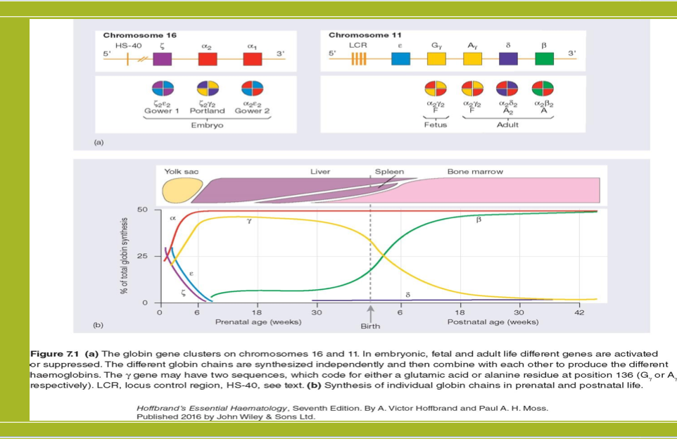
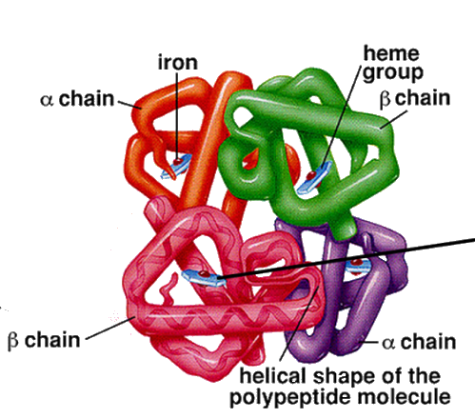
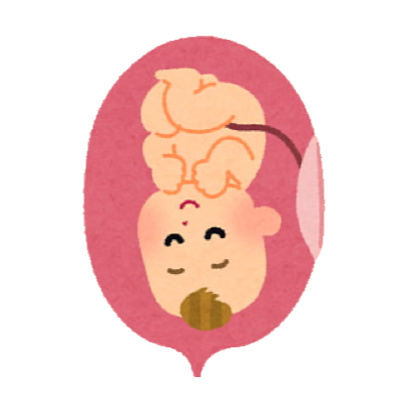
| Normal Structure of Hemoglobin
Hemoglobin is critical to the normal function of the red cell, the fundamental role of which is the transport of oxygen from the lungs to the tissues.
The normal tetramer hemoglobin molecule comprises
two ‘alpha-like’ globin polypeptide chains and two ‘beta-like’ globin chains; each globin molecule is associated with a heme group, which comprises a porphyrin ring with iron in its ferrous form at the center.
The α chains are encoded on chromosome 16.
The β-like globins are encoded on chromosome 11.
Explanation of HB synthesis:
Each stage has specific HB ex: Gower 1 , Portland , Gower 2 are only in found in the embryonic life , if I give you one of those stages in adult life = wrong information.
We have only HB F in Fetus life .
After birth: 3 types of HB:
HB A : 96-98 % “ mainly “.
HB A₂ : 1.5-3.5 % .
HB F : 0,5- 0,8 % “decreased but still there”.
Formation of HB :
From 0 to 6 week globin synthesized in yolk sac , after 6 week until birth spleen and liver takeover “shut down to yolk sac”
Before birth, bone marrow takeover and 6 week after birth shutdown to liver and spleen if not = diseases occur such as: Hepatosplenomegaly .
Fetal haemoglobin HbF (α₂γ₂).

Slide 4
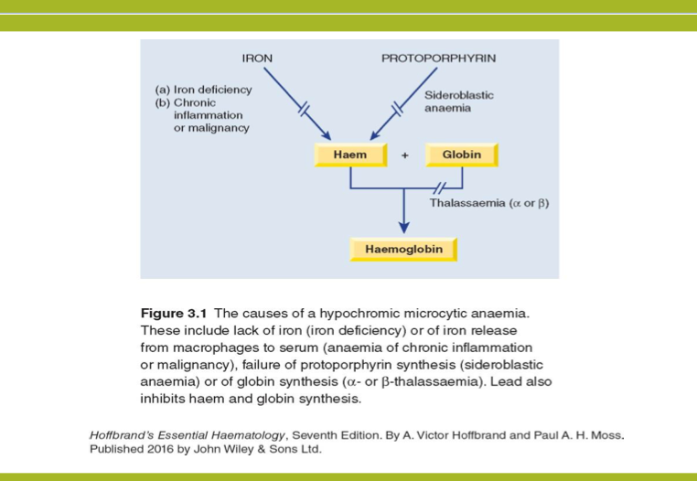
| Function Of Hemoglobin
The major adult haemoglobin is HbA (α₂β₂) with a much smaller contribution from HbA₂ (α₂δ₂ - usually 1.5-3.5% of adult haemoglobins).
The fetal haemoglobin HbF has a higher oxygen affinity than the adult haemoglobins, facilitating transfer of oxygen from the maternal to the fetal circulation.
Normally, the synthesis of α-like and β-like chains is balanced.
An imbalance between the production of α and β chains is the pathophysiological basis of the thalassemias
(a quantitative issue).
Hypochromic microcytic anaemia is the most important feature of thalassemia

Slide 5
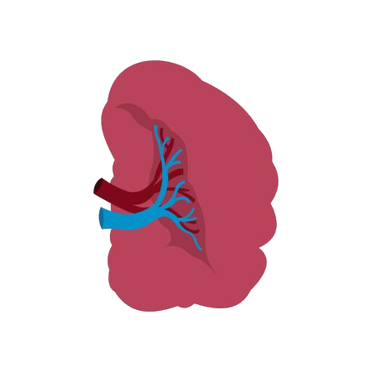
| Thalassemia
Divided into two main groups, depending on whether the defect lies in the synthesis;
Its pathophysiology includes the chains which are present in excess will precipitate in the precursor red cells, leading to their premature death prior to release from the bone marrow (ineffective erythropoiesis) resulting to an increased erythroid drive and further expansion of the marrow into bones not typically used for hemopoiesis, and into the spleen.
Long-term consequences of thalassemia include;
α-thalassemias
β-thalassemias
Thalassemic picture is: high RBC count, low MCV, low MCH, normal RDW
Splenomegaly
Bony deformities
Iron overload due to transfusion and ineffective erythropoiesis as well as chronic anemia.

Slide 6
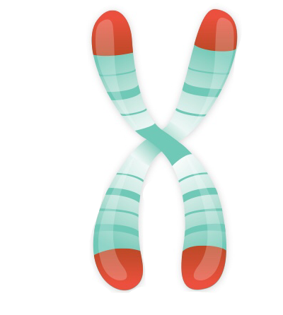
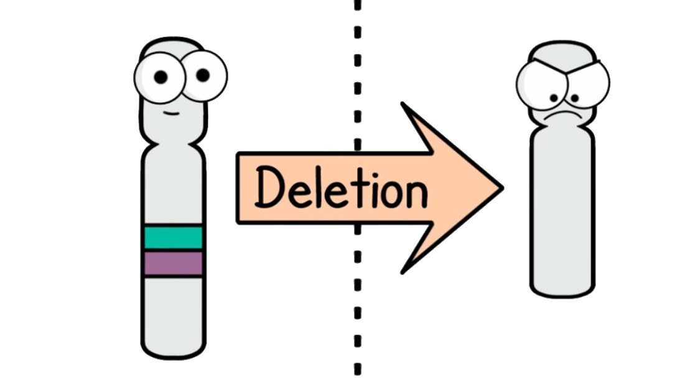
| α-Thalassemia
1- deficiency in chain leads to excess to other one which will precipitate in precursor red cells.
2- trying to increase in number.
3- Every 6 weeks need blood transfusions which cause iron overload.
5- hemolytic of RBC in circulation
6- increase demand → request from spleen for formation of RBC *
7- thalassemic phase
8- expansion to bone : Face and skull
9 - due to erythropoiesis
10 - best treatment
11- Trait means Mild
12- HB electrophoresis shows 20-45% HbS , above 45% Hbs = Sickle Cell Anemia
α-Thalassemia is seen with the greatest frequency in south-east Asia (Thailand, the Malay Peninsula and Indonesia) and west Africa.
-Cis deletion is when both deletion occur on the same chromosome; seen in Asians, And it's the most dangerous.
-Trans deletion is when one deletion occur on each chromosome; seen in Africans, including African Americans.
Each chromosome 16 has an α-globin locus consisting of two α-globin (i.e; 4 genes) genes plus the regulatory sequences essential for their normal expression.
In most patients with α-thalassemia, there is a deletion of one or more of the α-globin genes; there are occasional cases that are the consequence of non-deletional defects.
Mutations
Deletion of one or
two genes
Deletion of three of the four α-globin genes
Loss of all four α-globin genes
Causes
Causes
Causes
an asymptomatic condition with minor hematological features
a more severe imbalance of α:β-globin chains and results in hemoglobin H, four beta globins disease
Hb Bart’s, four gamma globins, (hydrops fetalis syndrome).
0.4% of deliveries are stillbirths due to Hb Bart’s hydrops fetalis syndrome and HbH disease is found in about 1% of the population.

Slide 7
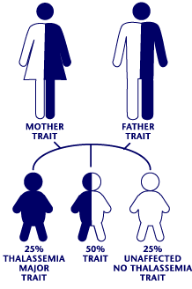
| α-Thalassemia
 | α+-Thalassemia trait | α0-Thalassaemia trait
Mutation | (deletion of one α globin gene) | (deletion of both α-globin genes in same allele on ch 16)
Mechanism | This is seen when an individual inherits the α+-thalassemia allele from one parent and a normal chromosome 16 from the other parent (i.e. heterozygotes for the α+ determinant). | —
Hb | — | either normal or slightly reduced
Symptoms | Affected individuals are asymptomatic, although they have minor hematological changes | —
MCV | slight reductions | low
MCH | slight reductions | low
RBC count | — | Elevated
RDW | — | Not affected

Slide 8
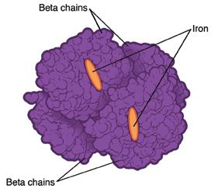
| α-Thalassemia
 | Hemoglobin H disease | Hb Bart’s hydrops fetalis syndrome
Mutation | (deletion of three α-globin genes) | Hb Bart’s hydrops fetalis syndrome
Mechanism | Results from: The inheritance of both the α+- and α0-thalassaemia alleles, leaving one functioning α-globin gene per cell. α-globin chains are produced at very low rates, leaving a considerable excess of β-chains, which combine to form tetramers (β4). This tetramer is known as HbH. | No α-chains can be formed, and the fetal β-like chain γ- globin forms tetramers known as Hb Bart’s.
Effect on RBC | 1- HbH is unstable and precipitates as the erythrocytes age, forming rigid membrane-bound inclusions that are removed during the passage of affected red cells through the spleen. 2- The damage to the membrane brought about by this removal results in a shortened red cell lifespan. | Structure
Diagnosis | 1- Most patients are moderately affected, with a mild anemia of 7-11g/dl and markedly hypochromic, microcytic indices. 2- Supravital staining of the blood film demonstrates cells with many HbH inclusions, giving a characteristic ‘golf-ball’ appearance.
Treatment | Most patients will be transfusion independent.
Complication | Splenomegaly is seen in most patients. | This hemoglobin is not useful for oxygen transport and, despite the persistence of the embryonic hemoglobin Hb Portland (δ₂γ₂), there is intrauterine or neonatal death due to hydrops

Slide 9
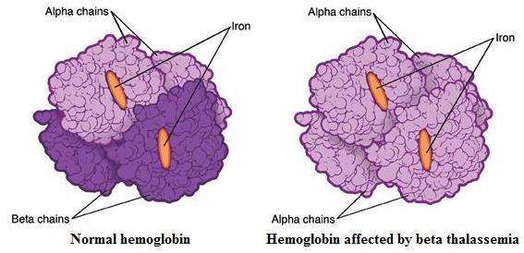
| β-Thalassemia
Epidemiology:
The World Health Organization estimates that 1.5% of the world’s population are carriers of β-thalassemia.
The prevalence of the β-thalassemia trait is particularly high in southern Europe (10-30%) and south-east Asia (5%), common in Africa, the Middle East, India, Pakistan and southern China.
• Most affected subjects with beta thalassemia trait are asymptomatic.
• Hb concentration is normal or slightly reduced, hypochromic and microcytic red cell indices are seen.
Defects of β-globin on both copies of chromosome 11
-Examination of peripheral blood film may shows red cell abnormalities such as target cells and poikilocytes.
• Marked anemia
• Transfusion dependent
Heterozygous β-thalassemia (Beta-thalassemia trait)
Homozygous β-Thalassemia
 | α-thalassaemia | arises from gene deletions
 | β-Thalassemia | results from a multiplicity of different single nucleotide substitutions, insertions or small deletions affecting the β-gene itself or occasionally in promoting regions.
The difference between
• HbA2 levels will be raised above the normal range to 3.5- 7.0%.
• Sometimes, a slightly increased Hb F levels, in the range of 1-5%.
Structure
In Beats Thalassemia there will be elevation of HbA2 due to absence of Beta gene and the shifting of presentation of Beta gene to Delta gene (the next gene in the order)
Autosomal recessive mutation in β chain in hemoglobin
Arises when two abnormal β genes are present
 | Heterozygous β-thalassemia (Beta-thalassemia trait) | Homozygous β-Thalassemia
Mechanism | Most affected subjects with beta thalassemia trait are asymptomatic. | Defects of β-globin on both copies of chromosome 11.
Hb concentration | normal or slightly reduced, hypochromic and microcytic red cell indices are seen. | __
Examination of peripheral blood film may show | red cell abnormalities such as target cells and poikilocytes. | Marked anemia.
HbA2 level | raised above the normal range to 3.5- 7.0% | __
HbF level | Sometimes, a slightly increased, in the range of 1-5%. | __
Treatment | __ | Transfusion dependent.
Heterozygous β-thalassemia (Beta-thalassemia trait) | Homozygous β-Thalassemia
• Most affected subjects with beta thalassemia trait are asymptomatic. • The Hb concentration is either normal or slightly reduced, hypochromic and microcytic red cell indices are seen. • Examination of peripheral blood film may show red cell abnormalities such as target cells and poikilocytes. • β-thalassemia HbA2 levels will be raised above the normal range to 3.5- 7.0%. Sometimes, a slightly increased Hb F levels, in the range of 1-5%. | • Defects of β-globin on both copies of chromosome 11. • Marked anemia. • Transfusion dependent.

Slide 10
01:
03:
Thalassemia minima
Thalassemia Intermedia
Clinical classiﬁcation
of the thalassemias
02:
04:
Thalassemia minor
Thalassemia major
Thalassemia minima | Describes
Thalassemia minor | Describes patients with microcytosis and hypochromic red cells secondary to thalassemia mutations, but with only mild anemia or a normal hemoglobin. Patients who inherit a single affected allele are usually in this category.
Thalassemia intermedia | Patients will also have a microcytic hypochromic anemia, increased erythroid drive to maintain their hemoglobin, packed bone marrow with a decreased myeloid to erythroid ratio, and extramedullary hematopoiesis, giving splenomegaly. Transfusion may be required to maintain the hemoglobin at times of additional physiological stress.
Thalassemia major | Have severe anemia and are transfusion dependent. Their increased erythroid drive leads to a packed erythroid marrow and splenomegaly, development of bony abnormalities secondary to unchecked marrow expansion. Patients in this category are those with complete loss of β-globin expression from both copies of Ch11.
|
The presence of a thalassemia mutation that is without clinical consequences.
Patients will also have a microcytic hypochromic anemia, increased erythroid drive to maintain their hemoglobin, packed bone marrow with a decreased myeloid to erythroid ratio, and extramedullary hematopoiesis increase demand → request from spleen for formation of RBC *, giving splenomegaly. Transfusion may be required to maintain the hemoglobin at times of additional physiological stress.
Patients with microcytosis and hypochromic red cells secondary to thalassemia mutations, but with only mild anemia or a normal hemoglobin. Patients who inherit a single affected allele are usually in this category.
Have severe anemia and are transfusion dependent.
Their increased erythroid drive leads to a packed erythroid marrow and splenomegaly, development of bony abnormalities (thalassemic phase) secondary to unchecked marrow expansion (expansion to bone : Face and skull). Patients in this category are those with complete loss of β-globin expression from both copies of Ch11.

Slide 11
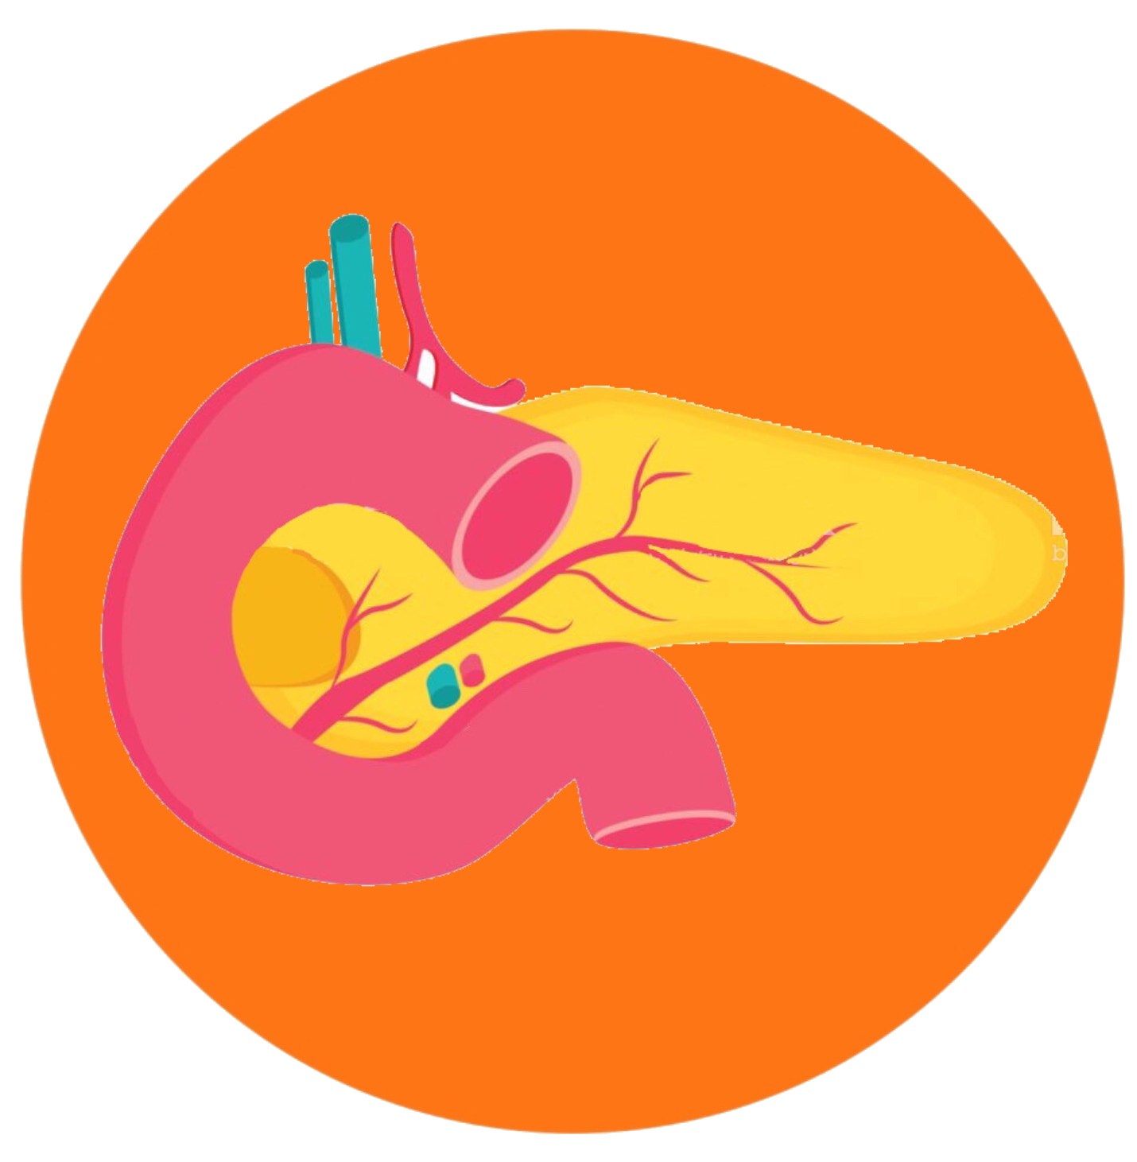
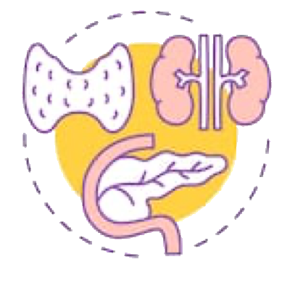
|
The clinical course and complications of thalassemia major
Anemia - is the principal feature of thalassemia major, the massive expansion of erythroid activity results in several complications:
Splenomegaly
Bony deformities
Growth retardation
Iron absorption from the gut is increased
Marked iron overload.
In thalassemia major, splenectomy is done to:
A- preserve the semi functional RBCs from degradation
B- to relieve pressure from overactive spleen
due to erythropoiesis
Results of Iron deposition due to overload:
in the myocardium → congestive cardiac failure and potentially fatal arrhythmias
in the liver → cirrhosis
in the pancreas → diabetes mellitus
in other endocrine organs → delayed puberty

Slide 12
| Treatment of β-thalassemia major
01
02
03
04
05
Transfusion
Transfusion are planned to maintain the pre-transfusion Hb concentration at 9-10g/dL or above.
Splenectomy
Splenectomy can be performed.
Iron chelator
Iron chelator, required subcutaneous infusion treatment over several hours on five days of the week.
HSCT
Hematopoietic stem cell transplantation (HSCT) is curative.
Gene therapy
(see the NEJM quick tack),click here
| Genetic counselling and antenatal diagnosis of β-thalassemia major
Antenatal diagnosis can be made early during pregnancy from an analysis of chorionic villous DNA (at 9-12 weeks) or amniocyte DNA
(at 13-16 weeks), or later using DNA from blood obtained from an 18- 20-week-old fetus.
Newer techniques focus on the
non-invasive analysis of fetal DNA
in the maternal circulation.
A pre-marital screening, national program, is one of the major intervention leading to reduced incidence of beta thal major.

Slide 13
| Structural Hemoglobin Variants
Over 1000 abnormal hemoglobin variants have been reported. The majority of structural Hb variants are the consequence of a single-point mutation with a single amino acid substitution in the affected globin chain (e.g. HbS, HbE, HbC and HbD).
01
When the amino acid substitution results in an overall change in the charge of the hemoglobin molecule, its migration in a voltage gradient is altered and this can be demonstrated by standard electrophoretic techniques. The speed of migration is characteristic for each abnormal hemoglobin.
02
Autosomal recessive mutation in β chain in hemoglobin
Arises when two abnormal β genes are present
Abnormal hemoglobin variants are now usually detected by high-performance liquid chromatography (HPLC). The most common structural Hb variant is hemoglobin S (HbS).
03
Hemoglobin S | Sickle Cell Trait | Sickle Cell Anemia
• A mutation in the β-globin gene results in the charged glutamic acid residue in position 6 of the normal β-chain being replaced by an uncharged valine molecule. • The interaction of sickle β-globin chains with normal α-globin chains forms HbS. • When deoxygenated, HbS is much less soluble than deoxygenated HbA, and HbS molecules polymerize, eventually forming long fibers. These result in the deformation of the cell into the well-recognized sickle shape. | • Heterozygotes (one gene for normal β-globin and one for βS) are described as having sickle cell trait. Their red cells contain between 20% and 45% HbS, the rest being mainly HbA. • Individuals with sickle cell trait are usually asymptomatic. However, spontaneous hematuria may occur occasionally due to microvascular infarctions in the renal medulla. Renal papillary necrosis may rarely occur. The red cells do not sickle until the O2 saturation falls below 40%. | • It is a descriptive name when patient have at least a copy of beta globin being S and another beta harbor any mutations (beta that/S, S/S, S/D, ect). • Homozygotes for sickle β-globin are described as having sickle-cell anemia. Their red cells contain almost exclusively HbS and NO HbA; there is a small but variable percentage of fetal hemoglobin. • Sickled red cells then occlude the microvasculature, with poor downstream perfusion and oxygenation. They may be lysed directly in the circulation, where the resulting free hemoglobin scavenges nitric oxide. • HbS are less deformable than normal red cells and this results in a chronic, extravascular, hemolytic anaemia. The Hb usually varies between 6 and 9 g/dL.
Inherited mutation; carries are protected against Plasmodium falciparum malaria

Slide 14
Different clinical and hematological abnormalities associated with some structural hemoglobin variants.
Variant | Clinical and haematological abnormalities
HbS | Recurrent painful crises (in adults) and chronic haemolytic anemia, both related to sticking or red cells on deoxygenation
HbC | Chronic haemolytic anemia due to reduced red cell deformability on deoxygenation; deoxygenated HbC is less soluble than deoxygenated HbA Present with mild anemia due to extravascular hemolysis.
Hb Köln, Hb Hammersmith | Spontaneous or drug-induced hemolytic anemia due to instability of the Hb and consequent intracellular precipitation
HbM Boston, HbM Saskatoon | Cyanosis due to congenital methemoglobinemia as a consequence of a substitution near or in the harem pocket
Hb Chesapeake, Hb Radcliffe | Hereditary polycythemia due to increased O₂ affinity
Hb Kansas | Anemia and cyanosis due to decreased O₂ affinity
Hb Constant Spring, Hb Lenore, HbE | Thalassemia-like syndrome due to decreased rate of synthesis of abnormal globin chain
Hb Indianapolis | Thalassemia-like syndrome due to marked instability of Hb
Clinical and haematological abnormalities
Chronic haemolytic anemia and consequent choleithiasis Splenic sequestration syndrome; rarely, hepatic sequestration Acute chest syndrome Cerebral infarction, TIA, intracranial haemorrhage Widespread painful vaso-occlusive crises Bone infarction (osteonecrosis) Osteomyelitis (Salmonella, staphylococcus) Chronic leg ulcers Priapism Chronic pulmonary diseases and pulmonary hypertension Haematuria, proteinuria , chronic renal failure Pregnancy: increased peripartum fetal loss, preterm births, babies small for gestational age Aplastic crisis due to parvovirus infection Proliferative sickle retinopathy (more common in HbSC disease)

Slide 15
| Diagnosis
Sickled cells are invariably present on the blood films of patients with HbSS. HbSS is made by finding;
1) A positive result with a screening test for HbS (Sickle solubility test) and
2) A peak at an appropriate position on an HPLC trace, confirmed by isoelectric focusing or hemoglobin
electrophoresis.
In young children, a classic acute painful presentation is with dactylitis, or the ‘hand-foot syndrome’, in which there is occlusion of the nutrient arteries to the metacarpals and metatarsals (Figure 4.8) and painful swelling of the hands and feet.
In the central nervous system, cerebral infarction occurs in approximately 10% of patients under the age of 20, and is a cause of significant morbidity in sickle cell patients. It has been found that children with an increased velocity of blood flow in the major cerebral vessels are at particular risk of stroke.
Dactylitis: swollen hands & feet due to vaso-occlusive infarcts in bones; common presenting sign in infants

Slide 16
| Treatment
Avoidance of factors precipitating painful crises
such as dehydration, hypoxia, circulatory stasis.
Management of the increased infection risk by immunization.
Blood transfusion when necessary.
The principles of the management of sickle cell anemia include:
Administration of folic acid daily to prevent secondary folate deficiency.
Treatment of painful crises with oral or intravenous fluids and analgesics, including opiates when necessary.
Early detection of the acute chest syndrome (blood gas measurements and chest X-ray). Exchange transfusions are often needed to lower the patient’s HbS levels and limit ongoing sickling.
Acute chest syndrome: vaso-occlusion in pulmonary microcirculation

Slide 17
| Hemoglobin E and C
Among the commonest are HbE and HbC, both of which result from single amino acid substitutions in the β-chains.
01
HbE is very common in south-east Asia (being found in about 50% of the population in some parts of Thailand).
HbC is the consequence of a glutamine to lysine substitution in the β-globin chain. HbC is also seen in homozygosity; here the hemoglobin does not polymerize as with HbSS, but can crystallize, with a resulting reduction in the flexibility of the red cell and a reduction in its survival.
02
Homozygotes have a mild anemia, low MCV, splenomegaly and many target cells in their blood film. HbC is found in patients of West African origin.
03
04
When one allele being S and other being C or E, it is an example of a sickle cell disease
(the most benign form is S/E).

Slide 18
| Quiz
Key answers: 1-B 2-C 3-B 4-D 5-C 6-B 7-B 8-A
Doctor’s questions
Doctor’s questions
1-Which ONE of the following statements is TRUE about sickle cell anemia?
The oxygen dissociation curve is shifted to the left.
It may cause ankle ulcers.
It is NOT associated with stroke.
It is NOT associated with atrophy of the spleen
2-Which ONE of the following statements is TRUE about β-thalassemia trait?
It is associated with a raised hemoglobin A2 level with normal CBC indices.
It is associated with iron overload.
It is associated with a normal reticulocyte index.
It is associated with splenomegaly.
3-Which ONE of the following statements is TRUE about beta-thalassemia?
It may cause hemoglobin H disease.
It causes a microcytic hypochromic blood picture.
It is frequently cause a hydrops fetalis.
It is very common in the Far East.
4-Which ONE of these statements is TRUE about β-thalassemia major?
It presents at birth.
It is usually caused by deletion of β globin genes.
It is associated with an increased risk of bone infarction.
It is associated with stunted growth.
5-Which ONE of the following is a feature of thalassemia intermedia?
It may be due to homozygous βo thalassemia without coinheritance alpha thalassemia.
It is not associated with extramedullary hemopoiesis.
It is usually associated with splenomegaly.
It can not cause iron overload.
6-Which ONE of these statements is TRUE concerning sickle cell trait?
It is a cause of anemia
It protects against malaria.
It is usually associated with splenomegaly.
It is a cause of frequent sickle cells in the peripheral blood
7- Which of the following statements concerning abnormalities of the hb molecules is true:
A. Alpha thalassemia is due to a deficiency of beta chain production
B. HbS is caused by a single base mutation of beta chain
C. Genes for the alpha and beta chains are located on the same chromosome
D. In thalassemia, persistence of HbF is an adverse prognostic sign
E. Bone marrow examination is the investigation of choice to diagnose hemoglobinopathy
8- The pathognomic abnormality in b-thalassemia is:
A. High level of Hb A2
B. Low level of HbF
C. Normal HbA.
D. Low serum unconugated bilirubin.
E. High urobilinogen in urine.

Slide 19
THANKS
| TEAM MEMBERS
| TEAM LEADERS
| Abdulaziz Alghamdi
| Elaf Almusahel
Amirah Alzahrani
Deema Almaziad
Jude Alotaibi
Njoud Almutairi
Nouf Albraikan
Noura Almazrou
Razan Alzohaifi
Rema Almutawa
Renad Alhaqbani
Renad Almutawa
Taif Alotaibi
Wejdan Alnufaie
Abdullah Alghamdi
Hashem Bassam
Mashal Abaalkhail
Moath Aljehani
Mohammed Alasmari
Mohammed H.Alshehri
Mohammed Alkhamees
Mohammed Alshalan
Naif Alsolais
Saud Bin Queid
= Done by
= Editor
ضلعي
= Note taker
= Textbooks note taker

