Slide 1
Hematology
438 teamwork
| Summary
Done by:
| Elaf Almusahel
| Njoud Alali
| Lamiss Alzahrani
| Muneera AlKhorayef
| Mohammed Alshalan
| Saud bin queid
Color index:
Red: Important
Gray: Extra, notes
Editing file

Slide 2
| Anemia
erythropoiesis | the bone marrow is the major site and it needs : Folic Acid - Vit.12 - Iron “ferrous” - Erythropoietin - Amino Acids - - Minerals and other regulatory factors
general clinical featurs of anemia | Weakness - Headache - Pallor -Lethargy - Dizziness ( those are related to anemia ) Palpitation (tachycardia) - Angina -Cardiac failure ( those are related to compensatory mechanism )
classification of anemia
Iron Deﬁciency Anemia
caused by | Limited absorption ability Excess loss due to hemorrhage
iron metabolism | absorption is controlled by hepcidin IL6 and Tfr2 (increase the release of hepcidin) hepcidin is inversely proportional to iron absorption ferroportin is the gate of iron to the circulation located in macrophages and duodenum cells stored is Ferritin and Haemosiderin
Factors affecting absorption | 1. Heam iron 4. Iron def. 2. Ferrous Iron (Fe2+) 5. Pregnancy 3. Acid 6. Hemochromatosis 7.Solubilizing agent (sugar)
Factors Redcing absorption | 1. Inorganic iron 5. Tea 2. Ferric iron Fe3+ 6. Increased hepcidin 3. Alkalines 7. Precipitating agent (phenol) 4. Iron overload

Slide 3
| Haemoglobinopathies
Normal Structure of Hemoglobin | two ‘alpha’ & and two ‘beta’. The α chains are encoded on chromosome 16. The β-like globins are encoded on chromosome 11. Fetal haemoglobin HbF (2α2γ).
Thalassemia (quantitative issue) | Two main groups depending on whether the defect lies in the synthesis. α-thalassemias. β-thalassemias.
α-Thalassemia | Each chromosome 16 has an α-globin locus consisting of two α-globin (4genes). Deletion of one or more of the α-globin genes. α+-Thalassemia trait : deletion of one α globin gene. α0-Thalassaemia trait : deletion of both α-globin genes. Hemoglobin H disease : deletion of three α-globin genes. Hb Bart’s hydrops fetalis syndrome : Loss of all four α-globin genes.
β-Thalassemia | Results from a multiplicity of different single nucleotide substitutions, insertions or small deletions affecting the β-gene itself or occasionally in promoting regions. Homozygous β-thalassemia : Defects of β-globin on both copies of chromosome 11. Marked anemia. Transfusion dependent. Heterozygous β-thalassemia.
Classification of thalassemia | Thalassemia minima. Thalassemia minor. Thalassemia Intermedia. Thalassemia major: severe anemia and are transfusion dependent.
Hemoglobin S | A mutation in the β-globin gene results in the charged glutamic acid residue in position 6 of the normal β-chain being replaced by an uncharged valine molecule. The interaction of sickle β-globin chains with normal α-globin chains forms HbS.
Sickle Cell Trait | Heterozygotes (one gene for normal β-globin and one for βS).
Sickle Cell Anemia | Copy of beta globin being S and another beta harbor any mutations. (Homozygotes).
Hemoglobin E and C | Both result from single amino acid substitutions in the β-chains.

Slide 4
| Acute leukemia
Diagnosis: Microscopy shows >20% Blast cells
Markers:
Blast cells:
1- Myeloblast
2- Lymphoblast
1- Stem cell: CD34 + TDT
2- Myeloid: MPO
3- B-Lymphoid: CD19
4- T- Lymphoid: CD3
Myeloblast
Microscopy: | Auer rods
Marker: | MPO
Age group: | Adult
disease: | Acute myeloid Leukemia
Disease fab classification
Signs & Sym | 1- Pancytopenia 2- Hepatosplenomegaly 3- Leucostasis 4- Disseminated Intravascular coagulation
Treatment | 1-Chemotherapy ( For M3 Atra/ Arsenic) 2- Stem cell replacement
AML Type | Cell Type | Karyotype/Marker | Character
M2 | With Maturation | (8,21)
M3 | Promyelocytic | (15,17) | DIC (Emergency leukemia)
M4 | Granulocytic + Monocytic | (16,16) | Gum Hyperplasia
M5 | Monoblastic + Monocytic | (9,11) | Gum Hyperplasia CNS Disease
M6 | Erythroid | CD235a
M7 | Megakaryocytic | CD41
Lymphoblast
Microscopy | Vacuolated
Marker | CD3 for T-cell - CD19 for B-cell
Age group | Children
Disease | Depends on cells type and stage
T-ALL
B-ALL
Cell stage | precursor | mature | precursor | precursor | mature
Markers | Completely Positive or negative both CD4+CD8 | CD4+CD8 One positive and other negative | Stem cell markers (CD34 + TDT) | CD34 TDT CD10 | Surface immunoglobulin
Disease | T- Acute lymphoid leukemia | T-cell lymphoma | B-ALL | Common B-ALL | Burkitt lymphoma
Karyotype | - | -
Signs
+CD3
+CD19
(4,11) (9,22) (12,21)
1- Pancytopenia 2- Lymphadenopathy
Mediastinal Mass

Slide 5
| Megaloblastic Anemia
impaired DNA synthesis which results in enlarged RBCs
Causes of megaloblastic anaemia : | Cobalamin ( B12) or Folate deficiency. Therapy with antifolate drugs (e.g. methotrexate) . Some cases of acute myeloid leukaemia, myelodysplasia .
Clinical Features of Megaloblastic Anaemia | Weakness, anorexia, weight loss, diarrhoea or constipation, tiredness, shortness of breath, angina of effort, heart failure Mild jaundice, glossitis, stomatitis, angular cheilosis Purpura, melanin pigmentation
Vitamin B 12 and folate nutrition and absorption :
 | Vitamin B12 | Folate
Dietary sources | Only food of animal origin, especially liver | Most foods, especially liver, green vegetable and yeast
Average daily intake | 7 - 30 μg | 200-250 μg
Time to develop deficiency in the absence of intake or absorption | Anaemia in 2-10 years | Macrocytosis in 5 months.
Requirements for absorption | Intrinsic factor secreted by gastric parietal cells | Conversiion of polyglutamates to monoglutamates by intestinal folate conjugase
Site of absorption | Terminal ileum | Duodenum and jejunum
Cause of deficiency | Inadequate intake Veganism Inadequate secretion of intrinsic factor ( Pernicious anaemia ) Malabsorption | Inadequate dietary intake Malabsorption Increased requirement Anticonvulsant therapy, ethanol abuse
Haematological findings in Megaloblastic Anaemia :
Peripheral Blood | Macrocytic anaemia, oval macrocytes, anisocytosis, Hypersegmented Neutrophils. Leucopenia and thrombocytopenia
Bone Marrow | Hypercellular marrow Accumulation of primitive cells Giant and abnormally shaped, metamyelocytes, polypoid megakaryocytes.
Other laboratory abnormalities | Chromosomal abnormalities , Ineffective haemopoiesis ↑ urobillinogen and faecal stercobilinogen. ↑ LDH ↑ serum iron ↑ blood carbon monoxide , ↑ serum lysozyme

Slide 6
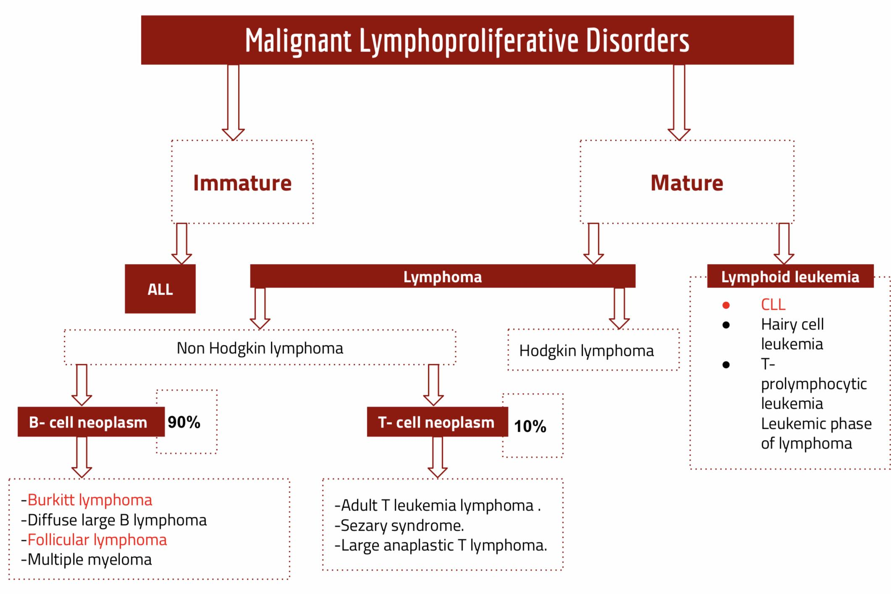
| Lymphoproliferative disorders :
Causes :
Autoimmune
Infection
Malignant
Chronic Lymphocytic Leukemia | Malignant neoplasm characterized by an increased number of small, mature lymphocytes in the blood (>5,000 ) and bone marrow Most Common Adult Leukemia Asymptomatic or Moderate lymphadenopathy and splenomegaly Small mature-appearing lymphocytes. Condensed (“soccer ball”) nuclear chromatin . Numerous “smudge cells” Autoimmune phenomena
Burkitt's lymphoma | rapidly growing and highly aggressive with extremely short doubling time (24 hrs). Highly associated with t(8;14) It is the fastest growing tumor in humans. Homogenous medium size cells with round nuclei and deeply basophilic and vacuolated cytoplasm
Follicular lymphoma | malignant proliferation of germinal center B cells Due to over expression of Bcl2 caused by t(14;18) . Present with Lymphadenopathy(100%) , splenomegaly (80%) Positive for CD10,CD20 and Bcl2 and Negative for CD5 ( in most cases). It’s accumulation disease so we don’t use chemotherapy on them
Multiple Myeloma | Malignant B neoplasm Accumulation of plasma cells in the bone marrow Production of a monoclonal immunoglobulin (Ig) or Ig fragments hypercalcemia due to osteoclast over stimulation and bone destruction and Lytic Bone lesions .
Classical Hodgkin | Indolent malignant lymphoma presence of few large binucleated cells (Reed-Sternberg ) surrounded by reactive cells (lymphocytes, plasma cells ,eosinophils) Involving cervical lymph nodes in young adults (most often )

Slide 7
| Polycythemia
Polycythemia features | In Greek, “too many cells in blood. Absolute increase in red blood cell volume ( mass) Manifests itself as raised Hb or packed cell volume pcv : Hb in Men >18,5 g/dl. Hb in Women >16.5 g/dl.
Relative polycythemia | Decreased plasma volume due to severe dehydration.
Secondary polycythemia | Increased RBC mass due to high EPO. 1- COPD. 2- sleep apnea 3- smoking 4- high altitude 5- Renal disease 6- EPO secreting tumor ( parathyroid adenoma
Polycythemia Vera | Increase RBC mass due to malignant proliferation.
Clinical features of PV | Thrombosis. Myocardial infarction. Hepatomegaly. Splenomegaly. Increased blood viscosity. Hypertension . Headache, dizziness, visual disturbances,paresthesia.
Myeloproliferative Neoplasm (MPN) | Increased red blood cell production independent of the mechanisms that normally regulate erythropoiesis.
Primary myeloﬁbrosis | It is a clonal MPN characterized by a proliferation of Megakaryocytes & Granulocytes in the bone marrow that is associated with: Deposition of fibrous connective tissue Extramedullary hematopoiesis Clinical features: Massive splenomegaly. JAK2 mutation. Anemia. Risk of AML transformation.. Leukoerythroblastic.
Essential Thrombocythemia | An MPN that involves primarily the megakaryocytic lineage & is characterised by sustained thrombocytosis. diagnostic features: Sustained thrombocytosis. Hypercellular BM with megakaryocytic proliferation. JAK2 mutation. Clinical Presentation: Asymptomatic. Mild splenomegaly. Thrombosis. Mild hepatomegaly. Bleeding.

Slide 8
| Approach to Hemolysis
Hemolytic Anemia: is a shorten in lifespan of RBC that can’t be compensated by bone marrow.
Extravascular Haemolysis involves RBC destruction by reticuloendothelial system (The majority of hemolytic anemia) | Intravascular Haemolysis involves destruction of RBCs within vessels.
Hyperbilirubinemia (unconjugated)
Increase Serum Lactate dehydrogenase (LDH,marked in intra)
Reticulocytosis: Increased reticulocyte count. Which indicates increased erythropoietic activity.
examination of the bone marrow shows: 1-increased Erythropoiesis 2-Erythroid hyperplasia.
Spherocytosis on the peripheral blood film. (Spherocyte) | Reduction of serum Haptoglobin
 | Hemoglobinuria, Haemoglobinaemia and Hemosiderinuria .
 | Schistocytes: red cell fragmentation
Classiﬁcation of Hemolytic Anemias
Congenital The defect is intrinsic to RBC itself, affecting Red cell: | Membrane | Hereditary spherocytosis (HS) Most common |  | Causes: loss of Ankyrin then leads to secondary reductions in spectrin, and protein 4.1 leading to a spheroid shape, vertical. Destroyed by splenic macrophages, extravascular hemolysis. Peripheral smear shows spherocytosis.
 |  | Hereditary Elliptocytosis (HE) |  | Causes: defects in α spectrin, horizontal interaction.
 |  | Hereditary Pyropoikilocytosis (HPP)
 | Its Enzymes | G6PD Deﬁciency (mutations in the G6PD gene on the X chromosome) |  | Favism: causes an acute hemolytic anemia after the ingestion of the broad bean in G6PD deficiency patients. Affects children. Severe anemia develops & accompanied by hemoglobinuria. Blood film shows: 1-Heinz bodies 2- Bite cells (in a patient who had received primaquine).
 | Its hemoglobin | Sickle cell anemia
Acquired Acquired causes, are typically due to extrinsic defects, outside the red cell (except *PNH) | Immune | Autoimmune | warm Autoimmune hemolytic anemia (AIHA) | autoantibodies react best with the red cell antigen at 37ºC and are usually of IgG. Secondary to: SLE and CLL. Peripheral smear shows spherocytosis.
 |  |  | Cold Hemagglutinin Disease (CHAD) | antibodies react best below 32ºC, they are usually of IgM.
 |  | Alloimmune
 | Non-immune | Some drugs

Slide 9
| Bleeding disorders
 | Disorders |  | Characteristics | Clinical features | Diagnosis | Treatment
Congenital/inherited Bleeding disorders | Hemophilia A (factor VIII deficiency) |  | an abnormality in the factor VIII gene on X-chromosome. Factor VIII is only found complexed with VWF. | post‐circumcision haemorrhage. haemarthroses and muscle haematomas. joint deformity and disability. Intracranial bleeding. | normal PT and prolonged APTT. (Suggestive test) factor VIII coagulant activity assay with normal VWF. (Confirmatory test). | intravenous injections of the deficient factor.
 | Hemophilia B (factor IX deficiency) |  | an abnormality in the factor IX gene on X-chromosome. |  | normal PT and prolonged APTT. Factor IX level assay.
 | VWB | Type 1 partial reduction (AD) Type 2 qualitative abnormalities (AD or AR) Type 3 absence of VWF (AR) | binds platelets to subendothelial tissues. It acts as a carrier for factor VIII. The reduction in VWF results in a reduction in factor VIII concentration (can be misdiagnosed as hemophilia A). |  | Prolonged PFA closure time. prolonged APTT . Reduced factor VIII. Reduced levels of VWF antigen or activity. Impaired ristocetin-induced platelet aggregation.
Acquired Bleeding disorders | DIC |  | high concentrations of FDPs, including D-dimers. |  | The platelet count is low. Fibrinogen concentration is low. RBCs fragments in blood smear.
 | Acquired hemophilia
 | Liver diseases
 | Vit K deficiency
Correlation of coagulation factor activity and disease severity in haemophilia A or B
Coagulation factor activity (percentage of normal) | Clinical manifestations
<1 | Severe disease with Frequent spontaneous bleeding.
1–5 | Moderate disease, Bleeding after minor trauma.
>5 | Mild disease, Bleeding only after significant trauma, surgery.

