Slide 1
SALIVARY GLANDS
Objectives:
Describe the microscopic structure of the major salivary glands in correlation with function.
Editing file
Important
Doctor notes / Extra

Slide 2
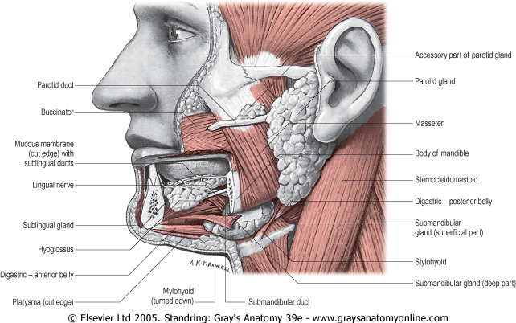
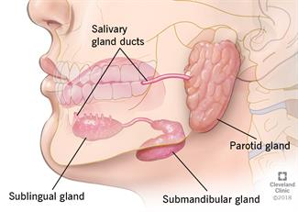
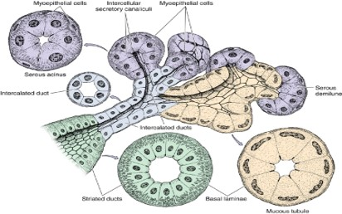
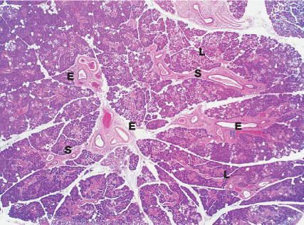
Types Salivary Glands
General Structure
Major Salivary Glands:
Parotid.
Submandibular.
Sublingual.
Minor Salivary Glands:
Labial (lips)
Lingual (tongue)
Buccal (cheek)
Palatine (Palate)
Produce 5% of salivary output.
Most of them are pure mucous or seromucous glands.
Stroma:
C.T. capsule.
C.T. septa dividing the glands into lobes and lobules.
Reticular C.T.
Parenchyma:
Acini. (secretory unite)
Duct system.

Slide 3
Types of Salivary Acini
Serous Acini: | Mucous Acini: | Mucoserous (Mixed) Acini:
Contain only serous cells. Small, spherical, and with a narrow lumen. Secrete serous secretion thin fluid rich in enzymes, such as amylase and lysozyme. | Contain only mucous cells. Larger, more tubular, and with a wider lumen. Secrete mucous secretion. thick viscid secretion and rich in mucin | Mucous acini with a cap of serous cells (serous demilunes). Half moon shape

Slide 4
Cells of Salivary Acini
Serous cells | Mucous cells | Myoepithelial cells (basket cells):
Pyramidal in shape. Nuclei are round and basal. Cytoplasm: Deeply basophilic (due to numerous RER), with apical acidophilic secretory granules (rich in salivary amylase). | Pyramidal or cuboidal. Nuclei are flattened and basal. Cytoplasm: Pale basophilic and vacuolated (foamy) (due to dissolved mucinogen secretory granules). | Contractile cells that embrace the basal aspect of the acini. Their contraction releases the secretion into the duct system.

Slide 5
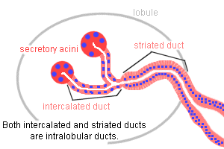
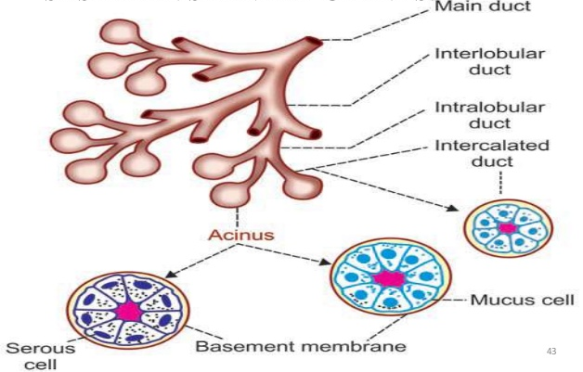
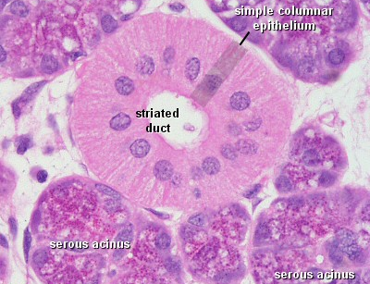
Duct System of Salivary Glands
1. Intralobular ducts (prominent):
Intercalated ducts: lined by small cuboidal cells.
Striated ducts: lined by low columnar cells.
2. Interlobular ducts:
lined by simple columnar epithelium.
3. Main duct:
lined by stratified columnar epithelium which becomes stratified squamous (nonkeratinized) in the distal end.

Slide 6
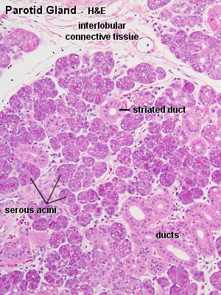
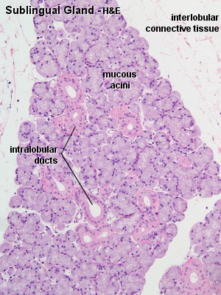
Major Salivary Glands
Parotid Gland | Submandibular Gland | Sublingual Gland
The largest salivary gland. Produces 30% of salivary output. Purely serous. Prominent intralobular ducts. Secretion rich in: Amylase. Lactoferrin. Lysozyme. Secretory IgA. Defensive enzymes lactoferrin (prevents bacteria from utilizing iron), IgA (antibody), and lysozyme (attacks bacterial cell wall). Amylase breaks down starch | Produces 60% of salivary output. Mixed but mostly serous (90%). Mucous acini are capped by serous demilunes. | The smallest salivary gland. Produces 5% of salivary output. Mixed but mostly mucous. Mucous acini are capped by serous demilunes.

Slide 7
1.A 2.D 3.C 4.C 5.B 6.D
4- Which one of the following is lined by simple columnar epithelium.
Main duct
Intercalated ducts Of Interlobular ducts
Interlobular ducts
Intercalated ducts Of Intralobular ducts
5- Which one of the following gland secrete the most enzymes
Sublingual gland
Parotid gland
Submandibular gland
Palatine gland
6- Which of the following is true about submandibular gland
Serous gland
The largest salivary gland
Secrete enzymes
Produce most of the salivary output
1- Which one of the following is a major salivary gland:
Sublingual
Lingual
Labial
Palatine
2- Serous acini secrete :
Thin fluid rich in hormones
Thick fluid rich in enzymes
Thick fluid rich in mucin
Thin fluid rich in enzymes
3- Which of the following is true about mucous cells
Secrete serous secretion
Deeply basophilic cytoplasm
Flattened nuclei
Pale eosinophilic cytoplasm

Slide 8
Team Leaders
Good luck
Abdullah shadid
Sarah alflaij

