Slide 1
ESOPHAGUS & STOMACH
Editing file
Important
Doctor notes / Extra
Objectives:
Describe the microscopic structure in correlation with the function of the following organs:
Esophagus.
Stomach.

Slide 2
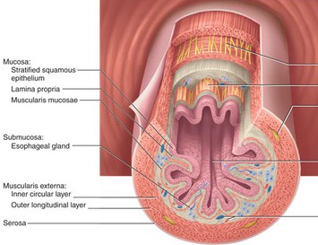
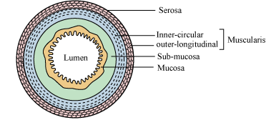
Alimentary Canal
Is the tubular portion of digestive system.
Is subdivided into: esophagus, stomach, small intestine (duodenum, jejunum and ileum), and large intestine (cecum, colon, rectum, anal canal, and appendix).
General Architecture of L/M Structure of Alimentary Canal:
Mucosa.
Submucosa.
Muscularis externa.
Adventitia OR serosa.
Adventitia: No mesothelium
Serosa: Have mesothelium

Slide 3
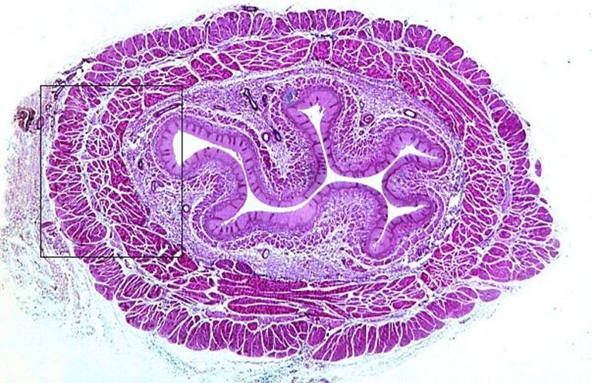
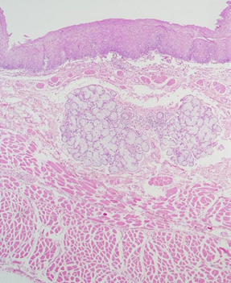
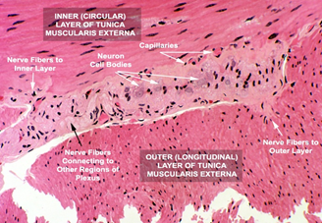
Esophagus Four concentric layers:
Mucosa | Epithelial Lining: Non-Keratinized Stratified Squamous Epithelium. Lamina propria: Loose areolar C.T. with mucosal esophageal glands (secretion of mucus) in the upper and lower ends. Muscularis mucosae: Few layers of smooth muscle fibers.
Submucosa | Loose areolar C.T. containing blood vessels, nerves, submucosal esophageal glands (secretion of mucus). Meissner’s plexus of nerve fibers and nerve cells.
Muscularis Externa | Two muscle layers: Inner circular layer & Outer longitudinal layer. Upper 1/3: both layers are skeletal M. Middle 1/3: inner layer is smooth muscle, outer layer is skeletal M. Lower 1/3: both layers are smooth M. Auerbach’s (myenteric) plexus (nerves) in between the 2 layers.
Serosa or Adventitia | Adventitia: is loose areolar C.T. not covered by mesothelium. Serosa: is loose areolar C.T. covered by mesothelium (simple squamous epithelium) in the abdominal part of the esophagus.

Slide 4
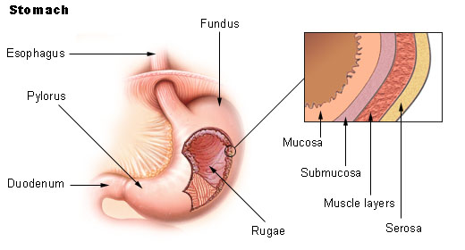
Stomach
It has 4 regions: cardia, fundus, body and pylorus.
Mucosa has folds, known as rugae that disappear
in the distended stomach.
 | Fundus (and Body) of Stomach | Pylorus of Stomach
Mucosa | is invaded by fundic glands. | is invaded by pyloric glands
 | The surface epithelium of the mucosa is simple columnar mucus-secreting cells.
Submucosa | Connective tissue containing blood vessels, nerves, and Meissner’s plexus. NO glands.
Muscularis Externa | Three smooth muscle layers: Inner oblique. Middle circular. Outer longitudinal. Auerbach’s (myenteric) plexus. | Two smooth muscle layers: Inner circular. Outer longitudinal. Auerbach’s plexus.
Serosa | C.T. covered by mesothelium.

Slide 5
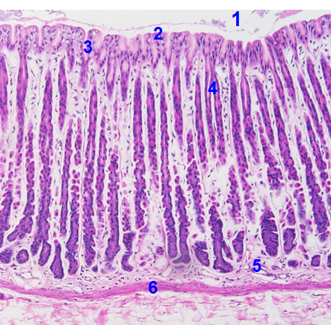
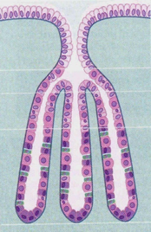
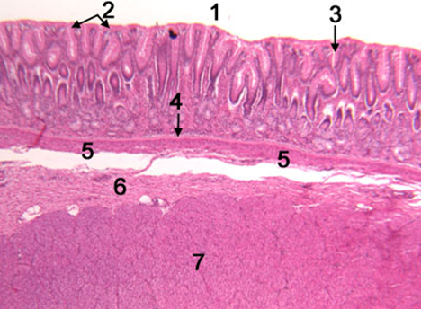
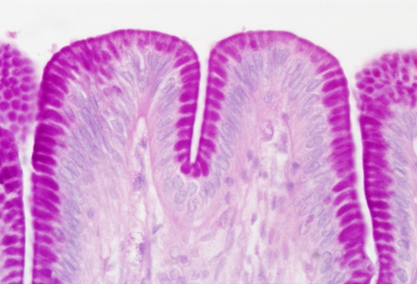
Mucosa of Fundus of Stomach | Lumen. Surface columnar epithelium. Pits of fundic glands. Fundic glands. Lamina propria. Muscularis mucosae.
Mucosa of Pylorus of Stomach | Lumen Surface epithelium Pits of pyloric glands Lamina propria Muscularis mucosae Submucosa (not in the mucosa) Muscularis externa (not in the mucosa)
Mucosa of Fundus of Stomach is composed of:
1. Surface Columnar Epithelium: Simple columnar epithelium: secretes mucus.
2. Lamina propria: C.T. invaded by numerous fundic glands with lymphoid elements.
3. Muscularis mucosae: 2 layers of smooth muscle fibers.

Slide 6
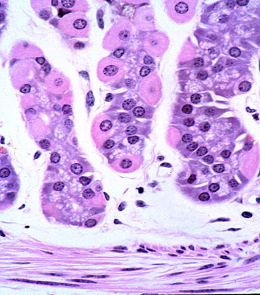
Fundic Glands (oxyntic)
Short pits (holes): one fourth of mucosa. Simple branched tubular glands. Are rich in parietal & chief cells.
Cell types
Peptic (chief) cells: The predominant cell type. Shape: Columnar cells. Nucleus: basal, round. Cytoplasm: basophilic with apical secretory granules. secrete pepsinogen. (inactive form of pepsin)
Parietal (oxyntic) cells: oxy- = acidophilic Shape: pyramidal or polygonal. Nucleus: central, round. Cytoplasm: deeply acidophilic, rich in SER and mitochondria (40% of the cell volume). C-shaped intracellular canaliculus. numerous mitochondria Secrete HCl and gastric intrinsic factor that helps absorption of vitamin B12.
Mucous neck cells: secrete mucus.
Enteroendocrine (EE) (DNES) cells: Enterochromaffin (EC) cells: secrete hormones (e.g. serotonin, endorphin).
Stem cells: regenerative cells. (renew the other cell types)
Pyloric glands
Deep pits (holes): half the length of mucosa. They are branched and convoluted, many cross sections.
Cell types
No Peptic (chief) cells
Few Parietal (oxyntic) cells
Mucous neck cells: The predominant cells
Enteroendocrine (EE) (DNES) cells: EC cells, G cells, D cells, A cells
Stem cells: regenerative cells.
rich in SER -> acidophilic
rich in RER -> basophilic

Slide 7
1.C 2.D 3.B 4A 5.C 6.A
1- which one of the following is NOT part of gastric (stomach) glands?
Peptic (chief) cells
Mucous neck cells
Simple columnar epith.
Enteroendocrine cells
2- Which of the following have Two muscle layers in it’s Muscularis Externa?
Esophagus
Fundus of stomach
Pylorus of stomach
A & C
3- Peptic (chief) cells secretes
HCl
pepsinogen
gastric intrinsic
4- The predominant cell type of fundic glands is:
Peptic (chief) cells
Parietal (oxyntic) cells
Mucous neck cells
EE cells
5- The predominant cell type of pyloric glands is:
Peptic (chief) cells
Parietal (oxyntic) cells
Mucous neck cells
EE cells
6- Cytoplasm of Parietal cells is:
Acidophilic
Basophilic

Slide 8
Team Leaders
Good luck
Abdullah shadid
Sarah alflaij

