Slide 1
BILIARY PASSAGES & PANCREAS
Objectives:es:
The student should be able to identify & describe the histological features of:
Intrahepatic biliary passages.
Extrahepatic bile ducts.
Gall bladder.
Exocrine pancreas.
Editing file
Important
Doctor notes / Extra

Slide 2
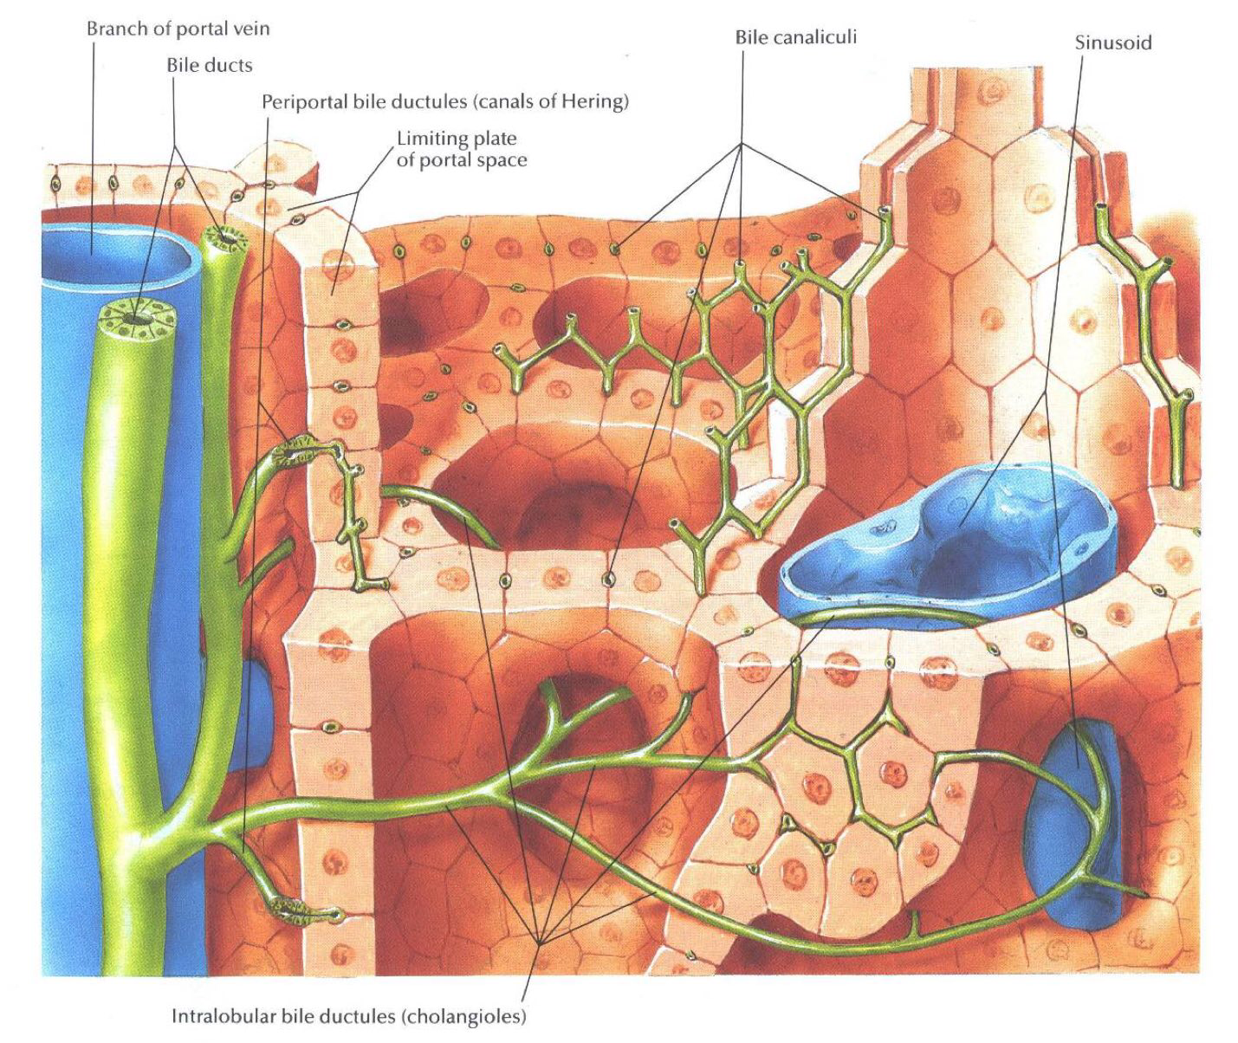
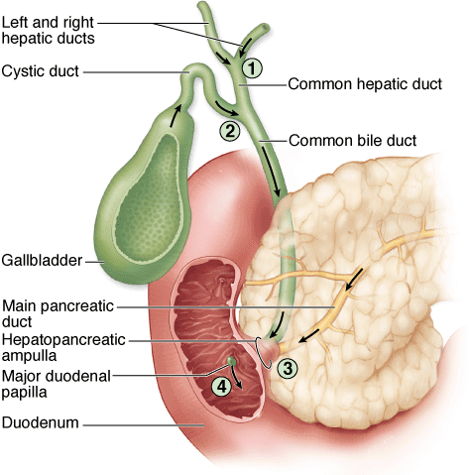
Biliary Passages
Intrahepatic passages:
1- Bile canaliculi.
2- Bile ductules (canals of Hering).
3- Interlobular bile ducts.
Extrahepatic passages:
4- Right & left Hepatic ducts.
5- Common hepatic duct.
6- Common bile duct.

Slide 3
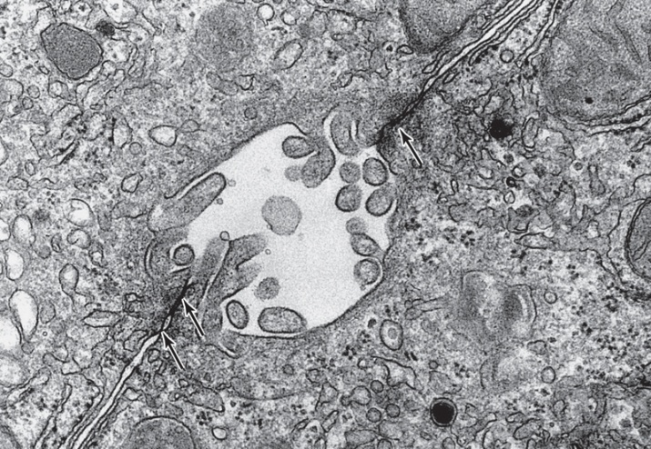
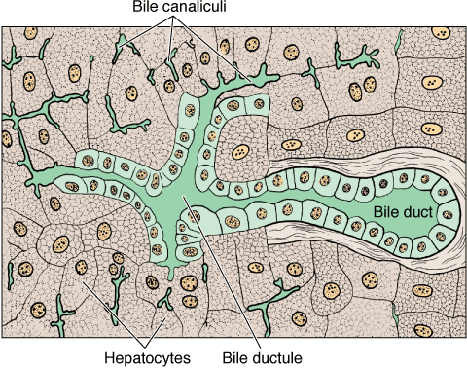
Intrahepatic passages
Bile Canaliculi | Bile Ductules (Canals of Hering) | Interlobular Bile Ducts
Narrow channels located between hepatocytes, limited only (& formed) by the cell membranes of 2 hepatocytes. They are the first portions of the bile duct system. Microvilli project from the hepatocyte into the bile canaliculi, thus increasing the surface area. Tight junctions between the cell membranes of the 2 hepatocytes prevent leakage of bile. | Near the peripheral portal areas, bile canaliculi empty into bile ductules composed of cuboidal epithelial cells called cholangiocytes. After a short distance, these ductules collect and end in the interlobular bile ducts in the portal areas | Are in the portal areas. Lined by simple cuboidal epithelium (becomes simple columnar epithelium near the porta hepatis). Interlobular bile ducts merge to form larger ducts, which eventually unite to form the right and left hepatic ducts.

Slide 4
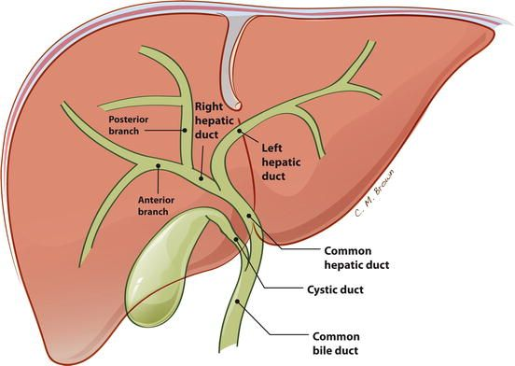
Extrahepatic passages:
Right & left Hepatic ducts. | Common Hepatic Duct | Common bile duct.
Formed by union of the right & left hepatic ducts. It joins the cystic duct, arising from the gallbladder, forming the common bile duct.
Similar in structure to the wall of gallbladder and other extrahepatic bile ducts.
Mucosa: ( no muscularis mucosae & submucosa )
Epithelium: Simple columnar.
Lamina propria.
Muscularis: bundles of smooth muscle fibers in all directions.
Adventitia.

Slide 5
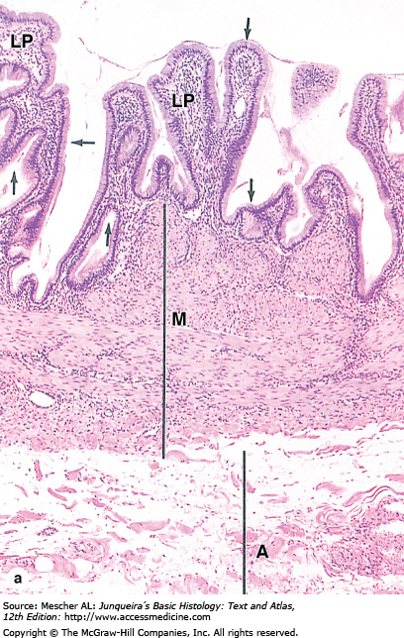
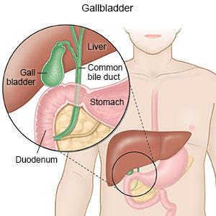
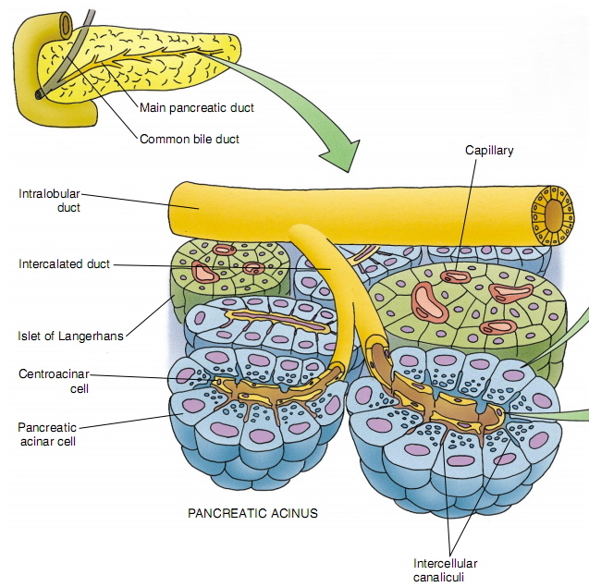
Gallbladder
A saclike structure that stores, concentrates and releases bile
Its wall is formed of:
Mucosa: highly folded.
Simple columnar epithelium.
Lamina propria: contains mucous glands in the neck of gallbladder.
Muscularis: bundles of smooth muscle fibers oriented in all directions.
Serosa or adventitia.
Pancreas
Stroma: capsule, septa & reticular fibers.
Parenchyma: Pancreas is a mixed gland:
Exocrine part (acini & ducts): produces digestive pancreatic enzymes.
Endocrine part (islets of Langerhans): produces hormones.

Slide 6
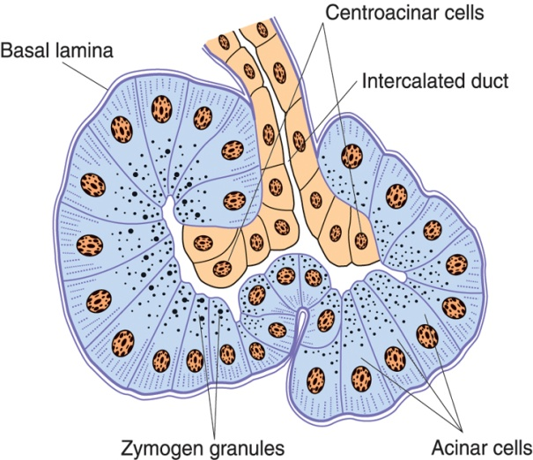
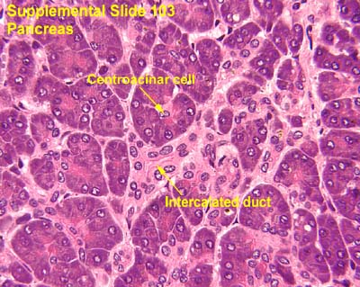
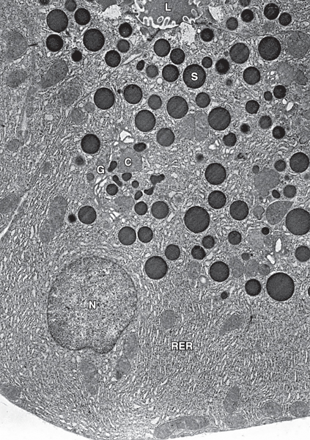
Exocrine Pancreas
Pancreatic Acini | Pancreatic Acinar Cells | Duct System:
They are serous acini: secreting a thin fluid rich in digestive pancreatic enzymes. Centroacinar cells: Their nuclei appear in the center of the acini. They represent the beginning of the ducts. No myoepithelial cells around the acini. (Stimulated by stomach hormones (hormonal Not neuronal)) | Pyramidal in shape. Nuclei are basal. Cytoplasm: Basal part basophilic (due to abundant rER). Apical part acidophilic (due to secretory granules). | Centroacinar cells.(flat cells) Intercalated ducts (low cuboidal). Intralobular ducts (NOT prominent). Interlobular ducts. Main pancreatic duct.

Slide 7
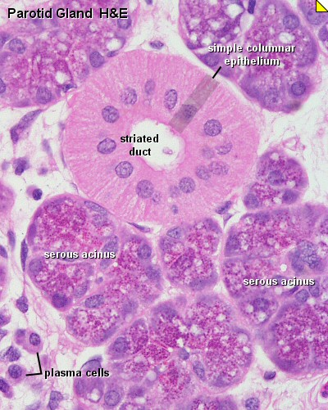
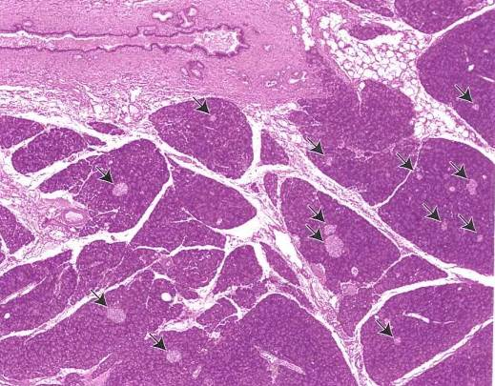
Parotid gland
intralobular duct = striated duct
Pancreas
islets of Langerhans
Under microscope we can differentiate Between parotid gland and pancreas by :
• prominent intralobular duct (in parotid gland) • islets of Langerhans (in pancreas only)

Slide 8
1.A 2.C 3.D 4.B 5.C 6.A
1- What is the lining epithelium of the gallbladder?
Simple columnar
Simple cuboidal
Simple squamous
Transitional epithelium
2- Which one of the following is Formed by union of the right & left hepatic ducts:
Interlobular bile ducts.
Common bile duct.
Common Hepatic Duct
Right bile duct
3- Which of the following is true about Bile Ductules
end in the intralobular bile ducts
composed of columnar epithelial
empty into bile canaliculi.
end in the interlobular bile ducts
4- Which one of the following is lined by simple columnar epithelium.
Bile Ductules
Common bile duct.
Interlobular Bile Ducts
A & B
5- Which cells are not found in the pancreatic acini?
Centroacinar cells
Serous cells
Myoepithelial cells
6- the Basal part of Pancreatic Acinar Cells is basophilic due to
due to abundant rER
due to abundant sER
due to secretory granules
due to myoepithelial cells

Slide 9
Team Leaders
Abdullah shadid
Sarah alflaij
Good luck

