Slide 1
SMALL & LARGE INTESTINE
Objectives:
Describe the microscopic structure of the of the small intestine , large intestine & Vermiform Appendix
Editing file
Important
Doctor notes / Extra

Slide 2
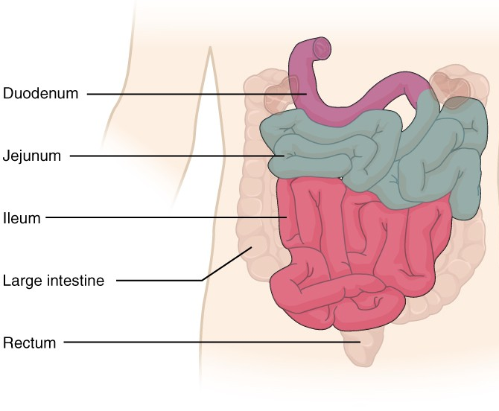
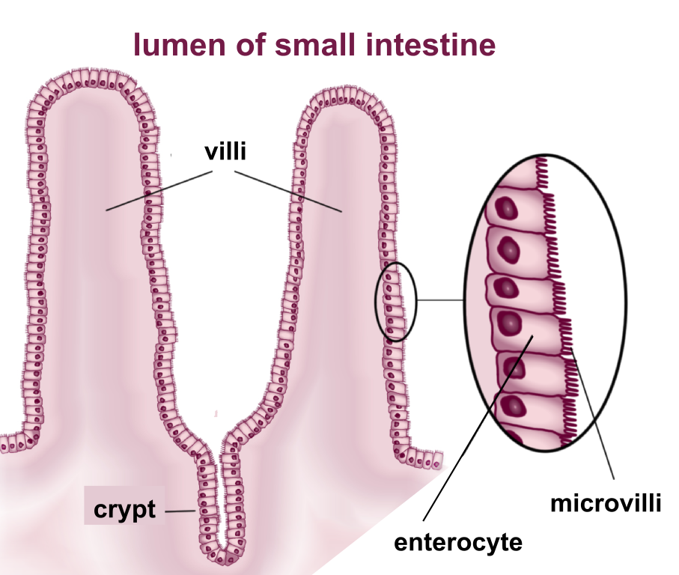
Small Intestine
It is divided into the duodenum, the jejunum, and the ileum.
the main functions of the small intestine are digestion, absorption of food and production of gastrointestinal hormones. The small intestine is 4-6 metres long in humans.
To increase surface area (To aid in digestion and absorption) the mucosa has:
Plicae circulares (circular folds): Permanent folds of the mucosa and submucosa.
Villi. only found in the small intestine
Intestinal crypts (crypts of Lieberkühn).
Microvilli (Brush border).

Slide 3
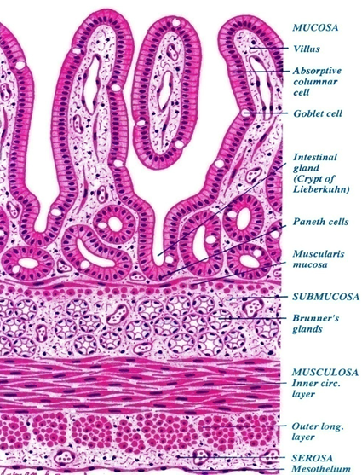
Duodenum
Mucosa | Shows villi and crypts. A- Epithelium: simple columnar epithelium with goblet cells (with brush border). B- Lamina propria: Loose areolar C.T. C- Muscularis mucosae: 2 layers of smooth muscle cells.
Submucosa | • Connective tissue containing blood vessels & nerves. • Contains Brunner’s glands (secrete mucus).
Muscularis Externa | 2 smooth muscle layers: • Inner circular layer • Outer longitudinal layer
Serosa or Adventitia | Duodenum is invested by a serosa or adventitia. 1st & 4th part = serosa , 2nd & 3rd part =adventitia
Exposed to peritoneum → Serosa
NOT Exposed to peritoneum → adventia

Slide 4
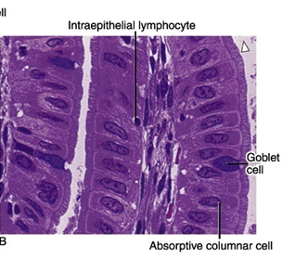
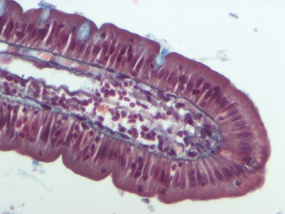
Mucosa of Duodenum
Cells Covering the Villi | 1- Surface columnar absorptive cells: They have brush border (microvilli). They are covered with thick glycocalx that has digestive enzymes. They have Junction complex (tight, adhering and desmosome junctions). 2- Goblet cells: Increase toward the ileum. 3- Enteroendocrine (EE) cells (DNES cells).
Intestinal villi | • Each Villus is a finger-like projection of small intestinal mucosa and it is formed of: 1- Central core of loose areolar C.T. containing: • Lymphocytes. • Plasma cells. • Fibroblasts. • Smooth muscle cells. • Capillary loops. • Lacteal (blindly ending lymphatic channels)(characteristic feature of the small intestine). 2- Villus-covering epithelium.
Intestinal Glands (Crypts) | • Simple tubular glands that open between villi. • Composed of 5 cell types: 1. Columnar absorptive cells. 2. Goblet cells: secrete mucus. 3. Enteroendocrine (EE) (DNES) cells: secrete hormones. 4. Paneth cells: secrete Lysozyme (antibacterial) (make the small intestine sterile) are found in the base of the crypts. 5. Stem cells: are regenerative cells. are found in the base of the crypts.

Slide 5
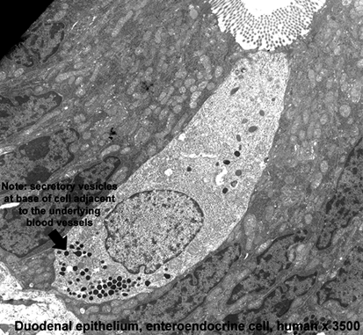
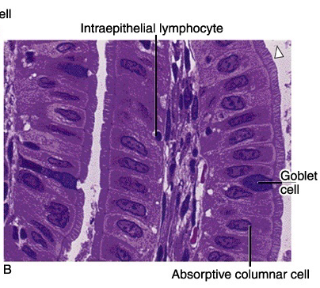
EE (DNES) cells:
M Cells (Microfold cells) (immune cells) antigen presenting cell
EC cells: secrete endorphin and serotonin.
S cells: secrete secretin.
D cells: secrete somatostatin.
A cells: secrete glucagon.
Mo cells: secrete motilin.
CCK-PZ cells: secrete cholecystokinin (pancreozymin)
They are mainly found within the intestinal epithelium overlying lymphatic nodules of lamina propria. Each is a dome-shaped cell (or specialized squamous cell) with a basal concavity that contains intraepithelial lymphocytes and macrophages. They phagocytose and transport antigens present in the intestinal lumen to the underlying lymphoid tissue cells to initiate the immune response to these antigens leading to the secretion of IgA.

Slide 6
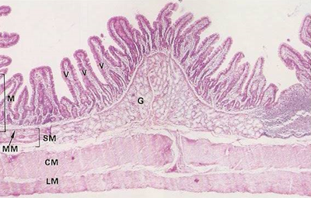
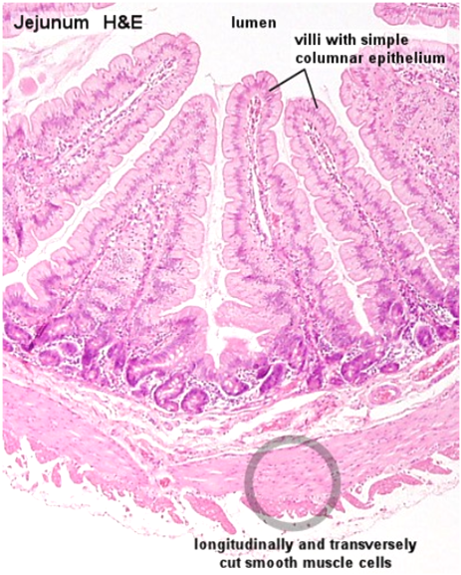
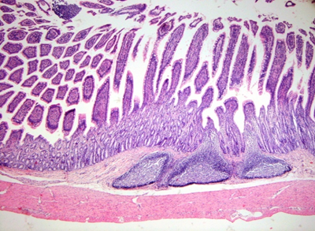
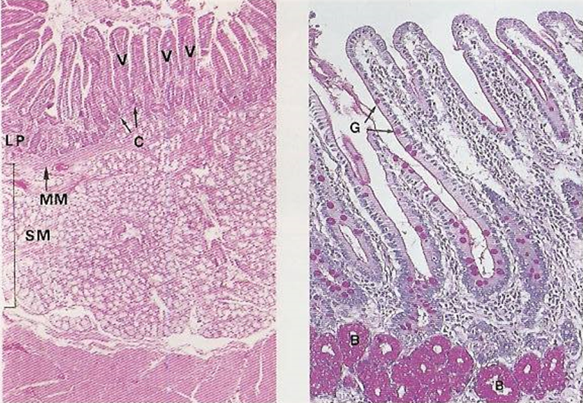
Regional differences of small intestine
Duodenum | Jejunum | Ileum
Its submucosa has Brunner’s glands. It is invested by serosa or adventitia. | has neither Brunner’s glands nor Peyer’s patches. Jejunum is invested by serosa. | Its lamina propria, opposite the attachment of the mesentery, lymphoid nodules (Peyer's patches) that extend to the submucosa. Ileum is invested by serosa. the peyer's patches are found in half of the circumference

Slide 7
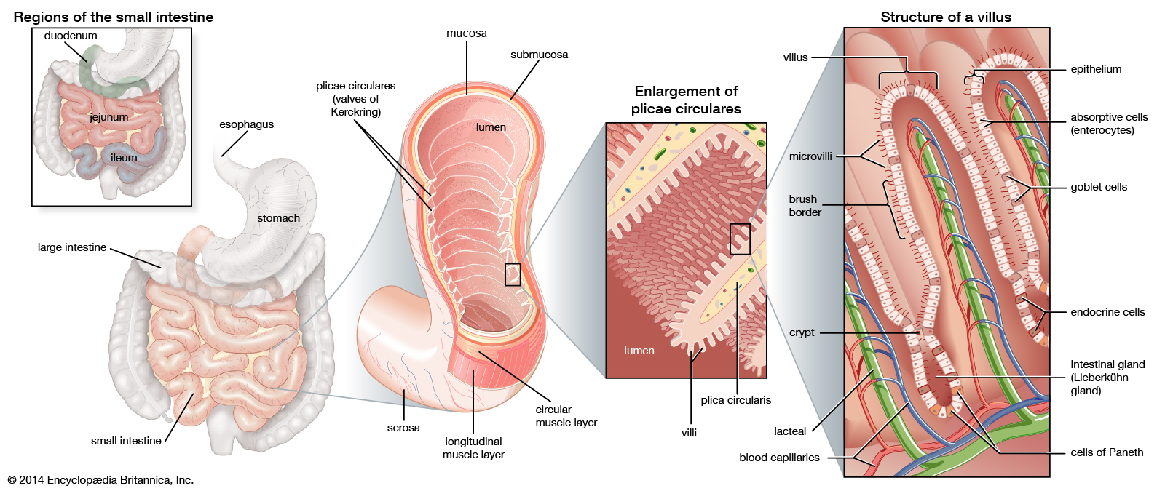

Slide 8
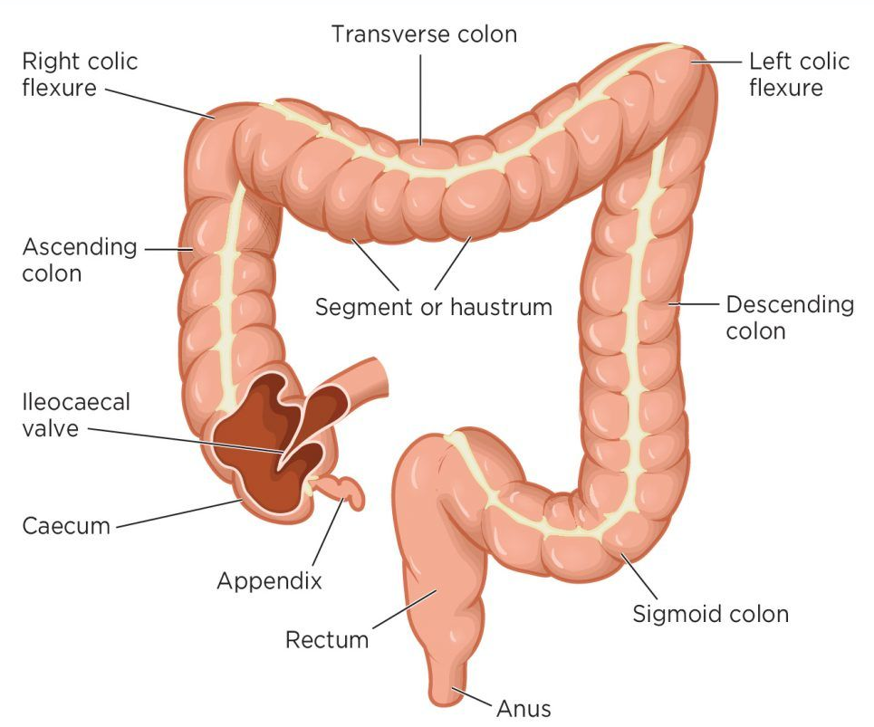
Large intestine
It is divided anatomically into:
Appendix
Cecum
Colon (ascending, transverse, descending & sigmoid)
Rectum
Anal canal.

Slide 9
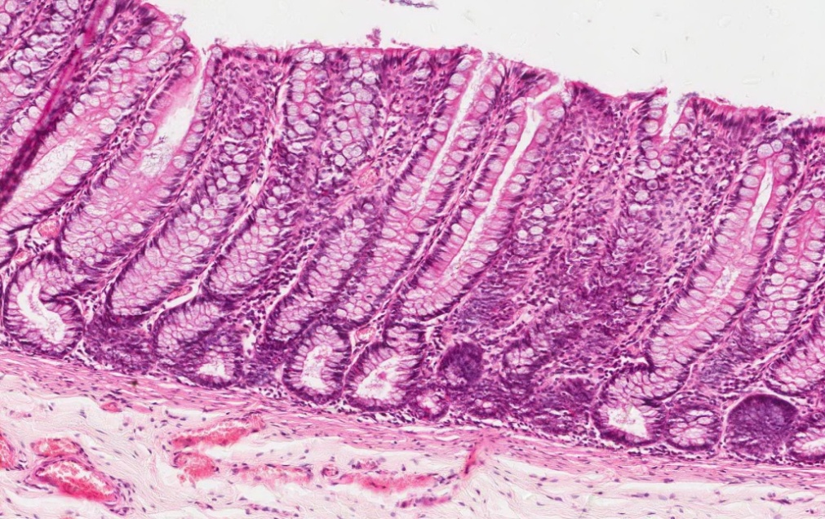
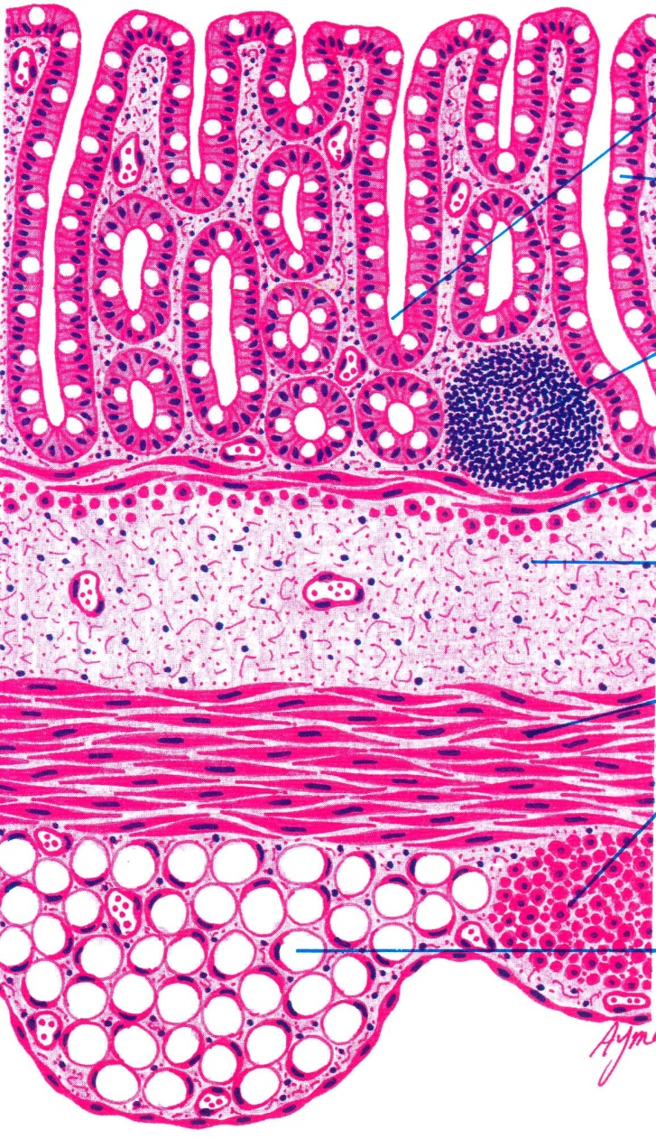
Colon
Mucosa | Shows only crypts (NO villi) Epithelium: simple columnar epithelium with numerous goblet cells. Lamina propria: Connective tissue containing numerous crypts. Cells of the crypts are the same as in small intestine but NO Paneth cells. Lymphatic nodules (solitary): frequent. Muscularis mucosae: 2 layers of smooth muscle.
Submucosa | NO glands. (Submuosal glands are only in esophagus and duodenum) Meissner’s nerve plexus.
Muscularis Externa | Inner circular & outer longitudinal smooth muscle layers. The longitudinal layer is not continuous but in the form of 3 longitudinal ribbons or bands (teniae coli). Auerbach’s nerve plexus.
Serosa | C.T. covered by mesothelium. Has fat-filled pouches (pendulous masses) called appendices epiploicae.

Slide 10
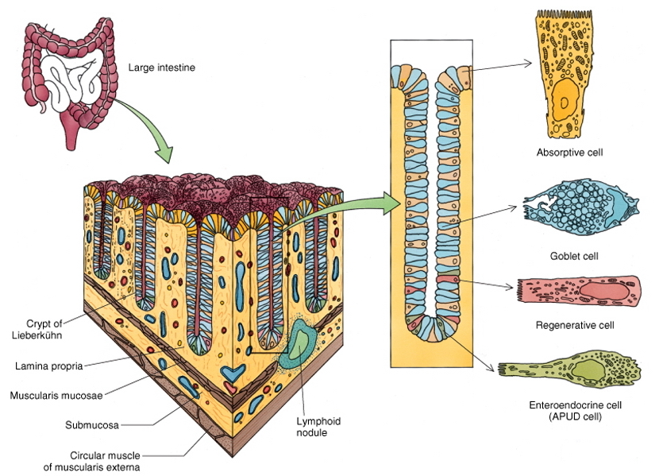
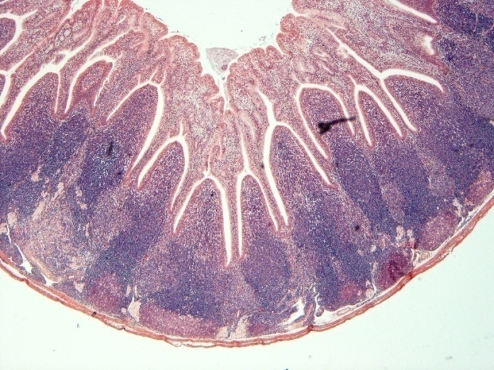
Intestinal Crypts of Colon
Cells lining the crypts are:
1. Surface columnar absorptive cells. most prominent
2. Goblet cells.
3. Enteroendocrine cells.
4. Stem cells.
5. M-cells.
Vermiform Appendix
Similar to the colon, but with much smaller diameter, shallow crypts, more lymphoid nodules (aggregated lymphoid nodules, all around, in lamina propria and extending into submucosa),
Cells lining the crypt are same as Intestinal Crypts of Colon with Few goblet cells and many EE cells.
Muscularis mucosae: Not continuous.
Muscularis externa:
No teniae coli. continuous.
It is invested by serosa.

Slide 11
1.C 2.C 3.C 4.B 5.C 6.A
1- Duodenum is covered by?
serosa
adventia
A & B
None
2- Which of the following is true about duodenum ?
Goblet cells decrease toward the ileum
No goblet cell
Goblet cells increase toward the ileum
Brunner’s glands in mucosa
3- submucosal glands are found in :
colon
ileum
esophagus
stomach
4- Paneth cells are found in :
submucosa of the duodenum
mucosa of the duodenum
mucosa of the Jejunum
Ileum
5- Peyer's patches are found in:
Duodenum
Jejunum
Ileum
ALL
6- help sterile the small intestine:
Paneth cells
Brunner’s glands
Goblet cells
Stem cells

Slide 12
1.A 2.C 3.C 4.A 5.A 6.B
1- What is the lining epithelium of the colon ?
Simple columnar with goblet cell
Simple columnar
Simple squamous
Transitional epithelium
2- Which one of the following is true about Vermiform Appendix?
has teniae coli
has many goblet cells
is covered by serosa
continuous Muscularis mucosae
3- Which of the following is true about colon?
is covered by adventitia
composed of squamous epithelium
The longitudinal muscle layer is not continuous
has submucosal glands
4- Which one of the following has mucosal villi?
small intestine
colon
stomach
Vermiform Appendix
5- appendices epiploicae of the colon are found in :
serosa
adventitia
mucosa
Muscularis Externa
6- the Lymphatic nodules are found in which layer of the colon?
serosa
lamina propria
submucosa
Muscularis mucosae

Slide 13
Team Leaders
Good luck
Abdullah shadid
Sarah alflaij

