Slide 1
LIVER & SPLEEN
Objectives:
The histological structure of liver and spleen
Getting the academic to kick me
out of the reviewing team
Editing file
Important
Doctor notes / Extra
Random song lyrics
jk there is none, but you fell for that lolololololol

Slide 2
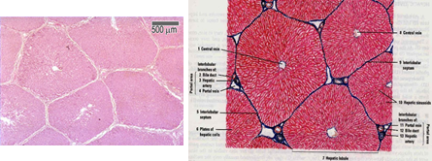
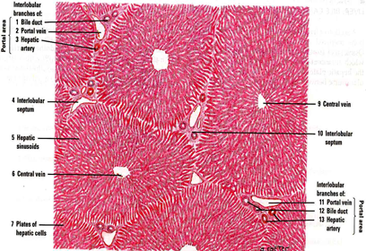
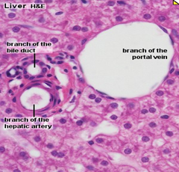
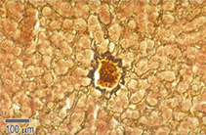
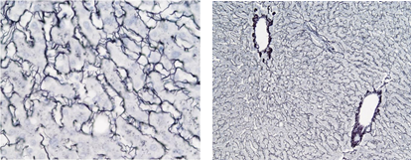
Liver
Stroma | Parenchyma; Classical liver (hepatic) lobules: It is formed of a polygonal mass of liver tissue, bounded by interlobular septa with portal areas at the periphery & central (centrolobular) vein in the center.
a- Capsule: Glisson’s Capsule. b- Septa (C.T.) (absent in human) & Portal areas (Portal tracts). c- Network of reticular fibers. (also found in spleen & bone marrow & lymph nodes) Reticular CT = collagen type 3 | Contents of the Classic Liver Lobule: | Borders of the Classical Liver Lobule:
 | 1- Anastomosing plates of hepatocytes. 2- Liver blood sinusoids (hepatic blood sinusoids): In between the plates. 3- Spaces of Disse (perisinusoidal spaces of Disse). 4- Central vein. 5- Bile canaliculi. | 1- Septa: C.T. septa (e.g. in pigs). 2- Portal areas (Portal tracts) (Portal triads): Are located in the corners of the classical hepatic lobule (usually 3 in No.) it contains: a- C.T. b- Bile ducts (interlobular bile ducts). c- Venule (Branch of portal vein). d- Arteriole ( Branch of hepatic artery).
Pig’s liver

Slide 3
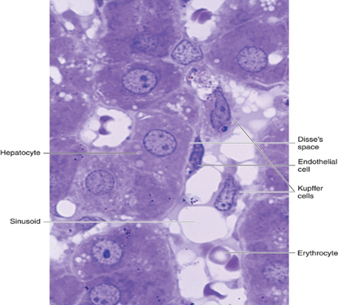
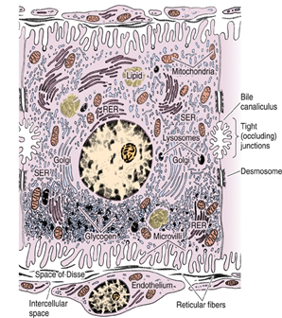
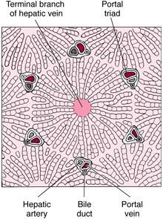
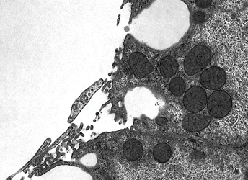
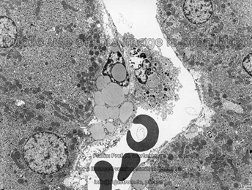
Contents of the Classic Liver Lobule:
Anastomosing plates of hepatocytes |  | Liver blood sinusoids (In between the plates) | Spaces of Disse (perisinusoidal spaces of Disse) | Central vein | Bile canaliculi
Hepatocytes (LM) Are grouped in interconnected plates. ■ Liver sinusoids are located in the spaces between these plates. ■ Are polyhedral in shape. ■ Nucleus: 1 or 2, vesicular (large & pale) with prominent nucleoli. ■ Cytoplasm: acidophilic. | Hepatocytes (EM) Organelles: 1- Mitochondria: ++++ 2- ER (sER & rER): abundant. 3- Golgi complex. 4- Lysosomes. 5- Peroxisomes. Inclusions (Deposits): 1- Glycogen 2- Lipid (few droplets) 3- Lipofuscin (old age) | (1) Endothelial Cells: – Fenestrated & discontinuous → free passage of plasma. – Basal lamina is absent. (2) Kupffer Cells: – Are macrophages. – Are found on the luminal surface of the endothelial cells. – Function: phagocytosis. | Contents: 1- Microvilli of hepatocytes. 2- Plasma of blood. 3- Hepatic stellate cells (Ito cells) (Fat-storing cells): – contain vitamin A-rich lipid. – form reticulin (reticular fibers). 4- Reticular fibers: (type III collagen). 5-Natural Killer (NK) cells. | - | formed by the membranes of 2 adjacent hepatocytes for bile passage, and is secured by desmosomes to prevent leakage of bile into sinusoid. leakage → cause jaundice.

Slide 4
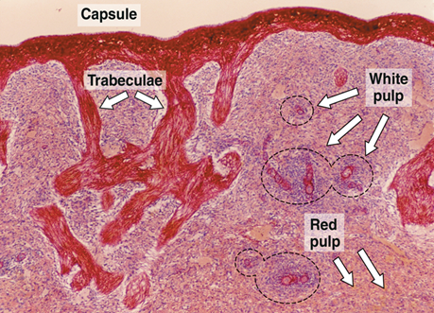
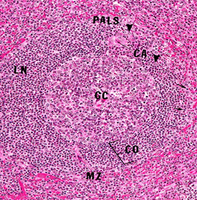
Spleen
Stroma | Parenchyma No cortex, No medulla, No afferent lymphatic vessel.
1- Capsule: – is covered by visceral layer of peritoneum; mesothelium – Is formed of fibromuscular C.T. (Dense fibrous C.T. + SMCs (smooth muscle cells). 2- Trabeculae: Are irregular, incomplete, divide the spleen into intercommunicating compartments (lobules). 3- Reticular C.T. | White pulp | Red pulp
 | 1- Periarterial lymphatic sheaths (PALS): housing (programmed) T lymphocytes. 2- Lymphoid follicles (with germinal centers): housing B lymphocytes. N.B. Both 1&2 have the eccentrically located central artery (central arteriole) (follicular arteriole). | 1- Splenic (pulp) cords: Extravasated blood cells, plasma cells, macrophages & reticular cells and fibers. 2- Splenic blood sinusoids: Are lined with elongated fusiform endothelial cells with large intercellular spaces & supported by discontinuous, circular basement membrane.
 | Cells of parenchyma of spleen
 | 1. Lymphocytes. 2. Plasma cells. 3. Macrophages. 4. Blood elements (RBCs, leukocytes and blood platelets).
ew foundation

Slide 5
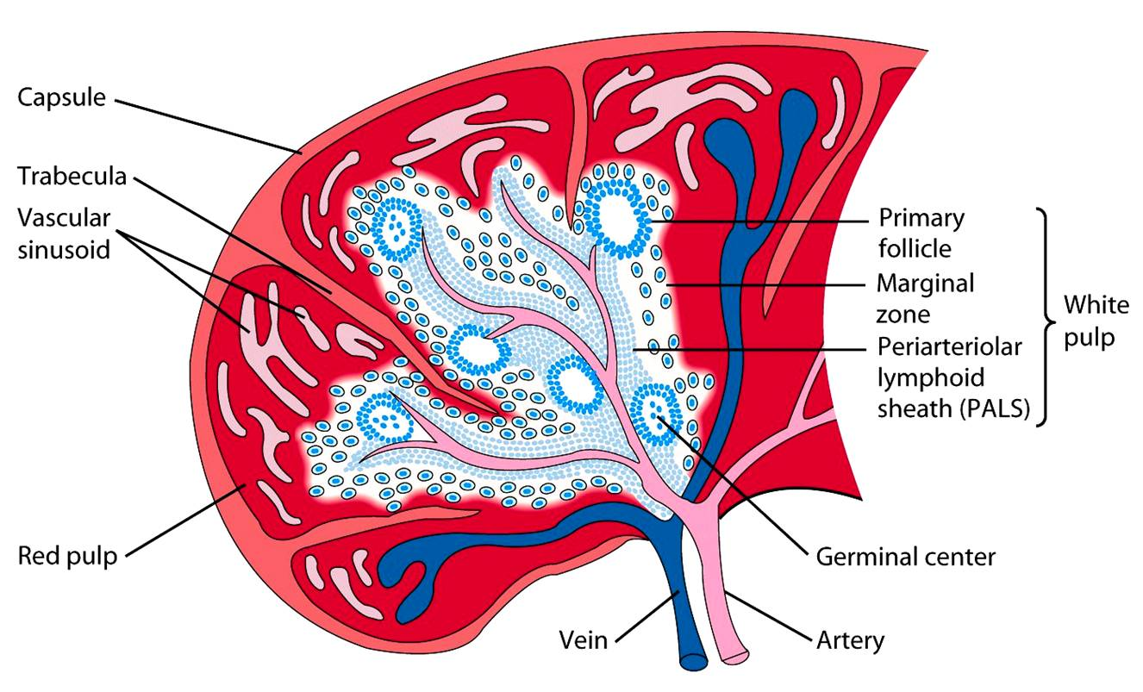
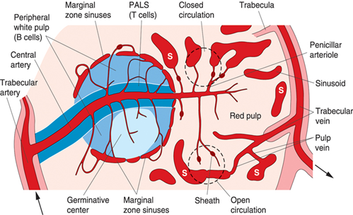
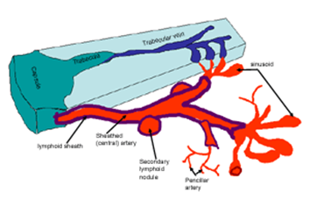
Splenic microcirculation
open circulation → free blood
close circulation → sinusoid

Slide 6
1.C 2.B 3.C 4.A 5.A 6.A
1- What is the Function of kupffer cells?
fat storage
form reticulin (reticular fibers)
phagocytosis
bile passage
2- Which one of the following have SMCs in it’s capsule?
liver
spleen
A&B
None
3- Endothelial cells of liver blood sinusoids are:
Basal lamina + fenestrated
Basal lamina + Not fenestrated
No basal lamina + fenestrated
No basal lamina + Not fenestrated
4- Which of the following is correct?
Periarterial lymphatic sheaths house T lymphocytes.
Periarterial lymphatic sheaths house B lymphocytes.
Lymphoid follicles house T lymphocytes.
A&C
5- Which of the following is true about Hepatocytes?
Acidophilic cytoplasm + polyhedral
basophilic cytoplasm + polyhedral
Acidophilic cytoplasm + few ER
A&C
6- The Portal triad contain:
Bile ducts + Venule + Arteriole + C.T.
Bile ducts + Nerves + Arteriole
Reticular fiber + Venule + Arteriole + C.T.
Bile ducts + Central vein + Arteriole

Slide 7
Team Leaders
Good luck
See you in the OSPE :)
“Life is too short to be sad, now show me that beautiful smile you nerd’ - Supposedly secret lec reviewer
but nah forreal tho go do something fun y’all really deserve it
and no I’m not writing these things cause I’m avoiding studying shut up
Help.
Abdullah shadid
Sarah alflaij

