Slide 1
Hemoflagellates:
Leishmaniasis & Trypanosomiasis
Lecture objectives:
1. Leishmaniasis
Know different stages of Leishmania parasites
Describe life cycle of Leishmania parasites
Discuss what diseases caused by Leishmania parasites and what is endemic in Saudi Arabia
Geographical distribution of Leishmania in the world either cutaneous or visceral
Leishmaniasis
Know what are the vectors of Leishmania
Discuss clinical types of Leishmaniasis
Know uncommon types of the diseases
How Leishmaniasis is diagnosed in the labs
What is the best treatment for Leishmaniasis
2. trypanosomiasis
Know stages of Hemoflagellates
Know geographical distribution of African sleeping sickness
Describe life cycle of African trypanosomiasis
Discuss pathology and diagnosis of African sleeping sickness
Describe life cycle of American trypanosomiasis.
Know signs and symptoms and how to diagnose American trypanosomiasis
discuss the treatment of trypanosomiasis.
Summarize major filarial infections of Humans.
Describe life cycle of Onchocerca volvulus.
Know pathology, diagnosis and treatment of onchocerciasis.
Discuss pathology caused by lymphatic filariasis
Describe life cycle of Wuchereria bancrofti.
Know about diagnosis and treatment of lymphatic filariasis.
Describe life cycle of Loa loa and how it diagnosed and treated
Color index:
Important
Found in Girls’ slides
Doctors’ note
Found in Boys’ slides
Extra
EDITING FILE

Slide 2
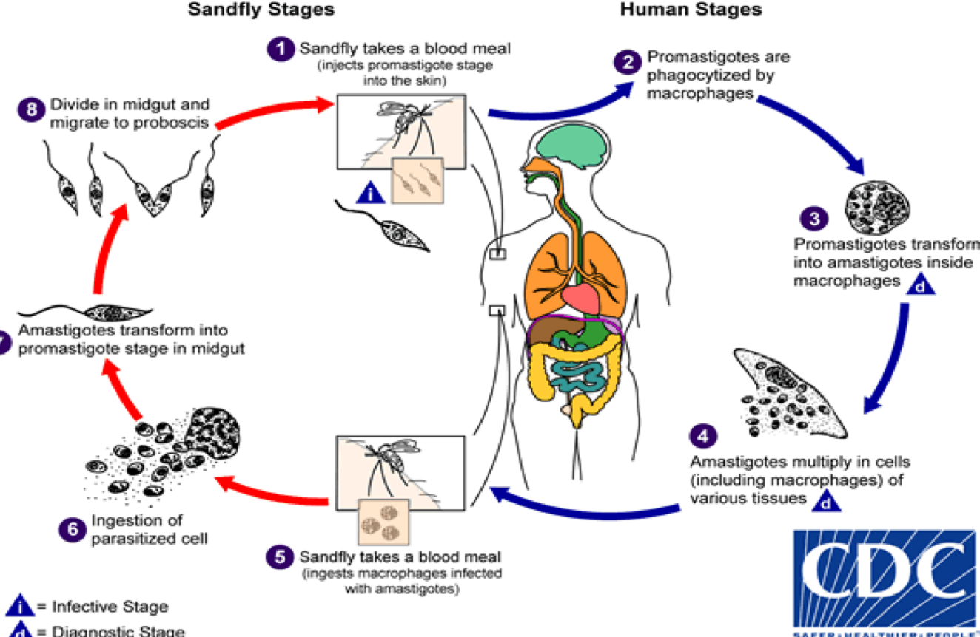
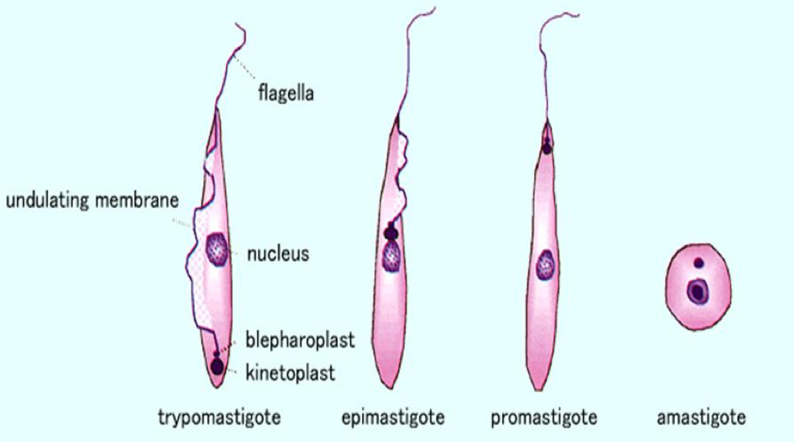
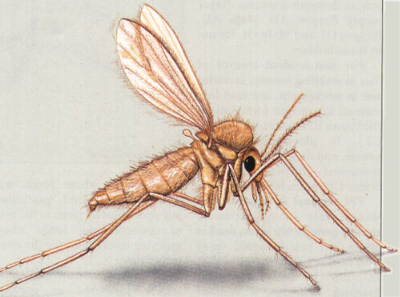
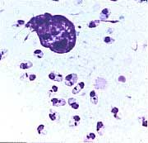
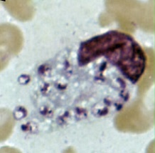
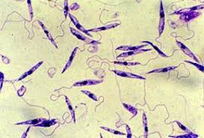
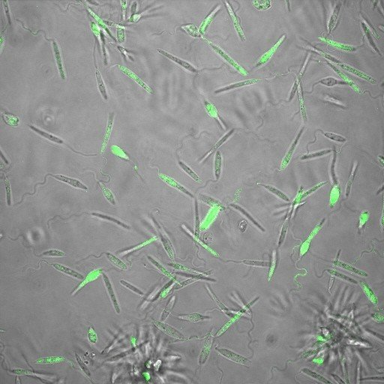
What is the biological vector/intermediate host for leishmaniasis? Female Sandfly
Infective stage: Promastigote
Diagnostic stage: Amastigote
????
Leishmaniasis
1
Introduction:
A parasitic disease caused by the Leishmania parasite.
This parasite typically lives in infected sand flies.
You can contract leishmaniasis from a bite of an infected sand fly.
The sand flies that carry the parasite typically reside in tropical and subtropical environments.
have occurred in areas of Asia, East Africa, and South America¹
The disease can present in three main ways : Cutaneous leishmaniasis, Mucocutaneous leishmaniasis and Visceral leishmaniasis
Different species of the Leishmania parasite are associated with each form. Experts believe that there are about 20 Leishmania species that can transmit the disease to humans.
Life cycle
Infective stage : promastigote
Diagnostic stage : Amastigote²
Leishmania species
Cutaneous Leishmaniasis
Mucocutaneous leishmaniasis
Visceral
leishmaniasis
Leishmania tropica*
Leishmania major*
Leishmania aethiopica
Leishmania mexicana
Leishmania braziliensis
Leishmania donovani*
Leishmania infantum*
Leishmania chagasi
* Endemic in saudi arabia
Amastigotes of leishmania
Promastigotes of leishmania
Sandfly
1- Common in iraq and alkharj too.
2- found inside the macrophages

Slide 3
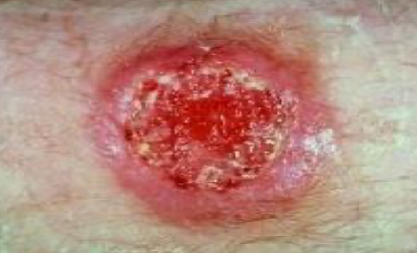
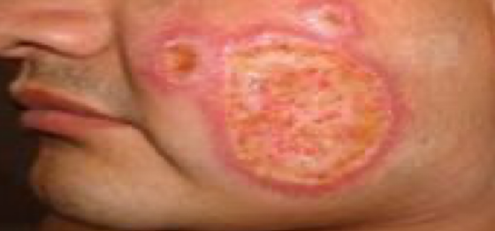
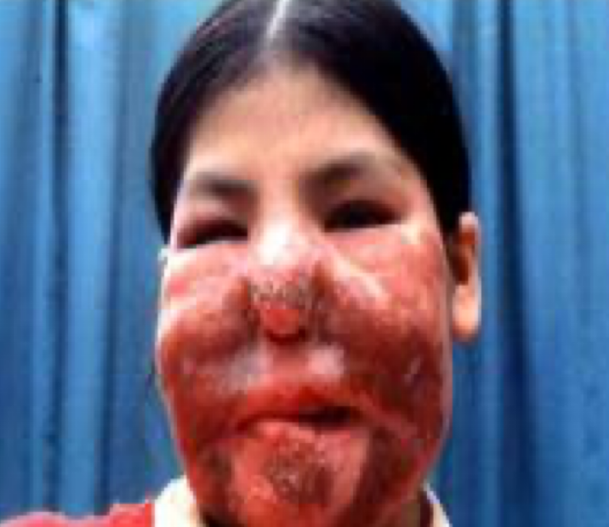
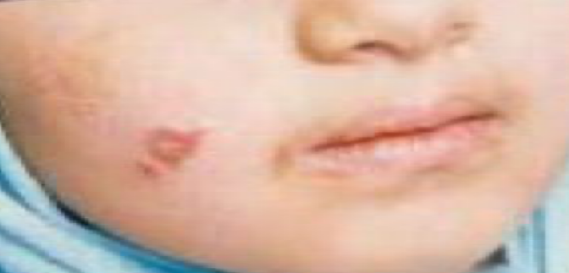
Leishmaniasis
2
1. Cutaneous Leishmaniasis
causes ulcers on your skin.
It’s the most common form of leishmaniasis.
Treatment may not always be necessary depending on the person, but it can speed healing and prevent complications.
Leishmania Major
Zoonotic cutaneous leishmaniasis
Wet type lesions with severe reaction
the ulcer may spread with an inflammatory zone around ,which heal slowly
Common Types of Cutaneous Leishmaniasis
Anthroponotic (human to human) cutaneous leishmaniasis
Dry type lesions with minimal ulceration
In some cases the ulcer remains dry and heals readily
Leishmania Tropica
Oriental sore (most common) classical self-limited ulcer¹
This starts as a painless papule on exposed parts of the body, generally the face
The lesion ulcerates after a few months producing an ulcer with an indurated margin
Uncommon Types of Cutaneous Leishmaniasis (Dr Mona told us to skip it)
Diffuse cutaneous leishmaniasis (DCL) | Leishmaniasis recidiva (lupoid leishmaniasis)
Caused by L. aethiopica diffuse nodular non-ulcerating lesions seen in a part of Africa people with low immunity to Leishmania antigens consists of nodules and a thickening of the skin, generally without any ulceration it needs numerous parasite | Severe immunological reaction to leishmania antigen leading to persistent dry skin lesion & few parasites
1- only cosmetic treatment may be needed.

Slide 4
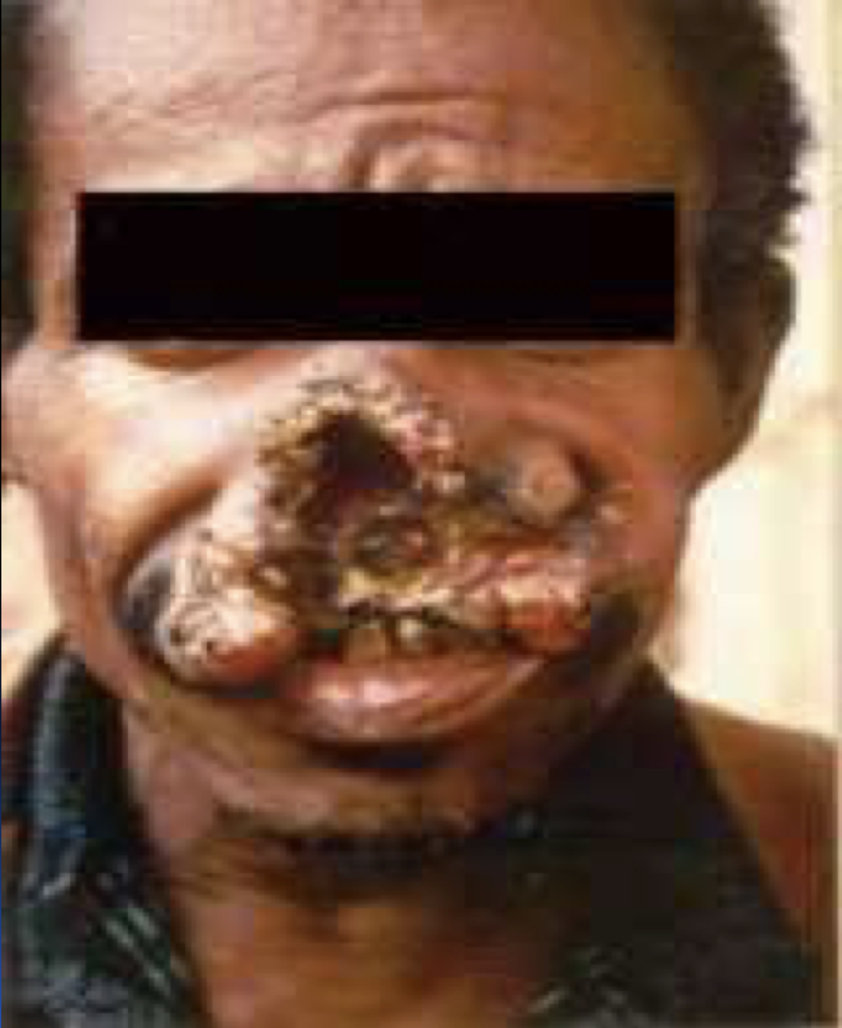
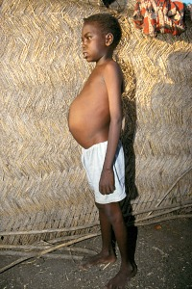
Leishmaniasis
3
2. Mucocutaneous leishmaniasis
A rare form of the disease is caused by the cutaneous form of the parasite and can occur several months after skin ulcers heal.
With this type of leishmaniasis, the parasites spread to your nose, throat, and mouth. This can lead to partial or complete destruction of the mucous membranes in those areas.
Although it's usually considered a subset of cutaneous leishmaniasis, it’s more serious. It doesn’t heal on its own and always requires treatment.
starts as a pustular swelling in the mouth or on the nostrils
may become ulcerative after many months and then extend into the naso-pharyngeal mucous membrane
Secondary infection is very common with destruction of the nasal cartilage and the facial bone
3. Visceral leishmaniasis
Is the most serious form, and is potentially fatal if untreated, there are geographical variations.
The diseases is called kala-azar
1) Leishmania infantum mainly affect children
2) Leishmania donovani mainly affects adult
The incubation period is usually 4-10 months.
The early symptoms are generally low-grade fever, malaise, sweating and anemia
In later stages, the fever becomes intermittent and then liver enlargement, spleen enlargement or hepatosplenomegaly because of the hyperplasia of the lymphoid-macrophage system and bone marrow.
Untreated diseases can be fatal
After recovery it might produce a condition called post kala-azar dermal leishmaniasis (PKDL)
PKDL

Slide 5
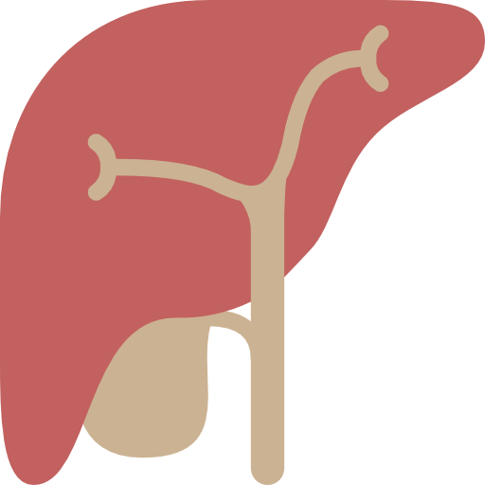
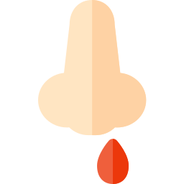
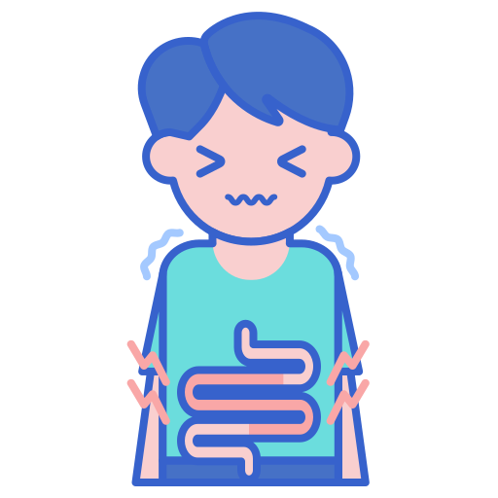
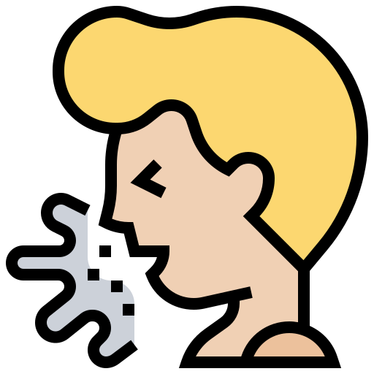
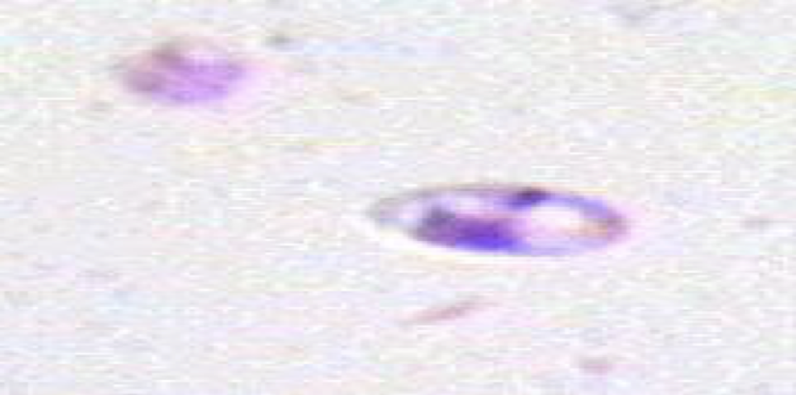
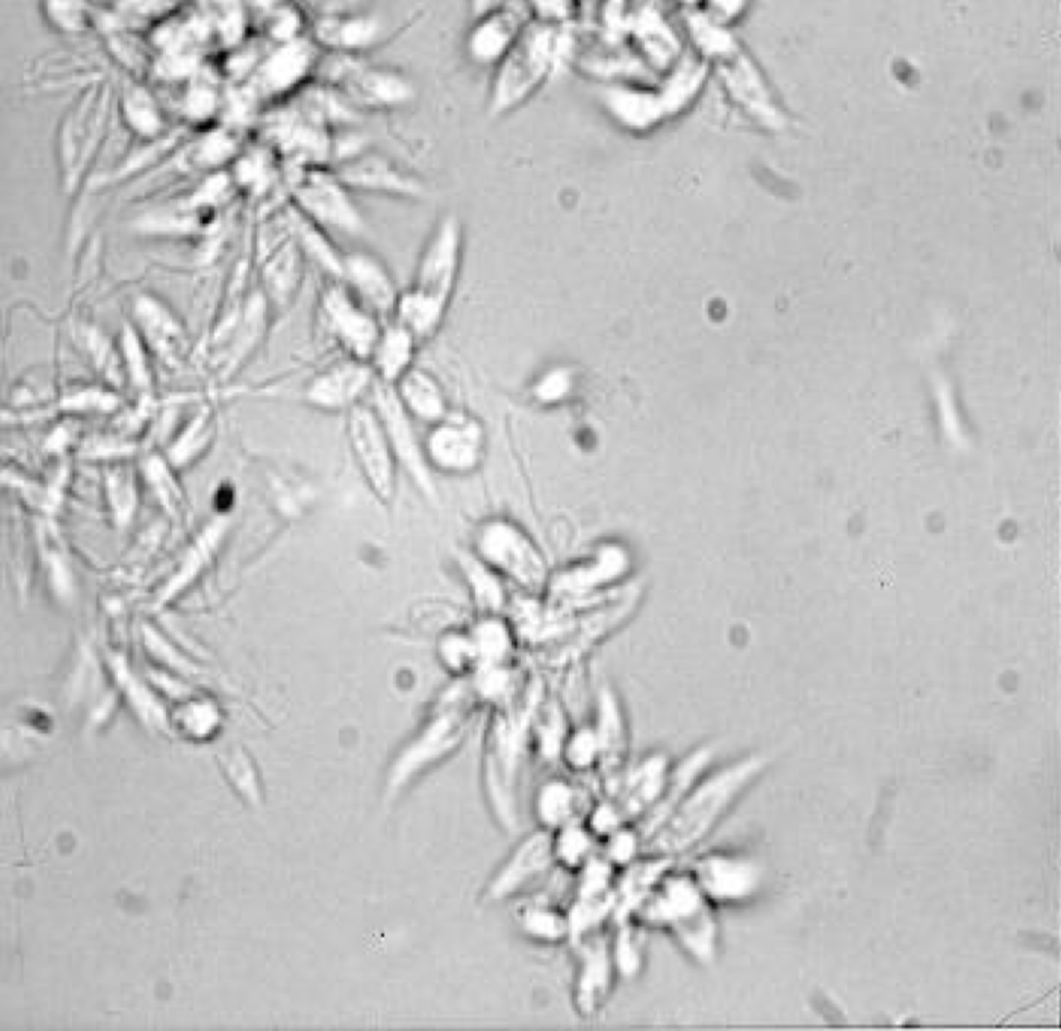
Leishmaniasis
4
3. Visceral leishmaniasis cont’
Clinical Presentation
Splenomegaly, or Hepatomegaly or Hepatosplenomegaly
Anaemia
Cough
Fever (2 times a day)
Weight loss
Epistaxis
Diarrhoea
Lab diagnosis and treatment
Cutaneous & Mucocutaneous Leishmaniasis
Diagnosis | Treatment (Dr mona told us to skip it )
- The parasite can be isolated from the margin of the ulcer. - A diagnostic skin test, known as Leishmanin test (Montenego test), is useful - Smear: Giemsa stain - microscopy for LD bodies (Leishman-Donovan bodies, amastigotes) in tissue macrophages - Skin Biopsy: microscopy from LD bodies or culture in NNN medium for promastigotes. - Polymerase chain reaction (PCR) tests are available for the detection of Leishmania DNA | - No treatment - self-healing lesions - Medical: - Pentavalent antimony (Pentostam) - Antifungal drugs - +/- Antibiotics for secondary bacterial infection. - Surgical: - Cryosurgery - Excision - Curettage - Cutaneous Leishmaniasis: cutaneous ulcers often heal without treatment. However, treatment can speed healing, reduce scarring, and decrease risk of further disease. Any skin ulcers that cause disfigurement may require plastic surgery. - Mucocutaneous Leishmaniasis: These lesions don’t heal naturally. They always require treatment. Liposomal amphotericin B and paramomycin can treat this.

Slide 6
Visceral Leishmaniasis con’
5
Diagnosis of visceral leishmaniasis
Parasitological diagnosis | Immunological diagnosis
- Bone marrow aspirate, splenic aspirate, lymph node, liver biopsy¹ using: 1) microscopy (LD bodies) (amastigotes)² 2) culture in NNN medium (promastigotes) - Leishmaniasis is diagnosed in the hematology laboratory by direct visualization of the amastigotes (Leishman-Donovan bodies). - Buffy-coat preparations of peripheral blood or aspirates from marrow, spleen, lymph nodes, or skin lesions should be spread on a slide to make a thin smear and stained with Leishman or Giemsa stain . - Amastigotes are seen within blood macrophage and spleen monocytes or, less commonly, in circulating neutrophils . | - Specific serologic tests: Direct Agglutination Test (DAT), ELISA, IFAT - Skin test (leishmanin test) for survey of populations and follow-up after treatment. - Polymerase chain reaction (PCR) tests are available for the detection of Leishmania DNA
Treatment ( Dr mona told us to skip it )
Visceral disease always requires treatment. Recommended treatment varies in different endemic areas: Pentavalent antimony - sodium stibogluconate (Pentostam) Amphotericin B Paromomycin Miltefosin (Impavido)
Treatment of Complications ( Dr mona told us to skip it )
Anemia, Bleeding, Infections, etc.
1- bone marrow aspirate is the most common and number #1 in diagnosing visceral leishmaniasis, so if they asked you a question about the diagnosis and the answers were : bone marrow aspirate , splenic aspirate, lymph nodes, liver biopsy choose bone marrow aspirate
By giemsa stain

Slide 7
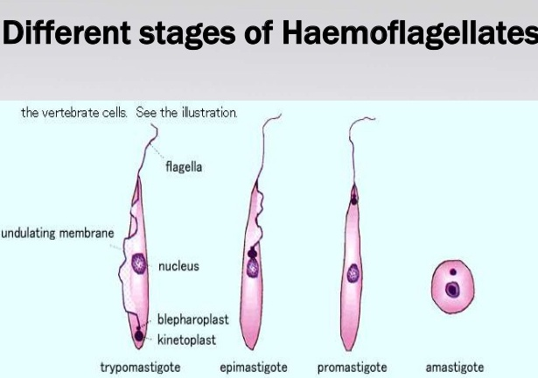
Trypanosomiasis
6
Introduction
There are 4 stages of hemaflagellates : Trypomastigote, Epimastigote, Promastigote and Amastigote
There are two types of trypanosomiasis¹ that affect humans divided based on their geographical location:
African trypanosomiasis
American trypanosomiasis
Known as African sleeping sickness.
Caused by Trypanosoma brucei parasites in Africa
transmitted by the tsetse fly (intermediate host).
Trypanosoma brucei rhodesiense:
East Africa, wild and domestic
animal reservoirs
Trypanosoma brucei gambiense:
West and Central Africa, mainly human infection
Development of the disease is
more rapid in Trypanosoma brucei rhodesiense
Known as Chaga’s disease.
Caused by Trypanosoma cruzi parasites in Latin America
transmitted by the 'kissing’ bugs².
Chaga’s disease in Central and South America
African Trypanosomiasis
What is African sleeping sickness?
African trypanosomiasis is a parasitic disease transmitted by the tsetse fly.
It gets its nickname ‘sleeping sickness’ because symptoms can include a disturbed sleep pattern
Infection occurs through the bite of infected tsetse flies (intermediate host).
Humans, domestic cattle and wild animals are the main reservoir host for Trypanosoma (definitive host).
T. gambiense causes a chronic illness.
T. rhodesiense causes a more acute illness & more rapid in developing the disease.
1- unicellular parasitic flagellate protozoa, causing blood and tissue infections.
2-Triatominae(family: Reduviid) (kissing bug) bites and defecates around mouth or eyes; Fecal transmission into bite site.

Slide 8
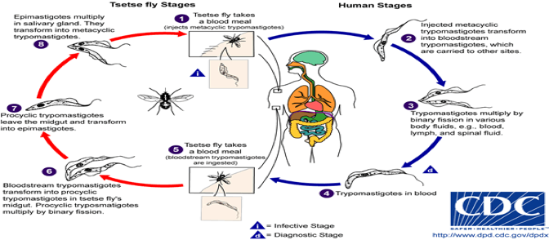
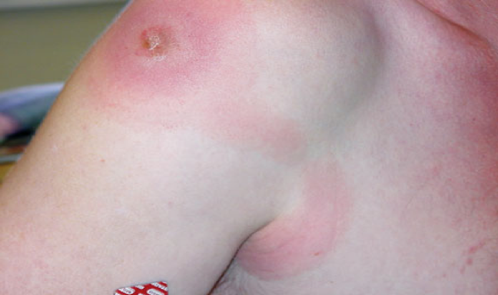
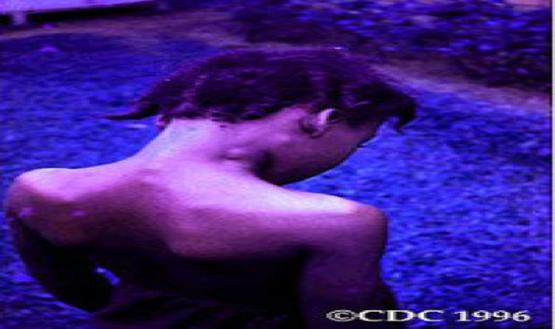
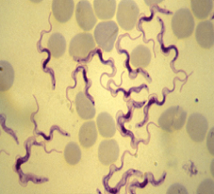
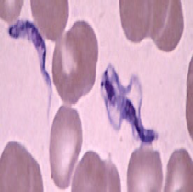
African trypanosomiasis cont’
7
Transmission
Trypanosoma are transmitted from human to human through the bite of the tsetse fly which is only found in rural parts of Africa.
Transmitted from mother to child as the parasite can cross the placenta in the blood and infect the baby while it is still in the womb (uterus)
Contaminated needles can also contribute to the spread of trypanosomes, but this is rare.
Life cycle
The trypanosome parasite is first introduced into the mammalian host as trypomastigotes (Infective stage & Diagnostic stage) when a tsetse fly
takes a blood meal and secretes parasite-filled saliva into the host’s skin
Once in the bloodstream the trypomastigotes multiply in the blood , lymph or spinal fluid¹.
Pathology and clinical picture, Has 3 stages:
Skin stage | Systemic Haemato-lymphatic stage | Central nervous system (CNS) stage
A primary reaction occurs at the site of inoculation of trypomastigotes, chancre which resolve in 2-3 weeks. | intermittent fever, headache & generalized lymphadenopathy mainly in the cervical & sub-occipital region (Winterbottom’ sign)², anemia. | This stage begins when the trypanosome parasites cross from the blood- brain barrier into the spinal fluid, infecting the CNS including the brain, result in change in behavior, confusion, poor coordination difficulties with speech and disturbance of sleep (sleeping during day and insomnia at night.) & (Meningoencephalitis) In a typical case, there is daytime sleeping, psychological changes, tremors, convulsions and finally coma. without treatment, the disease is invariably fatal.
Diagnosis
Diagnosis relies on recognition of the trypomastigote in peripheral blood & CSF during fever, sternal bone marrow,lymph node aspirates and CSF. Motile organisms may be visible in the buffy coat. Serological testing is also common as IF and ELIZA.
1- targeting the CNS.
2- lymph node enlargement due to the accumulation of the parasite.
“trypanosoma”

Slide 9
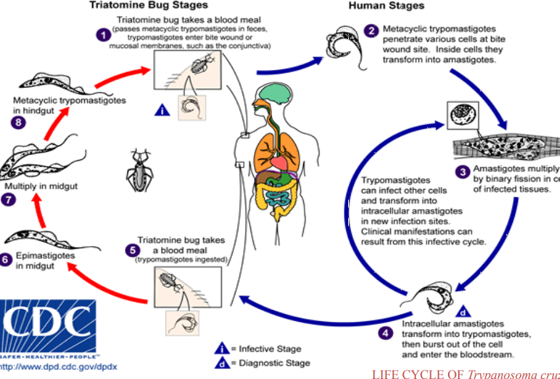
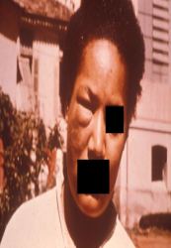
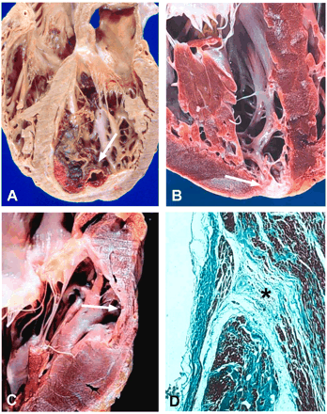
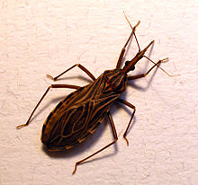
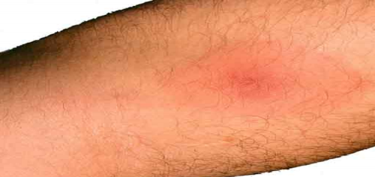
American Trypanosomiasis
8
General information
Chaga’s disease : is a tropical parasitic disease caused by the Trypanosoma cruzi. It is spread mostly by insects known as kissing bugs (Reduviid (Triatomine) bug). The human disease occurs in two stages: an acute stage and chronic stage
Life cycle
C-shape Trypomastigotes
Trypomastigotes in blood
Amastigotes in the muscle (tissue)
Infective & Diagnostic stages: Trypomastigotes
Pathogenesis
The parasites produce focal lymphangitis and oedema at the site of parasites entry (chagoma)
after that parasites (trypomastigote) enter the blood stream and find there way, mainly on the face near the eyelids, it produces a swelling of the eye and temporal region with conjunctivitis (Romanas sign)
and also find their way mainly the cardiac muscles cells . The most constant feature of the cardiac disease is cardiomyopathy, in severe cases can lead to partial or complete heart block which may lead to cardiac failure.
NOTE: Parasite when free in blood stream in form (Trypomastigote), but in the tissue it become in form of (Amastigote).
Romana’s sign
Heart damage due to American trypanosomiasis
kissing bug
T. cruzi causes cutaneous stage (chagoma)

Slide 10
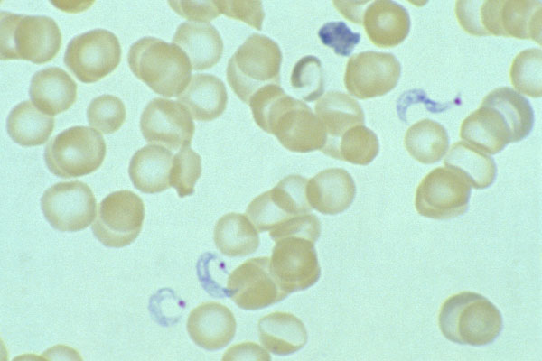
American Trypanosomiasis
9
Clinical features
Acute phase
Chronic phase
T.cruzi causes Acute illness in children, which is followed by chronic manifestations later in life.
In the early stage, symptoms are typically either not present or mild, and may include fever, swollen lymph nodes, headaches, or local swelling at the site of the bite (chagoma).
The most recognized marker of acute Chagas disease is called Romaña's sign, which includes swelling of the eyelids on the side of the face near the bite wound or where the bug feces were deposited or accidentally rubbed into the eye.
About two-thirds of people with chronic symptoms have cardiac damage, including dilated cardiomyopathy, which causes heart rhythm abnormalities and may result in sudden death.
T. cruzi causes a chronic illness with progressive myocardial damage leading to cardiac arrhythmias and cardiac dilatation.
Gastrointestinal involvement leading to megaesophagus and megacolon.
Intracellular amastigotes destroy the intramural neurons of the autonomic nervous system in the intestine and heart, leading to megaintestine and heart aneurysms, If left untreated, Chagas disease can be fatal, in most cases due to heart muscle damage.
Diagnosis
Microscopical examination of Giemsa – stained blood film,
we will find
C- shaped trypomastigotes
Serology:
IFAT
(immunofluoresc ence antibody test )
Xenodiagnosis: feeding bugs on a suspected cases.
PCR:
used to detect Trypomastigotes
Treatment (NOT IMP)
American
African
Benznidazole
Nitrofurazone
For early infection
Pentamidine
Suramin
for late infection
eflornithine (Difluoromethylornithine-DFMO)

Slide 11
Dr.Mona’s Notes (Trypanosomiasis)
10
African trypanosomiasis
Disease: Sleeping sickness
Caused by: Trypanosoma brucei
Transmission: by the tsetse fly
Infective stage: trypomastigotes
The trypomastigote enters through the skin and multiply in the blood, lymph or spinal fluid.
Primary reaction: chancre which resolve in 2-3 weeks.
Systemic Haemato-lymphatic stage: intermittent fever, Winterbottom sign
CNS stage: change in behavior, confusion, and disturbance of sleep
Diagnosis:
Microscopically: trypomastigote in peripheral blood and CSF stained by GIEMSA
American trypanosomiasis
Disease: Chagas disease
Caused by: Trypanosoma cruzi
Transmission: by the kissing bug
Infective Stage: trypomastigotes
The trypomastigotes first cause chagoma
Acute Chagas disease → Enters the bloodstream to the face, producing Romana’s sign
Chronic illness → MAINLY Cardiomyopathy and cardiomegaly, Also to the GIT causing megacolon
Trypomastigotes → in the blood
Amastigote → in the tissue ( seen in autopsy )
Diagnosis:
Microscopically: trypomastigote in the blood stained by GIEMSA
Serology: Immunofluorescence
Doctor’s Questions:
Q1: A patient came from latin America with inflammation, and enlarged eyelid. What is the most likely diagnosis? American trypanosomiasis (chagas disease)
Q2: A patient is having sleep disturbance, change in behaviors, & convulsions.
What is the most likely diagnosis ? African trypanosomiasis (sleeping sickness)
How it is transmitted ? by the tsetse fly
How to diagnose it ? trypomastigote in peripheral blood and CSF stained by GIEMSA
Q3: What is the causative organism of sleeping sickness ? Trypanosoma brucei
Q4: What is the causative organism of chagas disease ? Trypanosoma cruzi

Slide 12
Dr.Mona’s Notes (Leishmaniasis)
11
Transmission: by the sandfly
Infective stage: promastigote
Diagnostic stage: amastigote (phagocytized by macrophages where they transform)
Cutaneous leishmaniasis (keyword: skin)
Leishmania Major → zoonotic → wet lesions with severe reaction
Leishmania Tropica → human → dry lesions with minimal ulceration
It starts as a painless papule and it’s self limited ulcer.
Mucocutaneous leishmaniasis (keyword: mucus & cartilage)
Caused by: Leishmania braziliensis
Diagnosis: parasite can be isolated from the margin of the ulcer
Giemsa stain - microscopy for amastigotes
Culture in NNN medium for promastigotes
Visceral leishmaniasis (keyword: bone marrow)
Disease: kala-azar
Caused by:
Leishmania donovani → affect adults
Leishmania infantum → affect children
Symptoms: intermittent fever, and hepatosplenomegaly
Diagnosis:
Microscopy
Culture in NNN medium
Samples:
Bone marrow aspirate
Splenic aspirate
Lymph node
Tissue (liver) biopsy
Doctor’s Questions:
Q1: What is the most common sample obtained to diagnose Visceral leishmaniasis ?
Bone marrow aspirate
Q2: Which of the following samples is used to diagnose Visceral leishmaniasis ?
Nasal aspirate
Splenic aspirate
Margin biopsy

Slide 13
Quiz:
12
MCQ:
Q1:A, Q2:D, Q3:C, Q4:C , Q5:D
Q1: oriental sore is a clinical presentation to which one of the following?
A- Cutaneous Leishmaniasis
B- Mucocutaneous leishmaniasis
C-Visceral leishmaniasi
D- None of the above
Q2: Which ONE of the following transmits leishmaniasis?
A- Tsetse fly
B- Kissing bug
C- Cockroaches
D- Sandflies
Q3: Which ONE of the following medias are used for diagnosing leishmaniasis?
A- L-J media
B- Blood agars
C- NNN media
D- LD media
Q4: Which ONE of the following organisms causes mucocutaneous Leishmaniasis
A- Leishmania Tropica
B- Leishmania Donovani
C- Leishmania braziliensis
D- Leishmania Infantum
Q5: Which ONE of the following is the swelling of the eyelids Caused by american trypanosomiasis?
A- chagoma
B- Winterbottom’ sign
C- Chancre
D- Romanas sign
SAQ:
Case: this 23-year-old girl who resides in Central africa has had recurrent fevers for the last 6 weeks, accompanied by persistent diarrhea and weight loss. a physical examination reveals her to be alert, but with significant generalized weakness, widespread lymphadenopathy, hepatomegaly, and massive splenomegaly.
Q1; What is your diagnosis
Visceral leishmaniasis
Q2; What is most likely causative organism
Leishmania donovani
Q3; How is this disease transmitted
By sandfly
Q4; If the patient was 2 years old, what is the most likely organsim?
Leishmania infantum
Q5; How would you diagnose this patient?
Microscopy on giemsa stain (silver stain) and culture on NNN media of bone marrow aspirate

Slide 14
Quiz:
13
MCQ:
Q1:C, Q2:C, Q3:B, Q4:A , Q5:D
Q1 : which one of the following describes the parasite in the bloodstream ?
A- Trypanosoma cruzi
B-Amastigotes
C-Trypomastigotes
D-Trypanosoma brucei
Q2 : Chagas disease is caused by :
A-kissing bug
B-Trypanosoma brucei
C-Trypanosoma cruzi
D-Tsetse fly
Q3 : which of the following cause acute trypanosomiasis?
A-T. Gambiense
B-T. Rhodesiense
C-T. Cruzi
D- none of the above
Q4 : what is the intermediate host of African trypanosomiasis “sleeping sickness”?
A-Tsetse fly
B-kissing bug
C-Human
D-Sand fly
Q5: a 76 year old Argentinian man was diagnosed with Chaga’s disease. unforunately , he died. Upon performing an autopsy, which one of the following would be seen in his heart ?
A- C- shaped trypomastigote of T. cruzi
B- C- shaped trypomastigote of T. Brucei
C- Amastigote of T.Brucei
D- Amastigote of T. cruzi
SAQ:
CASE:A 64 year old American businessman presented to the clinic with fever, headache with a swelling in his neck. Upon taking history, he mentioned that he went to africa a month ago for a business trip, he also said that he had a painless purple nodule in his left forearm for a couple of weeks. He also said that the that his fever come and goes. His CBC showed anemia.
Q1: What is your diagnosis
African trypanosomiasis
Q2: What is the most likely pathogen?
T. Brucei
Q3: How is this disease transmitted
By Tsetse fly
Q4: The swelling on his neck s also known as
Winterbottom’s sign
Q5: what is the next expected complication if he wasn’t treated
CNS involvement that will result in change in behaviour, confusion, poor coordination, difficulties with speech and sleep disturbances

Slide 15
Members board:
Team Leaders:
Abdulaziz Alshomar Ghada Alsadhan
Team sub-leader:
Mohammed Alhumud
This lecture was done by:
Deana Awartani
Mohammed Alhamad
Noura Alturki
Ziyad Aljofan
Note takers:
Mashal Abaalkhail
Razan AlRabah

