Slide 1
Helicobacter Pylori
(We highly recommend reading the Dr notes at the end as they contain some highly imp info not in the main lec)
Lecture objectives:
To define peptic ulcer disease and assess its distribution among patients.
To briefly indicate the signs and symptoms.
To know impact of the discovery of H.pylori on the change of diagnosis and
management of peptic ulcer.
To understand the various gastric and duodenal diseases caused by H.pylori.
To learn laboratory characteristics of H. pylori and its identification and diagnosis.
To know the pathophysiology of H.pylori inside the stomach and duodenum.
To learn the prevention methods used for H.pylori infection.
To explore and learn the epidemiology and transmission ways of the disease.
To know the management and treatment regiments used for eradication of H.pylori.
Color index:
Important
Found in Girls’ slides
Doctors’ note
Found in Boys’ slides
Extra
EDITING FILE

Slide 2
Helicobacter Pylori
1
Discovered in 1983 in Perth (Australia), by Warren and Marshal. Their discovery revolutionised the treatment of duodenal and gastric ulcers. It earned them the Nobel Prize for Medicine in 2005.
General Info.
Nearly 20 species of Helicobacter are now recognised.
H. pylori are found in the human stomach.
Epidemiology
Around 50% of the world's population harbor H. pylori
Over 80% of individuals infected with the bacterium are asymptomatic.
Third world has more rate of infection.
Overall frequency of H pylori infection is ​declining.
Infections are usually acquired at childhood.
Prevalence varies greatly among countries and population groups, Infection is more prevalent in developing countries.
Poor sanitary conditions contribute to high rates.
The route of transmission is unknown, although it is known individuals typically become infected in childhood.
In USA high prevalence among African-American and Hispanic population-Due to socioeconomic status
Higher hygiene standards and widespread use of antibiotics behind lower rate of infection in the west.
H. pylori is found closely associated with gastric mucosa, and is an independent risk factor for the development of:
Chronic active gastritis.
Gastric and duodenal ulcer (Peptic ulcer).
Gastric adenocarcinoma.
Gastric mucosa-associated lymphoid tissue (MALT) lymphoma.

Slide 3
Helicobacter Pylori
2
Transmission |  | Prevention
● Contagious with an unknown route of transmission. Possible routes: Person to person (oral to oral or fecal-oral)​: Occurs mainly within families or community. Fecal-oral route of infection occurs by ingestion of contaminated food or water due poor hygiene. Using same spoons, forks and toothbrushes and kissing children mouth to mouth increases oral-oral route of infection. There is no evidence of animal-to-human transmission ● Gastric antrum is the most favoured site. ● Present in the mucus that overlies the mucosa. |  | ● Eradication of infection will: improve symptoms: e.g. (dyspepsia, gastritis, peptic ulcer and cancer). Potentially reverse progression ● Vaccination: Promising results with newer formulations No vaccine available yet ● Dietary methods: (eating broccoli, cabbage, honey, and drinking green tea) ● Proper sanitation and clean sources of drinking water.
The outcome of infection by H. pylori reflects an interaction between:
● Strain virulence. ● Environmental factors. ● Host genotype
Genome
● H pylori consist of large diversity of strains with around 1,550 genes. ● Study of H pylori is centered on trying to understand the pathogenesis of genome database. ● H pylori contains 40kb-long Cag pathogenicity island (PAI) with over 40 pathogenetic genes. ● Asymptomatic patients carry H.pylori strains lacking the Cag pathogenicity island (PAI).

Slide 4
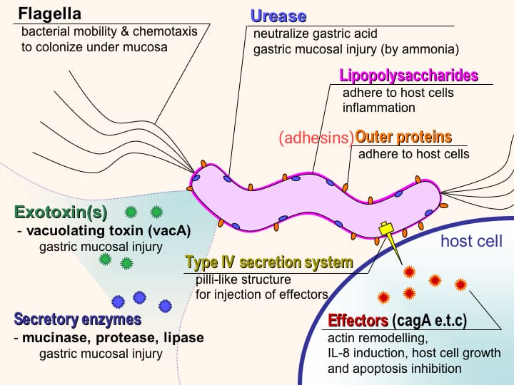
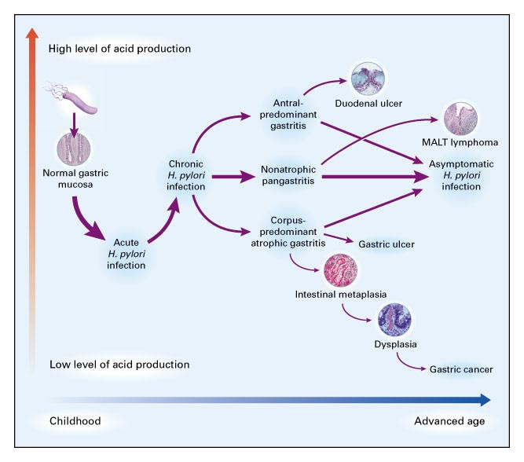
Helicobacter Pylori
3
Pathogenesis:
Colonization
Surviving the acidity (1)
Using flagella, H pylori moves through
stomach lumen and drill into the
mucoid lining of Stomach ➔ Produces adhesions (outer membrane proteins)
that binds to the epithelial cells.
To colonize the stomach, H. pylori must survive acidity.
1
2
Surviving the acidity (2)
3
4
Results
Produces large amounts of urease
enzyme that break down urea into
co2 + ammonia ➔ This in-turn neutralizes gastric acid ➔ Ammonia is toxic to
epithelial cells along with proteases,
VacA protein¹, and phospholipases
Colonization of stomach or duodenum results in chronic gastritis (inflammation of stomach lining) ➔ Inflammation stimulates more production of gastric acid.This leads to gastric and duodenal ulcers, atrophy and later cancer.
CagA protein² was found to contribute to peptic ulcer.
Neutrophil-Activating Protein (NAP) recruits neutrophils to gastric mucosa causing inflammation.
Free radical production in the gastric lining due to H pylori increases host cell mutation.
H pylori induces the production of TNF-α and Interleukin 8 that leads to host cells mutation.
VacA protein : vacuolating cytotoxin A
CagA protein: Cytotoxic associated protein A

Slide 5
Helicobacter Pylori
4
Laboratory Findings :
01
Morphology and characteristics
● Fastidious in terms of growth requirements
● Strictly microaerophilic
● Will grow in environments with increased Co2
● Blood agar based medium
Morphology and staining:
● Small, Gram negative spiral rods(bacilli), motile by polar flagella.
02
Culture
● On blood agar based medium in a moist microaerophilic atmosphere.
● Selective medium can be used for isolation from clinical specimens.
● Small colonies grow after 5-7 days at 37C
03
Biochemical reactions
● catalase-positive
● oxidase- positive
● strongly urease-positive.
Hallmark of the species is production of urease enzyme :
● Urease breaks urea down to Co2+NH3
● Ammonia is a strong base
● Urease helps H. pylori survive strongly acidic
stomach conditions.
● Very fragile (a point of importance when referring samples to the lab).
Diagnosis Checking dyspeptic patients for H pylori.
Non-invasive methods | Invasive methods (most reliable) on biopsy:
● Serology (Blood antibody) tests → poor accuracy. ● Stool antigen test. ● Carbon urea breath test (C14 or C13 ). - A urea solution labelled with C14 isotope is given to patient. the Co2 subsequently exhaled by the patient contains the C14 isotope and this is measured. - A high reading indicates presence of H. Pylori. | ● Histological examination of biopsy specimens of gastric/duodenal mucosa take at endoscopy. ● Rapid urease test (CLO-test ® : based again on urease-production by the organism->NH3 production-> rise in pH=>change in the colour indicator of the kit - High sensitivity and specificity. - Prompt result. ● Culturing the bacteria. Used for antibiotic resistance testing, as sensitive as the histology. Requires selective agars and incubation for growth. ● Molecular methods (e.g. PCR).
1

Slide 6
Helicobacter Pylori
5
Antibiotic Sensitivity: | Treatment
● In vitro (in tube (labs)) H.pylori is sensitive to amoxicillin, tetracycline, metronidazole, macrolides (clarithromycin). ● In vivo ( in human body) their efficacy is often poor due to the low pH of the stomach, their failure to penetrate the gastric mucus and the low concentration of antibiotic obtained in the mucosa of the stomach. ● Recently, Metronidazole in developing countries is becoming resistance (80-90%). | Clarithromycin Triple therapies (first line): | Second line
 | ● PPI (proton pump inhibitor) b.d. (twice a day) + clarithromycin + amoxicillin or metronidazole for 14 days We give metronidazole if patient is allergic to Penicillin (Amoxicillin). | ● PPI (proton pump inhibitor) b.d. + bismuth subsalicylate/subcitrate + nitroimidazole + tetracycline for 10-14 days -Can be used as salvage therapy if primary therapy with the Clarithromycin triple therapy fails ● Another option for salvage: levofloxacin + amoxicillin + PPI
 | ● Post Treatment Testing done 4-6 weeks post-therapy: After identification and treatment, eradication should be proven using: • Urea breath test • Fecal (stool) antigen test • Biopsy based testing ( usually not used)
Susceptibility Testing:
●Not available in all centers. ● Require growth from culture, so biopsy needed ● More recently molecular methods looking for mutations that code for resistance have been used. Susceptibility testing is available for clarithromycin.

Slide 7
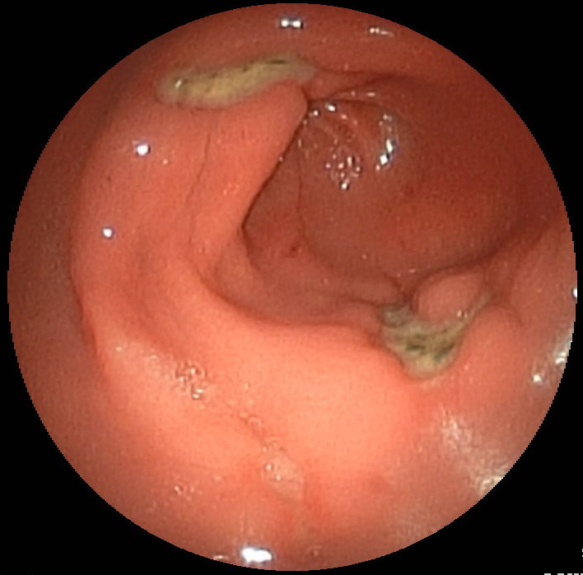
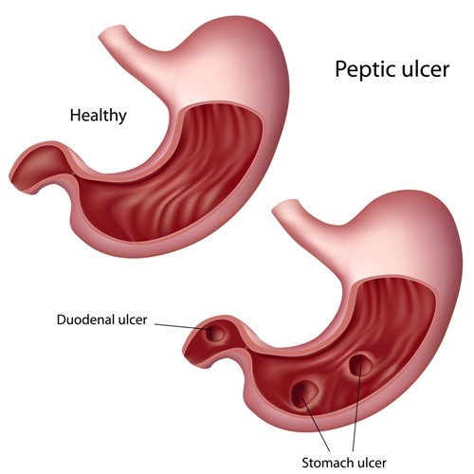
Peptic Ulcer Diseases
6
Definition:
○ Mucosal erosions (≥ 0.5cm)
Location:
○ More Peptic ulcers are arise in the duodenum ​than the stomach.
○ Peptic ulcers arise in an acidic area, thus they are very painful.
Characteristics:
○ Associated with the over usage of NSAIDs, smoking, alcohol.
○ Duodenal ulcers are generally benign.
○ H.pylori infection is the main cause.
Complications
○ 4% of stomach ulcer can turn to be malignant tumor. (Multiple biopsies are needed to exclude cancer)
Signs & Symptoms
Abdominal or
Epigastric (burning) pain w/severity relating to meal time
Gastric: shortly after meal
Duodenal: 2-3 hrs after meal
Bloating
and
abdominal fullness.
Nausea​ and​ vomiting.
Loss of appetite and weight loss​.
Haematemesis (vomiting of blood) due to gastric or esophageal damage.
Melena (foul-smelling& dark brown feces due to oxidized
hemoglobin iron).
Rarely, Gastric or duodenal perforation leading to
acute peritonitis.
(extremely painful require urgent surgery )

Slide 8
Helicobacter Pylori
7
Dr.Khalifa’s notes:
H.pylori:
• Half the world harbors H.pylori but 80% are asymptomatic. Because they usually carry H.pylori strains lacking CagA.
• Transmitted oral to oral or fecal-oral route
• Gastric antrum is the most favored site. (this explains why duodenal ulcers are more common)
• Virulence factors:
1- Flagella which is important for motility.
2- Adhesins that bind to epithelial cells
3- Urease enzyme which breaks urea into CO2 and ammonia to neutralize gastric acidity (note that Ammonia is toxic to epithelial tissue)
4- vacA which damages epithelial tissue
5- CagA which gives H.pylori the ability to cause cancer, by inducing the release of cytokines(e,g, TNF-alpha and IL-8) ➔ cell mutation ➔ Cancer
IMPORTANT to know that Gastric ulcers are what usually lead to cancer NOT Duodenal ulcers which are usually benign.
Signs and symptoms of peptic ulcer:
Common signs(main ones): Epigastric pain when stomach is empty (e.g. after 3 hours of a meal) with some burning sensations, nausea, vomiting and weight loss
Rare & severe signs: Haematemesis(indicates bleeding ulcers), Perforation which will lead to acute peritonitis(secondary peritonitis) and leakage of duodenal content like bacteria into the surrounding areas causing infection.
Description of H.pylori:
Gram -ve bacilli, strictly microaerophilic. Another example of a strictly microaerophilic is Campylobacter Jejuni
Culture:
We usually need biopsy for culture, & it requires microaerophilic (less amount of O2) blood agar based media.
We don’t use stool culture due to the high amount of normal flora. plus , the bacteria dies very quickly, because it’s very fastidious
Biochemical features:
Strongly urease-positive ( remember urease is important for the pathogenesis and identification of the bacteria)
Diagnosis:
We usually begin with non-invasive methods such as Stool antigen test (We use it to check if the disease is active) Or carbon urea breath, note that serology isn’t very useful because it can’t specify if the disease is active or not.
But in severe cases or if we suspect cancer we might use invasive methods(biopsy) and do rapid urease test or histological examination(to check for any malignancy).
Treatment:
First line: Proton pump inhibitors + clarithromycin + amoxicillin or metronidazole for 14 days
Dr.Fawzia’s notes:
H pylori
-Only human to human disease (advantage cause its easier to control)
Complication
-malignancy and perforation
Culture
- it’s fastidious ( grows slowly and requires special nutrient to grow) ➔ that’s why we rarely culture it
-strictly microaerophilic;behaves like anaerobes so needs small amount of oxygen to grow
Diagnosis
-invasive method (most important,so we can rule out malignancy)
Treatment
-dietary methods = garlic
-before H pylori,the treatment was mainly antacids to decrease the symptoms
-for H pylori we use antibiotics and management of stress,smoking,obesity
Lastly, don’t forget to check the SAQ at the end of the lecture. its based on the info mentioned in the doctor’s revision.

Slide 9
Quiz:
8
MCQ:
Q1:B, Q2:D, Q3:C, Q4:C, Q5:A
Q1: Which of the following is correct regarding peptic ulcer?
A- Most duodenal ulcers progress into tumors.
B- Stomach ulcers have a potential to progress into tumors.
C- Peptic ulcer is usually caused by Gram positive bacteria.
D- Stomach ulcers are more common than duodenal ulcers.
Q2: A 50 yo man presented to the ER with severe epigastric pain and burning sensations after 3 hours from his last meal (empty stomach), associated with nausea and vomiting. He was diagnosed with peptic ulcer. Which of the following is correct regarding the causative microorganism?
A- Gram negative, Urease negative
B- Gram negative, Non-motile organism
C- Gram positive, Grows on Skirrow agar
D- Gram negative, Microaerophilic, oxidase and urease positive
Q3: A 45-year-old man presents to the clinic complaining of several weeks of vague abdominal discomfort and early satiety. The physician orders upper GI endoscopy as part of his workup. During the study, mucosal rigidity and hyperplasia are seen in the stomach, and a biopsy is taken from the affected area. Microscopic analysis of the biopsy specimen shows sheets of atypical lymphocytes. The organism believed to be associated with this condition is best described urease, catalase, and oxidase positive, Which of the following is most likely the diagnosis?
A- Gastric adenocarcinoma
B- Acute pancreatitis
C- Gastric mucosa-associated lymphoid tissue (MALT) lymphoma.
D- Liver cirrhosis
Q4: Which of the following is a virulence factor of H.pylori that produces ammonia and neutralizes stomach acidity?
A- CagA
B- VacA
C- Urease
D- Phospholipase
Q5: A 27-year-old woman with no significant medical history complains of a month of sharp, nonradiating, epigastric pain. Her pain is relieved after eating food, and she has experienced weight loss. What is the most likely primary treatment for this patient?
A- Amoxicillin, clarithromycin, and omeprazole
B- Avoidance of nonsteroidal anti-inflammatory drugs
C- Gastrinoma resection
D- Metoclopramide
SAQ:
CASE: A 45-year-old man presents to his physician complaining of a five-month history of occasional burning mid-epigastric pain that improves when he eats food. He denies any history of recent travel or excessive use of non-steroidal anti-inflammatory drugs. The physician begins a course of pharmacologic therapy
to improve the patient’s symptoms.
Q1: What’s the most likely diagnosis?
A: Peptic ulcer
Q2: What’s the most likely organism causing this condition?
A: Helicobacter pylori
Q3: What’s the spectrum of diseases that are usually caused by this organism?
A: chronic active gastritis – gastric and duodenal ulcer (Peptic ulcer) – Gastric adenocarcinoma – Gastric mucosa-associated lymphoid tissue (MALT) lymphoma.
Q4: How is it transmitted?
A: Oral-Oral or Fecal-Oral
Q5: Mention 3 virulence factors for this organism.
A:
1- Urease: Break down urea into CO2 and ammonia, which will neutralize gastric acid and cause damage to tissue(by ammonia which is toxic to tissue)
2- CagA: Cytokine release(e.g. IL-8), Has a role in the development of cancer.
3- VacA: gastric tissue damage
Q6: Mention 3 risk factors for this disease.
A: Over usage of NSAIDs, smoking, alcohol
Q7: How do we diagnose it?
1- non-invasive methods such as: Stool antigen test, Carbon urea breath test.
2- Invasive methods such as: Rapid urease test, culture of bacteria or histology if we suspect cancer.
Q8: What’s the appropriate treatment?
Proton pump inhibitors + Clarithromycin + Amoxicillin or metronidazole for 14 days

Slide 10
Members board:
Team Leaders:
Abdulaziz Alshomar Ghada Alsadhan
Team sub-leader:
Mohammed Alhumud
This lecture was done by:
Noura Almazrou
Note takers:
Mashal abaalkhail
Badr alqarni
Leena alnassar

