Slide 1
Schistosomiasis
Lecture objectives:
know the global distribution of schistosomiasis
describe the life cycle of schistosomiasis
compare relation between chronic schistosomiasis and portal hypertension
know pathology, diagnosis and treatment of schistosomiasis
know life cycle of Fasciola hepatica
know pathology , diagnosis and treatment of Fasciola hepatica
compare between true infection and sheep liver infected with Fasciola hepatica which lead to false infection
Color index:
Important
Found in Girls’ slides
Doctors’ note
Found in Boys’ slides
Extra
EDITING FILE

Slide 2
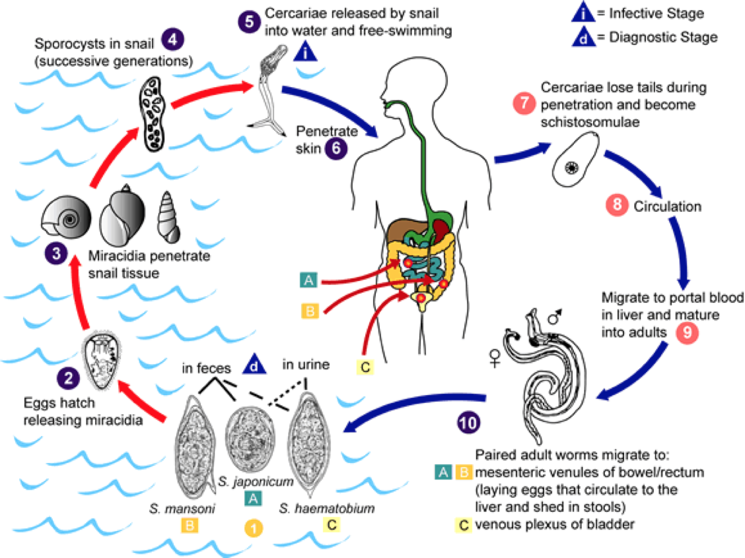
Schistosoma
1
Classification of parasites
Protozoa
Helminths
Unicellular, a single cell for all functions.
Amoebae: moves by pseudopodia
Flagellates: moves by flagella
Ciliates: moves by cilia
Apicomplexa (Sporozoa): tissue parasites
Multicellular, specialized cells.
Round worms (nematodes):
Elongated, cylindrical, unsegmented
Flat worms:
Trematodes: leaf like,unsegmented
Cestode: tape-like, segmented
Introduction:
○ Schistosoma is a genus of trematodes, commonly known as blood-flukes, which are parasitic flatworms responsible for a highly significant group of infections in humans termed schistosomiasis.
○ Schistosomiasis is considered by the WHO as the second most socioeconomically devastating parasitic disease (after malaria), with hundreds of millions infected worldwide.
Adult flatworms parasitize blood capillaries of either 1 or 2 depending on the infecting species
Mesenteries (Schistosoma mansoni)
plexus of the bladder (Schistosoma haematobium)
Pathogenesis (Simplified)
Cercaria is the infective stage
Cercaria emerge from snail in the water & penetrate the skin of the human.
Cercaria is transformed into a schistosomulae inside the host tissues.
The schistosomulae first enters the systemic circulation then finds its way into:
Portal circulation (S .mansoni &
S. japonicum) worms mature in the mesenteric veins of the portal circulation
S. haematobium worms generally remain in the systemic circulation & mature in the blood vessels of the vesical & venous plexus.
The egg is the diagnostic stage :
eggs of S.mansoni & S.japonicum are passed mainly in stool
eggs of S.haematobium passed mainly in the urine.
Human is the DEFINITIVE HOST .
SNAILS is the INTERMEDIATE HOST.

Slide 3
Schistosomiasis
2
Infective stage
Cercaria
Definitive host
Human
Life cycle of Schistosoma
Intermediate host
Snails
Diagnostic stage
Eggs pass in stool or urine
Pathogenesis (Extended)
After the eggs of the human-infected with S.mansoni & S.japonicum are passed in the feces into the water 0r the eggs are passed during micturition from host infected with S.haematobium .
The miracidium hatches out of the egg and searches for a suitable freshwater snail to act as an intermediate host . In the snail the miracidium develops to cercaria. From a single miracidium result a few thousand cercaria, every one of which is capable of infecting a human
Cercaria emerge from snail in the water during daylight actively seeking out their final host, they then penetrate the skin of the human. The cercaria is transformed into a schisosomula inside the host tissue.
Each schistosomule spends a few days in the skin and then enters the systemic circulation starting at the dermal lymphatics and venlues, they feed on blood.
The schistosomule migrates to the lung and then moves via circulation through the left side of the heart then it develops into a sexually mature adult and the pair migrate to the mesenteric portal circulation veins (S.mansoni & S.japonicum) or to urinary bladder veins (S.haematobium).
The female fluke (S.haematobium) generally remain in the systemic circulation and mature in the blood vessels of the vesical plexus & lays as many as 30 eggs per day which migrate to the lumen of the urinary bladder and ureters
Each female of (S.mansoni & S.japonicum) worms mature in the mesenteric veins of the portal circulation & lay 300 eggs a day the eggs move into the lumen of the host's intestines and are released into the environment with the feces .

Slide 4
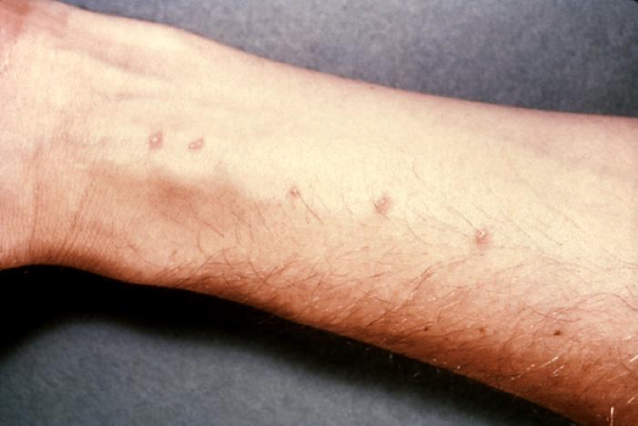
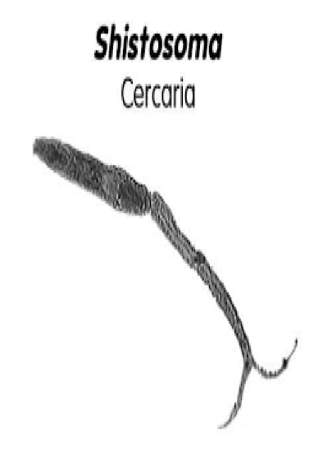
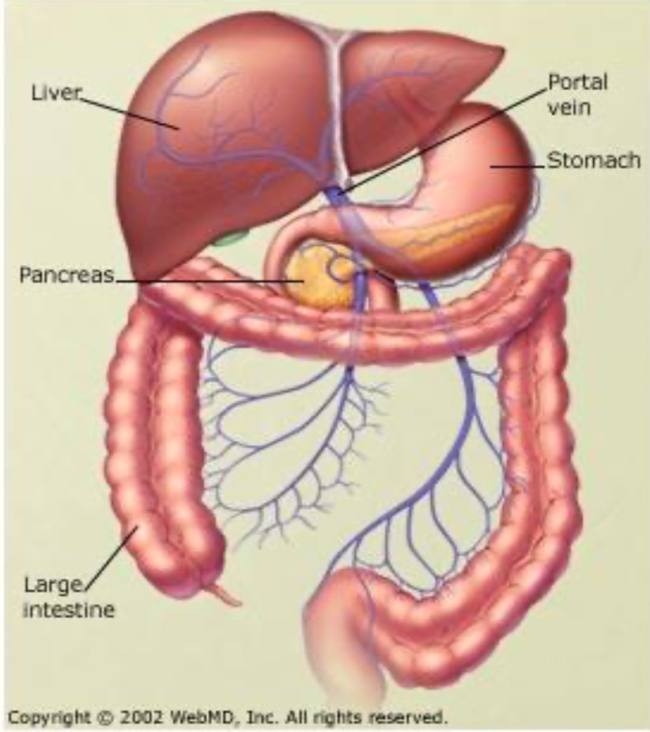
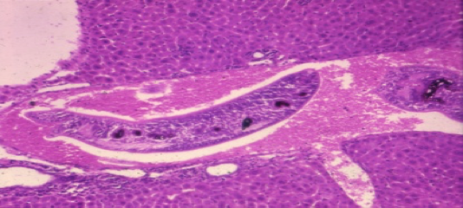
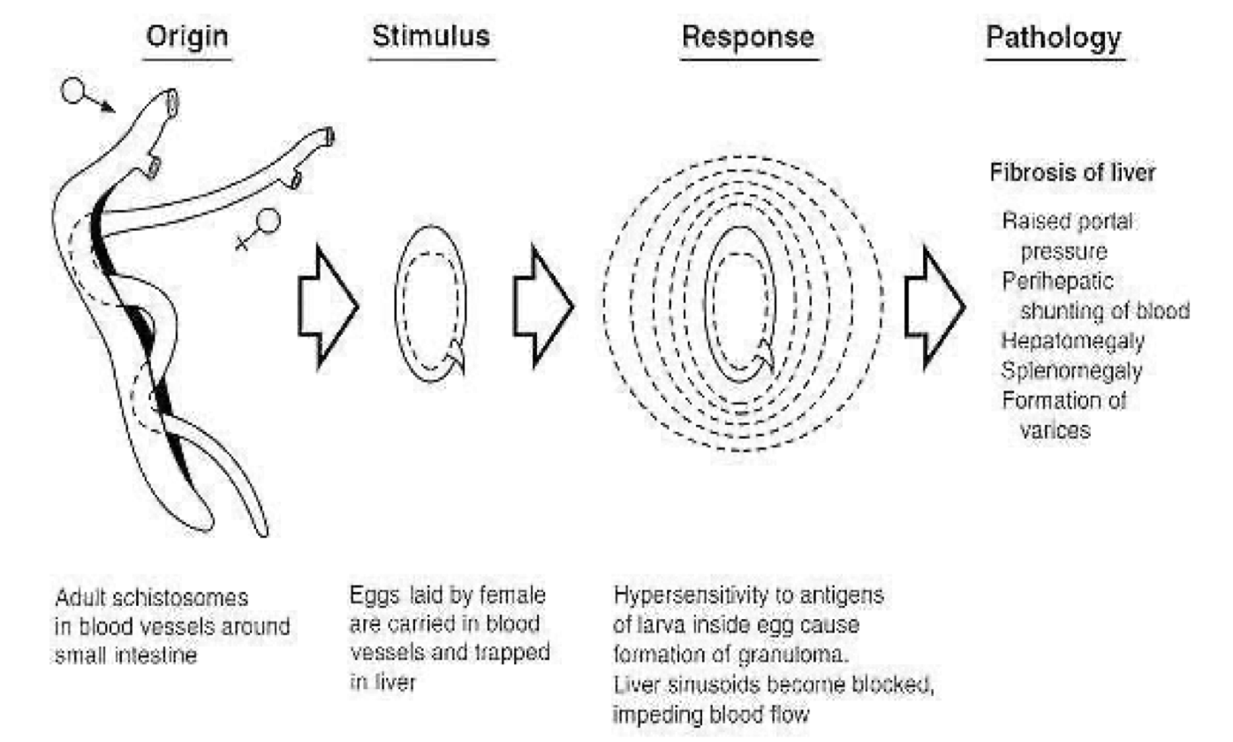
Schistosomiasis
3
Pathology
Schistosome dermatitis, or "swimmers itch” occurs when skin is penetrated by a free-swimming, fork-tailed infective cercaria.
The dermatitis often develops 24 hours after exposure and last for 2 to 3 days and then spontaneously disappears.
EGG is the main cause of pathology in schistosomiasis. Many eggs become stranded in the tissues or are carried by the bloodstream to other organs mainly the LIVER.
The host reaction to the eggs may vary from small granulomas to extensive fibrosis
The extent of damage is generally related to the number of eggs present in the tissues.
Developing Schistosome in liver:
S. mansoni & S. japonicum located mainly in mesenteric vein and its branches, the worm discharges EGGS, the eggs travel in 2 directions:
1- some eggs find their way into the lumen of the bowel and appear in the feces.
2- other flow with blood stream in the portal circulation and enter the LIVER.
Most of these eggs are trapped in the liver and give rise to pathology as ,fibrosis of the liver caused from eggs settled in the liver may produce portal hypertension¹, which may lead to hepatomegaly, splenomegaly, esophageal varices, hemorrhoids and ascites.
Pathogenicity of Schistosomiasis:
Cercarial dermatitis: at the site of entry of cercaria.
Toxic Metabolites: liberated during the growth of schistosomulae in the circulation veins, may cause anaphylactic reaction, fever, urticarial rashes and eosinophilia.
Terminal spined eggs : may erode blood vessels and cause hemorrhages.
Schistosome eggs, deposited in the tissues, act as foreign protein, cause irritation leading to cell infiltration and connective tissue hyperplasia, egg granuloma around each egg (cell mediated immunity).
Chronic schistosomiasis could cause:
Portal hypertension.
Hepatomegaly & Splenomegaly with ascites.
Eggs of Schistosoma mansoni in the liver and cellular reaction
Eggs of Schistosoma mansoni with lateral spine
1- Portal hypertension is the keyword ( Remember , visceral leishmania caused hepatosplenomegaly but not portal hypertension )

Slide 5
Schistosomiasis
4
 | Schistosoma haematobium | Schistosoma mansoni
Pathology
Causes | Urinary Schistosomiasis | Intestinal Schistosomiasis
Location | Vesical Venous plexus surrounding the urinary bladder. | Mesenteric portal circulation veins
Prepatent period | 10-12 weeks | 5-7 weeks
Egg deposition and extrusion | Painless hematuria. Inflammation of bladder and burning micturation. CNS involvement (rare). Eggs are trapped in the wall of the bladder where they may give rise to calcification and granuloma formation. | Dysentery (blood and mucus in stools). Hepato/splenomegaly. CNS involvement (rare).
Tissue proliferation and repair | Periportal fibrosis. Papillomata in the bladder and lower ureter (leading to obstructive uropathy). Constriction of the ureter may produce hydronephrosis and cancer of the bladder. Lung and CNS involvement. | Periportal fibrosis. Papillomata in the intestine. Lung and CNS involvement.
Diagnosis & Treatment
Microscopy | Examination of urine → Eggs with terminal spine | Examination of stools → Eggs with lateral spine
Immunology | Serology tests CFT, ELISA
Indirect | Radiology Cystoscopy | Radiology Endoscopy
Intradermal test | With cercarial antigen cause allergic reaction.
Treatment | Praziquantel
Egg of S. haematobium
Egg of S. mansoni

Slide 6
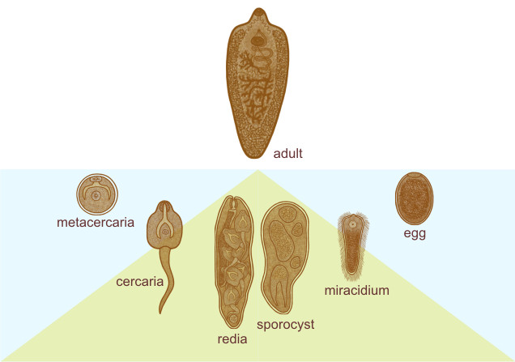
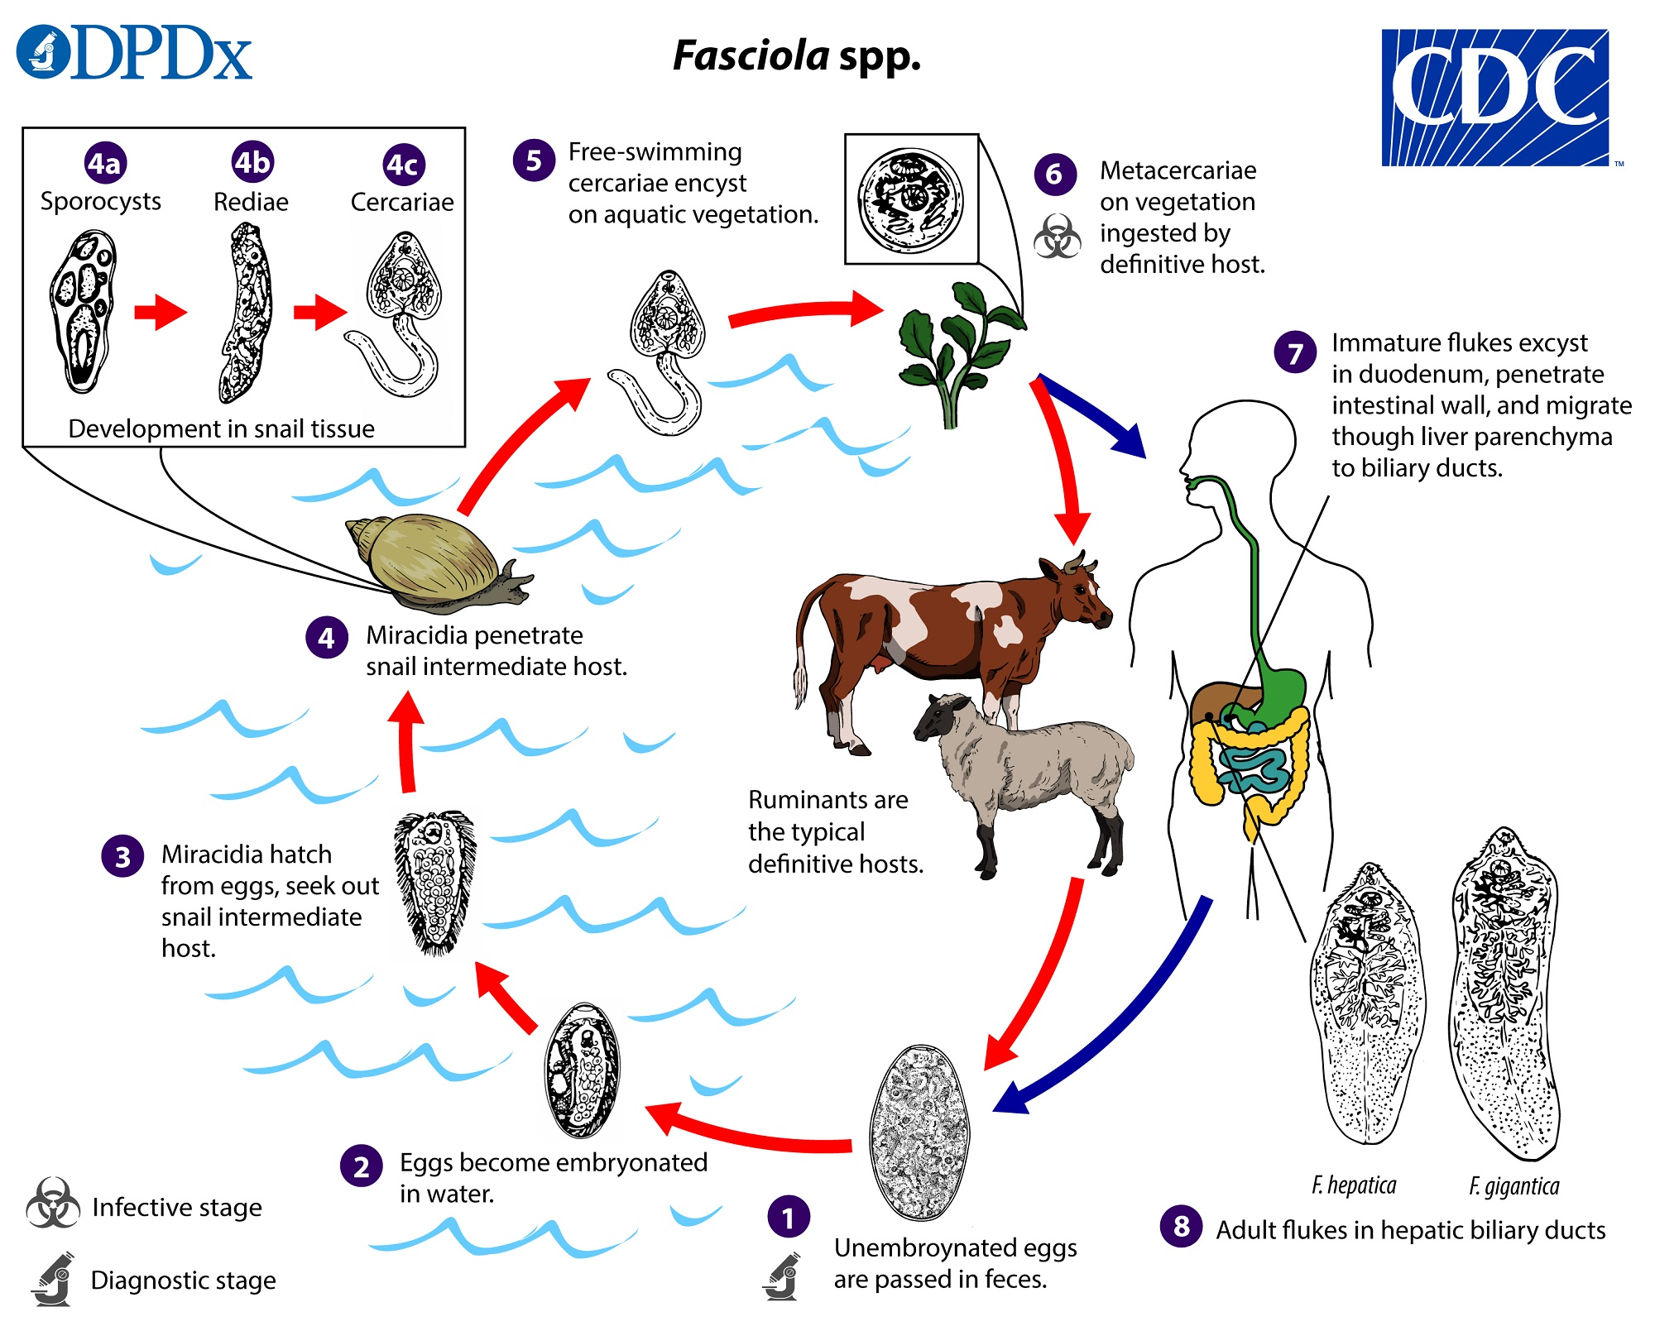
Fasciola Hepatica
5
Transmission¹:
Ingestion of raw, fresh-water vegetation contaminated
with metacercaria.
Pathogenesis:
Metacercaria excyst in the duodenum
(metacercaria encyst on water plants)
Migrate through intestinal wall to the liver and settle in the biliary tract
Grow into an adult worm and liberate eggs in bile
Then through bile, eggs reach the
intestine and are passed in stools.
Diagnostic stage
Definitive host
Eggs pass in stool or in duodenal aspirate
Sheep, cattle, goat & Human
2
1
Life cycle of Fasciola hepatica
3
4
Infective stage
Intermediate host
Metacercaria
(ingested with contaminated grass)
Snails
Water plants
Fasciola hepatica worm in the definitive host
Egg of Fasciola hepatica can be seen in true patient's stool or in false infection.
Snail intermediate host of :Fasciola hepatica
Fasciola hepatica in bile duct
1- fecal-oral route NOT through the skin

Slide 7
Fasciola Hepatica
6
Clinical picture:
False infection
Occurs when eggs are detected in stool after eating infected rotten animal (cattle) liver.
Eggs are found in stools but liver is not infected
True infection
occur when a person ingests water plant (watercress) contaminated with metacercaria.
Causes mainly:
Biliary colic with biliary obstruction and jaundice.
Generalized abdominal pain.
Cholecystitis and cholithiasis.
Clinical picture
Diagnosis
Eggs in stools or duodenal aspirate
Serological test: CFT and skin test.
Treatment
NOT IMP
Triclabendazole
(drug of choice to treat fascioliasis)
Dosage is calculated based on person’s weight (10mg/kg) tablets are given at one time
THE END ...

Slide 8
 | Adult worm | Live in blood capillary & produce its eggs in it , of : Mesenteries ( GIT region ) : mansonai Plexus of bladder ( urinary ) : haematobium
 | Microscopy detection | Mansoni has lateral spine found in stool Haematobium has terminal spine found in urine
 | Stages | infective stage —> cercaria Diagnostic stage —> eggs
 | Life cycle | Egg in water , reaches the snail grow & become cercaria Penetrate skin —> dermatitis Enter blood stream ( systemic circulation ) & damage vascular wall mansoni goes to portal circulation & mesenteric veins —> eggs in stool haematobium stay in systemic circulation —> eggs in urine sexual intercoarse & produce its eggs goes to liver —> hepatosplenomegaly & esophageal varices Some eggs will be excreted in stool , but most stay in bloodstream
 | Host | definitive host : man Intermediate host : snails
 | Pathogenicity | Cercarial dermatitis at site Toxic metabolites , may cause anaphylactic shock Terminal spined eggs : may erode BV & cause hemorrhage
 | Symptoms | mansoni : Portal hypertension يميزها عن ليشمانيا Hepatosplenomegaly Esophageal varices Hemorrhoids Ascites Haematobium Anything related to bladder Hematuria
 | Test & meds | Intradermal test : w/ cercarial Ag cause allergic reaction drug of choice : Praziquantel
6
Schistosomiasis “ blood flakes “
 | Stages | infective stage : metacercariae ingestion w/ contaminated grass Diagnostic stage : egg in stool or duodenal aspirate
 | Hosts | definitive host : sheep , cattle , goat , man Intermediate host : snails
 | Life cycle | Stool in water contain eggs reaches snail & grow to metacercaria Ingestion of contaminated grass Goes to portal area
 | Pathology | infection through oral-fecal route cause biliary obstruction jaundice by ingestion of water plant contaminated w/ metacercaria
Fasciola hepatica ( liver fluke )

Slide 9
Quiz:
7
MCQ:
Q1:B , Q2:C , Q3:D
Q1: Four weeks after his arrival from Egypt, a 24-year-old graduate student presents with blood in his urine. Microscopic examination of his urine reveals the presence of eggs with terminal spines. In the interview he admits that he has been working on his family’s rice field occasionally since his early childhood. The most likely etiologic agent of his complaint is:
A- Fasciolopsis buski
B- Schistosoma haematobium
C- Schistosoma japonicum
D- Schistosoma mansoni
Q2: A medical student presents to an infectious disease specialist complaining of abdominal distention and tenderness. The patient reports no recent changes in normal bowel habits. Physical examination shows hepatosplenomegaly. Bowel sounds are normal. On questioning, the patient reports that he traveled to Brazil several months ago to study tribal medical practices. He frequently went swimming in the Amazon River to wash himself. Several weeks after returning from his trip, he recalls having fever, diarrhea, weight loss, and “funny looking” stools. Which of the following conditions is most likely responsible for this patient’s present symptoms?
A- Bowel obstruction
B- Enterocolitis
C- Portal hypertension
D- Ruptured viscus
َQ3: Which of the following organisms penetrates skin, is endemic in Africa and latin america, and has a large lateral spine on eggs?
A- Paragonimus
B- Schistosoma haematobium
C- Schistosoma japonicum
D- Schistosoma mansoni
SAQ:
Case: A 21-year-old college student presents to the clinic with fever, hives, headache, weight loss, and cough. On review of systems, she reports doing field research in Egypt over the summer. She recalls an intense itching sensation while collecting samples in a river. Physical examination reveals lymphadenopathy and hepatosplenomegaly.
Q1: What’s the most likely diagnosis?
Schistosomiasis due to one of the 3 main flukes which are Schistosoma haematobium, Schistosoma japonicum, Schistosoma mansoni .
Q2: What’s the intermediate and definitive host for this case?
Intermediate: Snails
Definitive: Human
Q3: In which human organs are the organisms found?
Schistosoma japonicum, Schistosoma mansoni reside in intestine, where organisms mate in the mesenteric veins and release eggs into the feces as well as the portal circulation, Schistosoma haematobium resides in the bladder, where organisms mate in the vesicular (Bladder) veins and release eggs into the urine.
Q4: What’s the appropriate treatment?
Praziquantel is the treatment of choice

Slide 10
Members board:
Team Leaders:
Abdulaziz Alshomar Ghada Alsadhan
Team sub-leader:
Mohammed Alhumud
This lecture was done by:
Joud aljebreen
Sarah Alhelal
Note takers:
Mashal abaalkhail

